Slide 1
11
Insert 4 into this R-B Tree
14
2
15
1
7
5
8
Black node
Red node

Slide 2
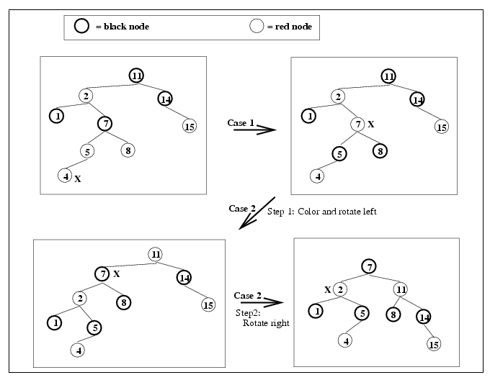

Slide 3
Insertion Practice
Insert the values 2, 1, 4, 5, 9, 3, 6, 7 into an initially empty Red-Black Tree

Slide 4
Constructing a RB tree by inserting 2, 1, 4, 5, 9, 3, 6, 7
case 1
2
2
2
2
2
1
1
4
1
4
1
4
5
5
2
case 3
2
2
1
4
1
5
1
5
5
4
9
4
9
9
2
3
2
case 2
2
1
5
1
5
1
5
4
9
4
9
4
7
3
3
6
6
3
6
9
7

Slide 5
65
50
80
10
60
70
90
62
Perform the following deletions, in the order specified
Delete 90, Delete 80, Delete 70

Slide 6
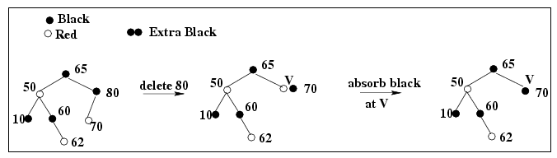
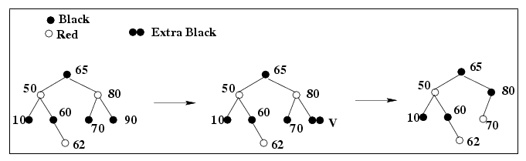
case 2

Slide 7
case 1
65
65
50
rotate 50 about 65
Recolor 50 and 65
50
70
50
V+
10
65
10
60
10
60
60
V+
62
62
62
case 4
case 3
50
50
Rotate62 about 65 recolor 62, 65 and 60
Rotate62 about 60 recolor 62 and 60
10
62
10
65
60
65
62
V+
60

