Slide 1
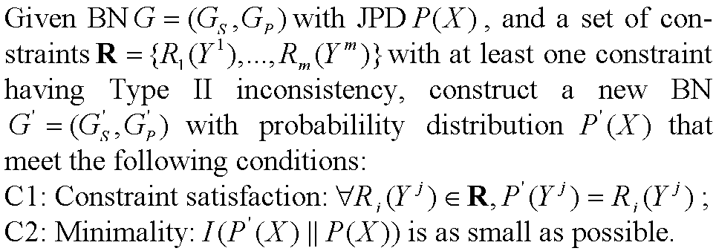
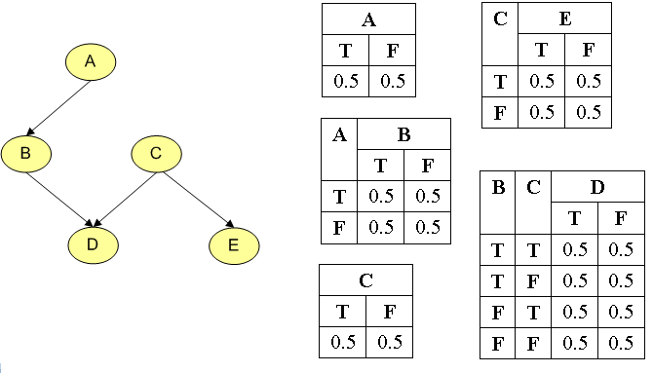
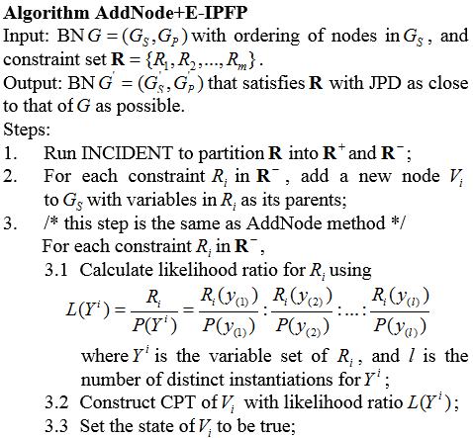
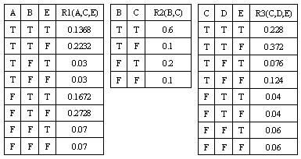
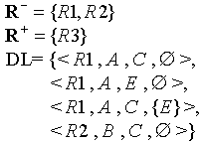
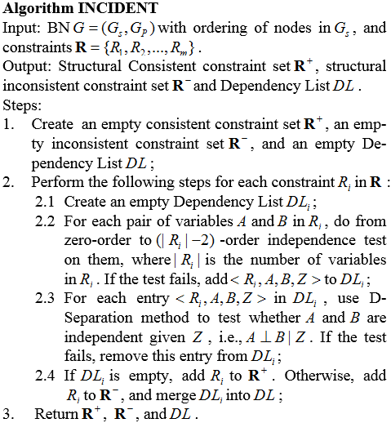
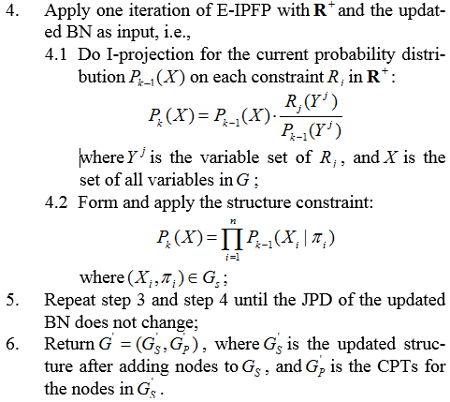
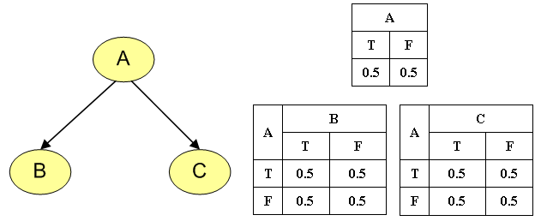
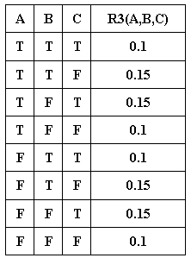
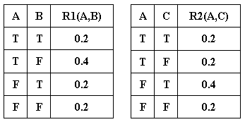
Inconsistent Knowledge Integration with Bayesian Network
Yi Sun and Yun Peng
Department of Computer Science and Electrical Engineering
University of Maryland Baltimore County
Background
The Problem
Methods
Experiment
Given a Bayesian network (BN) representing a probabilistic knowledge base of a domain, and a set of low-dimensional probability distributions (also called constraints) representing pieces of new knowledge coming from more up-to-date or more specific observations for a certain perspective of the domain, we present a theoretical framework and related methods for integrating the constraints into the BN, even when these constraints are inconsistent with the structure of the BN due to dependencies among relevant variables in the constraint being absent in the BN.
Our framework also allows for overcoming the identified structural inconsistencies during the knowledge integration by changing the structure of the BN. This is done by adding one node for each structural inconsistent constraint in a way similar to the use of the virtual evidence node in Pearl’s virtual evidence method. Other more computationally efficient variations of adding node methods are also considered.
Methods
Our framework allows for identifying the structural inconsistencies between the constraints and the existing BN. We use the d-separation method to find out dependency relations in the BN, and use the dependency test to find out dependency relations in each constraint. The dependency relations that exist in the constraint but are missing in the BN are the cause of the structural inconsistencies.
Inconsistent Constraints
Type I inconsistency: there does not exist a joint probability distribution that can satisfy all the constraints in the constraint set.
Result of INCIDENT:
Modified BN structure:
Type II inconsistency: some dependency implied in the constraint does not hold in the DAG of the BN.
Example:
R1 and R2 have Type I inconsistency because R1(A) R2(A). R3 has Type II inconsistency with the DAG because R3(B,C|A) R3(B|A) R3(C|A).
Comparison of different methods for the above BN
Comparison of different methods for 10 node BN
Conclusion
Compared to the existing methods for probabilistic knowledge integration, our methods have the advantage of being able to integrate new dependencies into the existing knowledge base as constraints become available from more reliable sources.

