Slide 1
Neural Networks
Chapter 18.7
Some material adopted from notes by
Raymond J. Mooney, University of Texas at Austin

Slide 2
Introduction
What is an (artificial) neural network
  A large set of nodes (units, neurons, processing elements)
    Each node has input and output
    Each node performs a simple computation by its node function
  Weighted connections between nodes
    Connectivity gives the structure/architecture of the net
    Connections/links have directions
    What can be computed by a NN is primarily determined by the connections and their weights
  A very much simplified version of networks of neurons in animal nerve systems

Slide 3
Introduction
Von Neumann machine
--------------------------------------------------------------------------------------------------------------------------------------------------------------------------
One or a few high speed (nm second) processors with considerable computing power
One or a few shared high speed buses for communication
Sequential memory access by address
Problem-solving knowledge is separated from the computing component
Hard to be adaptive
Human Brain
--------------------------------------------------------------------------------------------------------------------------------------------------------------------------
Large # (10¹¹) of low speed processors (ms) with limited computing power
Large # (10¹⁵) of low speed connections
Content addressable recall (CAM)
Problem-solving knowledge resides in the connectivity of neurons
Adaptation by changing the connectivity

Slide 4
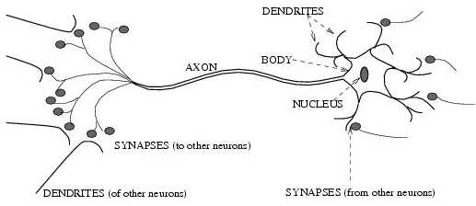
Biological neural activity
  Each neuron has a body, an axon, and many dendrites
    Can be in one of the two states: firing and rest.
    Neuron fires if the total incoming stimulus exceeds the threshold
  Synapse: thin gap between axon of one neuron and dendrite of another.
    Signal exchange
    Synaptic strength/efficiency

Slide 5
Introduction
ANN
--------------------------------------------------------------------------------------------------------------------------------------------------------------------------
Nodes
  input
  output
  node function
Connections
  connection strength
Bio NN
--------------------------------------------------------------------------------------------------------------------------------------------------------------------------
Cell body
  signals from other neurons
  firing frequency
  firing mechanism
Synapses
  synaptic strength
Highly parallel, simple local computation (at neuron level) achieves global results as emerging property of the interaction (at network level)
Pattern directed (meaning of individual nodes only in the context of a pattern)
Fault-tolerant/graceful degrading
Learning/adaptation plays important role.

Slide 6
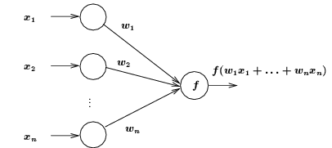
ANN Neuron Models
Node Input
  Each node has one or more inputs from other nodes, and one output to other nodes
  Input/output values can be
    Binary {0, 1}; Bipolar {-1, 1}; or Continuous (bounded or not)
Weighted sum of inputs

Slide 7
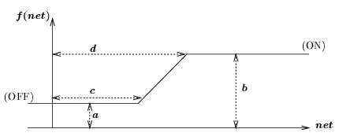
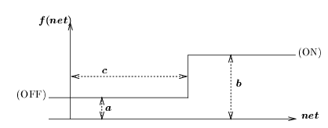
Node Functions
Node functions (linear)
Node functions (non-linear)
  Step functions and ramp functions
  Sigmoid functions (differentiable)
Step function
Ramp function

Slide 8
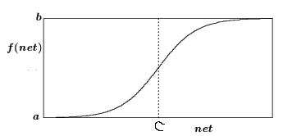
Sigmoid function
  S-shaped
  Continuous and everywhere differentiable
  Rotationally symmetric
  Asymptotically approaches saturation points
  Examples:
    Logistic function
    Hyperbolic tangent

Slide 9
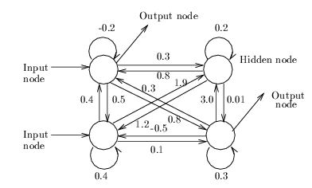
Network Architecture
(Asymmetric) Fully Connected Networks
  Every node is connected to every other node
  Connection may be excitatory (positive), inhibitory (negative), or irrelevant (≈ 0).
  Most general
  Symmetric fully connected nets: weights are symmetric (w_{ij} = w_{ji})
Input nodes: receive input from the environment
Output nodes: send signals to the environment
Hidden nodes: no direct interaction to the environment

Slide 10
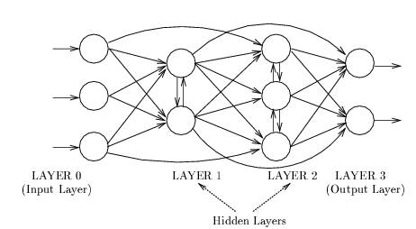
Network Architecture
Layered Networks
  Nodes are partitioned into subsets, called layers.
  No connections that lead from nodes in layer j to those in layer k if j > k.
Inputs from the environment are applied to nodes in layer 0 (input layer).
Nodes in input layer are place holders with no computation occurring (i.e., their node functions are identity function)

Slide 11
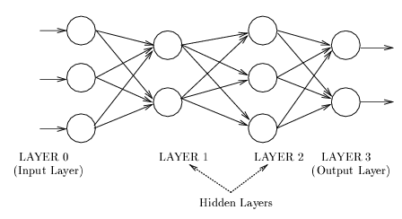
Network Architecture
Feedforward Networks
  A connection is allowed from a node in layer i only to nodes in layer i + 1.
  Most widely used architecture.
Conceptually, nodes at higher levels successively abstract features from preceding layers

Slide 12
Neural Network Learning
Real neural learning
  Synapses change size and strength with experience.
  Hebbian learning: When two connected neurons are firing at the same time, the strength of the synapse between them increases.
  “Neurons that fire together, wire together.”
ANN learning
  Construct the NN by training using samples
  Training is primarily to change the weights
  We will look at two particular training methods
    Perceptron
    backpropogation

Slide 13
Perceptron
1
Structure: single layer
Non-linear output nodes
Threshold units
Supervised learning
  Learning weights so that output node produces correct output for each training sample
w₁₂
w₁₅
w₁₆
w₁₃
w₁₄
2
3
4
5
6
o_{j}
1
0
T_{j}
net_{j}

Slide 14
Perceptron Learning Rule
Update weights by:
where η is the “learning rate”
t_{j} is the teacher specified output for unit j
(t_{j} – o_{j}) is the error (training is error driven)
Equivalent to rules:
  If output is correct do nothing.
  If output is high, lower weights on active inputs
  If output is low, increase weights on active inputs

Slide 15
Perceptron Learning Algorithm
Iteratively update weights until convergence.
Each execution of the outer loop is typically called an epoch.
Initialize weights to random values
Until outputs of all training examples are correct
For each training pair, E, do:
Compute current output o_{j} for E given its inputs
Compare current output to target value, t_{j ,} for E
Update synaptic weights using learning rule

Slide 16
Perceptron as a Linear Separator
Since perceptron uses linear threshold function, it is searching for a linear separator that discriminates the classes.
o₃
??
Or hyperplane in
n-dimensional space
o₂

Slide 17
Concept Perceptron Cannot Learn
Cannot learn exclusive-or, or parity function in general because they are not linearly separable.
o₃
1
+
–
??
–
+
0
o₂
1

Slide 18
Perceptron Convergence Theorem
Perceptron convergence theorem: If the data is linearly separable and therefore a set of weights exist that are consistent with the data, then the Perceptron algorithm will eventually converge to a consistent set of weights.
Perceptron cycling theorem: If the data is not linearly separable, the Perceptron algorithm will eventually repeat a set of weights and threshold at the end of some epoch and therefore enter an infinite loop.
  By checking for repeated weights+threshold, one can guarantee termination with either a positive or negative result.

Slide 19
Perceptron Limits
System obviously cannot learn concepts it cannot represent.
Minksy and Papert (1969) wrote a book analyzing the perceptron and demonstrating many functions it could not learn.
These results discouraged further research on neural nets; and symbolic AI became the dominate paradigm.

Slide 20
Multi-Layer Feed-Forward Networks
A typical multi-layer network consists of an input layer, one or more hidden and output layer, each fully connected to the next, with activation feeding forward.
Nodes at hidden layers MUST be non-linear (typically a sigmoid function)
Given an arbitrary number of hidden units with a single hidden layer, there exists a set of weights which can compute any given Boolean function (or any L2 function). But an effective learning algorithm for such networks was thought to be difficult.
output
hidden
activation
input

Slide 21
Sample Learned XOR Network
O
3.11
6.96
−7.38
−5.24
A
B
−2.03
−3.58
−3.6
−5.57
X
−5.74
Y
Hidden Unit A represents: ¬(X ∧ Y)
Hidden Unit B represents: ¬(X ∨ Y)
Output O represents: A ∧ ¬B = ¬(X ∧ Y) ∧ (X ∨ Y)
= X ⊕ Y

Slide 22
Gradient Descent
Define objective to minimize error:
where D is the set of training examples, K is the set of output units, t_{kd} and o_{kd} are, respectively, the teacher and current output for unit k for example d.
The derivative of a sigmoid unit with respect to net input is:
Learning rule to change weights to minimize error is:

Slide 23
Backpropagation Learning Rule
Each weight changed by:
where η is a constant called the learning rate
t_{j} is the correct teacher output for unit j
δ_{j} is the error measure for unit j

Slide 24
Error Backpropagation
First calculate error of output units and use this to change the top layer of weights.
Current output: o_{j}=0.2
Correct output: t_{j}=1.0
Error δ_{j} = o_{j}(1–o_{j})(t_{j}–o_{j})
0.2(1–0.2)(1–0.2)=0.128
output
Update weights into j
hidden
input

Slide 25
Error Backpropagation
Next calculate error for hidden units based on errors on the output units it feeds into.
output
hidden
input

Slide 26
Error Backpropagation
Finally update bottom layer of weights based on errors calculated for hidden units.
output
hidden
Update weights into j
input

Slide 27
Backpropagation Training Algorithm
Create the 3-layer network with H hidden units with full connectivity
between layers. Set weights to small random real values.
Until all training examples produce the correct value (within ε), or
mean squared error ceases to decrease, or other termination criteria:
Begin epoch
For each training example, d, do:
Calculate network output for d’s input values
Compute error between current output and correct output for d
Update weights by backpropagating error and using learning rule
End epoch

Slide 28
Hidden Unit Representations
Trained hidden units can be seen as newly constructed features that make the target concept linearly separable in the transformed space.
On many real domains, hidden units can be interpreted as representing meaningful features such as vowel detectors or edge detectors, etc..
However, the hidden layer can also become a distributed representation of the input in which each individual unit is not easily interpretable as a meaningful feature.

Slide 29
Representational Power
Boolean functions: Any boolean function can be represented by a two-layer network with sufficient hidden units.
Continuous functions: Any bounded continuous function can be approximated with arbitrarily small error by a two-layer network.
  Sigmoid functions can act as a set of basis functions for composing more complex functions, like sine waves in Fourier analysis.
Arbitrary function: Any function can be approximated to arbitrary accuracy by a three-layer network.

Slide 30
Successful Applications
Text to Speech (NetTalk)
Fraud detection
Financial Applications
  HNC (eventually bought by Fair Isaac)
Chemical Plant Control
  Pavillion Technologies
Automated Vehicles
Game Playing
  Neurogammon
Handwriting recognition

Slide 31
Hand-written character recognition
MNIST: a data set of hand-written digits
  60,000 training samples
  10,000 test samples
  Each sample consists of 28 x 28 = 784 pixels
Various techniques have been tried
  Linear classifier: 12.0%
  2-layer BP net (300 hidden nodes) 4.7%
  3-layer BP net (300+200 hidden nodes) 3.05%
  Support vector machine (SVM) 1.4%
  Convolutional net 0.4%
  6 layer BP net (7500 hidden nodes): 0.35%
Failure rate for
test samples

Slide 32
Strengths of BP Learning
Great representation power
  Any meaningful function can be represented by a BP net
  Many such functions can be approximated by BP learning (gradient descent approach)
Easy to apply
  Only requires a good set of training samples
  Does not require substantial prior knowledge or deep understanding of the domain itself (ill structured problems)
  Tolerates noise and missing data in training samples (graceful degrading)
Easy to implement the core of the learning algorithm
Good generalization power
  Often produces accurate results for inputs outside the training set

Slide 33
Deficiencies of BP Learning
Learning often takes a long time to converge
  Complex functions often need hundreds or thousands of epochs
The network is essentially a black box
  It may provide a desired mapping between input and output vectors (x, o) but does not have the information of why a particular x is mapped to a particular o.
  It thus cannot provide an intuitive (e.g., causal) explanation for the computed result.
  This is because the hidden nodes and the learned weights do not have clear semantics.
    What can be learned are operational parameters, not general, abstract knowledge of a domain
  Unlike many statistical methods, there is no theoretically well-founded way to assess the quality of BP learning
    What is the confidence level of o computed from input x using such net?
    What is the confidence level for a trained BP net, with the final training/test error (which may or may not be close to zero)?

Slide 34
Problem with gradient descent approach
  only guarantees to reduce the total error to a local minimum. (E might not be reduced to zero)
    Cannot escape from the local minimum error state
    Not every function that is representable can be learned
  How bad: depends on the shape of the error surface. Too many valleys/wells will make it easy to be trapped in local minima
  Possible remedies:
    Try nets with different # of hidden layers and hidden nodes (they may lead to different error surfaces, some might be better than others)
    Try different initial weights (different starting points on the surface)
    Forced escape from local minima by random perturbation (e.g., simulated annealing)

Slide 35
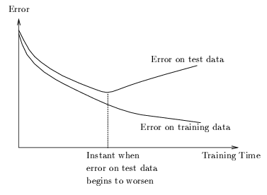
Generalization is not guaranteed even if the error is reduced to 0
  Over-fitting/over-training problem: trained net fits the training samples perfectly (E reduced to 0) but it does not give accurate outputs for inputs not in the training set
  Possible remedies:
    More and better samples
    Using smaller net if possible
    Using larger error bound (forced early termination)
    Introducing noise into samples
      modify (x₁,…, x_{n}) to (x₁+α₁,…, x_{n}+α_{n}) where α_{i} are small random displacements
    Cross-Validation
      leave some (~20%) samples as test data (not used for weight update)
      periodically check error on test data
      learning stops when error on test data starts to increase

