Slide 1
LEAN Mapping
Marc Olano, Dan Baker
Firaxis Games

Slide 2
LEAN Mapping
Linear Efficient Antialiased Normal Mapping
Fast and flexible solution for bump filtering
Shiny bumps are prone to aliasing
Distant bumps should change surface shading
Directional bumps change to anisotropic highlight
Existing solutions are too expensive
Allows blending layers of bumps
Works with existing Blinn-Phong pipeline

Slide 3
Bump Filtering

Slide 4
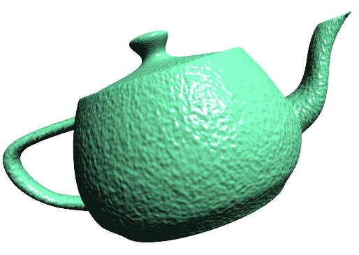
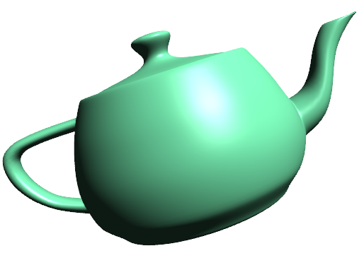
Bump Filtering
Normal Map
LEAN Map

Slide 5
Bump & Normal Maps
Bump maps [Blinn 1978]
Height displacement texture
Run-time partial derivatives
Normal maps [Cohen et al. 1998]
Texture holds normal
Often in surface tangent space

Slide 6
Prior Work
Posed by Kajiya 1985
Monte-Carlo
Cabral et al. 1987, Westin et al. 1992, Becker & Max 1993
Multi-lobed distributions
Fournier 1992, Han et al. 2007
Single Gaussian/Beckmann distribution
Olano & North 1997, Schilling 1997, Toksvig 2005
Diffuse [Kilgard 2000]

Slide 7
Filtering
Filter is linear combination over kernel
Linear representation → any linear filter
Summed Area, EWA, …
MIP map, Hardware Anisotropic

Slide 8
Filtering: Gaussians
Gaussian described by mean and variance
Mean combines linearly
Variance does not, but second moment does

Slide 9
Probability Distributions in Shading
Distribution of microfacet normals
Perfectly reflective facets
Only facets oriented with reflect to
Look up probability of in distribution
Beckmann distribution
Gaussian of facet tangents = projection

Slide 10
Distributions & Bumps
Each bump defines its own tangent plane
But how to combine them?

Slide 11
Distribution & Bumps
Per-level nonlinear fit [Fournier 1992]
Fake it
MIP variance values [Schilling 1997]
Spherical distribution
3D Gaussian | sphere [Olano and North 1997]
Von Mises-Fischer [Han 2007]

Slide 12
LEAN mapping
Blinn-Phong ↔ Beckmann
Filtering Bumps
Sub-facet shading
Layers of bumps

Slide 13
Blinn-Phong ↔ Beckmann
Blinn-Phong approximates Gaussian [Lyon 1993]
Better fit as increases
Variance , normalize with

Slide 14
Blinn-Phong ↔ Beckmann
Blinn-Phong
Beckmann

Slide 15
Filtering Bumps
Rather than bump-local frame
Use surface tangent frame
Bump normal = mean of off-center distribution

Slide 16
Bumps vs. Surface Frame
Bump-frame Beckmann
Surface-frame Beckmann

Slide 17
LEAN Data
Normal (for diffuse)
Bump center in tangent frame
Second moments

Slide 18
LEAN Use
Pre-process
Seed textures with , and
Build MIP chain
Render-time
Look up with HW filtering
Reconstruct 2D covariance
Compute diffuse & specular per light

Slide 19
Sub-facet Shading
What about base specularity?
Given base Blinn-Phong exponent,
Base Beckmann distribution
One of these at each facet = convolution
Gaussians convolve by adding ’s
Fold into , or add when reconstructing

Slide 20
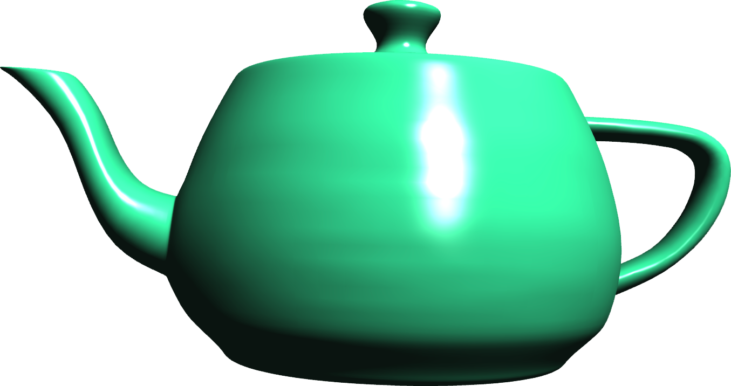
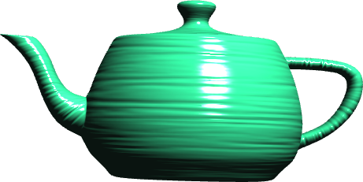
LEAN Map features
Seamless replacement for Blinn-Phong
Specular bump antialiasing
Turns directional bumps into anisotropic microfacets

Slide 21
Bump Layers
Uses
Bump motion (ocean waves)
Detail texture
Decals
Our approach
Conceptually a linear combination of heights
Equivalent to linear combination of ’s
Even from normal maps

Slide 22
Bump Layers: The Tricky Part
What about ?
Expands out to , , and terms
terms are in , terms are in
terms are new:
Total of four new cross terms

Slide 23
Layering Options
Generate single combined LEAN map
Mix actual heights, or use mixing equations
Time varying: need to generate per-frame
Decal or detail: need high-res LEAN map
Generate mixing texture
One per pair of layers
Decal or detail: need high-res LEAN mixture maps
Approximate cross terms
Use rather than a filtered mixing texture

Slide 24
Layer Options
Source 1
Source 1
Source 2
Source 2
Single LEAN Map
Mixture Texture
Approximation
Mixed
MIP Biased

Slide 25
Layer Options
Approximation misses layer coherence
Source 1
Source 1
Source 2
Source 2
Single LEAN Map
Mixture Texture
Approximation
Mixed
MIP Biased

Slide 26
Performance
 | Single Layer |  | Two Layers
 | Blinn-Phong | LEAN | Per-frame | Mix texture | Approx
ATI Radeon HD 5870 | 1570 FPS | 1540 FPS | 917 FPS | 1450 FPS | 1458 FPS
D3D Instructions | 30 ALU 1 TEX | 42 ALU 2 TEX | 50 ALU 3 TEX | 54 ALU 5 TEX | 54 ALU 4 TEX
1600 x 1200, single full screen object

Slide 27
Limitations
Mixing layers uses mixing terms
Mixture fractions cannot create bumps
Only one Gaussian lobe
No shiny cloth (two anisotropic directions)
No sharp grooves (two distinct peaks)

Slide 28
Conclusions
Linear
Linear texture filtering
Linear combination of layers
Efficient
One extra texture access
Small number of extra instructions
Antialiased
Works with hardware MIP and anisotropic filtering
Normal Mapping
Height map or normal map source
Compatible with existing Blinn-Phong assets and pipeline

