Slide 1
CMSC 611: Advanced Computer Architecture
I/O, Storage & Networks
Some material adapted from Mohamed Younis, UMBC CMSC 611 Spr 2003 course slides
Some material adapted from Hennessy & Patterson / © 2003 Elsevier Science

Slide 2
Input/Output
Computer
I/O Interface
  Device drivers
  Device controller
  Service queues
  Interrupt handling
Design Issues
  Performance
  Expandability
  Standardization
  Resilience to failure
Impact on Tasks
  Blocking conditions
  Priority inversion
  Access ordering
Processor
Memory
Devices
Control
Input
Datapath
Output
Network
Computer
Processor
Memory
Devices
Control
Input
Datapath
Output

Slide 3
Impact of I/O on System Performance
Suppose we have a benchmark that executes in 100 seconds of elapsed time, where 90 seconds is CPU time and the rest is I/O time. If the CPU time improves by 1.5x per year for the next five years but I/O time does not improve, how much faster will our program run at the end of the five years?
Answer: Elapsed Time = CPU time + I/O time
Over five years:
CPU improvement = 90/12 = 7. BUT System improvement = 100/22 = 4.5

Slide 4
I/O Device Examples
Device Behavior Partner Data Rate
Keyboard Input Human 10 B/s
Mouse Input Human 500 B/s
Printer Output Human 10 MB/s
Optical Disk Storage Machine 20 MB/s
Magnetic Disk Storage Machine 300 MB/s
SSD Storage Machine 200-2500 MB/s
Network-LAN Input or Output Machine 10–100 MB/s
Graphics Display Output Human 400 MB/s

Slide 5
Typical I/O System
Processor
interrupts
Cache
Memory - I/O Bus
Main
Memory
I/O
Controller
I/O
Controller
I/O
Controller
Disk
Disk
Graphics
Network
The connection between the I/O devices, processor, and memory is usually called a (local or internal) bus
Communication among the devices and the processor use both protocols on the bus and interrupts

Slide 6
Polling: Programmed I/O
CPU
while(! done()){
while(! ready()){}
read(data);
process(data);
}
busy wait loop
not an efficient
way to use the CPU
unless the device
is very fast!
Memory
IOC
while(!done()){
while(ready()) {
read(data);
process(data);
}
do_other_stuff();
}
but checks for I/O
completion can be
dispersed among
computation
intensive code
device
Advantage:
  Simple: the processor is totally in control and does all the work
Disadvantage:
  Polling overhead can consume a lot of CPU time

Slide 7
Interrupt Driven Data Transfer
add
sub
and
or
nop
CPU
(1) I/O
interrupt
user
program
(2) save PC
Memory
IOC
(3) interrupt
service addr
read
store
...
rti
interrupt
service
routine
device
:
(4)
memory
Advantage:
  User program progress is only halted during actual transfer
Disadvantage: special hardware is needed to:
  Cause an interrupt (I/O device)
  Detect an interrupt (processor)
  Save the proper states to resume after the interrupt (processor)

Slide 8
I/O Interrupt vs. Exception
An I/O interrupt is just like the exceptions except:
  An I/O interrupt is asynchronous
  Further information needs to be conveyed
  Typically exceptions are more urgent than interrupts
An I/O interrupt is asynchronous with respect to instruction execution:
  I/O interrupt is not associated with any instruction
  I/O interrupt does not prevent any instruction from completion
    You can pick your own convenient point to take an interrupt
I/O interrupt is more complicated than exception:
  Needs to convey the identity of the device generating the interrupt
  Interrupt requests can have different urgencies:
    Interrupt request needs to be prioritized
    Priority indicates urgency of dealing with the interrupt
    high speed devices usually receive highest priority

Slide 9
Direct Memory Access
Direct Memory Access (DMA):
  External to the CPU
  Use idle bus cycles (cycle stealing)
  Act as a master on the bus
  Transfer blocks of data to or from memory without CPU intervention
  Efficient for large data transfer, e.g. from disk
  Cache usage allows the processor to leave enough memory bandwidth for DMA
CPU sends a starting address,
direction, and length count
to DMAC. Then issues "start".
CPU
How does DMA work?:
  CPU sets up and supply device id, memory address, number of bytes
  DMA controller (DMAC) starts the access and becomes bus master
  For multiple byte transfer, the DMAC increment the address
  DMAC interrupts the CPU upon completion
Memory
DMAC
IOC
device
DMAC provides handshake
signals for Peripheral
Controller, and Memory
Addresses and handshake
signals for Memory.
For multiple bus system, each bus controller often contains DMA control logic

Slide 10
DMA Problems
With virtual memory systems: (pages would have physical and virtual addresses)
  Physical pages re-mapping to different virtual pages during DMA operations
  Multi-page DMA cannot assume consecutive addresses
Solutions:
  Allow virtual addressing based DMA
    Add translation logic to DMA controller
    OS allocated virtual pages to DMA prevent re-mapping until DMA completes
  Partitioned DMA
    Break DMA transfer into multi-DMA operations, each is single page
    OS chains the pages for the requester
In cache-based systems: (there can be two copies of data items)
  Processor might not know that the cache and memory pages are different
  Write-back caches can overwrite I/O data or makes DMA to read wrong data
Solutions:
  Route I/O activities through the cache
    Not efficient since I/O data usually is not demonstrating temporal locality
  OS selectively invalidates cache blocks before I/O read or force write-back prior
  to I/O write
    Usually called cache flushing and requires hardware support
DMA allows another path to main memory with no cache and address translation

Slide 11
I/O Processor
An I/O processor (IOP) offload the CPU
Some processors, e.g.
Motorola 860, include special purpose
IOP for serial communication
CPU
IOP
D1
main memory
bus
D2
Mem
. . .
Dn
I/O
bus
target device
where cmnds are
CPU
IOP
OP Device Address
(1) Issues
instruction
to IOP
(4) IOP interrupts
CPU when done
(2)
IOP looks in memory for commands
(3)
OP Addr Cnt Other
memory
Device to/from memory
transfers are controlled
by the IOP directly.
IOP steals memory cycles.
what
to do
special
requests
where
to put
data
how
much

Slide 12
Organization of a Hard Magnetic Disk
Platters
Track
Sector
Typical numbers (depending on the disk size):
  500 to 2,000 tracks per surface
  32 to 128 sectors per track
    A sector is the smallest unit that can be read or written to
Traditionally all tracks have the same number of sectors:
  Constant bit density: record more sectors on the outer tracks
  Recently relaxed: constant bit size, speed varies with track location

Slide 13
Magnetic Disk Operation
Track
Sector
Cylinder: all the tracks under the
head at a given point on all surface
Read/write is a three-stage process:
  Seek time
    position the arm over proper track
  Rotational latency
    wait for the sector to rotate under the read/write head
  Transfer time
    transfer a block of bits (sector) under the read-write head
Average seek time
  (∑ time for all possible seeks) / (# seeks)
  Typically in the range of 8 ms to 12 ms
  Due to locality of disk reference, actual average seek time may only be 25% to 33% of the advertised number
Cylinder
Head
Platter

Slide 14
Magnetic Disk Characteristic
Rotational Latency:
  Most disks rotate at 5,400 to 10,000 RPM
  Approximately 11 ms to 6 ms per revolution, respectively
  An average latency to the desired information is halfway around the disk:
    5.5 ms at 5400 RPM, 3 ms at 10000 RPM
Transfer Time is a function of :
  Transfer size (usually a sector): 1 KB / sector
  Rotation speed: 5400 RPM to 10000 RPM
  Recording density: bits per inch on a track
  Diameter: typical diameter ranges from 2.5 to 5.25”
  Typical values ~500MB per second

Slide 15
Example
Calculate the access time for a disk with 512 byte/sector and 12 ms advertised seek time. The disk rotates at 5400 RPM and transfers data at a rate of 4MB/sec. The controller overhead is 1 ms. Assume that the queue is idle (so no service time)
Answer:
Disk Time = Seek + Rotation + Transfer + Controller + Queue
  = 12 ms + .5/(5400 RPM) + 0.5 KiB / 4 MiB/s + 1 ms + 0
    = 12 ms + .5/(90 R/s) + (0.125 / 1024) s + 1 ms + 0
= 12 ms + 5.5 ms + 0.1 ms + 1 ms + 0
= 18.6 ms
If real seeks are 1/3 the advertised seeks, disk access time would be
10.6 ms, with rotation delay contributing 50% of the access time!

Slide 16
Reliability and Availability
Two terms that are often confused:
  Reliability: Is anything broken?
  Availability: Is the system still available to the user?
Availability can be improved by adding hardware:
  Example: adding ECC on memory
Reliability can only be improved by:
  Enhancing environmental conditions
  Building more reliable components
  Building with fewer components
    Improve availability may come at the cost of lower reliability

Slide 17
Disk Arrays
Increase potential throughput by
having many disk drives:
  Data is spread over multiple disk
  Multiple accesses are made to several disks
Reliability is lower than a single disk:
  Reliability of N disks = Reliability of 1 Disk ÷ N
    (50,000 Hours ÷ 70 disks = 700 hours)
    Disk system MTTF: Drops from 6 years to 1 month
  Arrays (without redundancy) too unreliable to be useful!
  But availability can be improved by adding redundant disks (RAID):
    Lost information can be reconstructed from redundant information

Slide 18
Redundant Arrays of Disks
Redundant Array of Inexpensive Disks (RAID)
  Widely available and used in today’s market
  Files are "striped" across multiple spindles
  Redundancy yields high data availability despite low reliability
  Contents of a failed disk is reconstructed from data redundantly stored in the disk array
  Drawbacks include capacity penalty to store redundant data and bandwidth penalty to update a disk block
  Different levels based on replication level and recovery techniques

Slide 19
RAID 1: Disk Mirroring/Shadowing
recovery
group
Each disk is fully duplicated onto its "shadow“
Very high availability can be achieved
Bandwidth sacrifice on write: Logical write = two physical writes
Reads may be optimized
Most expensive solution: 100% capacity overhead
Targeted for high I/O rate , high availability environments

Slide 20
RAID 3: Parity Disk
10010011
11001101
10010011
. . .
P
logical record
1
0
0
1
0
0
1
1
1
1
0
0
1
1
0
1
1
0
0
1
0
0
1
1
0
0
1
1
0
0
0
0
Striped physical
records
Parity computed across recovery group to protect against hard disk failures
33% capacity cost for parity in this configuration: wider arrays reduce
capacity costs, decrease expected availability, increase reconstruction time
Arms logically synchronized, spindles rotationally synchronized
(logically a single high capacity, high transfer rate disk)
Targeted for high bandwidth applications: Scientific, Image Processing

Slide 21
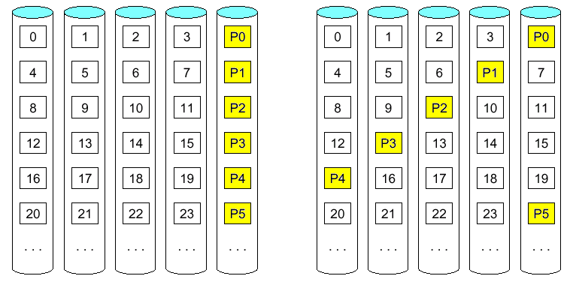
Block-Based Parity
Block-based parity leads to more efficient read access compared to RAID 3
Designating a parity disk allows recovery but will keep it idle in the absence
of a disk failure
RAID 5 distribute the parity block to allow the use of all disk and enhance
parallelism of disk access
RAID 4
RAID 5

Slide 22
RAID 5+: High I/O Rate Parity
D0
D1
D2
D3
P
Increasing
Logical
Disk
Addresses
A logical write
becomes four
physical I/Os
Independent writes
possible because of
interleaved parity
Reed-Solomon
Codes ("Q") for
protection during
reconstruction
D4
D5
D6
P
D7
D8
D9
P
D10
D11
D12
P
D13
D14
D15
Stripe
P
D16
D17
D18
D19
Stripe
Unit
D20
D21
D22
D23
P
.
.
.
.
.
.
.
.
.
.
.
.
.
.
.
Disk Columns

Slide 23
Problems of Small Writes
RAID-5: Small Write Algorithm
1 Logical Write = 2 Physical Reads + 2 Physical Writes
D0'
D0
D1
D2
D3
P
new
data
old
data
old
parity
(1. Read)
(2. Read)
+
XOR
+
XOR
(3. Write)
(4. Write)
D0'
D1
D2
D3
P'

Slide 24
Subsystem Organization
host
host
adapter
array
controller
single board
disk
controller
manages interface
to host, DMA
single board
disk
controller
control, buffering,
parity logic
single board
disk
controller
physical device
control
striping software off-loaded from
host to array controller
no applications modifications
no reduction of host performance
single board
disk
controller
often piggy-backed
in small format devices

Slide 25
System Availability: Orthogonal RAIDs
Array
Controller
String
Controller
. . .
String
Controller
. . .
String
Controller
. . .
String
Controller
. . .
String
Controller
. . .
String
Controller
. . .
Data Recovery Group: unit of data redundancy
Redundant Support Components: fans, power supplies, controller, cables
End to End Data Integrity: internal parity protected data paths

Slide 26
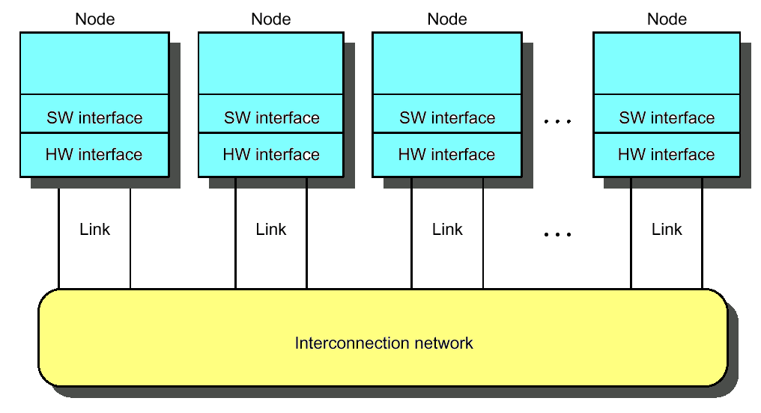
Interconnection Networks
Massively parallel processor networks (MPP)
  Thousands of nodes
  Short distance (<~25m)
  Traffic among nodes
Local area network (LAN)
  Hundreds of computers
  A few kilometers
  Many-to-one (clients-server)
Wide area network (WAN)
  Thousands of computers
  Thousands of kilometers

Slide 27
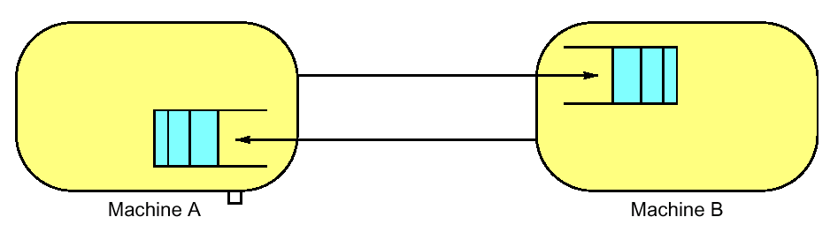
ABCs of Networks
Rules for communication are called the “protocol”, message header and data called a "packet"
  What if more than 2 computers want to communicate?
    Need computer “address field” (destination) in packet
  What if packet is garbled in transit?
    Add “error detection field” in packet (e.g., CRC)
  What if packet is lost?
    Time-out, retransmit; ACK & NACK
  What if multiple processes/machine?
    Queue per process to provide protection

Slide 28
Performance Metrics
Sender
Overhead
Transmission time
(size ÷ bandwidth)
Sender
(processor
busy)
Time of
Flight
Time of
Flight
Transmission time
(size ÷ bandwidth)
Receiver
Overhead
Receiver
Transport Latency
(processor
busy)
Total Latency
Bandwidth: maximum rate of propagating information
Time of flight: time for 1st bit to reach destination
Overhead: software & hardware time for encoding/decoding, interrupt handling, etc.
Notes:
Easy to get these things confused! Colors should help
Min (link BW, bisection BW)
Assumes no congestion
Receiver usually longer
Better to send then receive
Store Like send
Read like Receive

Slide 29
Network Interface Issues
Where to connect network to computer?
  Cache consistency to avoid flushes
    memory bus
  Low latency and high bandwidth
    memory bus
  Standard interface card?
    I/O bus
  Typically, MPP uses memory bus; while LAN, WAN connect through I/O bus
CPU
Network
Network
$
I/O
I/O
L2 $
Controller
Controller
Memory
Bus
I/O bus
Memory
Bus Adaptor
Ideal: high bandwidth, low latency, standard interface

