Slide 1
CMSC 611: Advanced Computer Architecture
Distributed Shared Memory
Most slides adapted from David Patterson. Some from Mohomed Younis

Slide 2
Centralized Shared Memory
Processor
Processor
Processor
Processor
One or more levels of cache
One or more levels of cache
One or more levels of cache
One or more levels of cache
Zero or more levels of cache
I/O
Memory
Processors share a single centralized memory
Feasible for small processor count to limit memory contention
Model for multi-core CPUs

Slide 3
Distributed Memory
Proc
Proc
Proc
Proc
Cache
Cache
Cache
Cache
Mem
Mem
Mem
Mem
Mem
Mem
Mem
Mem
Cache
Cache
Cache
Cache
Proc
Proc
Proc
Proc
Uses physically distributed memory to support large processor counts (to avoid memory contention)
Advantages
Allows cost-effective way to scale the memory bandwidth
Reduces memory latency
Disadvantage
Increased complexity of communicating data

Slide 4
NUMA vs. UMA
PE = Processing Element
UMA = Uniform Memory Access
Shared memory
Same cost for any PE to access
NUMA = Non-Uniform Memory Access
All memory is associated with some PE
Faster for that PE, slower for other PEs

Slide 5
Shared Address Model
Physical locations
Each PE can name every physical location in the machine
Shared data
Each process can name all data it shares with other processes

Slide 6
Shared Address Model
Data transfer
Use load and store, VM maps to local or remote location
Extra memory level: cache remote data
Significant research on making the translation transparent and scalable for many nodes
Handling data consistency and protection challenging
Latency depends on the underlying hardware architecture (bus bandwidth, memory access time and support for address translation)
Scalability is limited given that the communication model is so tightly coupled with process address space

Slide 7
Three Fundamental Issues (#1: Naming)
What data is shared?
How it is addressed?
What operations can access data?
How processes refer to each other?
Choice of naming affects code produced by a compiler
Just remember and load address or keep track of processor number and local virtual address for message passing
Choice of naming affects replication of data
In cache memory hierarchy or via SW replication and consistency

Slide 8
Naming Address Spaces
Global physical address space
any processor can generate, address and access it in a single operation
Global virtual address space
if the address space of each process can be configured to contain all shared data of the parallel program
memory can be anywhere: virtual address translation handles it
Segmented shared address space
locations are named <process number, address> uniformly for all processes of the parallel program

Slide 9
Three Fundamental Issues (#2: Synchronization)
To cooperate, processes must coordinate
Message passing is implicit coordination with transmission or arrival of data
Shared address → additional operations to explicitly coordinate: e.g., write a flag, awaken a thread, interrupt a processor

Slide 10
Three Fundamental Issues (#3: Latency & Bandwidth)
Bandwidth
Need high bandwidth in communication
Match limits in network, memory, and processor
Overhead to communicate is a problem in many machines
Latency
Affects performance, since processor may have to wait
Affects ease of programming, since requires more thought to overlap communication and computation
Latency Hiding
How can a mechanism help hide latency?
Examples: overlap message send with computation, pre-fetch data, switch to other tasks

Slide 11
Snooping Cache Coherency
Send all requests for data to all processors
Processors snoop to see if they have a copy and respond accordingly
Requires broadcast, since caching information is at processors
Works well with bus (natural broadcast medium)

Slide 12
Directory Cache Coherency
Keep track of what is being shared in one centralized place
Distributed memory ⇒ distributed directory for scalability (avoids bottlenecks)
Send point-to-point requests to processors via network
Scales better than Snooping
Actually existed before Snooping-based schemes

Slide 13
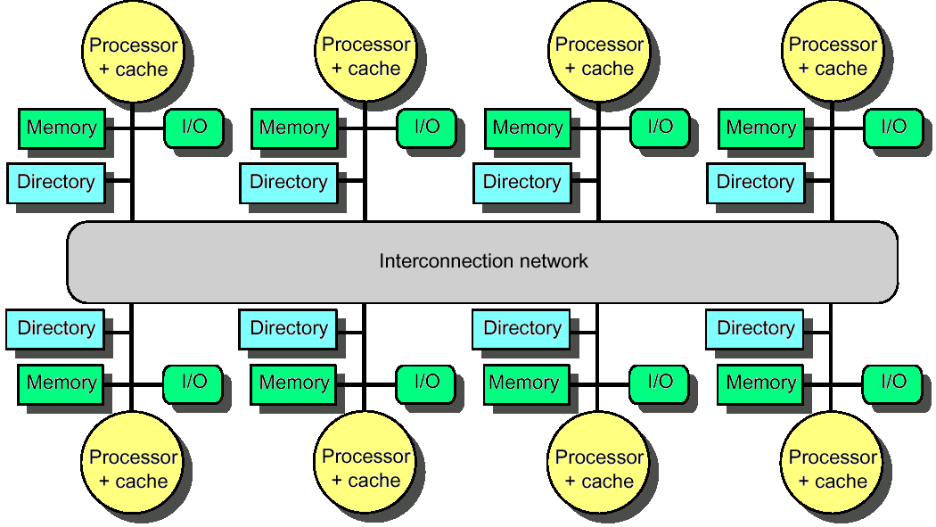
Distributed Directory Multiprocessors
Directory per cache that tracks state of every block in every cache
Which caches have a block, dirty vs. clean, ...
Info per memory block vs. per cache block?
simpler protocol (centralized/one location)
directory is O(memory size) vs. O(cache size)
To prevent directory from being a bottleneck
Distribute directory entries with memory
Each tracks of which processor has their blocks

Slide 14
Directory Protocol
Similar to Snoopy Protocol: Three states
Shared: Multiple processors have the block cached and the contents of the block in memory (as well as all caches) is up-to-date
Uncached No processor has a copy of the block (not valid in any cache)
Exclusive: Only one processor (owner) has the block cached and the contents of the block in memory is out-to-date (the block is dirty)
In addition to cache state, must track which processors have data when in the shared state
Usually bit vector, 1 if processor has copy

Slide 15
Directory Protocol
Keep it simple(r):
Writes to non-exclusive data = write miss
Processor blocks until access completes
Assume messages received and acted upon in order sent
Terms: typically 3 processors involved
Local node where a request originates
Home node where the memory location of an address resides
Remote node has a copy of a cache block, whether exclusive or shared
No bus and do not want to broadcast:
Interconnect no longer single arbitration point
All messages have explicit responses

Slide 16
Example Directory Protocol
Message sent to directory causes two actions:
Update the directory
More messages to satisfy request
We assume operations atomic, but they are not; reality is much harder; must avoid deadlock when run out of buffers in network

Slide 17
Directory Protocol Messages
Type | SRC | DEST | MSG
Read miss | local cache | home directory | P,A
P has read miss at A; request data and make P a read sharer
Write miss | local cache | home directory | P,A
P has write miss at A; request data and make P exclusive owner
Invalidate | home directory | remote cache | A
Invalidate shared data at A
Fetch | home directory | remote cache | A
Fetch block A home; change A remote state to shared
Fetch/invalidate | home directory | remote cache | A
Fetch block A home; invalidate remote copy
Data value reply | home directory | local cache | D
Return data value from home memory
Data write back | remote cache | home directory | A,D
Write back data value for A

Slide 18
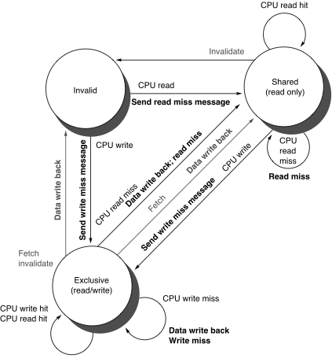
Cache Controller State Machine
States identical to snoopy case
Transactions very similar.
Miss messages to home directory
Explicit invalidate & data fetch requests
State machine for CPU requests for each memory block

Slide 19
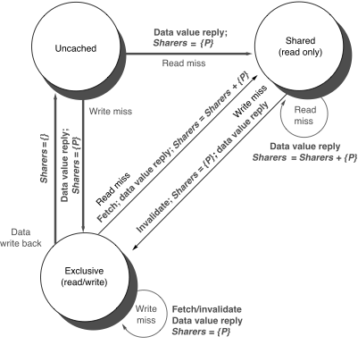
Directory Controller State Machine
Same states and structure as the transition diagram for an individual cache
Actions:
update of directory state
send messages to satisfy requests
Tracks all copies of each memory block
Sharers set implementation can use a bit vector of a size of # processors for each block
State machine
for Directory requests for each
memory block

Slide 20
Example
P2: Write 20 to A1
Assumes memory blocks A1 and A2 map to same cache block

Slide 21
Example
WrMs
P1
A1
A1
Ex
{P1}
Excl.
A1
10
DaRp
P1
A1
0
P2: Write 20 to A1
Assumes memory blocks A1 and A2 map to same cache block

Slide 22
Example
WrMs
P1
A1
A1
Ex
{P1}
Excl.
A1
10
DaRp
P1
A1
0
Excl.
A1
10
P2: Write 20 to A1
Assumes memory blocks A1 and A2 map to same cache block

Slide 23
Example
WrMs
P1
A1
A1
Ex
{P1}
Excl.
A1
10
DaRp
P1
A1
0
Excl.
A1
10
Shar.
A1
RdMs
P2
A1
Shar.
A1
10
Ftch
P1
A1
10
A1
10
Shar.
A1
10
DaRp
P2
A1
10
A1
Shar.
{P1,P2}
10
P2: Write 20 to A1
Write Back
Assumes memory blocks A1 and A2 map to same cache block

Slide 24
Example
Excl.
A1
10
DaRp
P1
A1
0
Excl.
A1
10
Shar.
A1
RdMs
P2
A1
Shar.
A1
10
Ftch
P1
A1
10
A1
10
Shar.
A1
10
DaRp
P2
A1
10
A1
Shar.
{P1,P2}
10
P2: Write 20 to A1
Excl.
A1
20
WrMs
P2
A1
10
Inv.
Inval.
P1
A1
A1
Excl.
{P2}
10
Assumes memory blocks A1 and A2 map to same cache block

Slide 25
Example
WrMs
P1
A1
A1
Ex
{P1}
Excl.
A1
10
DaRp
P1
A1
0
Excl.
A1
10
Shar.
A1
RdMs
P2
A1
Shar.
A1
10
Ftch
P1
A1
10
A1
10
Shar.
A1
10
DaRp
P2
A1
10
A1
Shar.
{P1,P2}
10
P2: Write 20 to A1
Excl.
A1
20
WrMs
P2
A1
10
Inv.
Inval.
P1
A1
A1
Excl.
{P2}
10
WrMs
P2
A2
A2
Excl.
{P2}
0
WrBk
P2
A1
20
A1
Unca.
{}
20
Excl.
A2
40
DaRp
P2
A2
0
A2
Excl.
{P2}
0
Assumes memory blocks A1 and A2 map to same cache block

