Slide 1
CMSC 611: Advanced Computer Architecture
Shared Memory
Most slides adapted from David Patterson. Some from Mohomed Younis

Slide 2
Shared Memory
Processors communicate with shared address space
Multi-core processors
Advantages:
  Model of choice for uniprocessors,
  small-scale multiprocessor
  Ease of programming
  Lower latency
  Easier to use hardware controlled caching
Difficult to handle node failure

Slide 3
Centralized Shared Memory
Processor
Processor
Processor
Processor
One or more levels of cache
One or more levels of cache
One or more levels of cache
One or more levels of cache
Zero or more levels of cache
I/O
Memory
Processors share a single centralized memory
Feasible for small processor count to limit memory contention
Model for multi-core CPUs

Slide 4
Cache Coherency
A cache coherence problem arises when the cache reflects a view of memory which is different from reality
A memory system is coherent if:
  P reads X, P writes X, no other processor writes X, P reads X
    Always returns value written by P
  P reads X, Q writes X, P reads X
    Returns value written by Q (provided sufficient W/R separation)
  P writes X, Q writes X
    Seen in the same order by all processors
Notes:
Processor
b) Writes green, red stale
c) Update memory (green), red stale in cache

Slide 5
Snooping Cache Coherency
AKA Snoopy Bus
  Send all requests for data to all processors
  Processors snoop to see if they have a copy and respond accordingly
  Requires broadcast, since caching information is at processors
  Works well with bus (natural broadcast medium)
  Dominates for small scale machines (most of the market)

Slide 6
Basic Snooping Protocols
Write Invalidate Protocol:
  Write to shared data: an invalidate is sent to all caches which snoop and invalidate any copies
  Cache invalidation will force a cache miss when accessing the modified shared item
  For multiple writers only one will win the race ensuring serialization of the write operations
  Read Miss:
    Write-through: memory is always up-to-date
    Write-back: snoop in caches to find most recent copy

Slide 7
Basic Snooping Protocols
Write Broadcast (Update) Protocol (typically write through):
  Write to shared data: broadcast on bus, processors snoop, and update any copies
  To limit impact on bandwidth, track data sharing to avoid unnecessary broadcast of written data that is not shared
  Read miss: memory is always up-to-date
  Write serialization: bus serializes requests!

Slide 8
Invalidate vs. Update
Write-invalidate has emerged as the winner for the vast majority of designs
Qualitative Performance Differences :
  Spatial locality
    WI: 1 transaction/cache block;
    WU: 1 broadcast/word
  Latency
    WU: lower write–read latency
    WI: must reload new value to cache

Slide 9
Invalidate vs. Update
Because the bus and memory bandwidth is usually in demand, write-invalidate protocols are very popular
Write-update can causes problems for some memory consistency models, reducing the potential performance gain it could bring
The high demand for bandwidth in write-update limits its scalability for large number of processors

Slide 10
An Example Snoopy Protocol
Invalidation protocol, write-back cache
Each block of memory is in one state:
  Clean in all caches and memory (Shared)
  OR Dirty in exactly one cache (Exclusive)
  OR Not in any caches
Each cache block is in one state:
  Shared: block can be read
  OR Exclusive: cache has only copy, it is writeable, and dirty
  OR Invalid: block contains no data
Read misses: cause all caches to snoop bus
Writes to clean line are treated as misses

Slide 11
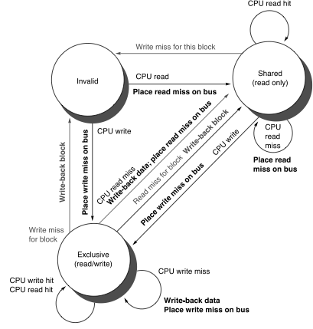
Snoopy-Cache Controller
Complications
  Cannot update cache until bus is obtained
  Two step process:
    Arbitrate for bus
    Place miss on bus and complete operation
  Split transaction bus:
    Bus transaction is not atomic
    Multiple misses can interleave, allowing two caches to grab block in the Exclusive state
    Must track and prevent multiple misses for one block

Slide 12
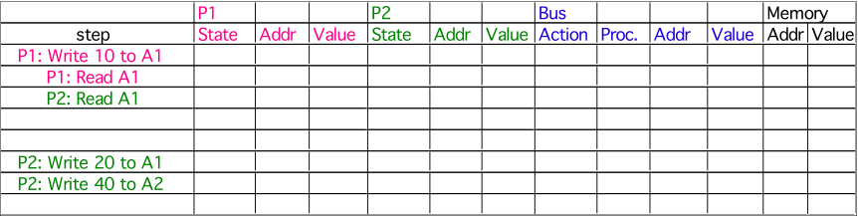
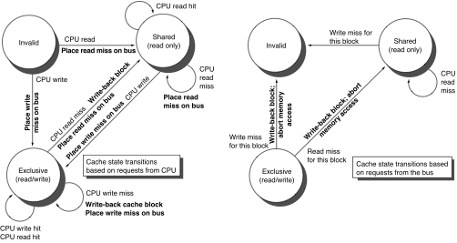
Example
Assumes memory blocks A1 and A2 map to same cache block, initial cache state is invalid

Slide 13
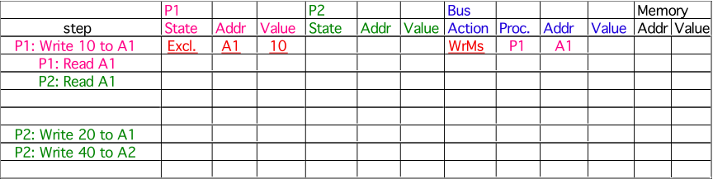
Example
Assumes memory blocks A1 and A2 map to same cache block

Slide 14

Example
Assumes memory blocks A1 and A2 map to same cache block

Slide 15
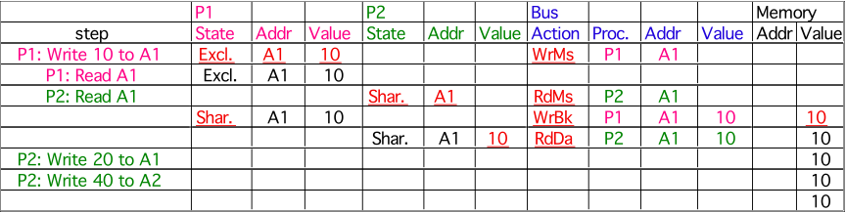
Example
Assumes memory blocks A1 and A2 map to same cache block

Slide 16
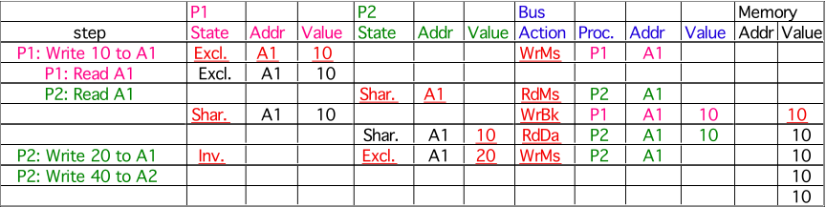
Example
Assumes memory blocks A1 and A2 map to same cache block

Slide 17
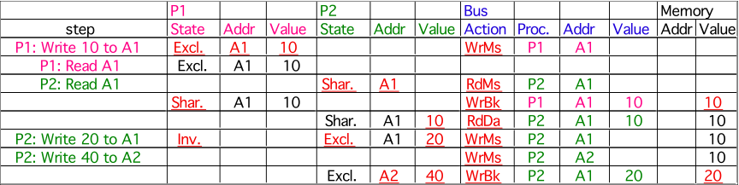
Example
A1
A1
Assumes memory blocks A1 and A2 map to same cache block
Notes:
Why write miss first?
Because in general, only write a piece of block, may need to read it first so that can have a full vblock; therefore, need to get
Write back is low priority event.

Slide 18
Modern Variations
MESI(F)
  Modified (renamed vs. 3-state protocol)
    1 core can be modified, rest must be Invalid
    Data has been changed, will need to write back
  Exclusive (new)
    Single read only core
    Can change to Modified without asking
    Forward data, and change to Shared on request
  Shared
    Read only: many cores can be shared, read only
  Invalid: no longer valid
  Forward (new)
    Most recent shared core, designated to forward data
    Forwarding saves slower memory access

Slide 19
Examples
ARM Cortex-A57
Intel Nehalem

Slide 20
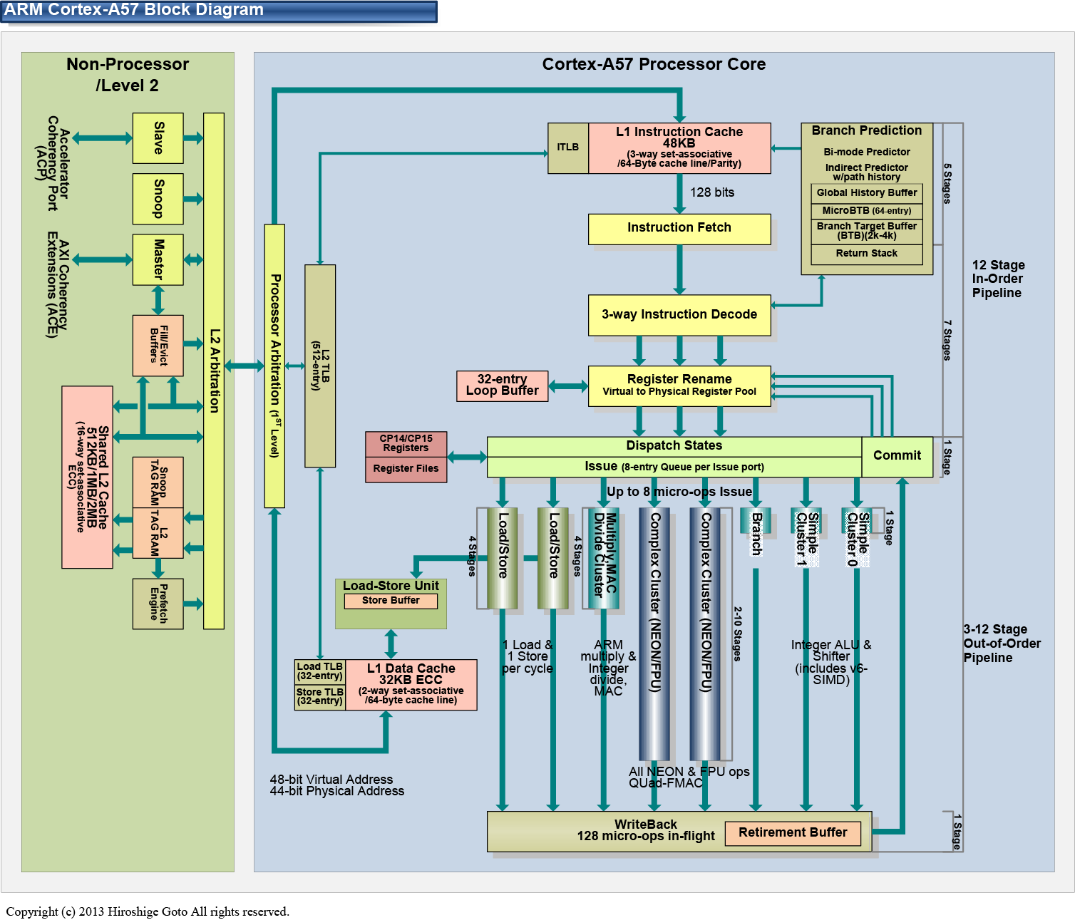
ARM Cortex-A57

Slide 21
ARM Cortex-A57

Slide 22
ARM Cortex-A57

Slide 23
ARM Cortex-A57

Slide 24
Intel Nehalem
Appaloosa, “Intel Nehalem Microarchitecture”, Wikimedia project, November 2008

Slide 25
Intel Nehalem

Slide 26
Intel Nehalem

Slide 27
Intel Nehalem

Slide 28
Cache Performance Benchmark
Same core
  Write a bunch of memory from CPU0
  Read from CPU0
Other core, same chip
  Write a bunch of memory from CPU0
  Read from CPU1-3
Other core, other socket
  Write a bunch of memory from CPU0
  Read from CPU4-7

Slide 29
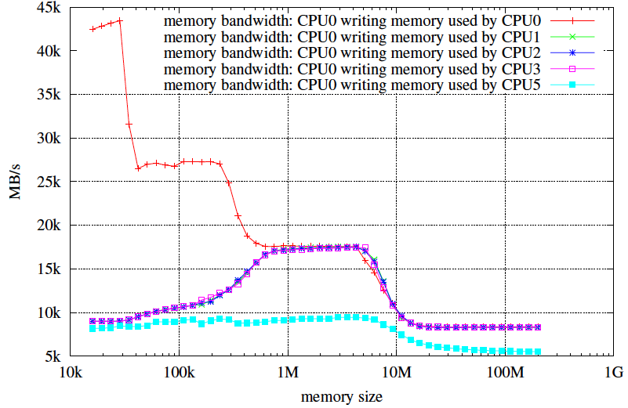
Cache Performance
Michael Thomadakis: The Architecture of the Nehalem Processor and Nehalem-EP SMP Platforms

