Slide 1
Some Intel CPU examples
Figures and data from Arstechnica
arstechnica.com/old/content/2004/07/pentium-1.ars
arstechnica.com/old/content/2001/05/p4andg4e.ars
arstechnica.com/old/content/2004/02/pentium-m.ars
arstechnica.com/hardware/news/2006/04/core.ars
arstechnica.com/hardware/news/2008/04/what-you-need-to-know-about-nehalem.ars

Slide 2
Pentium
Dual Issue
Two 5-stage integer pipes (some restrictions)
1: Prefetch/fetch
2: Decode 1
Branch predict (75%)
3: Decode 2
Address computation
4: Execute
5: Write back
6-stage float pipe

Slide 3
Pentium Pro, II, III
3 instruction issue
2 simple, 1 complex
40-entry ROB
Rotating queue
Execution
5 issue ports
Store addr/data
1 cycle EX for most
*÷ 4-cycle latency, 1 cycle issue

Slide 4
Pentium Pro, II, III
12-stage pipe
1-4.5: BTB & IF
Prediction 90+%
4.5-6: Decode
7: ROB rename
8: Write RS (20 inst.)
9: Issue
10: Execute
11-12: Retire

Slide 5
P4 (Pentium 4)
Trace cache
Internal RISC ISA
90% Hit rate
ROM for long instructions
Mini BTB for trace cache branches
20+ stage pipeline
More on trace cache miss

Slide 6
P4 (Pentium 4)
1-2: Trace cache next IP
3-4: Trace cache fetch
5: Drive signals
6-8: Allocate & Rename
128 µreg
9: Queue
10-12: Schedule
13-14: Dispatch
Up to 6 per cycle
15-16: Register file
17: Execute
18: Flags
19: Branch check
20: Drive signals

Slide 7
Pentium M
Branch prediction
4k BTB
Loop predictor
Indirect predictor
µop fusion
Avoid ROB

Slide 8
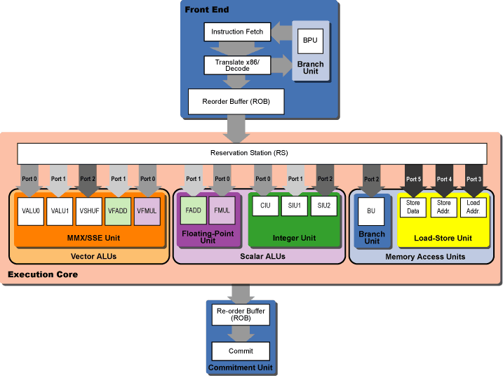
Core
← 96 entry

Slide 9
Core Decode
4-7 issue to 7 µop
Multiple x86 to one µop
Macro-fusion merges across x86 ops
µop fusion to avoid ROB

Slide 10
Memory Speculation
store A, addr1
-stall-
load addr2, B
-stall-
add B,C,D
If addr1 = addr2
Aliasing
load addr2, B
store A, add1
add B,C,D
If addr1 ≠ addr2
Assume no aliasing
Restart if wrong

Slide 11
Nehalem
Rely on hyperthreading
128-entry ROB
36-entry RS

