Slide 1
CMSC 611: Advanced Computer Architecture
Tomasulo
Some material adapted from Mohamed Younis, UMBC CMSC 611 Spr 2003 course slides
Some material adapted from Hennessy & Patterson / © 2003 Elsevier Science

Slide 2
Tomasulo “Register Renaming”
Registers in instructions replaced by values or pointers to reservation stations (RS)
  avoids WAR, WAW hazards
  More reservation stations than registers
  Can do optimizations compilers cannot perform
Operands to Functional Unit (FU) from RS, not registers
Results broadcast over Common Data Bus
Load and Stores treated as FU w/ RS
Can go past branches, allowing FP operations beyond basic block in FP queue

Slide 3
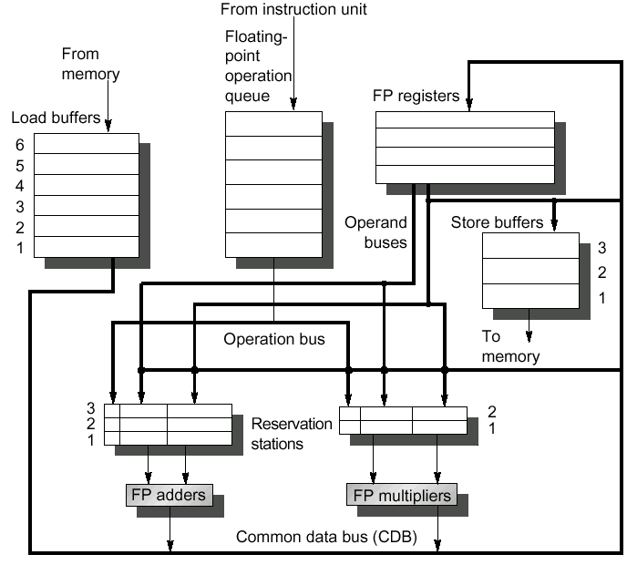
Tomasulo Organization
The reservation stations hold instructions that had been issued and are awaiting execution at a functional unit
All results from FP FU and loads are broadcasted on the CDB
Notes:
Resolve RAW memory conflict? (address in memory buffers)
Integer unit executes in parallel

Slide 4
Reservation Station Components
Functional Unit Reservation Station
  Op—Operation to perform in the unit (e.g., + or –)
  Vj, Vk—Value of Source operands
    Store buffers has V field, result to be stored
  Qj, Qk—Reservation stations producing source registers (value to be written)
    Store buffers only have Qi for RS producing result
  Busy—Indicates reservation station or FU is busy
Register Reservation Station
  Register result status—Indicates which functional unit will write each register, if one exists. Blank when no pending instructions that will write that register.
Notes:
What you might have thought
1. 4 stages of instruction executino
2.Status of FU: Normal things to keep track of (RAW & structura for busyl):
Fi from instruction format of the mahine (Fi is dest)
Add unit can Add or Sub
Rj, Rk - status of registers (Yes means ready)
Qj,Qk - If a no in Rj, Rk, means waiting for a FU to write result; Qj, Qk means wihch FU waiting for it
3.Status of register result (WAW &WAR)s:
which FU is going to write into registers
Scoreboard on 6600 = size of FU
6.7, 6.8, 6.9, 6.12, 6.13, 6.16, 6.17
FU latencies: Add 2, Mult 10, Div 40 clocks

Slide 5
Three Stages of Tomasulo Algorithm
Issue—get instruction from FP Op Queue
  If reservation station free (no structural hazard), control issues instruction & sends operands (renames registers).
Execution—operate on operands (EX)
  When both operands ready then execute; if not ready, watch Common Data Bus for result
Write result—finish execution (WB)
  Write on Common Data Bus to all awaiting units; mark reservation station available

Slide 6
Normal vs. Common Data Bus
Normal data bus: data + destination
  (“go to” bus)
Common data bus: data + source
  (“come from” bus)
  64 bits of data + 4 bits of Functional Unit source address
  Write if matches expected Functional Unit (produces result)
  Broadcast: one to many

Slide 7
Tomasulo Example

Slide 8
Tomasulo Example Cycle 1

Slide 9
Tomasulo Example Cycle 2
Note: Can have multiple loads outstanding

Slide 10
Tomasulo Example Cycle 3
Note: registers names are removed (“renamed”) in Reservation Stations
Load1 completing; what is waiting for Load1?

Slide 11
Tomasulo Example Cycle 4
Load2 completing; what is waiting for it?

Slide 12
Tomasulo Example Cycle 5

Slide 13
Tomasulo Example Cycle 6

Slide 14
Tomasulo Example Cycle 7
Add1 completing; what is waiting for it?

Slide 15
Tomasulo Example Cycle 8

Slide 16
Tomasulo Example Cycle 9

Slide 17
Tomasulo Example Cycle 10
Add2 completing; what is waiting for it?

Slide 18
Tomasulo Example Cycle 11

Slide 19
Tomasulo Example Cycle 12
Note: all quick instructions complete already

Slide 20
Tomasulo Example Cycle 13

Slide 21
Tomasulo Example Cycle 14

Slide 22
Tomasulo Example Cycle 15
Mult1 completing; what is waiting for it?

Slide 23
Tomasulo Example Cycle 16
Note: Just waiting for divide

Slide 24
Tomasulo Example Cycle 55

Slide 25
Tomasulo Example Cycle 56
Mult 2 completing; what is waiting for it?

Slide 26
Tomasulo Example Cycle 57
Again, in-order issue, out-of-order execution, completion

Slide 27
Tomasulo Drawbacks
Circuit complexity
Many associative stores (CDB) at high speed
Performance limited by Common Data Bus
  Multiple CDBs → more FU logic for parallel associative stores

Slide 28
Tomasulo Loop Example
Loop: LD F0, 0(R1)
MULTD F4, F0, F2
SD F4, 0(R1)
SUBI R1, R1, #8
BNEZ R1, Loop
Assume Multiply takes 4 clocks
Assume first load takes 8 clocks (cache miss), second load takes 4 clocks (hit)
To be clear, will show clocks for SUBI, BNEZ
Reality, integer instructions ahead

Slide 29
Loop Example Cycle 0

Slide 30
Loop Example Cycle 1

Slide 31
Loop Example Cycle 2

Slide 32
Loop Example Cycle 3
Note: MULT1 has no registers names in RS

Slide 33
Loop Example Cycle 4
Issue SUBI

Slide 34
Loop Example Cycle 5
Issue BNEZ

Slide 35
Loop Example Cycle 6
Note: F0 never sees Load1 result

Slide 36
Loop Example Cycle 7
Note: MULT2 has no registers names in RS

Slide 37
Loop Example Cycle 8

Slide 38
Loop Example Cycle 9
Load1 completing; what is waiting for it?

Slide 39
Loop Example Cycle 10
Load2 completing; what is waiting for it?

Slide 40
Loop Example Cycle 11

Slide 41
Loop Example Cycle 12

Slide 42
Loop Example Cycle 13

Slide 43
Loop Example Cycle 14
Mult1 completing; what is waiting for it?

Slide 44
Loop Example Cycle 15
Mult2 completing; what is waiting for it?

Slide 45
Loop Example Cycle 16

Slide 46
Loop Example Cycle 17

Slide 47
Loop Example Cycle 18

Slide 48
Loop Example Cycle 19

Slide 49
Loop Example Cycle 20

Slide 50
Loop Example Cycle 21

Slide 51
Multiple Issue
Static: Integer/FP instruction pairs
Dynamic: Extend Tomasulo
  Must handle dependencies on issue
  Two instructions: split clock in half
  More: Explicit dependency issue logic

Slide 52
Reorder Buffers
Most modern processors use a variation of Tomasulo
Add Reorder Buffer (ROB) in place of register stations & memory store
Write from ROB in order issued
Makes sure earlier instructions complete
  Simplifies exceptions & speculation

