Slide 1
CMSC 611: Advanced Computer Architecture
Instruction Level Parallelism
Some material adapted from Mohamed Younis, UMBC CMSC 611 Spr 2003 course slides
Some material adapted from Hennessy & Patterson / © 2003 Elsevier Science

Slide 2
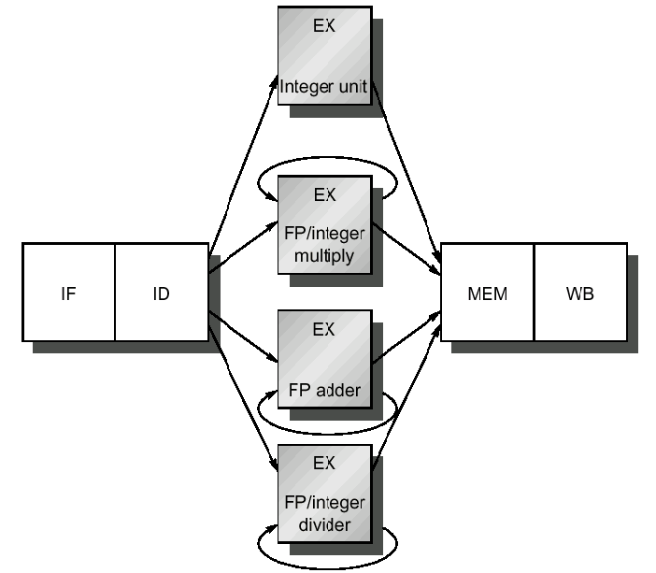
Floating-Point Pipeline
Impractical for FP ops to complete in one clock
  (complex logic and/or very long clock cycle)
More complex hazards
  Structural
  Data

Slide 3
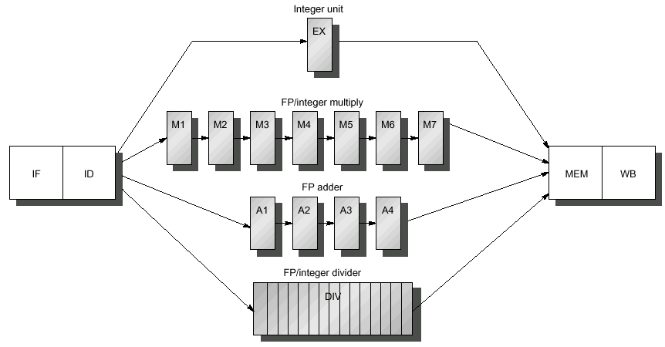
Multi-cycle FP Pipeline
7-stage pipelined FP multiply
Integer ALU
Non-pipelined DIV operation stalling the whole pipeline for 24 cycles
4-stage pipelined FP addition
Example: blue indicate where data is needed and red when result is available

Slide 4
Exception Types
I/O device request
Breakpoint
Integer arithmetic overflow
FP arithmetic anomaly
Page fault
Misaligned memory accesses
Memory-protection violation
Undefined instruction
Privilege violation
Hardware and power failure

Slide 5
Exception Requirements
Synchronous vs. asynchronous
  I/O exceptions: Asyncronous
    Allow completion of current instruction
  Exceptions within instruction: Synchronous
    Harder to deal with
User requested vs. coerced
  Requested predictable and easier to handle
User maskable vs. unmaskable
Resume vs. terminate
  Easier to implement exceptions that terminate program execution

Slide 6
Exceptions in MIPS
Multiple exceptions might occur since multiple instructions are executing
  (LW followed by DIV might cause page fault and an arith. exceptions in same cycle)
Exceptions can even occur out of order
  IF page fault before preceeding MEM page fault
Pipeline exceptions must follow order of execution of faulting instructions not according to the time they occur

Slide 7
Stopping & Restarting Execution
Some exceptions require restart of instruction
  e.g. Page fault in MEM stage
When exception occurs, pipeline control can:
  Force a trap instruction into next IF stage
  Until the trap is taken, turn off all writes for the faulting (and later) instructions
  OS exception-handling routine saves faulting instruction PC

Slide 8
Stopping & Restarting Execution
Precise exceptions
  Instructions before the faulting one complete
  Instructions after it restart
  As if execution were serial
Exception handling complex if faulting instruction can change state before exception occurs
Precise exceptions simplifies OS
Required for demand paging

Slide 9
Precise Exception Handling
The MIPS Approach:
  Hardware posts all exceptions caused by a given instruction in a status vector associated with the instruction
  The exception status vector is carried along as the instruction goes down the pipeline
  Once an exception indication is set in the exception status vector, any control signal that may cause a data value to be written is turned off
  Upon entering the WB stage the exception status vector is checked and the exceptions, if any, will be handled according the time they occurred
  Allowing an instruction to continue execution till the WB stage is not a problem since all write operations for that instruction will be disallowed

Slide 10
Instruction Set Complications
Early-Write Instructions
  MIPS only writes late in pipeline
  Machines with multiple writes usually require capability to rollback the effect of an instruction
    e.g. VAX auto-increment,
  Instructions that update memory state during execution, e.g. string copy, may need to save & restore temporary registers
Branching mechanisms
  Complications from condition codes, predictive execution for exceptions prior to branch
Variable, multi-cycle operations
  Instruction can make multiple writes

Slide 11
Maintaining Precise Exceptions
Pipelining FP instructions can cause out-of-order completion
Exceptions also a problem:
  DIVF F0, F2, F4
  ADDF F10, F10, F8
  SUBF F12, F12, F14
  No data hazards
  What if DIVF exception occurs after ADDF writes F10?

Slide 12
Four FP Exception Solutions
Settle for imprecise exceptions
  Some supercomputers still uses this approach
  IEEE floating point standard requires precise exceptions
  Some machine offer slow precise and fast imprecise exceptions
Buffer the results of all operations until previous instructions complete
  Complex and expensive design
  Most modern processors store results in a
  Reorder Buffer (ROB) and commit in order.

Slide 13
Four FP Exception Solutions
Allow imprecise exceptions and get the handler to clean up any miss
  Save PC + state about the interrupting instruction and all out-of-order completed instructions
  The trap handler will consider the state modification caused by finished instructions and prepare machine to resume correctly
  Issues: consider the following example
    Instruction1: Long running, eventual exception
    Instructions 2 … (n-1) : Instructions that do not complete
    Instruction n : An instruction that is finished
  The compiler can simplify the problem by grouping FP instructions so that the trap does not have to worry about unrelated instructions

Slide 14
Four FP Exception Solutions
Allow instruction issue to continue only if previous instruction are guaranteed to cause no exceptions:
  Mainly applied in the execution phase
  Used on MIPS R4000 and Intel Pentium

