Slide 1
CMSC 611: Advanced Computer Architecture
Branch Prediction
Some material adapted from Mohamed Younis, UMBC CMSC 611 Spr 2003 course slides
Some material adapted from Hennessy & Patterson / © 2003 Elsevier Science

Slide 2
Recall Branch Penalties

Slide 3
Branching Dilema
Deep pipelines
  Also instructions issued out of order and multiple instructions issued per cycle
  Intel Haswell: up to 192 instructions in flight
Control dependence = limiting factor
Compiler can only see static program properties
Hardware can use dynamic behavior of the program to predict

Slide 4
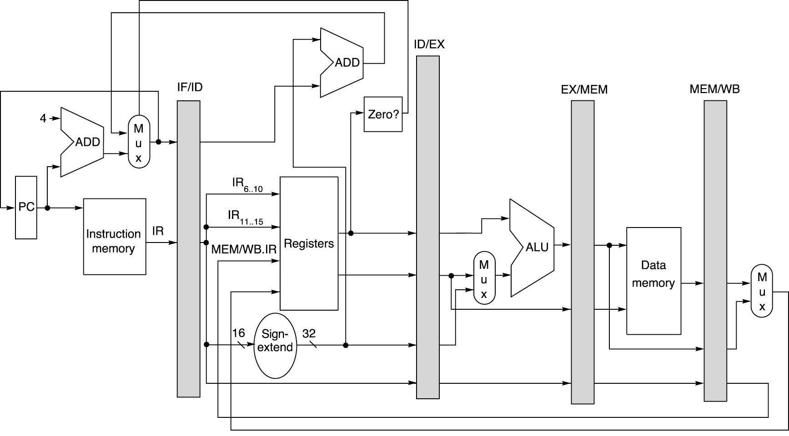
Recall MIPS 5-stage Pipeline
Figure: Dave Patterson

Slide 5
MIPS Prediction CPI
Assume
  20% of instructions are branches
  53% of branches are taken
Predict not taken
  CPI = 1 + 20% * (53%*1 + 47%*0) = 1.106
Predict taken
  CPI = 1 + 20% * (53%*1 + 47%*1) = 1.2
Penalty for being wrong
Penalty for being wrong
Penalty for not having the address ready in time

Slide 6
How to do Better?
Already moved branch logic to ID stage
Need something in IF stage
Only state available: PC
  Set at end of one cycle / beginning of next

Slide 7
Branch Target Buffer
Predict target address and taken/not taken based on PC
Works if you’ve seen a branch at that PC before. Only store if PC held a branch.
Cache predicted address based on address of branch instruction
Cache data to make a prediction on whether the branch is actually taken.

Slide 8
Branch Target Buffer in MIPS
BTB
Figure: Dave Patterson

Slide 9
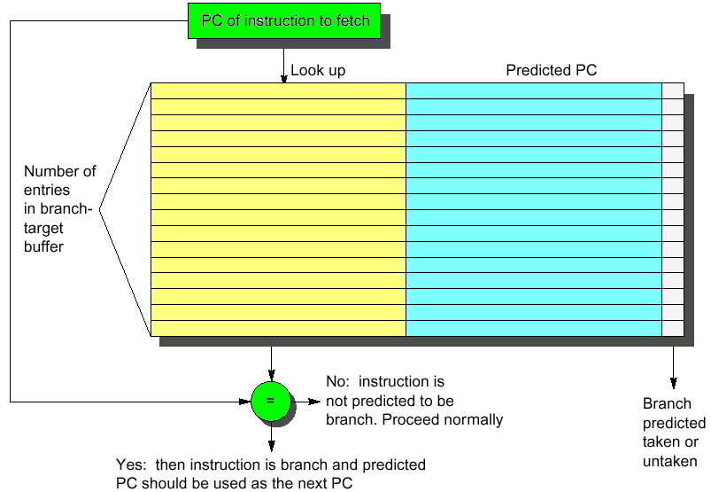
Branch Target Buffer
Branch PCs
Target PCs

Slide 10
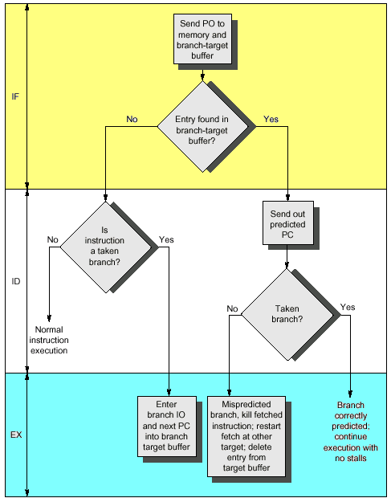
Handling Branch Target Cache
No branch delay if the a branch prediction entry is found and is correct
A penalty of one cycle is imposed for a wrong prediction or a cache miss
Cache update on misprediction and misses can extend the time penalty
Dealing with misses or misprediction is expensive and should be optimized

Slide 11
Basic Branch Prediction
Simplest dynamic branch-prediction scheme
  Use a branch history table to track when the branch was taken and not taken
  Branch history table is a 1-bit buffer indexed by lower bits of PC address where the bit is set to reflect the whether or not the branch was taken last time
Performance = ƒ(accuracy, cost of misprediction)
Problem: in a nested loop, 1-bit branch history table will cause two mispredictions:
  End of loop case, when it exits instead of looping
  First time through loop on next time through code, when it predicts exit instead of looping

Slide 12
2-bit Branch History Table
A two-bit buffer better captures the history of the branch instruction
Initialize to weak prediction of not taken
A prediction must miss twice to change
Taken
Taken
Taken
Predict Not Taken
Predict Not Taken
Predict Taken
Predict Taken
Not Taken
Not Taken
Not Taken
Strong
prediction
Weak
prediction
Weak
prediction
Strong
prediction

Slide 13
N-bit Predictors
Implement instead as n-bit counter
  For every entry in the prediction buffer
  Increment/decrement if branch taken/not
  If the top bit is 1, predict taken
Slow to change prediction, but can
Taken
Taken
Taken
Predict Not Taken
Predict Not Taken
Predict Taken
Predict Taken
00
01
10
11
Not Taken
Not Taken
Not Taken

Slide 14
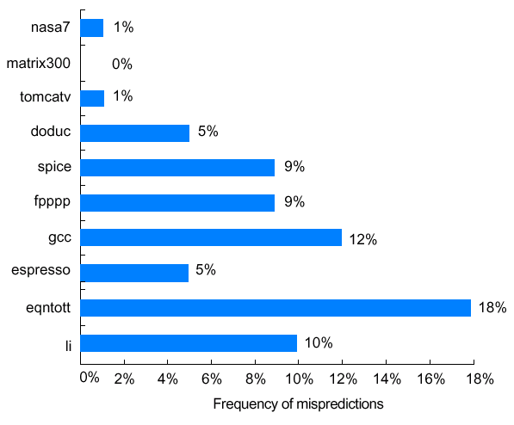
Performance of 2-bit Branch Buffer
Prediction accuracy of a 4096-entry prediction buffer ranges from 82% to 99% for the SPEC89 benchmarks
The performance impact depends on frequency of branching instructions and the penalty of misprediction
SPEC89 benchmarks

Slide 15
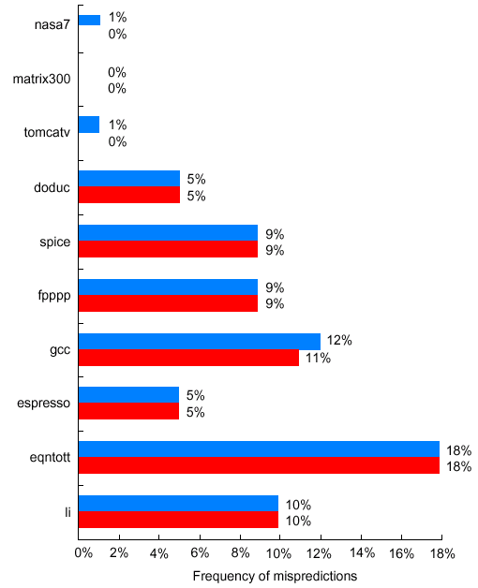
Optimal Size for 2-bit Branch Buffers
Buffer size has little impact beyond a certain size
Misprediction is because either:
  Wrong guess for that branch
  Got branch history of wrong branch (different branches with same low-bits of PC)
SPEC89 benchmarks
4096 entries (2 bits/entry)
Unlimited entries (2 bits/entry)

Slide 16
Correlating Predictors
  DSUBUI R3, R1, #2
  BNEZ R3, L1 ; branch b1 (aa!=2)
  ANDI R1, R1, #0 ; aa=0
L1: SUBUI R3, R2, #2
  BNEZ R3, L2 ; branch b2 (bb!=2)
  ANDI R2, R2, #0 ; bb=0
L2: SUBU R3, R1, R2 ; R3=aa-bb
  BEQZ R3, L3 ; branch b3 (aa==bb)
If (aa == 2)
aa = 0;
If (bb == 2)
bb = 0;
If (aa != bb) {
The behavior of branch b3 is correlated with the behavior of b1 and b2
Clearly if both branches b1 and b2 are untaken, then b3 will be taken
A predictor that uses only the behavior of a single branch to predict the outcome of that branch can never capture this behavior
Branch predictors that use the behavior of other branches to make a prediction are called correlating or two-level predictors
Hypothesis: recent branches are correlated; that is, behavior of
recently executed branches affects prediction of current branch

Slide 17
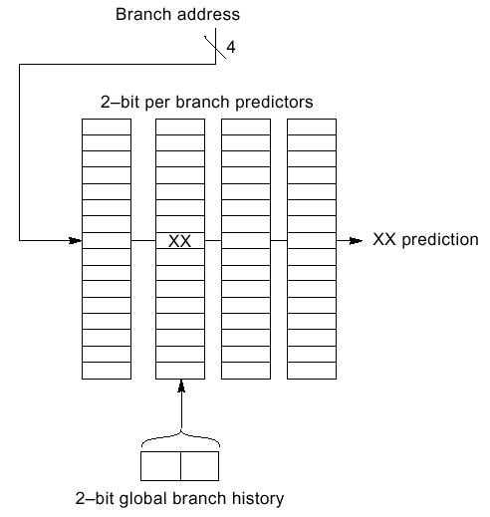
(2,2) Correlating Predictors
Record m most recently executed branches as taken or not taken, and use that pattern to select the proper branch history table
(m,n) predictor means record last m branches to select between 2^{m} history tables each with n-bit counters
  Old 2-bit branch history table is a (0,2) predictor
In a (2,2) predictor, the behavior of recent branches selects between, four predictions of next branch, updating just that prediction
Total size = 2^{m} × n × # prediction entries selected by branch address

Slide 18
Example
Assume that d has values 0, 1, or 2
(alternating between 0, 2 as we enter this segment)
Assume that the sequence will be executed repeatedly
Ignore all other branches including those causing the sequence to repeat (to simplify my example)
All branches are initially predicted to untaken state
if (d==0)
d=1;
if (d==1)
….
d = 4 - 2*d;
  BNEZ R1, L1 ; branch b1 (d!=0)
  DADDI R1, R0, #1 ; d==0, sp d=1
L1: DSUBUI R3, R1, #1
  BNEZ R3, L2 ; branch b2 (d!=1)
….
L2:

Slide 19
(0-1) Predictor
Tag | Predicted PC | Pred
BNEZ R1,L1 ; b1
DADDI R1,R0,#1
L1: DSUBI R3,R1,#1
BNEZ R3,L2 ; b2
…
L2:
d | b1 |  |  | b2
 | pred | action | new | pred | action | new
2
0
2
0

Slide 20
(0-1) Predictor
Tag | Predicted PC | Pred
b1 | L1 | NT
BNEZ R1,L1 ; b1
DADDI R1,R0,#1
L1: DSUBI R3,R1,#1
BNEZ R3,L2 ; b2
…
L2:
d | b1 |  |  | b2
 | pred | action | new | pred | action | new
2 | NT
0
2
0

Slide 21
(0-1) Predictor
Tag | Predicted PC | Pred
b1 | L1 | T
BNEZ R1,L1 ; b1
DADDI R1,R0,#1
L1: DSUBI R3,R1,#1
BNEZ R3,L2 ; b2
…
L2:
d | b1 |  |  | b2
 | pred | action | new | pred | action | new
2 | NT | T | T
0
2
0

Slide 22
(0-1) Predictor
Tag | Predicted PC | Pred
b1 | L1 | T
BNEZ R1,L1 ; b1
DADDI R1,R0,#1
L1: DSUBI R3,R1,#1
BNEZ R3,L2 ; b2
…
L2:
d | b1 |  |  | b2
 | pred | action | new | pred | action | new
2 | NT | T | T
0
2
0

Slide 23
(0-1) Predictor
Tag | Predicted PC | Pred
b1 | L1 | T
b2 | L2 | T
BNEZ R1,L1 ; b1
DADDI R1,R0,#1
L1: DSUBI R3,R1,#1
BNEZ R3,L2 ; b2
…
L2:
d | b1 |  |  | b2
 | pred | action | new | pred | action | new
2 | NT | T | T | NT | T | T
0
2
0

Slide 24
(0-1) Predictor
Tag | Predicted PC | Pred
b1 | L1 | T
b2 | L2 | T
BNEZ R1,L1 ; b1
DADDI R1,R0,#1
L1: DSUBI R3,R1,#1
BNEZ R3,L2 ; b2
…
L2:
d | b1 |  |  | b2
 | pred | action | new | pred | action | new
2 | NT | T | T | NT | T | T
0 | T
2
0

Slide 25
(0-1) Predictor
Tag | Predicted PC | Pred
b1 | L1 | NT
b2 | L2 | T
BNEZ R1,L1 ; b1
DADDI R1,R0,#1
L1: DSUBI R3,R1,#1
BNEZ R3,L2 ; b2
…
L2:
d | b1 |  |  | b2
 | pred | action | new | pred | action | new
2 | NT | T | T | NT | T | T
0 | T | NT | NT
2
0

Slide 26
(0-1) Predictor
Tag | Predicted PC | Pred
b1 | L1 | NT
b2 | L2 | T
BNEZ R1,L1 ; b1
DADDI R1,R0,#1
L1: DSUBI R3,R1,#1
BNEZ R3,L2 ; b2
…
L2:
d | b1 |  |  | b2
 | pred | action | new | pred | action | new
2 | NT | T | T | NT | T | T
0 | T | NT | NT | T
2
0

Slide 27
(0-1) Predictor
Tag | Predicted PC | Pred
b1 | L1 | NT
b2 | L2 | NT
BNEZ R1,L1 ; b1
DADDI R1,R0,#1
L1: DSUBI R3,R1,#1
BNEZ R3,L2 ; b2
…
L2:
d | b1 |  |  | b2
 | pred | action | new | pred | action | new
2 | NT | T | T | NT | T | T
0 | T | NT | NT | T | NT | NT
2
0

Slide 28
(0-1) Predictor
Tag | Predicted PC | Pred
b1 | L1 | NT
b2 | L2 | NT
BNEZ R1,L1 ; b1
DADDI R1,R0,#1
L1: DSUBI R3,R1,#1
BNEZ R3,L2 ; b2
…
L2:
d | b1 |  |  | b2
 | pred | action | new | pred | action | new
2 | NT | T | T | NT | T | T
0 | T | NT | NT | T | NT | NT
2 | NT
0

Slide 29
(0-1) Predictor
Tag | Predicted PC | Pred
b1 | L1 | T
b2 | L2 | NT
BNEZ R1,L1 ; b1
DADDI R1,R0,#1
L1: DSUBI R3,R1,#1
BNEZ R3,L2 ; b2
…
L2:
d | b1 |  |  | b2
 | pred | action | new | pred | action | new
2 | NT | T | T | NT | T | T
0 | T | NT | NT | T | NT | NT
2 | NT | T | T
0

Slide 30
(0-1) Predictor
Tag | Predicted PC | Pred
b1 | L1 | T
b2 | L2 | NT
BNEZ R1,L1 ; b1
DADDI R1,R0,#1
L1: DSUBI R3,R1,#1
BNEZ R3,L2 ; b2
…
L2:
d | b1 |  |  | b2
 | pred | action | new | pred | action | new
2 | NT | T | T | NT | T | T
0 | T | NT | NT | T | NT | NT
2 | NT | T | T | NT
0

Slide 31
(0-1) Predictor
Tag | Predicted PC | Pred
b1 | L1 | T
b2 | L2 | T
BNEZ R1,L1 ; b1
DADDI R1,R0,#1
L1: DSUBI R3,R1,#1
BNEZ R3,L2 ; b2
…
L2:
d | b1 |  |  | b2
 | pred | action | new | pred | action | new
2 | NT | T | T | NT | T | T
0 | T | NT | NT | T | NT | NT
2 | NT | T | T | NT | T | T
0

Slide 32
(0-1) Predictor
Tag | Predicted PC | Pred
b1 | L1 | T
b2 | L2 | T
BNEZ R1,L1 ; b1
DADDI R1,R0,#1
L1: DSUBI R3,R1,#1
BNEZ R3,L2 ; b2
…
L2:
d | b1 |  |  | b2
 | pred | action | new | pred | action | new
2 | NT | T | T | NT | T | T
0 | T | NT | NT | T | NT | NT
2 | NT | T | T | NT | T | T
0 | T

Slide 33
(0-1) Predictor
Tag | Predicted PC | Pred
b1 | L1 | NT
b2 | L2 | T
BNEZ R1,L1 ; b1
DADDI R1,R0,#1
L1: DSUBI R3,R1,#1
BNEZ R3,L2 ; b2
…
L2:
d | b1 |  |  | b2
 | pred | action | new | pred | action | new
2 | NT | T | T | NT | T | T
0 | T | NT | NT | T | NT | NT
2 | NT | T | T | NT | T | T
0 | T | NT | NT

Slide 34
(0-1) Predictor
Tag | Predicted PC | Pred
b1 | L1 | NT
b2 | L2 | T
BNEZ R1,L1 ; b1
DADDI R1,R0,#1
L1: DSUBI R3,R1,#1
BNEZ R3,L2 ; b2
…
L2:
d | b1 |  |  | b2
 | pred | action | new | pred | action | new
2 | NT | T | T | NT | T | T
0 | T | NT | NT | T | NT | NT
2 | NT | T | T | NT | T | T
0 | T | NT | NT | T

Slide 35
(0-1) Predictor
Tag | Predicted PC | Pred
b1 | L1 | NT
b2 | L2 | NT
BNEZ R1,L1 ; b1
DADDI R1,R0,#1
L1: DSUBI R3,R1,#1
BNEZ R3,L2 ; b2
…
L2:
d | b1 |  |  | b2
 | pred | action | new | pred | action | new
2 | NT | T | T | NT | T | T
0 | T | NT | NT | T | NT | NT
2 | NT | T | T | NT | T | T
0 | T | NT | NT | T | NT | NT

Slide 36
(0-1) Predictor
Wrong 100% of the time!
d | b1 |  |  | b2
 | pred | action | new | pred | action | new
2 | NT | T | T | NT | T | T
0 | T | NT | NT | T | NT | NT
2 | NT | T | T | NT | T | T
0 | T | NT | NT | T | NT | NT

Slide 37
(1-1) Predictor
Tag | Predicted PC | History
 |  | NT | T
BNEZ R1,L1 ; b1
DADDI R1,R0,#1
L1: DSUBI R3,R1,#1
BNEZ R3,L2 ; b2
…
L2:
d | b1 |  |  |  | b2
 | prev | pred | action | new | prev | pred | action | new
2
0
2
0

Slide 38
(1-1) Predictor
Tag | Predicted PC | History
 |  | NT | T
b1 | L1 | NT | NT
BNEZ R1,L1 ; b1
DADDI R1,R0,#1
L1: DSUBI R3,R1,#1
BNEZ R3,L2 ; b2
…
L2:
d | b1 |  |  |  | b2
 | prev | pred | action | new | prev | pred | action | new
2 | NT | NT
0
2
0

Slide 39
(1-1) Predictor
Tag | Predicted PC | History
 |  | NT | T
b1 | L1 | T | NT
BNEZ R1,L1 ; b1
DADDI R1,R0,#1
L1: DSUBI R3,R1,#1
BNEZ R3,L2 ; b2
…
L2:
d | b1 |  |  |  | b2
 | prev | pred | action | new | prev | pred | action | new
2 | NT | NT | T | T
0
2
0

Slide 40
(1-1) Predictor
Tag | Predicted PC | History
 |  | NT | T
b1 | L1 | T | NT
BNEZ R1,L1 ; b1
DADDI R1,R0,#1
L1: DSUBI R3,R1,#1
BNEZ R3,L2 ; b2
…
L2:
d | b1 |  |  |  | b2
 | prev | pred | action | new | prev | pred | action | new
2 | NT | NT | T | T
0
2
0

Slide 41
(1-1) Predictor
Tag | Predicted PC | History
 |  | NT | T
b1 | L1 | T | NT
b2 | L2 | NT | NT
BNEZ R1,L1 ; b1
DADDI R1,R0,#1
L1: DSUBI R3,R1,#1
BNEZ R3,L2 ; b2
…
L2:
d | b1 |  |  |  | b2
 | prev | pred | action | new | prev | pred | action | new
2 | NT | NT | T | T | T | NT
0
2
0

Slide 42
(1-1) Predictor
Tag | Predicted PC | History
 |  | NT | T
b1 | L1 | T | NT
b2 | L2 | NT | T
BNEZ R1,L1 ; b1
DADDI R1,R0,#1
L1: DSUBI R3,R1,#1
BNEZ R3,L2 ; b2
…
L2:
d | b1 |  |  |  | b2
 | prev | pred | action | new | prev | pred | action | new
2 | NT | NT | T | T | T | NT | T | T
0
2
0

Slide 43
(1-1) Predictor
Tag | Predicted PC | History
 |  | NT | T
b1 | L1 | T | NT
b2 | L2 | NT | T
BNEZ R1,L1 ; b1
DADDI R1,R0,#1
L1: DSUBI R3,R1,#1
BNEZ R3,L2 ; b2
…
L2:
d | b1 |  |  |  | b2
 | prev | pred | action | new | prev | pred | action | new
2 | NT | NT | T | T | T | NT | T | T
0 | T | NT
2
0

Slide 44
(1-1) Predictor
Tag | Predicted PC | History
 |  | NT | T
b1 | L1 | T | NT
b2 | L2 | NT | T
BNEZ R1,L1 ; b1
DADDI R1,R0,#1
L1: DSUBI R3,R1,#1
BNEZ R3,L2 ; b2
…
L2:
d | b1 |  |  |  | b2
 | prev | pred | action | new | prev | pred | action | new
2 | NT | NT | T | T | T | NT | T | T
0 | T | NT | NT | NT
2
0

Slide 45
(1-1) Predictor
Tag | Predicted PC | History
 |  | NT | T
b1 | L1 | T | NT
b2 | L2 | NT | T
BNEZ R1,L1 ; b1
DADDI R1,R0,#1
L1: DSUBI R3,R1,#1
BNEZ R3,L2 ; b2
…
L2:
d | b1 |  |  |  | b2
 | prev | pred | action | new | prev | pred | action | new
2 | NT | NT | T | T | T | NT | T | T
0 | T | NT | NT | NT | NT | NT
2
0

Slide 46
(1-1) Predictor
Tag | Predicted PC | History
 |  | NT | T
b1 | L1 | T | NT
b2 | L2 | NT | T
BNEZ R1,L1 ; b1
DADDI R1,R0,#1
L1: DSUBI R3,R1,#1
BNEZ R3,L2 ; b2
…
L2:
d | b1 |  |  |  | b2
 | prev | pred | action | new | prev | pred | action | new
2 | NT | NT | T | T | T | NT | T | T
0 | T | NT | NT | NT | NT | NT | NT | NT
2
0

Slide 47
(1-1) Predictor
Tag | Predicted PC | History
 |  | NT | T
b1 | L1 | T | NT
b2 | L2 | NT | T
BNEZ R1,L1 ; b1
DADDI R1,R0,#1
L1: DSUBI R3,R1,#1
BNEZ R3,L2 ; b2
…
L2:
d | b1 |  |  |  | b2
 | prev | pred | action | new | prev | pred | action | new
2 | NT | NT | T | T | T | NT | T | T
0 | T | NT | NT | NT | NT | NT | NT | NT
2 | NT | T
0

Slide 48
(1-1) Predictor
Tag | Predicted PC | History
 |  | NT | T
b1 | L1 | T | NT
b2 | L2 | NT | T
BNEZ R1,L1 ; b1
DADDI R1,R0,#1
L1: DSUBI R3,R1,#1
BNEZ R3,L2 ; b2
…
L2:
d | b1 |  |  |  | b2
 | prev | pred | action | new | prev | pred | action | new
2 | NT | NT | T | T | T | NT | T | T
0 | T | NT | NT | NT | NT | NT | NT | NT
2 | NT | T | T | T
0

Slide 49
(1-1) Predictor
Tag | Predicted PC | History
 |  | NT | T
b1 | L1 | T | NT
b2 | L2 | NT | T
BNEZ R1,L1 ; b1
DADDI R1,R0,#1
L1: DSUBI R3,R1,#1
BNEZ R3,L2 ; b2
…
L2:
d | b1 |  |  |  | b2
 | prev | pred | action | new | prev | pred | action | new
2 | NT | NT | T | T | T | NT | T | T
0 | T | NT | NT | NT | NT | NT | NT | NT
2 | NT | T | T | T | T | T
0

Slide 50
(1-1) Predictor
Tag | Predicted PC | History
 |  | NT | T
b1 | L1 | T | NT
b2 | L2 | NT | T
BNEZ R1,L1 ; b1
DADDI R1,R0,#1
L1: DSUBI R3,R1,#1
BNEZ R3,L2 ; b2
…
L2:
d | b1 |  |  |  | b2
 | prev | pred | action | new | prev | pred | action | new
2 | NT | NT | T | T | T | NT | T | T
0 | T | NT | NT | NT | NT | NT | NT | NT
2 | NT | T | T | T | T | T | T | T
0

Slide 51
(1-1) Predictor
Tag | Predicted PC | History
 |  | NT | T
b1 | L1 | T | NT
b2 | L2 | NT | T
BNEZ R1,L1 ; b1
DADDI R1,R0,#1
L1: DSUBI R3,R1,#1
BNEZ R3,L2 ; b2
…
L2:
d | b1 |  |  |  | b2
 | prev | pred | action | new | prev | pred | action | new
2 | NT | NT | T | T | T | NT | T | T
0 | T | NT | NT | NT | NT | NT | NT | NT
2 | NT | T | T | T | T | T | T | T
0 | T | NT

Slide 52
(1-1) Predictor
Tag | Predicted PC | History
 |  | NT | T
b1 | L1 | T | NT
b2 | L2 | NT | T
BNEZ R1,L1 ; b1
DADDI R1,R0,#1
L1: DSUBI R3,R1,#1
BNEZ R3,L2 ; b2
…
L2:
d | b1 |  |  |  | b2
 | prev | pred | action | new | prev | pred | action | new
2 | NT | NT | T | T | T | NT | T | T
0 | T | NT | NT | NT | NT | NT | NT | NT
2 | NT | T | T | T | T | T | T | T
0 | T | NT | NT | NT

Slide 53
(1-1) Predictor
Tag | Predicted PC | History
 |  | NT | T
b1 | L1 | T | NT
b2 | L2 | NT | T
BNEZ R1,L1 ; b1
DADDI R1,R0,#1
L1: DSUBI R3,R1,#1
BNEZ R3,L2 ; b2
…
L2:
d | b1 |  |  |  | b2
 | prev | pred | action | new | prev | pred | action | new
2 | NT | NT | T | T | T | NT | T | T
0 | T | NT | NT | NT | NT | NT | NT | NT
2 | NT | T | T | T | T | T | T | T
0 | T | NT | NT | NT | NT | NT

Slide 54
(1-1) Predictor
Tag | Predicted PC | History
 |  | NT | T
b1 | L1 | T | NT
b2 | L2 | NT | T
BNEZ R1,L1 ; b1
DADDI R1,R0,#1
L1: DSUBI R3,R1,#1
BNEZ R3,L2 ; b2
…
L2:
d | b1 |  |  |  | b2
 | prev | pred | action | new | prev | pred | action | new
2 | NT | NT | T | T | T | NT | T | T
0 | T | NT | NT | NT | NT | NT | NT | NT
2 | NT | T | T | T | T | T | T | T
0 | T | NT | NT | NT | NT | NT | NT | NT

Slide 55
(1-1) Predictor
No mispredictions after first iteration
d | b1 |  |  |  | b2
 | prev | pred | action | new | prev | pred | action | new
2 | NT | NT | T | T | T | NT | T | T
0 | T | NT | NT | NT | NT | NT | NT | NT
2 | NT | T | T | T | T | T | T | T
0 | T | NT | NT | NT | NT | NT | NT | NT

Slide 56
Correlating predictor effectiveness

Slide 57
Adaptive Predictors
M-branch History
Pattern History: 2^{M} N-bit predictors
1
1
0
Local (per-branch) branch history,
Local pattern history
  Complex per-branch patterns
  E.g. (i % 3 != 0) in a loop
  Patterns up to M in length

Slide 58
Adaptive Predictors
M-branch History
Pattern History: 2^{M} N-bit predictors
1
1
0
Global branch history,
Local pattern history
  Correlated branches – (m,n) predictor
  E.g. if (x==0)…; if (x==1)...; if (x==2)...;
  M most recently executed branches
  Unrelated branches add training time

Slide 59
Adaptive Predictors
M-branch History
Pattern History: 2^{M} N-bit predictors
1
1
0
Local branch history,
Global pattern history
  Assume unique patterns, share history memory
  Similar to local/local, but saving memory in exchange for occasional aliasing

Slide 60
Adaptive Predictors
M-branch History
Pattern History: 2^{M} N-bit predictors
1
1
0
Global branch history,
Global pattern history
  Just matches branching pattern
  Similar to correlating predictor, but saving memory in exchange for aliasing

Slide 61
Loop Predictor
Add iteration counter and count register
First time through
  Always predict taken, increment iteration
    Assume it’ll loop again
  When not taken, remember loop count
Subsequent predictions
  Taken N times, Not Taken once
  Taken N times, Not Taken once
  Taken N times, Not Taken once
  …

Slide 62
Loop Predictor
State
  Previous count (initialize to counter max)
  Current count (initialize to 0)
Prediction:
  If (current < previous) predict Taken (loop)
  Else predict Not Taken (end of loop)
Update
  If (actually Taken) current++ (another loop)
  Else previous = current (remember count)

Slide 63
Branch Folding
Unconditional jumps are always taken
Put predicted instruction in BTB
Start executing predicted instruction in place of jump
Makes unconditional jump “free”
Keep enough info to abandon if code changed (JIT compilation)

Slide 64
Return Address
For calls from multiple sites, not clustered in time
Store a fixed-sized stack of return addresses in BTB
Use in place of PC-specific target for any function return

Slide 65
Multiple Predictors
Also called multilevel prediction
Run all predictors
Keep score for each branch
Use predictor that is most effective for that branch

Slide 66
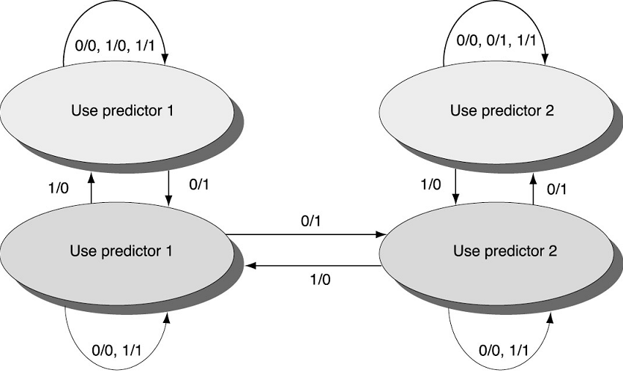
Tournament Predictors
Form of multi-level predictor for 2 choices (can extend to more)
2-bit predictor between choices
  Transition if one predictor
  is WRONG and other
  predictor is RIGHT
  Change after two
  mispredictions the other
  predictor would have
  predicted correctly
Predictor_1/Predictor_2

Slide 67
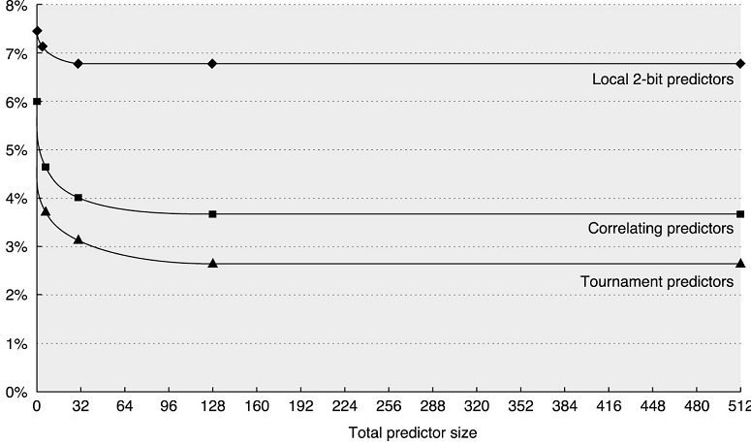
Performance of Tournament Predictors
Based on SPEC 89 benchmark
Conditional branch misprediction rate
Tournament predictors slightly outperform correlating predictors

