Slide 1
CMSC 611: Advanced Computer Architecture
Pipelining
Some material adapted from Mohamed Younis, UMBC CMSC 611 Spr 2003 course slides
Some material adapted from Hennessy & Patterson / © 2003 Elsevier Science

Slide 2
Sequential Laundry
6 PM
7
8
9
10
11
Midnight
Time
30
40
20
30
40
20
30
40
20
30
40
20
T
a
s
k
O
r
d
e
r
A
B
C
D
Washer takes 30 min, Dryer takes 40 min, folding takes 20 min
Sequential laundry takes 6 hours for 4 loads
If they learned pipelining, how long would laundry take?
Slide: Dave Patterson

Slide 3
Pipelined Laundry
6 PM
7
8
9
10
11
Midnight
Time
30
40
40
40
40
20
T
a
s
k
O
r
d
e
r
A
B
C
D
Pipelining means start work as soon as possible
Pipelined laundry takes 3.5 hours for 4 loads
Slide: Dave Patterson

Slide 4
Pipelining Lessons
6 PM
7
8
9
Pipelining doesn’t help latency of single task, it helps throughput of entire workload
Pipeline rate limited by slowest pipeline stage
Multiple tasks operating simultaneously using different resources
Potential speedup = Number pipe stages
Unbalanced lengths of pipe stages reduces speedup
Time to “fill” pipeline and time to “drain” it reduce speedup
Stall for Dependencies
Time
30
40
40
40
40
20
T
a
s
k
O
r
d
e
r
A
B
C
D
Slide: Dave Patterson

Slide 5
Single Cycle
Cycle 1
Cycle 2
Clk
Load
Store
Waste
Cycle time long enough for longest instruction
Shorter instructions waste time
No overlap
Figure: Dave Patterson
Notes:
Here are the timing diagrams showing the differences between the single cycle, multiple cycle, and pipeline implementations.
For example, in the pipeline implementation, we can finish executing the Load, Store, and R-type instruction sequence in seven cycles.
In the multiple clock cycle implementation, however, we cannot start executing the store until Cycle 6 because we must wait for the load instruction to complete.
Similarly, we cannot start the execution of the R-type instruction until the store instruction has completed its execution in Cycle 9.
In the Single Cycle implementation, the cycle time is set to accommodate the longest instruction, the Load instruction.
Consequently, the cycle time for the Single Cycle implementation can be five times longer than the multiple cycle implementation.
But may be more importantly, since the cycle time has to be long enough for the load instruction, it is too long for the store instruction so the last part of the cycle here is wasted.
+2 = 77 min. (X:57)

Slide 6
MIPS Instruction Set
RISC architecture:
  ALU operations only on registers
  Memory is affected only by load and store
  Instructions follow very few formats and typically are of the same size
31
26
21
16
11
6
0
op
rs
rt
rd
shamt
funct
6 bits
5 bits
5 bits
5 bits
5 bits
6 bits
31
26
21
16
0
op
rs
rt
immediate
6 bits
5 bits
5 bits
16 bits
31
26
0
op
target address
6 bits
26 bits

Slide 7
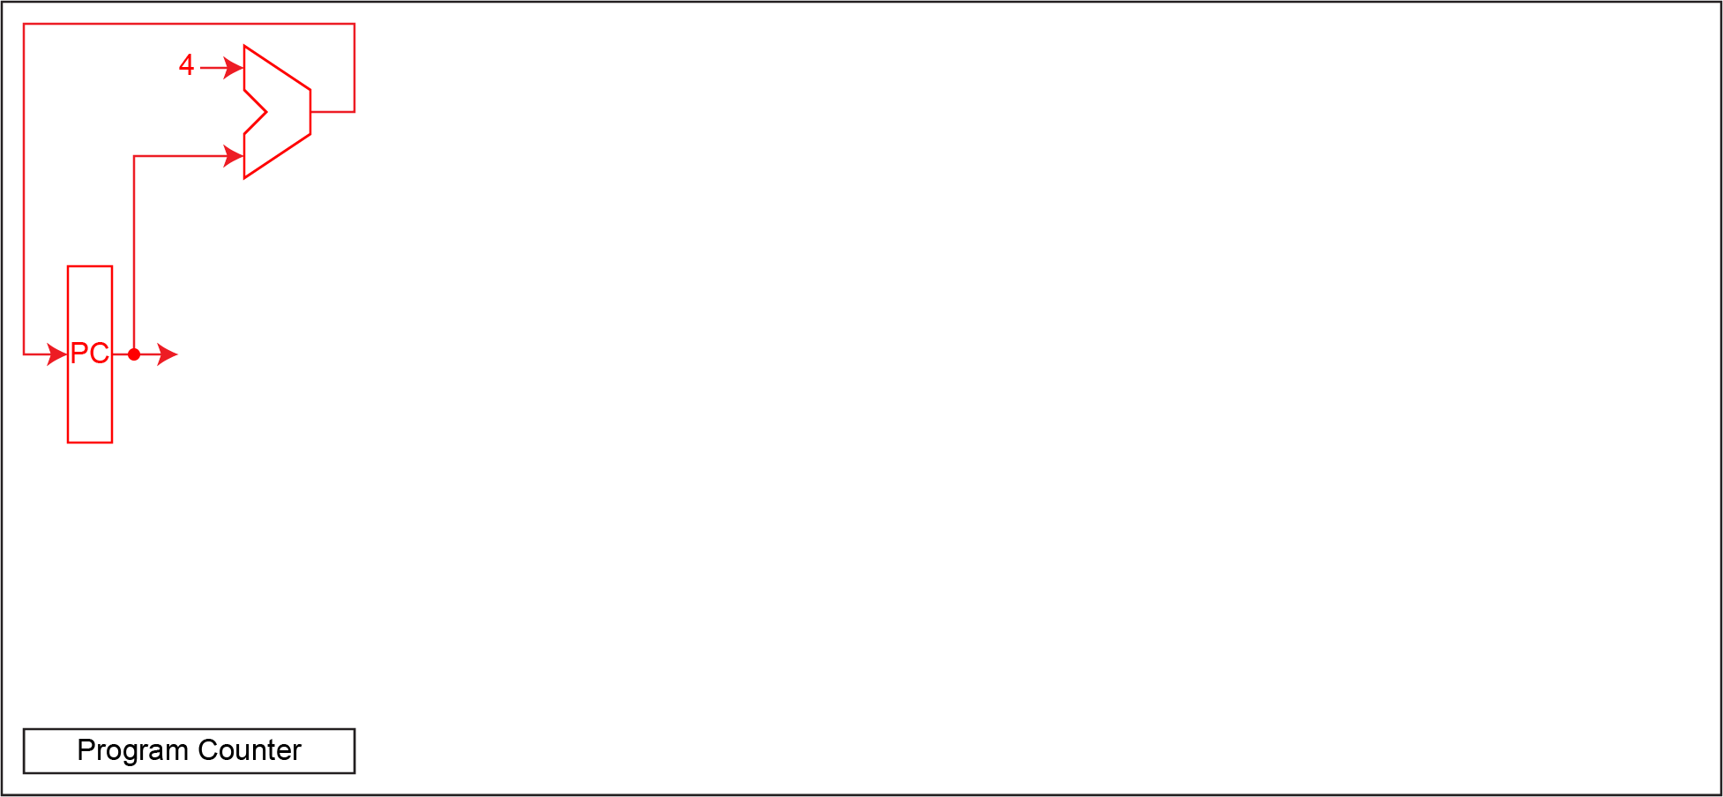
Single Cycle Execution
Need a register for PC
Add 4 each cycle to get next PC

Slide 8
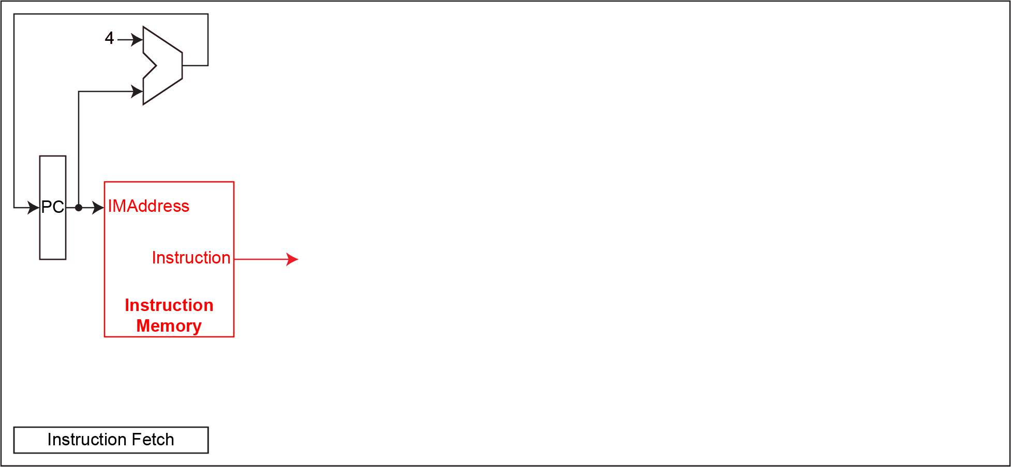
Single Cycle Execution
Fetch instruction at current PC

Slide 9
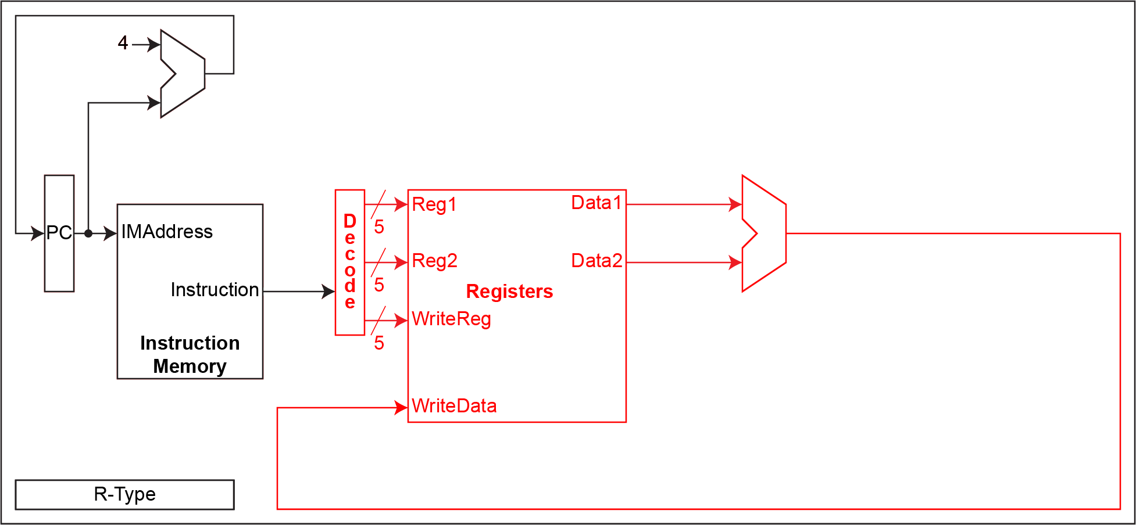
Single Cycle Execution
Fetch 2 registers, do ALU op, write
Fetch at beginning of cycle, write at end

Slide 10
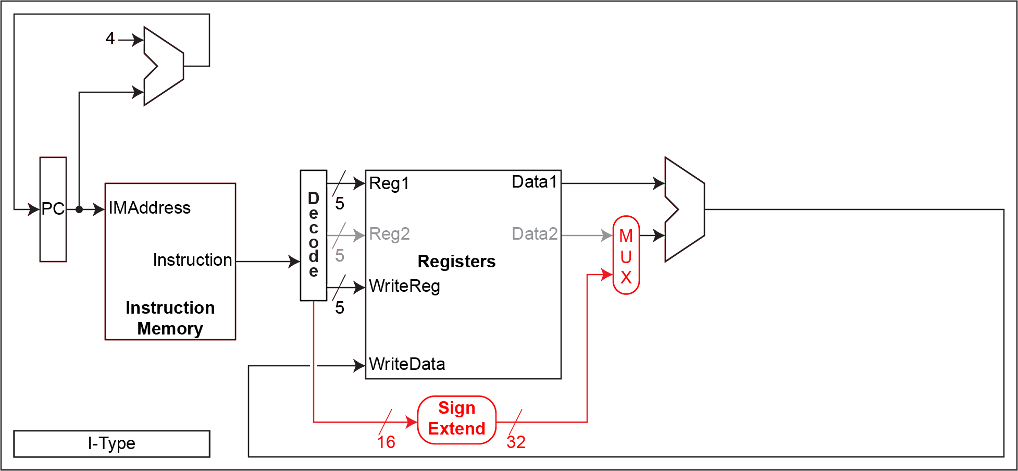
Single Cycle Execution
Use bits from instruction in place of Reg2
Decode sets MUX to select ALU input

Slide 11
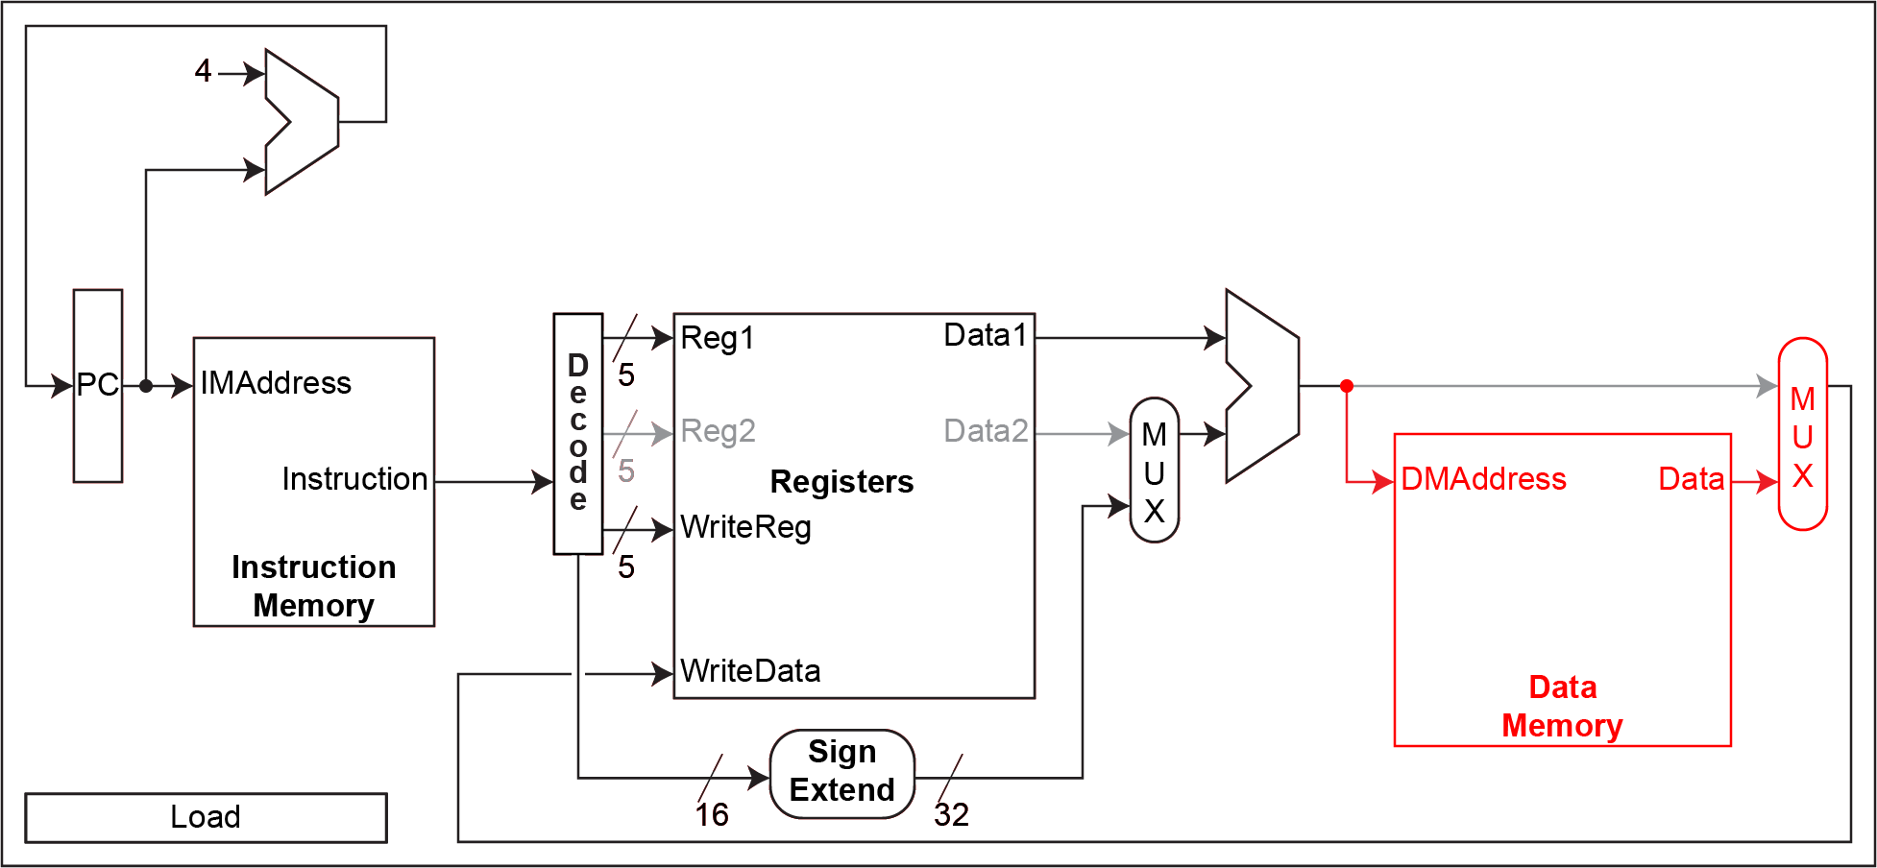
Single Cycle Execution
Use Reg1+Imm as data address
New MUX to select data to write

Slide 12
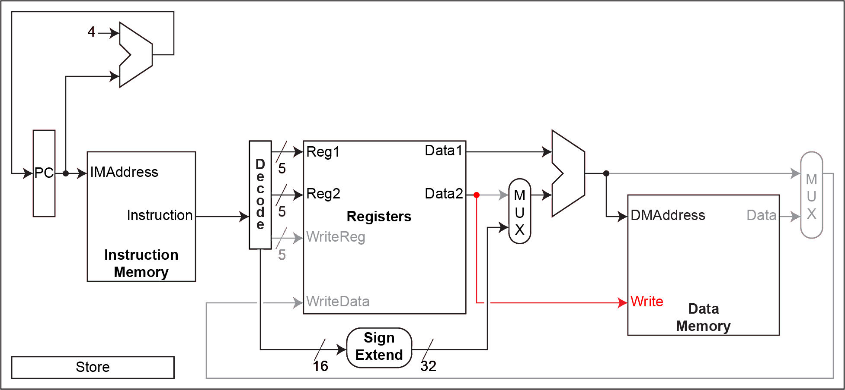
Single Cycle Execution
Store Reg2, ignored by ALU MUX

Slide 13
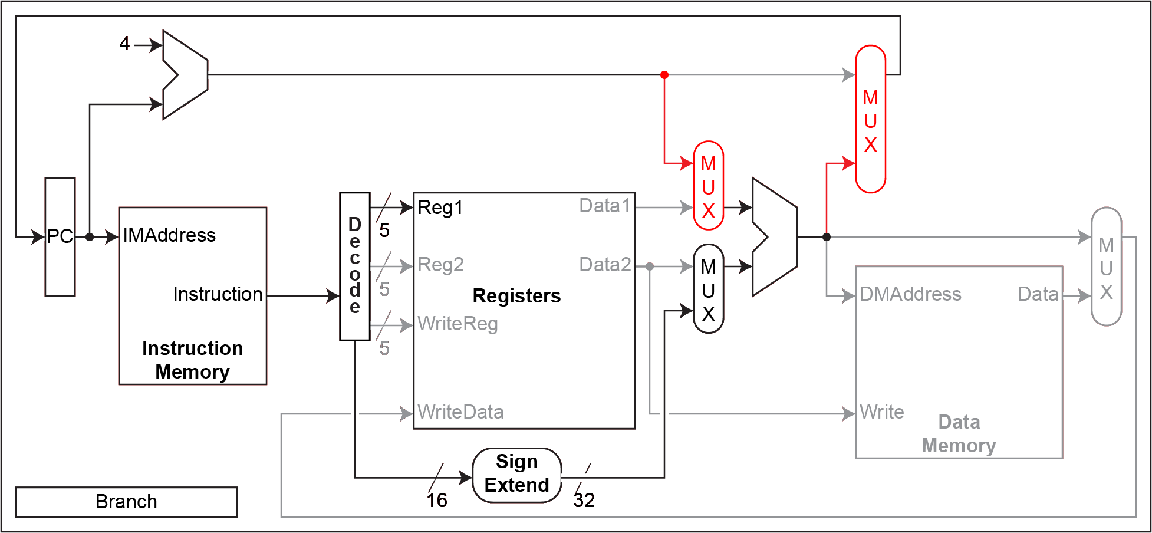
Single Cycle Execution
NextPC as option for 1st ALU input
Choose ALU output as source for PC

Slide 14
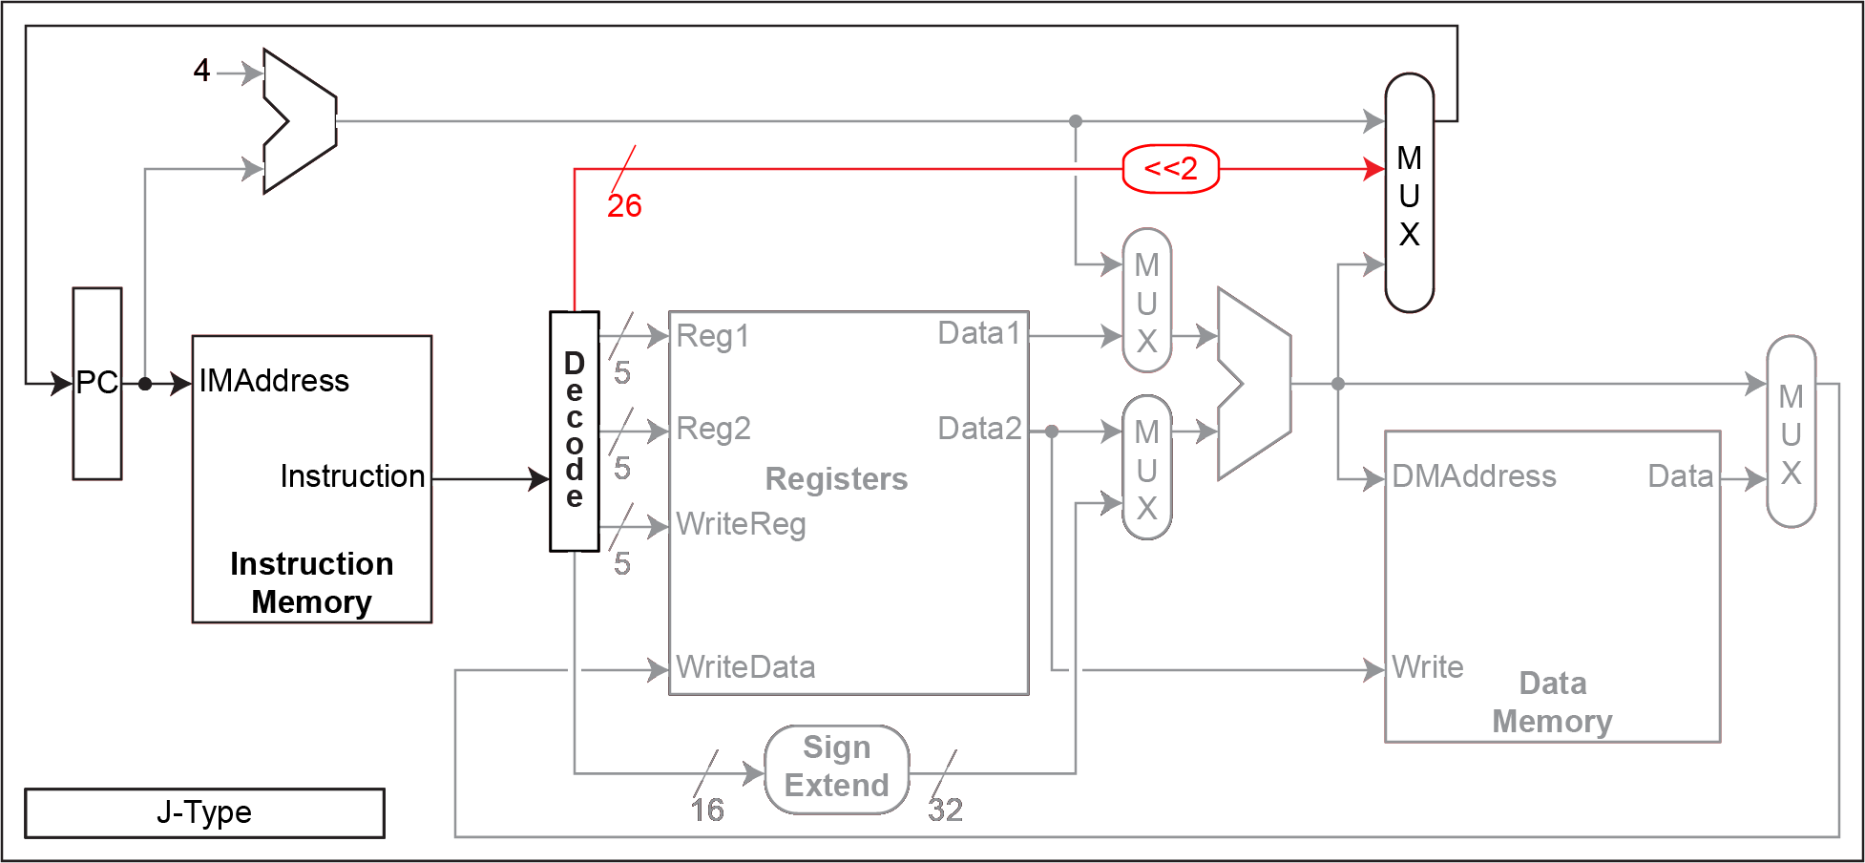
Single Cycle Execution
Another choice for PC from J-type target address

Slide 15
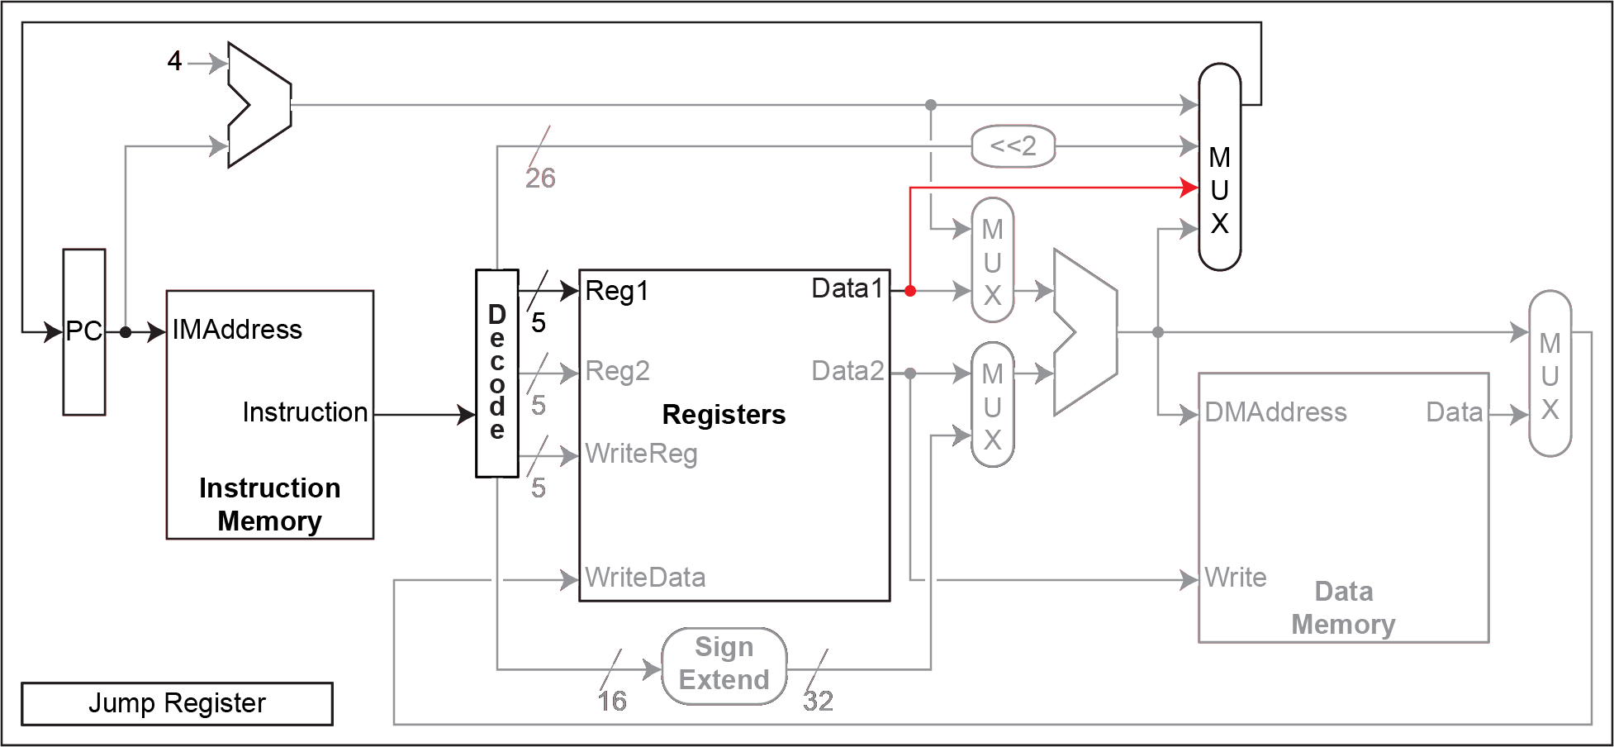
Single Cycle Execution
Yet another choice for PC from Reg1

Slide 16
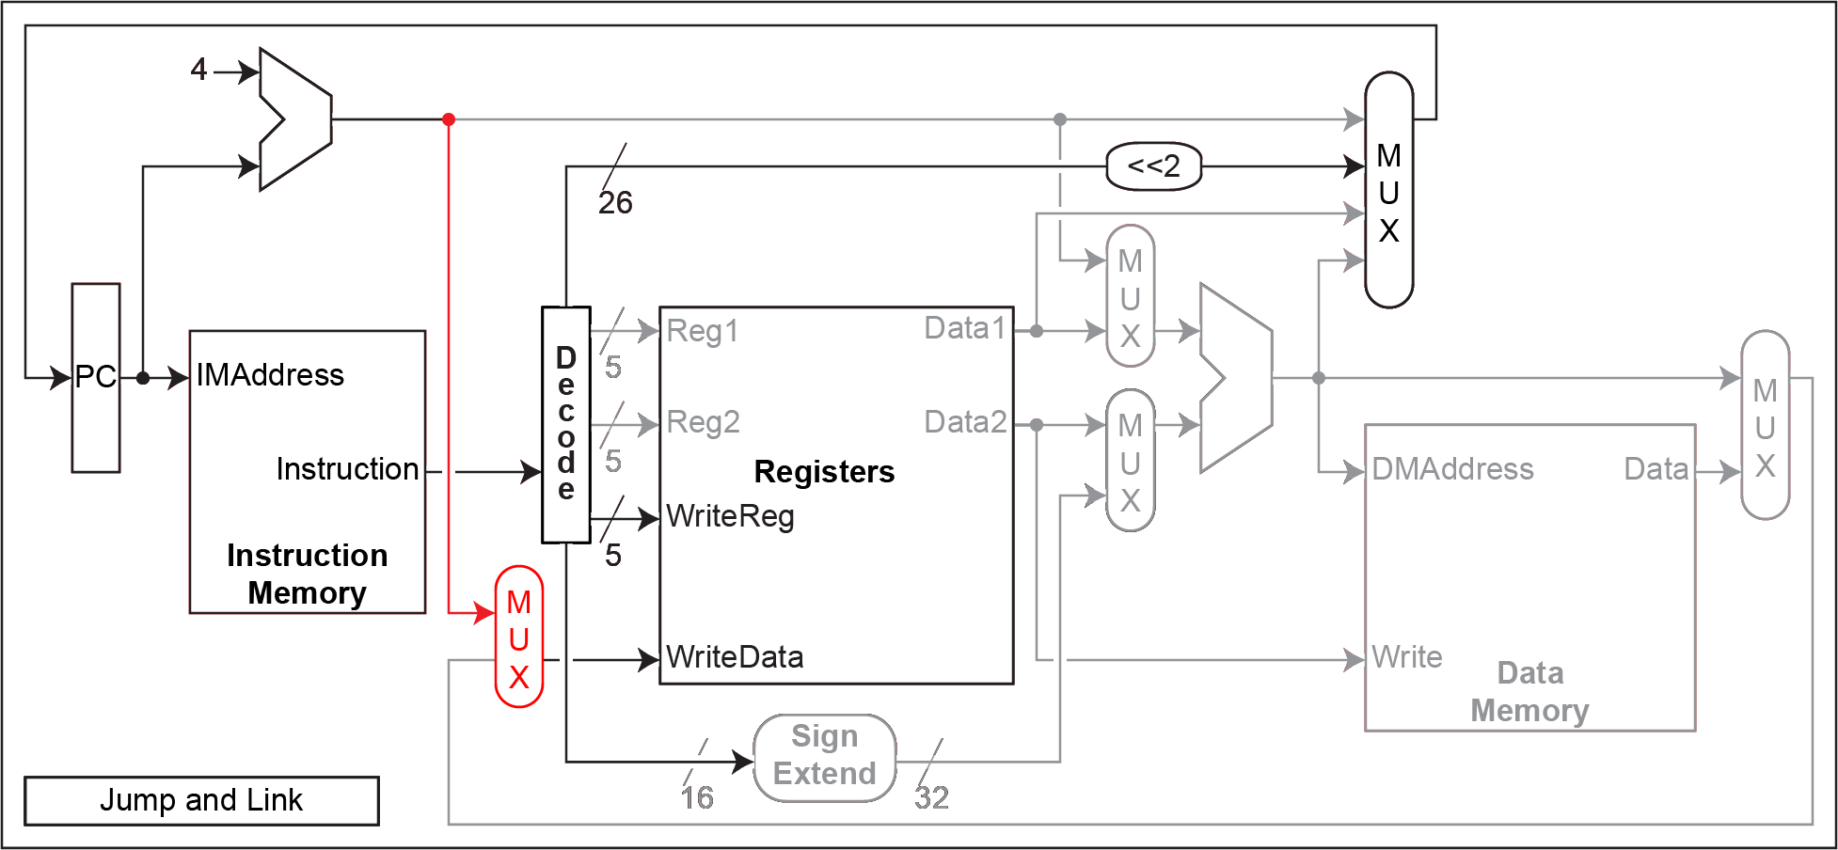
Single Cycle Execution
MIPS Jump-and-link = function call
J-type, with return address saved in R31

Slide 17
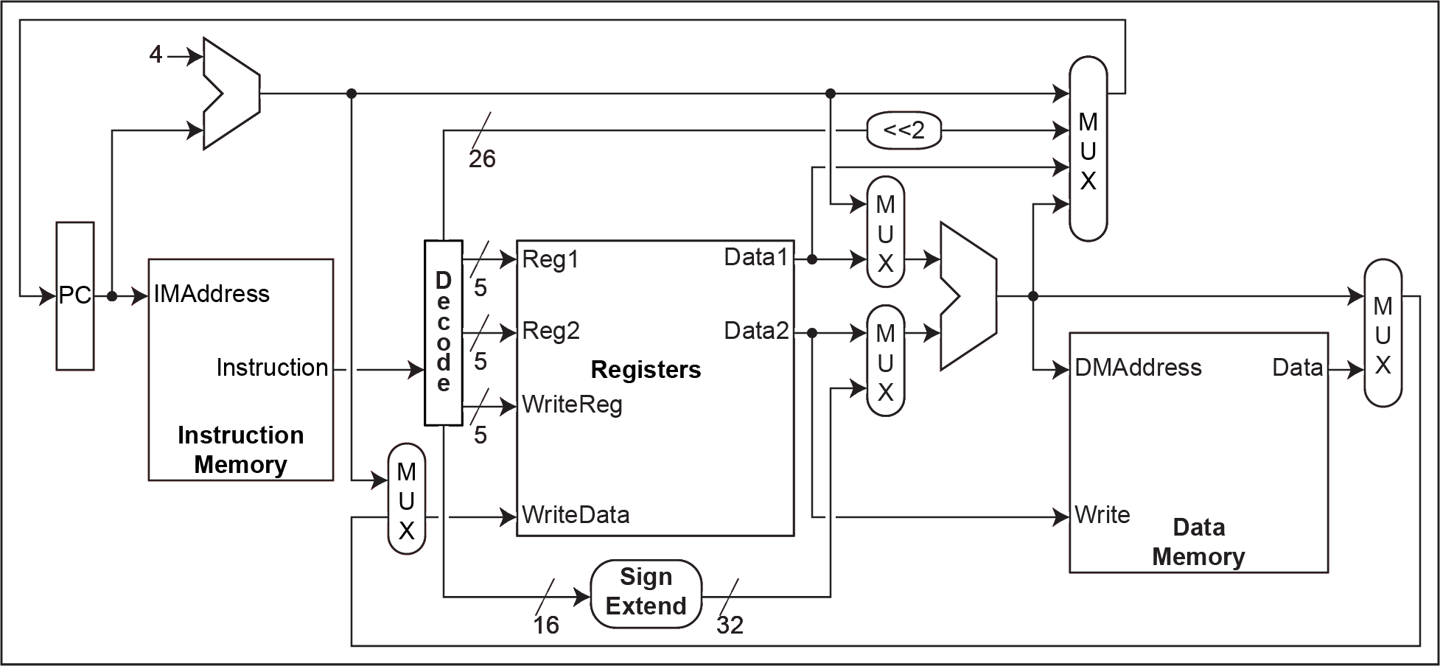
Single Cycle Execution
Longest path = IF + decode + register fetch + ALU + data fetch + register store

Slide 18
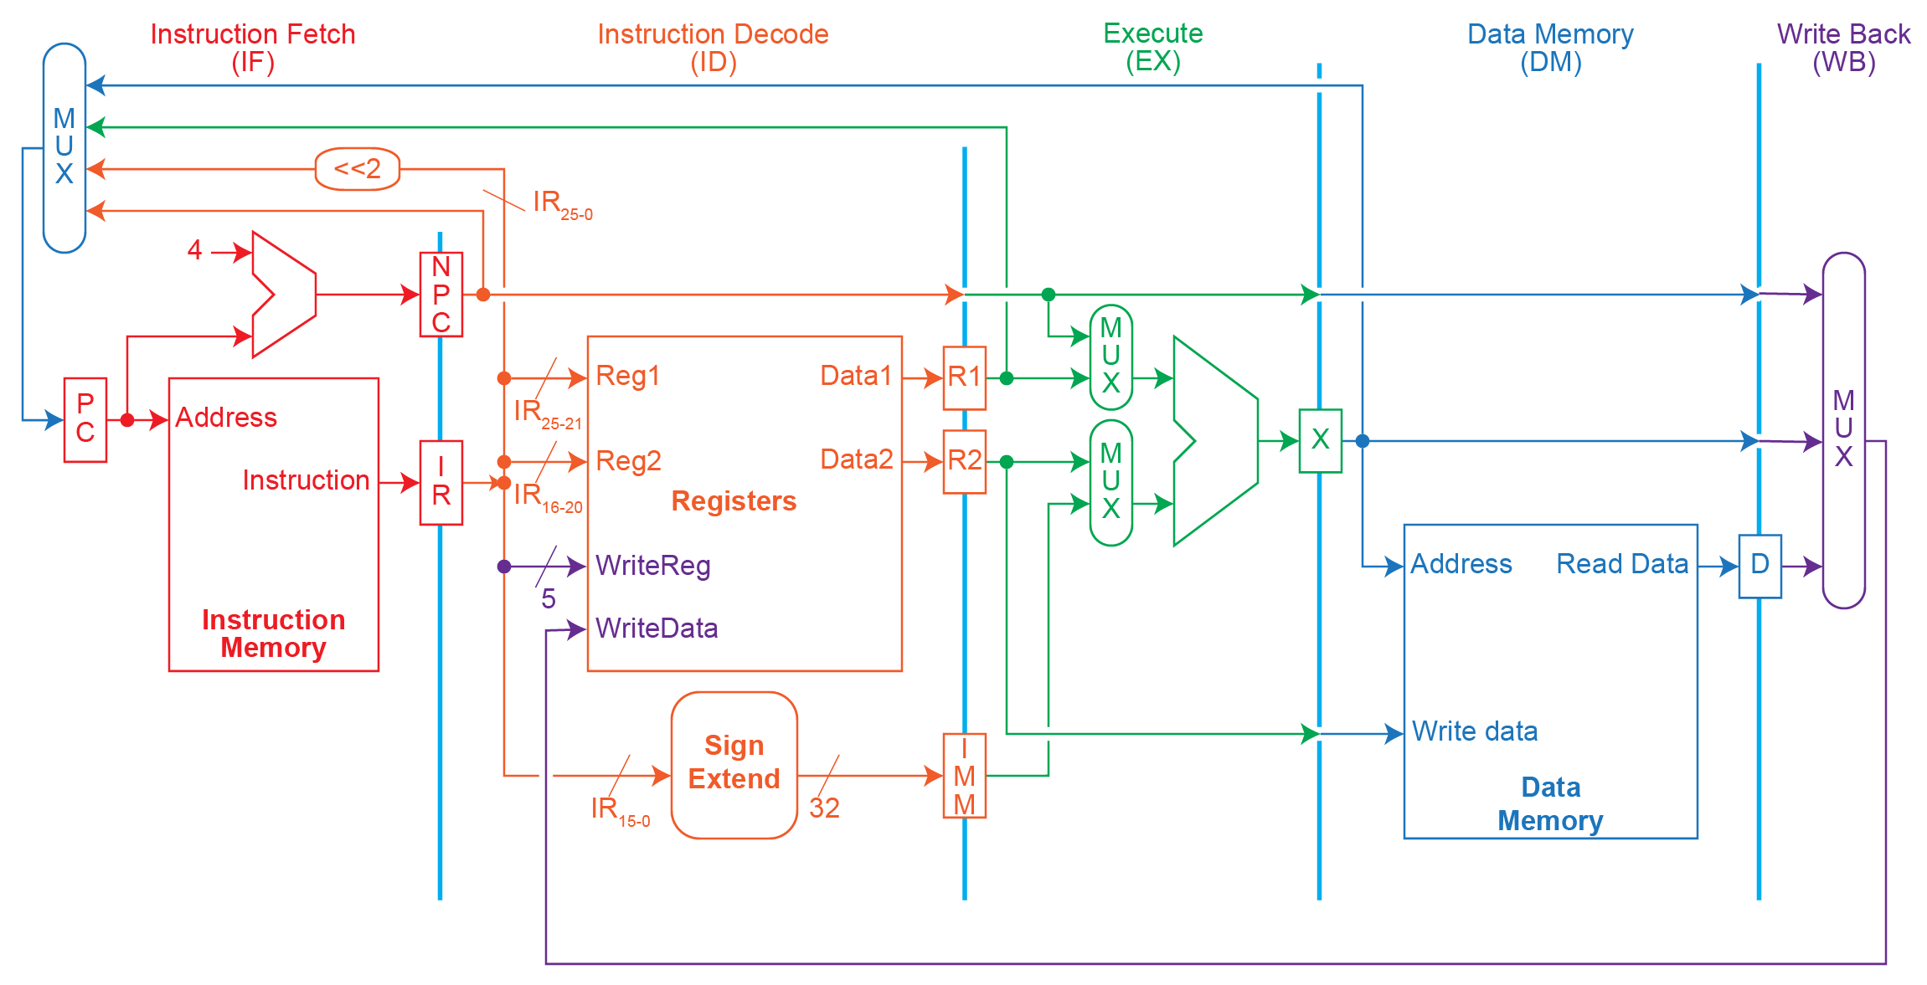
Multi-Cycle Execution

Slide 19
Multiple Cycle
Cycle 1
Cycle 2
Cycle 3
Cycle 4
Cycle 5
Cycle 6
Cycle 7
Cycle 8
Cycle 9
Cycle 10
Clk
Load
Store
R-type
Ifetch
Reg
Exec
Mem
Wr
Ifetch
Reg
Exec
Mem
Ifetch
Cycle time long enough for longest stage
Shorter stages waste time
Shorter instructions can take fewer cycles
No overlap
Figure: Dave Patterson
Notes:
Here are the timing diagrams showing the differences between the single cycle, multiple cycle, and pipeline implementations.
For example, in the pipeline implementation, we can finish executing the Load, Store, and R-type instruction sequence in seven cycles.
In the multiple clock cycle implementation, however, we cannot start executing the store until Cycle 6 because we must wait for the load instruction to complete.
Similarly, we cannot start the execution of the R-type instruction until the store instruction has completed its execution in Cycle 9.
In the Single Cycle implementation, the cycle time is set to accommodate the longest instruction, the Load instruction.
Consequently, the cycle time for the Single Cycle implementation can be five times longer than the multiple cycle implementation.
But may be more importantly, since the cycle time has to be long enough for the load instruction, it is too long for the store instruction so the last part of the cycle here is wasted.
+2 = 77 min. (X:57)

Slide 20
Multi-Cycle Implementation of MIPS
Instruction fetch cycle (IF)
IR ← Mem[PC]; NPC ← PC + 4
Instruction decode/register fetch cycle (ID)
A ← Regs[IR_{6..10}]; B ← Regs[IR_{11..15}]; Imm ← ((IR₁₆)¹⁶ ##IR_{16..31})
Execution/effective address cycle (EX)
Memory ref: ALUOutput ← A + Imm;
  Reg-Reg ALU: ALUOutput ← A func B;
  Reg-Imm ALU: ALUOutput ← A op Imm;
  Branch: ALUOutput ← NPC + Imm; Cond ← (A op 0)
Memory access/branch completion cycle (DM)
  Memory ref: LMD ← Mem[ALUOutput] or Mem(ALUOutput] ← B;
  Branch: if (cond) PC ←ALUOutput;
Write-back cycle (WB)
  Reg-Reg ALU: Regs[IR_{16..20}] ← ALUOutput;
  Reg-Imm ALU: Regs[IR_{11..15}] ← ALUOutput;
  Load: Regs[IR_{11..15}] ← LMD;

Slide 21
Stages of Instruction Execution
Cycle 1
Cycle 2
Cycle 3
Cycle 4
Cycle 5
Load
Ifetch
Reg/Dec
Exec
Mem
WB
The load instruction is the longest
All instructions follows at most the following five steps:
  Ifetch: Instruction Fetch
    Fetch the instruction from the Instruction Memory and update PC
  Reg/Dec: Registers Fetch and Instruction Decode
  Exec: Calculate the memory address
  Mem: Read the data from the Data Memory
  WB: Write the data back to the register file
Slide: Dave Patterson
Notes:
As shown here, each of these five steps will take one clock cycle to complete.
And in pipeline terminology, each step is referred to as one stage of the pipeline.
+1 = 8 min. (X:48)

Slide 22
Pipeline
Cycle 1
Cycle 2
Cycle 3
Cycle 4
Cycle 5
Cycle 6
Cycle 7
Cycle 8
Cycle 9
Cycle 10
Clk
Load
Ifetch
Reg
Exec
Mem
Wr
Store
Ifetch
Reg
Exec
Mem
Wr
R-type
Ifetch
Reg
Exec
Mem
Wr
Cycle time long enough for longest stage
Shorter stages waste time
No additional benefit from shorter instructions
Overlap instruction execution
Figure: Dave Patterson
Notes:
Here are the timing diagrams showing the differences between the single cycle, multiple cycle, and pipeline implementations.
For example, in the pipeline implementation, we can finish executing the Load, Store, and R-type instruction sequence in seven cycles.
In the multiple clock cycle implementation, however, we cannot start executing the store until Cycle 6 because we must wait for the load instruction to complete.
Similarly, we cannot start the execution of the R-type instruction until the store instruction has completed its execution in Cycle 9.
In the Single Cycle implementation, the cycle time is set to accommodate the longest instruction, the Load instruction.
Consequently, the cycle time for the Single Cycle implementation can be five times longer than the multiple cycle implementation.
But may be more importantly, since the cycle time has to be long enough for the load instruction, it is too long for the store instruction so the last part of the cycle here is wasted.
+2 = 77 min. (X:57)

Slide 23
Multi-Cycle Execution

Slide 24
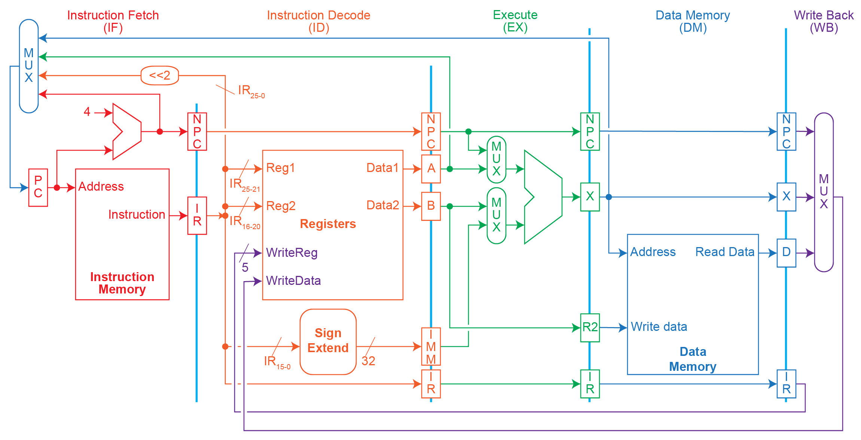
Pipeline

Slide 25
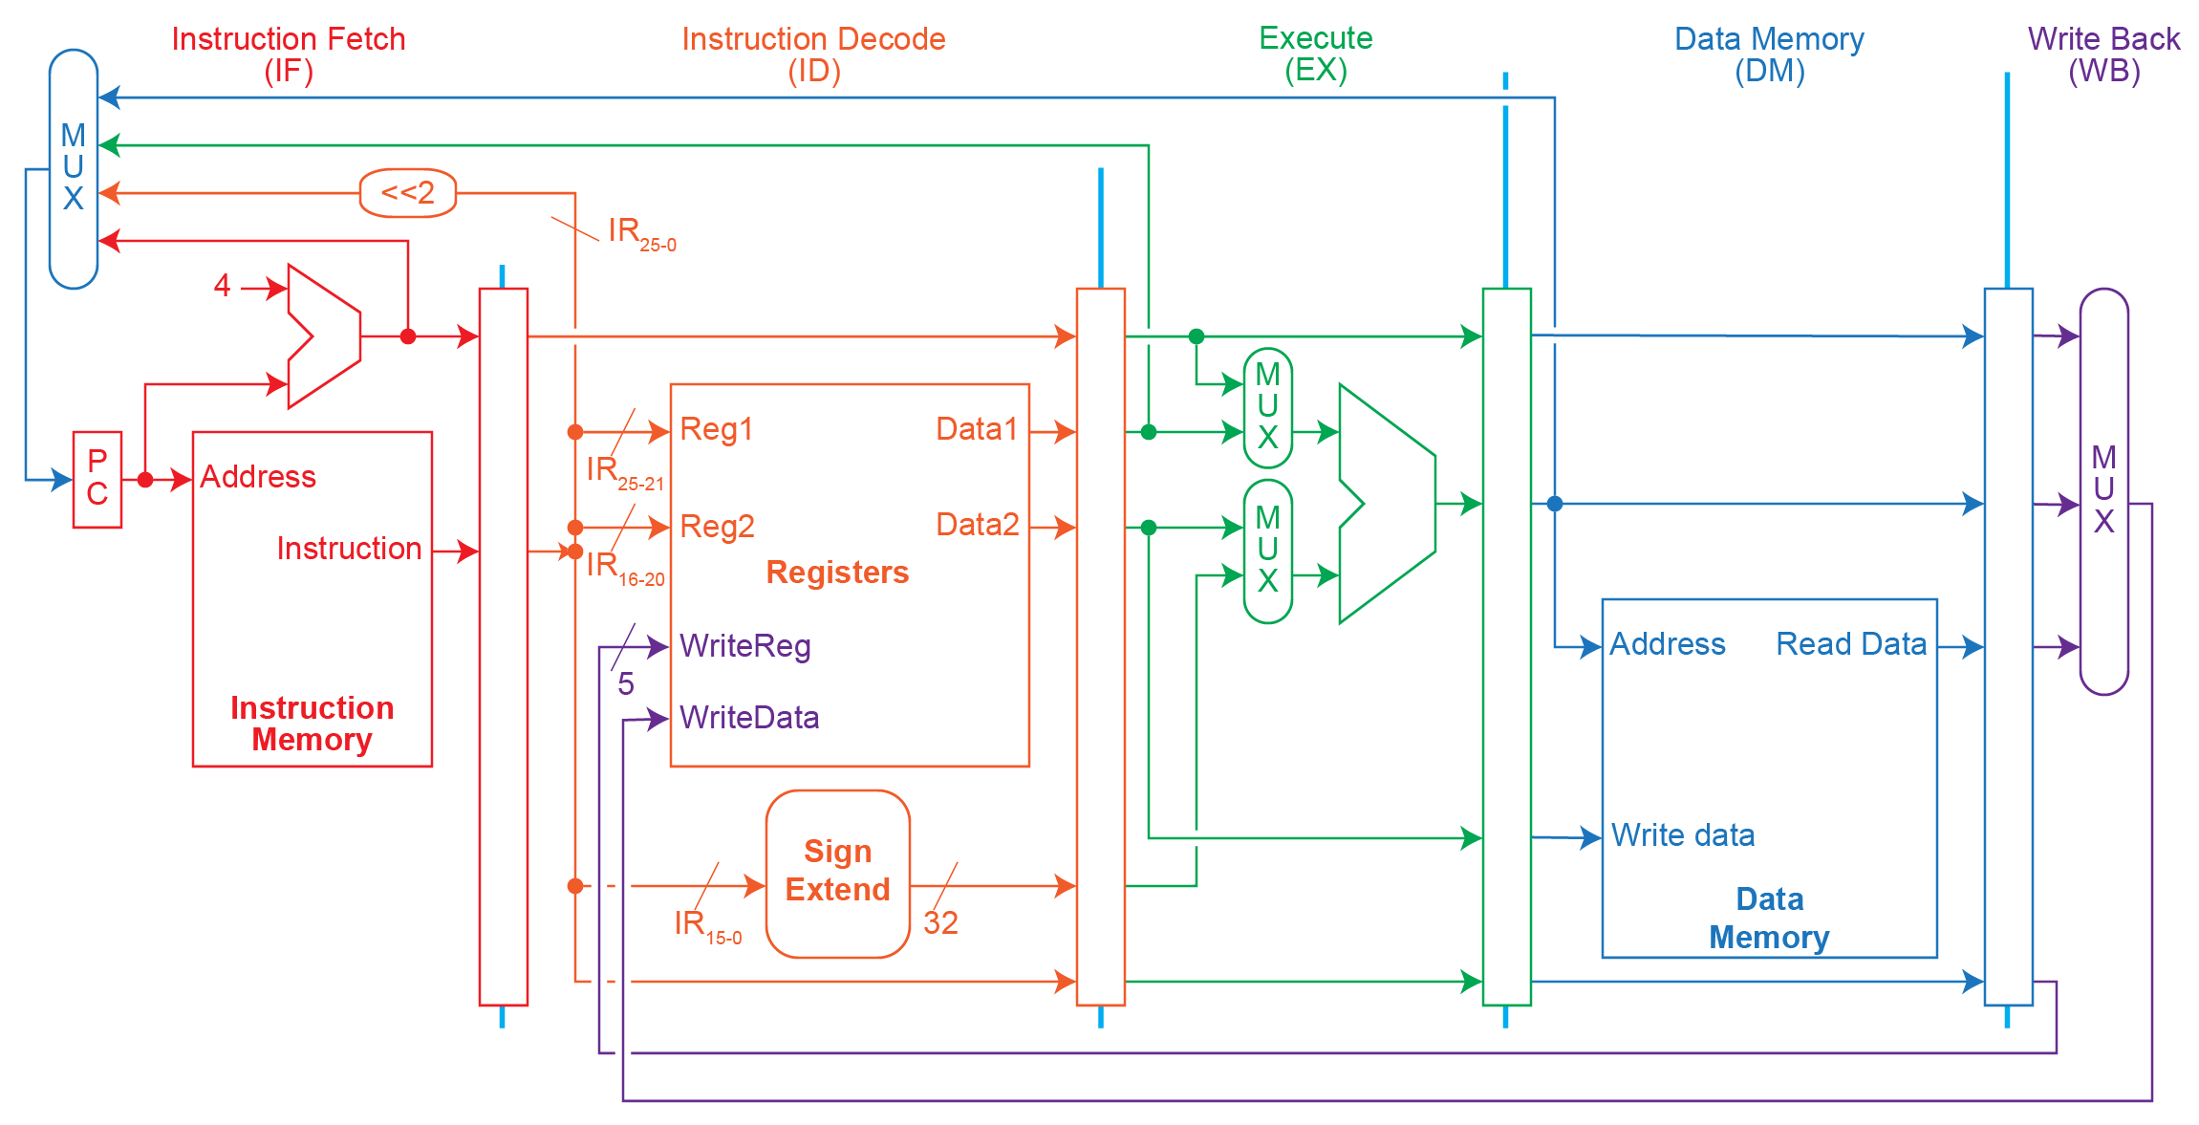
Pipeline Datapath
Every stage must be completed in one clock cycle to avoid stalls
Values must be latched to ensure correct execution of instructions
The PC multiplexer spans stages, more on that later.
Data Stationary

Slide 26
Instruction Pipelining
Start handling next instruction while the current instruction is in progress
Feasible when different devices at different stages
Time
IFetch
Dec
Exec
Mem
WB
IFetch
Dec
Exec
Mem
WB
IFetch
Dec
Exec
Mem
WB
IFetch
Dec
Exec
Mem
WB
IFetch
Dec
Exec
Mem
WB
Program Flow
IFetch
Dec
Exec
Mem
WB
Pipelining improves performance by increasing instruction throughput

Slide 27
Example of Instruction Pipelining
Time between first & fourth instructions is 3 × 8 = 24 ns
Time between first & fourth instructions is 3 × 2 = 6 ns
Ideal and upper bound for speedup is number of stages in the pipeline

Slide 28
Pipeline Performance
Pipeline increases the instruction throughput
  not execution time of an individual instruction
An individual instruction can be slower:
  Additional pipeline control
  Imbalance among pipeline stages
Suppose we execute 100 instructions:
  Single Cycle Machine
    45 ns/cycle x 1 CPI x 100 inst = 4500 ns
  Multi-cycle Machine
    10 ns/cycle x 4.2 CPI (due to inst mix) x 100 inst = 4200 ns
  Ideal 5 stages pipelined machine
    10 ns/cycle x (1 CPI x 100 inst + 4 cycle drain) = 1040 ns
Lose performance due to fill and drain

Slide 29
Pipeline Stage Interface

Slide 30
Pipeline Hazards
Cases that affect instruction execution semantics and thus need to be detected and corrected
Hazards types
  Structural hazard: attempt to use a resource two different ways at same time
    Single memory for instruction and data
  Data hazard: attempt to use item before it is ready
    Instruction depends on result of prior instruction still in the pipeline
  Control hazard: attempt to make a decision before condition is evaluated
    branch instructions
Hazards can always be resolved by waiting

Slide 31
Visualizing Pipelining
Time (clock cycles)
Cycle 1
Cycle 2
Cycle 3
Cycle 4
Cycle 5
Cycle 6
Cycle 7
I
n
s
t
r.
O
r
d
e
r
Ifetch
Reg
ALU
DMem
Reg
Ifetch
Reg
ALU
DMem
Reg
Ifetch
Reg
ALU
DMem
Reg
Ifetch
Reg
ALU
DMem
Reg
Slide: David Culler

Slide 32
Example: One Memory Port/Structural Hazard
Time (clock cycles)
Cycle 1
Cycle 2
Cycle 3
Cycle 4
Cycle 5
Cycle 6
Cycle 7
I
n
s
t
r.
O
r
d
e
r
Load
Ifetch
Reg
DMem
Reg
ALU
DMem
Instr 1
Ifetch
Reg
ALU
DMem
Reg
Instr 2
Ifetch
Reg
ALU
DMem
Reg
Instr 3
Ifetch
Reg
ALU
DMem
Reg
Instr 4
Structural Hazard
Slide: David Culler

Slide 33
Resolving Structural Hazards
Wait
  Must detect the hazard
    Easier with uniform ISA
  Must have mechanism to stall
    Easier with uniform pipeline organization
Throw more hardware at the problem
  Use instruction & data cache rather than direct access to memory

Slide 34
Detecting and Resolving Structural Hazard
Time (clock cycles)
Cycle 1
Cycle 2
Cycle 3
Cycle 4
Cycle 5
Cycle 6
Cycle 7
I
n
s
t
r.
O
r
d
e
r
Load
Ifetch
Reg
ALU
DMem
Reg
Instr 1
Ifetch
Reg
ALU
DMem
Reg
Instr 2
Ifetch
Reg
ALU
DMem
Reg
Stall
Bubble
Bubble
Bubble
Bubble
Bubble
Instr 3
Ifetch
Reg
ALU
DMem
Reg
Slide: David Culler

Slide 35
Stalls & Pipeline Performance
Assuming all stages are balanced

Slide 36
Data Hazards
Time (clock cycles)
IF
ID/RF
EX
MEM
WB
I
n
s
t
r.
O
r
d
e
r
add r1,r2,r3
Reg
Ifetch
Reg
ALU
DMem
sub r4,r1,r3
Ifetch
Reg
ALU
DMem
Reg
and r6,r1,r7
Ifetch
Reg
ALU
DMem
Reg
or r8,r1,r9
Ifetch
Reg
ALU
DMem
Reg
xor r10,r1,r11
Ifetch
Reg
ALU
DMem
Reg
Slide: David Culler

Slide 37
Three Generic Data Hazards
Read After Write (RAW)
Instr_{J} tries to read operand before Instr_{I} writes it
Caused by a “Data Dependence” (in compiler nomenclature). This hazard results from an actual need for communication.
I: add r1,r2,r3
J: sub r4,r1,r3
Slide: David Culler

Slide 38
Three Generic Data Hazards
Write After Read (WAR)
Instr_{J} writes operand before Instr_{I} reads it
Called an “anti-dependence” in compilers.
  This results from reuse of the name “r1”.
Can’t happen in 5-stage MIPS
Can happen in out-of-order execution pipelines:
  sub is waiting for multiply, but add is not
  Could start add early
  But the add might finish before the sub reads r1
  sub will get the wrong r1 data.
I: mul r3,r1,r7
J: sub r4,r1,r3
K: add r1,r2,r5
Slide: David Culler

Slide 39
Three Generic Data Hazards
Write After Write (WAW)
Instr_{J} writes operand before Instr_{I} writes it.
Called an “output dependence” in compilers
  This also results from the reuse of name “r1”.
Can’t happen in 5-stage MIPS
Can happen in out-of-order execution pipelines
  Start both add and mul together
  add finishes first, writes r1
  mul finishes second, overwrites r1!
I: mul r1,r4,r3
J: add r1,r2,r3
K: sub r6,r1,r7
Slide: David Culler

Slide 40
Data Hazards
Time (clock cycles)
IF
ID/RF
EX
MEM
WB
I
n
s
t
r.
O
r
d
e
r
add r1,r2,r3
Reg
Ifetch
Reg
ALU
DMem
sub r4,r1,r3
Ifetch
Reg
ALU
DMem
Reg
and r6,r1,r7
Ifetch
Reg
ALU
DMem
Reg
or r8,r1,r9
Ifetch
Reg
ALU
DMem
Reg
xor r10,r1,r11
Ifetch
Reg
ALU
DMem
Reg
Slide: David Culler

Slide 41
Forwarding to Avoid Data Hazard
Time (clock cycles)
I
n
s
t
r.
O
r
d
e
r
add r1,r2,r3
Ifetch
Reg
ALU
DMem
Reg
sub r4,r1,r3
Ifetch
Reg
ALU
DMem
Reg
and r6,r1,r7
Ifetch
Reg
ALU
DMem
Reg
or r8,r1,r9
Ifetch
Reg
ALU
DMem
Reg
xor r10,r1,r11
Ifetch
Reg
ALU
DMem
Reg
Slide: David Culler

Slide 42
HW Change for Forwarding
NextPC
ID/EX
EX/MEM
MEM/WR
mux
Registers
ALU
Data
Memory
mux
mux
Immediate
Slide: David Culler

Slide 43
Data Hazard Even with Forwarding
Time (clock cycles)
I
n
s
t
r.
O
r
d
e
r
lw r1, 0(r2)
Ifetch
Reg
ALU
DMem
Reg
sub r4,r1,r6
Ifetch
Reg
ALU
DMem
Reg
and r6,r1,r7
Ifetch
Reg
ALU
DMem
Reg
or r8,r1,r9
Ifetch
Reg
ALU
DMem
Reg
Slide: David Culler
Notes:
MIPS actutally didn’t interlecok: MPU without Interlocked Pipelined Stages

Slide 44
Resolving Load Hazards
Adding hardware? How? Where?
Detection?
Compilation techniques?
What is the cost of load delays?
Slide: David Culler

Slide 45
Resolving the Load Data Hazard
Time (clock cycles)
I
n
s
t
r.
O
r
d
e
r
lw r1, 0(r2)
Ifetch
Reg
ALU
DMem
Reg
Bubble
sub r4,r1,r6
Ifetch
Reg
ALU
DMem
Reg
Bubble
and r6,r1,r7
Ifetch
Reg
ALU
DMem
Reg
Bubble
ALU
or r8,r1,r9
Ifetch
Reg
DMem
How is this different from the instruction issue stall?
Slide: David Culler

Slide 46
Software Scheduling to Avoid Load Hazards
Try producing fast code for
a = b + c;
d = e – f;
assuming a, b, c, d ,e, and f in memory.
Slow code:
LW Rb,b
LW Rc,c
ADD Ra,Rb,Rc
SW a,Ra
LW Re,e
LW Rf,f
SUB Rd,Re,Rf
SW d,Rd
Fast code:
LW Rb,b
LW Rc,c
LW Re,e
ADD Ra,Rb,Rc
LW Rf,f
SW a,Ra
SUB Rd,Re,Rf
SW d,Rd
Slide: David Culler

Slide 47
Instruction Set Connection
What is exposed about this organizational hazard in the instruction set?
k cycle delay?
  bad, CPI is not part of ISA
k instruction slot delay
  load should not be followed by use of the value in the next k instructions
Nothing, but code can reduce run-time delays
Slide: David Culler

Slide 48
Pipeline Hazards
Cases that affect instruction execution semantics and thus need to be detected and corrected
Hazards types
  Structural hazard: attempt to use a resource two different ways at same time
    Single memory for instruction and data
  Data hazard: attempt to use item before it is ready
    Instruction depends on result of prior instruction still in the pipeline
  Control hazard: attempt to make a decision before condition is evaluated
    branch instructions
Hazards can always be resolved by waiting

Slide 49
Control Hazard on Branches
Three Stage Stall
10: beq r1,r3,36
Ifetch
Reg
ALU
DMem
Reg
14: and r2,r3,r5
Ifetch
Reg
ALU
DMem
Reg
18: or r6,r1,r7
Ifetch
Reg
ALU
DMem
Reg
22: add r8,r1,r9
Ifetch
Reg
ALU
DMem
Reg
36: xor r10,r1,r11
Ifetch
Reg
ALU
DMem
Reg
Slide: David Culler

Slide 50
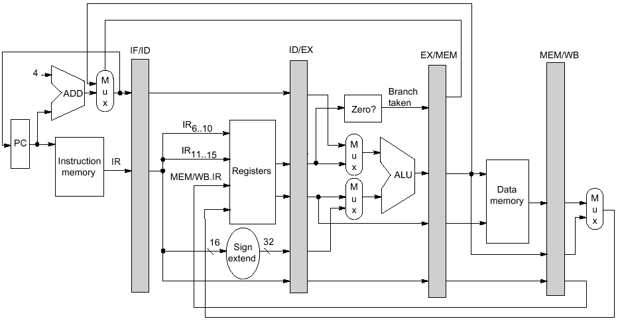
Datapath Reminder

Slide 51
Example: Branch Stall Impact
If 20% branch, 3-cycle stall significant!
Two part solution:
  Determine branch taken or not sooner, AND
  Compute taken branch address earlier
MIPS branch tests if register = 0 or ≠ 0
MIPS Solution:
  Move Zero test to ID/RF stage
  Adder to calculate new PC in ID/RF stage
  1 clock cycle penalty for branch versus 3
Slide: David Culler

Slide 52
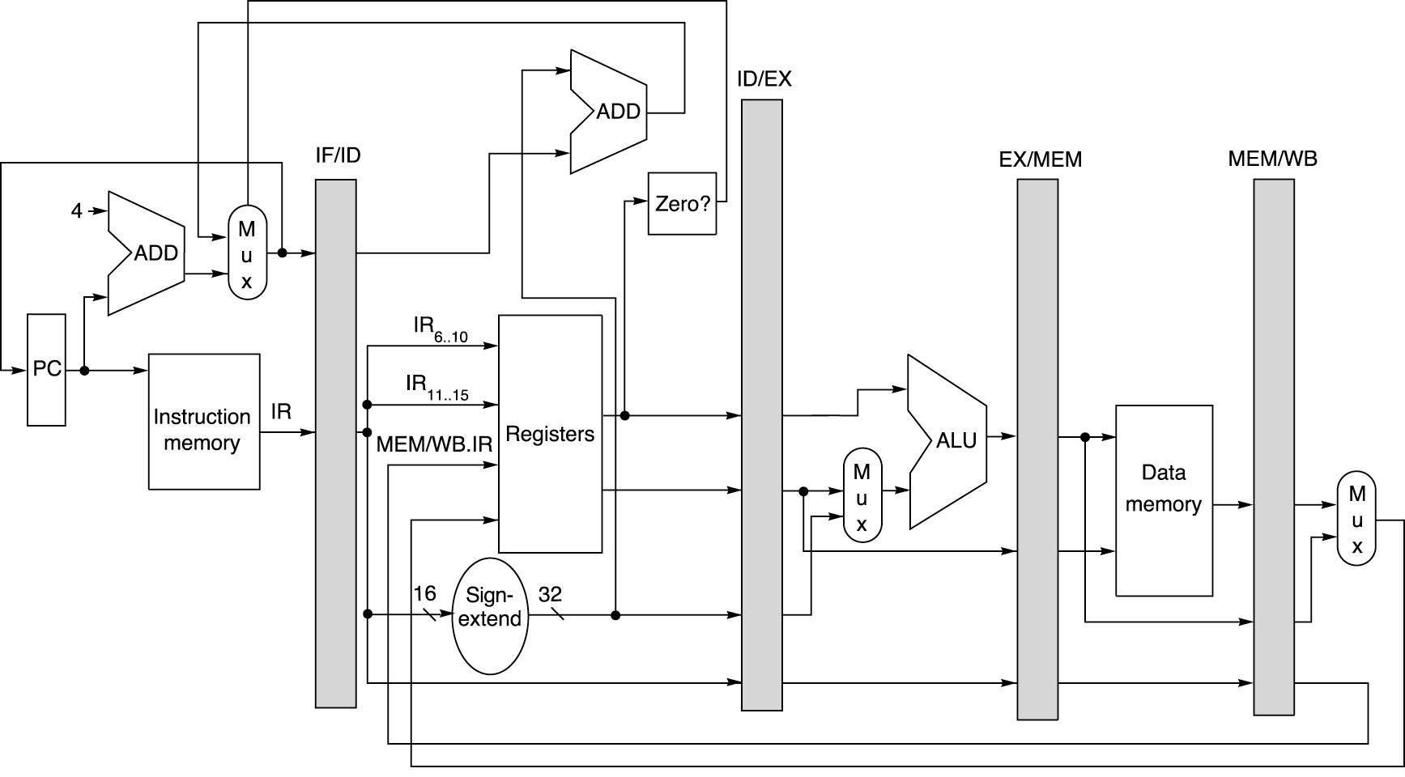
Pipelined MIPS Datapath
Add
Zero?
Figure: Dave Patterson

Slide 53
Four Branch Hazard Alternatives
Stall until branch direction is clear
Predict Branch Not Taken
  Execute successor instructions in sequence
  “Squash” instructions in pipeline if branch taken
  Advantage of late pipeline state update
  47% MIPS branches not taken on average
  PC+4 already calculated, so use it to get next instruction
Predict Branch Taken
  53% MIPS branches taken on average
  But haven’t calculated branch target address in MIPS
    MIPS still incurs 1 cycle branch penalty
    Other machines: branch target known before outcome
Slide: David Culler

Slide 54
Four Branch Hazard Alternatives
Delayed Branch
  Always execute instructions immediately after the branch instruction, then branch
  branch instruction
  always execute₁
  ........
  always execute_{n}
  not taken₁
  not taken₂
  ........
  branch target if taken
  1 slot delay allows proper decision and branch target address in 5 stage pipeline
  MIPS used this
Branch delay of length n
Slide: David Culler

Slide 55
Branch-Delay Scheduling Requirements
Limitation on delayed-branch scheduling arise from:
  Restrictions on instructions scheduled into the delay slots
  Ability to predict at compile-time whether a branch is likely to be taken
May have to fill with a no-op instruction
  Average 30% wasted
Additional PC is needed to allow safe operation in case of interrupts (more on this later)

Slide 56
Example: Evaluating Branch Alternatives
Assume:
14% Conditional & Unconditional
65% Taken; 52% Delay slots not usefully filled
Scheduling Scheme | Branch Penalty | CPI | Pipeline Speedup | Speedup vs stall
Stall pipeline | 3.00 | 1.42 | 3.52 | 1.00
Predict taken | 1.00 | 1.14 | 4.39 | 1.25
Predict not taken | 1.00 | 1.09 | 4.58 | 1.30
Delayed branch | 0.52 | 1.07 | 4.66 | 1.32
Slide: David Culler
Notes:
Stall: 1+.14(branches)*3(cycle stall)
Taken: 1+.14(branches)*(.65(taken)*1(delay to find address)+.35(not taken)*1(penalty))
Not taken: 1+.14*(.65(taken)*1+[.35(not taken)*0])
Delayed: 1+.14*(.52(not usefully filled)*1)

Slide 57
Recall Branch Penalties

