Slide 1
CMSC 611: Advanced Computer Architecture
Getting Data:
Benchmarks, Simulation & Profiling
Some material adapted from Mohamed Younis, UMBC CMSC 611 Spr 2003 course slides
Some material adapted from Hennessy & Patterson / © 2003 Elsevier Science

Slide 2
Performance Variations
Performance is dependent on workload
Task dependent
Need a measure of workload
Best = run your program
  Often cannot
Benchmark = “typical” workload
  Standardized for comparison

Slide 3
Synthetic Benchmarks
Synthetic benchmarks are artificial programs that are constructed to match the characteristics of large set of programs
Whetstone (scientific programs), Dhrystone (systems programs), LINPACK (linear algebra), …

Slide 4
Synthetic Benchmark Drawbacks
They may not reflect the user interest since they are not real applications
They may not reflect real program behavior (e.g. memory access pattern)
Compiler and hardware can inflate the performance of these programs far beyond what the same optimization can achieve for real-programs

Slide 5
Application Benchmarks
Real applications typical of expected workload
Applications and mix important

Slide 6
The SPEC Benchmarks
System Performance Evaluation Cooperative
Suite of benchmarks
  Created by a set of companies to improve the measurement and reporting of CPU performance
SPEC2017 is the latest suite
  SPEC speed and SPEC rate
  Integer and Float
  10 programs per set
Since SPEC requires running applications on real hardware, the memory system has a significant effect on performance
  Reported with results

Slide 7
Performance Reports
Hardware
  CPU model, speed, cores, cache
  Memory, storage
Software (with versions)
  OS, compiler
  Firmware, filesystem
Results
  3 reported per test, use median
  Time and speedup vs. reference platform
Guiding principle is reproducibility (report environment & experiments setup)

Slide 8
The SPEC Benchmarks
Bigger numeric values of the SPEC ratio indicate faster machine
“historical” reference machine
  Sun Fire V490 w/ 2.1 GHz Ultra-SPARC-IV+
  2006 update of 1997 300 MHz UltraSparc II

Slide 9
Comparing & Summarizing Performance
Wrong summary can present a confusing picture
  A is 10 times faster than B for program 1
  B is 10 times faster than A for program 2
Total execution time is a consistent summary measure
Relative execution times for the same workload
  Assuming that programs 1 and 2 are executing for the same number of times on computers A and B
Execution time is the only valid and unimpeachable measure of performance

Slide 10
Performance Summary
Where: n is the number of programs executed
w_{i} is a weighting factor that indicates the frequency of executing program i
with and
Weighted arithmetic means summarize performance while tracking exec. time
Never use AM for normalizing time relative to a reference machine

Slide 11
Effect of Compilation
App. and arch. specific optimization can dramatically impact performance

Slide 12
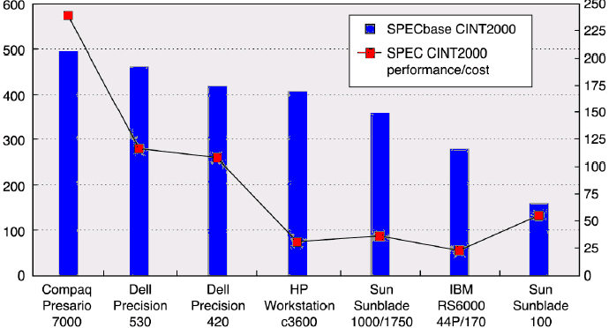
Price-Performance Metric
Prices reflects those of July 2001
SPECbase CINT2000
SPEC CINT2000 per $1000 in price
Different results are obtained for other benchmarks, e.g. SPEC CFP2000
With the exception of the Sunblade price-performance metrics were consistent with performance

Slide 13
Simulation
Model effects of hardware
Limitation
  Not real hardware
  Only as accurate as the model
  Runs 10-100x slower
Bonus
  Can compare options and test new ones
  Overall picture likely pretty close

Slide 14
Valgrind
Open-source profiler (win/mac/linux)
Runs unmodified x86 programs
JIT compiles x86 to intermediate code
Tools add tracking code
Compiled back to x86 to run

Slide 15
Valgrind tools
Tools for cache, branches, memory, …
Cache
  2 levels of cache: L1 & lowest level (e.g. L3)
  Compare cache sizes, strategies
Branching
  Conditional & indirect
Cycle counts

Slide 16
Instrumented Profiling
Modify program when compiling
  gprof compiler flags
Manual modifications
  Add timers to code
  Add simulation to class members

Slide 17
Statistical Profiling
Periodically interrupt program
See where it is and what’s happening
  Hardware counters help
  Get real data for cache, branch, CPI, …
Need to run longer to get valid data
Can start & stop mid-run

Slide 18
Statistical Profilers
Vtune (Intel)
  Windows only
  $$$, but educational trials
CodeAnalyst / CodeXL (AMD)
  Windows & Linux
Xcode Instruments (Apple)
  Mac only
gprof (anything using gcc)
  Statistical and instrumented modes

