Slide 1
CMSC 611: Advanced Computer Architecture
Performance
Some material adapted from Mohamed Younis, UMBC CMSC 611 Spr 2003 course slides
Some material adapted from Hennessy & Patterson / © 2003 Elsevier Science

Slide 2
Integrated Circuits: Fueling Innovation
Technology innovations over time
Advances of the IC technology affect H/W and S/W design philosophy

Slide 3
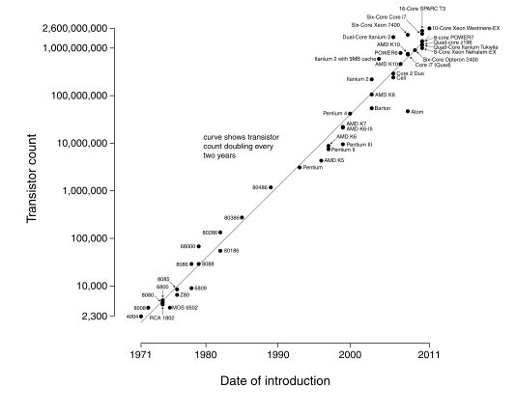
Moore’s Law
Transistors double every year
  Revised to every two years
  Sometimes revised to performance instead of transistors
(Source: Intel)
(Wgsimon - Wikipedia)

Slide 4
Defining Performance
Performance means different things to different people, therefore its assessment is subtle
Analogy from the airlines industry:
How to measure performance for an airplane?
  Cruising speed (How fast it gets to the destination)
  Flight range (How far it can reach)
  Passenger capacity (How many passengers it can carry)
Criteria of performance evaluation differs among users and designers

Slide 5
Performance Metrics
Response (execution) time:
  The time between the start and the completion of a task
  Measures user perception of the system speed
  Common in reactive and time critical systems
  Single-user computer
Throughput:
  The total number of tasks done in a given time
  Relevant to batch processing (billing, credit card processing)
  Also many-user services (web servers)
Power:
  Power consumed or battery life
  Especially relevant for mobile

Slide 6
Response-time Metric
Maximizing performance means minimizing response (execution) time

Slide 7
Response-time Metric
Performance of Processor P1 is better than P2 if
  For a given work load L
  P1 takes less time to execute L than P2

Slide 8
Response-time Metric
Relative performance captures the performance ratio
  For the same work load

Slide 9
Designer’s Performance Metrics
Users and designers measure performance using different metrics
  Users: quotable metrics (GHz)
  Designers: program execution
Designer focuses on reducing the clock cycle time and the number of cycles per program
Many techniques to decrease the number of clock cycles also increase the clock cycle time or the average number of cycles per instruction (CPI)

Slide 10
Example
A program runs in 10 seconds on a computer “A” with a 400 MHz clock.
We desire a faster computer “B” that could run the program in 6 seconds.
The designer has determined that a substantial increase in the clock speed is possible, however it would cause computer “B” to require 1.2 times as many clock cycles as computer “A”. What should be the clock rate of computer “B”?
Why would this happen?
  Maybe one operation takes one full clock cycle at 400 MHz (1/400 MHz = 2.5 ns)
  All the rest take less than one cycle
  Split this operation across multiple cycles
  Can now increase clock rate, but also increase total cycles

Slide 11
Example
A program runs in 10 seconds on a computer “A” with a 400 MHz clock.
We desire a faster computer “B” that could run the program in 6 seconds.
The designer has determined that a substantial increase in the clock speed is possible, however it would cause computer “B” to require 1.2 times as many clock cycles as computer “A”. What should be the clock rate of computer “B”?
To get the clock rate of the faster computer, we use the same formula

Slide 12
Calculation of CPU Time
Or

Slide 13
CPU Time (Cont.)
CPU execution time can be measured by running the program
The clock cycle is usually published by the manufacture
Measuring the CPI and instruction count is not trivial
  Instruction counts can be measured by: software profiling, using an architecture simulator, using hardware counters on some architecture
  The CPI depends on many factors including: processor structure, memory system, the mix of instruction types and the implementation of these instructions

Slide 14
CPU Time (Cont.)
Designers sometimes uses the following formula:
Where: C_{i} is the count of number of instructions of class i executed
CPI_{i} is the average number of cycles per instruction for that instruction class
n is the number of different instruction classes

Slide 15
Example
Suppose we have two implementation of the same instruction set architecture. Machine “A” has a clock cycle time of 1 ns and a CPI of 2.0 for some program, and machine “B” has a clock cycle time of 2 ns and a CPI of 1.2 for the same program. Which machine is faster for this program and by how much?
Both machines execute the same instructions for the program. Assume the number of instructions is “I”,
CPU clock cycles (A) = I  2.0 CPU clock cycles (B) = I  1.2
The CPU time required for each machine is as follows:
CPU time (A) = CPU clock cycles (A)  Clock cycle time (A)
= I  2.0  1 ns = 2  I ns
CPU time (B) = CPU clock cycles (B)  Clock cycle time (B)
= I  1.2  2 ns = 2.4  I ns
Therefore machine A will be faster by the following ratio:

Slide 16
Comparing Code Segments
A compiler designer is trying to decide between two code sequences for a particular machine. The hardware designers have supplied the following facts:
For a particular high-level language statement, the compiler writer is considering two code sequences that require the following instruction counts:
Which code sequence executes the most instructions? Which will be faster? What is the CPI for each sequence?
Answer:
  Sequence 1: executes 2 + 1 + 2 = 5 instructions
  Sequence 2: executes 4 + 1 + 1 = 6 instructions 

Slide 17
Comparing Code Segments
Using the formula:
Sequence 1: CPU clock cycles = (2 ×1) + (1 ×2) + (2 ×3) = 10 cycles
Sequence 2: CPU clock cycles = (4 ×1) + (1 ×2) + (1 ×3) = 9 cycles
Therefore Sequence 2 is faster although it executes more instructions
Using the formula:
Sequence 1: CPI = 10/5 = 2
Sequence 2: CPI = 9/6 = 1.5
Since Sequence 2 takes fewer overall clock cycles but has more
instructions it must have a lower CPI

Slide 18
The Role of Performance
Hardware performance is a key to the effectiveness of the entire system
Performance has to be measured and compared to evaluate designs
To optimize the performance, major affecting factors have to be known
For different types of applications
  different performance metrics may be appropriate
  different aspects of a computer system may be most significant
Instructions use and implementation, memory hierarchy and I/O handling are among the factors that affect the performance

Slide 19
Calculation of CPU Time
Where: C_{i} is the count of number of instructions of class i executed
CPI_{i} is the average number of cycles per instruction for that instruction class
n is the number of different instruction classes

Slide 20
Important Equations (so far)

Slide 21
Amdahl’s Law
Time from speedup
Partitioning execution time

Slide 22
Amdahl’s Law
The performance enhancement possible with a given improvement is limited by the amount that the improved feature is used
A common theme in Hardware design is to make the common case fast
Increasing the clock rate would not affect memory access time
Using a floating point processing unit does not speed integer ALU operations

Slide 23
Ahmdal’s Law Visually
Example: Floating point instructions improved to run 2X; but only 34% of actual instructions are floating point
Time_{old}
notFP
FP
Time_{new}
notFP
FP / S

Slide 24
Ahmdal’s Law for Speedup

