Slide 1
CMSC 611: Advanced Computer Architecture
Complex Parallel Systems

Slide 2
Computational Examples
Connection Machine 5
SGI Origin
Intel Nehalem

Slide 3
Thinking Machines CM5 (1993)
MIMD, SPARC processors
Fat Tree communication network
D. Hillis and L. Tucker, “The CM-5 Connection Machine: A Scalable Supercomputer,” Communications of the ACM, v36n11, November 1993

Slide 4
SGI Origin (1998)
MIPS R10000 processor
Hypercube connected
ccNUMA / directory protocol

Slide 5
SGI Origin Node
Ammon, "Hypercube Connectivity within ccNUMA Architecture", Silicon Graphics, 1998.

Slide 6
Origin Communication
Level | Latency (ns)
L1 cache | 5.1
L2 cache | 56.4
local memory | 310
4P remote memory | 540
8P avg. remote memory | 707
16P avg. remote memory | 726
32P avg. remote memory | 773
64P avg. remote memory | 867
128P avg. remote memory | 945
Laudon and Lenoski, "SGI Origin: A ccNUMA Highly Scalable Server", Proceedings of Computer Architecture 1997

Slide 7
Intel Nehalem Design
Appaloosa, “Intel Nehalem Microarchitecture”, Wikimedia project, November 2008

Slide 8
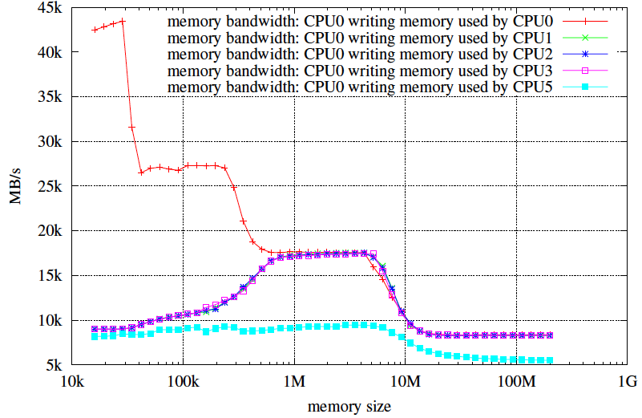
Communication Performance
Michael Thomadakis: The Architecture of the Nehalem Processor and Nehalem-EP SMP Platforms

Slide 9
Graphics Hardware
Problem domain
Pixel-Planes 4
Pixel-Planes 5
SGI Reality Engine
Pixel Flow
NVIDIA GeForce 6
NVIDIA Maxwell

Slide 10
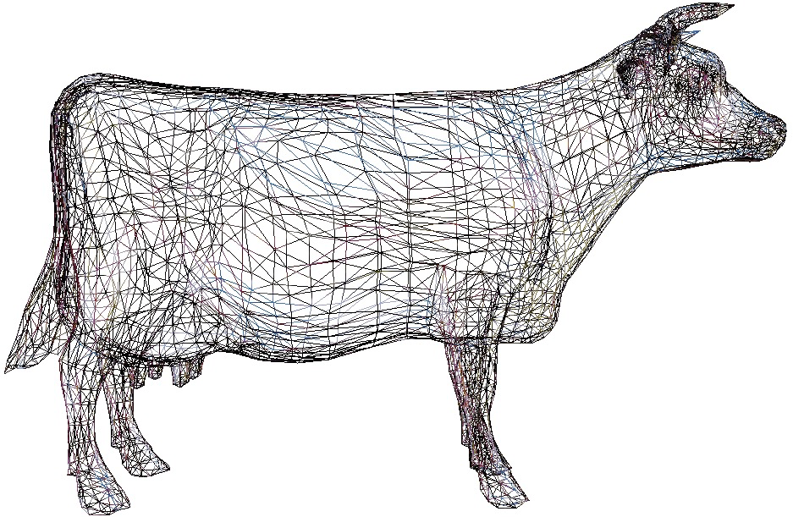
Graphics Rendering
Just model the surfaces
  (that’s all you can see)
Approximate them with a mesh of triangles
Get really good at rendering triangles

Slide 11
Graphics Pipeline
Transform: find where each vertex goes on the screen
Transform
Clip
Rasterize
Shade
Visibility/Blend
Display

Slide 12
Graphics Pipeline
Clip: get rid of off-screen parts (especially behind the viewer)
Transform
Clip
Rasterize
Shade
Visibility/Blend
Display

Slide 13
Graphics Pipeline
Rasterize: find which pixels are inside the triangle
Transform
Clip
Rasterize
Shade
Visibility/Blend
Display

Slide 14
Graphics Pipeline
Shade: compute the color for each pixel
Transform
Clip
Rasterize
Shade
Visibility/Blend
Display

Slide 15
Graphics Pipeline
Visibility: throw out pixels covered by opaque stuff that’s already rendered
Blend: Combine colors for partially transparent objects
Transform
Clip
Rasterize
Shade
Visibility/Blend
Display

Slide 16
Graphics Pipeline
Display: Show results to user
Transform
Clip
Rasterize
Shade
Visibility/Blend
Display

Slide 17
Graphics Pipeline
vertex
Transform
Clip
Rasterize
Shade
Visibility/Blend
Display
triangle
pixel
frame

Slide 18
Computation and Bandwidth
Based on:
• 100 Mtri/sec (1.6M/frame @ 60Hz)
• 256 Bytes vertex data
• 128 Bytes interpolated
• 68 Bytes pixel output
• 5x depth complexity
• 16 4-Byte textures
• 223 ops/vertex
• 1664 ops/pixel
• No caching
• No compression
Vertex
75 GB/s
67 GFLOPS
Triangle
13 GB/s
335 GB/s Texture
45 GB/s Fragment
Pixel
1.1 TFLOPS

Slide 19
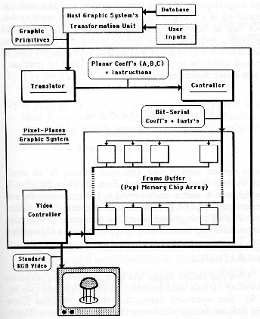
UNC Pixel-Planes 4 (1985)
DSP vertex processor
Custom rasterizer
512x512 SIMD array
  Full screen
Fuchs et al., ”Fast spheres, shadows, textures, transparencies, and image enhancements in pixel-planes", SIGGRAPH 1985

Slide 20
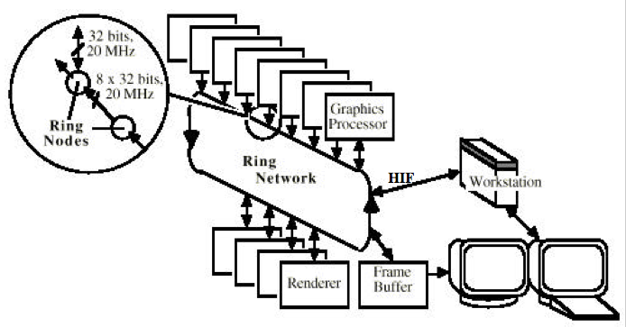
UNC Pixel-Planes 5 (1989)
~40 i860 CPUs for vertex processing
~20 128x128 SIMD arrays for pixel processing
Fuchs et al., ”Pixel-Planes 5: a heterogeneous multiprocessor graphics system using processor enhanced memory", SIGGRAPH 1989

Slide 21
SGI Reality Engine (1993)
Akeley, ”Reality Engine Graphics", SIGGRAPH 1993

Slide 22
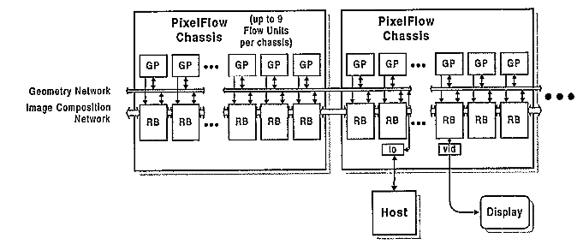
Pixel-Flow (1992-1997)
~35 nodes, each with
  2 HP-PA 8000 CPUs
  128x64 SIMD array (~160 tiles/screen)
Eyles, et al., "PixelFlow: The Realization", Graphics Hardware 1997

Slide 23
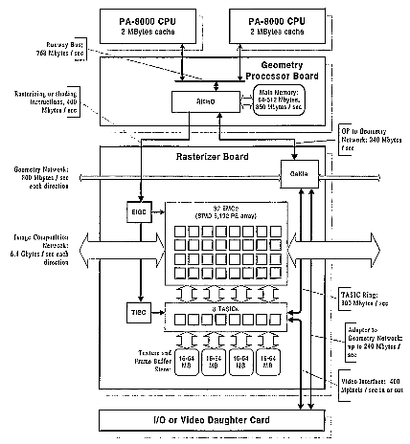
Pixel-Flow
Eyles, et al., "PixelFlow: The Realization", Graphics Hardware 1997

Slide 24
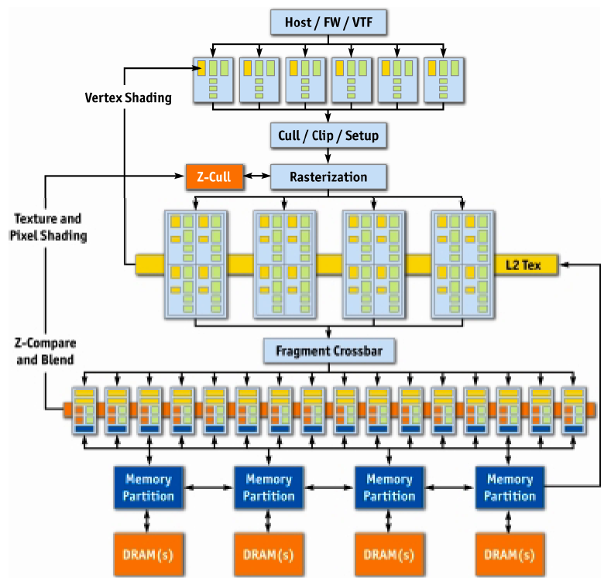
NVIDIA GeForce 6 (2004)
Kilgariff and Fernando, ”The GeForce 6 GPU Architecture", GPU Gems 2, 2005

Slide 25
GeForce 6 Parallelism
Data Parallel
More Parallel
Vertex
…
Triangle
Pixel
Pipeline
More Parallel
More Pipeline

Slide 26
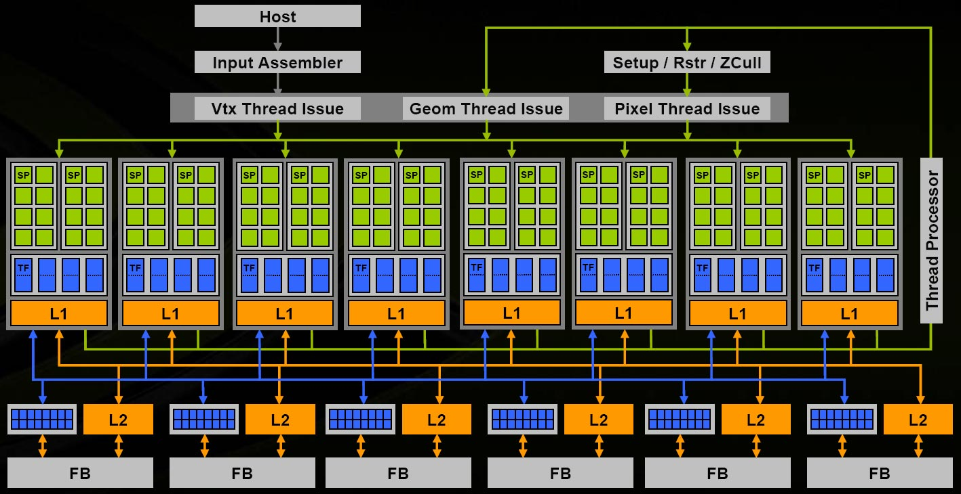
NVIDIA G80/Tesla (2006)
NVIDIA, “NVIDIA GeForce 8800 GPU Architecture Overview”, TB-02787-001_v01, November 2006

Slide 27
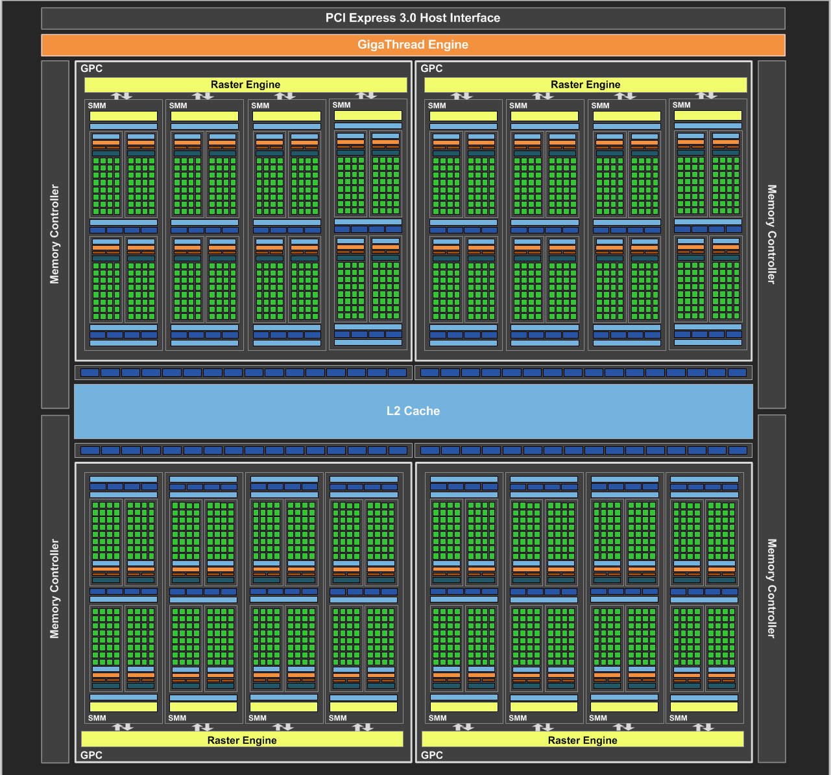
NVIDIA Maxwell (2014)
NVIDIA, NVIDIA GeForce GTX 980 Whitepaper, 2014

Slide 28
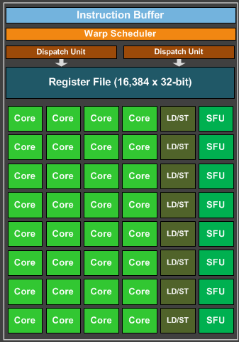
Maxwell SIMD Processing Block
32 Cores
8 Special Function
NVIDIA Terminology:
  Warp = interleaved threads
    Hide memory latency
    Want at least 4-8
  Thread Block
  = Warps*Cores
Flexible Registers
  Trade registers for warps
NVIDIA, NVIDIA GeForce GTX 980 Whitepaper, 2014

Slide 29
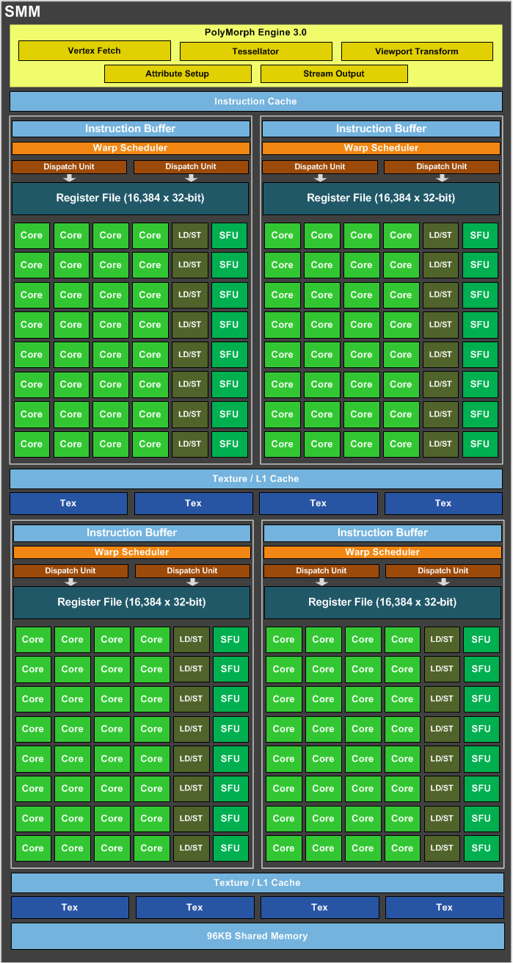
Maxwell Streaming
Multiprocessor (SMM)
4 SIMD blocks
Share L1 Caches
Share memory
Share tessellation HW
NVIDIA, NVIDIA GeForce GTX 980 Whitepaper, 2014

Slide 30
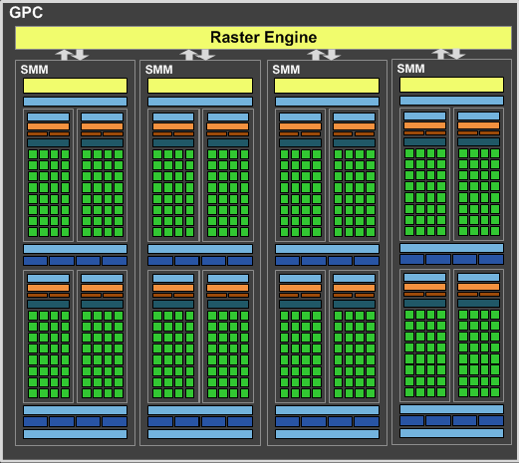
Maxwell Graphics Processing Cluster
4 SMM
Share rasterizer
NVIDIA, NVIDIA GeForce GTX 980 Whitepaper, 2014

Slide 31
Full Maxwell (again)
NVIDIA, NVIDIA GeForce GTX 980 Whitepaper, 2014

