Slide 1
CMSC 611: Advanced Computer Architecture
Shared Memory
Directory Protocol
Most slides adapted from David Patterson. Some from Mohomed Younis

Slide 2
Snoopy-Cache Controller

Slide 3
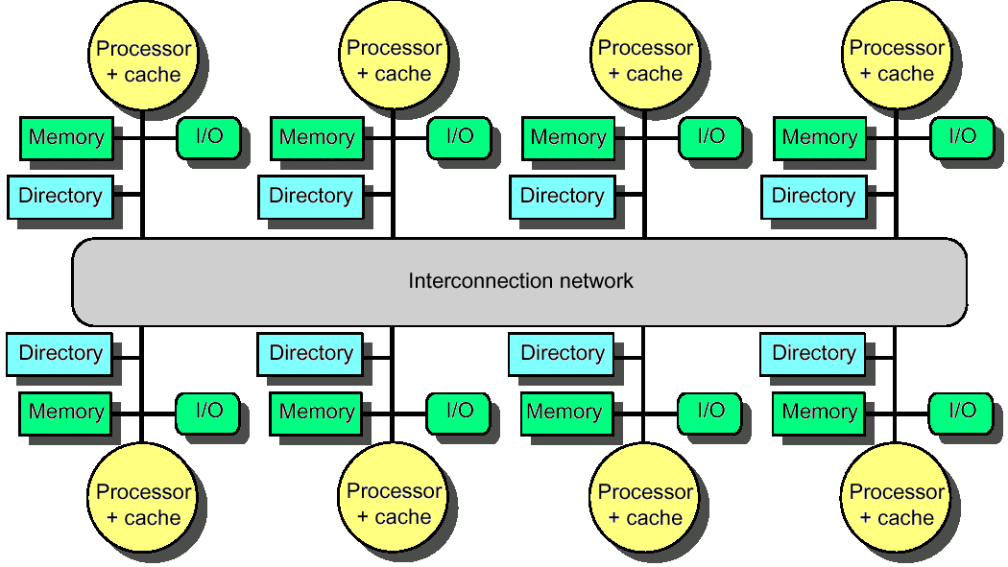
Distributed Directory Multiprocessors
Directory per cache that tracks state of every block in every cache
Which caches have a block, dirty vs. clean, ...
Info per memory block vs. per cache block?
simpler protocol (centralized/one location)
directory is O(memory size) vs. O(cache size)
To prevent directory from being a bottleneck
Distribute directory entries with memory
Each tracks of which processor has their blocks

Slide 4
Directory Protocol
Similar to Snoopy Protocol: Three states
Shared: Multiple processors have the block cached and the contents of the block in memory (as well as all caches) is up-to-date
Uncached No processor has a copy of the block (not valid in any cache)
Exclusive: Only one processor (owner) has the block cached and the contents of the block in memory is out-to-date (the block is dirty)
In addition to cache state, must track which processors have data when in the shared state
Usually bit vector, 1 if processor has copy

Slide 5
Directory Protocol
Keep it simple(r):
Writes to non-exclusive data = write miss
Processor blocks until access completes
Assume messages received and acted upon in order sent
Terms: typically 3 processors involved
Local node where a request originates
Home node where the memory location of an address resides
Remote node has a copy of a cache block, whether exclusive or shared
No bus and do not want to broadcast:
Interconnect no longer single arbitration point
All messages have explicit responses

Slide 6
Example Directory Protocol
Message sent to directory causes two actions:
Update the directory
More messages to satisfy request
We assume operations atomic, but they are not; reality is much harder; must avoid deadlock when run out of buffers in network

Slide 7
Directory Protocol Messages
Type | SRC | DEST | MSG
Read miss | local cache | home directory | P,A
P has read miss at A; request data and make P a read sharer
Write miss | local cache | home directory | P,A
P has write miss at A; request data and make P exclusive owner
Invalidate | home directory | remote cache | A
Invalidate shared data at A
Fetch | home directory | remote cache | A
Fetch block A home; change A remote state to shared
Fetch/invalidate | home directory | remote cache | A
Fetch block A home; invalidate remote copy
Data value reply | home directory | local cache | D
Return data value from home memory
Data write back | remote cache | home directory | A,D
Write back data value for A

Slide 8
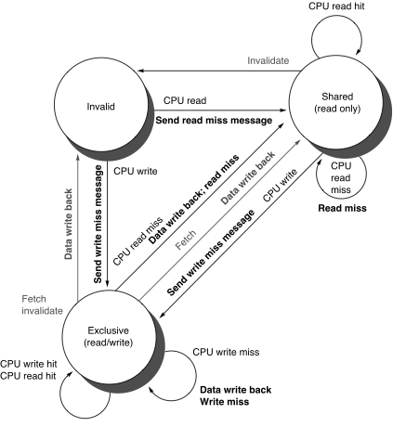
Cache Controller State Machine
States identical to snoopy case
Transactions very similar.
Miss messages to home directory
Explicit invalidate & data fetch requests
State machine for CPU requests for each memory block

Slide 9
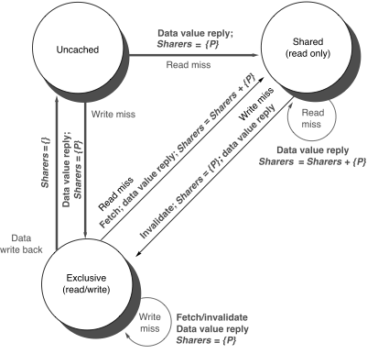
Directory Controller State Machine
Same states and structure as the transition diagram for an individual cache
Actions:
update of directory state
send messages to satisfy requests
Tracks all copies of each memory block
Sharers set implementation can use a bit vector of a size of # processors for each block
State machine
for Directory requests for each
memory block

Slide 10
Example
P2: Write 20 to A1
Assumes memory blocks A1 and A2 map to same cache block

Slide 11
Example
WrMs
P1
A1
A1
Ex
{P1}
Excl.
A1
10
DaRp
P1
A1
0
P2: Write 20 to A1
Assumes memory blocks A1 and A2 map to same cache block

Slide 12
Example
WrMs
P1
A1
A1
Ex
{P1}
Excl.
A1
10
DaRp
P1
A1
0
Excl.
A1
10
P2: Write 20 to A1
Assumes memory blocks A1 and A2 map to same cache block

Slide 13
Example
WrMs
P1
A1
A1
Ex
{P1}
Excl.
A1
10
DaRp
P1
A1
0
Excl.
A1
10
Shar.
A1
RdMs
P2
A1
Shar.
A1
10
Ftch
P1
A1
10
A1
10
Shar.
A1
10
DaRp
P2
A1
10
A1
Shar.
{P1,P2}
10
P2: Write 20 to A1
Write Back
Assumes memory blocks A1 and A2 map to same cache block

Slide 14
Example
Excl.
A1
10
DaRp
P1
A1
0
Excl.
A1
10
Shar.
A1
RdMs
P2
A1
Shar.
A1
10
Ftch
P1
A1
10
A1
10
Shar.
A1
10
DaRp
P2
A1
10
A1
Shar.
{P1,P2}
10
P2: Write 20 to A1
Excl.
A1
20
WrMs
P2
A1
10
Inv.
Inval.
P1
A1
A1
Excl.
{P2}
10
Assumes memory blocks A1 and A2 map to same cache block

Slide 15
Example
WrMs
P1
A1
A1
Ex
{P1}
Excl.
A1
10
DaRp
P1
A1
0
Excl.
A1
10
Shar.
A1
RdMs
P2
A1
Shar.
A1
10
Ftch
P1
A1
10
A1
10
Shar.
A1
10
DaRp
P2
A1
10
A1
Shar.
{P1,P2}
10
P2: Write 20 to A1
Excl.
A1
20
WrMs
P2
A1
10
Inv.
Inval.
P1
A1
A1
Excl.
{P2}
10
WrMs
P2
A2
A2
Excl.
{P2}
0
WrBk
P2
A1
20
A1
Unca.
{}
20
Excl.
A2
40
DaRp
P2
A2
0
A2
Excl.
{P2}
0
Assumes memory blocks A1 and A2 map to same cache block

Slide 16
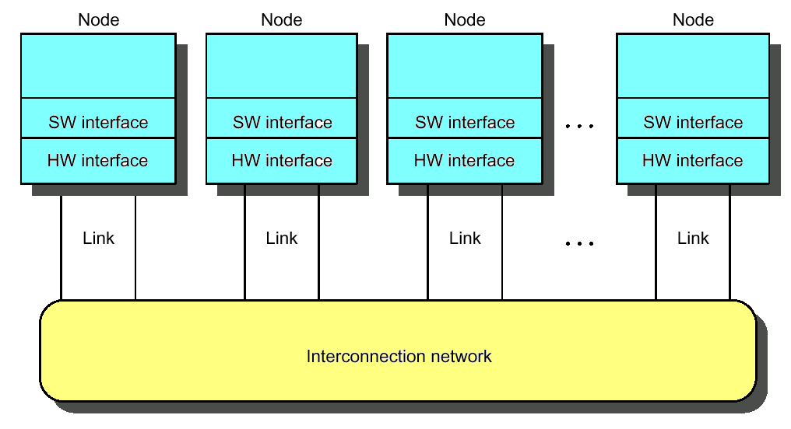
Interconnection Networks
Massively parallel processor networks (MPP)
Thousands of nodes
Short distance (<~25m)
Traffic among nodes
Local area network (LAN)
Hundreds of computers
A few kilometers
Many-to-one (clients-server)
Wide area network (WAN)
Thousands of computers
Thousands of kilometers

Slide 17
ABCs of Networks
Rules for communication are called the “protocol”, message header and data called a "packet"
What if more than 2 computers want to communicate?
Need computer “address field” (destination) in packet
What if packet is garbled in transit?
Add “error detection field” in packet (e.g., CRC)
What if packet is lost?
Time-out, retransmit; ACK & NACK
What if multiple processes/machine?
Queue per process to provide protection

Slide 18
Performance Metrics
Sender
Overhead
Transmission time
(size ÷ bandwidth)
Sender
(processor
busy)
Time of
Flight
Time of
Flight
Transmission time
(size ÷ bandwidth)
Receiver
Overhead
Receiver
Transport Latency
(processor
busy)
Total Latency
Bandwidth: maximum rate of propagating information
Time of flight: time for 1st bit to reach destination
Overhead: software & hardware time for encoding/decoding, interrupt handling, etc.
Notes:
Easy to get these things confused! Colors should help
Min (link BW, bisection BW)
Assumes no congestion
Receiver usually longer
Better to send then receive
Store Like send
Read like Receive

Slide 19
Network Interface Issues
Where to connect network to computer?
Cache consistency to avoid flushes
memory bus
Low latency and high bandwidth
memory bus
Standard interface card?
I/O bus
Typically, MPP uses memory bus; while LAN, WAN connect through I/O bus
CPU
Network
Network
$
I/O
I/O
L2 $
Controller
Controller
Memory
Bus
I/O bus
Memory
Bus Adaptor
Ideal: high bandwidth, low latency, standard interface

Slide 20
I/O Control
Processor
interrupts
Cache
Memory - I/O Bus
Main
Memory
I/O
Controller
I/O
Controller
I/O
Controller
Disk
Disk
Graphics
Network

Slide 21
Polling: Programmed I/O
CPU
Is the
data
ready?
busy wait loop
not an efficient
way to use the CPU
unless the device
is very fast!
Memory
yes
no
IOC
read
data
but checks for I/O
completion can be
dispersed among
computation
intensive code
device
store
data
done?
no
yes
Advantage:
Simple: the processor is totally in control and does all the work
Disadvantage:
Polling overhead can consume a lot of CPU time

Slide 22
Interrupt Driven Data Transfer
add
sub
and
or
nop
CPU
(1) I/O
interrupt
user
program
(2) save PC
Memory
IOC
(3) interrupt
service addr
read
store
...
rti
interrupt
service
routine
device
:
(4)
memory
Advantage:
User program progress is only halted during actual transfer
Disadvantage: special hardware is needed to:
Cause an interrupt (I/O device)
Detect an interrupt (processor)
Save the proper states to resume after the interrupt (processor)

Slide 23
I/O Interrupt vs. Exception
An I/O interrupt is just like the exceptions except:
An I/O interrupt is asynchronous
Further information needs to be conveyed
Typically exceptions are more urgent than interrupts
An I/O interrupt is asynchronous with respect to instruction execution:
I/O interrupt is not associated with any instruction
I/O interrupt does not prevent any instruction from completion
You can pick your own convenient point to take an interrupt
I/O interrupt is more complicated than exception:
Needs to convey the identity of the device generating the interrupt
Interrupt requests can have different urgencies:
Interrupt request needs to be prioritized
Priority indicates urgency of dealing with the interrupt
high speed devices usually receive highest priority

Slide 24
Direct Memory Access
Direct Memory Access (DMA):
External to the CPU
Use idle bus cycles (cycle stealing)
Act as a master on the bus
Transfer blocks of data to or from memory without CPU intervention
Efficient for large data transfer, e.g. from disk
Cache usage allows the processor to leave enough memory bandwidth for DMA
CPU sends a starting address,
direction, and length count
to DMAC. Then issues "start".
CPU
How does DMA work?:
CPU sets up and supply device id, memory address, number of bytes
DMA controller (DMAC) starts the access and becomes bus master
For multiple byte transfer, the DMAC increment the address
DMAC interrupts the CPU upon completion
Memory
DMAC
IOC
device
DMAC provides handshake
signals for Peripheral
Controller, and Memory
Addresses and handshake
signals for Memory.
For multiple bus system, each bus controller often contains DMA control logic

Slide 25
DMA Problems
With virtual memory systems: (pages would have physical and virtual addresses)
Physical pages re-mapping to different virtual pages during DMA operations
Multi-page DMA cannot assume consecutive addresses
Solutions:
Allow virtual addressing based DMA
Add translation logic to DMA controller
OS allocated virtual pages to DMA prevent re-mapping until DMA completes
Partitioned DMA
Break DMA transfer into multi-DMA operations, each is single page
OS chains the pages for the requester
In cache-based systems: (there can be two copies of data items)
Processor might not know that the cache and memory pages are different
Write-back caches can overwrite I/O data or makes DMA to read wrong data
Solutions:
Route I/O activities through the cache
Not efficient since I/O data usually is not demonstrating temporal locality
OS selectively invalidates cache blocks before I/O read or force write-back prior
to I/O write
Usually called cache flushing and requires hardware support
DMA allows another path to main memory with no cache and address translation

Slide 26
I/O Processor
An I/O processor (IOP) offload the CPU
Some processors, e.g.
Motorola 860, include special purpose
IOP for serial communication
CPU
IOP
D1
main memory
bus
D2
Mem
. . .
Dn
I/O
bus
target device
where cmnds are
CPU
IOP
OP Device Address
(1) Issues
instruction
to IOP
(4) IOP interrupts
CPU when done
(2)
IOP looks in memory for commands
(3)
OP Addr Cnt Other
memory
Device to/from memory
transfers are controlled
by the IOP directly.
IOP steals memory cycles.
what
to do
special
requests
where
to put
data
how
much

