Slide 1
CMSC 611: Advanced Computer Architecture
Shared Memory
Most slides adapted from David Patterson. Some from Mohomed Younis

Slide 2
Shared Memory
Processors communicate with shared address space
Easy on small-scale machines
Advantages:
Model of choice for uniprocessors, small-scale multiprocessor
Ease of programming
Lower latency
Easier to use hardware controlled caching
Difficult to handle node failure

Slide 3
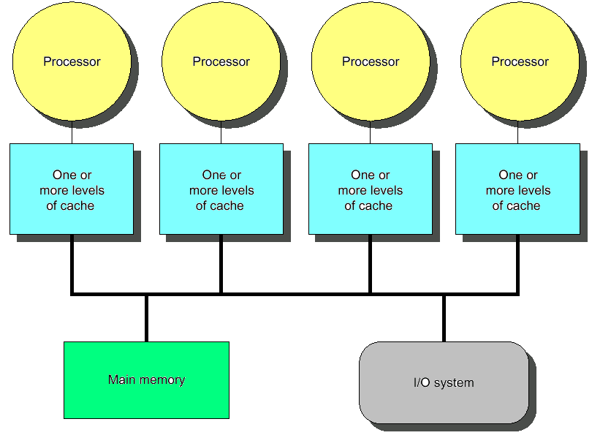
Centralized Shared Memory
Processors share a single centralized (UMA) memory through a bus interconnect
Feasible for small processor count to limit memory contention
Model for multi-core CPUs

Slide 4
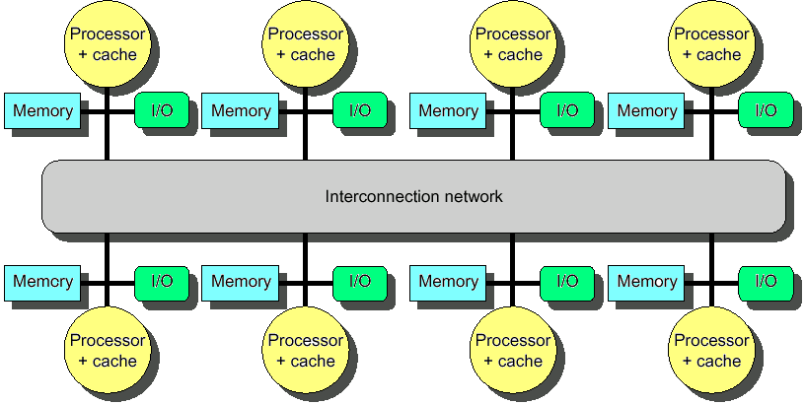
Distributed Memory
Uses physically distributed (NUMA) memory to support large processor counts (to avoid memory contention)
Advantages
Allows cost-effective way to scale the memory bandwidth
Reduces memory latency
Disadvantage
Increased complexity of communicating data

Slide 5
Shared Address Model
Physical locations
Each PE can name every physical location in the machine
Shared data
Each process can name all data it shares with other processes

Slide 6
Shared Address Model
Data transfer
Use load and store, VM maps to local or remote location
Extra memory level: cache remote data
Significant research on making the translation transparent and scalable for many nodes
Handling data consistency and protection challenging
Latency depends on the underlying hardware architecture (bus bandwidth, memory access time and support for address translation)
Scalability is limited given that the communication model is so tightly coupled with process address space

Slide 7
Three Fundamental Issues (#1: Naming)
What data is shared?
How it is addressed?
What operations can access data?
How processes refer to each other?
Choice of naming affects code produced by a compiler
Just remember and load address or keep track of processor number and local virtual address for message passing
Choice of naming affects replication of data
In cache memory hierarchy or via SW replication and consistency

Slide 8
Naming Address Spaces
Global physical address space
any processor can generate, address and access it in a single operation
Global virtual address space
if the address space of each process can be configured to contain all shared data of the parallel program
memory can be anywhere: virtual address translation handles it
Segmented shared address space
locations are named <process number, address> uniformly for all processes of the parallel program

Slide 9
Three Fundamental Issues (#2: Synchronization)
To cooperate, processes must coordinate
Message passing is implicit coordination with transmission or arrival of data
Shared address → additional operations to explicitly coordinate: e.g., write a flag, awaken a thread, interrupt a processor

Slide 10
Three Fundamental Issues (#3: Latency & Bandwidth)
Bandwidth
Need high bandwidth in communication
Match limits in network, memory, and processor
Overhead to communicate is a problem in many machines
Latency
Affects performance, since processor may have to wait
Affects ease of programming, since requires more thought to overlap communication and computation
Latency Hiding
How can a mechanism help hide latency?
Examples: overlap message send with computation, pre-fetch data, switch to other tasks

Slide 11
Centralized Shared Memory MIMD
Processors share a single centralized memory through a bus interconnect
Memory contention: Feasible for small # processors
Caches serve to:
Increase bandwidth versus bus/memory
Reduce latency of access
Valuable for both private data and shared data
Access to shared data is optimized by replication
Decreases latency
Increases memory bandwidth
Reduces contention
Reduces cache coherence problems

Slide 12
Cache Coherency
A cache coherence problem arises when the cache reflects a view of memory which is different from reality
A memory system is coherent if:
P reads X, P writes X, no other processor writes X, P reads X
Always returns value written by P
P reads X, Q writes X, P reads X
Returns value written by Q (provided sufficient W/R separation)
P writes X, Q writes X
Seen in the same order by all processors
Notes:
Processor
b) Writes green, red stale
c) Update memory (green), red stale in cache

Slide 13
Potential HW Coherency Solutions
Snooping Solution (Snoopy Bus)
Send all requests for data to all processors
Processors snoop to see if they have a copy and respond accordingly
Requires broadcast, since caching information is at processors
Works well with bus (natural broadcast medium)
Dominates for small scale machines (most of the market)

Slide 14
Potential HW Coherency Solutions
Directory-Based Schemes
Keep track of what is being shared in one centralized place
Distributed memory ⇒ distributed directory for scalability (avoids bottlenecks)
Send point-to-point requests to processors via network
Scales better than Snooping
Actually existed before Snooping-based schemes

Slide 15
Basic Snooping Protocols
Write Invalidate Protocol:
Write to shared data: an invalidate is sent to all caches which snoop and invalidate any copies
Cache invalidation will force a cache miss when accessing the modified shared item
For multiple writers only one will win the race ensuring serialization of the write operations
Read Miss:
Write-through: memory is always up-to-date
Write-back: snoop in caches to find most recent copy

Slide 16
Basic Snooping Protocols
Write Broadcast (Update) Protocol (typically write through):
Write to shared data: broadcast on bus, processors snoop, and update any copies
To limit impact on bandwidth, track data sharing to avoid unnecessary broadcast of written data that is not shared
Read miss: memory is always up-to-date
Write serialization: bus serializes requests!

Slide 17
Invalidate vs. Update
Write-invalidate has emerged as the winner for the vast majority of designs
Qualitative Performance Differences :
Spatial locality
WI: 1 transaction/cache block;
WU: 1 broadcast/word
Latency
WU: lower write–read latency
WI: must reload new value to cache

Slide 18
Invalidate vs. Update
Because the bus and memory bandwidth is usually in demand, write-invalidate protocols are very popular
Write-update can causes problems for some memory consistency models, reducing the potential performance gain it could bring
The high demand for bandwidth in write-update limits its scalability for large number of processors

Slide 19
An Example Snoopy Protocol
Invalidation protocol, write-back cache
Each block of memory is in one state:
Clean in all caches and up-to-date in memory (Shared)
OR Dirty in exactly one cache (Exclusive)
OR Not in any caches
Each cache block is in one state (track these):
Shared : block can be read
OR Exclusive : cache has only copy, it is write-able, and dirty
OR Invalid : block contains no data
Read misses: cause all caches to snoop bus
Writes to clean line are treated as misses

Slide 20
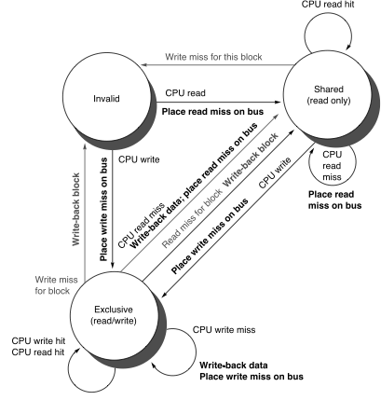
Snoopy-Cache Controller
Complications
Cannot update cache until bus is obtained
Two step process:
Arbitrate for bus
Place miss on bus and complete operation
Split transaction bus:
Bus transaction is not atomic
Multiple misses can interleave, allowing two caches to grab block in the Exclusive state
Must track and prevent multiple misses for one block

Slide 21
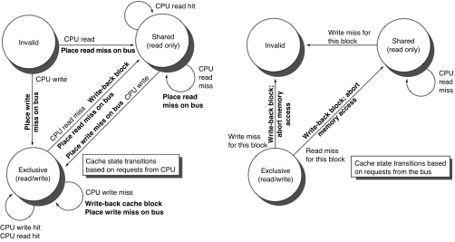
Example
Assumes memory blocks A1 and A2 map to same cache block, initial cache state is invalid

Slide 22
Example
Assumes memory blocks A1 and A2 map to same cache block

Slide 23
Example
Assumes memory blocks A1 and A2 map to same cache block

Slide 24
Example
Assumes memory blocks A1 and A2 map to same cache block

Slide 25
Example
Assumes memory blocks A1 and A2 map to same cache block

Slide 26
Example
A1
A1
Assumes memory blocks A1 and A2 map to same cache block
Notes:
Why write miss first?
Because in general, only write a piece of block, may need to read it first so that can have a full vblock; therefore, need to get
Write back is low priority event.

Slide 27
Modern Variations
MESI(F)
Invalid: no longer valid
Modified (renamed vs. 3-state protocol)
1 core can be modified, rest must be Invalid
Data has been changed, will need to write back
Shared
Read only: many cores can be shared, read only
Forward (new)
Most recent shared core, designated to forward data
Forwarding saves slower memory access
Exclusive (new)
Single read only core
Like Forward, but can change to Modified without asking

