Slide 1
CMSC 611: Advanced Computer Architecture
I/O & Storage
Some material adapted from Mohamed Younis, UMBC CMSC 611 Spr 2003 course slides
Some material adapted from Hennessy & Patterson / © 2003 Elsevier Science

Slide 2
Input/Output
Computer
I/O Interface
  Device drivers
  Device controller
  Service queues
  Interrupt handling
Design Issues
  Performance
  Expandability
  Standardization
  Resilience to failure
Impact on Tasks
  Blocking conditions
  Priority inversion
  Access ordering
Processor
Memory
Devices
Control
Input
Datapath
Output
Network
Computer
Processor
Memory
Devices
Control
Input
Datapath
Output

Slide 3
Impact of I/O on System Performance
Suppose we have a benchmark that executes in 100 seconds of elapsed time, where 90 seconds is CPU time and the rest is I/O time. If the CPU time improves by 1.5x per year for the next five years but I/O time does not improve, how much faster will our program run at the end of the five years?
Answer: Elapsed Time = CPU time + I/O time
Over five years:
CPU improvement = 90/12 = 7. BUT System improvement = 100/22 = 4.5

Slide 4
Typical I/O System
Processor
interrupts
Cache
Memory - I/O Bus
Main
Memory
I/O
Controller
I/O
Controller
I/O
Controller
Disk
Disk
Graphics
Network
The connection between the I/O devices, processor, and memory are usually called (local or internal) bus
Communication among the devices and the processor use both protocols on the bus and interrupts

Slide 5
I/O Device Examples
Device Behavior Partner Data Rate
Keyboard Input Human 200 B/s
Mouse Input Human 500 B/s
Printer Output Human 20 KB/s
Optical Disk Storage Machine 10 MB/s
Magnetic Disk Storage Machine 1 GB/s
Network-LAN Input or Output Machine 1–125 MB/s
Graphics Display Output Human 300 MB/s

Slide 6
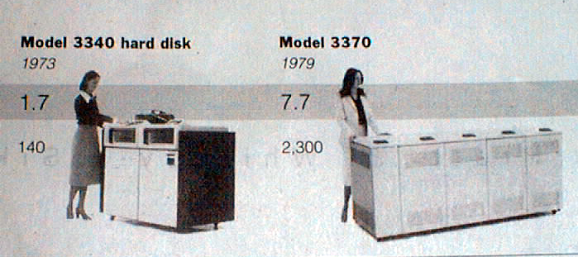
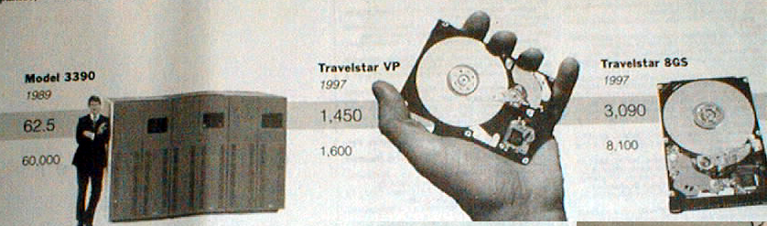
Disk History
Data density in
Mbit/square inch
Capacity of Unit Shown in Megabytes
source: New York Times, 2/23/98, page C3

Slide 7
Organization of a Hard Magnetic Disk
Platters
Track
Sector
Typical numbers (depending on the disk size):
  500 to 2,000 tracks per surface
  32 to 128 sectors per track
    A sector is the smallest unit that can be read or written to
Traditionally all tracks have the same number of sectors:
  Constant bit density: record more sectors on the outer tracks
  Recently relaxed: constant bit size, speed varies with track location

Slide 8
Magnetic Disk Operation
Track
Sector
Cylinder: all the tracks under the
head at a given point on all surface
Read/write is a three-stage process:
  Seek time
    position the arm over proper track
  Rotational latency
    wait for the sector to rotate under the read/write head
  Transfer time
    transfer a block of bits (sector) under the read-write head
Average seek time
  (∑ time for all possible seeks) / (# seeks)
  Typically in the range of 8 ms to 12 ms
  Due to locality of disk reference, actual average seek time may only be 25% to 33% of the advertised number
Cylinder
Head
Platter

Slide 9
Magnetic Disk Characteristic
Rotational Latency:
  Most disks rotate at 5,400 to 10,000 RPM
  Approximately 11 ms to 6 ms per revolution, respectively
  An average latency to the desired information is halfway around the disk:
    5.5 ms at 5400 RPM, 3 ms at 10000 RPM
Transfer Time is a function of :
  Transfer size (usually a sector): 1 KB / sector
  Rotation speed: 5400 RPM to 10000 RPM
  Recording density: bits per inch on a track
  Diameter: typical diameter ranges from 2.5 to 5.25”
  Typical values ~500MB per second

Slide 10
Example
Calculate the access time for a disk with 512 byte/sector and 12 ms advertised seek time. The disk rotates at 5400 RPM and transfers data at a rate of 4MB/sec. The controller overhead is 1 ms. Assume that the queue is idle (so no service time)
Answer:
Disk Time = Seek + Rotation + Transfer + Controller + Queue
  = 12 ms + .5/5400 RPM + 0.5 KiB / 4 MiB/s + 1 ms + 0
    = 12 ms + .5/90 RPs + (0.125 / 1024) s + 1 ms + 0
= 12 ms + 5.5 ms + 0.1 ms + 1 ms + 0
= 18.6 ms
If real seeks are 1/3 the advertised seeks, disk access time would be
10.6 ms, with rotation delay contributing 50% of the access time!

Slide 11
Historical Trend
Characteristics IBM 3090 IBM UltraStar Integral 1820
Disk diameter (inches) 10.88 3.50 1.80
Formatted data capacity (MB) 22,700 4,300 21
MTTF (hours) 50,000 1,000,000 100,000
Number of arms/box 12 1 1
Rotation speed (RPM) 3,600 7,200 3,800
Transfer rate (MB/sec) 4.2 9-12 1.9
Power/box (watts) 2,900 13 2
MB/watt 8 102 10.5
Volume (cubic feet) 97 0.13 0.02
MB/cubic feet 234 33000 1050

Slide 12
Reliability and Availability
Two terms that are often confused:
  Reliability: Is anything broken?
  Availability: Is the system still available to the user?
Availability can be improved by adding hardware:
  Example: adding ECC on memory
Reliability can only be improved by:
  Enhancing environmental conditions
  Building more reliable components
  Building with fewer components
    Improve availability may come at the cost of lower reliability

Slide 13
Disk Arrays
Increase potential throughput by
having many disk drives:
  Data is spread over multiple disk
  Multiple accesses are made to several disks
Reliability is lower than a single disk:
  Reliability of N disks = Reliability of 1 Disk ÷ N
    (50,000 Hours ÷ 70 disks = 700 hours)
    Disk system MTTF: Drops from 6 years to 1 month
  Arrays (without redundancy) too unreliable to be useful!
  But availability can be improved by adding redundant disks (RAID):
    Lost information can be reconstructed from redundant information

Slide 14
Redundant Arrays of Disks
Redundant Array of Inexpensive Disks (RAID)
  Widely available and used in today’s market
  Files are "striped" across multiple spindles
  Redundancy yields high data availability despite low reliability
  Contents of a failed disk is reconstructed from data redundantly stored in the disk array
  Drawbacks include capacity penalty to store redundant data and bandwidth penalty to update a disk block
  Different levels based on replication level and recovery techniques

Slide 15
RAID 1: Disk Mirroring/Shadowing
recovery
group
Each disk is fully duplicated onto its "shadow“
Very high availability can be achieved
Bandwidth sacrifice on write: Logical write = two physical writes
Reads may be optimized
Most expensive solution: 100% capacity overhead
Targeted for high I/O rate , high availability environments

Slide 16
RAID 3: Parity Disk
10010011
11001101
10010011
. . .
P
logical record
1
0
0
1
0
0
1
1
1
1
0
0
1
1
0
1
1
0
0
1
0
0
1
1
0
0
1
1
0
0
0
0
Striped physical
records
Parity computed across recovery group to protect against hard disk failures
33% capacity cost for parity in this configuration: wider arrays reduce
capacity costs, decrease expected availability, increase reconstruction time
Arms logically synchronized, spindles rotationally synchronized
(logically a single high capacity, high transfer rate disk)
Targeted for high bandwidth applications: Scientific, Image Processing

Slide 17
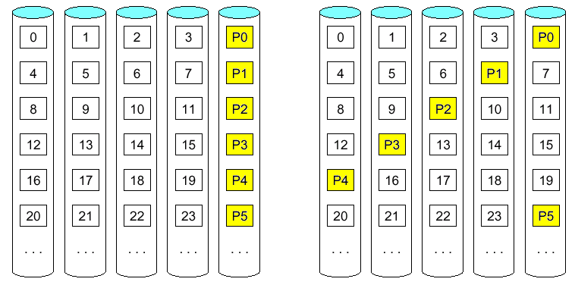
Block-Based Parity
Block-based parity leads to more efficient read access compared to RAID 3
Designating a parity disk allows recovery but will keep it idle in the absence
of a disk failure
RAID 5 distribute the parity block to allow the use of all disk and enhance
parallelism of disk access
RAID 4
RAID 5

Slide 18
RAID 5+: High I/O Rate Parity
D0
D1
D2
D3
P
Increasing
Logical
Disk
Addresses
A logical write
becomes four
physical I/Os
Independent writes
possible because of
interleaved parity
Reed-Solomon
Codes ("Q") for
protection during
reconstruction
D4
D5
D6
P
D7
D8
D9
P
D10
D11
D12
P
D13
D14
D15
Stripe
P
D16
D17
D18
D19
Stripe
Unit
D20
D21
D22
D23
P
.
.
.
.
.
.
.
.
.
.
.
.
.
.
.
Disk Columns

Slide 19
Problems of Small Writes
RAID-5: Small Write Algorithm
1 Logical Write = 2 Physical Reads + 2 Physical Writes
D0'
D0
D1
D2
D3
P
new
data
old
data
old
parity
(1. Read)
(2. Read)
+
XOR
+
XOR
(3. Write)
(4. Write)
D0'
D1
D2
D3
P'

Slide 20
Subsystem Organization
host
host
adapter
array
controller
single board
disk
controller
manages interface
to host, DMA
single board
disk
controller
control, buffering,
parity logic
single board
disk
controller
physical device
control
striping software off-loaded from
host to array controller
no applications modifications
no reduction of host performance
single board
disk
controller
often piggy-backed
in small format devices

Slide 21
System Availability: Orthogonal RAIDs
Array
Controller
String
Controller
. . .
String
Controller
. . .
String
Controller
. . .
String
Controller
. . .
String
Controller
. . .
String
Controller
. . .
Data Recovery Group: unit of data redundancy
Redundant Support Components: fans, power supplies, controller, cables
End to End Data Integrity: internal parity protected data paths

