Slide 1
CMSC 611: Advanced Computer Architecture
Memory & Virtual Memory
Some material adapted from Mohamed Younis, UMBC CMSC 611 Spr 2003 course slides
Some material adapted from Hennessy & Patterson / © 2003 Elsevier Science

Slide 2
Avoiding Address Translation
Send virtual address to cache?
  Called Virtually Addressed Cache or just Virtual Cache vs. Physical Cache
  Every time process is switched logically must flush the cache; otherwise get false hits
    Cost is time to flush + “compulsory” misses from empty cache
  Dealing with aliases (sometimes called synonyms)
    Two different virtual addresses map to same physical address causing unnecessary read misses or even RAW
  I/O must interact with cache, so need virtual address

Slide 3
Solutions
Solution to aliases
  HW guarantees that every cache block has unique physical address (simply check all cache entries)
  SW guarantee: lower n bits must have same address so that it overlaps with index; as long as covers index field & direct mapped, they must be unique; called page coloring
Solution to cache flush
  Add process identifier tag that identifies process as well as address within process: cannot get a hit if wrong process

Slide 4

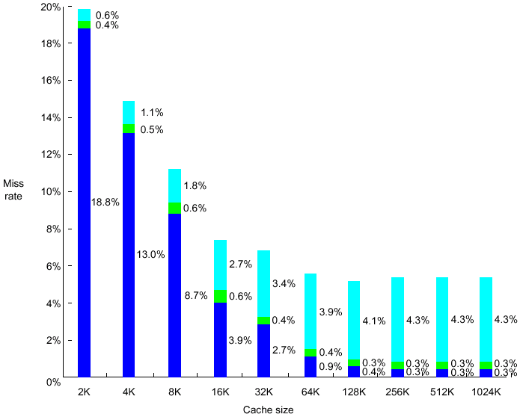
Impact of Using Process ID
Miss rate vs. virtually addressed cache size of a program measured three ways:
  Without process switches (uniprocessor)
  With process switches using a PID tag (PID)
  With process switches but without PID (purge)

Slide 5
Virtually Addressed Caches
VA: Virtual address TB: Translation buffer PA: Page address
CPU
CPU
CPU
VA
VA
VA
TB
VA
Tags
$
VA
Tags
$
TB
PA
VA
PA
$
TB
L2 $
PA
PA
MEM
MEM
MEM
Overlap $ access
with VA translation:
requires $ index to
remain invariant
across translation
Conventional
Organization
Virtually Addressed Cache
Translate only on miss
Synonym Problem

Slide 6

Indexing via Physical Addresses
If index is physical part of address, can start tag access in parallel with translation
To get the best of the physical and virtual caches, use the page offset (not affected by the address translation) to index the cache
The drawback is that direct-mapped caches cannot be bigger than the page size (typically 4-KB)
To support bigger caches and use same technique:
  Use higher associativity since the tag size gets smaller
  OS implements page coloring since it will fix a few least significant bits in the address (move part of the index to the tag)

Slide 7
TLB and Cache in MIPS
Fully associative TLB
Address translation and block identification
Direct-mapped Cache

Slide 8
TLB and Cache in MIPS
A cache hit can only occur after TLB hit
(TLB miss & No Page fault ➔ load page address to TLB)
Write-through cache

Slide 9
Memory Related Exceptions
Possible exceptions:
Cache miss: referenced block not in cache and needs to be fetched from main memory
TLB miss: referenced page of virtual address needs to be checked in the page table
Page fault: referenced page is not in main memory and needs to be copied from disk

Slide 10
Memory Protection
Want to prevent a process from corrupting memory space of other processes
  Privileged and non-privileged execution
Implementation can map independent virtual pages to separate physical pages
Write protection bits in the page table for authentication
Sharing pages through mapping virtual pages of different processes to same physical pages

Slide 11
Memory Protection
To enable the operating system to implement protection, the hardware must provide at least the following capabilities:
  Support at least two mode of operations, one of them is a user mode
  Provide a portion of CPU state that a user process can read but not write,
    e.g. page pointer and TLB
  Enable change of operation modes through special instructions

