Slide 1
CMSC 611: Advanced Computer Architecture
Cache
Some material adapted from Mohamed Younis, UMBC CMSC 611 Spr 2003 course slides
Some material adapted from Hennessy & Patterson / © 2003 Elsevier Science

Slide 2
Example
Assume an instruction cache miss rate for gcc of 2% and a data cache miss rate of 4%. If a machine has a CPI of 2 without any memory stalls and the miss penalty is 40 cycles for all misses, determine how much faster a machine would run with a perfect cache that never missed. Assume 36% combined frequencies for load and store instructions
Answer:
  Assume number of instructions = I
  Instruction miss cycles = I × 2% × 40 = 0.8 × I
  Data miss cycles = I × 36% × 4% × 40 = 0.56 × I
  Total number of memory-stall cycles = 0.8 I + 0.56 I = 1.36 I
  The CPI with memory stalls = 2 + 1.36 = 3.36
What happens if the CPU gets faster?

Slide 3
Classifying Cache Misses
Compulsory
  First access to a block not in cache
  Also called cold start or first reference misses
  (Misses in even an Infinite Cache)
Capacity
  If the cache cannot contain all needed blocks
  Due to blocks discarded and re-retrieved
  (Misses in Fully Associative Cache)
Conflict
  Set associative or direct mapped: too many blocks in set
  Also called collision or interference
  (Misses in N-way Associative Cache)
Notes:
Intuitive Model by Mark Hill

Slide 4
Miss Rate Distribution
Compulsory misses are small compared to other categories
Capacity misses diminish with increased cache size
Increasing associativity limits the placement conflicts
Conflict
Based on SPEC92

Slide 5
Techniques for Reducing Misses
1. Larger Block Size
2. Higher Associativity
3. Victim Cache
4. Pseudo-Associativity
5. Hardware Prefetching (Instructions & Data)
6. Software Prefetching Data
7. Compiler & Code Optimizations

Slide 6
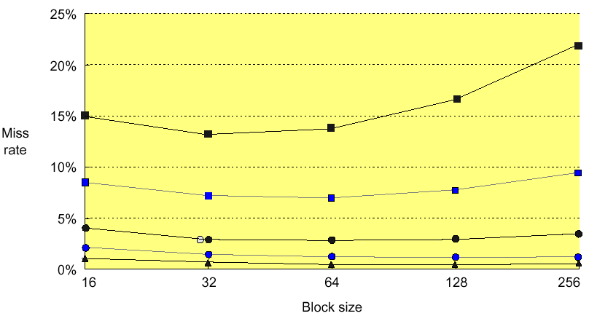

Reduce Misses via Larger Block Size
Larger block sizes reduces compulsory misses (principle of spatial locality)
Conflict misses increase for larger block sizes since cache has fewer blocks

Slide 7
Reduce Misses via Higher Associativity
2:1 Cache Rule:
Miss Rate for direct mapped cache of size N = Miss Rate 2-way
cache size N/2
Greater associativity comes at the expense of larger hit access time
Hardware complexity grows for high associativity and clock cycle increases

Slide 8
Example
Assume hit time is 1 clock cycle and average miss penalty is 50 clock cycles for a direct mapped cache. The clock cycle increases by a factor of 1.10 for 2-way, 1.12 for 4-way, 1.14 for 8-way associative cache. Compare the average memory access based on the previous figure miss rates
A good size of direct mapped cache can be very efficient given its simplicity
High associativity becomes a negative aspect

Slide 9
Victim Cache
Combines fast hit time of direct
mapped yet still avoids conflict misses
  Adds small fully associative cache between the direct mapped cache and memory to place data discarded from cache
  Jouppi [1990]: 4-entry victim cache removed 20% to 95% of conflicts for a 4 KB direct mapped data cache
  Used in HP and Alpha

Slide 10
Pseudo-Associativity Mechanism
Combine fast hit time of Direct Mapped and lower conflict misses of 2-way set associative
Divide cache: on a miss, check other half of cache to see if there, if so have a pseudo-hit
To limit the impact of hit time variability on performance, swap block contents
Drawback: CPU pipeline is hard if hit takes 1 or 2 cycles
  Better for caches not tied directly to processor (L2)
  Used in MIPS R1000 L2 cache, similar in UltraSPARC

Slide 11
H/W Pre-fetching of Instructions & Data
Hardware pre-fetches instructions and data while handing other cache misses
  Assume pre-fetched items will be referenced shortly
Pre-fetching relies on having extra memory bandwidth that can be used without penalty
Examples of Instruction Pre-fetching:
  Alpha 21064 fetches 2 blocks on a miss
  Extra block placed in “stream buffer”
  On miss check stream buffer
Works with data blocks too:
  Jouppi [1990] 1 data stream buffer got 25% misses from 4KB cache; 4 streams got 43%
  Palacharla & Kessler [1994] for scientific programs for 8 streams got 50% to 70% of misses from 2 64KB, 4-way set associative caches

Slide 12
Software Pre-fetching Data
Uses special instructions to pre-fetch data:
  Load data into register (HP PA-RISC loads)
  Cache Pre-fetch: load into cache (MIPS IV, PowerPC, SPARC v. 9)
Special pre-fetching instructions cannot cause faults (undesired exceptions) since it is a form of speculative execution
Makes sense if the processor can proceeds without blocking for a cache access (lock-free cache)
Loops are typical target for pre-fetching after unrolling (miss penalty is small) or after applying software pipelining (miss penalty is large)
Issuing Pre-fetch Instructions takes time
  Is cost of pre-fetch issues < savings in reduced misses?
  Higher superscalar reduces difficulty of issue bandwidth
for (j = 0; j < 100; j = j+1)
pre-fetch (b[i+7][0]);
a[0][j] = b[j][0] * b[j+1][0];
for (i = 1; i < 3; i = i+1)
pre-fetch (a[i][j+7]);
a[i-1][j] = b[j][0] * b[j+1][0];
for (i = 0; i < 3; i = i+1)
for (j = 0; j < 100; j = j+1)
a[i][j] = b[j][0] * b[j+1][0];

Slide 13
Compiler-based Cache Optimizations
Complier-based cache optimization reduces the miss rate without any hardware change
McFarling [1989] reduced caches misses by 75% (8KB direct mapped / 4 byte blocks)
For Instructions
  Reorder procedures in memory to reduce conflict
  Profiling to determine likely conflicts among groups of instructions
For Data
  Merging Arrays: improve spatial locality by single array of compound elements vs. two arrays
  Loop Interchange: change nesting of loops to access data in order stored in memory
  Loop Fusion: Combine two independent loops that have same looping and some variables overlap
  Blocking: Improve temporal locality by accessing “blocks” of data repeatedly vs. going down whole columns or rows

Slide 14
Examples
Repack/Merge Arrays:
/* After: 1 array of stuctures */
struct merge {
int val;
int key;
};
struct merge merged_array[SIZE];
/* Before: 2 sequential arrays */
int val[SIZE];
int key[SIZE];
Reduces misses by improving spatial locality through combined arrays that are accessed simultaneously
Loop Interchange:
/* Before */
for (k = 0; k < 100; k = k+1)
for (j = 0; j < 100; j = j+1)
for (i = 0; i < 5000; i = i+1)
x[i][j] = 2 * x[i][j];
/* After */
for (k = 0; k < 100; k = k+1)
for (i = 0; i < 5000; i = i+1)
for (j = 0; j < 100; j = j+1)
x[i][j] = 2 * x[i][j];
Sequential accesses instead of striding through memory every 100 words; improved spatial locality

Slide 15
Loop Fusion Example
Some programs have separate sections of code that access the same arrays (performing different computation on common data)
Fusing multiple loops into a single loop allows the data in cache to be used repeatedly before being swapped out
Loop fusion reduces missed through improved temporal locality (rather than spatial locality in array merging and loop interchange)
/* Before */
for (i = 0; i < N; i = i+1)
for (j = 0; j < N; j = j+1)
a[i][j] = 1/b[i][j] * c[i][j];
for (i = 0; i < N; i = i+1)
for (j = 0; j < N; j = j+1)
d[i][j] = a[i][j] + c[i][j];
/* After */
for (i = 0; i < N; i = i+1)
for (j = 0; j < N; j = j+1) { a[i][j] = 1/b[i][j] * c[i][j];
d[i][j] = a[i][j] + c[i][j];
}
Accessing array “a” and “c” would have caused twice the number of misses without loop fusion

Slide 16
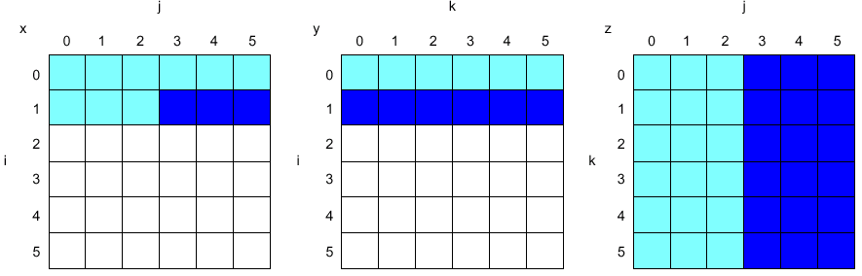
Blocking Example
/* Before */
for (i = 0; i < N; i = i+1)
for (j = 0; j < N; j = j+1) {
r = 0;
for (k = 0; k < N; k = k+1)
r = r + y[i][k] * z[k][j];
x[i][j] = r;
};
Two Inner Loops:
  Read all NxN elements of z[]
  Read N elements of 1 row of y[] repeatedly
  Write N elements of 1 row of x[]
Capacity Misses a function of N & Cache Size:
  3 × N × N × 4 bytes => no capacity misses;
Idea: compute on B × B sub-matrix that fits

Slide 17
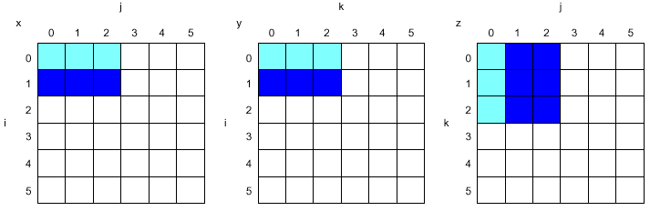
Blocking Example
/* After */
for (jj = 0; jj < N; jj = jj+B)
for (kk = 0; kk < N; kk = kk+B)
for (i = 0; i < N; i = i+1)
for (j = jj; j < min(jj+B-1,N); j = j+1) {
r = 0;
for (k = kk; k < min(kk+B-1,N); k = k+1) {
r = r + y[i][k] * z[k][j];};
x[i][j] = x[i][j] + r;
};
B called Blocking Factor
Memory words accessed
2N³ + N² → 2N³/B +N²
Conflict misses can go down too
Blocking is also useful for register allocation

Slide 18
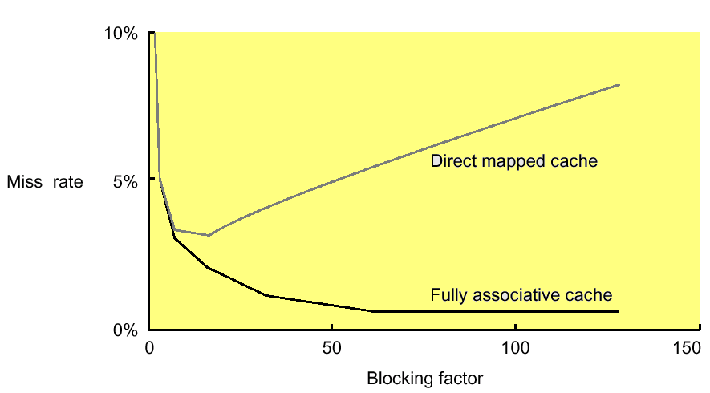
Blocking Factor
Traditionally blocking is used to reduce capacity misses relying on high associativity to tackle conflict misses
Choosing smaller blocking factor than the cache capacity can also reduce conflict misses (fewer words are active in cache)
Lam et al [1991] a blocking factor of 24 had a fifth the misses compared to a factor of 48 despite both fit in cache

Slide 19
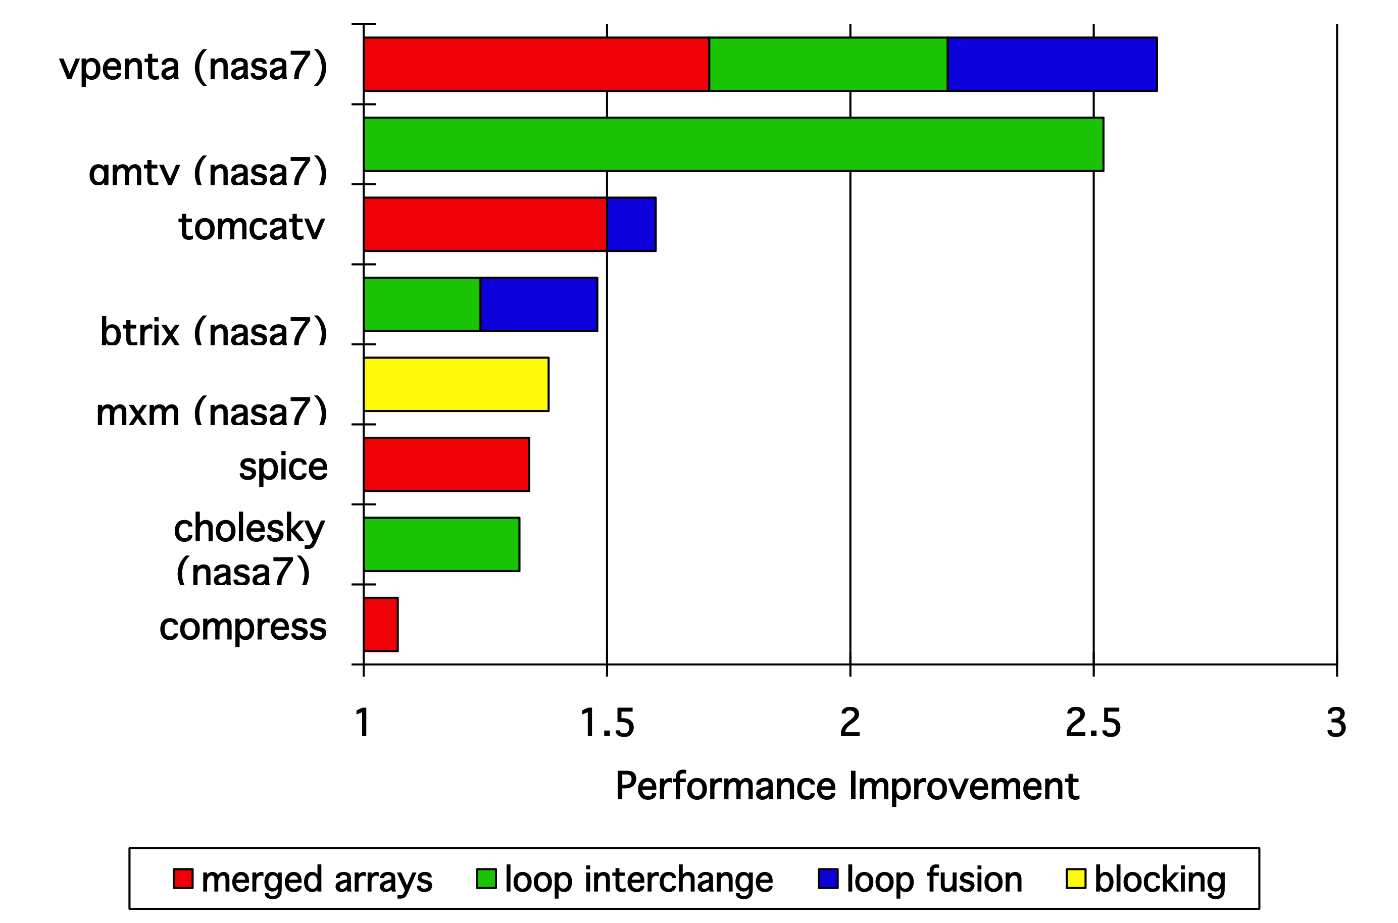
Efficiency of Compiler-Based Cache Opt.

Slide 20
Reducing Miss Penalty
Read Priority over Write
Sub-block Placement
Merging Write Buffer
Victim Cache
Early Restart and Critical Word First
Non-blocking Caches
  Hit under Miss
  Miss under Miss
Extra Cache Levels

Slide 21
Read Priority over Write on Miss
Write through with write buffers offer RAW conflicts with main memory reads on cache misses
If simply wait for write buffer to empty, might increase read miss penalty (old MIPS 1000 by 50% )
Check write buffer contents before read; if no conflicts, let the memory access continue
Cache
Processor
DRAM
Write Buffer
Write Back?
  Read miss replacing dirty block
  Normal: Write dirty block to memory, and then do the read
  Instead copy the dirty block to a write buffer, then do the read, and then
  do the write
  CPU stall less since restarts as soon as do read

Slide 22
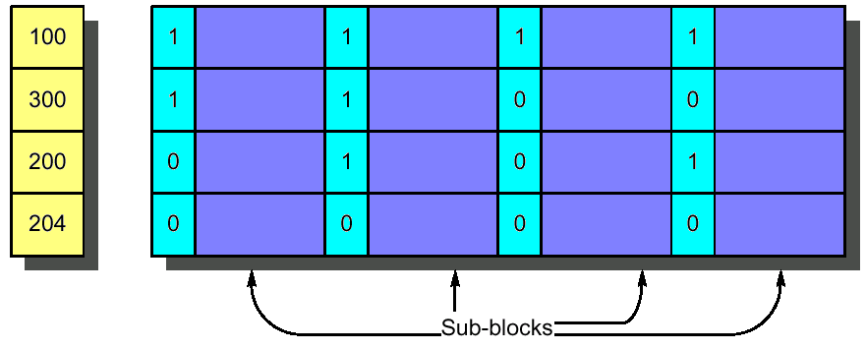
Sub-block Placement
Originally invented to reduce tag storage while avoiding the increased miss penalty caused by large block sizes
Enlarge the block size while dividing each block into smaller units (sub-blocks) and thus does not have to load full block on a miss
Include valid bits per sub-block to indicate the status of the sub-block (in cache or not)
Valid Bits

Slide 23
Early Restart and Critical Word First
Don’t wait for full block to be loaded before restarting CPU
  Early restart
    As soon as the requested word of the block arrives, send it to the CPU and let the CPU continue execution
  Critical Word First
    Request the missed word first from memory
    Also called wrapped fetch and requested word first
Complicates cache controller design
CWF generally useful only in large blocks
Given spatial locality programs tend to want next sequential word, limits benefit
block

Slide 24
Victim Cache
Lower both miss rate
Reduce average miss penalty
Slightly extend the worst case miss penalty

Slide 25
Non-blocking Caches
Early restart still waits for the requested word to arrive before the CPU can continue execution
For machines that allows out-of-order execution using a scoreboard or a Tomasulo-style control the CPU should not stall on cache misses
“Non-blocking cache” or “lock-free cache” allows data cache to continue to supply cache hits during a miss
“hit under miss” reduces the effective miss penalty by working during miss vs. ignoring CPU requests
“hit under multiple miss” or “miss under miss” may further lower the effective miss penalty by overlapping multiple misses
  Significantly increases the complexity of the cache controller as there can be multiple outstanding memory accesses
  Requires multiple memory banks (otherwise cannot support)
  Pentium Pro allows 4 outstanding memory misses

Slide 26

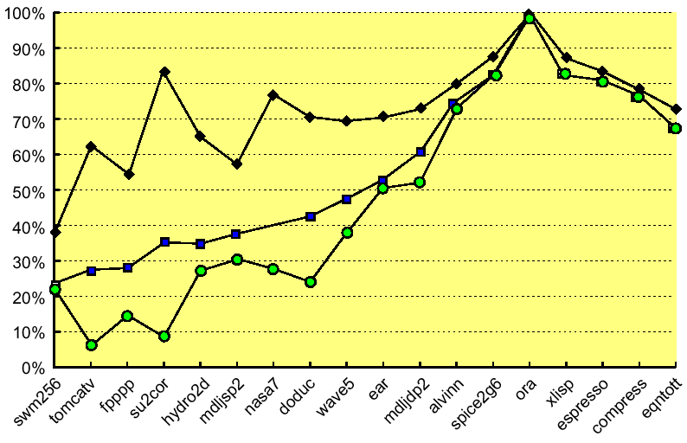
Performance of Non-blocking Caches
Ratio of the average memory stall time
Benchmark

Slide 27
Second Level Cache
The previous techniques reduce the impact of the miss penalty on the CPU
  L2 cache handles the cache-memory interface
Measuring cache performance
Local miss rate
  misses in this cache divided by the total number of memory accesses to this cache (MissRate_{L2})
Global miss rate (& biggest penalty!)
  misses in this cache divided by the total number of memory accesses generated by the CPU (MissRate_{L1} × MissRate_{L2})

Slide 28
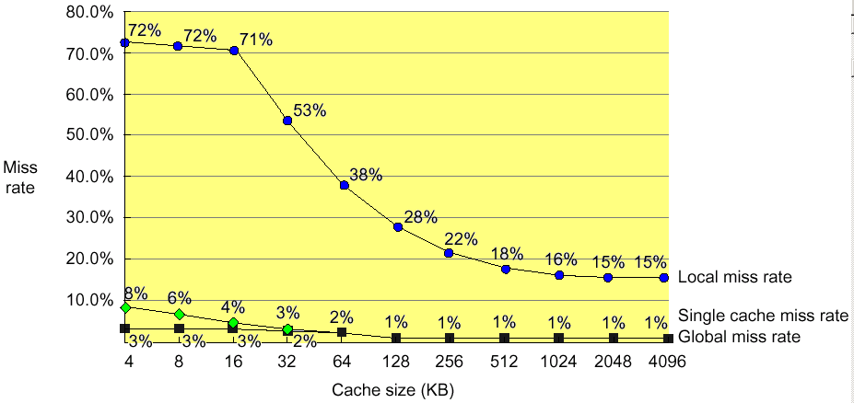
Local vs Global Misses
(Global miss rate close to single level cache rate provided L2 >> L1)

Slide 29
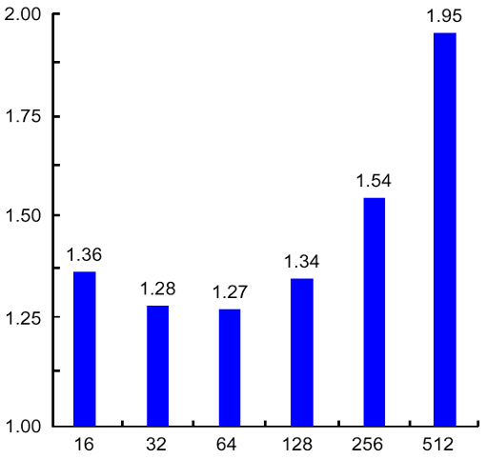
L2 Cache Parameters
32 bit bus
512KB cache
L1 cache directly affects the processor design and clock cycle: should be simple and small
Bulk of optimization techniques can go easily to L2 cache
Miss-rate reduction more practical for L2
Considering the L2 cache can improve the L1 cache design,
  e.g. use write-through if L2 cache applies write-back
Relative execution time
Block size of second-level cache (byte)

Slide 30
Reducing Hit Time
Average Access Time = Hit Time x (1 - Miss Rate) + Miss Time x Miss Rate
Hit rate is typically very high compared to miss rate
  any reduction in hit time is magnified
Hit time critical: affects processor clock rate
Three techniques to reduce hit time:
  Simple and small caches
  Avoid address translation during cache indexing
  Pipelining writes for fast write hits
Simple and small caches
Design simplicity limits control logic complexity and allows shorter clock cycles
On-chip integration decreases signal propagation delay, thus reducing hit time
  Alpha 21164 has 8KB Instruction and 8KB data cache and 96KB second level cache to reduce clock rate

