Slide 1
CMSC 611: Advanced Computer Architecture
Instruction Level Parallelism
Some material adapted from Mohamed Younis, UMBC CMSC 611 Spr 2003 course slides
Some material adapted from Hennessy & Patterson / © 2003 Elsevier Science

Slide 2
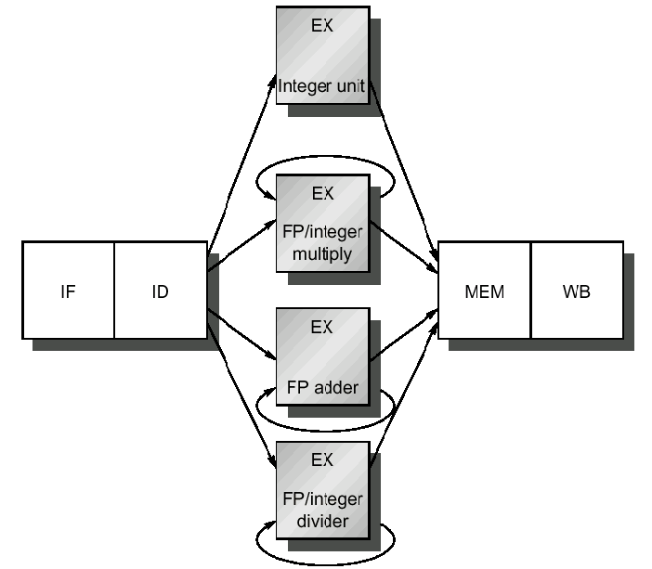
Floating-Point Pipeline
Impractical for FP ops to complete in one clock
  (complex logic and/or very long clock cycle)
More complex hazards
  Structural
  Data

Slide 3
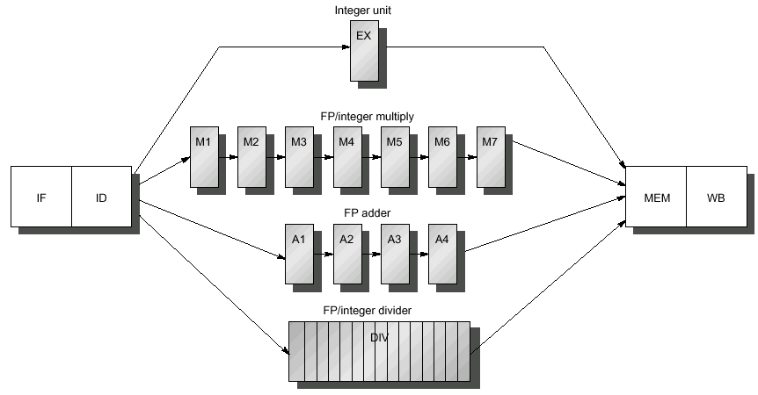
Multi-cycle FP Pipeline
7-stage pipelined FP multiply
Integer ALU
Non-pipelined DIV operation stalling the whole pipeline for 24 cycles
4-stage pipelined FP addition
Example: blue indicate where data is needed and red when result is available

Slide 4
Multi-cycle FP: EX Phase
Latency: cycles between instruction that produces result and instruction that uses it
  Since most operations consume their operands at the beginning of the EX stage, latency is usually number of the stages of the EX an instruction uses
Long latency increases the frequency of RAW hazards
Initiation (Repeat) interval: cycles between issuing two operations of a given type

Slide 5
FP Pipeline Challenges
Non-pipelined divide causes structural hazards
Number of register writes required in a cycle can be larger than 1
WAW hazards are possible
  Instructions no longer reach WB in order
WAR hazards are NOT possible
  Register reads are still taking place during the ID stage
Instructions can complete out of order
  Complicates exceptions
Longer latency makes RAW stalls more frequent
Example of RAW hazard caused by the long latency

Slide 6
Structural Hazard
At cycle 10, MULTD, ADDD and LD instructions all in MEM
At cycle 11, MULTD, ADDD and LD instructions all in WB
  Additional write ports are not cost effective since they are rarely used
Instead
  Detect at ID and stall
  Detect at MEM or WB and stall

Slide 7
WAW Data Hazards
WAW hazards can be corrected by either:
  Stalling the latter instruction at MEM until it is safe
  Preventing the first instruction from overwriting the register
Correcting at cycle 11 OK unless intervening RAW/use of F2
WAW hazards can be detected at the ID stage
  Convert 1st instruction to no-op
WAW hazards are generally very rare, designers usually go with the simplest solution

Slide 8
Detecting Hazards
Hazards among FP instructions & and combined FP and integer instructions
Separate int & fp register files limits latter to FP load and store instructions
Assuming all checks are to be performed in the ID phase:
  Check for structural hazards:
    Wait if the functional unit is busy (Divides in our case)
    Make sure the register write port is available when needed
  Check for a RAW data hazard
    Requires knowledge of latency and initiation interval to decide when to forward and when to stall
  Check for a WAW data hazard
    Write completion has to be estimated at the ID stage to check with other instructions in the pipeline
Data hazard detection and forwarding logic from values stored between the stages

Slide 9
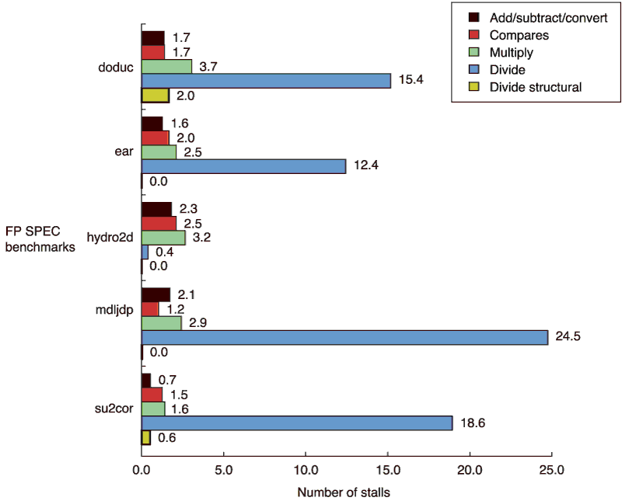
Stalls/Instruction, FP Pipeline

Slide 10
Instruction Level Parallelism (ILP)
Overlap the execution of unrelated instructions
Both instruction pipelining and ILP enhance instruction throughput not the execution time of the individual instruction
Potential of IPL within a basic block is very limited
  in “gcc” 17% of instructions are control transfer meaning on average 5 instructions per branch

Slide 11
Loops: Simple & Common
for (i=1; i<=1000; i=i+1)
x[i] = x[i] + y[i];
Techniques like loop unrolling convert loop-level parallelism into instruction-level parallelism
  statically by the compiler
  dynamically by hardware
Loop-level parallelism can also be exploited using vector processing
IPL feasibility is mainly hindered by data and control dependence among the basic blocks
Level of parallelism is limited by instruction latencies

Slide 12
Major Assumptions
Basic MIPS integer pipeline
Branches with one delay cycle
Functional units are fully pipelined or replicated (as many times as the pipeline depth)
  An operation of any type can be issued on every clock cycle and there are no structural hazard

Slide 13
Motivating Example
for(i=1000; i!=0; i=i-1)
x[i] = x[i] + s;
Loop: LD F0,x(R1) ;F0=x[i]
ADDD F4,F0,F2 ;add F2(=s)
SD x(R1),F4 ;store result
SUBI R1,R1,8 ;i=i-1
BNEZ R1,Loop ;loop to 0
Standard Pipeline execution
Loop: LD F0,x(R1)
stall
ADDD F4,F0,F2
stall
stall
SD x(R1),F4
SUBI R1,R1,8
stall
BNEZ R1,Loop
stall
Loop: LD F0,x(R1)
SUBI R1,R1,8
ADDD F4,F0,F2
stall ;F4
BNEZ R1,Loop
SD x+8(R1),F4
Smart compiler
Sophisticated compiler optimization reduced execution time from 10 cycles to only 6 cycles

Slide 14
Loop Unrolling
Loop: LD F0,x(R1)
ADDD F4,F0,F2
SD x(R1),F4
SUBI R1,R1,8
BNEZ R1,Loop
Replicate loop body 4 times, will need cleanup
phase if loop iteration is not a multiple of 4
Loop: LD F0,x(R1)
ADDD F4,F0,F2
SD x(R1),F4
LD F6,x-8(R1) ;drop SUBI/BNEZ
ADDD F8,F6,F2
SD x-8(R1),F8
LD F10,x-16(R1) ;drop again
ADDD F12,F10,F2
SD x-16(R1),F12
LD F14,x-24(R1) ;drop again
ADDD F16,F14,F2
SD x-24(R1),F16
SUBI R1,R1,32 ;alter to 4*8
BNEZ R1,LOOP
6 cycles, but only 3 are loop body
Loop unrolling limits overhead at the expense of a larger code
  Eliminates branch delays
  Enable effective scheduling
Use of different registers needed to limit data hazard

Slide 15
Scheduling Unrolled Loops
Cycle Instruction
1 Loop: LD F0,x(R1)
3 ADDD F4,F0,F2
6 SD x(R1),F4
7 LD F6,x-8(R1)
9 ADDD F8,F6,F2
12 SD x-8(R1),F8
13 LD F10,x-16(R1)
15 ADDD F12,F10,F2
18 SD x-16(R1),F12
19 LD F14,x-24(R1)
21 ADDD F16,F14,F2
24 SD x-24(R1),F16
25 SUBI R1,R1,#32
27 BNEZ R1,LOOP
28 NOOP
Loop unrolling exposes more computation that can be scheduled to minimize the pipeline stalls
Cycle Instruction
1 Loop: LD F0,x(R1)
2 LD F6,x-8(R1)
3 LD F10,x-16(R1)
4 LD F14,x-24(R1)
5 ADDD F4,F0,F2
6 ADDD F8,F6,F2
7 ADDD F12,F10,F2
8 ADDD F16,F14,F2
9 SD x(R1),F4
10 SD x-8(R1),F8
11 SUBI R1,R1,#32
12 SD x+16(R1),F12
13 BNEZ R1,LOOP
14 SD x+8(R1),F1
Understanding dependence among instructions is the key for for detecting and performing the transformation

Slide 16
Exception Types
I/O device request
Breakpoint
Integer arithmetic overflow
FP arithmetic anomaly
Page fault
Misaligned memory accesses
Memory-protection violation
Undefined instruction
Privilege violation
Hardware and power failure

Slide 17
Exception Requirements
Synchronous vs. asynchronous
  I/O exceptions: Asyncronous
    Allow completion of current instruction
  Exceptions within instruction: Synchronous
    Harder to deal with
User requested vs. coerced
  Requested predictable and easier to handle
User maskable vs. unmaskable
Resume vs. terminate
  Easier to implement exceptions that terminate program execution

Slide 18
Exceptions in MIPS
Multiple exceptions might occur since multiple instructions are executing
  (LW followed by DIV might cause page fault and an arith. exceptions in same cycle)
Exceptions can even occur out of order
  IF page fault before preceeding MEM page fault
Pipeline exceptions must follow order of execution of faulting instructions not according to the time they occur

Slide 19
Stopping & Restarting Execution
Some exceptions require restart of instruction
  e.g. Page fault in MEM stage
When exception occurs, pipeline control can:
  Force a trap instruction into next IF stage
  Until the trap is taken, turn off all writes for the faulting (and later) instructions
  OS exception-handling routine saves faulting instruction PC

Slide 20
Stopping & Restarting Execution
Precise exceptions
  Instructions before the faulting one complete
  Instructions after it restart
  As if execution were serial
Exception handling complex if faulting instruction can change state before exception occurs
Precise exceptions simplifies OS
Required for demand paging

Slide 21
Precise Exception Handling
The MIPS Approach:
  Hardware posts all exceptions caused by a given instruction in a status vector associated with the instruction
  The exception status vector is carried along as the instruction goes down the pipeline
  Once an exception indication is set in the exception status vector, any control signal that may cause a data value to be written is turned off
  Upon entering the WB stage the exception status vector is checked and the exceptions, if any, will be handled according the time they occurred
  Allowing an instruction to continue execution till the WB stage is not a problem since all write operations for that instruction will be disallowed

Slide 22
Instruction Set Complications
Early-Write Instructions
  MIPS only writes late in pipeline
  Machines with multiple writes usually require capability to rollback the effect of an instruction
    e.g. VAX auto-increment,
  Instructions that update memory state during execution, e.g. string copy, may need to save & restore temporary registers
Branching mechanisms
  Complications from condition codes, predictive execution for exceptions prior to branch
Variable, multi-cycle operations
  Instruction can make multiple writes

Slide 23
Maintaining Precise Exceptions
Pipelining FP instructions can cause out-of-order completion
Exceptions also a problem:
  DIVF F0, F2, F4
  ADDF F10, F10, F8
  SUBF F12, F12, F14
  No data hazards
  What if DIVF exception occurs after ADDF writes F10?

Slide 24
Four FP Exception Solutions
Settle for imprecise exceptions
  Some supercomputers still uses this approach
  IEEE floating point standard requires precise exceptions
  Some machine offer slow precise and fast imprecise exceptions
Buffer the results of all operations until previous instructions complete
  Complex and expensive design
  Most modern processors store results in a
  Reorder Buffer (ROB) and commit in order.

Slide 25
Four FP Exception Solutions
Allow imprecise exceptions and get the handler to clean up any miss
  Save PC + state about the interrupting instruction and all out-of-order completed instructions
  The trap handler will consider the state modification caused by finished instructions and prepare machine to resume correctly
  Issues: consider the following example
    Instruction1: Long running, eventual exception
    Instructions 2 … (n-1) : Instructions that do not complete
    Instruction n : An instruction that is finished
  The compiler can simplify the problem by grouping FP instructions so that the trap does not have to worry about unrelated instructions

Slide 26
Four FP Exception Solutions
Allow instruction issue to continue only if previous instruction are guaranteed to cause no exceptions:
  Mainly applied in the execution phase
  Used on MIPS R4000 and Intel Pentium

