Slide 1
CMSC 611: Advanced Computer Architecture
Pipelining
Some material adapted from Mohamed Younis, UMBC CMSC 611 Spr 2003 course slides
Some material adapted from Hennessy & Patterson / © 2003 Elsevier Science

Slide 2
Sequential Laundry
6 PM
7
8
9
10
11
Midnight
Time
30
40
20
30
40
20
30
40
20
30
40
20
T
a
s
k
O
r
d
e
r
A
B
C
D
Washer takes 30 min, Dryer takes 40 min, folding takes 20 min
Sequential laundry takes 6 hours for 4 loads
If they learned pipelining, how long would laundry take?
Slide: Dave Patterson

Slide 3
Pipelined Laundry
6 PM
7
8
9
10
11
Midnight
Time
30
40
40
40
40
20
T
a
s
k
O
r
d
e
r
A
B
C
D
Pipelining means start work as soon as possible
Pipelined laundry takes 3.5 hours for 4 loads
Slide: Dave Patterson

Slide 4
Pipelining Lessons
6 PM
7
8
9
Pipelining doesn’t help latency of single task, it helps throughput of entire workload
Pipeline rate limited by slowest pipeline stage
Multiple tasks operating simultaneously using different resources
Potential speedup = Number pipe stages
Unbalanced lengths of pipe stages reduces speedup
Time to “fill” pipeline and time to “drain” it reduce speedup
Stall for Dependencies
Time
30
40
40
40
40
20
T
a
s
k
O
r
d
e
r
A
B
C
D
Slide: Dave Patterson

Slide 5
MIPS Instruction Set
RISC architecture:
  ALU operations only on registers
  Memory is affected only by load and store
  Instructions follow very few formats and typically are of the same size
31
26
21
16
11
6
0
op
rs
rt
rd
shamt
funct
6 bits
5 bits
5 bits
5 bits
5 bits
6 bits
31
26
21
16
0
op
rs
rt
immediate
6 bits
5 bits
5 bits
16 bits
31
26
0
op
target address
6 bits
26 bits

Slide 6

Single Cycle Execution

Slide 7
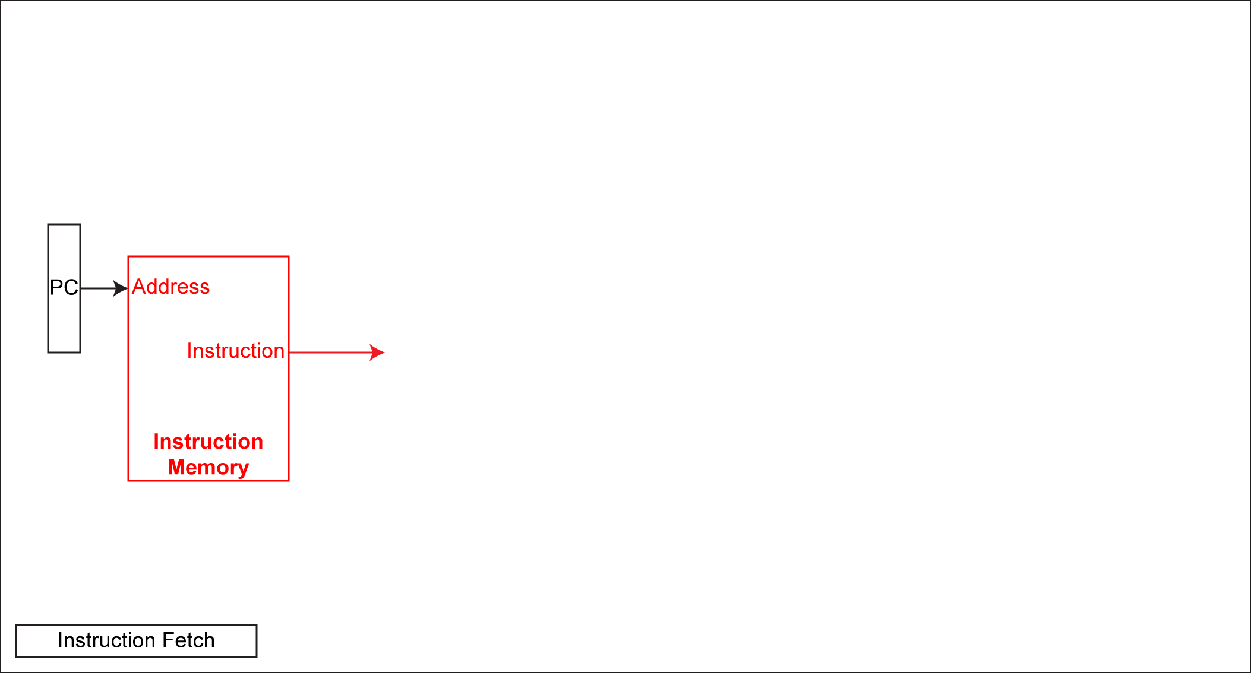
Single Cycle Execution

Slide 8
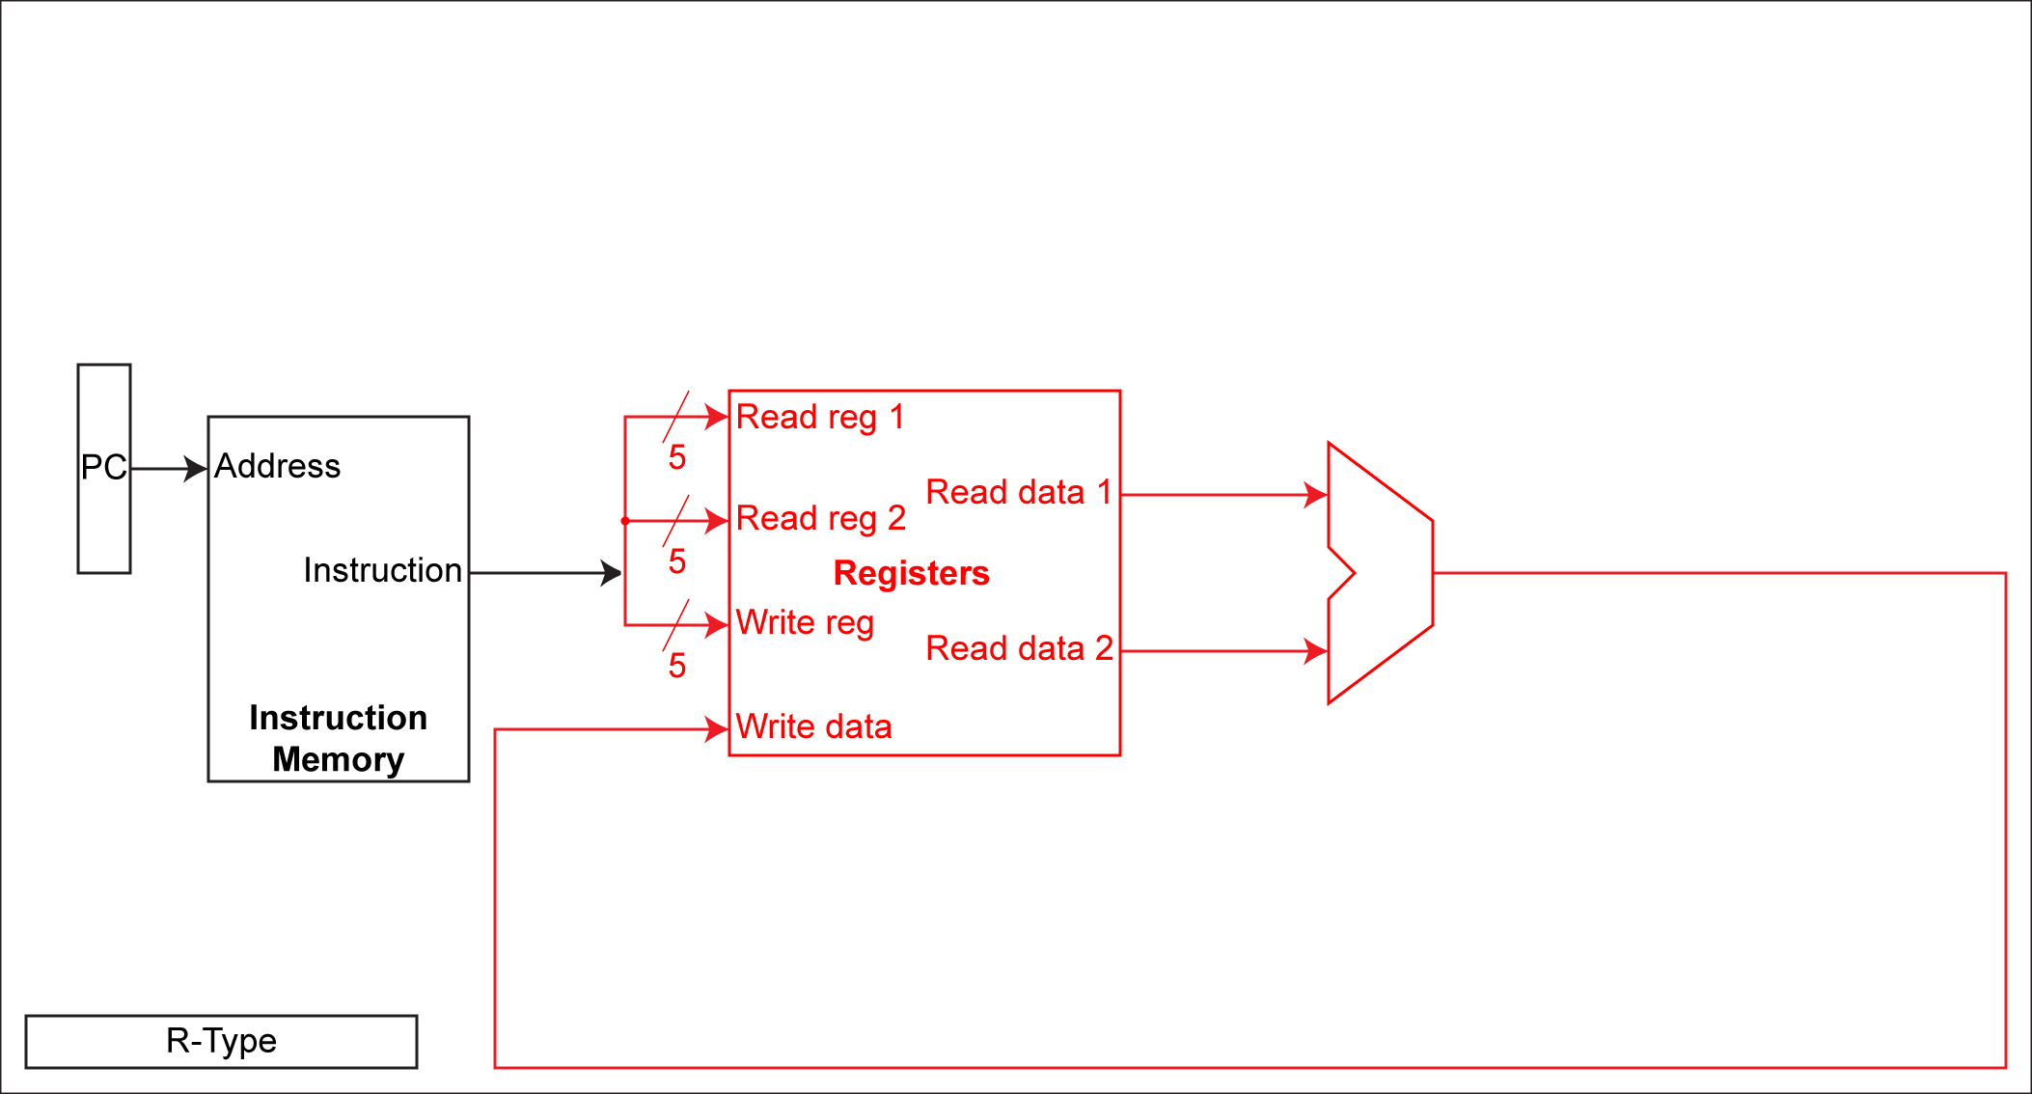
Single Cycle Execution

Slide 9
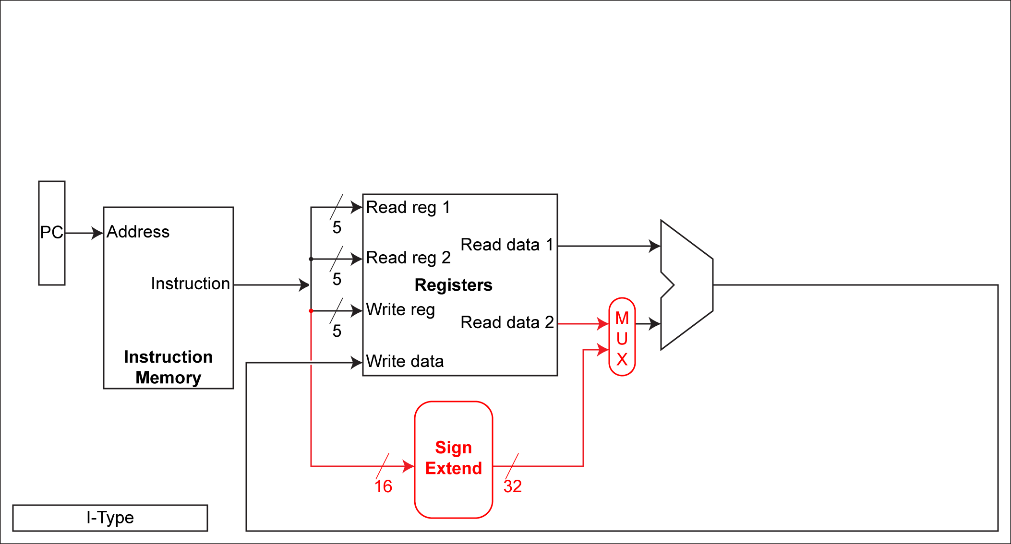
Single Cycle Execution

Slide 10
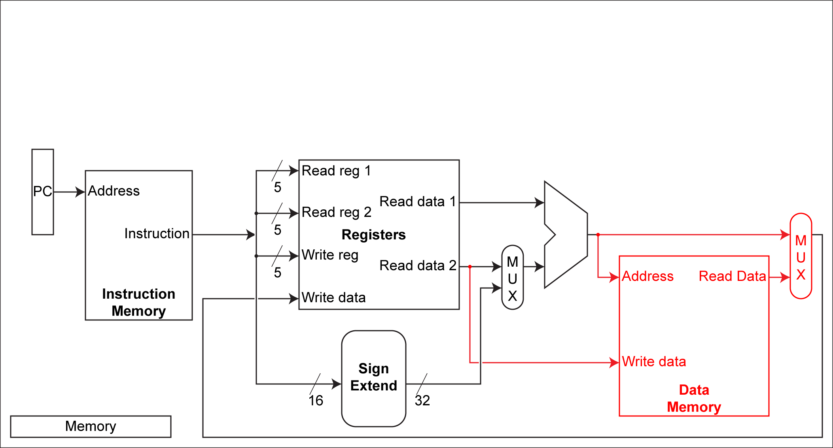
Single Cycle Execution

Slide 11
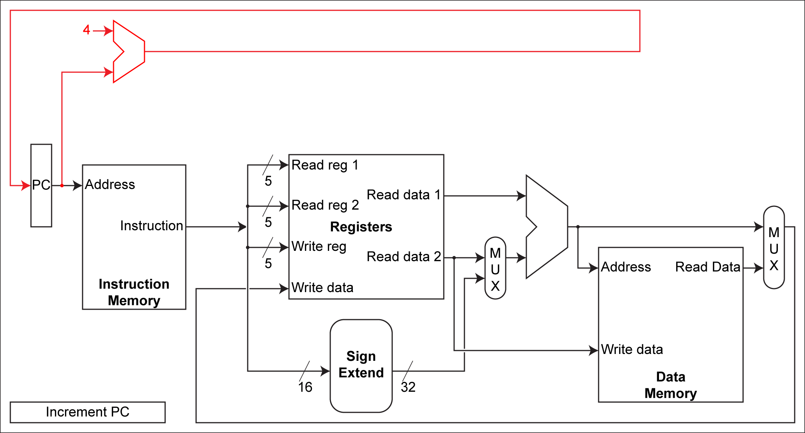
Single Cycle Execution

Slide 12
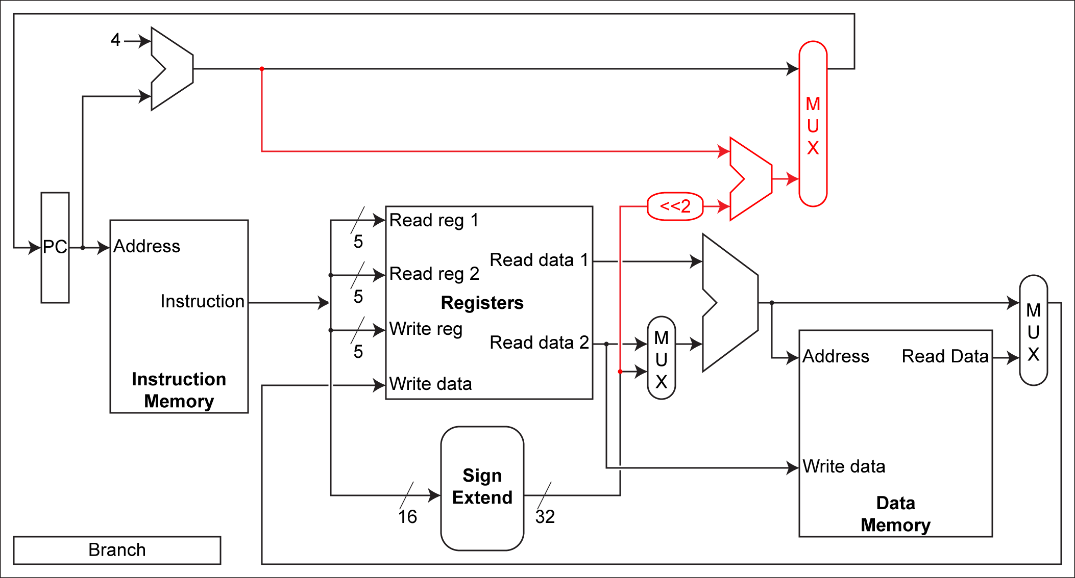
Single Cycle Execution

Slide 13
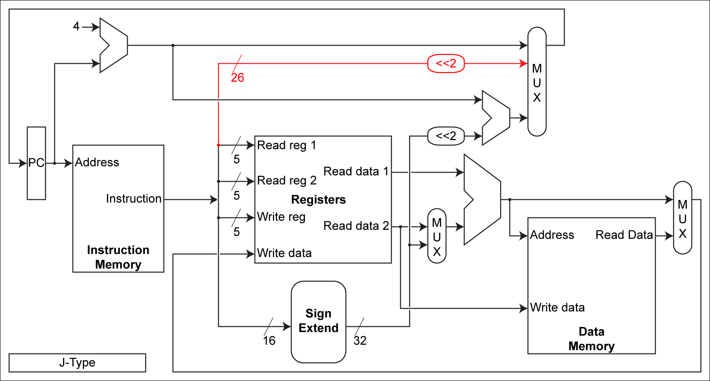
Single Cycle Execution

Slide 14
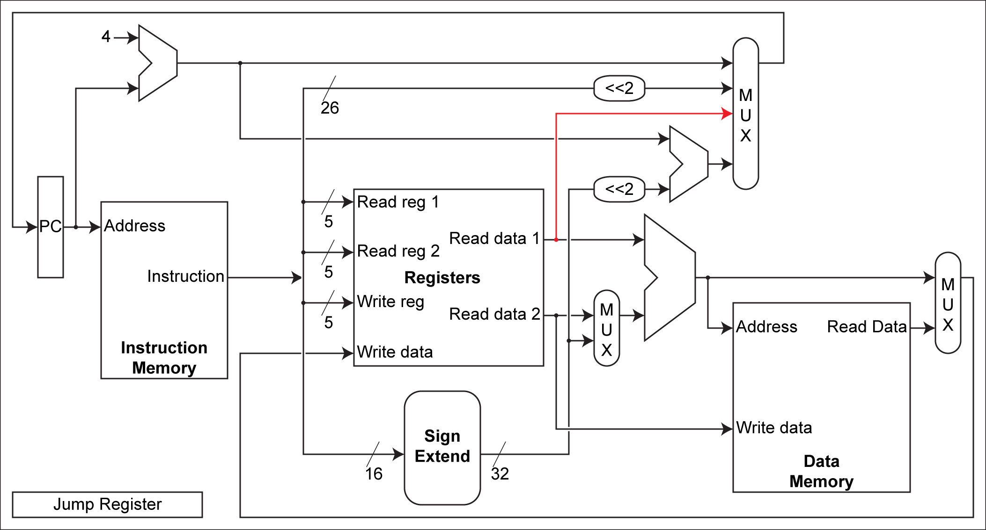
Single Cycle Execution

Slide 15
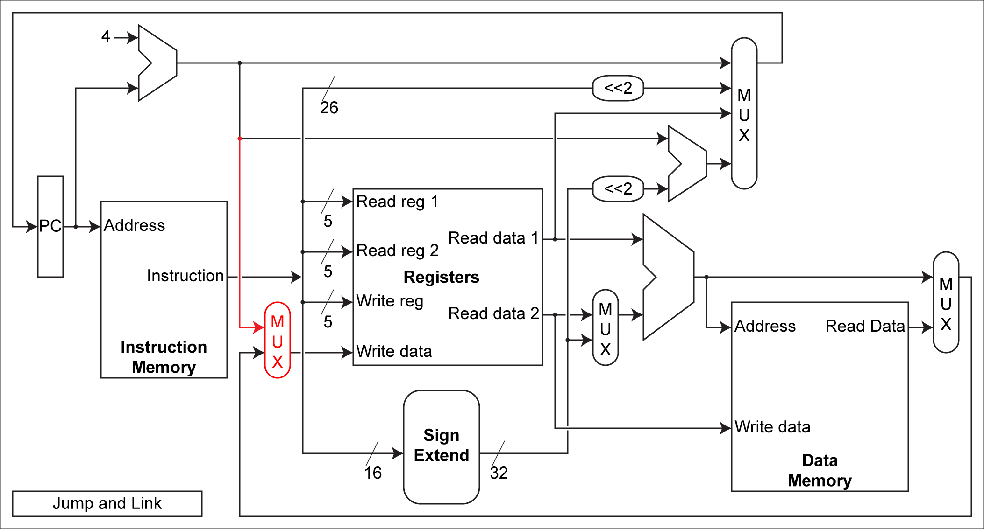
Single Cycle Execution

Slide 16
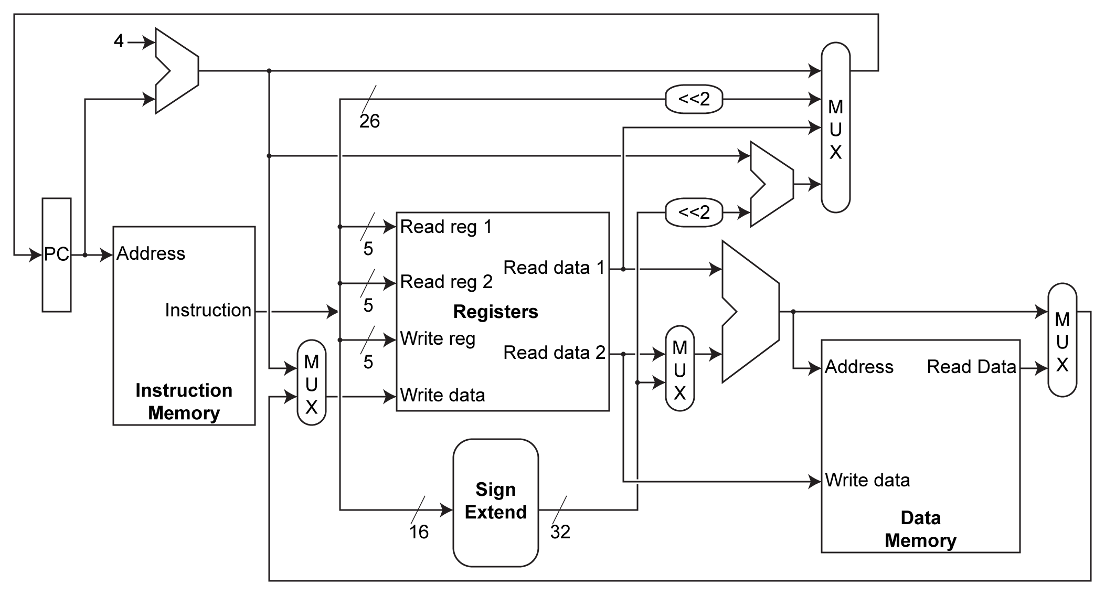
Single Cycle Execution

Slide 17
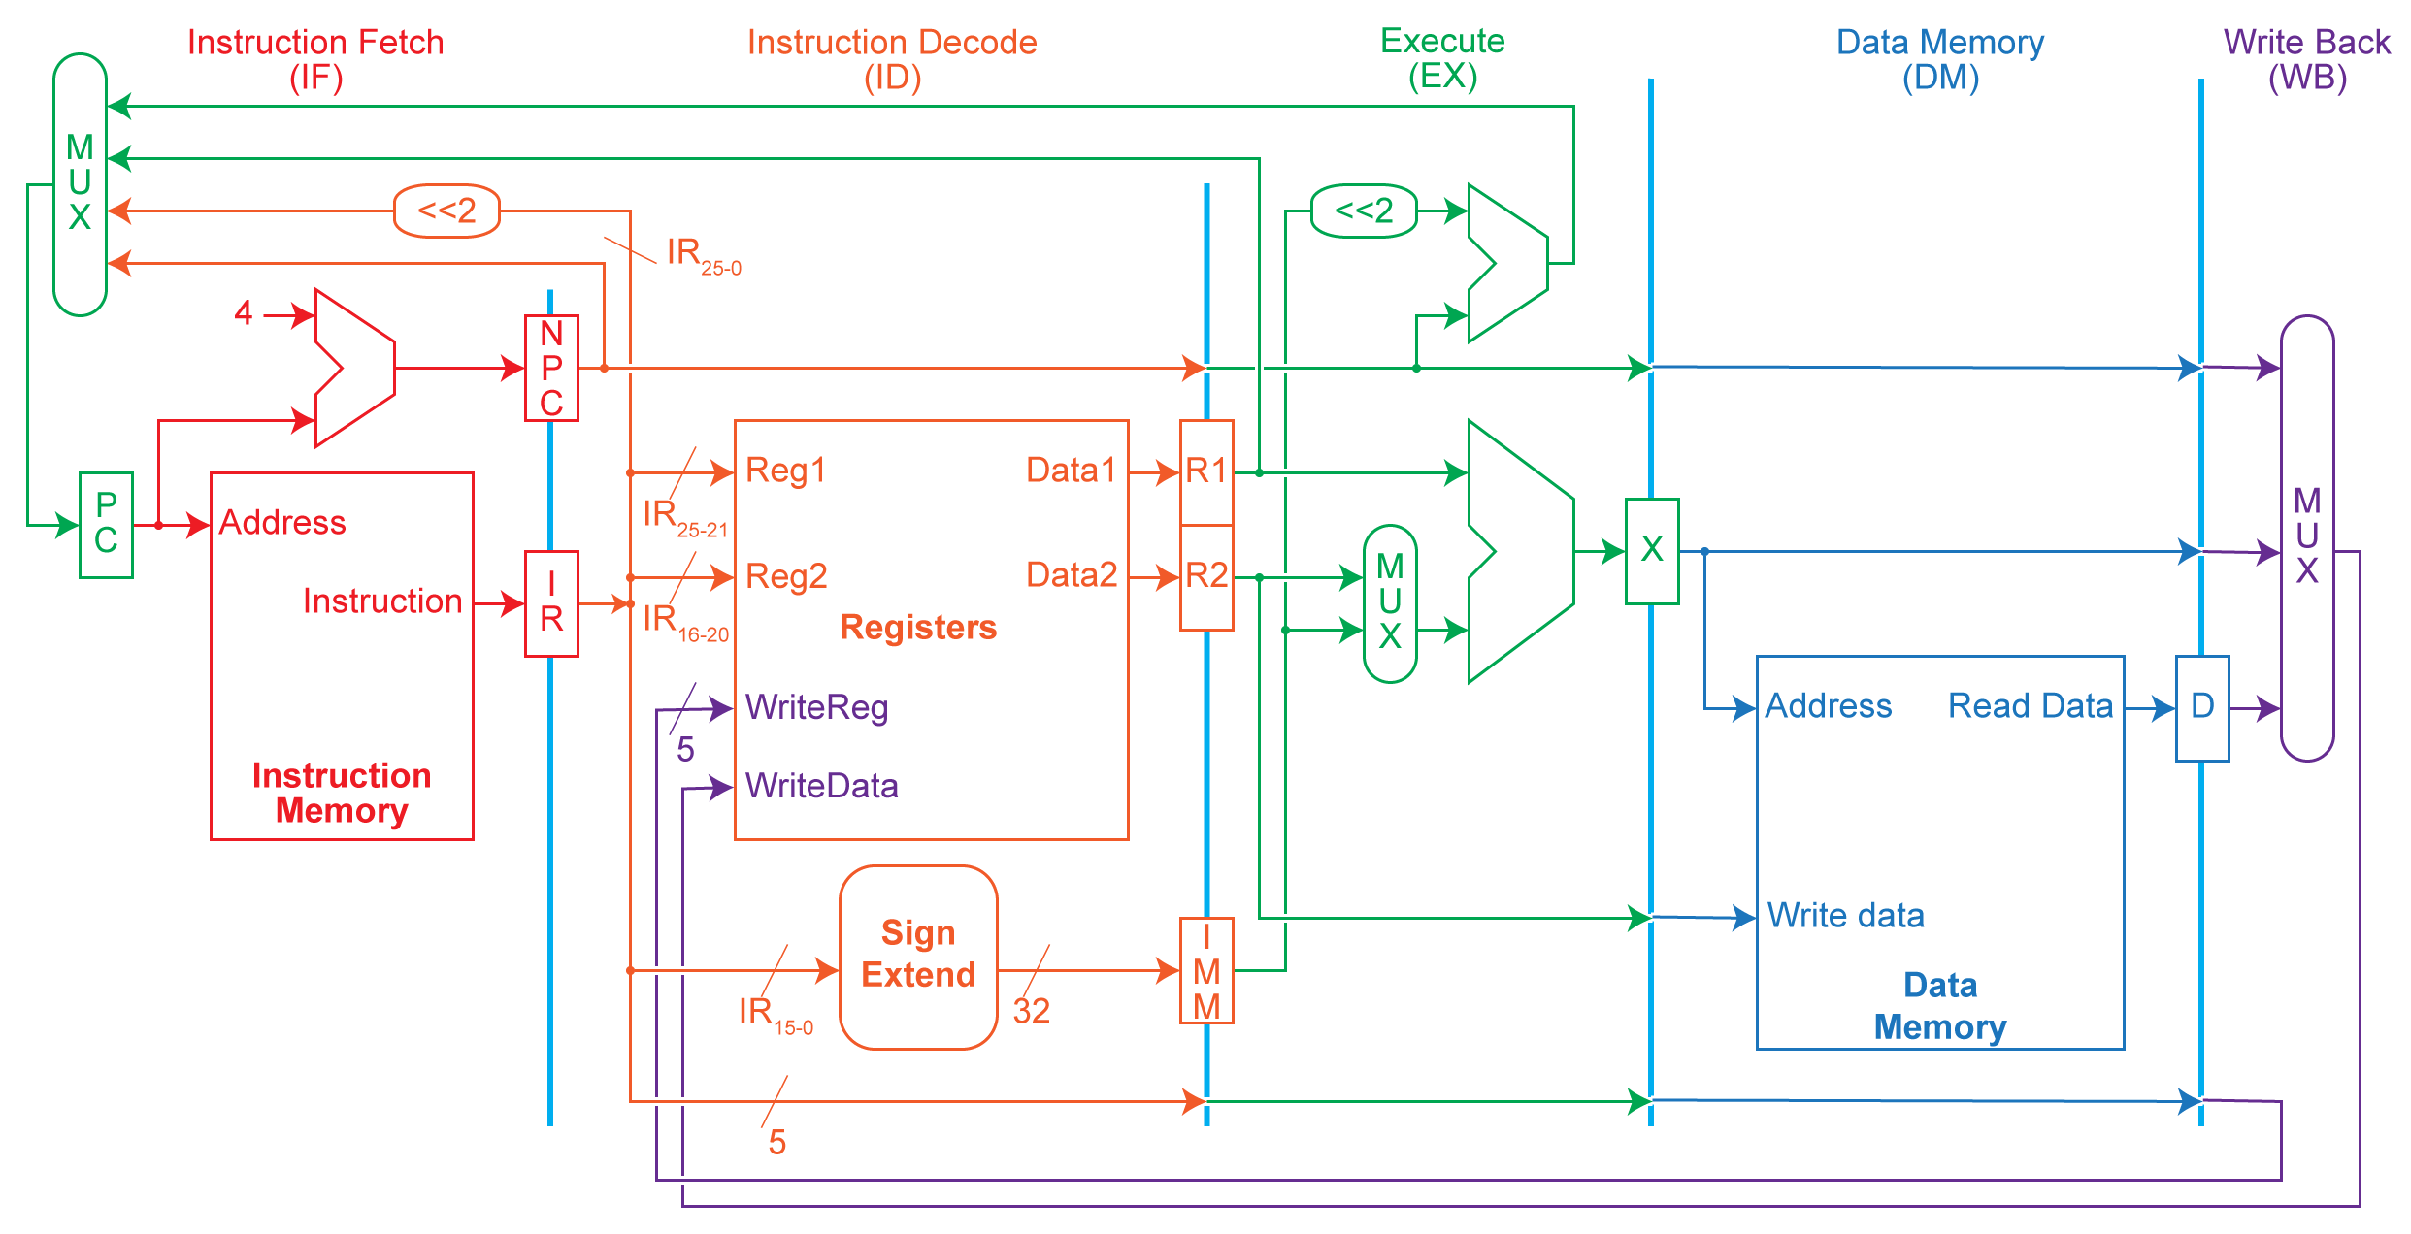
Multi-Cycle Execution

Slide 18
Multi-Cycle Implementation of MIPS
Instruction fetch cycle (IF)
IR ← Mem[PC]; NPC ← PC + 4
Instruction decode/register fetch cycle (ID)
A ← Regs[IR_{6..10}]; B ← Regs[IR_{11..15}]; Imm ← ((IR₁₆)¹⁶ ##IR_{16..31})
Execution/effective address cycle (EX)
Memory ref: ALUOutput ← A + Imm;
  Reg-Reg ALU: ALUOutput ← A func B;
  Reg-Imm ALU: ALUOutput ← A op Imm;
  Branch: ALUOutput ← NPC + Imm; Cond ← (A op 0)
Memory access/branch completion cycle (MEM)
  Memory ref: LMD ← Mem[ALUOutput] or Mem(ALUOutput] ← B;
  Branch: if (cond) PC ←ALUOutput;
Write-back cycle (WB)
  Reg-Reg ALU: Regs[IR_{16..20}] ← ALUOutput;
  Reg-Imm ALU: Regs[IR_{11..15}] ← ALUOutput;
  Load: Regs[IR_{11..15}] ← LMD;

Slide 19
Single Cycle
Cycle 1
Cycle 2
Clk
Load
Store
Waste
Cycle time long enough for longest instruction
Shorter instructions waste time
No overlap
Figure: Dave Patterson
Notes:
Here are the timing diagrams showing the differences between the single cycle, multiple cycle, and pipeline implementations.
For example, in the pipeline implementation, we can finish executing the Load, Store, and R-type instruction sequence in seven cycles.
In the multiple clock cycle implementation, however, we cannot start executing the store until Cycle 6 because we must wait for the load instruction to complete.
Similarly, we cannot start the execution of the R-type instruction until the store instruction has completed its execution in Cycle 9.
In the Single Cycle implementation, the cycle time is set to accommodate the longest instruction, the Load instruction.
Consequently, the cycle time for the Single Cycle implementation can be five times longer than the multiple cycle implementation.
But may be more importantly, since the cycle time has to be long enough for the load instruction, it is too long for the store instruction so the last part of the cycle here is wasted.
+2 = 77 min. (X:57)

Slide 20
Multiple Cycle
Cycle 1
Cycle 2
Cycle 3
Cycle 4
Cycle 5
Cycle 6
Cycle 7
Cycle 8
Cycle 9
Cycle 10
Clk
Load
Store
R-type
Ifetch
Reg
Exec
Mem
Wr
Ifetch
Reg
Exec
Mem
Ifetch
Cycle time long enough for longest stage
Shorter stages waste time
Shorter instructions can take fewer cycles
No overlap
Figure: Dave Patterson
Notes:
Here are the timing diagrams showing the differences between the single cycle, multiple cycle, and pipeline implementations.
For example, in the pipeline implementation, we can finish executing the Load, Store, and R-type instruction sequence in seven cycles.
In the multiple clock cycle implementation, however, we cannot start executing the store until Cycle 6 because we must wait for the load instruction to complete.
Similarly, we cannot start the execution of the R-type instruction until the store instruction has completed its execution in Cycle 9.
In the Single Cycle implementation, the cycle time is set to accommodate the longest instruction, the Load instruction.
Consequently, the cycle time for the Single Cycle implementation can be five times longer than the multiple cycle implementation.
But may be more importantly, since the cycle time has to be long enough for the load instruction, it is too long for the store instruction so the last part of the cycle here is wasted.
+2 = 77 min. (X:57)

Slide 21
Stages of Instruction Execution
Cycle 1
Cycle 2
Cycle 3
Cycle 4
Cycle 5
Load
Ifetch
Reg/Dec
Exec
Mem
WB
The load instruction is the longest
All instructions follows at most the following five steps:
  Ifetch: Instruction Fetch
    Fetch the instruction from the Instruction Memory and update PC
  Reg/Dec: Registers Fetch and Instruction Decode
  Exec: Calculate the memory address
  Mem: Read the data from the Data Memory
  WB: Write the data back to the register file
Slide: Dave Patterson
Notes:
As shown here, each of these five steps will take one clock cycle to complete.
And in pipeline terminology, each step is referred to as one stage of the pipeline.
+1 = 8 min. (X:48)

Slide 22
Pipeline
Cycle 1
Cycle 2
Cycle 3
Cycle 4
Cycle 5
Cycle 6
Cycle 7
Cycle 8
Cycle 9
Cycle 10
Clk
Load
Ifetch
Reg
Exec
Mem
Wr
Store
Ifetch
Reg
Exec
Mem
Wr
R-type
Ifetch
Reg
Exec
Mem
Wr
Cycle time long enough for longest stage
Shorter stages waste time
No additional benefit from shorter instructions
Overlap instruction execution
Figure: Dave Patterson
Notes:
Here are the timing diagrams showing the differences between the single cycle, multiple cycle, and pipeline implementations.
For example, in the pipeline implementation, we can finish executing the Load, Store, and R-type instruction sequence in seven cycles.
In the multiple clock cycle implementation, however, we cannot start executing the store until Cycle 6 because we must wait for the load instruction to complete.
Similarly, we cannot start the execution of the R-type instruction until the store instruction has completed its execution in Cycle 9.
In the Single Cycle implementation, the cycle time is set to accommodate the longest instruction, the Load instruction.
Consequently, the cycle time for the Single Cycle implementation can be five times longer than the multiple cycle implementation.
But may be more importantly, since the cycle time has to be long enough for the load instruction, it is too long for the store instruction so the last part of the cycle here is wasted.
+2 = 77 min. (X:57)

Slide 23
Multi-Cycle Execution

Slide 24
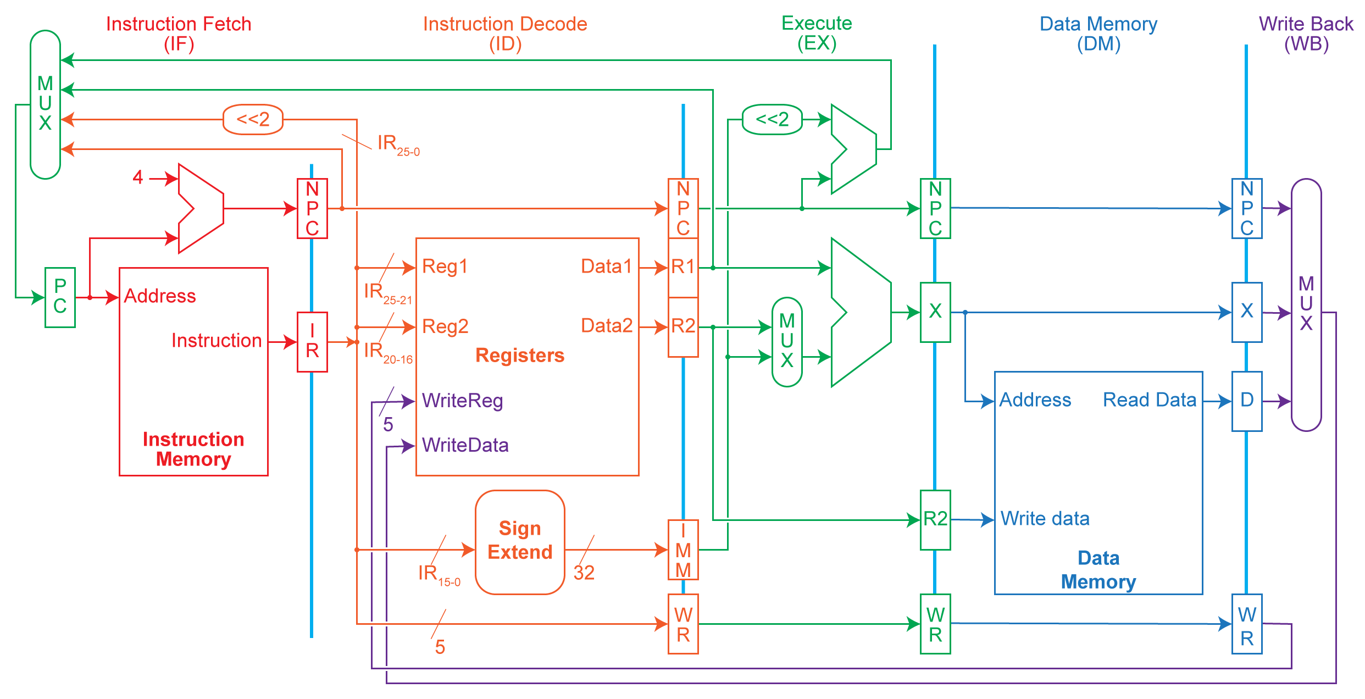
Pipeline

Slide 25
Instruction Pipelining
Start handling next instruction while the current instruction is in progress
Feasible when different devices at different stages
Time
IFetch
Dec
Exec
Mem
WB
IFetch
Dec
Exec
Mem
WB
IFetch
Dec
Exec
Mem
WB
IFetch
Dec
Exec
Mem
WB
IFetch
Dec
Exec
Mem
WB
Program Flow
IFetch
Dec
Exec
Mem
WB
Pipelining improves performance by increasing instruction throughput

Slide 26
Example of Instruction Pipelining
Time between first & fourth instructions is 3 × 8 = 24 ns
Time between first & fourth instructions is 3 × 2 = 6 ns
Ideal and upper bound for speedup is number of stages in the pipeline

Slide 27
Pipeline Performance
Pipeline increases the instruction throughput
  not execution time of an individual instruction
An individual instruction can be slower:
  Additional pipeline control
  Imbalance among pipeline stages
Suppose we execute 100 instructions:
  Single Cycle Machine
    45 ns/cycle x 1 CPI x 100 inst = 4500 ns
  Multi-cycle Machine
    10 ns/cycle x 4.2 CPI (due to inst mix) x 100 inst = 4200 ns
  Ideal 5 stages pipelined machine
    10 ns/cycle x (1 CPI x 100 inst + 4 cycle drain) = 1040 ns
Lose performance due to fill and drain

Slide 28
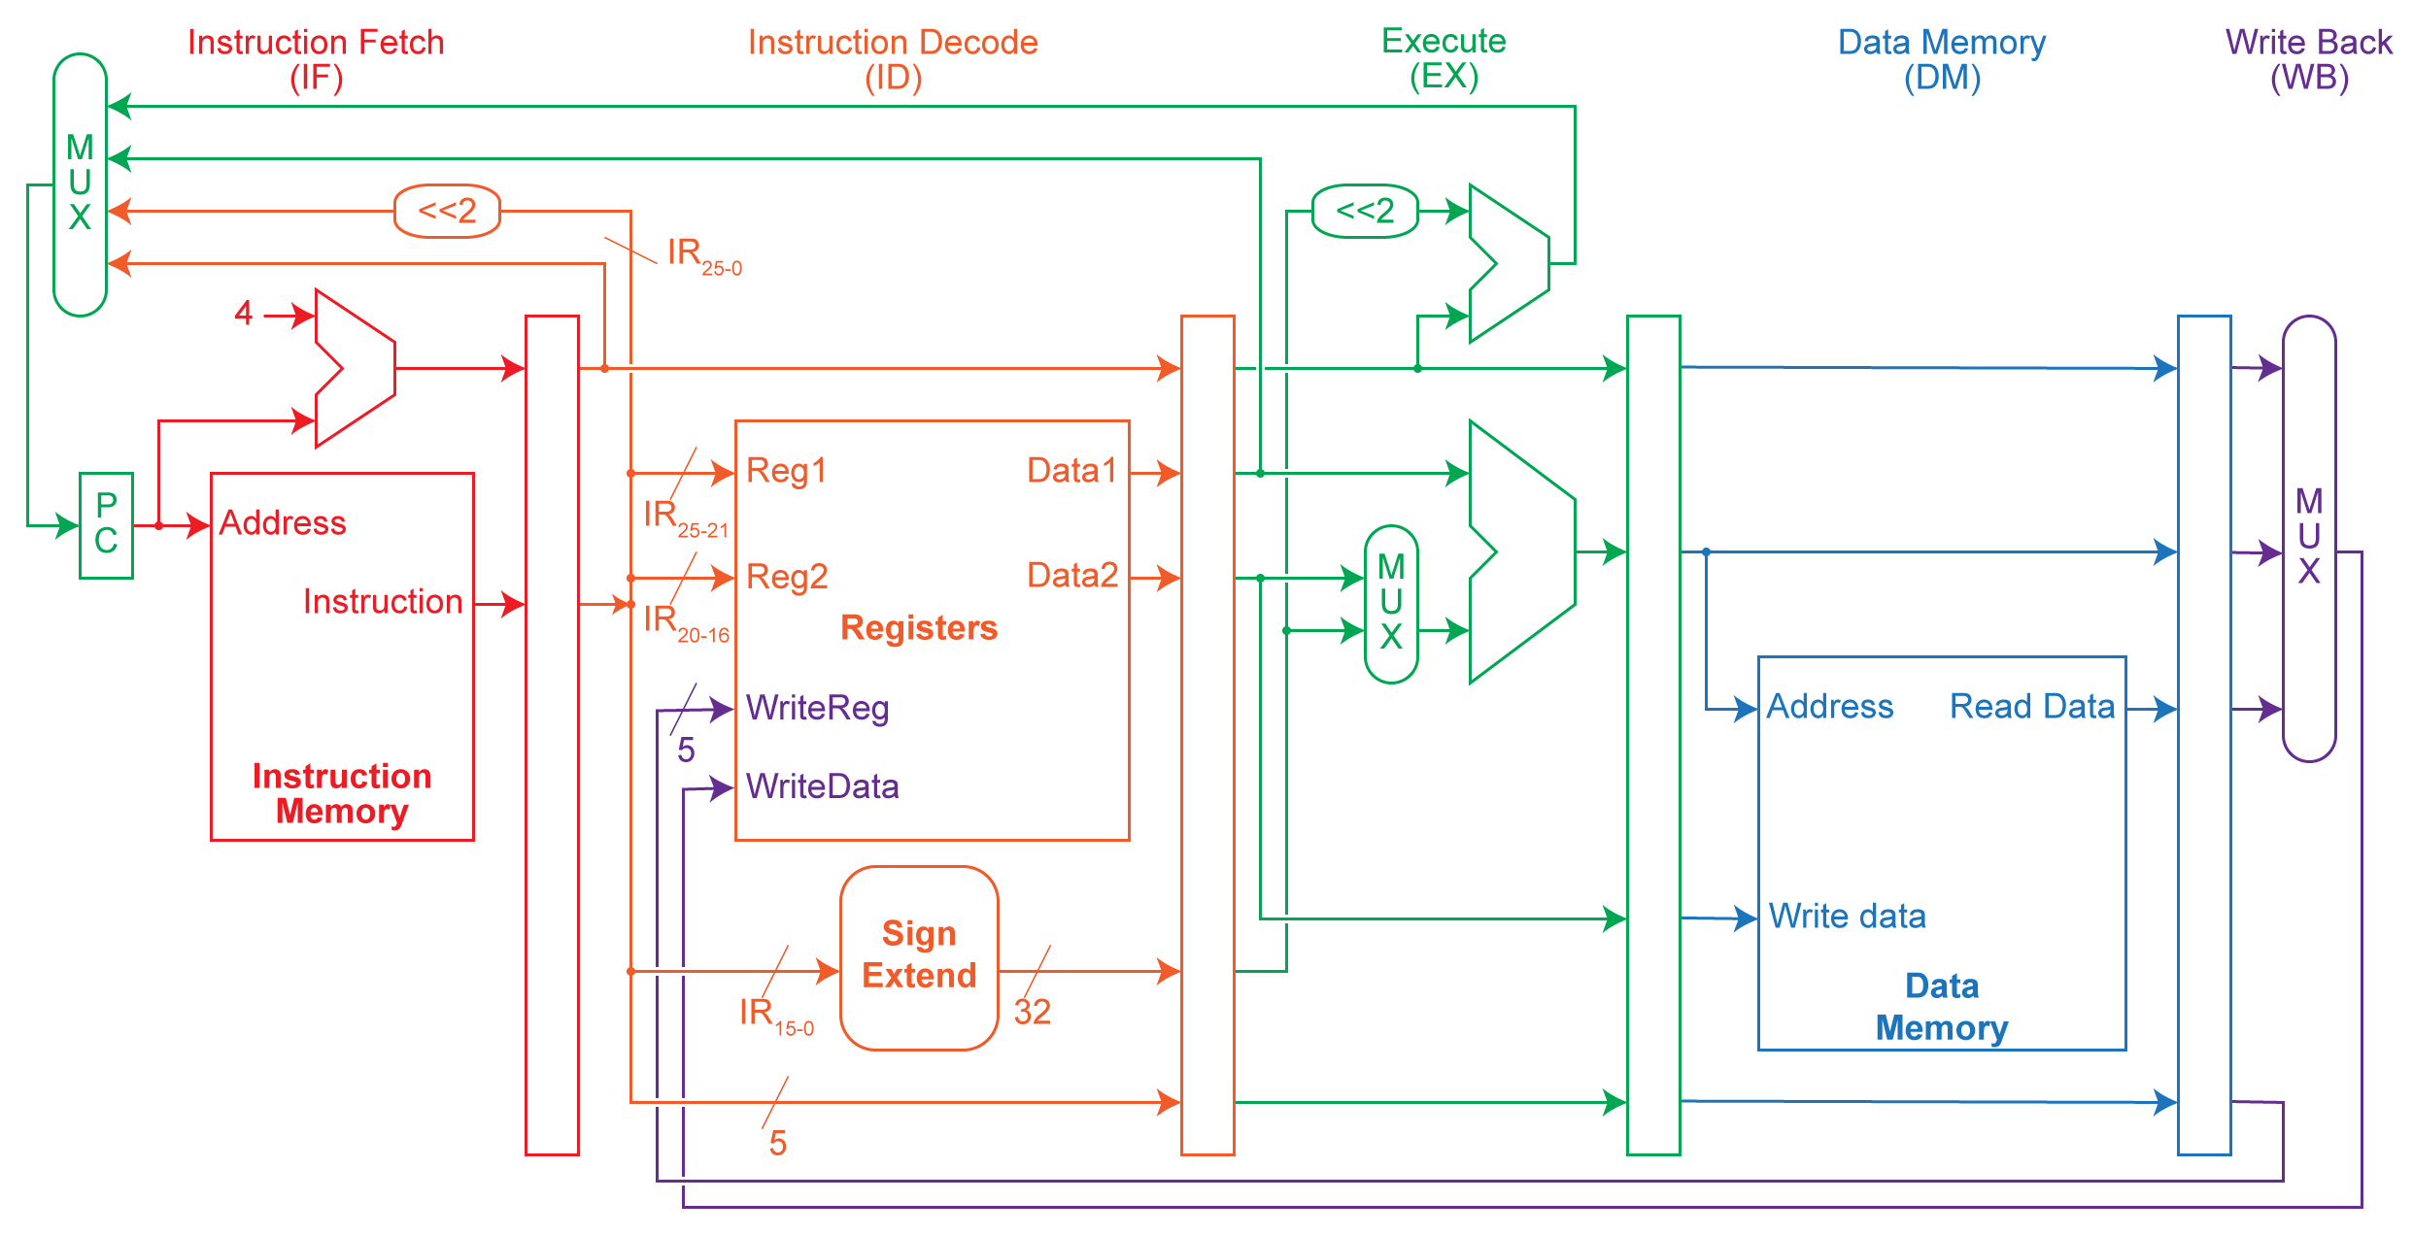
Pipeline Datapath
Every stage must be completed in one clock cycle to avoid stalls
Values must be latched to ensure correct execution of instructions
The PC multiplexer has moved to the IF stage to prevent two instructions from updating the PC simultaneously (in case of branch instruction)
Data Stationary

Slide 29
Pipeline Stage Interface

Slide 30
Pipeline Hazards
Cases that affect instruction execution semantics and thus need to be detected and corrected
Hazards types
  Structural hazard: attempt to use a resource two different ways at same time
    Single memory for instruction and data
  Data hazard: attempt to use item before it is ready
    Instruction depends on result of prior instruction still in the pipeline
  Control hazard: attempt to make a decision before condition is evaluated
    branch instructions
Hazards can always be resolved by waiting

Slide 31
Visualizing Pipelining
Time (clock cycles)
Cycle 1
Cycle 2
Cycle 3
Cycle 4
Cycle 5
Cycle 6
Cycle 7
I
n
s
t
r.
O
r
d
e
r
Ifetch
Reg
ALU
DMem
Reg
Ifetch
Reg
ALU
DMem
Reg
Ifetch
Reg
ALU
DMem
Reg
Ifetch
Reg
ALU
DMem
Reg
Slide: David Culler

Slide 32
Example: One Memory Port/Structural Hazard
Time (clock cycles)
Cycle 1
Cycle 2
Cycle 3
Cycle 4
Cycle 5
Cycle 6
Cycle 7
I
n
s
t
r.
O
r
d
e
r
Load
Ifetch
Reg
DMem
Reg
ALU
DMem
Instr 1
Ifetch
Reg
ALU
DMem
Reg
Instr 2
Ifetch
Reg
ALU
DMem
Reg
Instr 3
Ifetch
Reg
ALU
DMem
Reg
Instr 4
Structural Hazard
Slide: David Culler

Slide 33
Resolving Structural Hazards
Wait
  Must detect the hazard
    Easier with uniform ISA
  Must have mechanism to stall
    Easier with uniform pipeline organization
Throw more hardware at the problem
  Use instruction & data cache rather than direct access to memory

Slide 34
Detecting and Resolving Structural Hazard
Time (clock cycles)
Cycle 1
Cycle 2
Cycle 3
Cycle 4
Cycle 5
Cycle 6
Cycle 7
I
n
s
t
r.
O
r
d
e
r
Load
Ifetch
Reg
ALU
DMem
Reg
Instr 1
Ifetch
Reg
ALU
DMem
Reg
Instr 2
Ifetch
Reg
ALU
DMem
Reg
Stall
Bubble
Bubble
Bubble
Bubble
Bubble
Instr 3
Ifetch
Reg
ALU
DMem
Reg
Slide: David Culler

Slide 35
Stalls & Pipeline Performance
Assuming all pipeline stages are balanced

