Slide 1
CMSC 611: Advanced Computer Architecture
Performance & Benchmarks
Some material adapted from Mohamed Younis, UMBC CMSC 611 Spr 2003 course slides
Some material adapted from Hennessy & Patterson / © 2003 Elsevier Science

Slide 2
Calculation of CPU Time
Or

Slide 3
CPU Time (Cont.)
CPU execution time can be measured by running the program
The clock cycle is usually published by the manufacture
Measuring the CPI and instruction count is not trivial
  Instruction counts can be measured by: software profiling, using an architecture simulator, using hardware counters on some architecture
  The CPI depends on many factors including: processor structure, memory system, the mix of instruction types and the implementation of these instructions

Slide 4
CPU Time (Cont.)
Designers sometimes uses the following formula:
Where: C_{i} is the count of number of instructions of class i executed
CPI_{i} is the average number of cycles per instruction for that instruction class
n is the number of different instruction classes

Slide 5
Example
Suppose we have two implementation of the same instruction set architecture. Machine “A” has a clock cycle time of 1 ns and a CPI of 2.0 for some program, and machine “B” has a clock cycle time of 2 ns and a CPI of 1.2 for the same program. Which machine is faster for this program and by how much?
Both machines execute the same instructions for the program. Assume the number of instructions is “I”,
CPU clock cycles (A) = I  2.0 CPU clock cycles (B) = I  1.2
The CPU time required for each machine is as follows:
CPU time (A) = CPU clock cycles (A)  Clock cycle time (A)
= I  2.0  1 ns = 2  I ns
CPU time (B) = CPU clock cycles (B)  Clock cycle time (B)
= I  1.2  2 ns = 2.4  I ns
Therefore machine A will be faster by the following ratio:

Slide 6
Comparing Code Segments
A compiler designer is trying to decide between two code sequences for a particular machine. The hardware designers have supplied the following facts:
For a particular high-level language statement, the compiler writer is considering two code sequences that require the following instruction counts:
Which code sequence executes the most instructions? Which will be faster? What is the CPI for each sequence?
Answer:
  Sequence 1: executes 2 + 1 + 2 = 5 instructions
  Sequence 2: executes 4 + 1 + 1 = 6 instructions 

Slide 7
Comparing Code Segments
Using the formula:
Sequence 1: CPU clock cycles = (2 ×1) + (1 ×2) + (2 ×3) = 10 cycles
Sequence 2: CPU clock cycles = (4 ×1) + (1 ×2) + (1 ×3) = 9 cycles
Therefore Sequence 2 is faster although it executes more instructions
Using the formula:
Sequence 1: CPI = 10/5 = 2
Sequence 2: CPI = 9/6 = 1.5
Since Sequence 2 takes fewer overall clock cycles but has more
instructions it must have a lower CPI

Slide 8
The Role of Performance
Hardware performance is a key to the effectiveness of the entire system
Performance has to be measured and compared to evaluate designs
To optimize the performance, major affecting factors have to be known
For different types of applications
  different performance metrics may be appropriate
  different aspects of a computer system may be most significant
Instructions use and implementation, memory hierarchy and I/O handling are among the factors that affect the performance

Slide 9
Calculation of CPU Time
Where: C_{i} is the count of number of instructions of class i executed
CPI_{i} is the average number of cycles per instruction for that instruction class
n is the number of different instruction classes

Slide 10
Important Equations (so far)

Slide 11
Amdahl’s Law
The performance enhancement possible with a given improvement is limited by the amount that the improved feature is used
A common theme in Hardware design is to make the common case fast
Increasing the clock rate would not affect memory access time
Using a floating point processing unit does not speed integer ALU operations
Example: Floating point instructions improved to run 2X; but only 34% of
actual instructions are floating point
Exec-Time_{new} = Exec-Time_{old} x (0.66 + .34/2) = 0.83 x Exec-Time_{old}
Speedup_{overall} = Exec-Time_{old} / Exec-Time_{new} = 1/0.83 = 1.205

Slide 12
Ahmdal’s Law Visually
Time_{old}
notFP
FP
Time_{new}
notFP
FP / S

Slide 13
Ahmdal’s Law for Speedup

Slide 14
Performance Variations
Performance is dependent on workload
Task dependent
Need a measure of workload
Best = run your program
  Often cannot
Benchmark = “typical” workload
  Standardized for comparison

Slide 15
Synthetic Benchmarks
Synthetic benchmarks are artificial programs that are constructed to match the characteristics of large set of programs
Whetstone (scientific programs), Dhrystone (systems programs), LINPACK (linear algebra), …

Slide 16
Synthetic Benchmark Drawbacks
They do not reflect the user interest since they are not real applications
They do not reflect real program behavior (e.g. memory access pattern)
Compiler and hardware can inflate the performance of these programs far beyond what the same optimization can achieve for real-programs

Slide 17
Application Benchmarks
Real applications typical of expected workload
Applications and mix important

Slide 18
The SPEC Benchmarks
System Performance Evaluation Cooperative
Suite of benchmarks
  Created by a set of companies to improve the measurement and reporting of CPU performance
SPEC2006 is the latest suite
SPECint = 12 integer programs
SPECfloat = 17 floating point programs
Since SPEC requires running applications on real hardware, the memory system has a significant effect on performance
  Reported with results

Slide 19
Performance Reports
Guiding principle is reproducibility (report environment & experiments setup)

Slide 20
The SPEC Benchmarks
Bigger numeric values of the SPEC ratio indicate faster machine
1997 “historical” reference machine

Slide 21
SPEC95 for Pentium and Pentium Pro
The performance measured may be different on other Pentium-based hardware with different memory system and using different compilers
  At the same clock rate, the SPECint95 measure shows that Pentium Pro is 1.4-1.5 times faster while the SPECfp95 shows that it is 1.7-1.8 times faster
  When the clock rate is increased by a certain factor, the processor performance increases by a lower factor

Slide 22
Comparing & Summarizing Performance
Wrong summary can present a confusing picture
  A is 10 times faster than B for program 1
  B is 10 times faster than A for program 2
Total execution time is a consistent summary measure
Relative execution times for the same workload
  Assuming that programs 1 and 2 are executing for the same number of times on computers A and B
Execution time is the only valid and unimpeachable measure of performance

Slide 23
Effect of Compilation
App. and arch. specific optimization can dramatically impact performance

Slide 24
Performance Summary
Where: n is the number of programs executed
w_{i} is a weighting factor that indicates the frequency of executing program i
with and
Weighted arithmetic means summarize performance while tracking exec. time
Never use AM for normalizing time relative to a reference machine

Slide 25
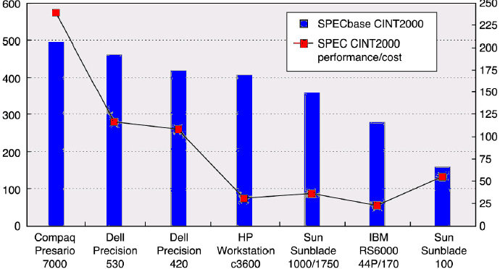
Price-Performance Metric
Prices reflects those of July 2001
SPECbase CINT2000
SPEC CINT2000 per $1000 in price
Different results are obtained for other benchmarks, e.g. SPEC CFP2000
With the exception of the Sunblade price-performance metrics were consistent with performance

