Slide 1
CMSC 611: Advanced Computer Architecture
Performance
Some material adapted from Mohamed Younis, UMBC CMSC 611 Spr 2003 course slides
Some material adapted from Hennessy & Patterson / © 2003 Elsevier Science

Slide 2
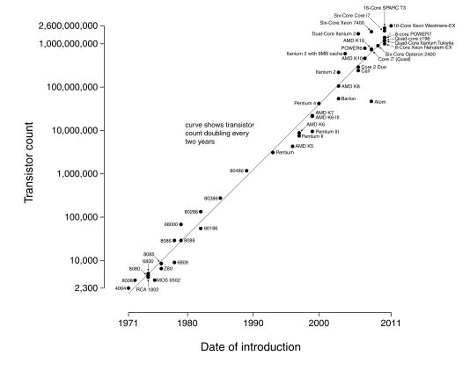
Moore’s Law
Transistors double every year
  Revised to every two years
  Sometimes revised to performance instead of transistors
(Source: Intel)
(Wgsimon - Wikipedia)

Slide 3
Defining Performance
Performance means different things to different people, therefore its assessment is subtle
Analogy from the airlines industry:
How to measure performance for an airplane?
  Cruising speed (How fast it gets to the destination)
  Flight range (How far it can reach)
  Passenger capacity (How many passengers it can carry)
Criteria of performance evaluation differs among users and designers

Slide 4
Performance Metrics
Response (execution) time:
  The time between the start and the completion of a task
  Measures user perception of the system speed
  Common in reactive and time critical systems
  Single-user computer
Throughput:
  The total number of tasks done in a given time
  Relevant to batch processing (billing, credit card processing)
  Also many-user services (web servers)
Power:
  Power consumed or battery life
  Especially relevant for mobile

Slide 5
Response-time Metric
Maximizing performance means minimizing response (execution) time

Slide 6
Response-time Metric
Performance of Processor P1 is better than P2 if
  For a given work load L
  P1 takes less time to execute L than P2

Slide 7
Response-time Metric
Relative performance captures the performance ratio
  For the same work load

Slide 8
Designer’s Performance Metrics
Users and designers measure performance using different metrics
  Users: quotable metrics (GHz)
  Designers: program execution
Designer focuses on reducing the clock cycle time and the number of cycles per program
Many techniques to decrease the number of clock cycles also increase the clock cycle time or the average number of cycles per instruction (CPI)

Slide 9
Example
A program runs in 10 seconds on a computer “A” with a 2 GHz clock.
We desire a faster computer “B” that could run the program in 6 seconds.
The designer has determined that a substantial increase in the clock speed is possible, however it would cause computer “B” to require 1.2 times as many clock cycles as computer “A”. What should be the clock rate of computer “B”?
Why would this happen?
  Maybe one operation takes one full clock cycle at 2 GHz (1/2 GHz = 0.5 ns)
  All the rest take less than one cycle
  Split this operation across multiple cycles
  Can now increase clock rate, but also increase total cycles

Slide 10
Example
A program runs in 10 seconds on a computer “A” with a 2 GHz clock.
We desire a faster computer “B” that could run the program in 6 seconds.
The designer has determined that a substantial increase in the clock speed is possible, however it would cause computer “B” to require 1.2 times as many clock cycles as computer “A”. What should be the clock rate of computer “B”?
To get the clock rate of the faster computer, we use the same formula

