Slide 1
CMSC 611: Advanced Computer Architecture
Shared Memory
Most slides adapted from David Patterson. Some from Mohomed Younis

Slide 2
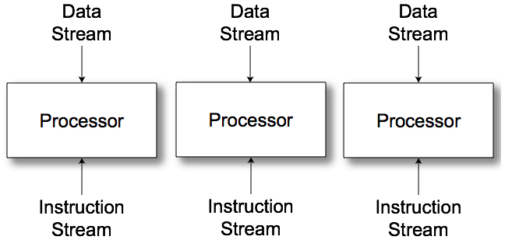
MIMD
Message Passing
Shared memory/distributed memory
  Uniform Memory Access (UMA)
  Non-Uniform Memory Access (NUMA)
Can support either SW model on either HW basis

Slide 3
Message passing
Processors have private memories, communicate via messages
Advantages:
  Less hardware, easier to design
  Focuses attention on costly non-local operations

Slide 4
Message Passing Model
Each PE has local processor, data, (I/O)
  Explicit I/O to communicate with other PEs
  Essentially NUMA but integrated at I/O vs. memory system
Free run between Send & Receive
  Send + Receive = Synchronization between processes (event model)
    Send: local buffer, remote receiving process/port
    Receive: remote sending process/port, local buffer

Slide 5
History of message passing
Early machines
  Local communication
  Blocking send & receive
Later: DMA with non-blocking sends
  DMA for receive into buffer until processor does receive, and then data is transferred to local memory
Later still: SW libraries to allow arbitrary communication

Slide 6
Shared Memory
Processors communicate with shared address space
Easy on small-scale machines
Advantages:
  Model of choice for uniprocessors, small-scale multiprocessor
  Ease of programming
  Lower latency
  Easier to use hardware controlled caching
Difficult to handle node failure

Slide 7
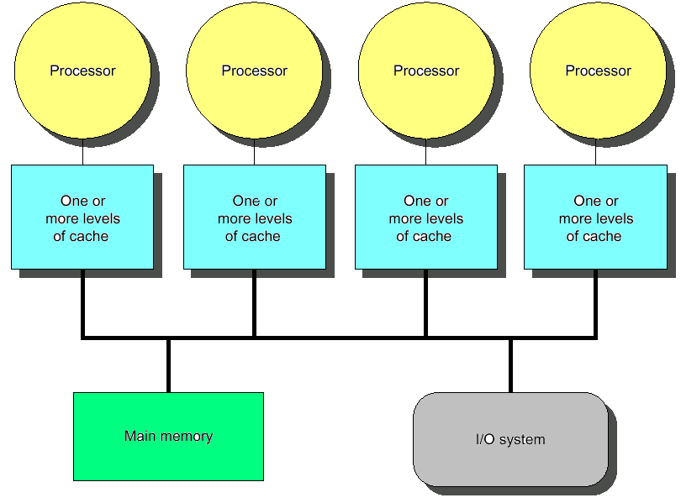
Centralized Shared Memory
Processors share a single centralized (UMA) memory through a bus interconnect
Feasible for small processor count to limit memory contention
Model for multi-core CPUs

Slide 8
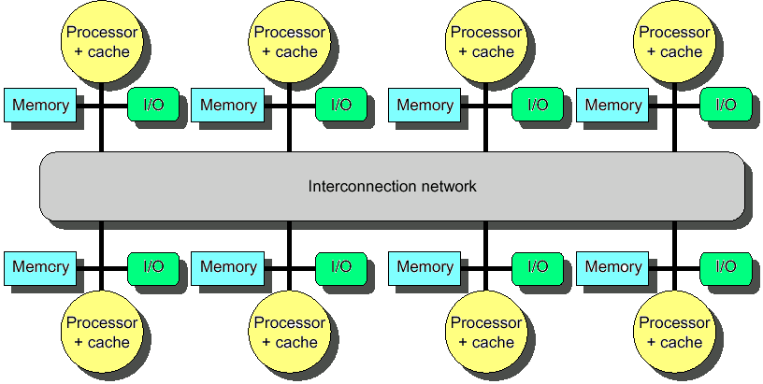
Distributed Memory
Uses physically distributed (NUMA) memory to support large processor counts (to avoid memory contention)
Advantages
  Allows cost-effective way to scale the memory bandwidth
  Reduces memory latency
Disadvantage
  Increased complexity of communicating data

Slide 9
Shared Address Model
Physical locations
  Each PE can name every physical location in the machine
Shared data
  Each process can name all data it shares with other processes

Slide 10
Shared Address Model
Data transfer
  Use load and store, VM maps to local or remote location
  Extra memory level: cache remote data
  Significant research on making the translation transparent and scalable for many nodes
    Handling data consistency and protection challenging
    Latency depends on the underlying hardware architecture (bus bandwidth, memory access time and support for address translation)
    Scalability is limited given that the communication model is so tightly coupled with process address space

Slide 11
Three Fundamental Issues
1: Naming: how to solve large problem fast
  what data is shared
  how it is addressed
  what operations can access data
  how processes refer to each other
Choice of naming affects code produced by a compiler
  Just remember and load address or keep track of processor number and local virtual address for message passing
Choice of naming affects replication of data
  In cache memory hierarchy or via SW replication and consistency

Slide 12
Naming Address Spaces
Global physical address space
  any processor can generate, address and access it in a single operation
Global virtual address space
  if the address space of each process can be configured to contain all shared data of the parallel program
    memory can be anywhere: virtual address translation handles it
Segmented shared address space
  locations are named <process number, address> uniformly for all processes of the parallel program

Slide 13
Three Fundamental Issues
2: Synchronization: To cooperate, processes must coordinate
  Message passing is implicit coordination with transmission or arrival of data
  Shared address → additional operations to explicitly coordinate:
  e.g., write a flag, awaken a thread, interrupt a processor

Slide 14
Three Fundamental Issues
3: Latency and Bandwidth
  Bandwidth
    Need high bandwidth in communication
    Cannot scale, but stay close
    Match limits in network, memory, and processor
    Overhead to communicate is a problem in many machines
  Latency
    Affects performance, since processor may have to wait
    Affects ease of programming, since requires more thought to overlap communication and computation
  Latency Hiding
    How can a mechanism help hide latency?
    Examples: overlap message send with computation, pre-fetch data, switch to other tasks

Slide 15
Centralized Shared Memory MIMD
Processors share a single centralized memory through a bus interconnect
  Memory contention: Feasible for small # processors
  Caches serve to:
    Increase bandwidth versus
    bus/memory
    Reduce latency of access
    Valuable for both private data
    and shared data
  Access to shared data is
  optimized by replication
    Decreases latency
    Increases memory bandwidth
    Reduces contention
    Reduces cache coherence problems

Slide 16
Cache Coherency
A cache coherence problem arises when the cache reflects a view of memory which is different from reality
A memory system is coherent if:
  P reads X, P writes X, no other processor writes X, P reads X
    Always returns value written by P
  P reads X, Q writes X, P reads X
    Returns value written by Q (provided sufficient W/R separation)
  P writes X, Q writes X
    Seen in the same order by all processors
Notes:
Processor
b) Writes green, red stale
c) Update memory (green), red stale in cache

Slide 17
Potential HW Coherency Solutions
Snooping Solution (Snoopy Bus)
  Send all requests for data to all processors
  Processors snoop to see if they have a copy and respond accordingly
  Requires broadcast, since caching information is at processors
  Works well with bus (natural broadcast medium)
  Dominates for small scale machines (most of the market)

Slide 18
Potential HW Coherency Solutions
Directory-Based Schemes
  Keep track of what is being shared in one centralized place
  Distributed memory ⇒ distributed directory for scalability (avoids bottlenecks)
  Send point-to-point requests to processors via network
  Scales better than Snooping
  Actually existed before Snooping-based schemes

Slide 19
Basic Snooping Protocols
Write Invalidate Protocol:
  Write to shared data: an invalidate is sent to all caches which snoop and invalidate any copies
  Cache invalidation will force a cache miss when accessing the modified shared item
  For multiple writers only one will win the race ensuring serialization of the write operations
  Read Miss:
    Write-through: memory is always up-to-date
    Write-back: snoop in caches to find most recent copy

Slide 20
Basic Snooping Protocols
Write Broadcast (Update) Protocol (typically write through):
  Write to shared data: broadcast on bus, processors snoop, and update any copies
  To limit impact on bandwidth, track data sharing to avoid unnecessary broadcast of written data that is not shared
  Read miss: memory is always up-to-date
  Write serialization: bus serializes requests!

Slide 21
Invalidate vs. Update
Write-invalidate has emerged as the winner for the vast majority of designs
Qualitative Performance Differences :
  Spatial locality
    WI: 1 transaction/cache block;
    WU: 1 broadcast/word
  Latency
    WU: lower write–read latency
    WI: must reload new value to cache

Slide 22
Invalidate vs. Update
Because the bus and memory bandwidth is usually in demand, write-invalidate protocols are very popular
Write-update can causes problems for some memory consistency models, reducing the potential performance gain it could bring
The high demand for bandwidth in write-update limits its scalability for large number of processors

Slide 23
An Example Snoopy Protocol
Invalidation protocol, write-back cache
Each block of memory is in one state:
  Clean in all caches and up-to-date in memory (Shared)
  OR Dirty in exactly one cache (Exclusive)
  OR Not in any caches
Each cache block is in one state (track these):
  Shared : block can be read
  OR Exclusive : cache has only copy, it is write-able, and dirty
  OR Invalid : block contains no data
Read misses: cause all caches to snoop bus
Writes to clean line are treated as misses

Slide 24
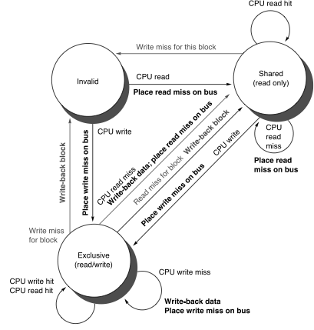
Snoopy-Cache Controller
Complications
  Cannot update cache until bus is obtained
  Two step process:
    Arbitrate for bus
    Place miss on bus and complete operation
  Split transaction bus:
    Bus transaction is not atomic
    Multiple misses can interleave, allowing two caches to grab block in the Exclusive state
    Must track and prevent multiple misses for one block

Slide 25
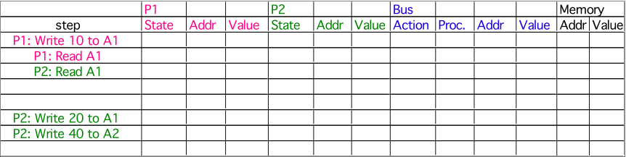
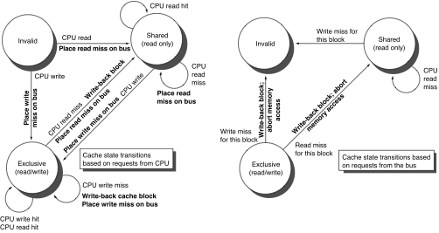
Example
Assumes memory blocks A1 and A2 map to same cache block, initial cache state is invalid

Slide 26
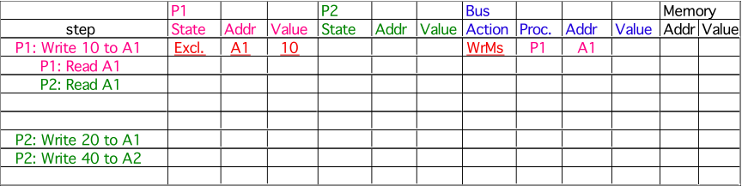
Example
Assumes memory blocks A1 and A2 map to same cache block

Slide 27

Example
Assumes memory blocks A1 and A2 map to same cache block

Slide 28
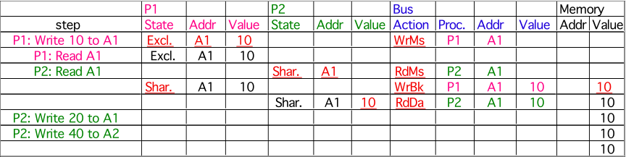
Example
Assumes memory blocks A1 and A2 map to same cache block

Slide 29
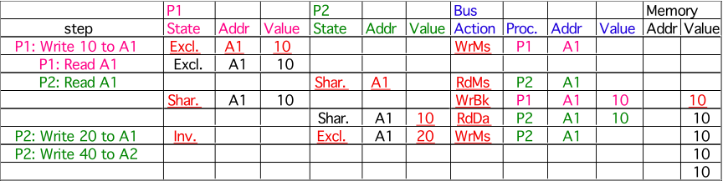
Example
Assumes memory blocks A1 and A2 map to same cache block

Slide 30
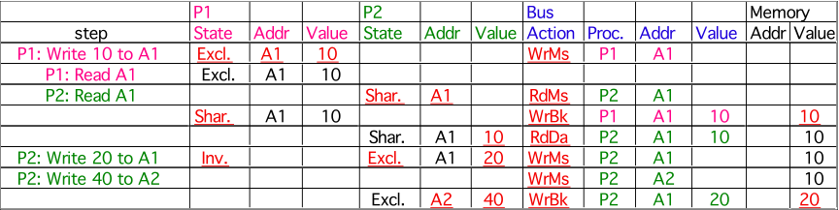
Example
A1
A1
Assumes memory blocks A1 and A2 map to same cache block
Notes:
Why write miss first?
Because in general, only write a piece of block, may need to read it first so that can have a full vblock; therefore, need to get
Write back is low priority event.

Slide 31
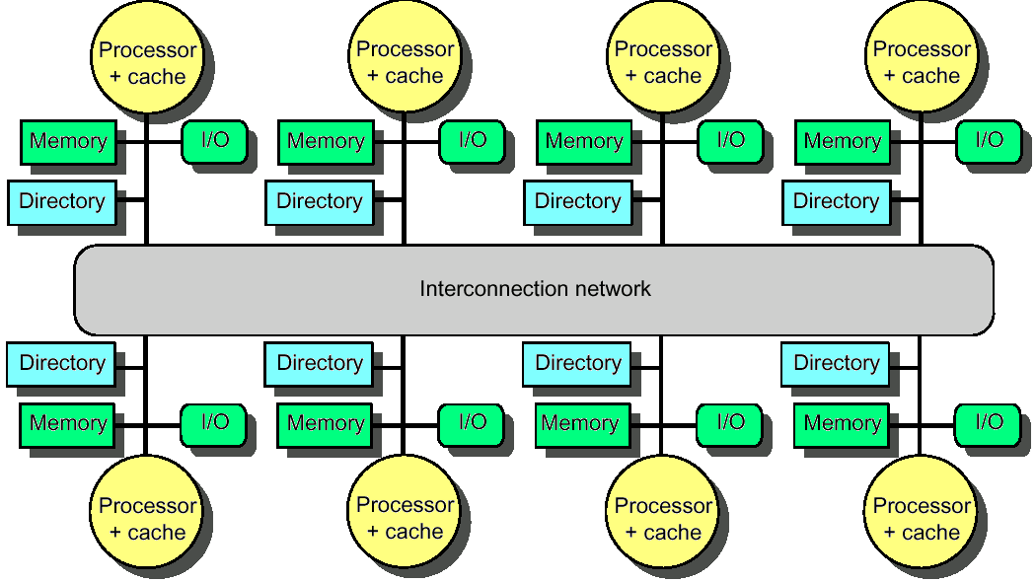
Distributed Directory Multiprocessors
Directory per cache that tracks state of every block in every cache
  Which caches have a block, dirty vs. clean, ...
  Info per memory block vs. per cache block?
    In memory => simpler protocol (centralized/one location)
    In memory => directory is f(memory size) vs. f(cache size)
To prevent directory from being a bottleneck
  distribute directory entries with memory
  each tracks of
  which processor
  has their blocks

Slide 32
Directory Protocol
Similar to Snoopy Protocol: Three states
  Shared: Multiple processors have the block cached and the contents of the block in memory (as well as all caches) is up-to-date
  Uncached No processor has a copy of the block (not valid in any cache)
  Exclusive: Only one processor (owner) has the block cached and the contents of the block in memory is out-to-date (the block is dirty)
In addition to cache state, must track which processors have data when in the shared state
  usually bit vector, 1 if processor has copy

Slide 33
Directory Protocol
Keep it simple(r):
  Writes to non-exclusive data => write miss
  Processor blocks until access completes
  Assume messages received and acted upon in order sent
Terms: typically 3 processors involved
  Local node where a request originates
  Home node where the memory location of an address resides
  Remote node has a copy of a cache block, whether exclusive or shared
No bus and do not want to broadcast:
  interconnect no longer single arbitration point
  all messages have explicit responses

Slide 34
Example Directory Protocol
Message sent to directory causes two actions:
  Update the directory
  More messages to satisfy request
We assume operations atomic, but they are not; reality is much harder; must avoid deadlock when run out of buffers in network

Slide 35
Directory Protocol Messages
Type | SRC | DEST | MSG
Read miss | local cache | home directory | P,A
P has read miss at A; request data and make P a read sharer
Write miss | local cache | home directory | P,A
P has write miss at A; request data and make P exclusive owner
Invalidate | home directory | remote cache | A
Invalidate shared data at A
Fetch | home directory | remote cache | A
Fetch block A home; change A remote state to shared
Fetch/invalidate | home directory | remote cache | A
Fetch block A home; invalidate remote copy
Data value reply | home directory | local cache | D
Return data value from home memory
Data write back | remote cache | home directory | A,D
Write back data value for A

Slide 36
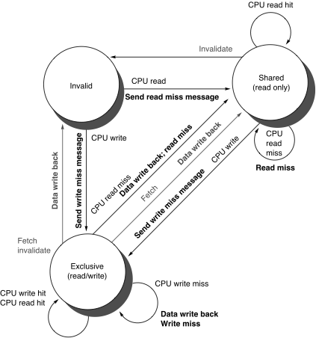
Cache Controller State Machine
States identical to snoopy case
  Transactions very similar.
    Miss messages to home directory
    Explicit invalidate & data fetch requests
State machine for CPU requests for each memory block

Slide 37
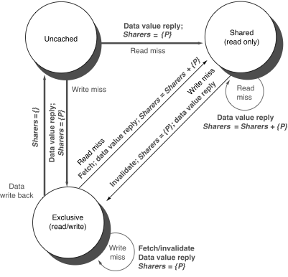
Directory Controller State Machine
Same states and structure as the transition diagram for an individual cache
  Actions:
    update of directory state
    send messages to satisfy requests
  Tracks all copies of each memory block
    Sharers set implementation can use a bit vector of a size of # processors for each block
State machine
for Directory requests for each
memory block

Slide 38
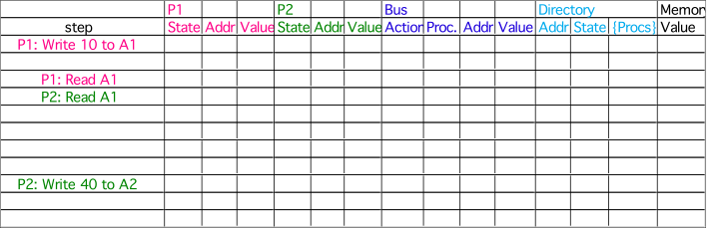
Example
P2: Write 20 to A1
Assumes memory blocks A1 and A2 map to same cache block

Slide 39
Example
WrMs
P1
A1
A1
Ex
{P1}
Excl.
A1
10
DaRp
P1
A1
0
P2: Write 20 to A1
Assumes memory blocks A1 and A2 map to same cache block

Slide 40
Example
WrMs
P1
A1
A1
Ex
{P1}
Excl.
A1
10
DaRp
P1
A1
0
Excl.
A1
10
P2: Write 20 to A1
Assumes memory blocks A1 and A2 map to same cache block

Slide 41
Example
WrMs
P1
A1
A1
Ex
{P1}
Excl.
A1
10
DaRp
P1
A1
0
Excl.
A1
10
Shar.
A1
RdMs
P2
A1
Shar.
A1
10
Ftch
P1
A1
10
A1
10
Shar.
A1
10
DaRp
P2
A1
10
A1
Shar.
{P1,P2}
10
P2: Write 20 to A1
Write Back
Assumes memory blocks A1 and A2 map to same cache block

Slide 42
Example
Excl.
A1
10
DaRp
P1
A1
0
Excl.
A1
10
Shar.
A1
RdMs
P2
A1
Shar.
A1
10
Ftch
P1
A1
10
A1
10
Shar.
A1
10
DaRp
P2
A1
10
A1
Shar.
{P1,P2}
10
P2: Write 20 to A1
Excl.
A1
20
WrMs
P2
A1
10
Inv.
Inval.
P1
A1
A1
Excl.
{P2}
10
Assumes memory blocks A1 and A2 map to same cache block

Slide 43
Example
WrMs
P1
A1
A1
Ex
{P1}
Excl.
A1
10
DaRp
P1
A1
0
Excl.
A1
10
Shar.
A1
RdMs
P2
A1
Shar.
A1
10
Ftch
P1
A1
10
A1
10
Shar.
A1
10
DaRp
P2
A1
10
A1
Shar.
{P1,P2}
10
P2: Write 20 to A1
Excl.
A1
20
WrMs
P2
A1
10
Inv.
Inval.
P1
A1
A1
Excl.
{P2}
10
WrMs
P2
A2
A2
Excl.
{P2}
0
WrBk
P2
A1
20
A1
Unca.
{}
20
Excl.
A2
40
DaRp
P2
A2
0
A2
Excl.
{P2}
0
Assumes memory blocks A1 and A2 map to same cache block

Slide 44
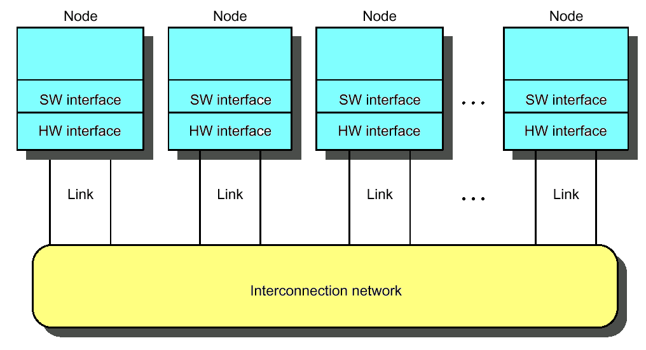
Interconnection Networks
Massively processor networks (MPP)
  Thousands of nodes
  Short distance (<~25m)
  Traffic among nodes
Local area network (LAN)
  Hundreds of computers
  A few kilometers
  Many-to-one (clients-server)
Wide area network (WAN)
  Thousands of computers
  Thousands of kilometers

Slide 45
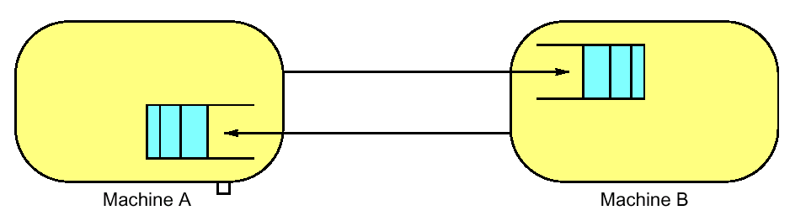
ABCs of Networks
Rules for communication are called the “protocol”, message header and data called a "packet"
  What if more than 2 computers want to communicate?
    Need computer “address field” (destination) in packet
  What if packet is garbled in transit?
    Add “error detection field” in packet (e.g., CRC)
  What if packet is lost?
    Time-out, retransmit; ACK & NACK
  What if multiple processes/machine?
    Queue per process to provide protection

Slide 46
Performance Metrics
Sender
Overhead
Transmission time
(size ÷ bandwidth)
Sender
(processor
busy)
Time of
Flight
Time of
Flight
Transmission time
(size ÷ bandwidth)
Receiver
Overhead
Receiver
Transport Latency
(processor
busy)
Total Latency
Bandwidth: maximum rate of propagating information
Time of flight: time for 1st bit to reach destination
Overhead: software & hardware time for encoding/decoding, interrupt handling, etc.
Notes:
Easy to get these things confused! Colors should help
Min (link BW, bisection BW)
Assumes no congestion
Receiver usually longer
Better to send then receive
Store Like send
Read like Receive

Slide 47
Network Interface Issues
Where to connect network to computer?
  Cache consistency to avoid flushes
    memory bus
  Low latency and high bandwidth
    memory bus
  Standard interface card?
    I/O bus
  Typically, MPP uses memory bus; while LAN, WAN connect through I/O bus
CPU
Network
Network
$
I/O
I/O
L2 $
Controller
Controller
Memory
Bus
I/O bus
Memory
Bus Adaptor
Ideal: high bandwidth, low latency, standard interface

Slide 48
Taxonomy of Parallel Architecture
Flynn Categories
  SISD (Single Instruction Single Data)
  MIMD (Multiple Instruction Multiple Data)
  MISD (Multiple Instruction Single Data)
  SIMD (Single Instruction Multiple Data)

Slide 49
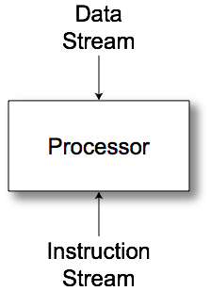
SISD
Uniprocessor

Slide 50
MIMD
Multiple communicating processes

Slide 51
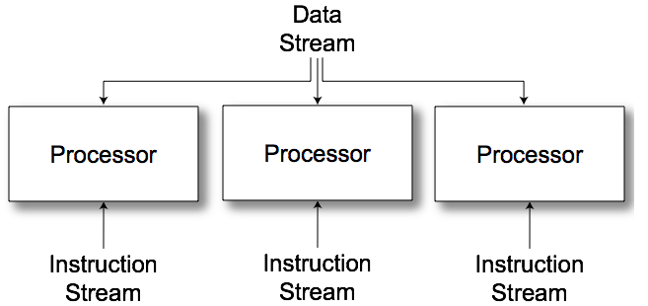
MISD
No commercial examples
Different operations to a single data set
  Find primes
  Crack passwords

Slide 52
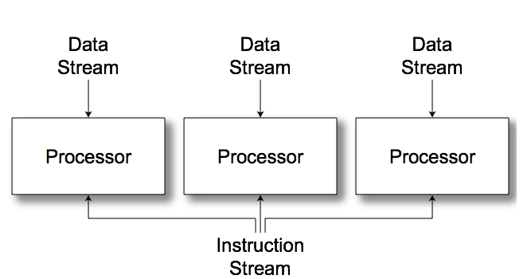
SIMD
Vector/Array computers

Slide 53
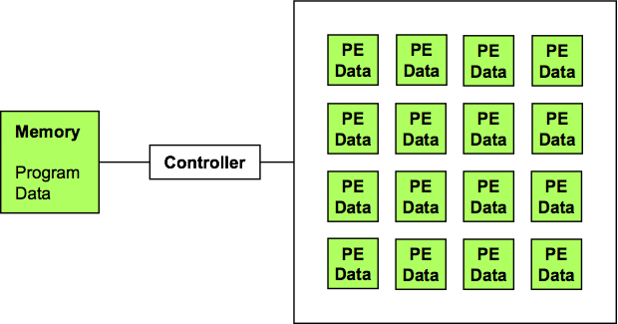
SIMD Arrays
Performance keys
  Utilization
  Communication

Slide 54
Data Parallel Model
Operations performed in parallel on each element of a large regular data structure, such as an array
  One Control Processor broadcast to many processing elements (PE) with condition flag per PE so that can skip
For distributed memory architecture data is distributed among memories
  Data parallel model requires fast global synchronization
  Data parallel programming languages lay out data to processor
  Vector processors have similar ISAs, but no data placement restriction

