Slide 1
CMSC 611: Advanced Computer Architecture
Memory & Virtual Memory
Some material adapted from Mohamed Younis, UMBC CMSC 611 Spr 2003 course slides
Some material adapted from Hennessy & Patterson / © 2003 Elsevier Science

Slide 2
Memory Hierarchy
Capacity
Access Time
Upper Level
Staging
Transfer Unit
faster
CPU Registers
100s Bytes
<10s ns
Registers
Instr. Operands
Prog./compiler
1-8 bytes
Cache
K-M Bytes
10-40 ns
Cache
Blocks
cache cntl
8-128 bytes
Main Memory
G Bytes
70ns-1us
Main Memory
Pages
OS
512-4K bytes
Disk
G-T Bytes
ms
Disk
Files
user/operator
Mbytes
Tape
infinite
sec-min
Larger
Tape
Lower Level

Slide 3
Main Memory Background
Performance of Main Memory:
Latency: affects cache miss penalty
Access Time: time between request and word arrives
Cycle Time: time between requests
Bandwidth: primary concern for I/O & large block
Main Memory is DRAM: Dynamic RAM
Dynamic since needs to be refreshed periodically
Addresses divided into 2 halves (Row/Column)
Cache uses SRAM: Static RAM
No refresh
6 transistors/bit vs. 1 transistor/bit, 10X area
Address not divided: Full address

Slide 4
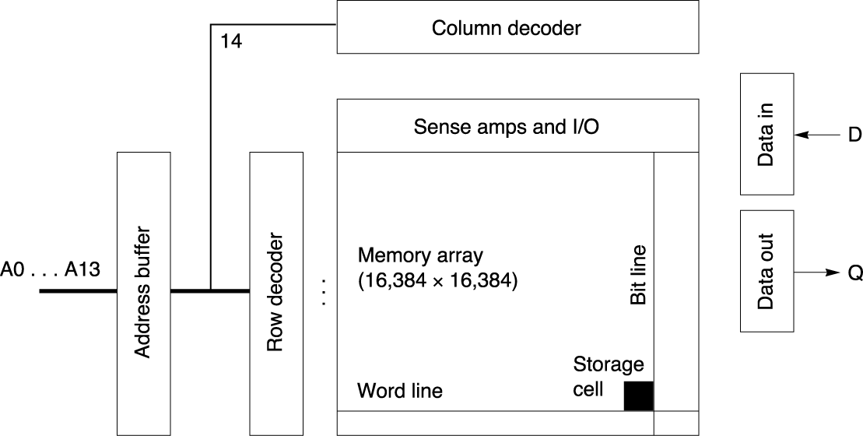
DRAM Logical Organization
4 Mbit DRAM:
square root of bits per RAS/CAS
Refreshing prevent access to the DRAM (typically 1-5% of the time)
Reading one byte refreshes the entire row
Read is destructive and thus data need to be re-written after reading
Cycle time is significantly larger than access time

Slide 5
Processor-Memory Performance
µProc
60%/yr.
(2X/1.5yr)
1000
CPU
CPU-DRAM Gap“Moore’s Law”
100
Processor-Memory
Performance Gap: (grows 50% / year)
Performance
10
DRAM
9%/yr.
(2X/10 yrs)
DRAM
1
1980
1989
1981
1982
1983
1984
1985
1986
1987
1988
1990
1991
1992
1993
1994
1995
1996
1997
1998
1999
2000
Time
Problem:
Improvements in access time are not enough to catch up
Solution:
Increase the bandwidth of main memory (improve throughput)

Slide 6
Memory Organization
Simple: CPU, Cache, Bus, Memory same width (32 bits)
Wide: CPU/Mux 1 word; Mux/Cache, Bus, Memory N words
Interleaved: CPU, Cache, Bus 1 word: Memory N Modules (4 Modules); example is word interleaved
Memory organization would have significant effect on bandwidth

Slide 7
Memory Interleaving
Access Pattern without Interleaving:
Access Pattern with 4-way Interleaving:
CPU
Memory
D1 available
Start Access for D1
Start Access for D2
Memory
Bank 0
Memory
Bank 1
CPU
Memory
Bank 2
Memory
Bank 3
Access Bank 0
Access Bank 1
Access Bank 2
Access Bank 3
We can Access Bank 0 again

Slide 8
Virtual Memory
Using virtual addressing, main memory plays the role of cache for disks
The virtual space is much larger than the physical memory space
Physical main memory contains only the active portion of the virtual space
Address space can be divided into fixed size (pages) or variable size (segments) blocks
Cache Virtual memory
Block ⇒ Page
Cache miss ⇒ page fault
Block ⇒ Address
addressing translation

Slide 9
Virtual Memory
Advantages
Allows efficient and safe data sharing of memory among multiple programs
Moves programming burdens of a small, limited amount of main memory
Simplifies program loading and avoid the need for contiguous memory block
allows programs to be loaded at any physical memory location
Cache Virtual memory
Block ⇒ Page
Cache miss ⇒ page fault
Block ⇒ Address
addressing translation

Slide 10
Virtual Addressing
Page faults are costly and take millions of cycles to process (disks are slow)
Optimization Strategies:
Pages should be large enough to amortize the access time
Fully associative placement of pages reduces page fault rate
Software-based so can use clever page placement
Write-through can make writing very time consuming (use copy back)

Slide 11
Page Table
Hardware supported
Page table:
Resides in main memory
One entry per virtual page
No tag is requires since it covers all virtual pages
Point directly to physical page
Table can be very large
Operating sys. may maintain one page table per process
A dirty bit is used to track modified pages for copy back

Slide 12
Page Faults
A page fault happens when the valid bit of a virtual page is off
A page fault generates an exception to be handled by the operating system to bring the page to main memory from a disk
The operating system creates space for all pages on disk and keeps track of the location of pages in main memory and disk
Page location on disk can be stored in page table or in an auxiliary structure
LRU page replacement strategy is the most common
Simplest LRU implementation uses a reference bit per page and periodically reset reference bits

Slide 13
Optimizing Page Table Size
With a 32-bit virtual address, 4-KB pages, and 4 bytes per page table entry:
Optimization techniques:
Keep bound registers to limit the size of page table for given process in order to avoid empty slots
Store only physical pages and apply hashing function of the virtual address (inverted page table)
Use multi-level page table to limit size of the table residing in main memory
Allow paging of the page table
Cache the most used pages ⇒ Translation Look-aside Buffer

Slide 14
Multi-Level Page Table
32-bit address:
1K
PTEs
4KB
10
10
12
P1 index
P2 index
page offest
° 2 GB virtual address space
° 4 MB of PTE2
– paged, holes
° 4 KB of PTE1
4 bytes
Inverted page table can be the only practical solution for huge address space, e.g 64-bit address space
4 bytes

Slide 15
Translation Look-aside Buffer
Special cache for recently used translation
TLB misses are typically handled as exceptions by operating system
Simple replacement strategy since TLB misses happen frequently

Slide 16
Avoiding Address Translation
Send virtual address to cache?
Called Virtually Addressed Cache or just Virtual Cache vs. Physical Cache
Every time process is switched logically must flush the cache; otherwise get false hits
Cost is time to flush + “compulsory” misses from empty cache
Dealing with aliases (sometimes called synonyms)
Two different virtual addresses map to same physical address causing unnecessary read misses or even RAW
I/O must interact with cache, so need virtual address

Slide 17
Solutions
Solution to aliases
HW guarantees that every cache block has unique physical address (simply check all cache entries)
SW guarantee: lower n bits must have same address so that it overlaps with index; as long as covers index field & direct mapped, they must be unique; called page coloring
Solution to cache flush
Add process identifier tag that identifies process as well as address within process: cannot get a hit if wrong process

Slide 18
Impact of Using Process ID
Miss rate vs. virtually addressed cache size of a program measured three ways:
Without process switches (uniprocessor)
With process switches using a PID tag (PID)
With process switches but without PID (purge)

Slide 19
Virtually Addressed Caches
VA: Virtual address TB: Translation buffer PA: Page address
CPU
CPU
CPU
VA
VA
VA
TB
VA
Tags
$
VA
Tags
$
TB
PA
VA
PA
$
TB
L2 $
PA
PA
MEM
MEM
MEM
Overlap $ access
with VA translation:
requires $ index to
remain invariant
across translation
Conventional
Organization
Virtually Addressed Cache
Translate only on miss
Synonym Problem

Slide 20
Indexing via Physical Addresses
If index is physical part of address, can start tag access in parallel with translation
To get the best of the physical and virtual caches, use the page offset (not affected by the address translation) to index the cache
The drawback is that direct-mapped caches cannot be bigger than the page size (typically 4-KB)
To support bigger caches and use same technique:
Use higher associativity since the tag size gets smaller
OS implements page coloring since it will fix a few least significant bits in the address (move part of the index to the tag)

Slide 21
TLB and Cache in MIPS
Fully associative TLB
Address translation and block identification
Direct-mapped Cache

Slide 22
TLB and Cache in MIPS
A cache hit can only occur after TLB hit
(TLB miss & No Page fault ➔ load page address to TLB)
Write-through cache

Slide 23
Memory Related Exceptions
Possible exceptions:
Cache miss: referenced block not in cache and needs to be fetched from main memory
TLB miss: referenced page of virtual address needs to be checked in the page table
Page fault: referenced page is not in main memory and needs to be copied from disk

Slide 24
Memory Protection
Want to prevent a process from corrupting memory space of other processes
Privileged and non-privileged execution
Implementation can map independent virtual pages to separate physical pages
Write protection bits in the page table for authentication
Sharing pages through mapping virtual pages of different processes to same physical pages

Slide 25
Memory Protection
To enable the operating system to implement protection, the hardware must provide at least the following capabilities:
Support at least two mode of operations, one of them is a user mode
Provide a portion of CPU state that a user process can read but not write,
e.g. page pointer and TLB
Enable change of operation modes through special instructions

