Slide 1
Some Intel CPU examples
Figures and data from Arstechnica
arstechnica.com/old/content/2004/07/pentium-1.ars
arstechnica.com/old/content/2001/05/p4andg4e.ars
arstechnica.com/old/content/2004/02/pentium-m.ars
arstechnica.com/hardware/news/2006/04/core.ars
arstechnica.com/hardware/news/2008/04/what-you-need-to-know-about-nehalem.ars

Slide 2
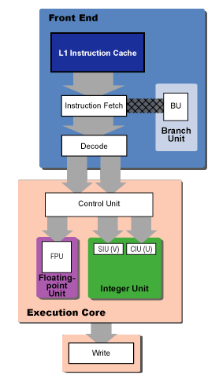
Pentium
Notes:
Dual issue
Two 5-stage integer pipes (some restrictions & coupling)
1: Prefetch/fetch – align in prefetch buffer for decoding (variable instruction size)
2: Decode 1 – decode to internal format, branch prediction
3: Decode 2 – complex decode, address computation
4: Execute
5: Write Back
One 6-stage float pipe
Branch prediction ~75%

Slide 3
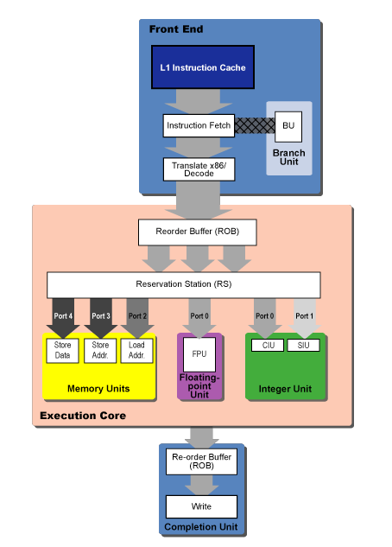
Pentium Pro, II, III
Notes:
3 instruction issue (2 simple/fast, 1 complex)
ROB = 40-entry rotating queue, visited twice
Rename in ROB to 40 microarchitectural registers
RS up to 20 instructions
Execution
5 issue ports
Store addr & store data
1 cycle for most, *,/ 4-cycle latency, 1-cycle issue
12-stage pipeline
1-4.5: BTB & Instruction fetch
4.5-6: Decode
7: register rename/ROB
8: write to RS
9: issue
10: execute
11-12: retire
Branch prediction
90+%

Slide 4
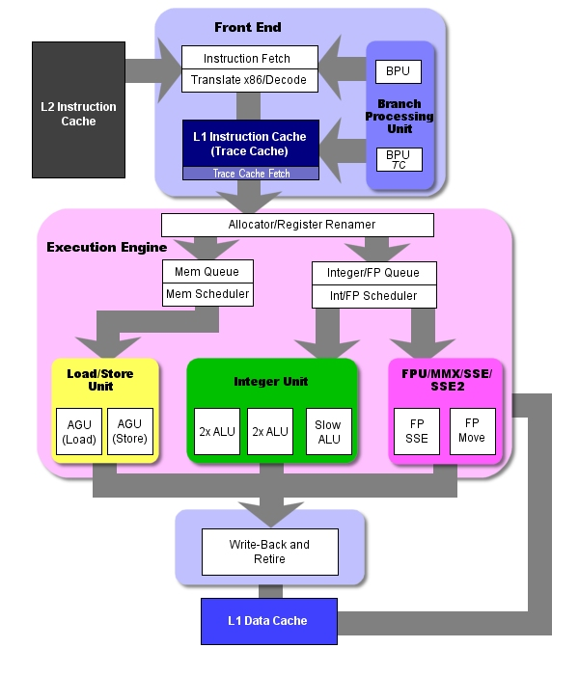
P4 (Pentium 4)
Notes:
Trace cache: decoded instruction blocks (90% hit rate)
ROM for long instructions
Mini BTB for trace cache branches
20+ stage pipeline
More on cache miss (10?)
1-2: Trace cache next IP
3-4: Trace cache fetch
5: Drive signals across chip
6-8: Allocate & rename (128 microarchitectural registers)
9: Queue
10-12: Schedule
13-14: Dispatch (up to 6 per cycle)
15-16: Register file
17: Execute
18: Flags
19: Branch check
20: Drive signals across chip

Slide 5
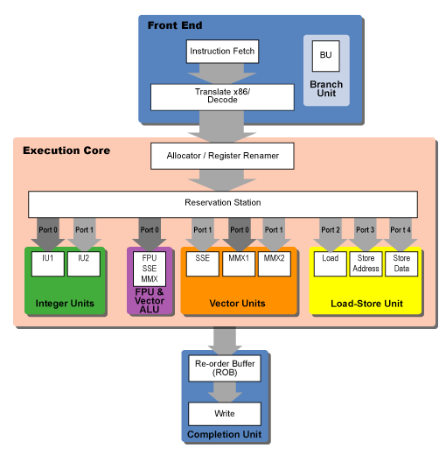
Pentium M
Notes:
Branch Prediction
4k BTB
Loop predictor + “indirect” predictor
Micro op fusion to avoid ROB

Slide 6
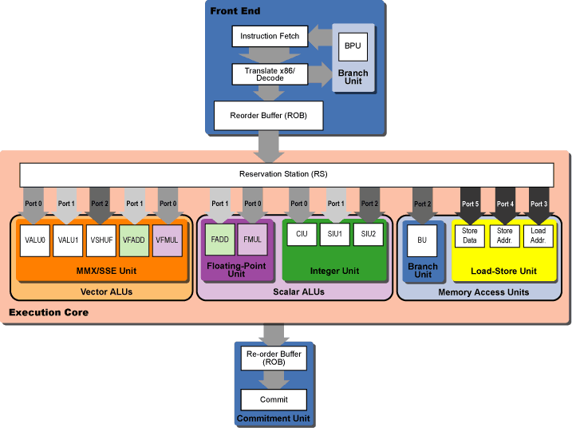
Core
Notes:
96-entry ROB

Slide 7
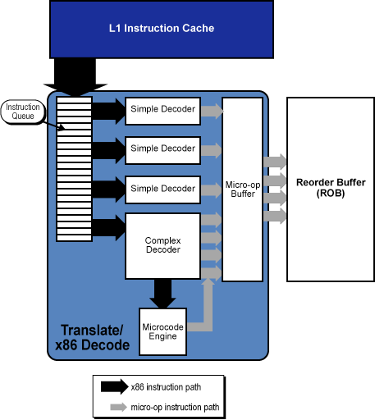
Core Decode
Notes:
4-7 (w/ fusion) issue to 7 micro op
More x86 into single micro-ops
Macro-fusion to merge across x86 ops
Micro-op fusion to avoid ROB
Branch prediction
Loop predictor
Indirect predictor / BTB
Target address by condition

Slide 8
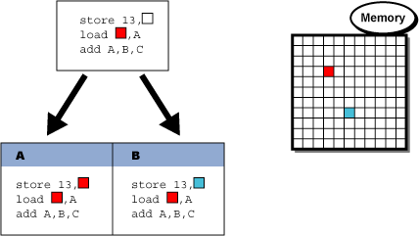
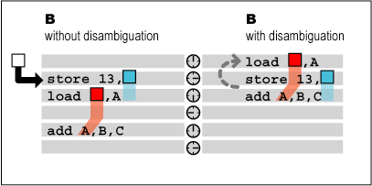
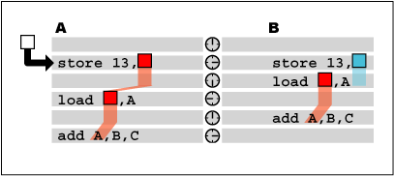
Memory Speculation
Notes:
Cannot rearrange load/store for fear of aliasing
Assume no aliasing, restart if wrong

Slide 9
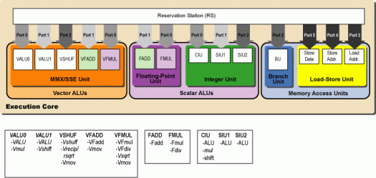
Nehalem
Notes:
Decode
Loop
Execute
Rely on simultaneous multithreading / hyperthreading
128-entry ROB (partitioned by thread)
36-entry RS

