Slide 1
CMSC 611: Advanced Computer Architecture
Instruction Set Architecture
Some material adapted from Mohamed Younis, UMBC CMSC 611 Spr 2003 course slides
Some material adapted from Hennessy & Patterson / © 2003 Elsevier Science

Slide 2
Instruction Set Architecture
To command a computer's hardware, you must speak its language
  Instructions: the “words” of a machine's language
  Instruction set: its “vocabulary”
Goals:
  Introduce design alternatives
  Present a taxonomy of ISA alternatives
    + some qualitative assessment of pros and cons
  Present and analyze some instruction set measurements
  Address the issue of languages and compilers and their bearing on instruction set architecture
  Show some example ISA’s

Slide 3
Interface Design
A good interface:
  Lasts through many implementations (portability, compatibility)
  Is used in many different ways (generality)
  Provides convenient functionality to higher levels
  Permits an efficient implementation at lower levels
Design decisions must take into account:
  Technology
  Machine organization
  Programming languages
  Compiler technology
  Operating systems
use
imp 1
Interface
use
imp 2
Time
use
imp 3
Slide: Dave Patterson

Slide 4
Memory ISAs
Terms
  Result = Operand <operation> Operand
Stack
  Operate on top stack elements, push result back on stack
Memory-Memory
  Operands (and possibly also result) in memory

Slide 5
Register ISAs
Accumulator Architecture
  Common in early computers when hardware was expensive
  Machine has only one register (accumulator) involved in all math & logic operations
  Accumulator = Accumulator op Memory
Extended Accumulator Architecture (8086)
  Dedicated registers for specific operations, e.g stack and array index registers
General-Purpose Register Architecture (MIPS)
  Register flexibility
  Can further divide these into:
    Register-memory: allows for one operand to be in memory
    Register-register / load-store: all operands in registers

Slide 6
Other types of Architecture
High-Level-Language Architecture
  In the 1960s, systems software was rarely written in high-level languages
    virtually every commercial operating system before Unix was written in assembly
  Some people blamed the code density on the instruction set rather than the programming language
  A machine design philosophy advocated making the hardware more like high-level languages

Slide 7
Well Known ISA

Slide 8
ISA Complexity
Reduced Instruction Set Architecture
  With the recent development in compiler technology and expanded memory sizes less programmers are using assembly level coding
  Drives ISA to favor benefit for compilers over ease of manual programming
RISC architecture favors simplified hardware design over rich instruction set
  Rely on compilers to perform complex operations
Virtually all new architecture since 1982 follows the RISC philosophy:
  fixed instruction lengths, load-store operations, and limited addressing mode

Slide 9
Compact Code
Scarce memory or limited transmit time (JVM)
Variable-length instructions (Intel 80x86)
  Match instruction length to operand specification
  Minimize code size
  But … recent x86 architectures have an internal RISC form
Stack machines abandon registers altogether
  Stack machines simplify compilers
  Lend themselves to a compact instruction encoding
  BUT limit compiler optimization

Slide 10
Evolution of Instruction Sets
Single Accumulator (EDSAC 1950)
Accumulator + Index Registers
(Manchester Mark I, IBM 700 series 1953)
Separation of Programming Model
from Implementation
High-level Language Based
Concept of a Family
(B5000 1963)
(IBM 360 1964)
General Purpose Register Machines
Complex Instruction Sets
Load/Store Architecture
(Vax, Intel 432 1977-80)
(CDC 6600, Cray 1 1963-76)
RISC
(MIPS,SPARC,IBM RS6000, . . .1987)
Slide: Dave Patterson

Slide 11
Register-Memory Arch
Effect of the number of memory operands:

Slide 12
Instruction Representation
All data in computer systems is represented in binary
Instructions are no exception
The program that translates the human-readable code to numeric form is called an Assembler
Hence machine-language or assembly-language
Example:
Assembly: ADD $t0, $s1, $s2
Note: by default MIPS $t0..$t7 map to reg. 8..15, $s0..$s7 map to reg. 16-23
ADD
$t0, $s1, $s2
$t0
$s1
$s2
0x12
0x8
0x020
M/C language (hex by field):
M/C language (binary):
0x0
0x11
000000
10001
10010
01000
00000100000
0x02324020
M/C language (hex):

Slide 13
Encoding an Instruction Set
Fixed size instruction encoding simplifies CPU design but limits addressing choices
Affects the size of the compiled program
Complexity of the CPU implementation
Must balance:
  Desire to support many registers and addressing modes
  Effect of operand specification on the size of the instruction
  Desire to simplify instruction fetching and decoding
  Size vs. Orthogonality of instruction set

Slide 14
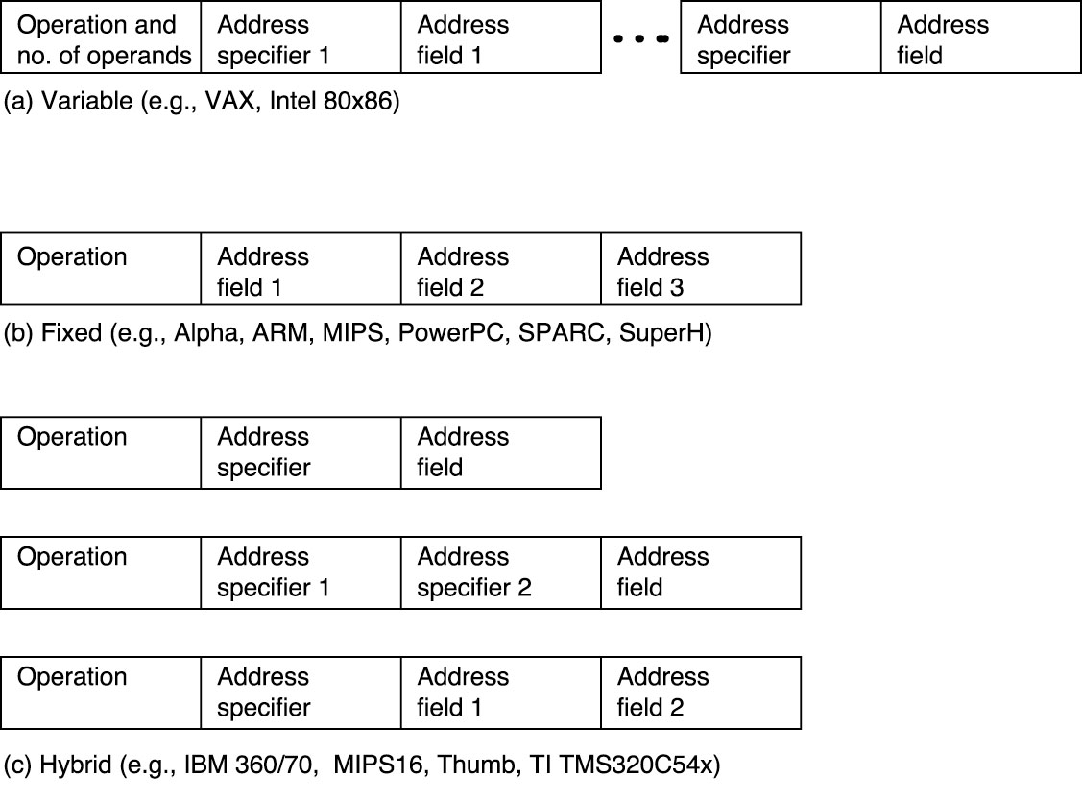
Encoding Examples

Slide 15
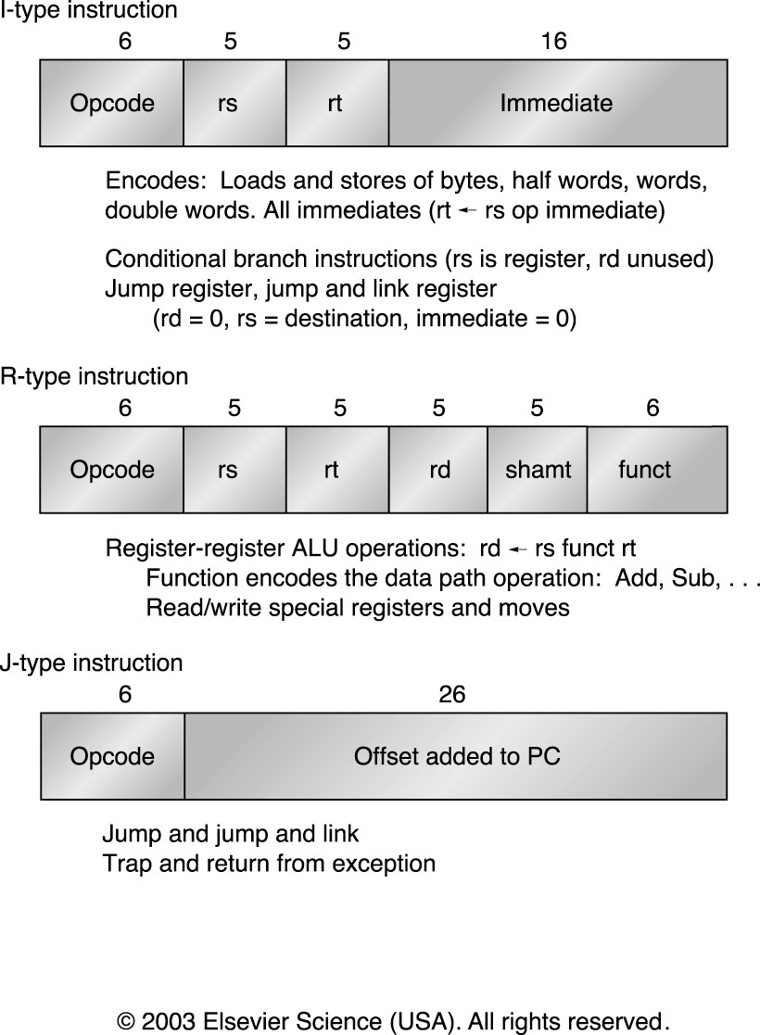
MIPS Instruction Formats

Slide 16
ISA Decisions
ISA choices balance
  What you want to express
  How you will encode it
  How hard it will be to use
  How hard it will be to implement
  …

Slide 17
Memory Alignment
Byte addressing: Unique address for every byte
  The addresses of sequential words differ by the word size (0, 4, 8, …)
  Alternative: word addresses differ by 1 (0, 1, 2, …), cannot access sub-word
Aligned access divisible by data size
  16-bit data address must be divisible by 2
  32-bit data addresses must be divisible by 4
  64-bit data addresses must be divisible by 8
  128-bit data addresses must be divisible by 16
Misalignment (if allowed) complicates memory access and causes programs to run slower

Slide 18
Byte Order
Given N bytes, which is the most significant, which is the least significant?
  “Little Endian”
    Leftmost / least significant byte = word address
    Intel (among others)
  “Big Endian”
    Leftmost / most significant byte = word address
    Motorola, TCP/IP (among others)
Byte ordering can be as problem when exchanging data among different machines
Can also affect array index calculation or any other operation that treat the same data a both byte and word.

Slide 19
Addressing Modes
How to specify the location of an operand (effective address)
Addressing modes have the ability to:
  Significantly reduce instruction counts
  Increase the average CPI
  Increase the complexity of building a machine
VAX machine is used for benchmark data since it supported huge range of memory addressing modes
Can classify based on:
  source of the data (register, immediate or memory)
  the address calculation (direct, indirect, indexed)

Slide 20
Example of Addressing Modes
R = register, # = immediate, () = memory access, d = word size

Slide 21
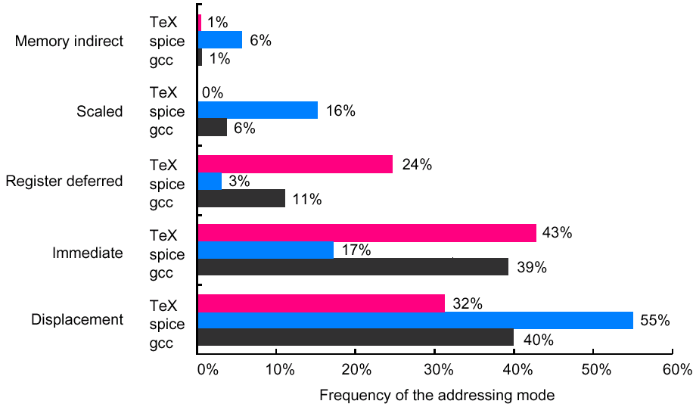
Addressing Mode Use
Focus on immediate and displacement modes since they are used the most
Based on SPEC89 on VAX

Slide 22
Example
If memory operations are 30% of all instructions and scaled addressing is 6% of all memory operations, what is the performance cost of removing this addressing mode? Assume the CPI and clock rate do not change.
What percentage of instructions use scaled addressing?
  6% of 30% = 0.06 * 0.30 = 0.018 = 1.8%
Old: MOV $r1, 100($r3)[$r4]
New:
  MUL $t0, $r4, #4
  ADD $t0, $t0, $r3
  LOAD $r1, 100($t0)
Instruction count change
  instructions affected
  Add 2 more instructions for each =
  Total =
  Slowdown:

Slide 23
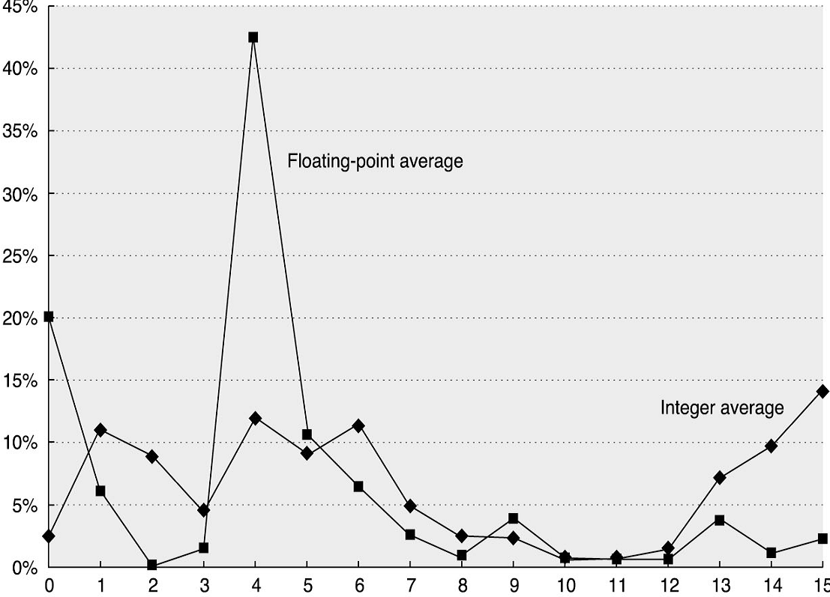
Distribution of Immediate Values
Range affects instruction length
  Measurements on Alpha (≤16-bit immediates)
  Similar measurements (w/ 32-bit immediate values) show 20-25% longer than 16-bits
Percentage of Immediate Values
Number of bits needed for a immediate values in SPEC2000 benchmark

Slide 24
Tradeoff
Smaller = shorter instruction
But what about cases that need more?
Multiple instructions
  MIPS 16-bit load upper immediate + 16-bit add immediate = 32-bit immediate
  Could go smaller with a shift and load
Compile into memory
  Hope it’s in cache!
  2 GHz = 0.5 ns
  100 clock cycles in a 50 ns memory access!

Slide 25
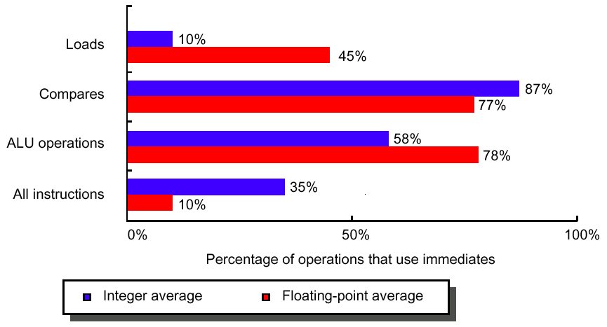
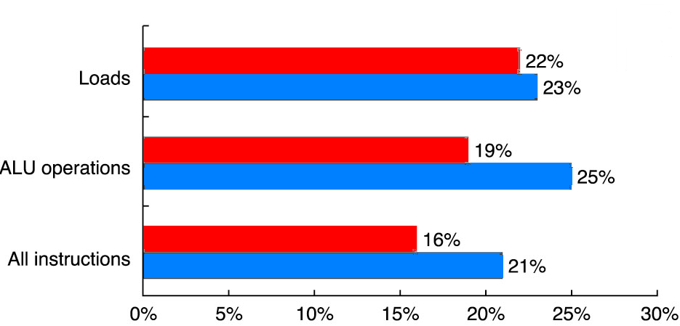
Immediate Addressing Modes
Immediate values for what operations?
Statistics are based on SPEC2000 benchmark on Alpha

Slide 26
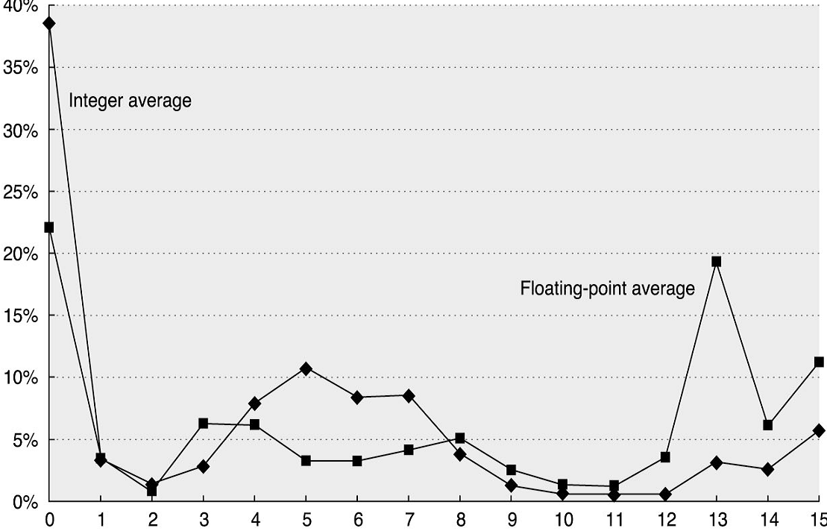
Displacement Addressing Modes
The range of displacement supported affects the length of the instruction
Data is based on SPEC2000 on Alpha (only 16 bit displacement allowed)
Percentage of displacement
Number of bits needed for a displacement value in SPEC2000 benchmark

Slide 27
Addressing Mode for Signal Processing
DSP offers special addressing modes to better serve popular algorithms
Special features requires either hand coding or a compiler that uses such features

Slide 28
Addressing Mode for Signal Processing
Modulo addressing:
  Since DSP deals with continuous data streams, circular buffers common
  Circular or modulo addressing: automatic increment and decrement / reset pointer at end of buffer
Reverse addressing:
  Address is the reverse order of the current address
  Expedites access / otherwise require a number of logical instructions or extra memory accesses
Fast Fourier Transform
0 (000₂) ➔ 0 (000₂)
1 (001₂) ➔ 4 (100₂)
2 (010₂) ➔ 2 (010₂)
3 (011₂) ➔ 6 (110₂)
4 (100₂) ➔ 1 (001₂)
5 (101₂) ➔ 5 (101₂)
6 (110₂) ➔ 3 (011₂)
7 (111₂) ➔ 7 (111₂)

Slide 29
Summary of MIPS Addressing Modes

Slide 30
Operations of the Computer Hardware
“There must certainly be instructions for performing the
fundamental arithmetic operations.”
Burkes, Goldstine and Von Neumann, 1947
MIPS assembler allows only one instruction/line and ignore comments following # until end of line
Example:
  Translation of a segment of a C program to MIPS assembly instructions:
  C: f = (g + h) - (i + j)
  (pseudo)MIPS:
      add t0, g, h # temp. variable t0 contains "g + h"
      add t1, i, j # temp. variable t1 contains "i + j"
      sub f, t0, t1 # f = t0 - t1 = (g + h) - (i + j)

Slide 31
Operations in the Instruction Set
Arithmetic, logical, data transfer and control are almost standard categories for all machines
System instructions are required for multi-programming environment although support for system functions varies
Others can be primitives (e.g. decimal and string on IBM 360 and VAX), provided by a co-processor, or synthesized by compiler.

Slide 32
Operations for Media & Signal Process.
Partitioned Add:
  Partition a single register into multiple data elements (e.g. 4 16-bit words in 1 64-bit register)
  Perform the same operation independently on each
  Increases ALU throughput for multimedia applications
Paired single operations
  Perform multiple independent narrow operations on one wide ALU (e.g. 2 32-bit float ops)
  Handy in dealing with vertices and coordinates
Multiply and accumulate
  Very handy for calculating dot products of vectors (signal processing) and matrix multiplication

Slide 33
Frequency of Operations Usage
The most widely executed instructions are the simple operations of an instruction set
Average usage in SPECint92 on Intel 80x86:
Make the common case fast by focusing on these operations

Slide 34
Control Flow Instructions
Data is based on SPEC2000 on Alpha
Jump: unconditional change in the control flow
Branch: conditional change in the control flow
Procedure calls and returns

Slide 35
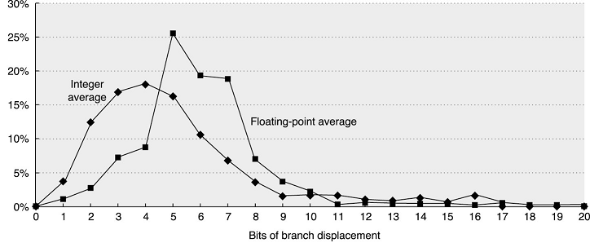
Destination Address Definition
Data is based SPEC2000 on Alpha
PC-relative addressing
  Good for short position-independent forward & backward jumps
Register indirect addressing
  Good for dynamic libraries, virtual functions & packed case statements

Slide 36
Type and Size of Operands
Operand type encoded in instruction opcode
  The type of an operand effectively gives its size
Common types include character, half word and word size integer, single- and double-precision floating point
  Characters are almost always in ASCII, though 16-bit Unicode (for international characters) is gaining popularity
  Integers in 2’s complement
  Floating point in IEEE 754

Slide 37


Unusual Types
Business Applications
  Binary Coded Decimal (BCD)
    Exactly represents all decimal fractions (binary doesn’t!)
DSP
  Fixed point
    Good for limited range numbers: more mantissa bits
  Block floating point
    Single shared exponent for multiple numbers
Graphics
  4-element vector operations (RGBA or XYZW)
    8-bit, 16-bit or single-precision floating point
8-bit exponent
24-bit mantissa
fixed exponent
32-bit mantissa

Slide 38
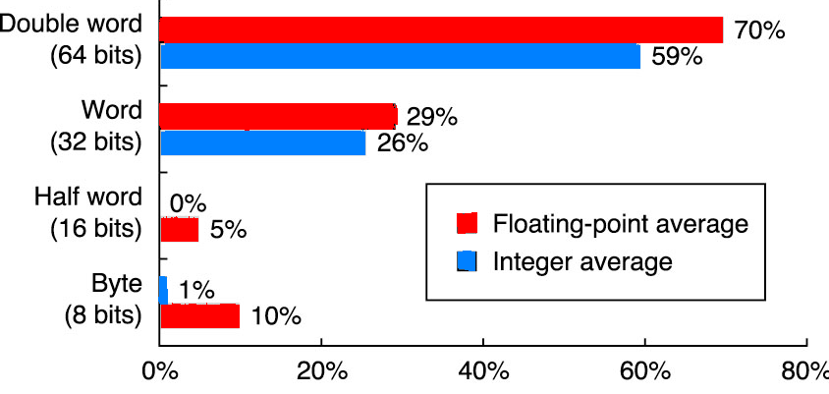
Size of Operands
Frequency of reference by size
based on SPEC2000 on Alpha
Double-word: double-precision floating point + addresses in 64-bit machines
Words: most integer operations + addresses in 32-bit machines
For the mix in SPEC, word and double-word data types dominates

Slide 39
Identify MIPS ISA Decisions
Notes:
32-bit words
Byte addressing, but no non-aligned access
Big endian
Integer instructions
but extensions exist for float
+ reserved extension opcodes not shown can have alternate encodings
Register/Register RISC
Fixed size encoding
Opcode distinguishes instruction type
Could have used fewer common bits at decoding cost
Effectively R-type has variable-sized opcode w/ 000000 enabling funct
Destination location not consistent
Don’t know why, I would have done differently!
I-type decisions lock many encoding decisions
16-bit immediate + 2x32 registers = 6 bits left for opcode
6-bit opcode = 26 bits left for J offset
6-bit opcode + 3x32 registers = 11 bits left in R
Don’t need all 11 for ops (2048 ops!), so special-purpose 5
Lack of orthogonality for I vs. R: not all ALU ops available with I

Slide 40
GPU Shading ISA
Data
  IEEE-like floating point
  4-element vectors
    Most instructions perform operation on all four
Addressing
  No addresses
  ATTRIB, PARAM, TEMP, OUTPUT
  Limited arrays
  Element selection (read & write)
    C.xyw, C.rgba

Slide 41
GPU Shading ISA
Instructions:

Slide 42
GPU Shading ISA
Notable:
  Many special-purpose instructions
  No binary encoding, interface is text form
    No ISA limits on future expansion
    No ISA limits on registers
    No ISA limits on immediate values
  Originally no branching! (exists now)

