Slide 1
CMSC 611: Advanced Computer Architecture
Benchmarking
Some material adapted from Mohamed Younis, UMBC CMSC 611 Spr 2003 course slides
Some material adapted from Hennessy & Patterson / © 2003 Elsevier Science

Slide 2
Important Equations (so far)

Slide 3
Ahmdal’s Law for Speedup

Slide 4
Performance Benchmarks
Many widely-used benchmarks are small programs that have significant locality of instruction and data reference
Universal benchmarks can be misleading since hardware and compiler vendors do optimize their design for these programs
The best types of benchmarks are real applications since they reflect the end-user interest
Architectures might perform well for some applications and poorly for others
Compilation can boost performance by taking advantage of architecture-specific features
Application-specific compiler optimization are becoming more popular

Slide 5
Comparing & Summarizing Performance
Wrong summary can present a confusing picture
  A is 10 times faster than B for program 1
  B is 10 times faster than A for program 2
Total execution time is a consistent summary measure
Relative execution times for the same workload
  Assuming that programs 1 and 2 are executing for the same number of times on computers A and B
Execution time is the only valid and unimpeachable measure of performance

Slide 6
The SPEC Benchmarks
SPEC stands for System Performance Evaluation Cooperative suite of benchmarks
  Created by a set of companies to improve the measurement and reporting of CPU performance
SPEC2006 is the latest suite that consists of 12 integer (C or C++) and 17 floating-point (Fortran, C, and C++) programs
  Customized SPEC suites assess performance of graphics and transaction systems.
Since SPEC requires running applications on real hardware, the memory system has a significant effect on performance

Slide 7
Effect of Compilation
App. and arch. specific optimization can dramatically impact performance

Slide 8
Performance Reports
Guiding principle is reproducibility (report environment & experiments setup)

Slide 9
The SPEC Benchmarks
Bigger numeric values of the SPEC ratio indicate faster machine
1997 “historical” reference machine

Slide 10
SPEC95 for Pentium and Pentium Pro
The performance measured may be different on other Pentium-based hardware with different memory system and using different compilers
  At the same clock rate, the SPECint95 measure shows that Pentium Pro is 1.4-1.5 times faster while the SPECfp95 shows that it is 1.7-1.8 times faster
  When the clock rate is increased by a certain factor, the processor performance increases by a lower factor

Slide 11
Performance Summary
Where: n is the number of programs executed
w_{i} is a weighting factor that indicates the frequency of executing program i
with and
Weighted arithmetic means summarize performance while tracking exec. time
Never use AM for normalizing time relative to a reference machine

Slide 12
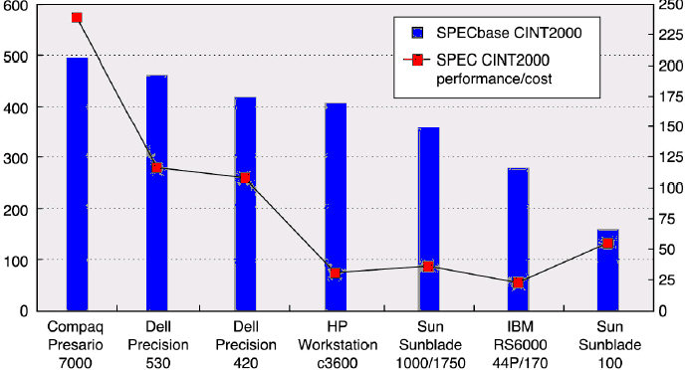
Price-Performance Metric
Prices reflects those of July 2001
SPECbase CINT2000
SPEC CINT2000 per $1000 in price
Different results are obtained for other benchmarks, e.g. SPEC CFP2000
With the exception of the Sunblade price-performance metrics were consistent with performance

Slide 13
Historic Perspective
In early computers most instructions of a machine took the same execution time
  The measure of performance for old machines was the time required performing an individual operation (e.g. addition)
New computers have diverse set of instructions with different execution times
  The relative frequency of instructions across many programs was calculated
  The average instruction execution time was measured by multiplying the time of each instruction by its frequency
The average instruction execution time was a small step to MIPS that grew in popularity

Slide 14
Using MIPS
MIPS = Million of Instructions Per Second
  one of the simplest metrics
  valid only in a limited context
There are three problems with MIPS:
  MIPS specifies the instruction execution rate but not the capabilities of the instructions
  MIPS varies between programs on the same computer
  MIPS can vary inversely with performance (see next example)
The use of MIPS is simple and intuitive, faster machines have bigger MIPS

