Slide 1
CMSC 611: Advanced Computer Architecture
Parallel Computation
Most slides adapted from David Patterson. Some from Mohomed Younis

Slide 2
Parallel Computers
Definition: “A parallel computer is a collection of processing elements that cooperate and communicate to solve large problems fast.”
Almasi and Gottlieb, Highly Parallel Computing,1989
Parallel machines have become increasingly important since:
Power & heat problems grow for big/fast processors
Even with double transistors, how do you use them to make a single processor faster?
CPUs are being developed with an increasing number of cores

Slide 3
Questions about parallel computers:
How large a collection?
How powerful are processing elements?
How do they cooperate and communicate?
How are data transmitted?
What type of interconnection?
What are HW and SW primitives for programmers?
Does it translate into performance?

Slide 4
Level of Parallelism
Bit-level parallelism
ALU parallelism: 1-bit, 4-bits, 8-bit, ...
Instruction-level parallelism (ILP)
Pipelining, Superscalar, VLIW, Out-of-Order execution
Process/Thread-level parallelism
Divide job into parallel tasks
Job-level parallelism
Independent jobs on one computer system

Slide 5
Applications
Scientific Computing
Nearly Unlimited Demand (Grand Challenge):
Successes in some real industries:
Petroleum: reservoir modeling
Automotive: crash simulation, drag analysis, engine
Aeronautics: airflow analysis, engine, structural mechanics
Pharmaceuticals: molecular modeling
App | Perf (GFLOPS) | Memory (GB)
48 hour weather | 0.1 | 0.1
72 hour weather | 3 | 1
Pharmaceutical design | 100 | 10
Global Change, Genome | 1000 | 1000

Slide 6
Commercial Applications
Transaction processing
File servers
Electronic CAD simulation
Large WWW servers
WWW search engines
Graphics
Graphics hardware
Render Farms

Slide 7
Framework
Extend traditional computer architecture with a communication architecture
abstractions (HW/SW interface)
organizational structure to realize abstraction efficiently
Programming Model:
Multiprogramming: lots of jobs, no communication
Shared address space: communicate via memory
Message passing: send and receive messages
Data Parallel: operate on several data sets simultaneously and then exchange information globally and simultaneously (shared or message)

Slide 8
Communication Abstraction
Shared address space:
e.g., load, store, atomic swap
Message passing:
e.g., send, receive library calls
Debate over this topic (ease of programming, scaling)
many hardware designs 1:1 programming model

Slide 9
Taxonomy of Parallel Architecture
Flynn Categories
SISD (Single Instruction Single Data)
MIMD (Multiple Instruction Multiple Data)
MISD (Multiple Instruction Single Data)
SIMD (Single Instruction Multiple Data)

Slide 10
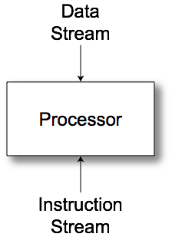
SISD
Uniprocessor

Slide 11
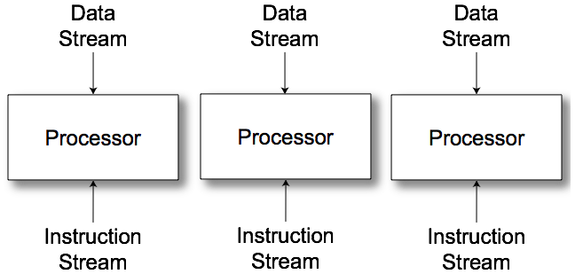
MIMD
Multiple communicating processes

Slide 12
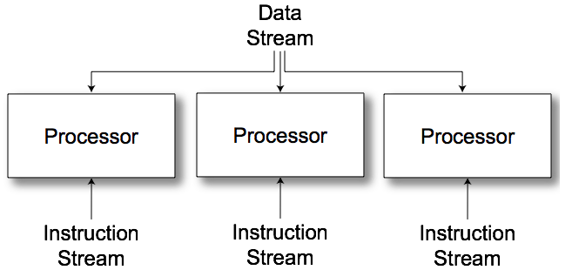
MISD
No commercial examples
Different operations to a single data set
Find primes
Crack passwords

Slide 13
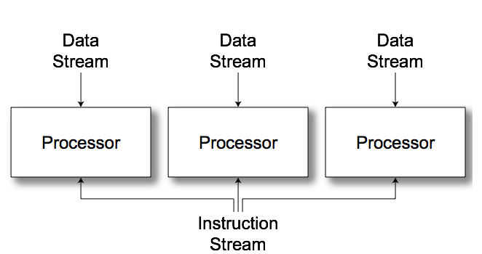
SIMD
Vector/Array computers

Slide 14
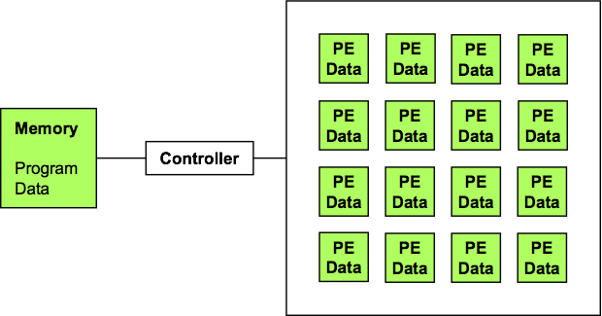
SIMD Arrays
Performance keys
Utilization
Communication

Slide 15
Data Parallel Model
Operations performed in parallel on each element of a large regular data structure, such as an array
One Control Processor broadcast to many processing elements (PE) with condition flag per PE so that can skip
For distributed memory architecture data is distributed among memories
Data parallel model requires fast global synchronization
Data parallel programming languages lay out data to processor
Vector processors have similar ISAs, but no data placement restriction

Slide 16
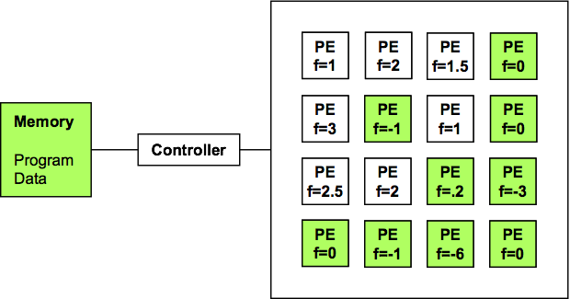
SIMD Utilization
Conditional Execution
PE Enable
if (f<.5) {...}
Global enable check
while (t > 0) {...}

Slide 17
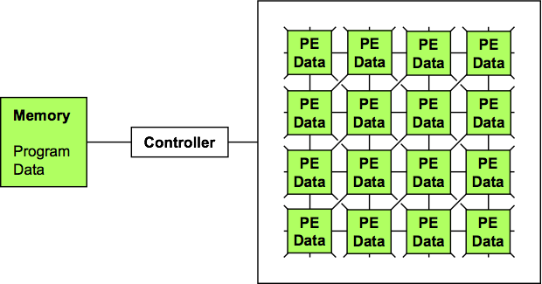
Communication: MasPar MP1
Fast local X-net
Slow global routing

Slide 18
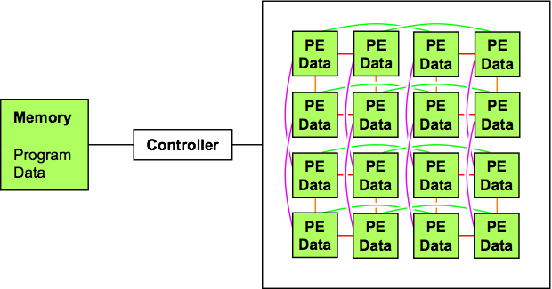
Communication: CM2
Hypercube local routing
Wormhole global routing

Slide 19
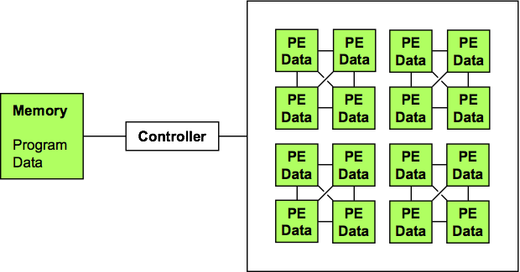
Communication: PixelFlow
Dense connections within block
Single swizzle operation collects one word from each PE in block
Designed for antialiasing
NO inter-block connection
NO global routing

Slide 20
Data Parallel Languages
SIMD programming
PE point of view
Data: shared or per-PE
What data is distributed?
What is shared over PE subset
What data is broadcast with instruction stream?
Data layout: shape [256][256]d;
Communication primitives
Higher-level operations
Scan/Prefix sum: [i]r = ∑_{j≤i} [j]d
1,1,2,3,4 → 1,1+1=2,2+2=4,4+3=7,7+4=11

Slide 21
Single Program Multiple Data
Many problems do not map well to SIMD
Better utilization from MIMD or ILP
Data parallel model ⇒ Single Program Multiple Data (SPMD) model
All processors execute identical program
Same program for SIMD, SISD or MIMD
Compiler handles mapping to architecture

