Slide 1
CMSC 611: Advanced Computer Architecture
Cache
Some material adapted from Mohamed Younis, UMBC CMSC 611 Spr 2003 course slides
Some material adapted from Hennessy & Patterson / © 2003 Elsevier Science

Slide 2
Memory Hierarchy
Temporal Locality (Locality in Time):
  ⇒ Keep most recently accessed data items closer to the processor
Spatial Locality (Locality in Space):
  ⇒ Move blocks consists of contiguous words to the faster levels
Processor
Control
Secondary
Storage
(Disk)
Second
Level
Cache
(SRAM)
Main
Memory
(DRAM)
Datapath
On-Chip
Cache
Registers
Compiler
Hardware
Speed:
Fastest
Operating System
Slowest
Size:
Smallest
Biggest
Cost:
Highest
Lowest

Slide 3
Memory Hierarchy Terminology
Hit: data appears in some block in the faster level (example: Block X)
  Hit Rate: the fraction of memory access found in the faster level
  Hit Time: Time to access the faster level which consists of
    Memory access time + Time to determine hit/miss
Miss: data needs to be retrieve from a block in the slower level (Block Y)
  Miss Rate = 1 - (Hit Rate)
  Miss Penalty: Time to replace a block in the upper level + Time to deliver the block the processor
Hit Time << Miss Penalty
Slower Level
Memory
To Processor
Faster Level
Memory
Block X
From Processor
Block Y

Slide 4
Memory Hierarchy Design Issues
Block identification
  How is a block found if it is in the upper (faster) level?
    Tag/Block
Block placement
  Where can a block be placed in the upper (faster) level?
    Fully Associative, Set Associative, Direct Mapped
Block replacement
  Which block should be replaced on a miss?
    Random, LRU
Write strategy
  What happens on a write?
    Write Back or Write Through (with Write Buffer)

Slide 5
The Basics of Cache
Cache: level of hierarchy closest to processor
Caches first appeared in research machines in early 1960s
Virtually every general-purpose computer produced today includes cache
Requesting X_{n} generates a miss and the word X_{n} will be brought from main memory to cache
Issues:
How do we know that a data item is in cache?
If so, How to find it?

Slide 6
Direct-Mapped Cache
Valid Bit
Cache Tag
Cache Data
Byte 3
Byte 2
Byte 1
Byte 0
Worst case is to keep replacing a block followed by a miss for it: Ping Pong Effect
To reduces misses:
  make the cache size bigger
  multiple entries for the same Cache Index
Memory words can be mapped only to one cache block
Cache block address = (Block address) modulo (Number of cache blocks)

Slide 7
Accessing Cache
Cache Size depends on:
  # cache blocks
  # address bits
  Word size
Example:
  For n-bit address, 4-byte word & 1024 cache blocks:
  cache size =
  1024 [(n-10 -2) + 1 + 32] bit
Valid bit
# cache blocks
Tag
Word size

Slide 8
Cache with Multi-Word/Block
Takes advantage of spatial locality to improve performance
Cache block address = (Block address) modulo (Number of cache blocks)
Block address = (byte address) / (bytes per block)

Slide 9
Determining Block Size
Larger block size take advantage of spatial locality BUT:
  Larger block size means larger miss penalty:
    Takes longer time to fill up the block
  If block size is too big relative to cache size, miss rate will go up
    Too few cache blocks
Average Access Time = Hit Time + Miss Penalty * Miss Rate
Average
Access
Time
Miss
Penalty
Miss
Rate
Exploits Spatial Locality
Fewer blocks:
compromises
temporal locality
Increased Miss Penalty
& Miss Rate
Block Size
Block Size
Block Size

Slide 10
Block Placement
Hardware Complexity
Cache utilization
Set number = (Block number) modulo (Number of sets in the cache)
Increased flexibility of block placement reduces probability of cache misses

Slide 11
N-way Set Associative Cache
N entries for each Cache Index
Example: Two-way set associative cache
  Cache Index selects a “set” from the cache
  The two tags in the set are compared in parallel
  Data is selected based on the tag result
Cache Index
Valid
Cache Tag
Cache Data
Cache Data
Cache Tag
Valid
Cache Block 0
Cache Block 0
:
:
:
:
:
:
Adr Tag
Compare
1
Mux
0
Compare
Sel1
Sel0
OR
Cache Block
Hit

Slide 12
Locating a Block in Associative Cache
Tag size increases with higher level of associativity

Slide 13
Fully Associative Cache
Forget about the Cache Index
Compare the Cache Tags of all cache entries in parallel
Example: Block Size = 32 Byte blocks, we need N 27-bit comparators
By definition: Conflict Miss = 0 for a fully associative cache
31
4
0
Cache Tag (27 bits long)
Byte Select
Ex: 0x01
Cache Tag
Valid Bit
Cache Data
X
Byte 31
:
Byte 1
Byte 0
X
Byte 63
:
Byte 33
Byte 32
X
X
:
:
:
X
Notes:
Direct mapped = simple / fully associative = complex
Like N-way set associative with N = # cache entries
i.e. no cache index bits in address.
Very hardware intensive: usually, fully associative cache is limited to 64 or less entries.
Never conflict, but can have Capacity Miss (on 65th item in 64-element cache)

Slide 14
Handling Cache Misses
Read misses bring blocks from memory
Write access requires careful maintenance of consistency between cache and main memory
Two write strategies:
  Write through: write to both cache and memory
    Read misses cannot result in writes
    No allocation of a cache block is needed
    Always combined with write buffers so that don’t wait for slow memory
  Write back: write cache only; write to memory when cache block is replaced
    Is block clean or dirty?
    No writes to slow memory for repeated write accesses
    Requires allocation of a cache block

Slide 15
Write Through via Buffering
Cache
Processor
DRAM
Write Buffer
Processor writes data into the cache and the write buffer
Memory controller writes contents of the buffer to memory
Increased write frequency can cause saturation of write buffer
If CPU cycle time too fast and/or too many store instructions in a row:
  Store buffer will overflow no matter how big you make it
  The CPU Cycle Time get closer to DRAM Write Cycle Time
Write buffer saturation can be handled by installing a second level (L2) cache
Cache
L2
Cache
Processor
DRAM
Write Buffer

Slide 16
Block Replacement Strategy
Straight forward for Direct Mapped since every block has only one location
Set Associative or Fully Associative:
  Random: pick any block
  LRU (Least Recently Used)
    requires tracking block reference
    for two-way set associative cache, reference bit attached to every block
    more complex hardware is needed for higher level of cache associativity
Empirical results indicates less significance of replacement strategy with
increased cache sizes

Slide 17
Measuring Cache Performance
To enhance cache performance, one can:
  Reduce the miss rate (e.g. diminishing blocks collisions)
  Reduce the miss penalty (e.g. adding multi-level caching)
  Enhance hit access time (e.g. simple and small cache)
For write-through scheme:
Hard to control, assume enough buffer size

Slide 18
Example
Assume an instruction cache miss rate for gcc of 2% and a data cache miss rate of 4%. If a machine has a CPI of 2 without any memory stalls and the miss penalty is 40 cycles for all misses, determine how much faster a machine would run with a perfect cache that never missed. Assume 36% combined frequencies for load and store instructions
Answer:
  Assume number of instructions = I
  Instruction miss cycles = I × 2% × 40 = 0.8 × I
  Data miss cycles = I × 36% × 4% × 40 = 0.56 × I
  Total number of memory-stall cycles = 0.8 I + 0.56 I = 1.36 I
  The CPI with memory stalls = 2 + 1.36 = 3.36
What happens if the CPU gets faster?

Slide 19
Classifying Cache Misses
Compulsory
  First access to a block not in cache
  Also called cold start or first reference misses
  (Misses in even an Infinite Cache)
Capacity
  If the cache cannot contain all needed blocks
  Due to blocks discarded and re-retrieved
  (Misses in Fully Associative Cache)
Conflict
  Set associative or direct mapped: too many blocks in set
  Also called collision or interference
  (Misses in N-way Associative Cache)
Notes:
Intuitive Model by Mark Hill

Slide 20
Improving Cache Performance
Capacity misses can be damaging to the performance (excessive main memory access)
Increasing associativity, cache size and block width can reduces misses
Changing cache size affects both capacity and conflict misses since it spreads out references to more blocks
Some optimization techniques that reduces miss rate also increases hit access time
Notes:
Intuitive Model by Mark Hill

Slide 21
Miss Rate Distribution
Compulsory misses are small compared to other categories
Capacity misses diminish with increased cache size
Increasing associativity limits the placement conflicts
Conflict
Based on SPEC92

Slide 22
Techniques for Reducing Misses
1. Reducing Misses via Larger Block Size
2. Reducing Misses via Higher Associativity
3. Reducing Misses via Victim Cache
4. Reducing Misses via Pseudo-Associativity
5. Reducing Misses by H/W Prefetching Instr. and Data
6. Reducing Misses by S/W Prefetching Data
7. Reducing Misses by Compiler Optimizations

Slide 23
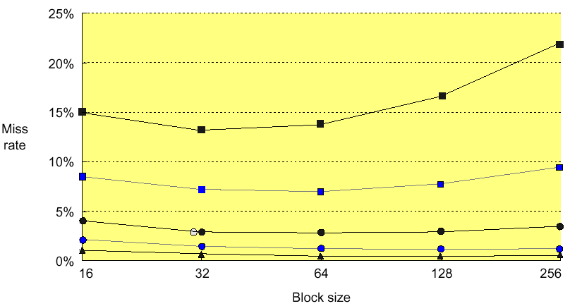

Reduce Misses via Larger Block Size
Larger block sizes reduces compulsory misses (principle of spatial locality)
Conflict misses increase for larger block sizes since cache has fewer blocks
The miss penalty usually outweighs the decrease of the miss rate making large block sizes less favored

Slide 24
Reduce Misses via Higher Associativity
2:1 Cache Rule:
Miss Rate for direct mapped cache of size N = Miss Rate 2-way
cache size N/2
Greater associativity comes at the expense of larger hit access time
Hardware complexity grows for high associativity and clock cycle increases

Slide 25
Example
Assume hit time is 1 clock cycle and average miss penalty is 50 clock cycles for a direct mapped cache. The clock cycle increases by a factor of 1.10 for 2-way, 1.12 for 4-way, 1.14 for 8-way associative cache. Compare the average memory access based on the previous figure miss rates
A good size of direct mapped cache can be very efficient given its simplicity
High associativity becomes a negative aspect

Slide 26
Victim Cache Approach
Combines fast hit time of direct
mapped yet still avoids conflict misses
  Adds small fully asssociative cache between the direct mapped cache and memory to place data discarded from cache
  Jouppi [1990]: 4-entry victim cache removed 20% to 95% of conflicts for a 4 KB direct mapped data cache
  Technique is used in Alpha, HP machines and does not impair the clock rate

Slide 27
Pseudo-Associativity Mechanism
Combine fast hit time of Direct Mapped and lower conflict misses of 2-way set associative
Divide cache: on a miss, check other half of cache to see if there, if so have a pseudo-hit
Simplest implementation inverts the index field MSB to find the other pseudo set
To limit the impact of hit time variability on performance, swap block contents
Drawback: CPU pipeline is hard if hit takes 1 or 2 cycles
  Better for caches not tied directly to processor (L2)
  Used in MIPS R1000 L2 cache, similar in UltraSPARC

Slide 28
H/W Pre-fetching of Instructions & Data
Hardware pre-fetches instructions and data while handing other cache misses
  Assume pre-fetched items will be referenced shortly
Pre-fetching relies on having extra memory bandwidth that can be used without penalty
Examples of Instruction Pre-fetching:
  Alpha 21064 fetches 2 blocks on a miss
  Extra block placed in “stream buffer”
  On miss check stream buffer
Works with data blocks too:
  Jouppi [1990] 1 data stream buffer got 25% misses from 4KB cache; 4 streams got 43%
  Palacharla & Kessler [1994] for scientific programs for 8 streams got 50% to 70% of misses from 2 64KB, 4-way set associative caches

Slide 29
Software Pre-fetching Data
Uses special instructions to pre-fetch data:
  Load data into register (HP PA-RISC loads)
  Cache Pre-fetch: load into cache (MIPS IV, PowerPC, SPARC v. 9)
Special pre-fetching instructions cannot cause faults (undesired exceptions) since it is a form of speculative execution
Makes sense if the processor can proceeds without blocking for a cache access (lock-free cache)
Loops are typical target for pre-fetching after unrolling (miss penalty is small) or after applying software pipelining (miss penalty is large)
Issuing Pre-fetch Instructions takes time
  Is cost of pre-fetch issues < savings in reduced misses?
  Higher superscalar reduces difficulty of issue bandwidth
for (j = 0; j < 100; j = j+1)
pre-fetch (b[i+7][0]);
a[0][j] = b[j][0] * b[j+1][0];
for (i = 1; i < 3; i = i+1)
pre-fetch (a[i][j+7]);
a[i-1][j] = b[j][0] * b[j+1][0];
for (i = 0; i < 3; i = i+1)
for (j = 0; j < 100; j = j+1)
a[i][j] = b[j][0] * b[j+1][0];

Slide 30
Techniques for Reducing Misses
1. Reducing Misses via Larger Block Size
2. Reducing Misses via Higher Associativity
3. Reducing Misses via Victim Cache
4. Reducing Misses via Pseudo-Associativity
5. Reducing Misses by H/W Prefetching Instr. and Data
6. Reducing Misses by S/W Prefetching Data
7. Reducing Misses by Compiler Optimizations

Slide 31
Compiler-based Cache Optimizations
Complier-based cache optimization reduces the miss rate without any hardware change
McFarling [1989] reduced caches misses by 75% (8KB direct mapped / 4 byte blocks)
For Instructions
  Reorder procedures in memory to reduce conflict
  Profiling to determine likely conflicts among groups of instructions
For Data
  Merging Arrays: improve spatial locality by single array of compound elements vs. two arrays
  Loop Interchange: change nesting of loops to access data in order stored in memory
  Loop Fusion: Combine two independent loops that have same looping and some variables overlap
  Blocking: Improve temporal locality by accessing “blocks” of data repeatedly vs. going down whole columns or rows

Slide 32
Examples
Merging Arrays:
/* After: 1 array of stuctures */
struct merge {
int val;
int key;
};
struct merge merged_array[SIZE];
/* Before: 2 sequential arrays */
int val[SIZE];
int key[SIZE];
Reduces misses by improving spatial locality through combined arrays that are accessed simultaneously
Loop Interchange:
/* Before */
for (k = 0; k < 100; k = k+1)
for (j = 0; j < 100; j = j+1)
for (i = 0; i < 5000; i = i+1)
x[i][j] = 2 * x[i][j];
/* After */
for (k = 0; k < 100; k = k+1)
for (i = 0; i < 5000; i = i+1)
for (j = 0; j < 100; j = j+1)
x[i][j] = 2 * x[i][j];
Sequential accesses instead of striding through memory every 100 words; improved spatial locality

Slide 33
Loop Fusion Example
Some programs have separate sections of code that access the same arrays (performing different computation on common data)
Fusing multiple loops into a single loop allows the data in cache to be used repeatedly before being swapped out
Loop fusion reduces missed through improved temporal locality (rather than spatial locality in array merging and loop interchange)
/* Before */
for (i = 0; i < N; i = i+1)
for (j = 0; j < N; j = j+1)
a[i][j] = 1/b[i][j] * c[i][j];
for (i = 0; i < N; i = i+1)
for (j = 0; j < N; j = j+1)
d[i][j] = a[i][j] + c[i][j];
/* After */
for (i = 0; i < N; i = i+1)
for (j = 0; j < N; j = j+1) { a[i][j] = 1/b[i][j] * c[i][j];
d[i][j] = a[i][j] + c[i][j];
}
Accessing array “a” and “c” would have caused twice the number of misses without loop fusion

Slide 34
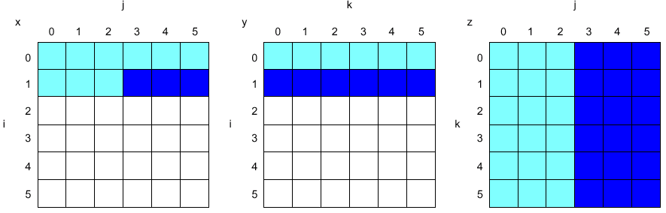
Blocking Example
/* Before */
for (i = 0; i < N; i = i+1)
for (j = 0; j < N; j = j+1) {
r = 0;
for (k = 0; k < N; k = k+1)
r = r + y[i][k] * z[k][j];
x[i][j] = r;
};
Two Inner Loops:
  Read all NxN elements of z[]
  Read N elements of 1 row of y[] repeatedly
  Write N elements of 1 row of x[]
Capacity Misses a function of N & Cache Size:
  3 × N × N × 4 bytes => no capacity misses;
Idea: compute on B × B sub-matrix that fits

Slide 35
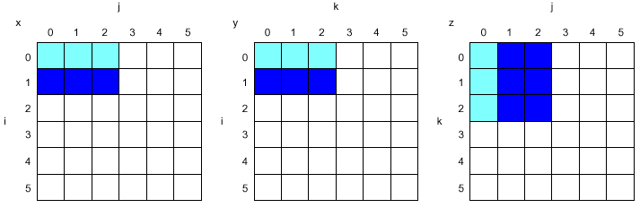
Blocking Example
/* After */
for (jj = 0; jj < N; jj = jj+B)
for (kk = 0; kk < N; kk = kk+B)
for (i = 0; i < N; i = i+1)
for (j = jj; j < min(jj+B-1,N); j = j+1) {
r = 0;
for (k = kk; k < min(kk+B-1,N); k = k+1) {
r = r + y[i][k] * z[k][j];};
x[i][j] = x[i][j] + r;
};
B called Blocking Factor
Memory words accessed
2N³ + N² → 2N³/B +N²
Conflict misses can go down too
Blocking is also useful for register allocation

Slide 36
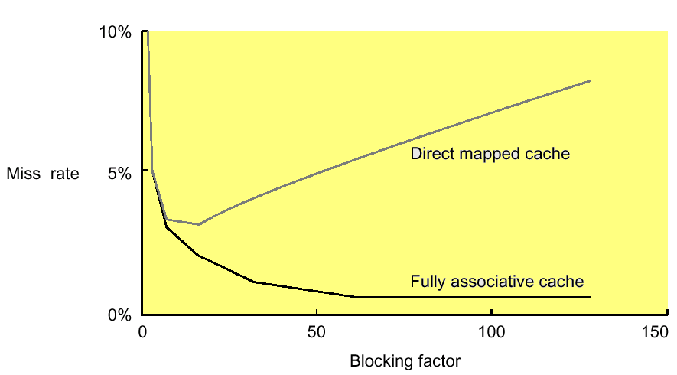
Blocking Factor
Traditionally blocking is used to reduce capacity misses relying on high associativity to tackle conflict misses
Choosing smaller blocking factor than the cache capacity can also reduce conflict misses (fewer words are active in cache)
Lam et al [1991] a blocking factor of 24 had a fifth the misses compared to a factor of 48 despite both fit in cache

Slide 37
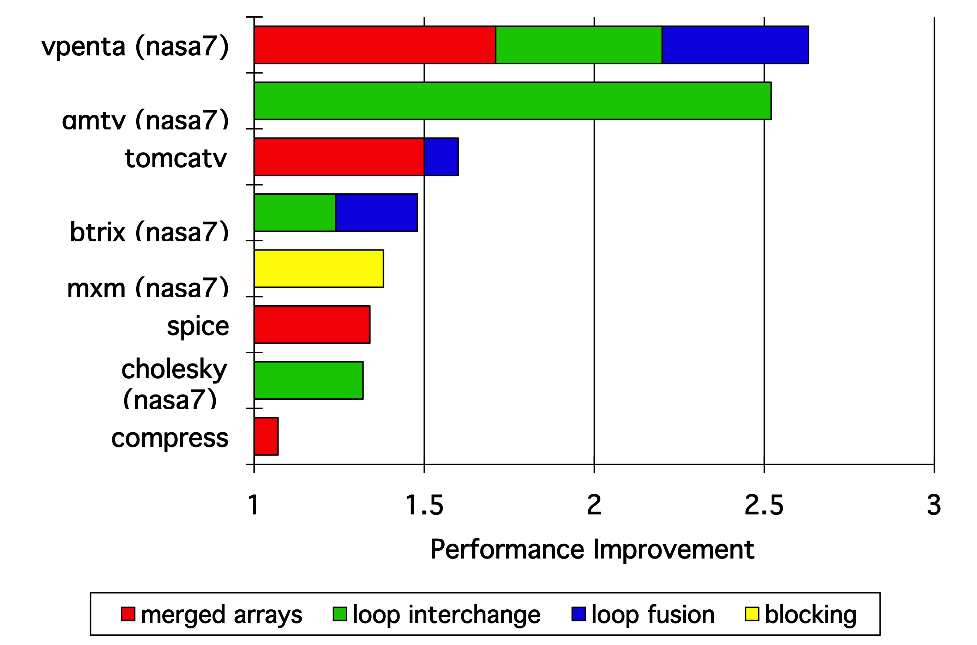
Efficiency of Compiler-Based Cache Opt.

Slide 38
Reducing Miss Penalty
Reducing miss penalty can be as effective as the reducing miss rate
With the gap between the processor and DRAM widening, the relative cost of the miss penalties increases over time
Seven techniques
  Read priority over write on miss
  Sub-block placement
  Merging write buffer
  Victim cache
  Early Restart and Critical Word First on miss
  Non-blocking Caches (Hit under Miss, Miss under Miss)
  Second Level Cache
Can be applied recursively to Multilevel Caches
  Danger is that time to DRAM will grow with multiple levels in between
  First attempts at L2 caches can make things worse, since increased worst case is worse

Slide 39
Read Priority over Write on Miss
Write through with write buffers offer RAW conflicts with main memory reads on cache misses
If simply wait for write buffer to empty, might increase read miss penalty (old MIPS 1000 by 50% )
Check write buffer contents before read; if no conflicts, let the memory access continue
Cache
Processor
DRAM
Write Buffer
Write Back?
  Read miss replacing dirty block
  Normal: Write dirty block to memory, and then do the read
  Instead copy the dirty block to a write buffer, then do the read, and then
  do the write
  CPU stall less since restarts as soon as do read

Slide 40
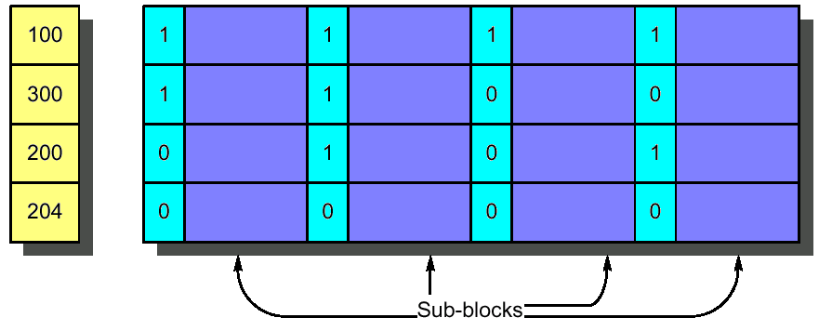
Sub-block Placement
Originally invented to reduce tag storage while avoiding the increased miss penalty caused by large block sizes
Enlarge the block size while dividing each block into smaller units (sub-blocks) and thus does not have to load full block on a miss
Include valid bits per sub-block to indicate the status of the sub-block (in cache or not)
Valid Bits

Slide 41
Early Restart and Critical Word First
Don’t wait for full block to be loaded before restarting CPU
  Early restart
    As soon as the requested word of the block arrives, send it to the CPU and let the CPU continue execution
  Critical Word First
    Request the missed word first from memory
    Also called wrapped fetch and requested word first
Complicates cache controller design
CWF generally useful only in large blocks
Given spatial locality programs tend to want next sequential word, limits benefit
block

Slide 42
Victim Cache Approach
Lower both miss rate
Reduce average miss penalty
Slightly extend the worst case miss penalty

Slide 43
Non-blocking Caches
Early restart still waits for the requested word to arrive before the CPU can continue execution
For machines that allows out-of-order execution using a scoreboard or a Tomasulo-style control the CPU should not stall on cache misses
“Non-blocking cache” or “lock-free cache” allows data cache to continue to supply cache hits during a miss
“hit under miss” reduces the effective miss penalty by working during miss vs. ignoring CPU requests
“hit under multiple miss” or “miss under miss” may further lower the effective miss penalty by overlapping multiple misses
  Significantly increases the complexity of the cache controller as there can be multiple outstanding memory accesses
  Requires multiple memory banks (otherwise cannot support)
  Pentium Pro allows 4 outstanding memory misses

Slide 44

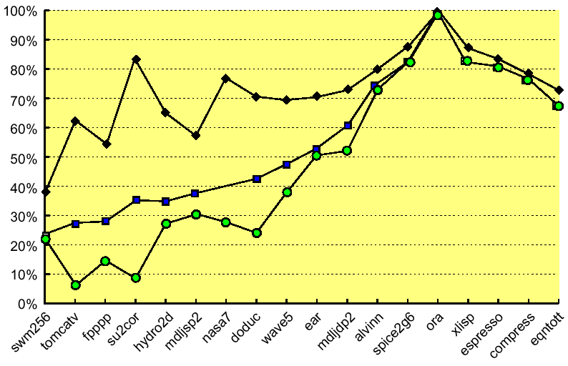
Performance of Non-blocking Caches
Ratio of the average memory stall time
Benchmark

Slide 45
Second Level Cache
The previous techniques reduce the impact of the miss penalty on the CPU
  L2 cache handles the cache-memory interface
Measuring cache performance
Local miss rate
  misses in this cache divided by the total number of memory accesses to this cache (MissRate_{L2})
Global miss rate (& biggest penalty!)
  misses in this cache divided by the total number of memory accesses generated by the CPU (MissRate_{L1} × MissRate_{L2})

Slide 46
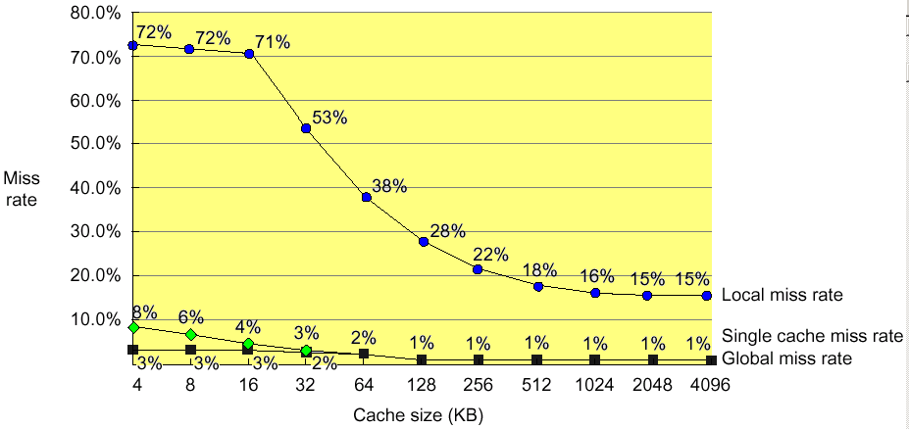
Local vs Global Misses
(Global miss rate close to single level cache rate provided L2 >> L1)

Slide 47
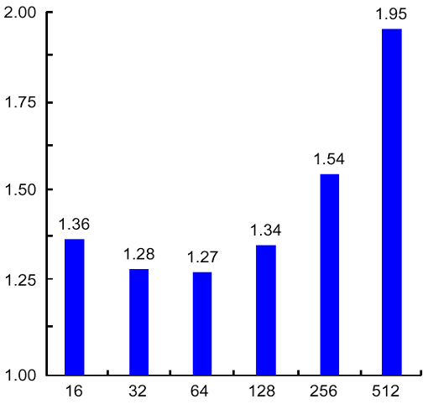
L2 Cache Parameters
32 bit bus
512KB cache
L1 cache directly affects the processor design and clock cycle: should be simple and small
Bulk of optimization techniques can go easily to L2 cache
Miss-rate reduction more practical for L2
Considering the L2 cache can improve the L1 cache design,
  e.g. use write-through if L2 cache applies write-back
Relative execution time
Block size of second-level cache (byte)

Slide 48
Reducing Hit Time
Average Access Time = Hit Time x (1 - Miss Rate) + Miss Time x Miss Rate
Hit rate is typically very high compared to miss rate
  any reduction in hit time is magnified
Hit time critical: affects processor clock rate
Three techniques to reduce hit time:
  Simple and small caches
  Avoid address translation during cache indexing
  Pipelining writes for fast write hits
Simple and small caches
Design simplicity limits control logic complexity and allows shorter clock cycles
On-chip integration decreases signal propagation delay, thus reducing hit time
  Alpha 21164 has 8KB Instruction and 8KB data cache and 96KB second level cache to reduce clock rate

