Slide 1
CMSC 611: Advanced Computer Architecture
Branch Prediction
Some material adapted from Mohamed Younis, UMBC CMSC 611 Spr 2003 course slides
Some material adapted from Hennessy & Patterson / © 2003 Elsevier Science

Slide 2
Recall Branch Penalties
CPI = (1-branch%) * non-branch CPI
+ branch% * branch CPI
CPI = (1-branch%) * 1
+ branch% * (1 + penalty)
CPI = 1 + (branch% * penalty)
penalty = not taken% * not taken cost
+ taken% * taken cost

Slide 3
Branching Dilema
Instruction Level Parallelism increases throughput
  Worse, the more advanced the method
    Deep pipeline, multiple functional units, n-issue per clock, …
Control dependence rapidly becomes the limiting factor to the amount of ILP
Compiler-based techniques can only rely on static program properties to handle control hazards
Hardware-based techniques refer to the dynamic behavior of the program to predict the outcome of a branch

Slide 4
Recall 5-stage Prediction
Assume
  20% of instructions are branches
  53% of branches are taken
Predict not taken
  CPI = 1 + 20% * (53%*1 + 47%*0) = 1.106
Predict taken
  CPI = 1 + 20% * (53%*1 + 47%*1) = 1.2
Penalty for being wrong
Penalty for being wrong
Penalty for not having the address ready in time

Slide 5
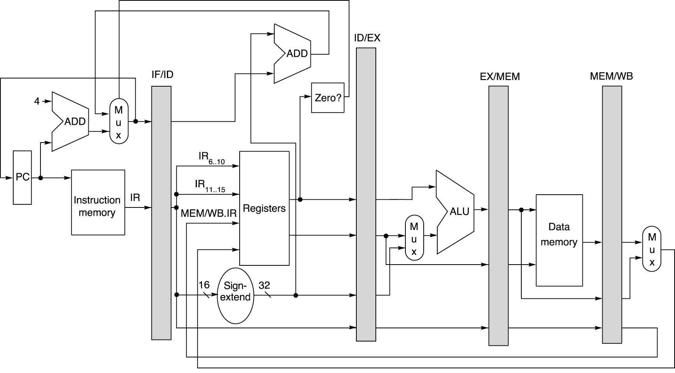
Pipelined MIPS Datapath
Figure: Dave Patterson

Slide 6
Branch Target Cache
Predict not-taken: still stalls to wait for branch target computation
If address could be guessed, the branch penalty becomes zero
Cache predicted address based on address of branch instruction
Complications for complex predictors: do we know in time?

Slide 7
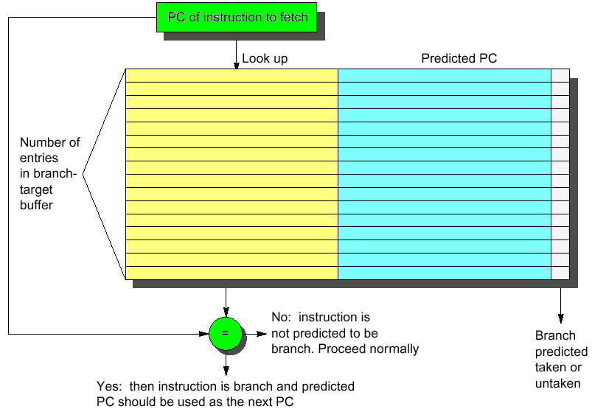
Branch Target Cache

Slide 8
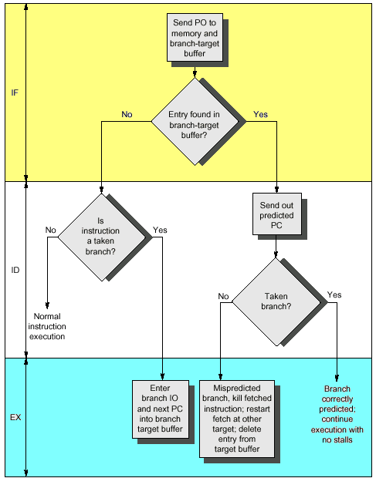
Handling Branch Target Cache
No branch delay if the a branch prediction entry is found and is correct
A penalty of two cycle is imposed for a wrong prediction or a cache miss
Cache update on misprediction and misses can extend the time penalty
Dealing with misses or misprediction is expensive and should be optimized

Slide 9
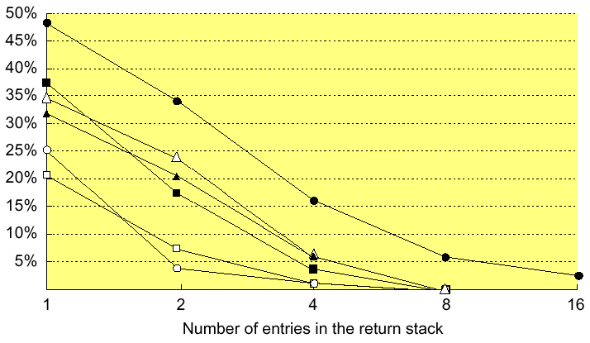

Return Address Cache
Branch target caching can be applied to expedite unconditional jumps (branch folding) and returns for procedure calls
For calls from multiple sites, not clustered in time, a stack implementation of the branch target cache can be useful
Misprediction rate

Slide 10
Basic Branch Prediction
Simplest dynamic branch-prediction scheme
  Use a branch history table to track when the branch was taken and not taken
  Branch history table is a small 1-bit buffer indexed by lower bits of PC address with the bit is set to reflect the whether or not branch taken last time
Performance = ƒ(accuracy, cost of misprediction)
Problem: in a nested loop, 1-bit branch history table will cause two mispredictions:
  End of loop case, when it exits instead of looping
  First time through loop on next time through code, when it predicts exit instead of looping

Slide 11
2-bit Branch History Table
A two-bit buffer better captures the history of the branch instruction
A prediction must miss twice to change
Taken
Taken
Taken
Predict Not Taken
Predict Not Taken
Predict Taken
Predict Taken
Not Taken
Not Taken
Not Taken

Slide 12
N-bit Predictors
Implement instead as n-bit counter
  For every entry in the prediction buffer
  Increment/decrement if branch taken/not
  If the counter value is one half of the maximum value (2n-1), predict taken
Slow to change prediction, but can
Taken
Taken
Taken
Predict Not Taken
Predict Not Taken
Predict Taken
Predict Taken
00
01
10
11
Not Taken
Not Taken
Not Taken

Slide 13
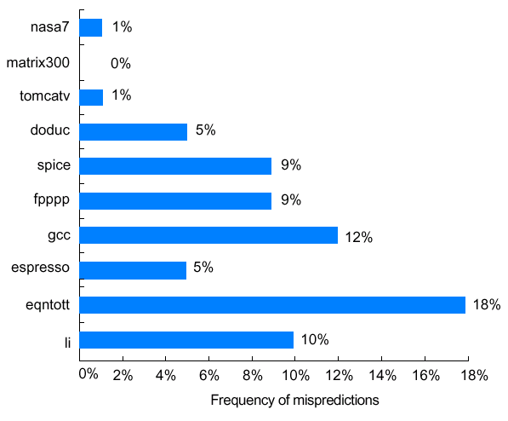
Performance of 2-bit Branch Buffer
Prediction accuracy of a 4096-entry prediction buffer ranges from 82% to 99% for the SPEC89 benchmarks
The performance impact depends on frequency of branching instructions and the penalty of misprediction
SPEC89 benchmarks

Slide 14
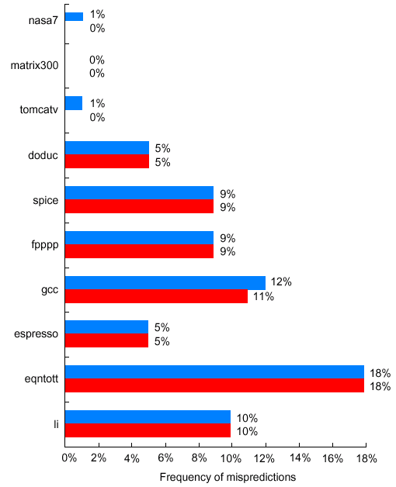
Optimal Size for 2-bit Branch Buffers
Buffer size has little impact beyond a certain size
Misprediction is because either:
  Wrong guess for that branch
  Got branch history of wrong branch (different branches with same low-bits of PC)
SPEC89 benchmarks
4096 entries (2 bits/entry)
Unlimited entries (2 bits/entry)

Slide 15
Correlating Predictors
  DSUBUI R3, R1, #2
  BNEZ R3, L1 ; branch b1 (aa!=2)
  ANDI R1, R1, #0 ; aa=0
L1: SUBUI R3, R2, #2
  BNEZ R3, L2 ; branch b2 (bb!=2)
  ANDI R2, R2, #0 ; bb=0
L2: SUBU R3, R1, R2 ; R3=aa-bb
  BEQZ R3, L3 ; branch b3 (aa==bb)
If (aa == 2)
aa = 0;
If (bb == 2)
bb = 0;
If (aa != bb) {
The behavior of branch b3 is correlated with the behavior of b1 and b2
Clearly if both branches b1 and b2 are untaken, then b3 will be taken
A predictor that uses only the behavior of a single branch to predict the outcome of that branch can never capture this behavior
Branch predictors that use the behavior of other branches to make a prediction are called correlating or two-level predictors
Hypothesis: recent branches are correlated; that is, behavior of
recently executed branches affects prediction of current branch

Slide 16
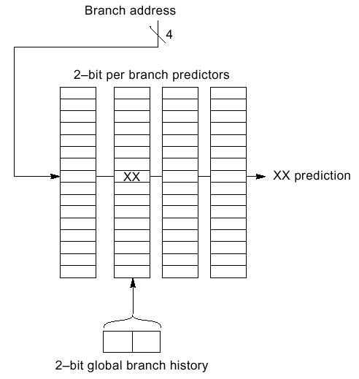
(2,2) Correlating Predictors
Record m most recently executed branches as taken or not taken, and use that pattern to select the proper branch history table
(m,n) predictor means record last m branches to select between 2^{m} history tables each with n-bit counters
  Old 2-bit branch history table is a (0,2) predictor
In a (2,2) predictor, the behavior of recent branches selects between, four predictions of next branch, updating just that prediction
Total size = 2^{m} × n × # prediction entries selected by branch address

Slide 17
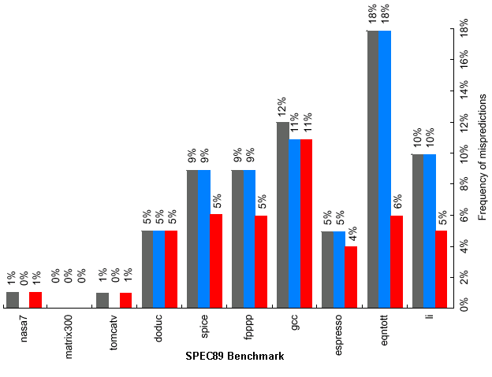
Accuracy of Different Schemes
4096 entries (2 bits/entry)
Unlimited entries (2 bits/entry)
1024 entries (2,2)

Slide 18
Example
Assume that d has values 0, 1, or 2
(alternating between 0, 2 as we enter this segment)
Assume that the sequence will be executed repeatedly
Ignore all other branches including those causing the sequence to repeat
All branches are initially predicted to untaken state
if (d==0)
d=1;
if (d==1)
….
d = 4 - 2*d;
  BNEZ R1, L1 ; branch b1 (d!=0)
  DADDI R1, R0, #1 ; d==0, sp d=1
L1: DSUBUI R3, R1, #1
  BNEZ R3, L2 ; branch b2 (d!=1)
….
L2:

Slide 19
(0-1) Predictor
Tag | Predicted PC | Pred
BNEZ R1,L1 ; b1
DADDI R1,R0,#1
L1: DSUBI R3,R1,#1
BNEZ R3,L2 ; b2
…
L2:
d | b1 |  |  | b2
 | pred | action | new | pred | action | new
2
0
2
0

Slide 20
(0-1) Predictor
Tag | Predicted PC | Pred
b1 | L1 | NT
BNEZ R1,L1 ; b1
DADDI R1,R0,#1
L1: DSUBI R3,R1,#1
BNEZ R3,L2 ; b2
…
L2:
d | b1 |  |  | b2
 | pred | action | new | pred | action | new
2 | NT
0
2
0

Slide 21
(0-1) Predictor
Tag | Predicted PC | Pred
b1 | L1 | T
BNEZ R1,L1 ; b1
DADDI R1,R0,#1
L1: DSUBI R3,R1,#1
BNEZ R3,L2 ; b2
…
L2:
d | b1 |  |  | b2
 | pred | action | new | pred | action | new
2 | NT | T | T
0
2
0

Slide 22
(0-1) Predictor
Tag | Predicted PC | Pred
b1 | L1 | T
BNEZ R1,L1 ; b1
DADDI R1,R0,#1
L1: DSUBI R3,R1,#1
BNEZ R3,L2 ; b2
…
L2:
d | b1 |  |  | b2
 | pred | action | new | pred | action | new
2 | NT | T | T
0
2
0

Slide 23
(0-1) Predictor
Tag | Predicted PC | Pred
b1 | L1 | T
b2 | L2 | T
BNEZ R1,L1 ; b1
DADDI R1,R0,#1
L1: DSUBI R3,R1,#1
BNEZ R3,L2 ; b2
…
L2:
d | b1 |  |  | b2
 | pred | action | new | pred | action | new
2 | NT | T | T | NT | T | T
0
2
0

Slide 24
(0-1) Predictor
Tag | Predicted PC | Pred
b1 | L1 | T
b2 | L2 | T
BNEZ R1,L1 ; b1
DADDI R1,R0,#1
L1: DSUBI R3,R1,#1
BNEZ R3,L2 ; b2
…
L2:
d | b1 |  |  | b2
 | pred | action | new | pred | action | new
2 | NT | T | T | NT | T | T
0 | T
2
0

Slide 25
(0-1) Predictor
Tag | Predicted PC | Pred
b1 | L1 | NT
b2 | L2 | T
BNEZ R1,L1 ; b1
DADDI R1,R0,#1
L1: DSUBI R3,R1,#1
BNEZ R3,L2 ; b2
…
L2:
d | b1 |  |  | b2
 | pred | action | new | pred | action | new
2 | NT | T | T | NT | T | T
0 | T | NT | NT
2
0

Slide 26
(0-1) Predictor
Tag | Predicted PC | Pred
b1 | L1 | NT
b2 | L2 | T
BNEZ R1,L1 ; b1
DADDI R1,R0,#1
L1: DSUBI R3,R1,#1
BNEZ R3,L2 ; b2
…
L2:
d | b1 |  |  | b2
 | pred | action | new | pred | action | new
2 | NT | T | T | NT | T | T
0 | T | NT | NT | T
2
0

Slide 27
(0-1) Predictor
Tag | Predicted PC | Pred
b1 | L1 | NT
b2 | L2 | NT
BNEZ R1,L1 ; b1
DADDI R1,R0,#1
L1: DSUBI R3,R1,#1
BNEZ R3,L2 ; b2
…
L2:
d | b1 |  |  | b2
 | pred | action | new | pred | action | new
2 | NT | T | T | NT | T | T
0 | T | NT | NT | T | NT | NT
2
0

Slide 28
(0-1) Predictor
Tag | Predicted PC | Pred
b1 | L1 | NT
b2 | L2 | NT
BNEZ R1,L1 ; b1
DADDI R1,R0,#1
L1: DSUBI R3,R1,#1
BNEZ R3,L2 ; b2
…
L2:
d | b1 |  |  | b2
 | pred | action | new | pred | action | new
2 | NT | T | T | NT | T | T
0 | T | NT | NT | T | NT | NT
2 | NT
0

Slide 29
(0-1) Predictor
Tag | Predicted PC | Pred
b1 | L1 | T
b2 | L2 | NT
BNEZ R1,L1 ; b1
DADDI R1,R0,#1
L1: DSUBI R3,R1,#1
BNEZ R3,L2 ; b2
…
L2:
d | b1 |  |  | b2
 | pred | action | new | pred | action | new
2 | NT | T | T | NT | T | T
0 | T | NT | NT | T | NT | NT
2 | NT | T | T
0

Slide 30
(0-1) Predictor
Tag | Predicted PC | Pred
b1 | L1 | T
b2 | L2 | NT
BNEZ R1,L1 ; b1
DADDI R1,R0,#1
L1: DSUBI R3,R1,#1
BNEZ R3,L2 ; b2
…
L2:
d | b1 |  |  | b2
 | pred | action | new | pred | action | new
2 | NT | T | T | NT | T | T
0 | T | NT | NT | T | NT | NT
2 | NT | T | T | NT
0

Slide 31
(0-1) Predictor
Tag | Predicted PC | Pred
b1 | L1 | T
b2 | L2 | T
BNEZ R1,L1 ; b1
DADDI R1,R0,#1
L1: DSUBI R3,R1,#1
BNEZ R3,L2 ; b2
…
L2:
d | b1 |  |  | b2
 | pred | action | new | pred | action | new
2 | NT | T | T | NT | T | T
0 | T | NT | NT | T | NT | NT
2 | NT | T | T | NT | T | T
0

Slide 32
(0-1) Predictor
Tag | Predicted PC | Pred
b1 | L1 | T
b2 | L2 | T
BNEZ R1,L1 ; b1
DADDI R1,R0,#1
L1: DSUBI R3,R1,#1
BNEZ R3,L2 ; b2
…
L2:
d | b1 |  |  | b2
 | pred | action | new | pred | action | new
2 | NT | T | T | NT | T | T
0 | T | NT | NT | T | NT | NT
2 | NT | T | T | NT | T | T
0 | T

Slide 33
(0-1) Predictor
Tag | Predicted PC | Pred
b1 | L1 | NT
b2 | L2 | T
BNEZ R1,L1 ; b1
DADDI R1,R0,#1
L1: DSUBI R3,R1,#1
BNEZ R3,L2 ; b2
…
L2:
d | b1 |  |  | b2
 | pred | action | new | pred | action | new
2 | NT | T | T | NT | T | T
0 | T | NT | NT | T | NT | NT
2 | NT | T | T | NT | T | T
0 | T | NT | NT

Slide 34
(0-1) Predictor
Tag | Predicted PC | Pred
b1 | L1 | NT
b2 | L2 | T
BNEZ R1,L1 ; b1
DADDI R1,R0,#1
L1: DSUBI R3,R1,#1
BNEZ R3,L2 ; b2
…
L2:
d | b1 |  |  | b2
 | pred | action | new | pred | action | new
2 | NT | T | T | NT | T | T
0 | T | NT | NT | T | NT | NT
2 | NT | T | T | NT | T | T
0 | T | NT | NT | T

Slide 35
(0-1) Predictor
Tag | Predicted PC | Pred
b1 | L1 | NT
b2 | L2 | NT
BNEZ R1,L1 ; b1
DADDI R1,R0,#1
L1: DSUBI R3,R1,#1
BNEZ R3,L2 ; b2
…
L2:
d | b1 |  |  | b2
 | pred | action | new | pred | action | new
2 | NT | T | T | NT | T | T
0 | T | NT | NT | T | NT | NT
2 | NT | T | T | NT | T | T
0 | T | NT | NT | T | NT | NT

Slide 36
(0-1) Predictor
Wrong 100% of the time!
d | b1 |  |  | b2
 | pred | action | new | pred | action | new
2 | NT | T | T | NT | T | T
0 | T | NT | NT | T | NT | NT
2 | NT | T | T | NT | T | T
0 | T | NT | NT | T | NT | NT

Slide 37
(1-1) Predictor
Tag | Predicted PC | History
 |  | NT | T
BNEZ R1,L1 ; b1
DADDI R1,R0,#1
L1: DSUBI R3,R1,#1
BNEZ R3,L2 ; b2
…
L2:
d | b1 |  |  |  | b2
 | prev | pred | action | new | prev | pred | action | new
2
0
2
0

Slide 38
(1-1) Predictor
Tag | Predicted PC | History
 |  | NT | T
b1 | L1 | NT | NT
BNEZ R1,L1 ; b1
DADDI R1,R0,#1
L1: DSUBI R3,R1,#1
BNEZ R3,L2 ; b2
…
L2:
d | b1 |  |  |  | b2
 | prev | pred | action | new | prev | pred | action | new
2 | NT | NT
0
2
0

Slide 39
(1-1) Predictor
Tag | Predicted PC | History
 |  | NT | T
b1 | L1 | T | NT
BNEZ R1,L1 ; b1
DADDI R1,R0,#1
L1: DSUBI R3,R1,#1
BNEZ R3,L2 ; b2
…
L2:
d | b1 |  |  |  | b2
 | prev | pred | action | new | prev | pred | action | new
2 | NT | NT | T | T
0
2
0

Slide 40
(1-1) Predictor
Tag | Predicted PC | History
 |  | NT | T
b1 | L1 | T | NT
BNEZ R1,L1 ; b1
DADDI R1,R0,#1
L1: DSUBI R3,R1,#1
BNEZ R3,L2 ; b2
…
L2:
d | b1 |  |  |  | b2
 | prev | pred | action | new | prev | pred | action | new
2 | NT | NT | T | T
0
2
0

Slide 41
(1-1) Predictor
Tag | Predicted PC | History
 |  | NT | T
b1 | L1 | T | NT
b2 | L2 | NT | NT
BNEZ R1,L1 ; b1
DADDI R1,R0,#1
L1: DSUBI R3,R1,#1
BNEZ R3,L2 ; b2
…
L2:
d | b1 |  |  |  | b2
 | prev | pred | action | new | prev | pred | action | new
2 | NT | NT | T | T | T | NT
0
2
0

Slide 42
(1-1) Predictor
Tag | Predicted PC | History
 |  | NT | T
b1 | L1 | T | NT
b2 | L2 | NT | T
BNEZ R1,L1 ; b1
DADDI R1,R0,#1
L1: DSUBI R3,R1,#1
BNEZ R3,L2 ; b2
…
L2:
d | b1 |  |  |  | b2
 | prev | pred | action | new | prev | pred | action | new
2 | NT | NT | T | T | T | NT | T | T
0
2
0

Slide 43
(1-1) Predictor
Tag | Predicted PC | History
 |  | NT | T
b1 | L1 | T | NT
b2 | L2 | NT | T
BNEZ R1,L1 ; b1
DADDI R1,R0,#1
L1: DSUBI R3,R1,#1
BNEZ R3,L2 ; b2
…
L2:
d | b1 |  |  |  | b2
 | prev | pred | action | new | prev | pred | action | new
2 | NT | NT | T | T | T | NT | T | T
0 | T | NT
2
0

Slide 44
(1-1) Predictor
Tag | Predicted PC | History
 |  | NT | T
b1 | L1 | T | NT
b2 | L2 | NT | T
BNEZ R1,L1 ; b1
DADDI R1,R0,#1
L1: DSUBI R3,R1,#1
BNEZ R3,L2 ; b2
…
L2:
d | b1 |  |  |  | b2
 | prev | pred | action | new | prev | pred | action | new
2 | NT | NT | T | T | T | NT | T | T
0 | T | NT | NT | NT
2
0

Slide 45
(1-1) Predictor
Tag | Predicted PC | History
 |  | NT | T
b1 | L1 | T | NT
b2 | L2 | NT | T
BNEZ R1,L1 ; b1
DADDI R1,R0,#1
L1: DSUBI R3,R1,#1
BNEZ R3,L2 ; b2
…
L2:
d | b1 |  |  |  | b2
 | prev | pred | action | new | prev | pred | action | new
2 | NT | NT | T | T | T | NT | T | T
0 | T | NT | NT | NT | NT | NT
2
0

Slide 46
(1-1) Predictor
Tag | Predicted PC | History
 |  | NT | T
b1 | L1 | T | NT
b2 | L2 | NT | T
BNEZ R1,L1 ; b1
DADDI R1,R0,#1
L1: DSUBI R3,R1,#1
BNEZ R3,L2 ; b2
…
L2:
d | b1 |  |  |  | b2
 | prev | pred | action | new | prev | pred | action | new
2 | NT | NT | T | T | T | NT | T | T
0 | T | NT | NT | NT | NT | NT | NT | NT
2
0

Slide 47
(1-1) Predictor
Tag | Predicted PC | History
 |  | NT | T
b1 | L1 | T | NT
b2 | L2 | NT | T
BNEZ R1,L1 ; b1
DADDI R1,R0,#1
L1: DSUBI R3,R1,#1
BNEZ R3,L2 ; b2
…
L2:
d | b1 |  |  |  | b2
 | prev | pred | action | new | prev | pred | action | new
2 | NT | NT | T | T | T | NT | T | T
0 | T | NT | NT | NT | NT | NT | NT | NT
2 | NT | T
0

Slide 48
(1-1) Predictor
Tag | Predicted PC | History
 |  | NT | T
b1 | L1 | T | NT
b2 | L2 | NT | T
BNEZ R1,L1 ; b1
DADDI R1,R0,#1
L1: DSUBI R3,R1,#1
BNEZ R3,L2 ; b2
…
L2:
d | b1 |  |  |  | b2
 | prev | pred | action | new | prev | pred | action | new
2 | NT | NT | T | T | T | NT | T | T
0 | T | NT | NT | NT | NT | NT | NT | NT
2 | NT | T | T | T
0

Slide 49
(1-1) Predictor
Tag | Predicted PC | History
 |  | NT | T
b1 | L1 | T | NT
b2 | L2 | NT | T
BNEZ R1,L1 ; b1
DADDI R1,R0,#1
L1: DSUBI R3,R1,#1
BNEZ R3,L2 ; b2
…
L2:
d | b1 |  |  |  | b2
 | prev | pred | action | new | prev | pred | action | new
2 | NT | NT | T | T | T | NT | T | T
0 | T | NT | NT | NT | NT | NT | NT | NT
2 | NT | T | T | T | T | T
0

Slide 50
(1-1) Predictor
Tag | Predicted PC | History
 |  | NT | T
b1 | L1 | T | NT
b2 | L2 | NT | T
BNEZ R1,L1 ; b1
DADDI R1,R0,#1
L1: DSUBI R3,R1,#1
BNEZ R3,L2 ; b2
…
L2:
d | b1 |  |  |  | b2
 | prev | pred | action | new | prev | pred | action | new
2 | NT | NT | T | T | T | NT | T | T
0 | T | NT | NT | NT | NT | NT | NT | NT
2 | NT | T | T | T | T | T | T | T
0

Slide 51
(1-1) Predictor
Tag | Predicted PC | History
 |  | NT | T
b1 | L1 | T | NT
b2 | L2 | NT | T
BNEZ R1,L1 ; b1
DADDI R1,R0,#1
L1: DSUBI R3,R1,#1
BNEZ R3,L2 ; b2
…
L2:
d | b1 |  |  |  | b2
 | prev | pred | action | new | prev | pred | action | new
2 | NT | NT | T | T | T | NT | T | T
0 | T | NT | NT | NT | NT | NT | NT | NT
2 | NT | T | T | T | T | T | T | T
0 | T | NT

Slide 52
(1-1) Predictor
Tag | Predicted PC | History
 |  | NT | T
b1 | L1 | T | NT
b2 | L2 | NT | T
BNEZ R1,L1 ; b1
DADDI R1,R0,#1
L1: DSUBI R3,R1,#1
BNEZ R3,L2 ; b2
…
L2:
d | b1 |  |  |  | b2
 | prev | pred | action | new | prev | pred | action | new
2 | NT | NT | T | T | T | NT | T | T
0 | T | NT | NT | NT | NT | NT | NT | NT
2 | NT | T | T | T | T | T | T | T
0 | T | NT | NT | NT

Slide 53
(1-1) Predictor
Tag | Predicted PC | History
 |  | NT | T
b1 | L1 | T | NT
b2 | L2 | NT | T
BNEZ R1,L1 ; b1
DADDI R1,R0,#1
L1: DSUBI R3,R1,#1
BNEZ R3,L2 ; b2
…
L2:
d | b1 |  |  |  | b2
 | prev | pred | action | new | prev | pred | action | new
2 | NT | NT | T | T | T | NT | T | T
0 | T | NT | NT | NT | NT | NT | NT | NT
2 | NT | T | T | T | T | T | T | T
0 | T | NT | NT | NT | NT | NT

Slide 54
(1-1) Predictor
Tag | Predicted PC | History
 |  | NT | T
b1 | L1 | T | NT
b2 | L2 | NT | T
BNEZ R1,L1 ; b1
DADDI R1,R0,#1
L1: DSUBI R3,R1,#1
BNEZ R3,L2 ; b2
…
L2:
d | b1 |  |  |  | b2
 | prev | pred | action | new | prev | pred | action | new
2 | NT | NT | T | T | T | NT | T | T
0 | T | NT | NT | NT | NT | NT | NT | NT
2 | NT | T | T | T | T | T | T | T
0 | T | NT | NT | NT | NT | NT | NT | NT

Slide 55
(1-1) Predictor
No mispredictions after first iteration
d | b1 |  |  |  | b2
 | prev | pred | action | new | prev | pred | action | new
2 | NT | NT | T | T | T | NT | T | T
0 | T | NT | NT | NT | NT | NT | NT | NT
2 | NT | T | T | T | T | T | T | T
0 | T | NT | NT | NT | NT | NT | NT | NT

Slide 56
Loop Predictor
Add iteration counters
First time through
  Always predict taken
    Assume it’ll loop again
  Remember actual loop count
Subsequent predictions
  Taken N times, Not Taken once
  Taken N times, Not Taken once
  Taken N times, Not Taken once
  …

Slide 57
Loop Predictor
State
  Previous count (initialize to 0xFFFF)
  Current count (initialize to 0)
Prediction:
  If (current < previous) predict Taken (loop)
  Else predict Not Taken (end of loop)
Update
  If (actually Taken) current++ (another loop)
  Else previous = current (remember count)

Slide 58
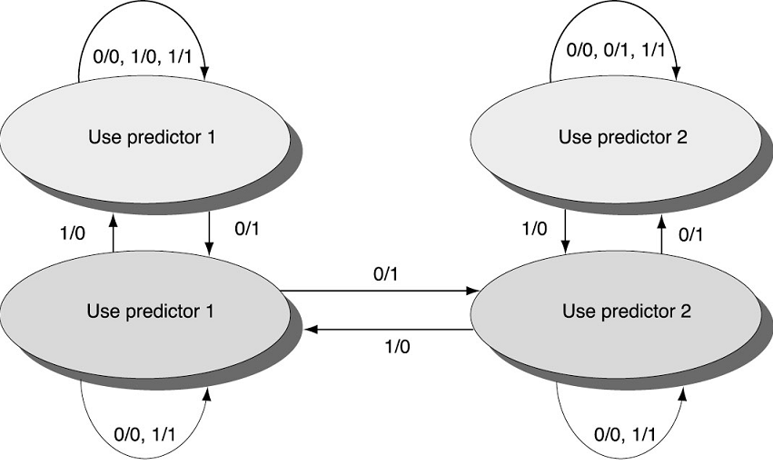
Tournament Predictors
Multilevel branch predictors use several levels of branch prediction tables together with an algorithm to choose among them
Tournament selectors are the most popular form of multilevel branch predictors
Tournament between local and global predictor:
  2-bit counter to select
  predictor
  Transition if one predictor
  is WRONG and other
  predictor is RIGHT
  Change after two
  mispredictions the other
  predictor would have
  predicted correctly
Predictor_1/Predictor_2

Slide 59
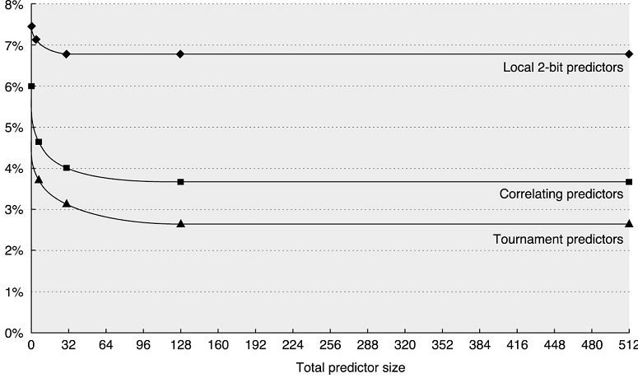
Performance of Tournament Predictors
Based on SPEC 89 benchmark
Conditional branch misprediction rate
Tournament predictors slightly outperform correlating predictors

