Slide 1
Cloud Shader Walkthrough

Slide 2
The goals of this lecture are to
  Show how to use Material Custom nodes to write shader code
  Show how to add code to the engine shader files to augment what is available for use in a Custom node
  Demonstrate volume ray marching
By the end of this lecture you will be able to
  Create a Material
  Add shader code to a Material using a Custom node
  Create inputs to a Custom node to connect to results from an existing Material node or node network
  Add functions to the engine shader files to be used in a Custom node
  Create a volume ray marching shader

Slide 3
Shaders in UE5

Slide 4
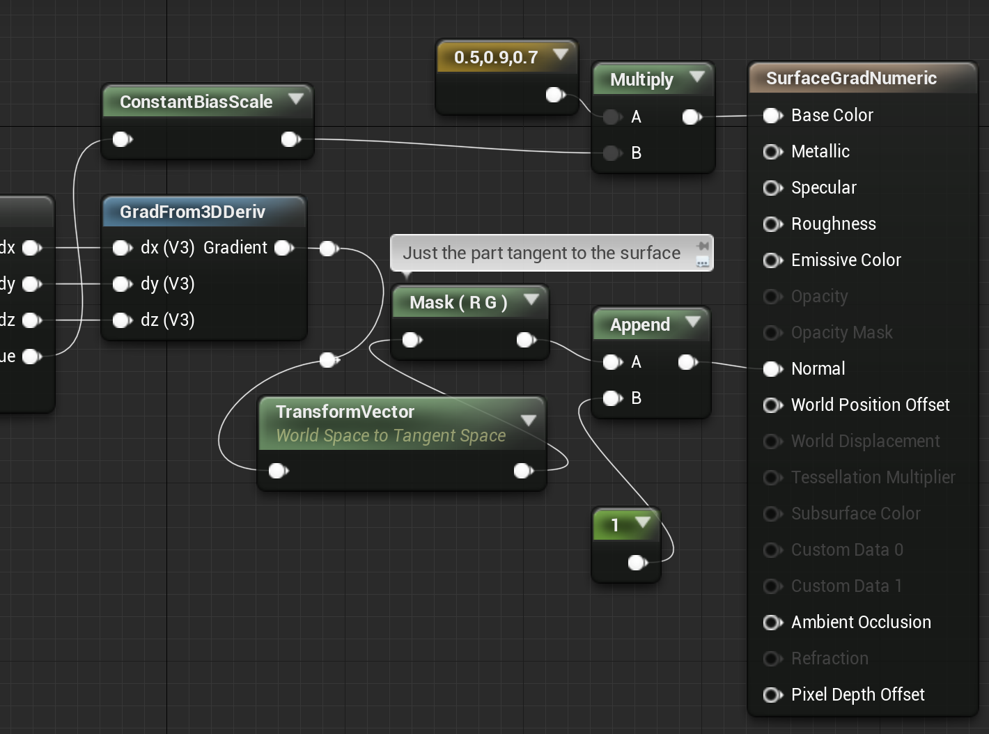
UE5 Materials
Vertex Shader
  Anything connected to World Position Offset or World Displacement.
  Anything attached to the input of a VertexInterpolator node.
Pixel Shader
  Everything else goes into the G-buffers during the base pass.

Slide 5
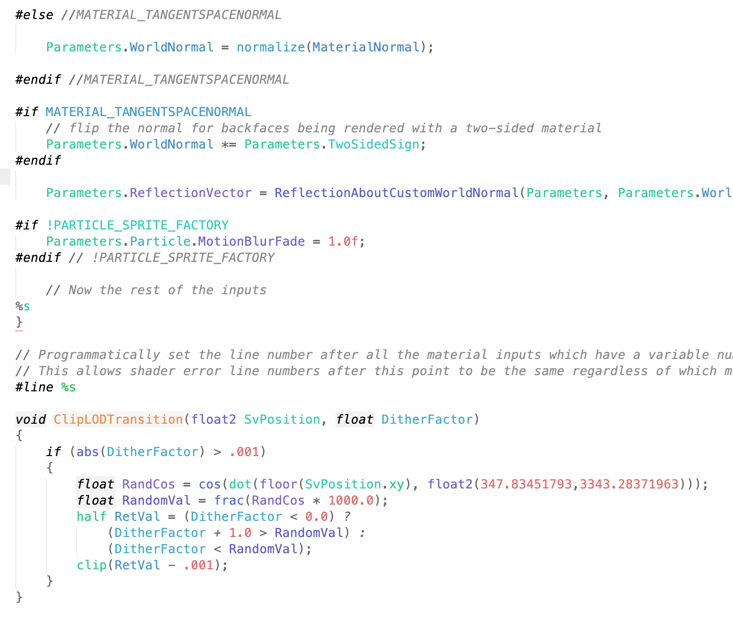
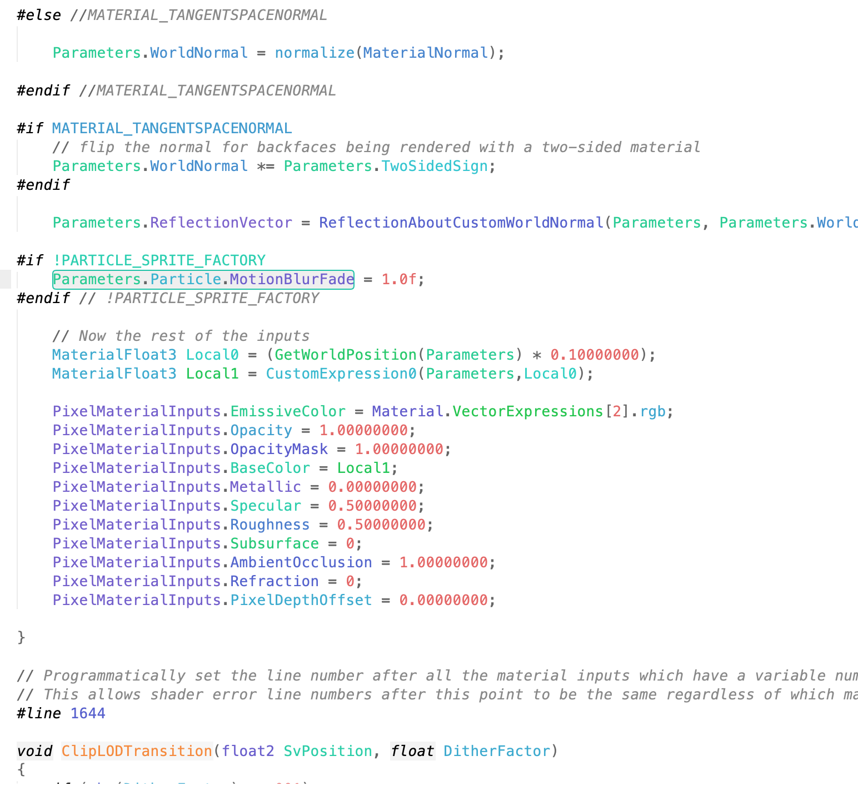
Shader Internals
Engine shader files live in Engine/Shaders.
  .ush files = Shader code header files.
  .usf files = Files containing shader code for a pass.
MaterialTemplate.ush is the boilerplate template for all Materials.
  %s = Where boilerplate code pieces will go.
  Material Editor > Window > Shader Code > HLSL Code = Where you can see the template filled in.

Slide 6
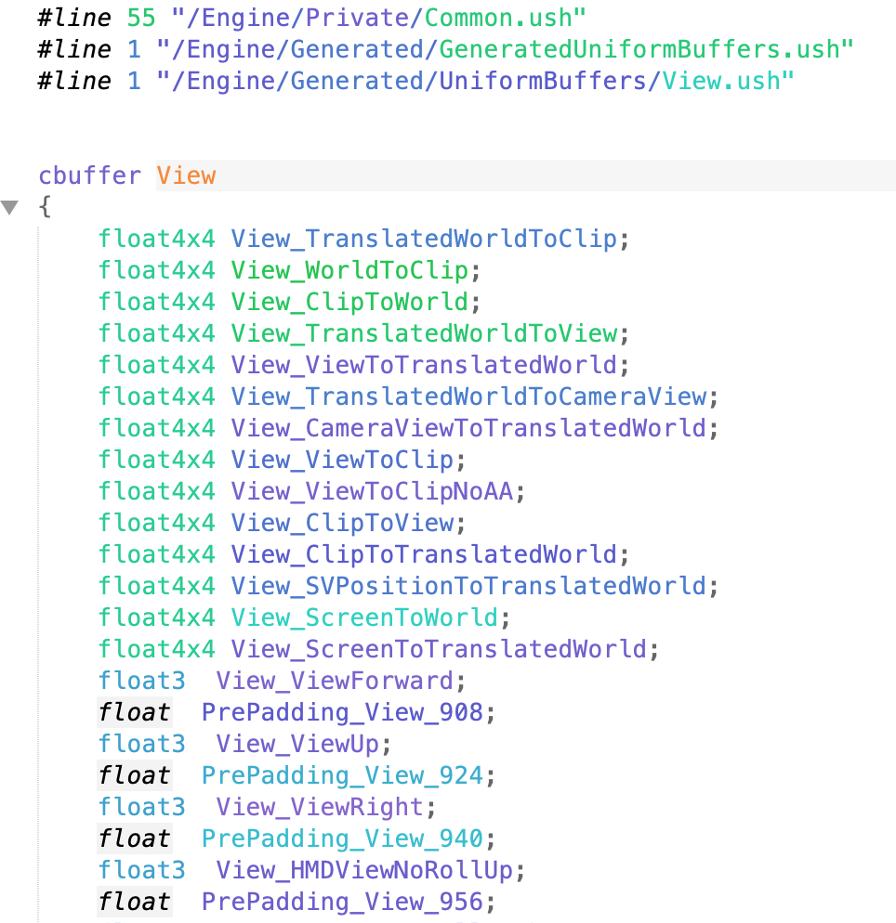
Deep Shader Details
The HLSL Code results still have all of the preprocessor commands, including references to generated #includes that define data sent between the engine and shaders. To see those, you need to dump the final shader after preprocessing.
Set the r.DumpShaderDebugInfo console variable to 1 (back-quote to bring up the console, then type “r.DumpShaderDebugInfo 1”).
Force the shader to recompile.
  Can even just move a node in the Material Editor and then click “Apply”.
  Set r.DumpShaderDebugInfo back to 0 to avoid filling up your disk with shader files.
In your project, look in Saved/ShaderDebugInfo for any of the TBasePassPS files.

Slide 7
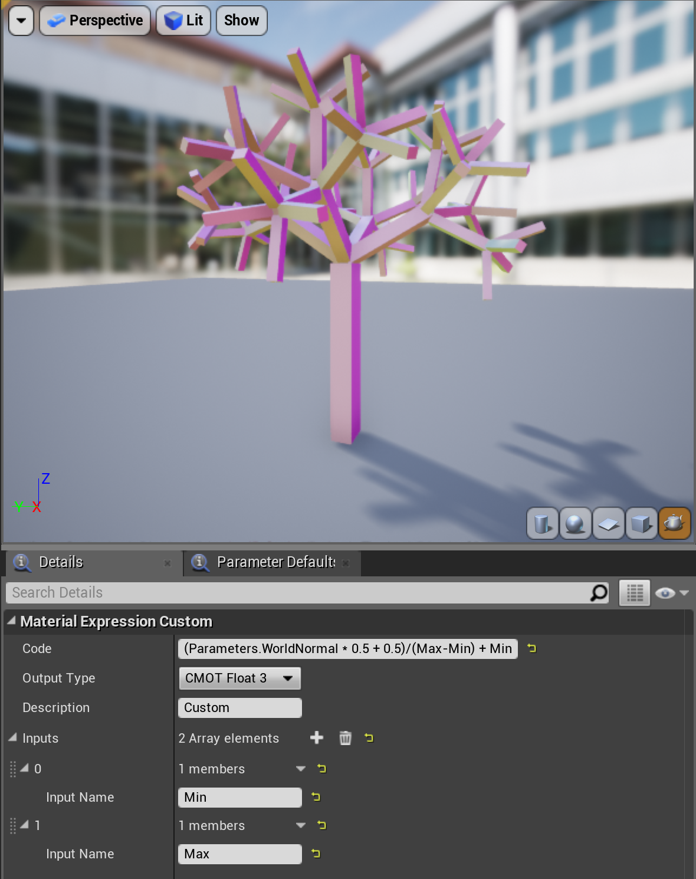
Simple Custom Node
The easiest way to write your own shader code is to create a Custom node in the Material Editor.
In its simplest form, this is a single-line expression computing a result (equivalent to what Cook’s shade trees did).
Additional named input pins are available as variables.
A Custom node also has access to anything in the Parameters, Primitive, and View structs.
  Some data, however, is not generated unless used by a regular Material system node (e.g., Parameters.TexCoord).
  Dig into dumped shader code from DumpShaderDebugInfo to see what’s there.

Slide 8
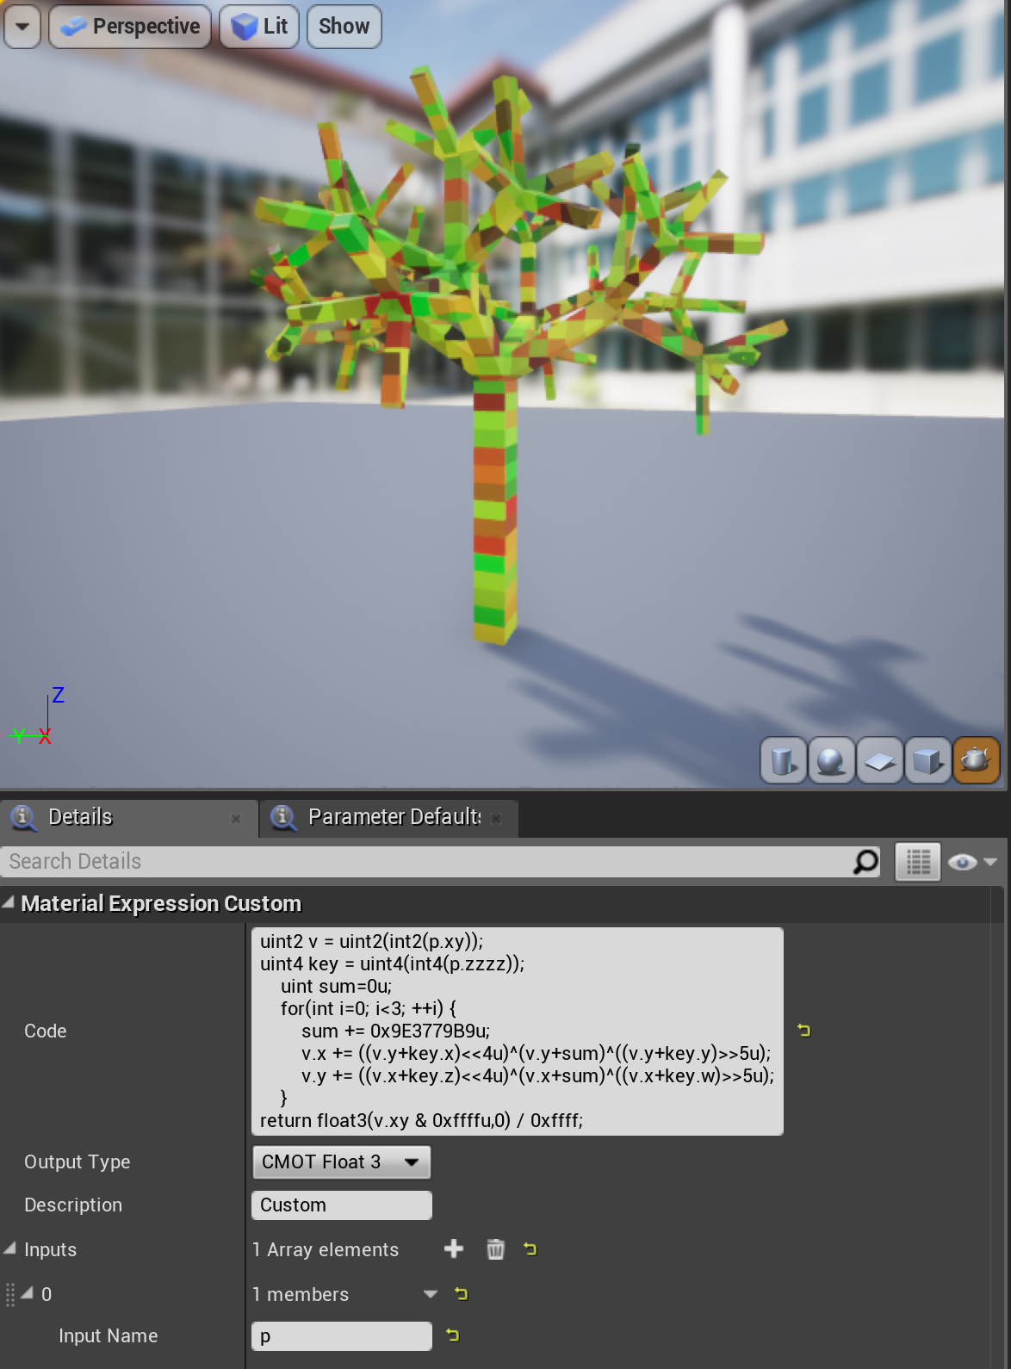
Complex Custom Node
For more complex code, the Custom node can contain a function body ending in a return statement.
The Custom node box is not great for editing, so cut and paste between there and a regular editor.
Can include an external ush that declares one or more functions, and call them from the Custom node. View and Primitive structs are global, so directly accessible, but Parameters needs to be passed into these functions to access.
Virtual include paths: /Engine is expanded to Engine/Shaders, /Plugin/PluginName is expanded to the Shader directory for that plugin.
AddShaderSourceDirectoryMapping() can add more virtual paths. Common to add /Project or /Game mapping in a C++ game’s startup code.

Slide 9
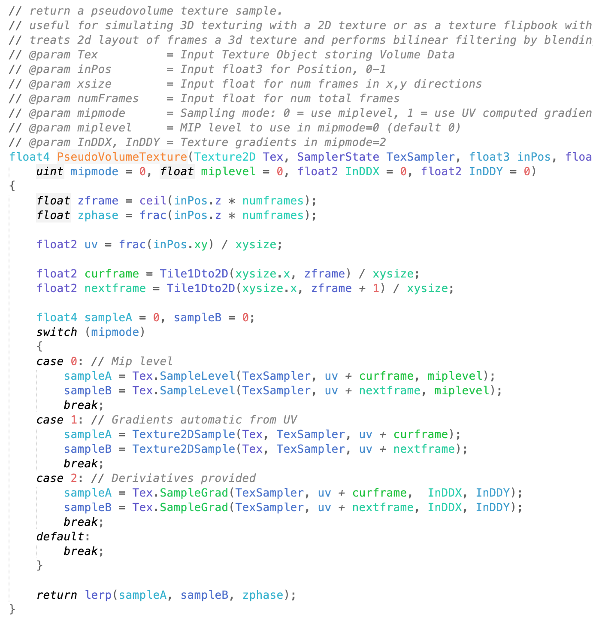
Adding Shader Functions
If there’s some complex code you want to call from many Custom nodes, it’s easy to add it to the engine. Just add a new function to MaterialTemplate.ush or one of the files it includes (e.g., Common.ush).
Custom nodes that use the new function will only work with your modified engine.
Set r.ShaderDevelopmentMode to 1 for messages on shader errors and the chance to fix and recompile.
The RecompileShaders console command will detect which shaders need to be recompiled, but for these files that’ll be all of them. If you can work primarily in the Material Editor, you can just recompile the one Material you are using for testing.

Slide 10
Setting Up the Project

Slide 11
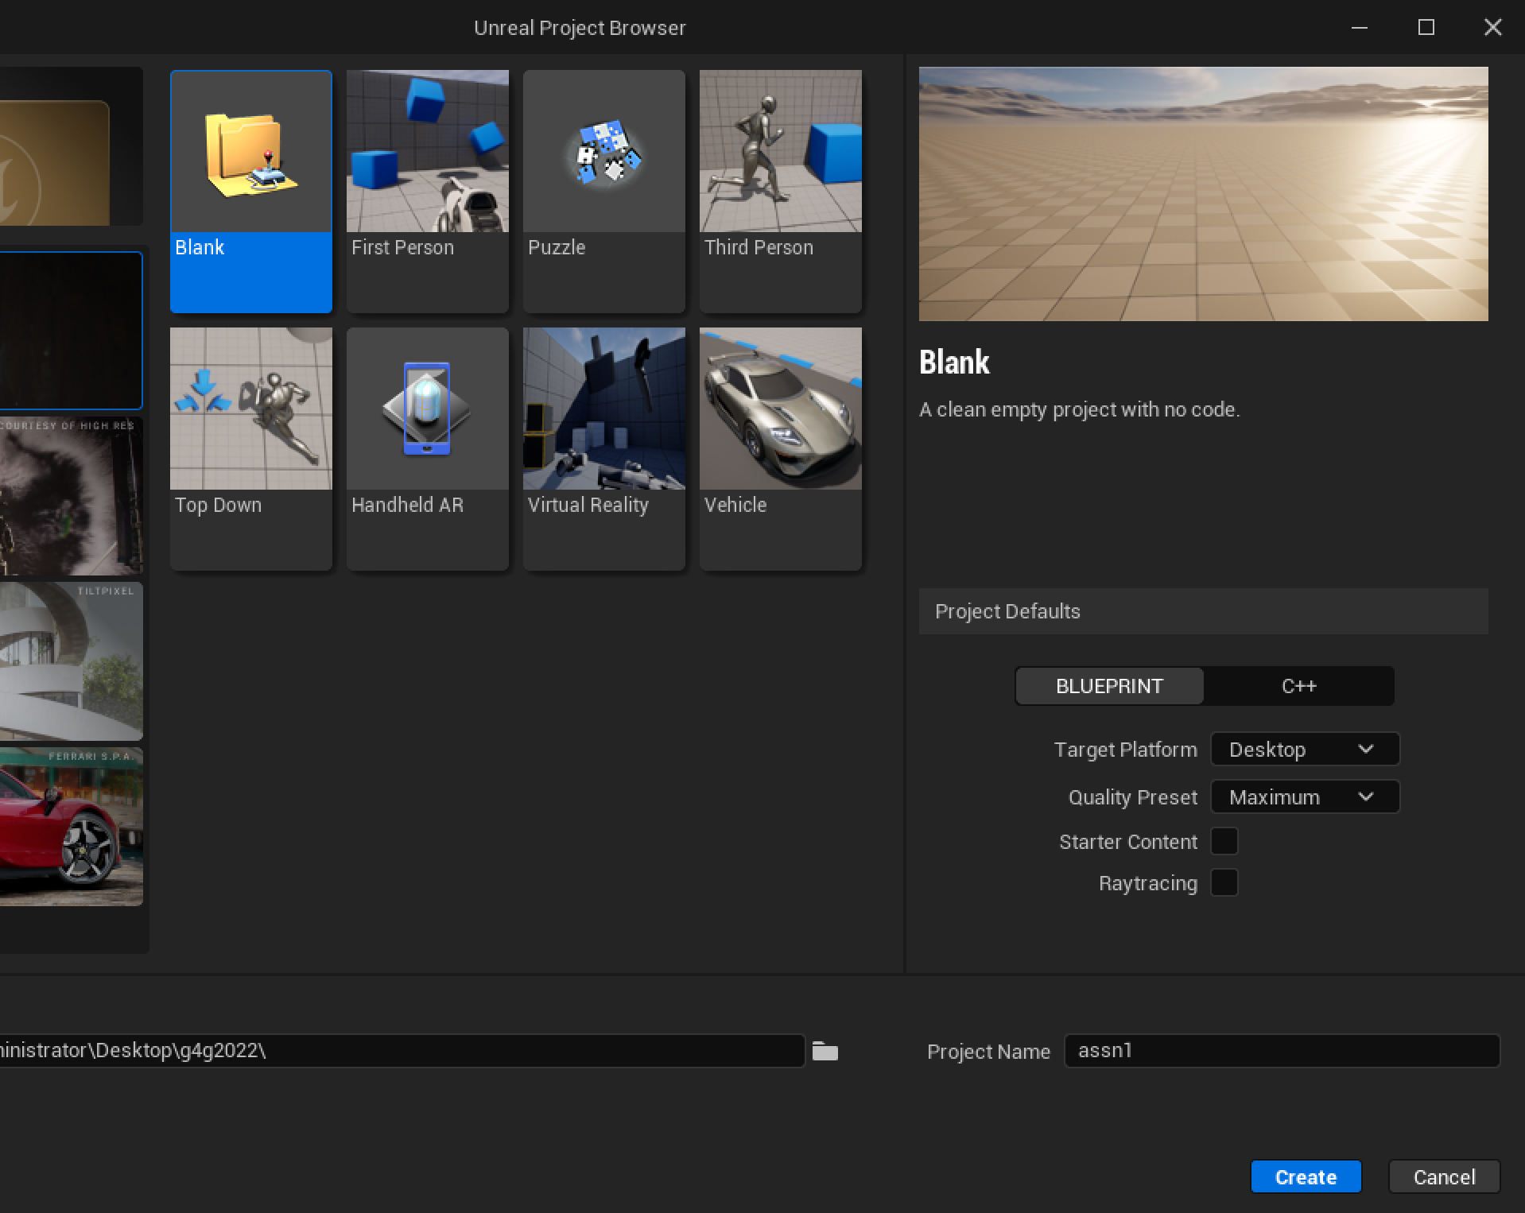
Create a Project
Launch your home-built UE5, choose the “Games” project category.
Use the Blank template, to create a C++ project with No Starter Content.
Set the folder where your project will be created to the base folder for your engine source (the directory containing the Setup and GenerateProjectFiles scripts).

Slide 12
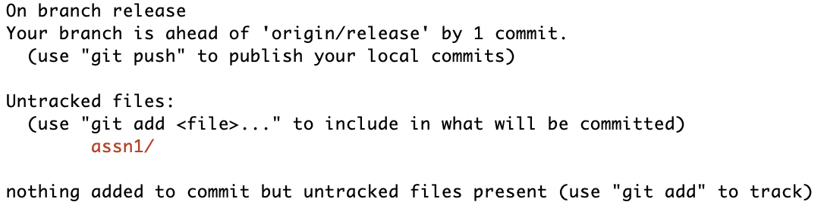
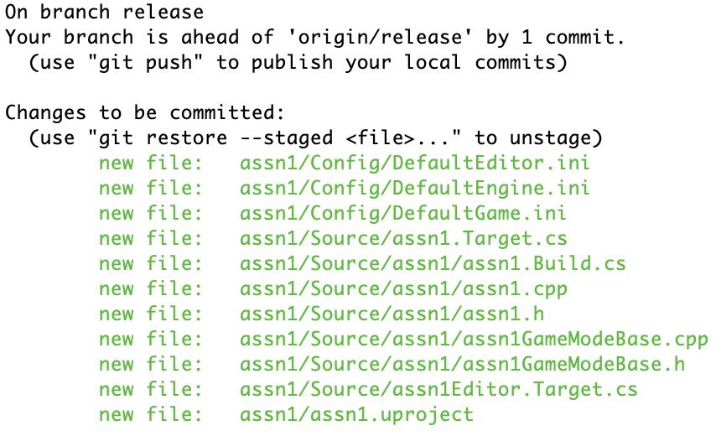
git status
First Commit
Once the project is created and launched, quit it and commit it to your local Git repository.
git add assn1
git status
git commit –m "created cloud project"

Slide 13
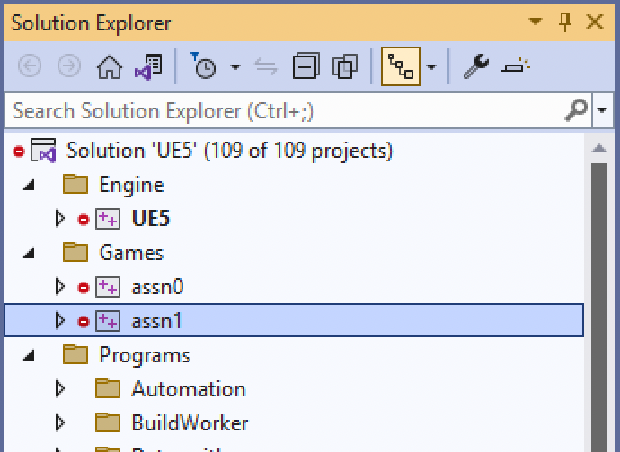
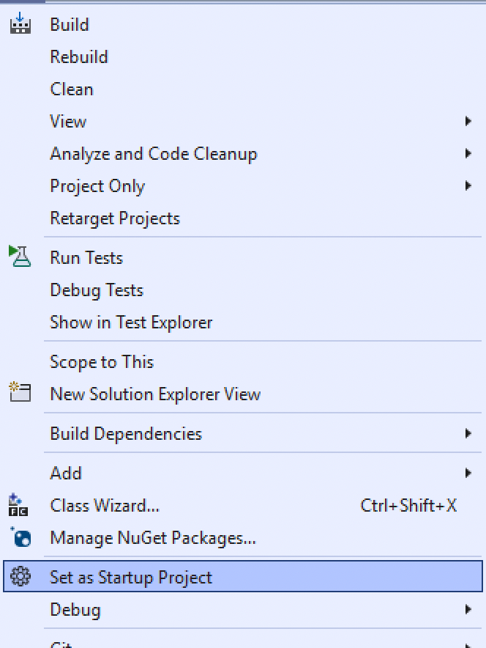
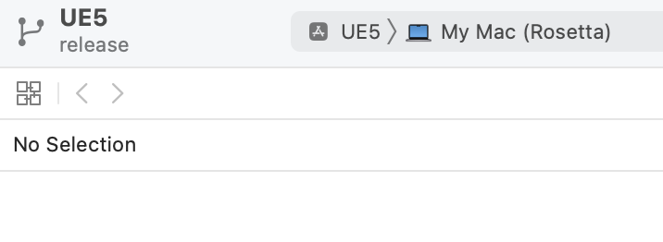
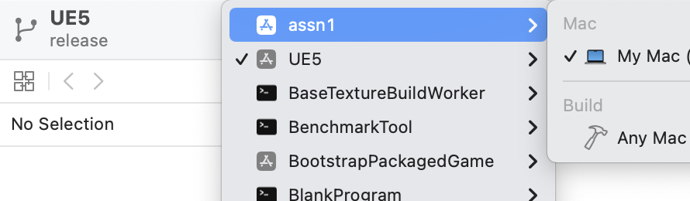
Run from your IDE
Creating the project runs GenerateProjectFiles for you.
If you do not see the project listed, you mayneed to quit and re-open Visual Studio or Xcode.
In Visual Studio, right click on the project to Select as Startup Project.
In Xcode, choose the project from the drop-down list.
Run (using the Play button). It’ll launch directly into the project.
For most changes made inside UE5, it will re-run GenerateProjectFiles for you if necessary. If you later add or remove files or make build configuration changes outside of UE5, you will have to run GenerateProjectFiles manually.

Slide 14
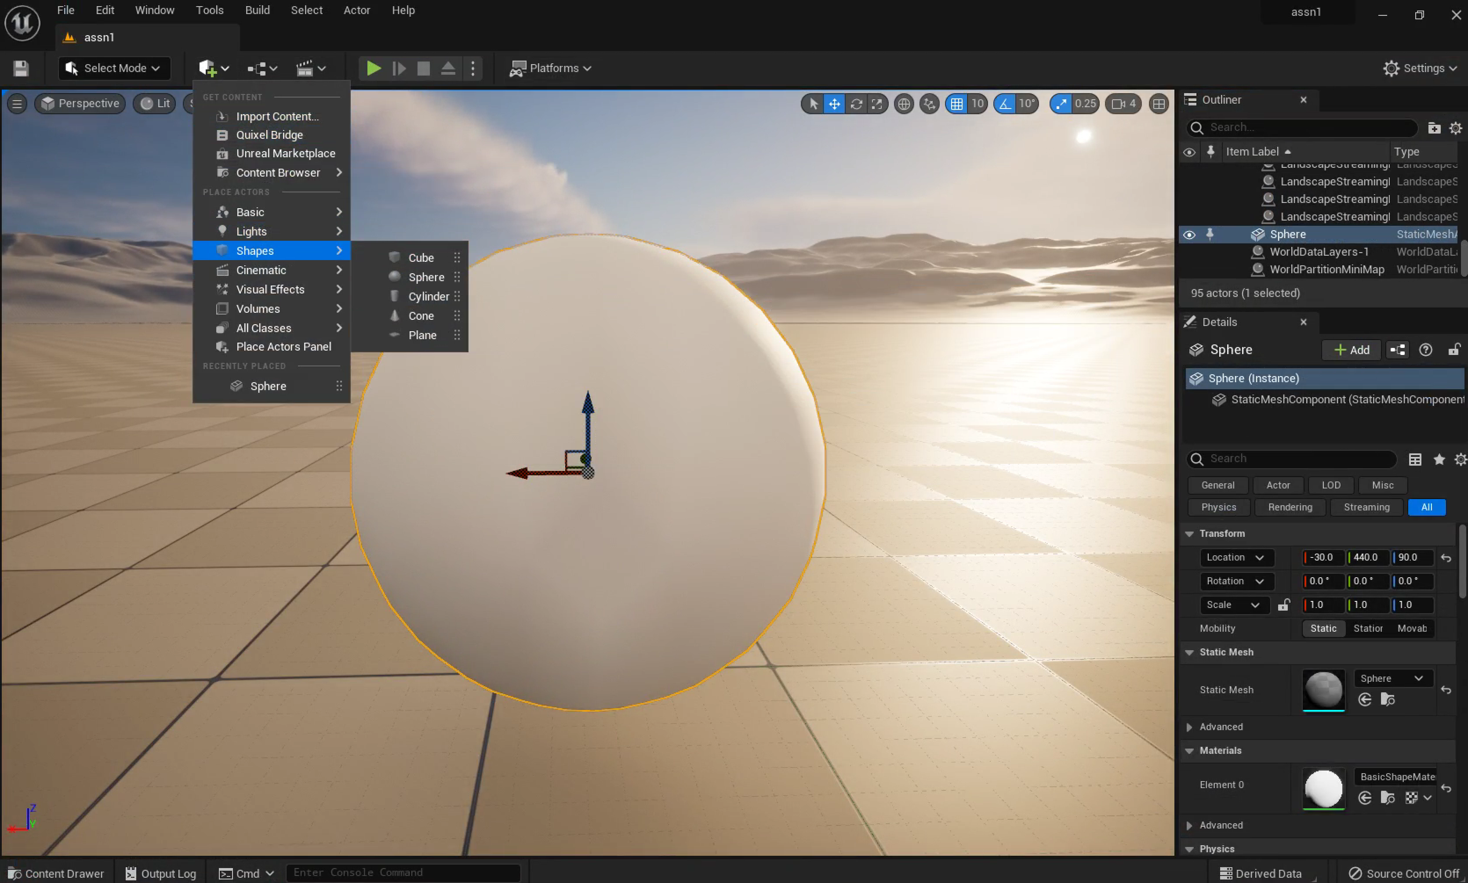
Set Up a Scene
Add a new sphere shape into the scene and position it above the ground plane.
Save the current Level (you’ll have to name it), then set it as the Editor Startup Map in Settings > Project Settings ...
Add and commit the project Content directory and DefaultEngine.ini files to Git. This will add the .umap and .uasset files for the new Level.
It is reasonable to commit at each major step along the way. You don’t need to quit the Editor, but be sure to “Save All” before each commit to make sure you are not missing unsaved work.
UE5 has Git support for asset changes like this, but the support doesn’t apply to the source changes we’ll make later, so better to get used to using Git directly.

Slide 15
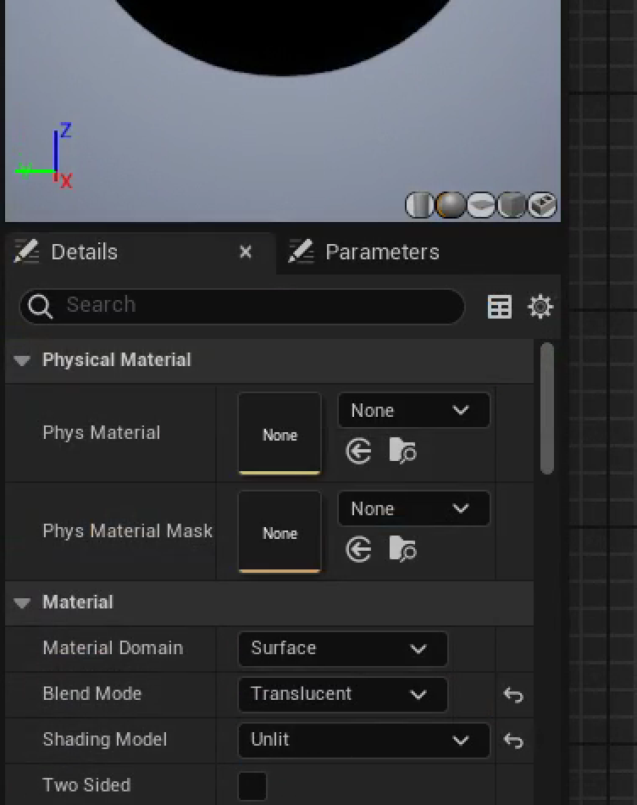
New Material
Create a new Material on the sphere, open it in the Material Editor, and change it to “Translucent” and “Unlit”.
We will ultimately include some lighting calculation, but the shader will do it, so we don’t want UE5 to add its own surface lighting on top of that.
The Emissive Color input is not affected by scene lighting, and we can use the Opacity input to make the cloud transparent.

Slide 16
Computing Cloud Density

Slide 17
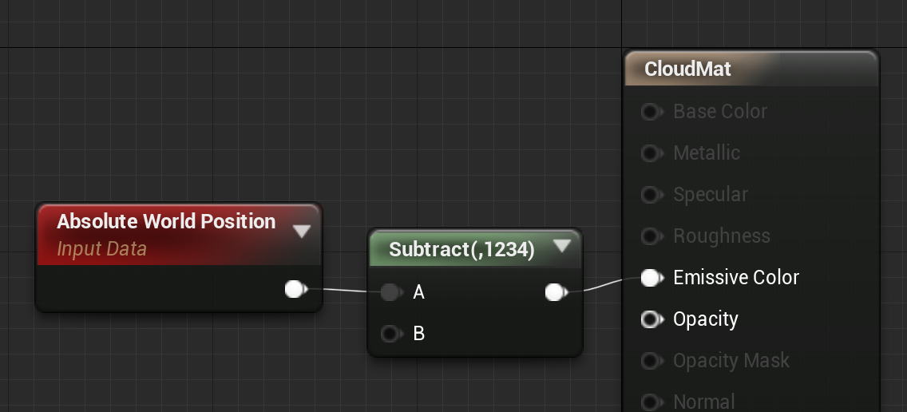
Accessing Data
We’ll need to access several pieces of data in shader code. The first of those is the 3D world position for each point on the surface of the sphere. How do you figure out the shader code to get that position?
  Look at the source.
    In this case, look at the results of Window > Shader Code > HLSL Code, or r.DumpShaderDebugInfo.
  Find an example.
    Look at the code in Engine/Shaders to see if any of the examples do something similar.
    Add a Material node that does what you want, then look at the HLSL Code results to see the corresponding code.
We’ll use the Material node way. You can make it easier to find by tagging with something easy to search for in the code like the constant 1234.

Slide 18
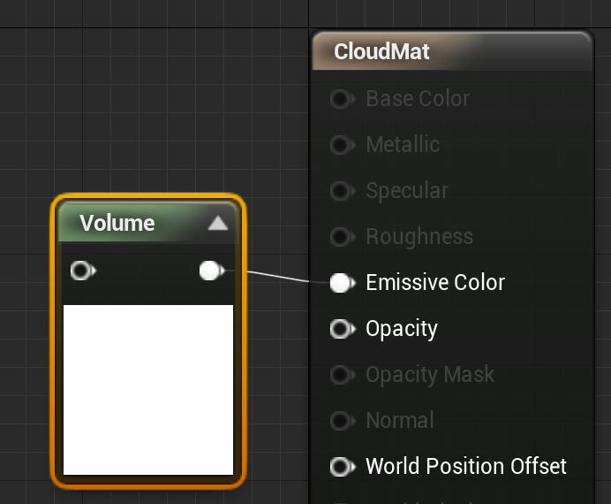
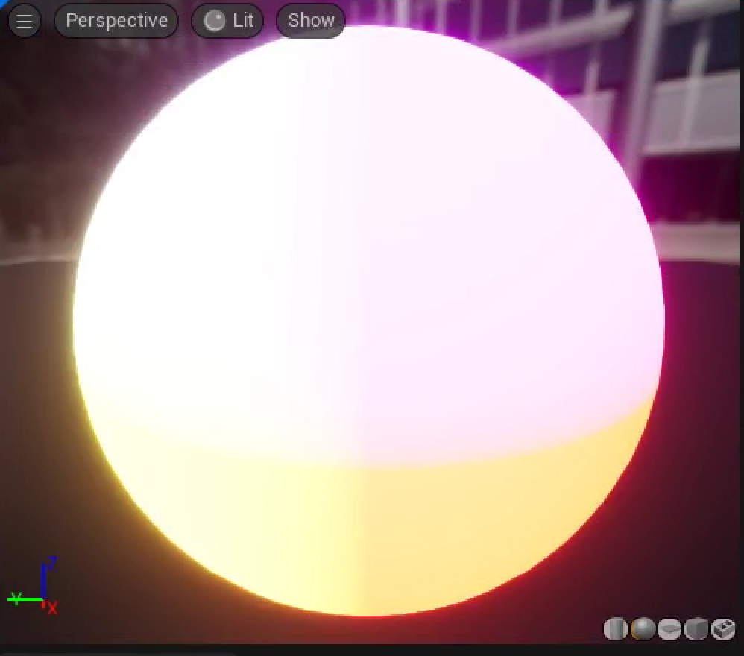
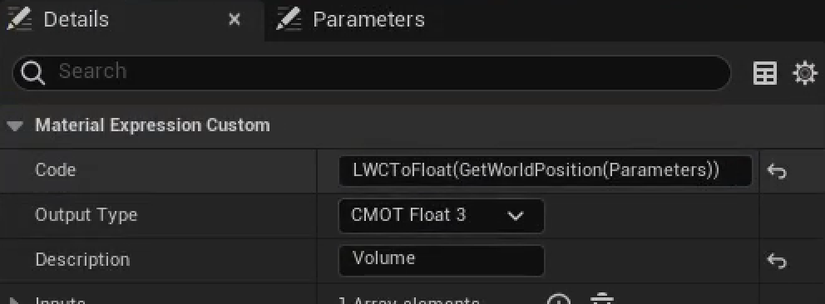
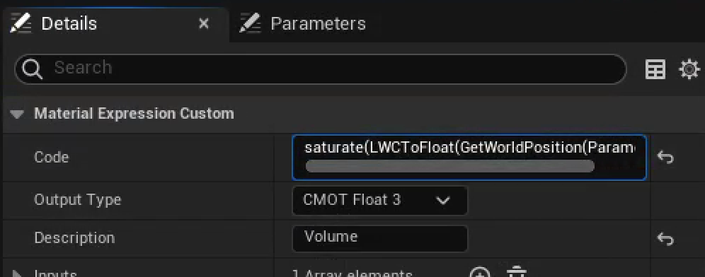
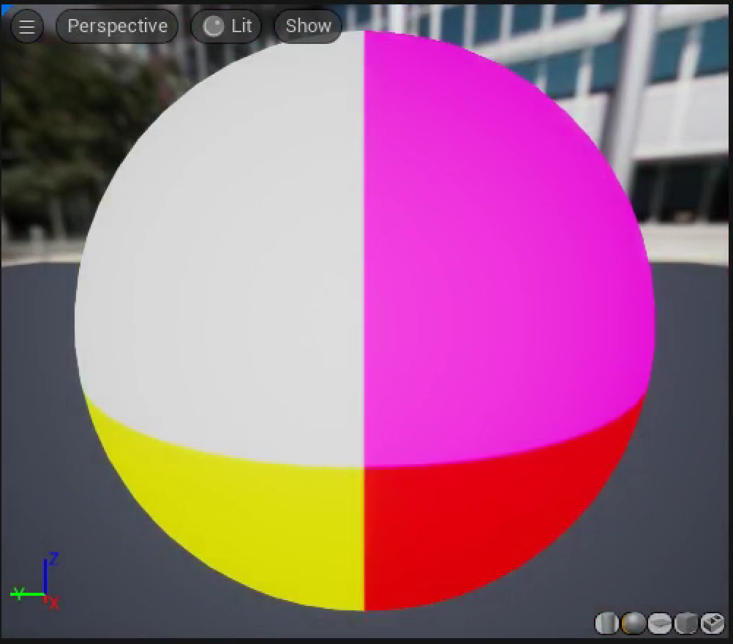
Custom Node
Add a Custom node connected to the Emissive Color input. You can name it by setting the Description field.
Set it to return the results of GetWorldPosition.
  Displaying data as color is a helpful tool for shader debugging. This will map x to red, y to green, and z to blue. Negative values look the same as 0, but large positive values will be interpreted as very, very bright.
Everything else will turn dark, because the position is huge compared to normal color values.
We can improve this by as a debugging tool using the saturate shader function, which clamps values less than 0 to 0 and values greater than 1 to 1. Now big solid color regions just mean ≥1.

Slide 19
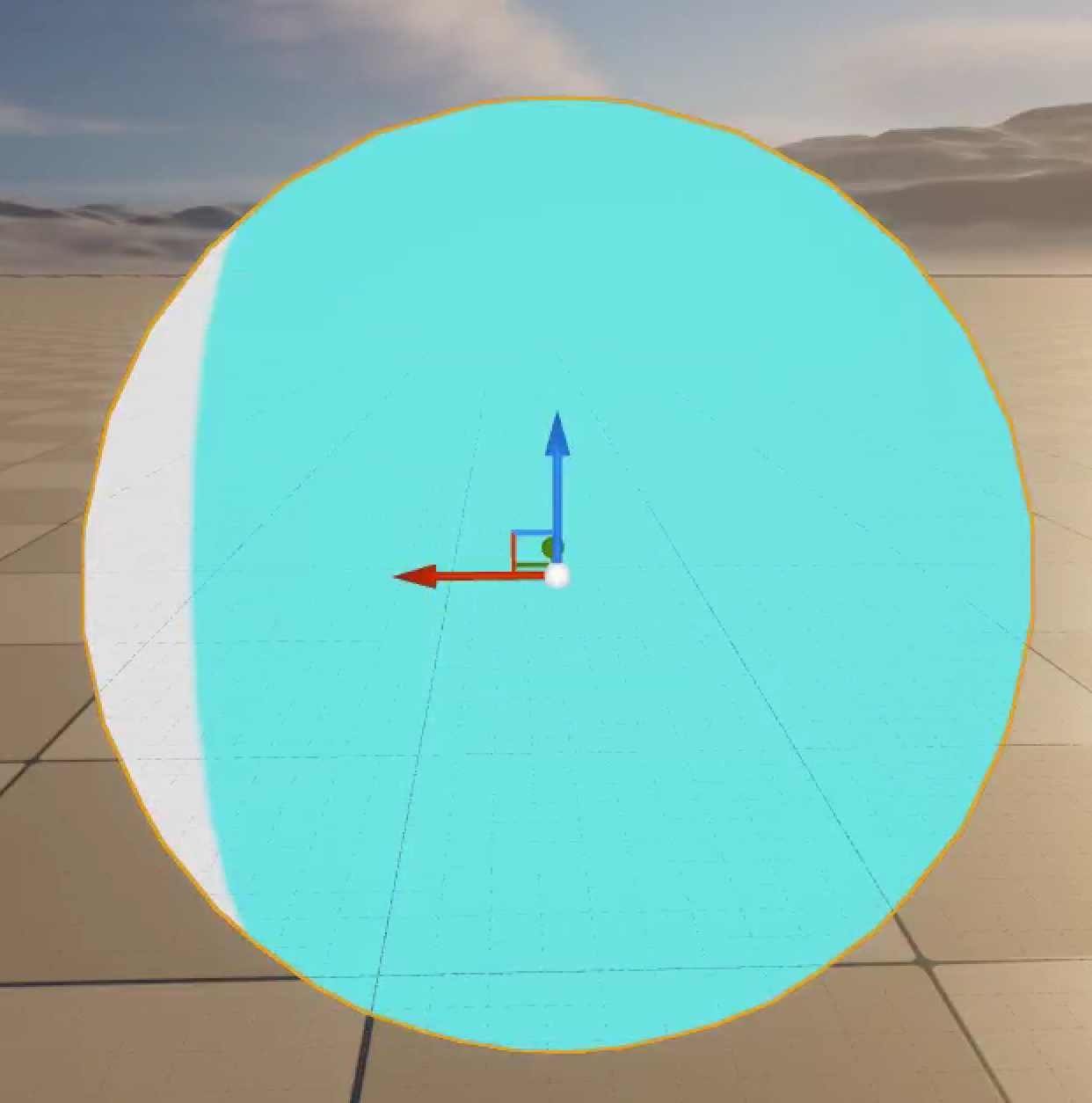
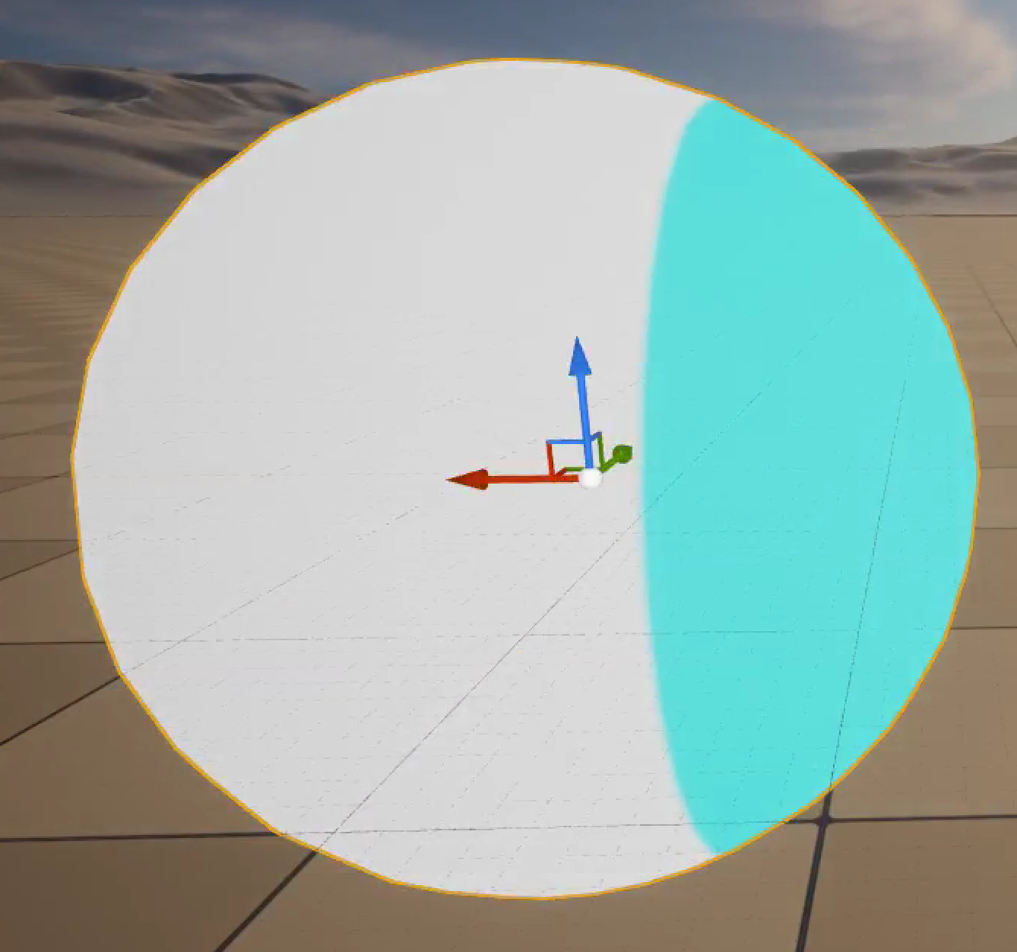
Where to View
Usually, updating and viewing a shader in the Material Editor gives the fastest iteration time to see shader changes, but you should still periodically check how the shader behaves in the scene.
If you apply this shader and switch back to the main view, you’ll see that when you move the sphere around the scene, the Material slides through it. That’s not what we want.
You’d miss this in the Material Editor because the preview object is always centered at the preview scene origin.

Slide 20
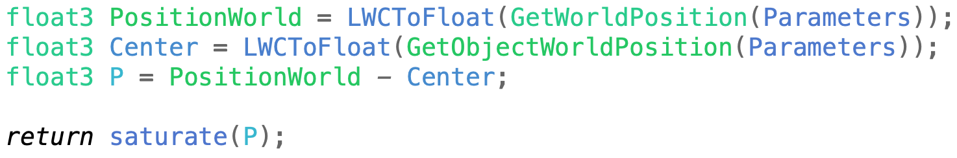
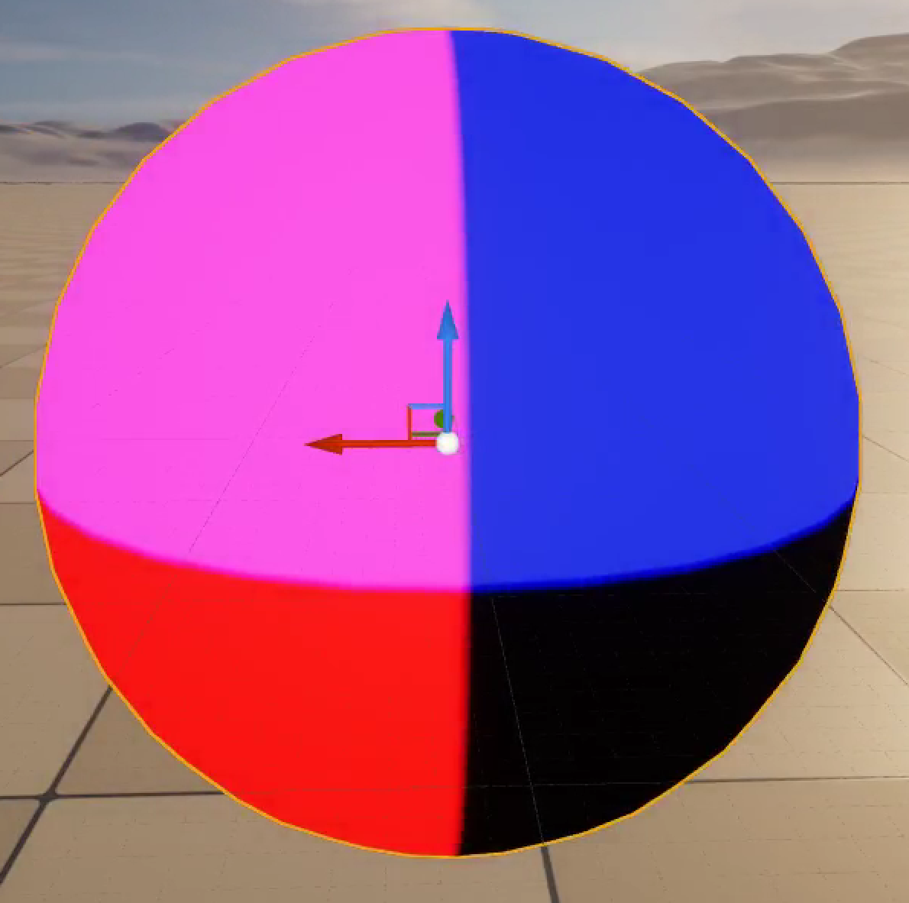
Locking to the Object
We can fix this by switching to a more complex multiline shader. You will definitely want to start working in an external editor, then copy into the Code box in the Material. Plus, if you tell your editor to treat it like C++ code, you’ll get benefits of syntax coloring and automatic indentation.
We need to use the object’s position to center. We can dump code for the ObjectPositionWS Material node to find what we need to use.
Subtracting the AbsoluteWorldPosition from that gives us the position relative to the center, which locks the shader to the object no matter how you move it.

Slide 21
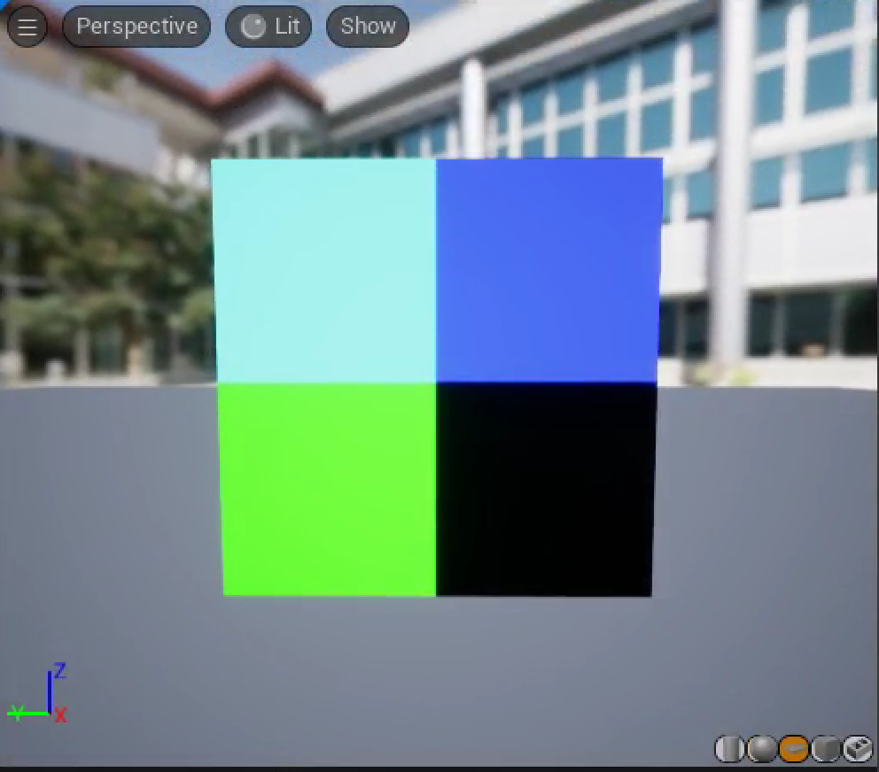
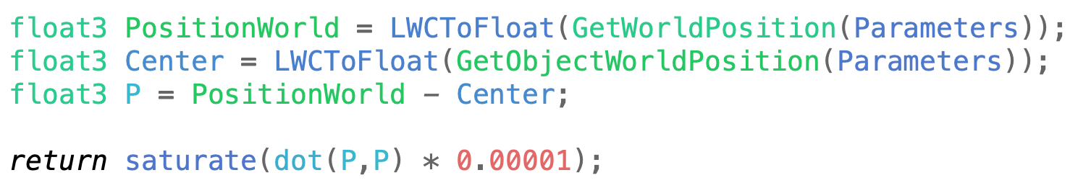
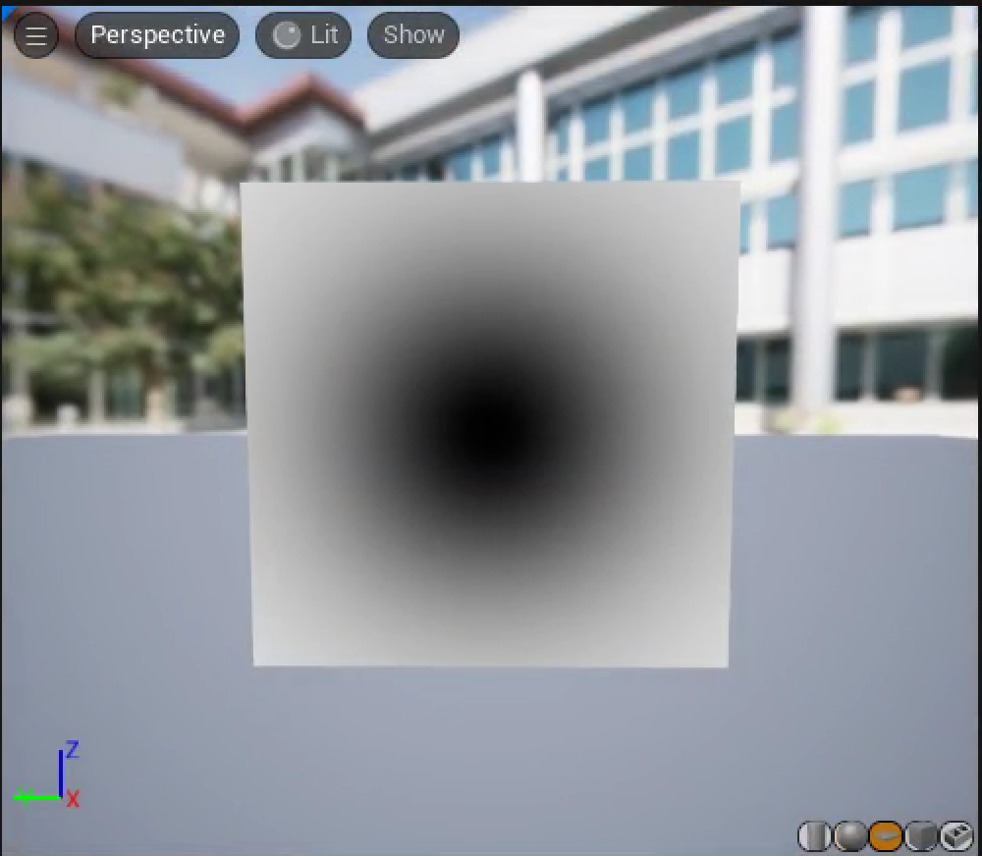
Radial Mask
Next, we’ll start computing a cloud density. The first part of that should be a soft-edged mask to the edge of the sphere.
To see what’s happening inside the sphere, switch to a square as the preview object. It’s invisible from the back, so you might need to spin the view around.
The dot product, P•P, gives the squared distance of each pixel from the object center. Since the size of P is large, we can try a few scale factors until we find one that’ll show how the dot product changes over the surface.

Slide 22
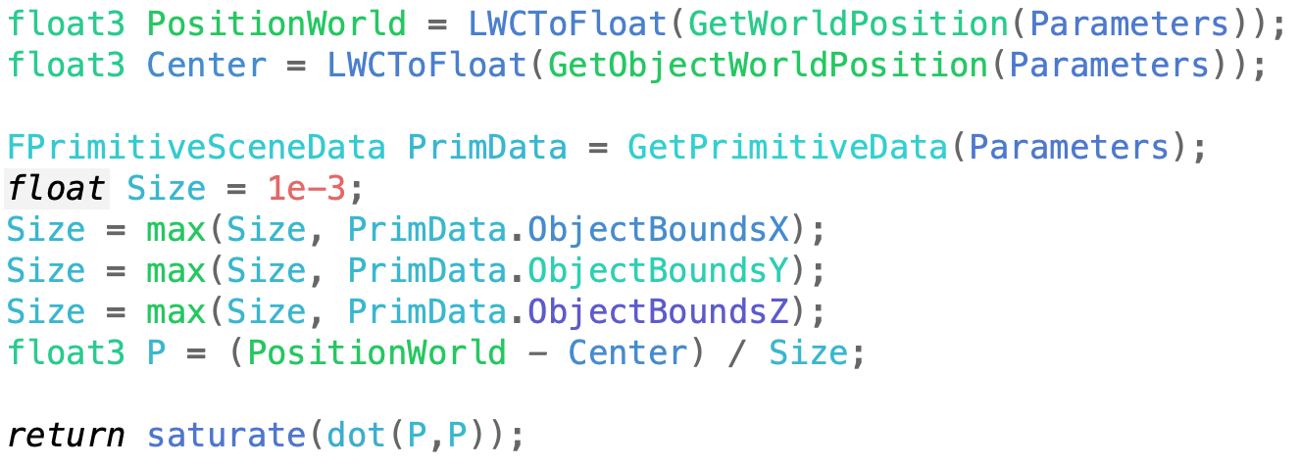
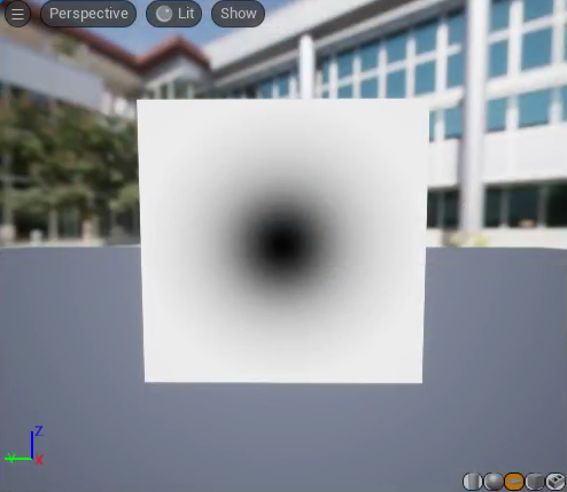
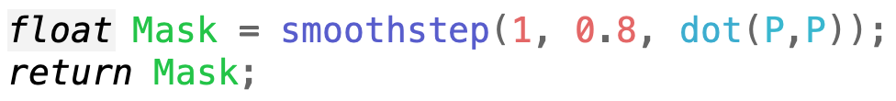
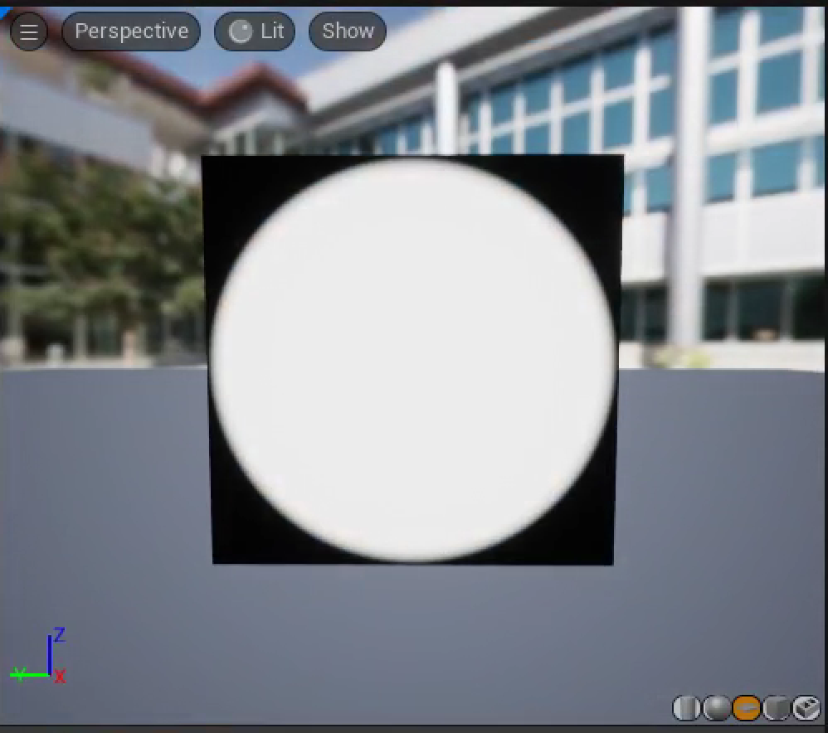
Scale by Object Radius
Instead of choosing an ad hoc scale, we can check how ObjectBounds gets its result.
We can use a max operation to avoid division by 0.
We can then turn that into a smooth-edged mask with the smoothstep shader function.

Slide 23
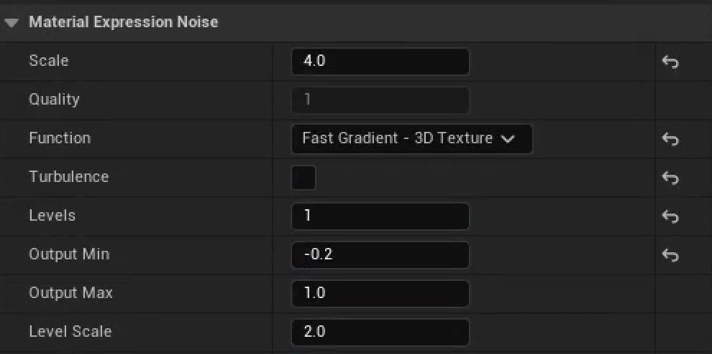
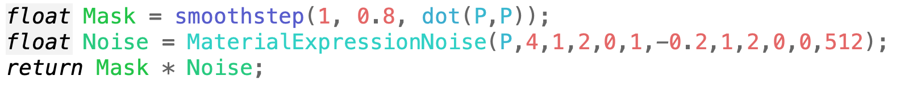
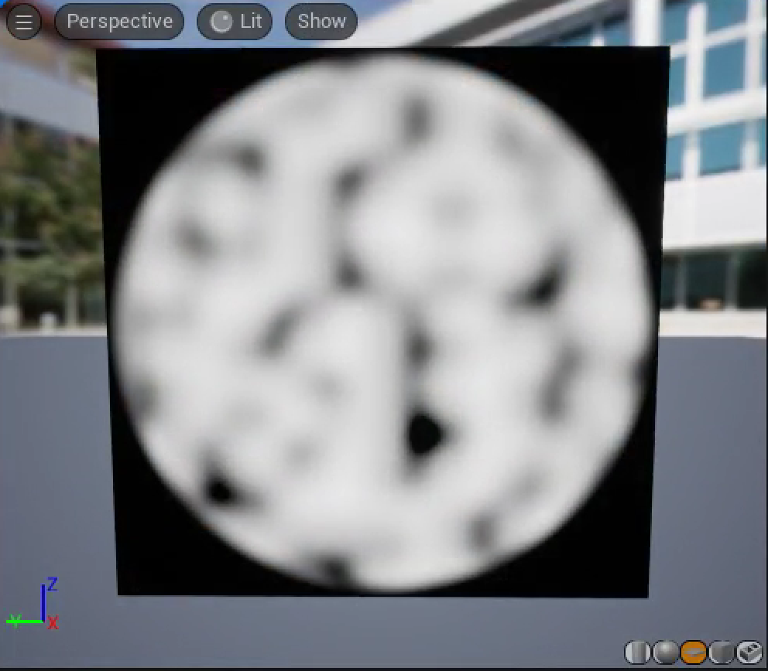
Cloud Base
The basic structure of our clouds will be built using a Noise function.
Noise has a bunch of obscure parameters, so it’s reasonable to start by tweaking some of them in the Material node, then looking at the corresponding code to include in the shader.

Slide 24

Simplifying the Code
MaterialExpressionNoise has a bunch of obscure parameters that map directly to the Material node user interface.
If we dig just a little into the shader code for that function, we can convert to a much simpler equivalent directly using the internal function.
  There are options for Turbulence that we’re not using.
  There’s a loop, but we only do it once.
  Inside that loop is a call to the Noise3D_Multiplexer function, which just picks between noise choices, and we’re only using one.
  There are two different a*noise+b adjustments made to the output that can be folded together.

Slide 25
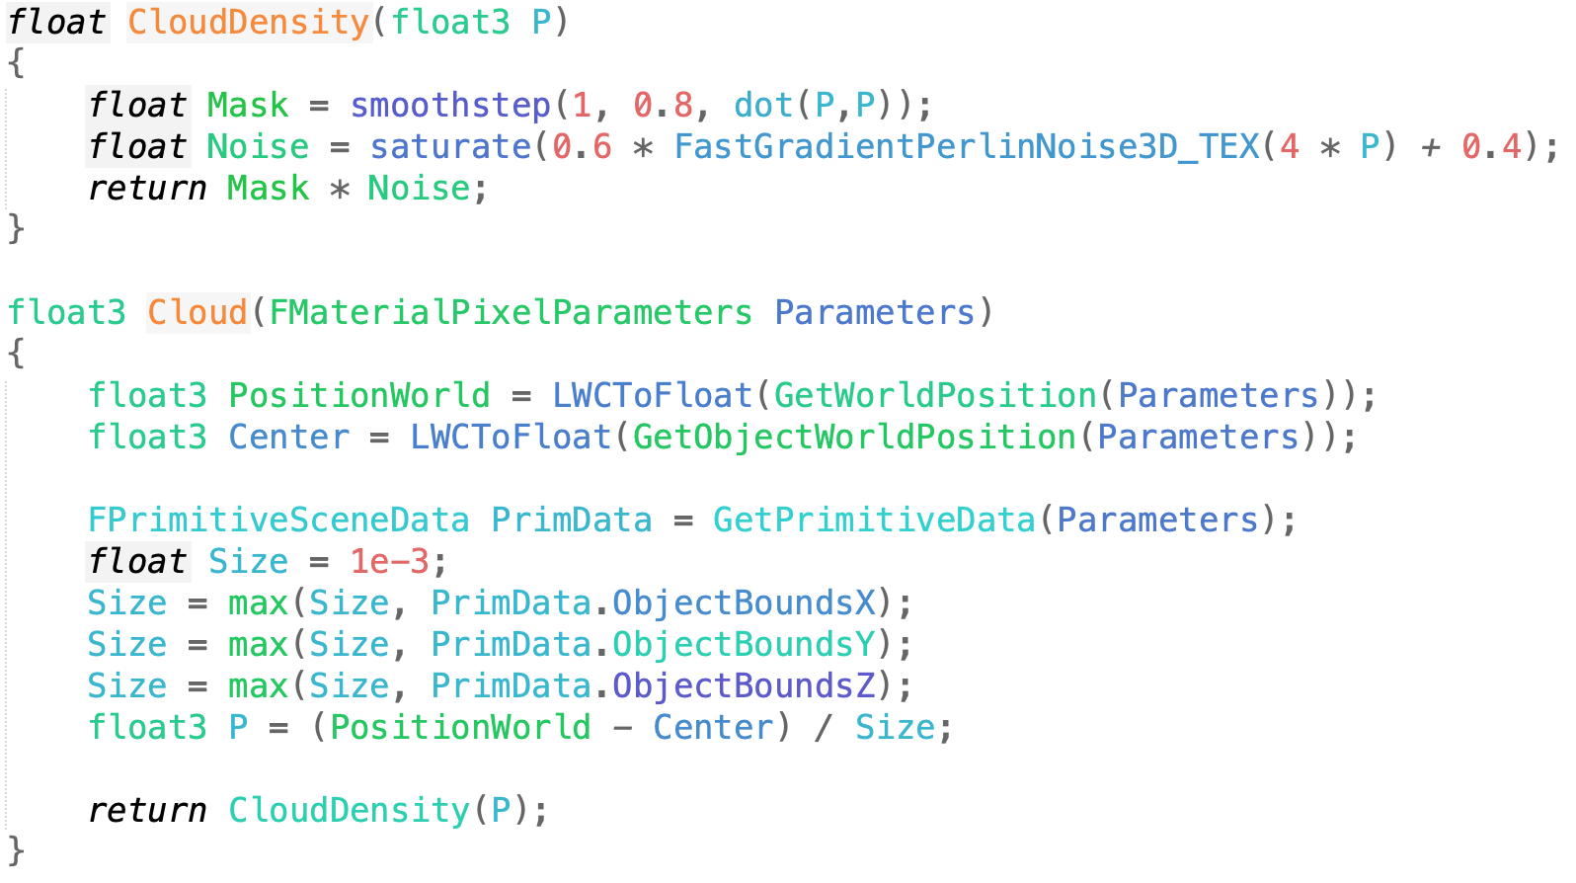
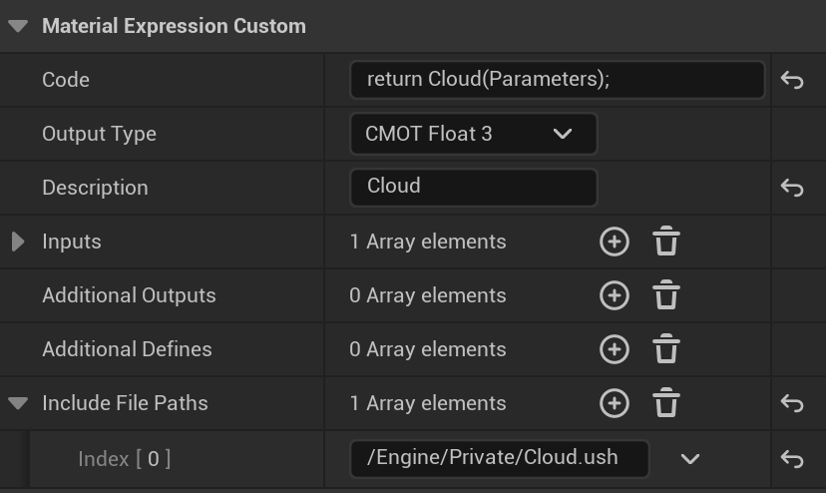
Moving to a Function
We’ll want to compute this cloud density many times in the shader, so it’d be convenient to have it in a function.
We can add a new shader function directly in the engine’s MaterialTemplate.ush file in the Engine/Shaders/Private folder for use in any material custom node, or to a new file in the same directory for use in just some.
To use just for this custom node, add a new Cloud.ush file under the Engine/Shaders directory. There is a built-in Directory Mapping to turn paths starting with /Engine to that Engine/Shaders directory. Add it to the Include File Paths section of the custom node.
Re-run GenerateProjectFiles to get this new file to show up in the shader files list in Visual Studio or Xcode.

Slide 26
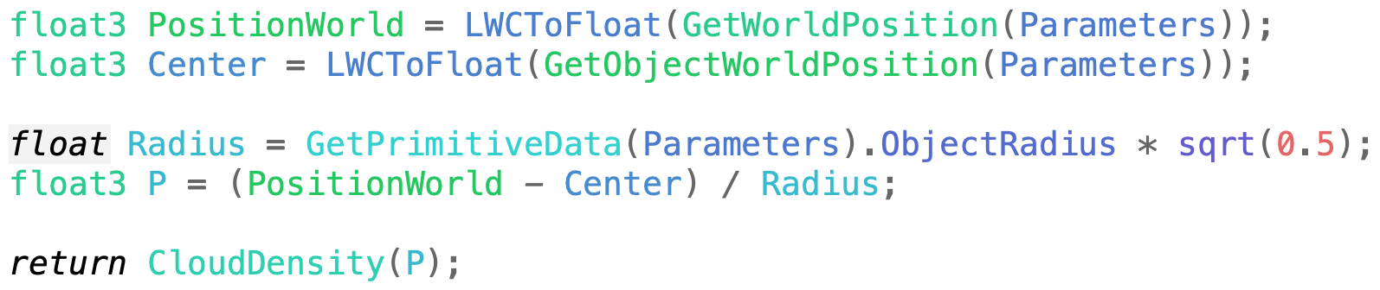
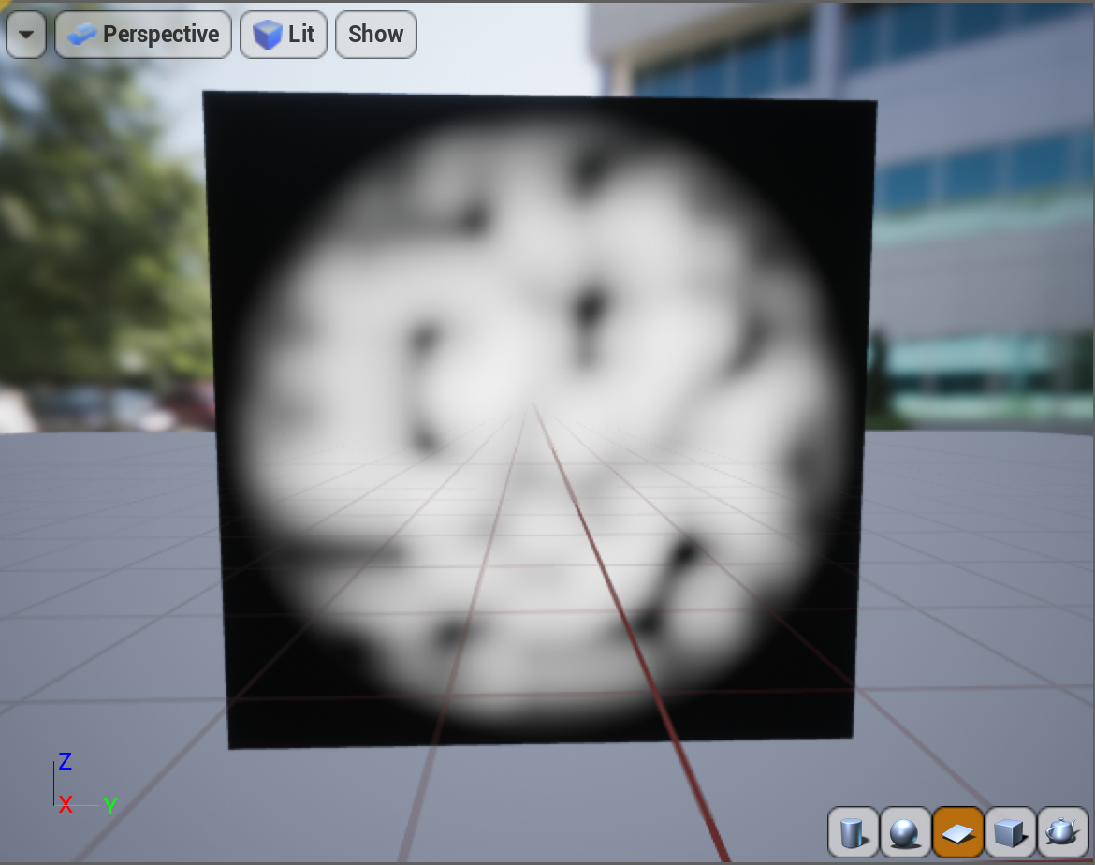
Using in Custom Node
Now any Custom node in any Material can use that new function, just by adding it to their include paths.
Note that changes to MaterialTemplate.ush will cause a recompile of all Material shaders the next time you launch the engine or do a full RecompileShaders. An explicit include will only recompile the materials using it.
In either case, If you work in the Material Editor, you can recompile just the one Material during testing, saving the full recompile for once it’s working.
If the custom node code block is the same, UE5 may used a previously compiled cached copy of the shader even if the included file changes. A numbered comment that you change after editing the shader file can force a recompile.

Slide 27
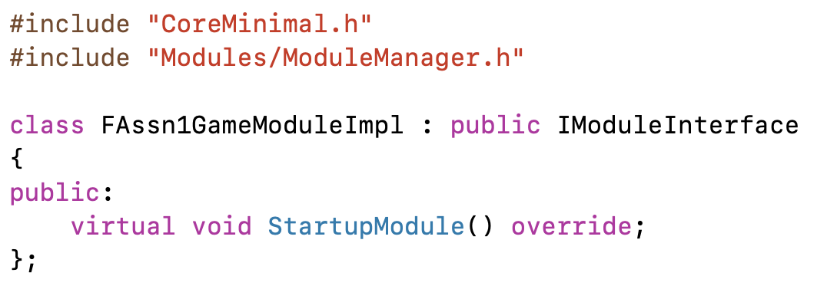
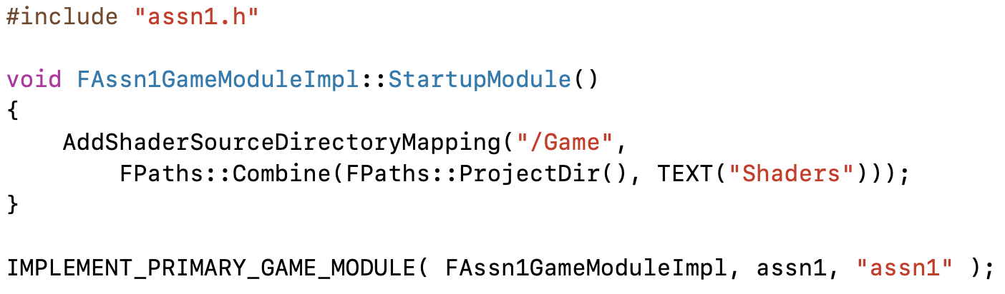
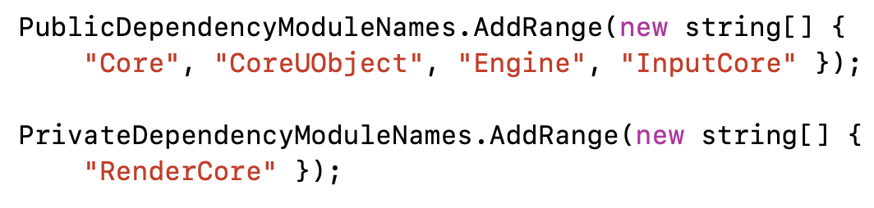
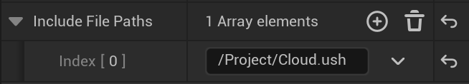
Project Shader Files
If the ush file is added to the engine, you must distribute a modified engine to every programmer and artist. Instead, you can keep it with the project.
Create a Shaders directory in your project folder and add the shader files there.
Add RenderCore as a private module dependency in the Game.Build.cs
Add a module class with a StartupModule member to the Game.h file.
Add the directory mapping in the new StartupModule code, and the new module in place of the default one in the Game.cpp file.
Use /Game in the material include list.

Slide 28
Ray Marching

Slide 29
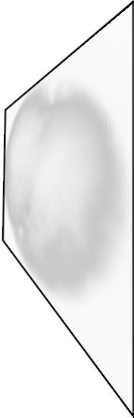
Ray Marching
To create a volumetric shader, we will use a technique called ray marching.
The shader runs on a surface. Ray marching takes steps through a volume imagined to be behind that surface.

Slide 30
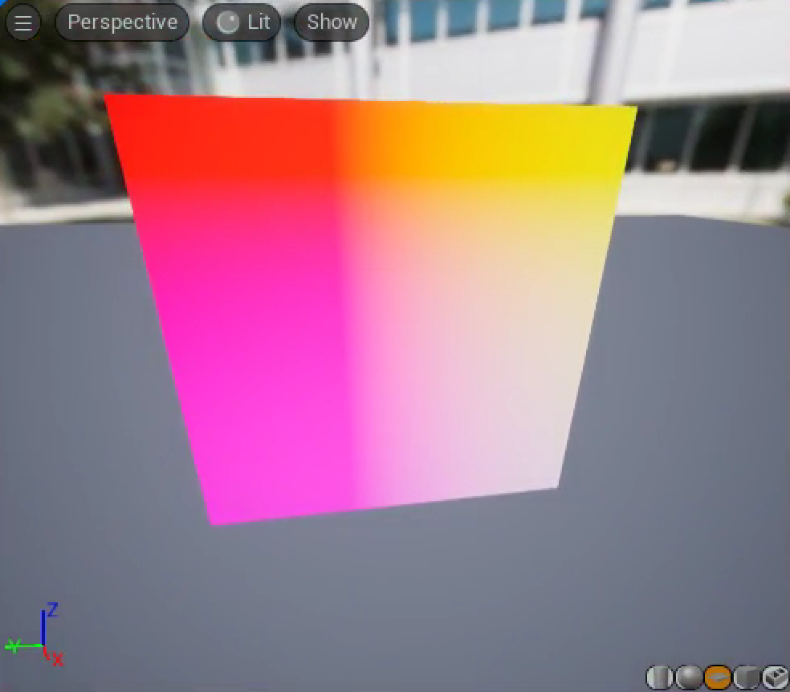
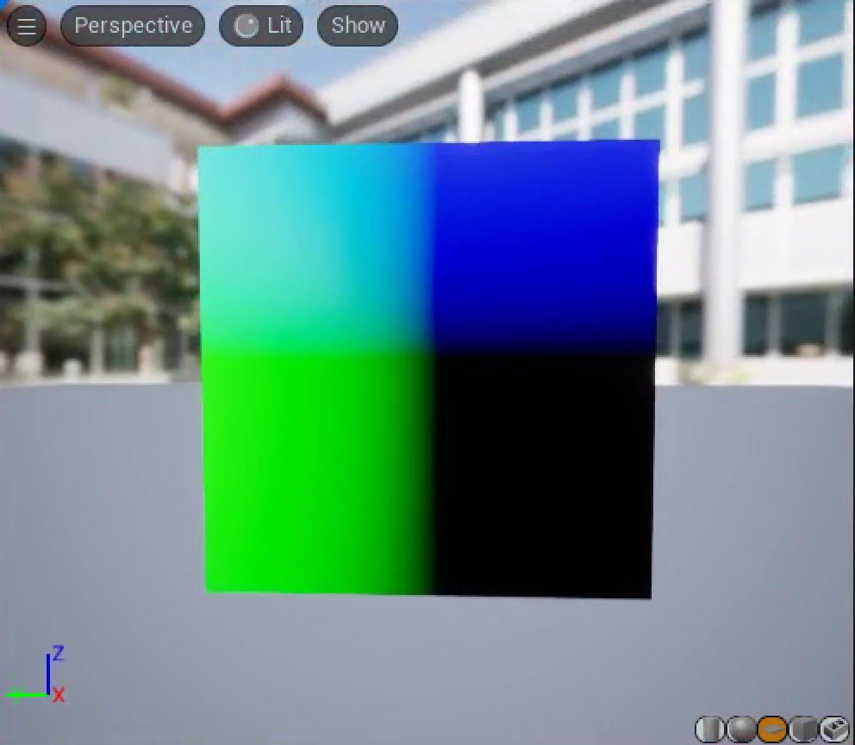
Direction to March
The first thing we need is the direction from the camera to the pixel. This is the direction to march.
Place a Custom node into your Material Editor graph and switch the preview object back to a sphere.
From looking at the code generated by the CameraVector node, we know there’s a Parameters.CameraVector.
Comparing the color to the axes, it is mostly red, implying that the CameraVector appears to be pointing toward the camera.
–Parameters.CameraVector looks like what we need.

Slide 31
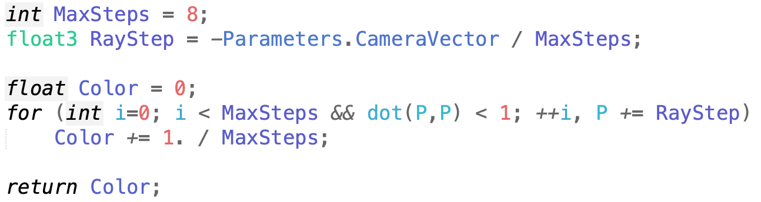
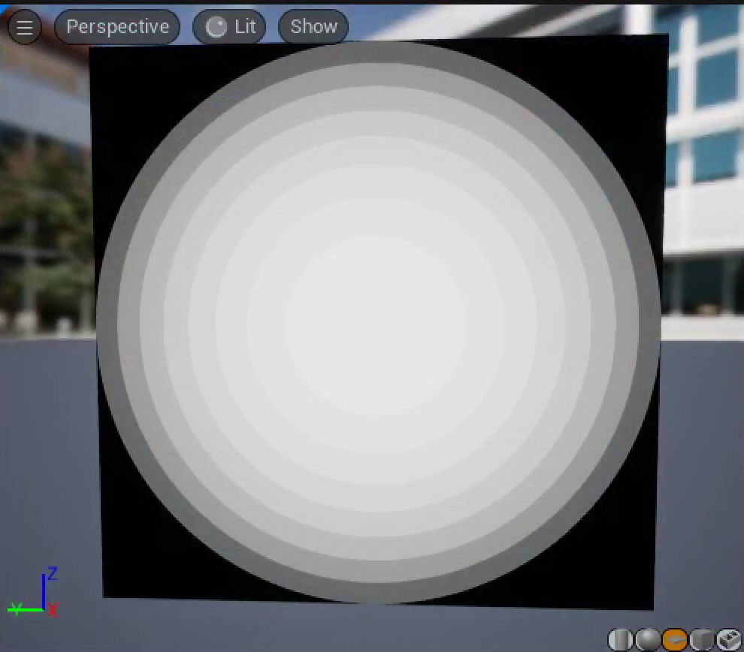
Basic March
Starting on the surface of the square, we’ll march into the hemisphere behind it until the marching point is outside the sphere’s radius.
The color just shows how many steps it took before the marching point was outside the sphere.

Slide 32
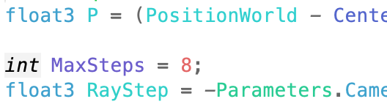




Shader Parameter
The value defining how many steps to take appears several places in the shader and may need to be adjusted for performance
Remove it from the shader and add it as a parameter to the Custom node to make it easier to change.

Slide 33


Back to a Sphere
The step size is scaled to go up to one unit distance in the maximum number of steps allowed. That’s enough to get from the middle of the sphere to the back, but not to get from the front to the back. A unit sphere has a diameter of 2, so the step sizes need to be twice as big to make sure we can make it all the way through.

Slide 34




Marching Cloud Density
To account for the cloud density, we need to accumulate the color and opacity with each step. We’ll augment the Color variable with a fourth alpha component to track that opacity, and use that to tell how much of the local color we can see at each step through all of the cloud we’ve marched so far.
We also may want to define a color for our cloud, as an additional parameter.
We can use the CloudDensity function added to Cloud.ush to compute the actual density.

Slide 35


Cloud Opacity
Of course, the cloud doesn’t look very cloudlike with the dark border. We’re computing the opacity as we go, so it’s in Color.a at the end of the march, but we’re not using it.
We’ll need to change the Custom node to return all four components of the final color.
Then we’ll need to extract the alpha component using a Component Mask node.

Slide 36
Volumetric Lighting

Slide 37



Light Direction
We won’t add lighting from all directions, just from the primary atmospheric light direction.
The AtmosphereSunLightVector node generates MaterialExpressionAtmosphericLightVector(Parameters).
We have a problem, though. A little test code shows this value is only provided to the material if the actual AtmosphericLightVector node is used in the material.
To make sure the data is available, we explicitly pass it in as a parameter to the custom node.

Slide 38


Shadow March
We won’t add lighting from all directions, just from the primary atmospheric light direction.
Check the AtmosphereSunLightVector node to see how to get this direction.
Now, at each point along the ray march, we have to march toward the light, accumulating opacity to see how much makes it through.

Slide 39


Removing Step Artifacts
There are bad stepping artifacts visible, especially in the shadow. One way to avoid these is to randomize the starting point for each march.
Temporal anti-aliasing blends across frames and can smooth the randomness out, but needs a different offset at every pixel, changing every frame.
Look at VectorNoise / CellNoise for hints on how to generate three random numbers from a three-element vector (it calls MaterialExpressionVectorNoise, but that just calls Rand3DPCG16).
Look at ScreenPosition / PixelPosition for how to get the x/y pixel position (use GetPixelPosition).
There’s no Material node for the frame number, but looking at r.DumpShaderDebugInfo results, we see that there is a View.FrameNumber.

Slide 40
Extensions

Slide 41

Baked Densities
Densities are expensive to compute every step O(MaxSteps²), including the shadow steps. If you precompute them into a Texture, it’s just a lookup or two per step.
The engine supports 3D Textures, but you’d need C++ code to generate them.
You can also decompose a 3D Texture into a grid of 2D slices packed into a 2D Texture. There’s a function, PseudoVolumeTexture in Common.ush, designed to access a Texture built this way.

Slide 42

Embedded Objects
Opaque objects are drawn before any transparent objects. You can look in the depth buffer to tell when the marched ray would hit an embedded object and stop the march early.

Slide 43

Deep Shadow Map
A separate pass before the cloud render can start at the light to march through the volume. There are various deep shadow algorithms that use the four color channels of a Texture to store data that you can use to approximate the shadow opacity. It’s not exact, but it’s way faster.
An even faster approach just assumes the fine whorls of the volume don’t matter that much and uses the distance until the shadow ray exits the sphere as an estimate of how much shadow to use.

Slide 44
We’ve been using Opacity, .
Can also represent this with Extinction, .
These are related by , for distance .
    For one unit of volume, , or .
    doesn’t scale linearly with step size, but does.
    Scaling by a step size of .
    Often approximate as .
Step- Independent Extinction
If you change MaxSteps, the overall volume opacity will change as well. That’s because we assume the same amount of light attenuation no matter how big the step is. But a thicker slab of translucent Material should block more light.
The UE5 built-in Volumetric Fog reformulates the ray march in terms of extinction instead of opacity in part to make the run-time step size adjustment cheaper.

