Slide 1
Development Environment
Getting Set Up for Engine Development

Slide 2
The goals of this lecture are to
  Learn the hardware and software requirements to work with Unreal Engine code.
  Learn how to get your own copy of the Unreal Engine from github.
  Learn how to build UE4 efficiently.
  Learn how to run UE4 from inside Visual Studio or Xcode
By the end of this lecture, you will be able to
  Set up a computer for UE4 development
  Get your own copy of the UE4 source code
  Build and run UE4 from source.

Slide 3
What You Need
Hardware & Software Requirements

Slide 4

Hardware
Refer to the “Get Started with UE4” pages at docs.unrealengine.com for up-to-date hardware and software specifications, and also the Recommended Hardware page on the Unreal Engine 4 wiki
The biggest concern when doing UE4 software development, as opposed to using the pre-built Editor, is the engine build times.
Most of the time, you can use a shorter incremental compile, but a full compile from scratch on a 4-core PC can take several hours.

Slide 5
Disk
Disk
Cores
Memory
Even if you have already invested in a computer and cannot customize it for UE4, you can still get a lot out of a fast disk drive
It is possible to do UE4 development on a 128 GB USB, but you won’t enjoy it. A hard drive is faster, and an SSD is even better.
If you do not have an SSD drive with at least 128 GB of free space, you can get an external one for half the cost of most textbooks.
Most external drives are initially formatted as FAT or EXFAT format. This will not work with UE4, so you’ll need to reformat to NTFS (for Windows) or HFS+ (for Mac)

Slide 6
Memory
Disk
Cores
Memory
If you do not have enough memory, it is possible to add more to most computers or laptops, and certainly worth it.
Current UE4 specs recommend at least 8 GB on a 4 core PC, but also mention that adding more cores can improve build time. Scale your memory with the number of cores: at least 2-4 GB per core.

Slide 7
Cores
Disk
Cores
Memory
If you are buying a new system for UE4 development, more cores can definitely help. UE4 will use them for a build, so twice as many cores result in a build that’s almost twice as fast. A 32 core processor can trim your several hour full-build time down to under 25 minutes.

Slide 8
UMBC Computing Options
Home Windows (W)
+ Dedicated: can leave long builds running
+ Well supported by UE4
Home Mac (M)
+ Dedicated: can leave long builds running
Lab Computer (L)
+ 4-core 3.4 GHz
Amazon (A)
+ Scalable
+ Potential to upgrade
– Limited by your hardware
– Not as well supported as Windows
– Only 9 available
+ One user per computer
+ Totally configurable
– Cannot change configuration or install
+ Totally configurable
– Costs can mount quickly!
In order of what I would recommend
Your own Windows (W) or Mac (M) computer, if capable
A lab computer (L)
Remote access to an Amazon instance (A)
Requirements in the following slides will be marked with one or more of W, M, L, or A.

Slide 9
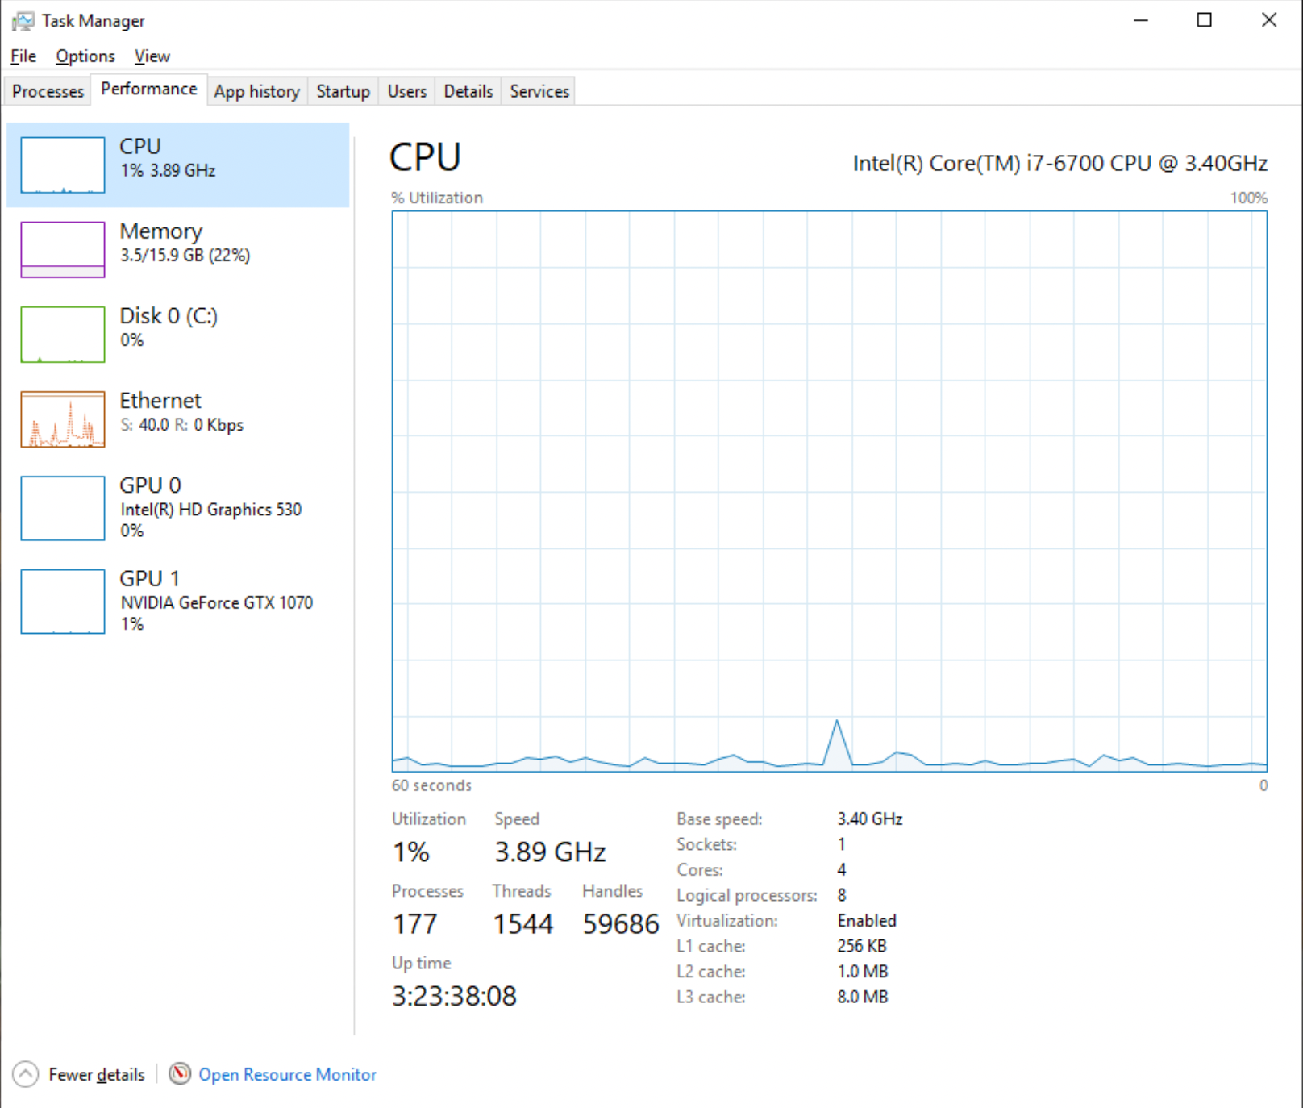
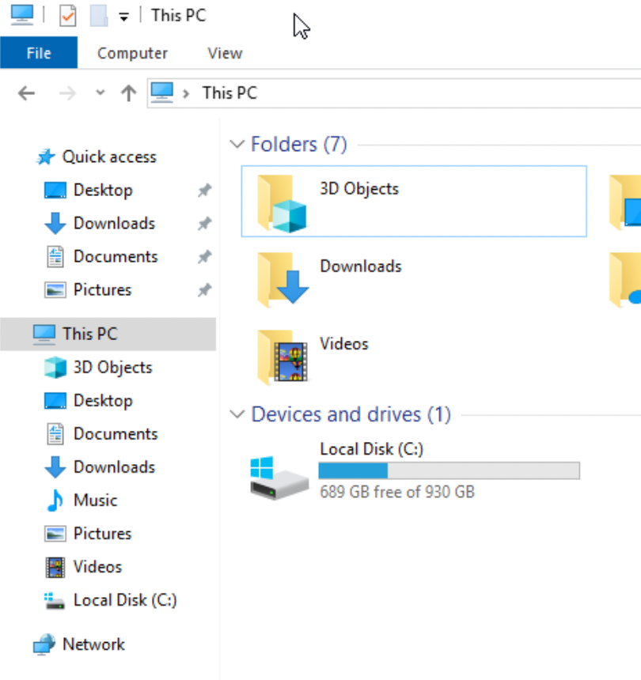
Home Windows (W)
Check system stats
CPU and Memory: Check Task Manager / Performance Tab
Disk: Check “This PC” in File Explorer
Consider adding memory or external SSD if necessary
Reformat SSD as NTFS

Slide 10
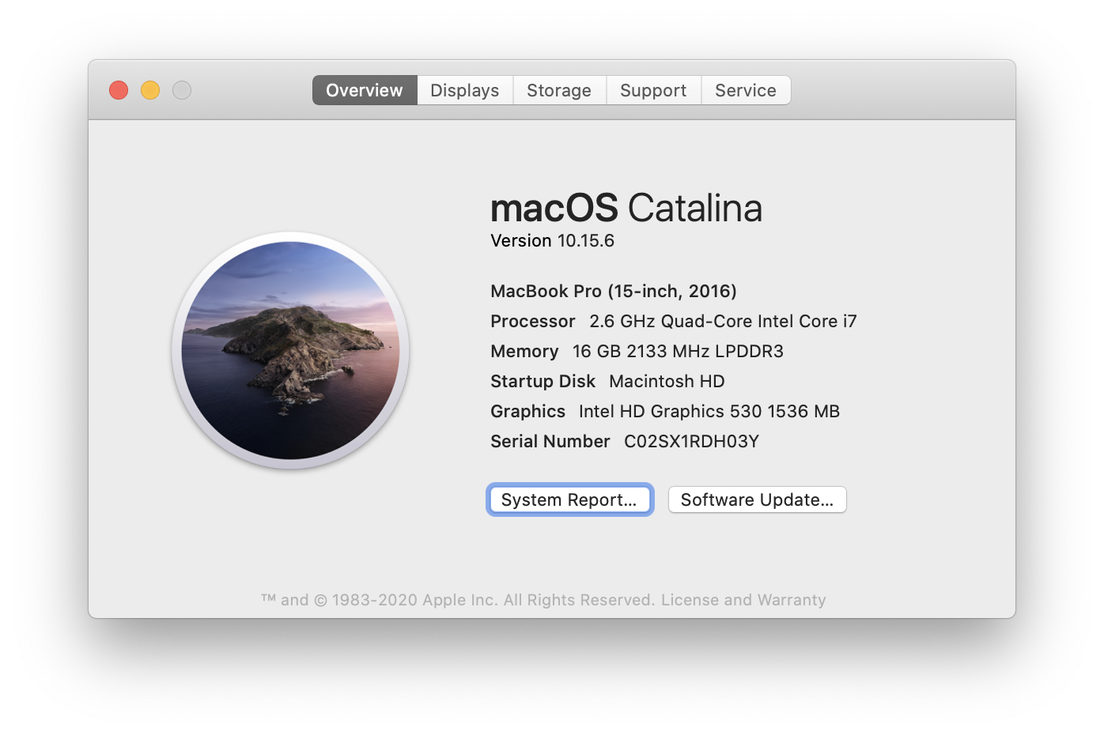
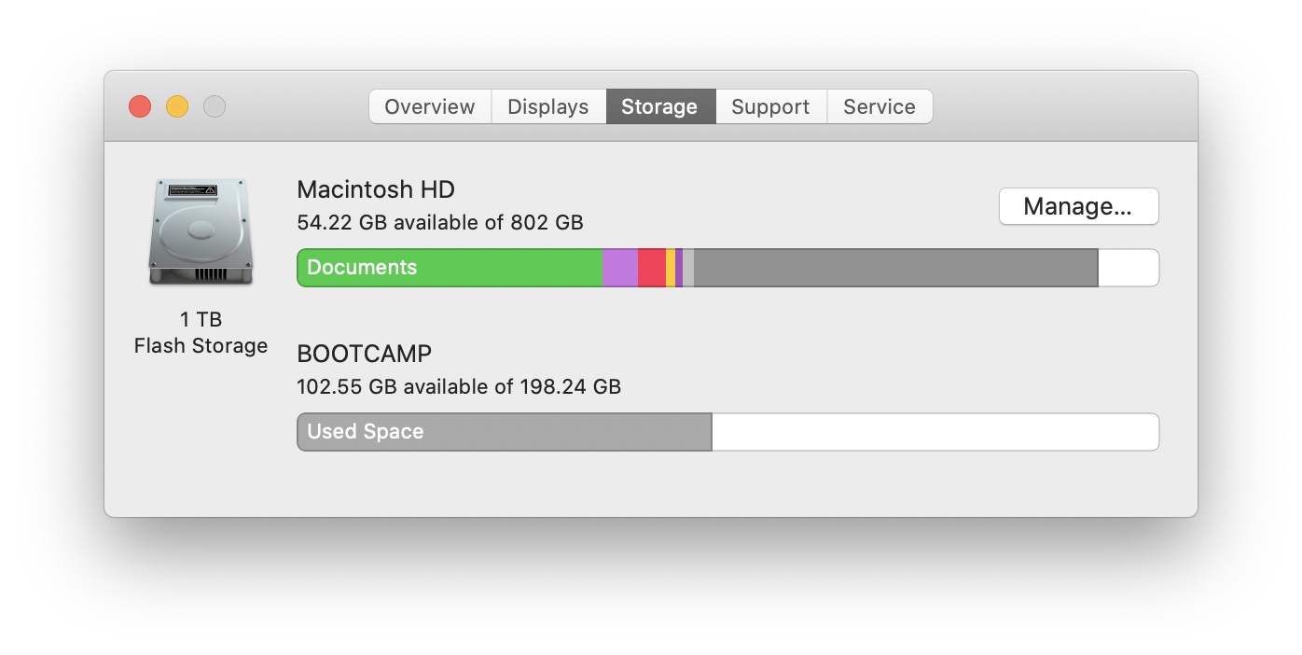
Home Mac (M)
Check system stats
Apple menu > About This Mac
Consider getting an external SSD if necessary
Reformat SSD as HFS+

Slide 11
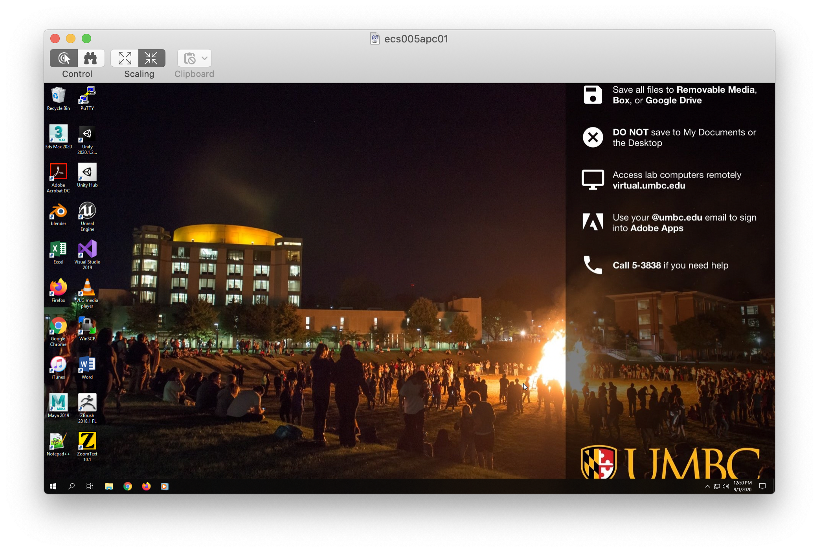
Lab Computer (L)
Get external SSD
Can store on local disk, but erased on reboot
Local disks are spinning hard drive, external SSD may be faster.
Shared lab
Game developers club, graphics class, other students
To avoid contention, suggest limiting to one student from this class per computer
Remote access is possible, but slower than in-person and would need to block from in-person use.

Slide 12
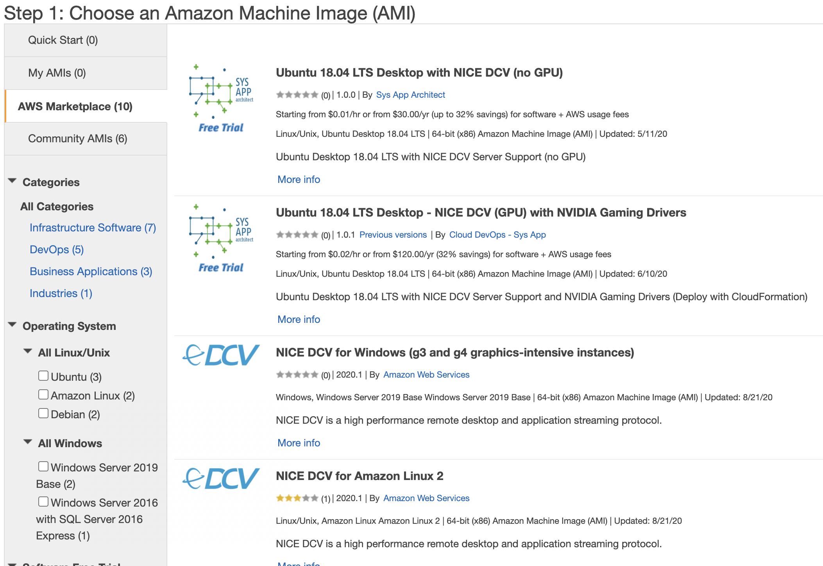
AWS EC2 Instance (A)
Create an AWS account
Download NICE DCV client
  Default RDP doesn’t work for graphics
Create an EC2 Instance
  Use the Windows NICE DCV template from the Amazon Marketplace
  Choose a GPU instance with at least 4 cores (e.g. g4dn.xlarge)
  Configure Instance Details
    Add Terminate Protection (Terminate deletes your instance and its drive)
    Increase the Root SSD size to 150+ GB
    Ignore “you won’t be able to connect” message on the Security Group page

Slide 13
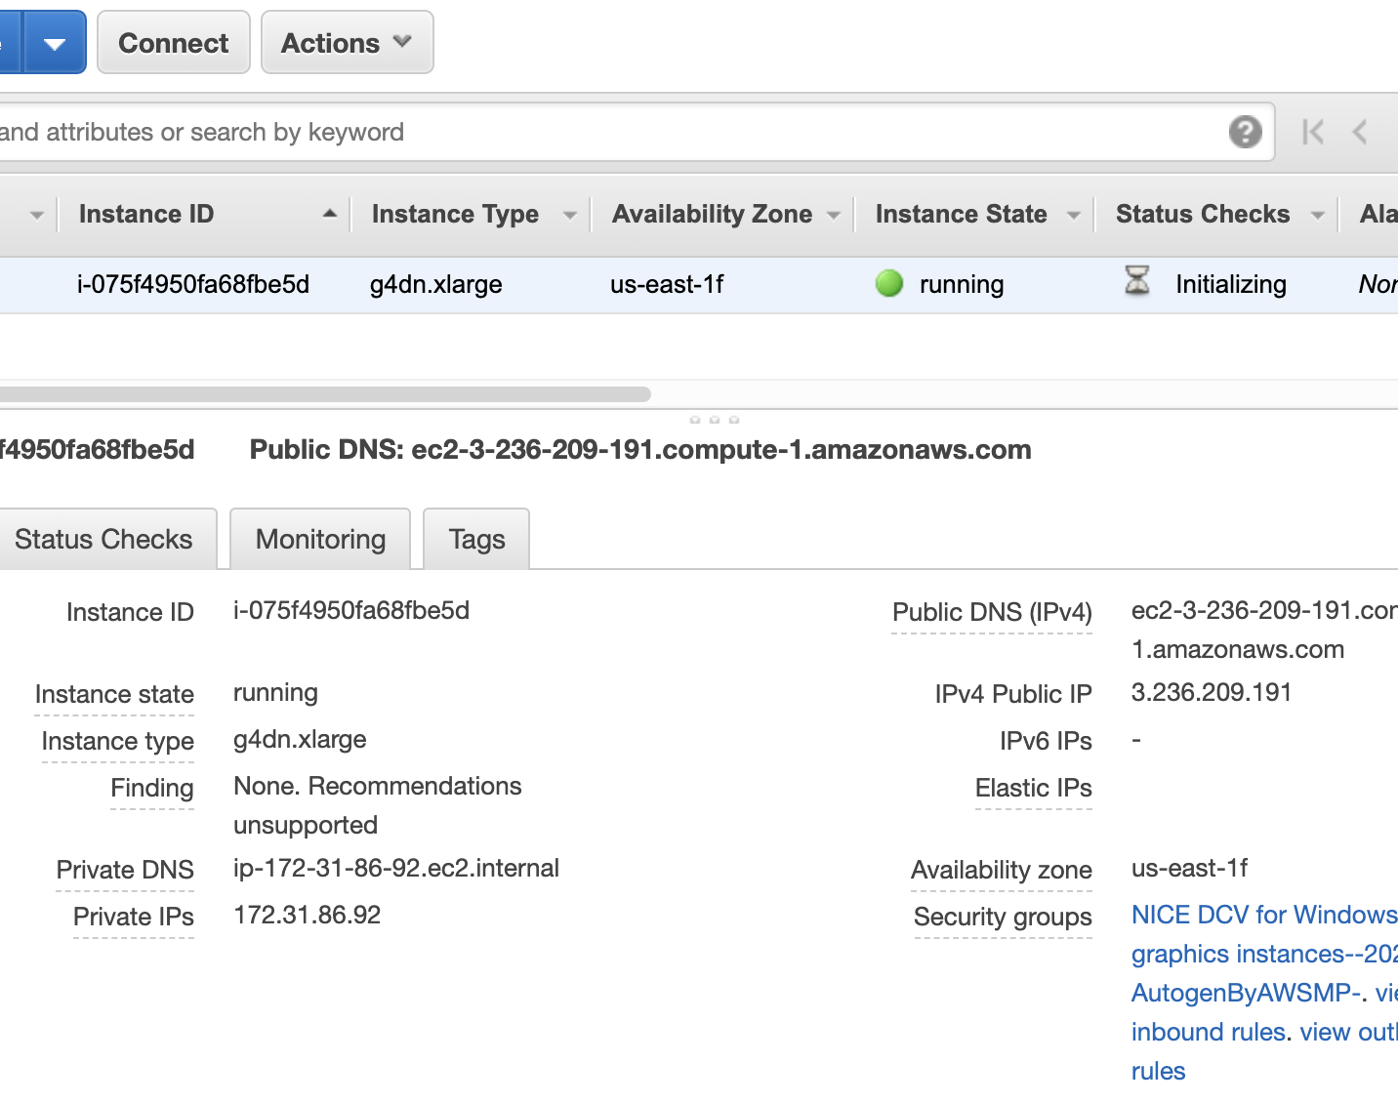
AWS Setup (A)
Launch & create and save a key pair
  Wait for instance state to show green
Connect with NICE DCV Client
  IP address from AWS console
  Username: Administrator
  Password from Actions > Get Windows Password (need your key from before)
Configure IE to allow downloading
  IE Settings > Internet Options > Security > Internet > Custom Level:
  Enable File Downloads and Active Scripting
ALWAYS STOP YOUR INSTANCE WHEN DONE!!!!!
  Running instances cost $$$

Slide 14
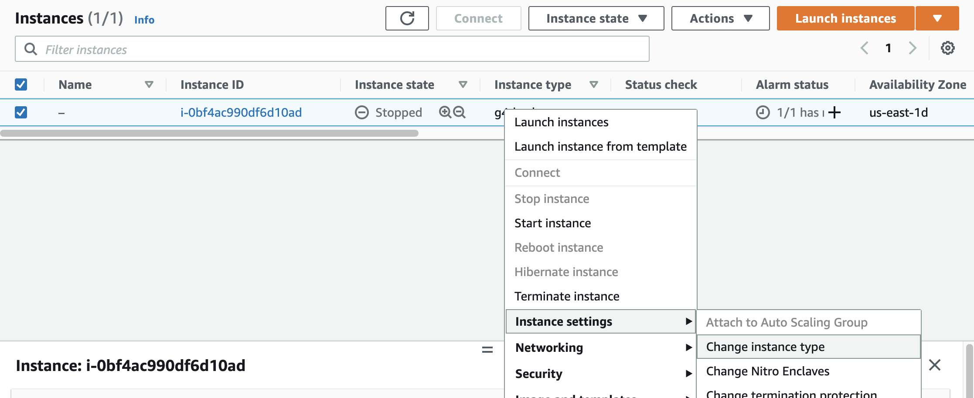
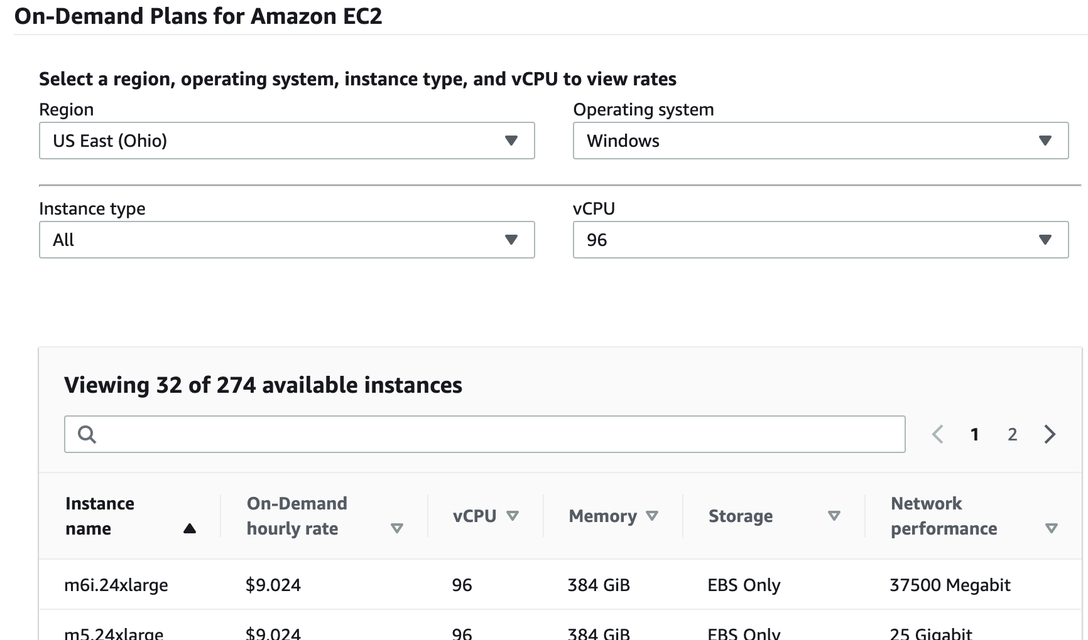
Switch Instance Type (A)
One advantage of using AWS is the ability to temporarily change from one instance type to another for configuration or price.
Can only change when instance is stopped.
Instances charge by the second, but consider shutdown/startup time when changing.
Install virtual display driver for non-GPU
Examples (including pricing as of this writing)
t3.medium ($0.06/hr) for system setup
  2 cores, 4 GiB
c5.metal ($8.50/hr) for full UE4 build
  96 cores, 192 GiB
g4dn.xlarge ($0.71/hr) for running
  4 cores, 16 GiB

Slide 15
GIT
Version Control Software (WMLA)
IDE
Integrated Development Environment
C++ Build and Debugging Tools
Visual Studio Community 2019 (WLA)
Xcode (M)
Critical Software

Slide 16
Version Control
  A Checkin or Commit is the set of files that constitute the changes for a new version. For projects with multiple contributors, you want each version you commit to at least run. Each commit includes a brief description of what changed.
  If multiple people are working on a project, you may need to merge your changes with ones they’ve already committed. The VCS can automatically handle non-overlapping changes in text and source files. If it can’t, you have a conflict that must be manually resolved.
  Small projects sometimes have a policy of frequent commits to make merging easier. This causes many near-simultaneous commits in a large project, leading to a policy of rare big commits, or committing often in a private branch, with occasional merging to the master or trunk branch.
A Version Control System (VCS) keeps track of every version of every file in a project.
Here are some key terms and ideas:
  In this context, a version is just a set of changes to the files that you want to track. There are usually thousands of VCS versions before any new release.
  The Repository is a database of all the files and versions.
  You want to track source files and art
  assets, but not data that is automatically
  generated from them (like object files or executables). An Ignore File tells the
  VCS which files, types of files, or
  directories to ignore.

Slide 17
Distributed VCS
Some version control systems like Perforce or Subversion use a single central repository. When you checkout a version, your local copy has just that version of each file.
In contrast, Git is a distributed VCS. You clone a copy of the entire history to your local computer. Changes recorded in your local repository exist only there until you fetch and merge with any concurrent changes in the central repository, then push your merged changes back.
Note that git is a version control system, while github is a site that hosts git repositories. Github introduces the concept of a fork, which is a clone of a repository on github, where github knows the two repositories are related.
Github also includes a web interface for a limited number of git commands directly on the central hosted repository. Mostly, we will be ignoring these and doing git operations directly to the local clone of the repository, then pushing those changes back to the central repository on github.

Slide 18
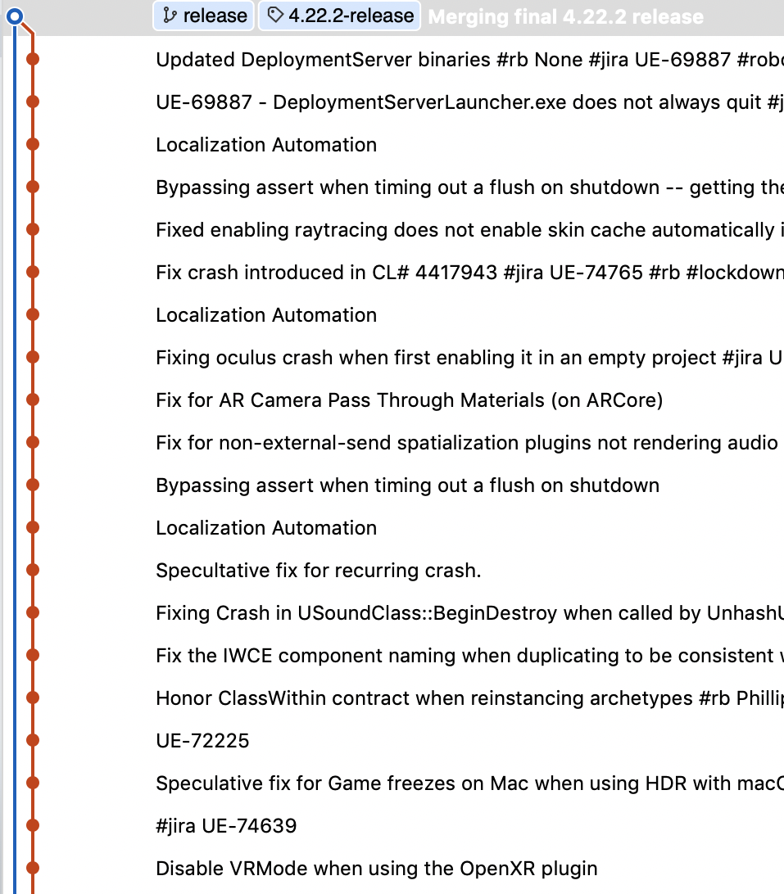
GIT version control
Version control software keeps track of the history of changes made in a code project, For UE4 this is every change, thousands per version, back to when it was put on github in 2014.
This is how UE4 software is distributed, so you will need the GIT software to be able to get the source code and commit your own changes
On Windows, you can download the command-line git tools from git-scm.com (WA). On Mac and the lab computers, the command-line interface comes pre-installed (ML).
You might choose to also get a visual GUI like SourceTree, but this is not necessary.

Slide 19
git pull
git status
git add
Gets the latest changes from github and attempts to merge them with your own changes. Conflicts (changes in binary files or in the same lines of code) may require you to assist with the merge by choosing which binary file to keep or editing the merged code.
git commit
git push
Tells you what files have changed, and what is ready to be committed.
Adds files to the list to include in the next commit. You use git add to add any change to the next commit (whether that change adds, changes, or removes files).
Checks in a new version to your local git repository. Only commits changes from git add.
Sends your local changes to the online repository at github. Only works if
you have done a git pull, resolved any conflicts, and are up to date.
git fetch
Gets the latest changes from github like git pull, but doesn't attempt to merge them with your changes yet.
git merge
Manual control over merging. git pull just does a streamlined fetch then merge.
Git Basics
There are plenty of online resources for doing anything complicated in git. For basic use, you need to know just six commands.

Slide 20
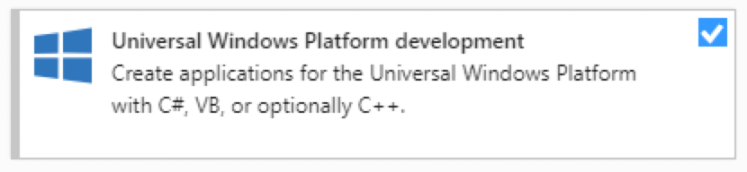
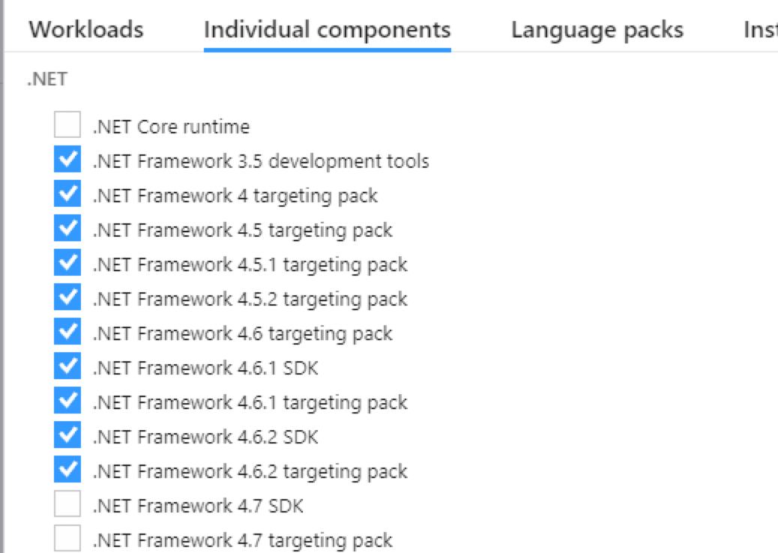
IDE & C++ Tools
On Windows, you’ll need Visual Studio (WA).
Be sure to configure it for the .NET desktop development, Desktop development with C++, Game Development with C++, and Universal Windows Platform Development workloads.
You’ll also need to add the 4.6.2 version of .NET as an individual component, since that version isn’t included in the basic .NET workload.
On Mac, you’ll need Xcode (M).

Slide 21
Accounts & Setup

Slide 22
Setting up your Accounts
Create a GitHub account if you don’t already have one.
Send me your git username so I can give you access to the class repository

Slide 23
Setting up your Accounts
Create an Unreal Engine account if you do not already have one, and link your GitHub account to your Unreal Engine profile.

Slide 24
Getting the UE4 Source Code
Making a fork of the g4g2021 repository on GitHub (which was forked from the main Unreal Engine repository). This will allow you to share access with the TA and instructor.
You can send changes of general interest back to Epic in a pull request.
GitHub only allows you to have one fork from the same base repository at a time, so if you already have a fork of the Unreal Engine, you may need to set up a new github account for this class.

Slide 25
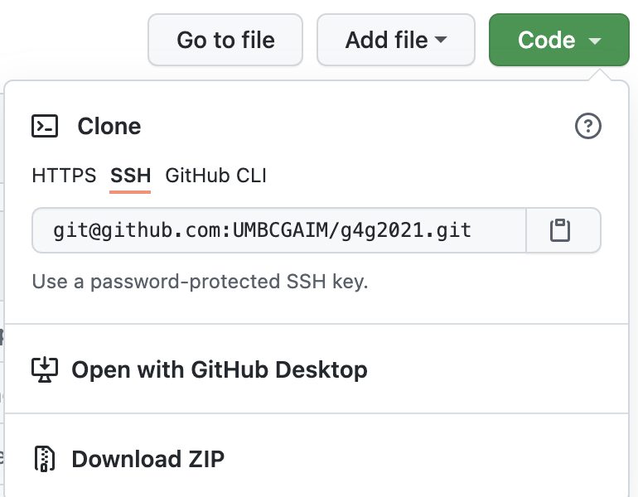
Setting up your Account
Try HTTPS access or follow the directions to enable SSH github access. HTTPS is easier, but SSH is generally more reliable. Do not use the GitHub CLI access, it doesn’t support all of the git commands.
Clone your copy to a local drive. This gives you a copy of the git repository with all of its history. You can make changes to this copy, and even commit new versions of files. None of these are reflected on GitHub unless you push those changes back.
Run the UE4 Setup script to download some additional files and get your repository ready to use.
This is in your clone directory
Lab computers: cancel out of and ignore any admin permission pop-ups (L)

Slide 26
Git Cloning Tips
DON’T use the GitHub web interface except for overall repository actions (fork, pull request, repository permissions). For everything else, use local git commands or a local git GUI.
For a minimal repository size, consider a shallow clone with the “--shallow-since 8/18” option for git clone. This will limit how far back in the history your local copy goes.
UE4 uses git tags for each release. I’ve already removed tags from g4g2021, but if you use a shallow clone in your own work, also use the --no-tags option to avoid getting all of the code for older tags you don’t want. Then you can explicitly fetch the tags you do want.

Slide 27
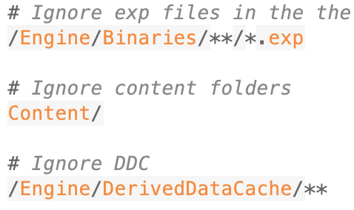
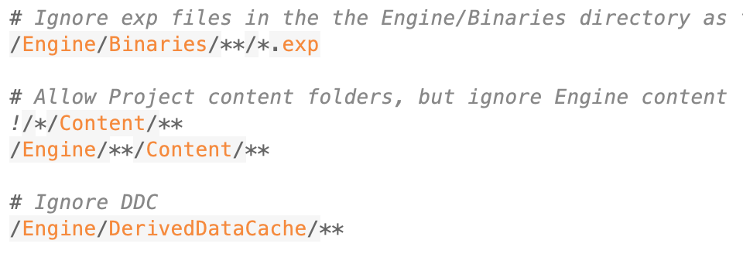
GIT Ignore
Your git repository includes a .gitignore file that tells it which files should and should not be checked into git.
The UE4 one is set to ignore all Content files, but when we put projects into the git directory, we will want those project Content files to be included. We need to edit the .gitignore to tell it to include those.
Once it’s edited, we should check in the changed .gitignore file.
git status
Refresh index: 100% (118712/118712), done.
On branch release
Your branch is ahead of 'origin/release' by 1 commit.
(use "git push" to publish your local commits)
Changes not staged for commit:
(use "git add <file>..." to update what will be committed)
(use "git checkout -- <file>..." to discard changes in working directory)
modified: .gitignore
no changes added to commit (use "git add" and/or "git commit -a")
git add .gitignore
git commit -m "Change gitignore to allow project content"
[release 8058f18acb5] Change gitignore to allow project content
1 file changed, 7 insertions(+), 2 deletions(-)

Slide 28
Tuning GIT Performance
The size of the UE4 codebase can strain git, and online sources don’t always help. “I tried it on a large repository with hundreds of files, and performance was fine” is not much help when you are working with 100K files. Here are some things to try. With each, time a build or git operation to see if it helps.
  git update-index --split-index
    This splits git’s internal index into smaller parts
  git update-index --test-untracked-cache
    This tells you if the modification times on your file system are reliable enough to use in place of scanning individual files.
    If that says OK, use ”git update-index --untracked-cache”
  Edit Engine/Saved/UnrealBuildTool/BuildConfiguration.xml
    Between the “<Configuration…>” and “</Configuration>” add
      <SourceFileWorkingSet>
      <Provider>None</Provider>
      </SourceFileWorkingSet>
    Skips a git check during the build that can time out if too slow.
    If your build output has a timeout message, you need this.

Slide 29
GenerateProjectFiles
Run this script to generate the Visual Studio solution or Xcode project. Rerun only when you add or remove a file.
Build
Open the UE4 file generated by GenerateProjectFiles. Do a Development Build of UE4. This will take at least an hour or two.
Run
Use the “Run” button in your IDE toolbar to start UE4. The first time you run, it will take a while to start as it does some first-time setup.
Building the UE4 Editor

Slide 30
Distributed Builds
Local System
Remote Build
Remote Build
Remote Build
Remote Build
Remote Build
Remote Build
Remote Build
Remote Build
Remote Build
The easiest way to get a faster build is to spread the work. We can’t really use these, but if you are ever working with UE4 in a professional environment, you’ll want to know about them.
IncrediBuild is a commercial product on Windows that will distribute your build across multiple machines. If you install it, it is automatically integrated into the UE4 build process.
FastBuild is a free alternative, but the existing FastBuild configurations for UE4 on github haven’t been updated for a couple of years.

Slide 31
Build Tips
Editing a single cpp file will be a quick incremental rebuild. Editing a widely used header can lead to rebuilding most of the engine.
Try to practice include what you use to reduce the impact of header changes:
Only include headers you directly use
If a class interface only uses another class by pointer or reference, use a forward declaration of the class rather than including its header.
Put class implementation code in a cpp file, not in the class header, to avoid having to recompile additional files if the implementation changes but the interface does not.

Slide 32
Running

Slide 33
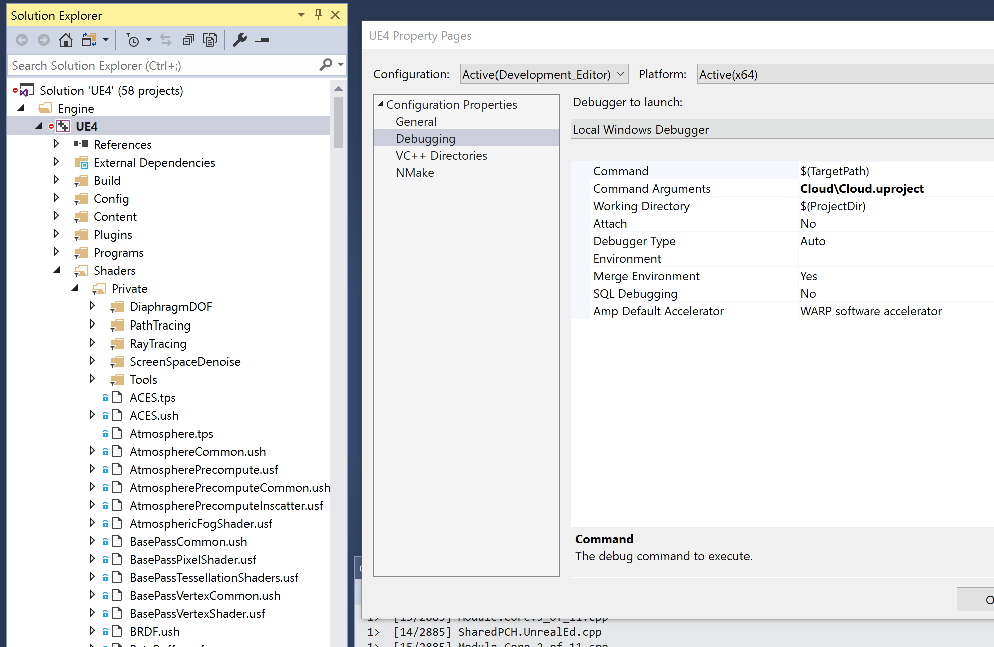
Running UE4 Projects
If you put UE4 game projects in the base directory of your UE4 git repository, GenerateProjectFiles will add them to the engine build files. This makes it easier to debug project and engine changes together.
On Windows, you can set the command line options in the Debugging pane of the UE4 project properties in the Visual Studio Solution Explorer.
  The UnrealVS plugin makes it easy to switch to a game project built this way, and to change the command-line options, but can hang on some systems. If this happens to you, open Visual Studio directly (without opening the UE4 solution) and disable the plugin in Tools > Extensions and Updates
On Mac, choose your game project from the selector in the Xcode window toolbar, and set command line options in the “Edit Scheme” dialog.

Slide 34
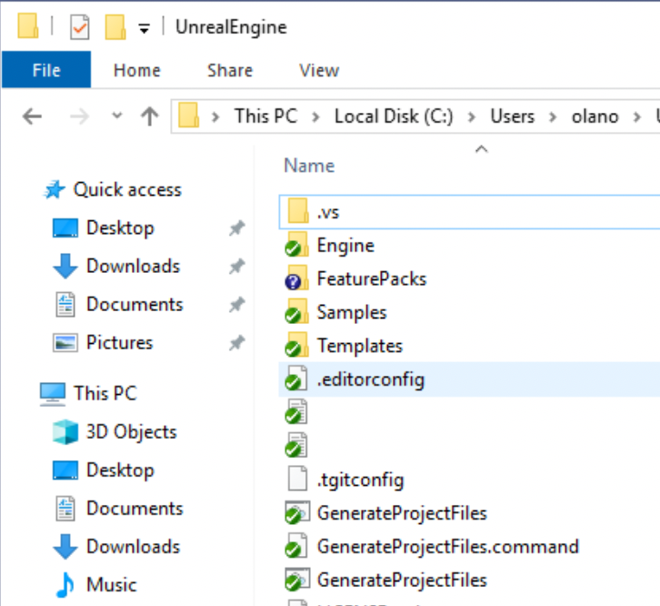
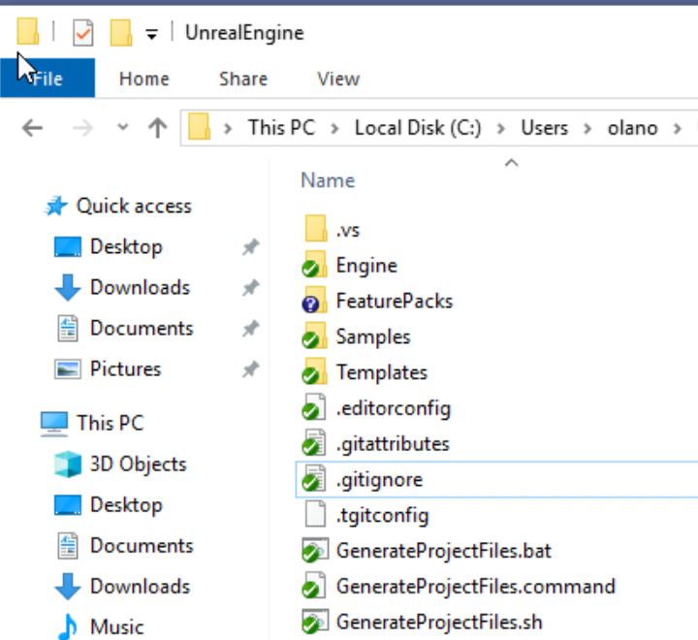
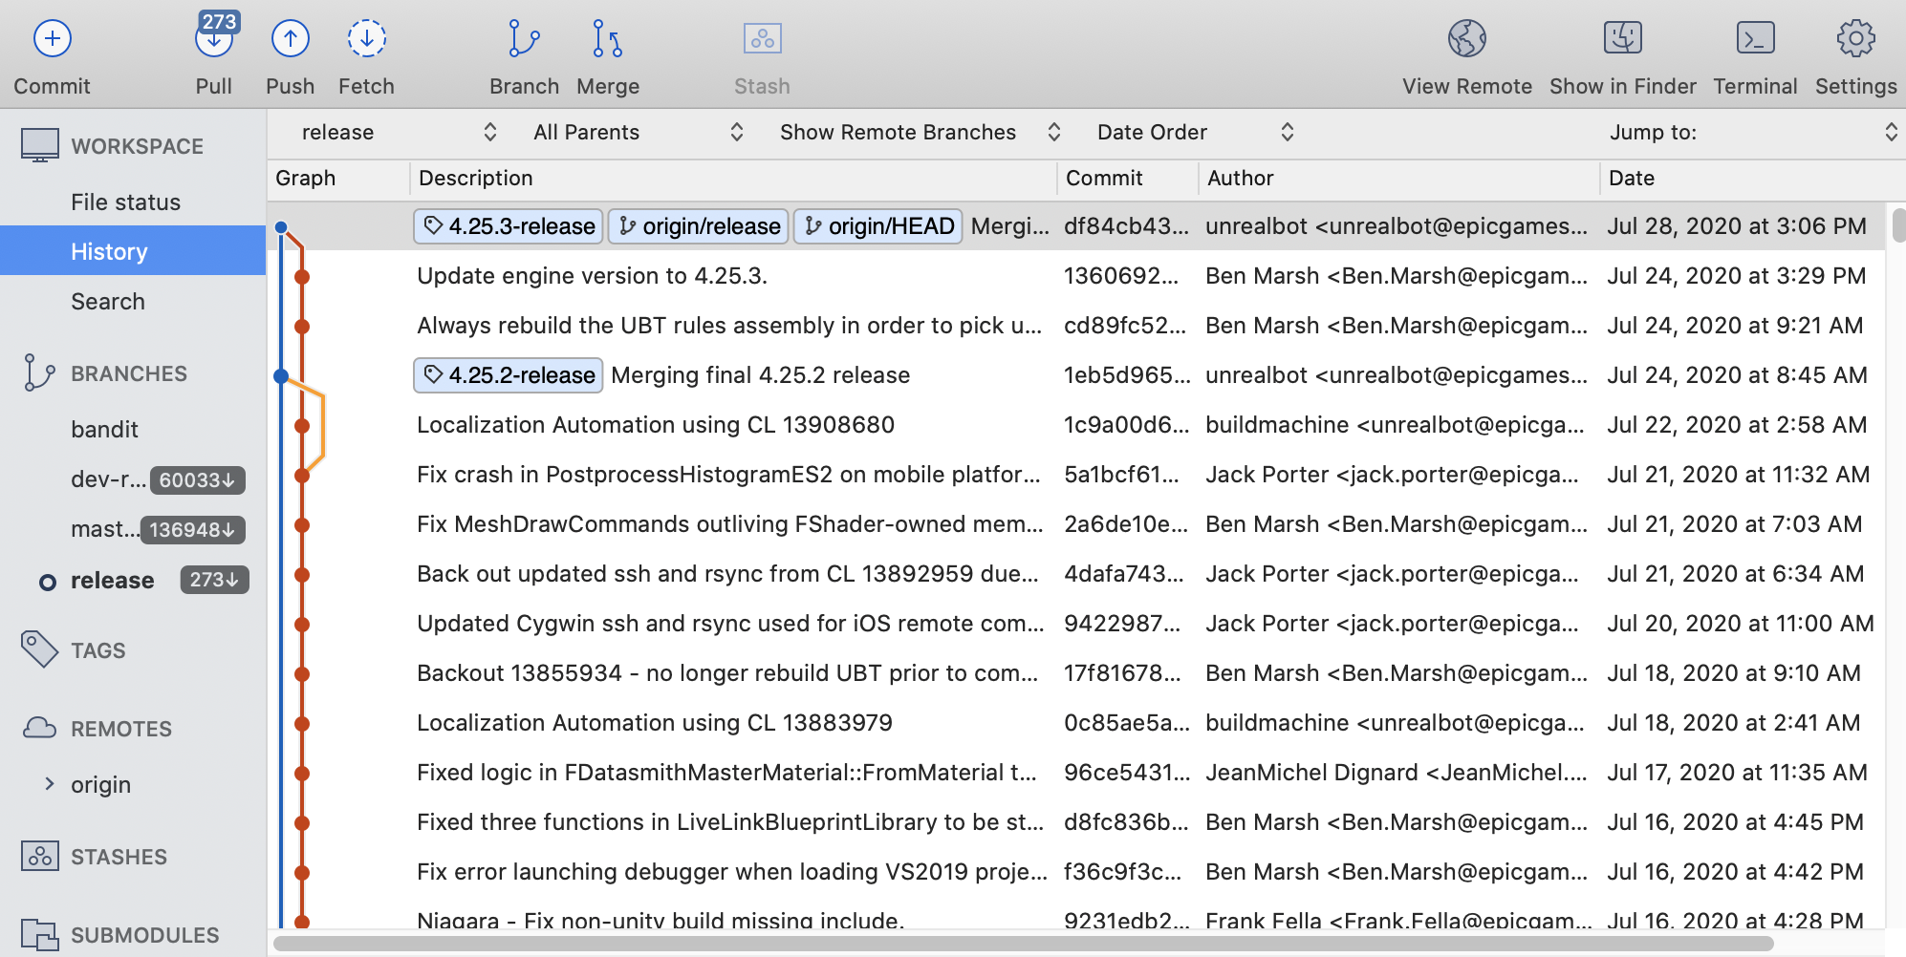
Additional Tips
Show file extensions (WLA)
File Explorer > View > File name extensions
Great for those config files starting with .
Consider a visual git GUI (WMLA)
I like SourceTree or Fork
Turn off any non-security Windows or Mac auto-updates
A new OS or IDE update can break your build!

Slide 35
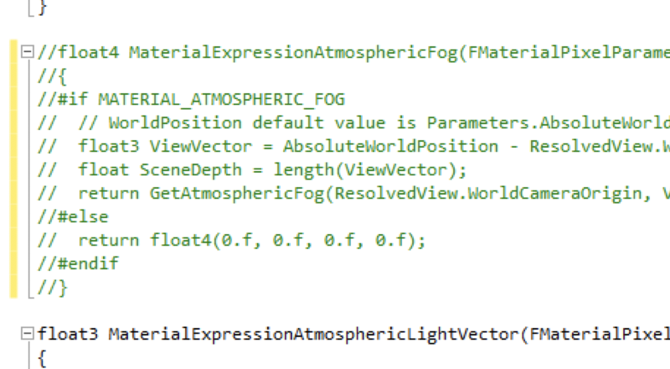
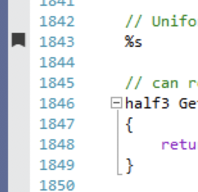
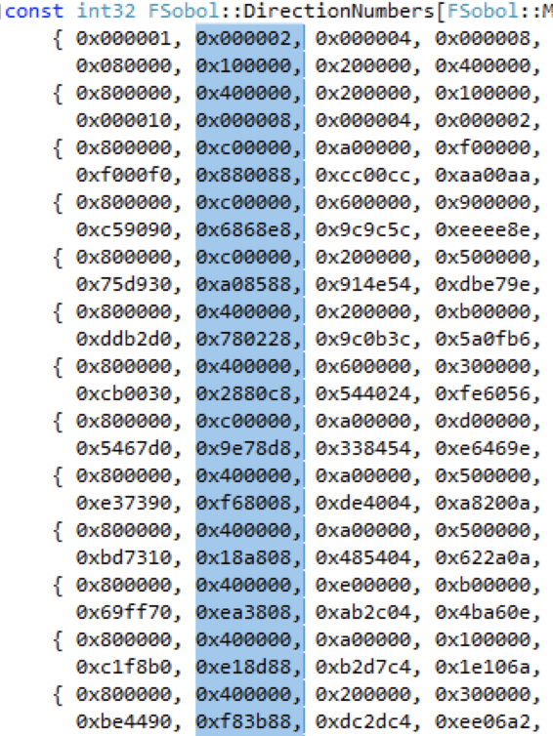
Visual Studio Tips (WLA)
Turn on VS build timing (WLA)
Tools > Options > Projects and Solutions > VC++ Project Settings > Build Timing;
Tools > Options > Projects and Solutions > Build and Run > Build output verbosity = Normal
Handy keyboard shortcuts
Comment/uncomment blocks of code:
Ctrl-K Ctrl-C; Ctrl-K Ctrl-U
Re-indent a block of C++ code:
Ctrl-K Ctrl-F
Bookmark / move between bookmarks
Ctrl-K Ctrl-K / Ctrl-K Ctrl-N; Ctrl-K Ctrl-P
Rectangular select / edit
Alt + select

Slide 36
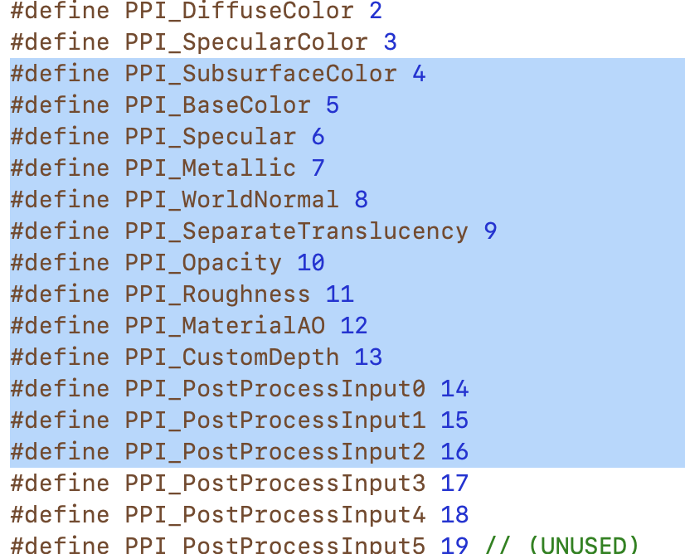
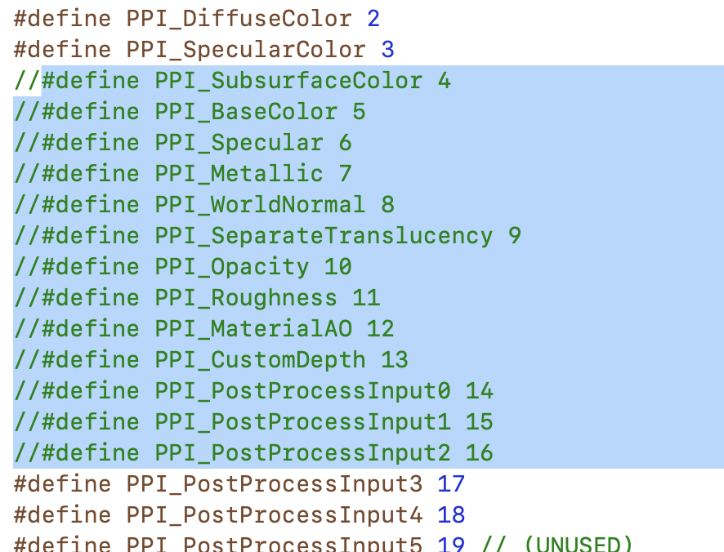
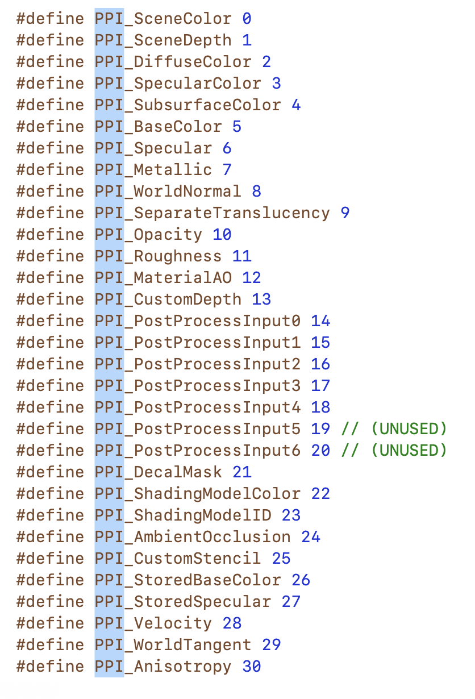
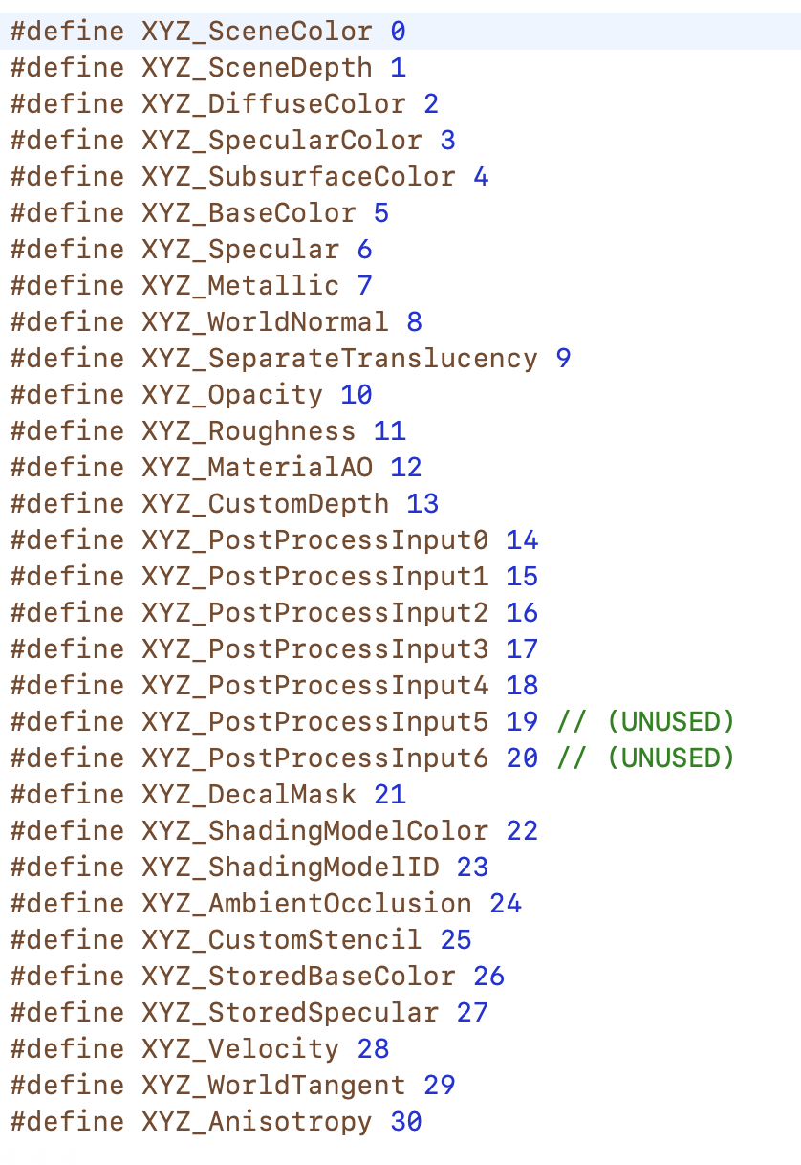
Xcode Tips (M)
Comment Block
⌘ /
Editing a bunch of stuff at once (anything you type or paste applies to all lines or copies)
Rectangle: ⌥ + select
Additional matching words: ⌥⌘E
Edit > Select All Find Matches

