Slide 1
Navigating a Large Codebase

Slide 2
The goals of this lecture are to
  Learn skills for finding things in a large source code project like the Unreal Engine
  Learn how to get a big-picture idea of how one part of a big project like UE4 works
  Learn how to develop detailed knowledge to change or duplicate one small component of a large software project like UE4
By the end of this lecture you will be able to
  Search the UE4 source to find relevant points in the code
  Combine knowledge about algorithms with stepping through the code to get a high-level understanding of one part of UE4
  Understand the basics of finding and duplicating sample code

Slide 3

What Is a “Large” Codebase?
The Unreal Engine is
13M lines of C++ in 82K files
773K lines of C# in almost 3K files
177K lines of shader code in almost 700 files
And you didn’t write it.
No one person did.

Slide 4
Big Picture
Broad understanding of how a large component of the code works
Local View
Detailed understanding of a small part of the code so that you can make changes
Two possible goals:
Develop a big-picture understanding.
Develop a local view.

Slide 5
Tools of the Trade

Slide 6
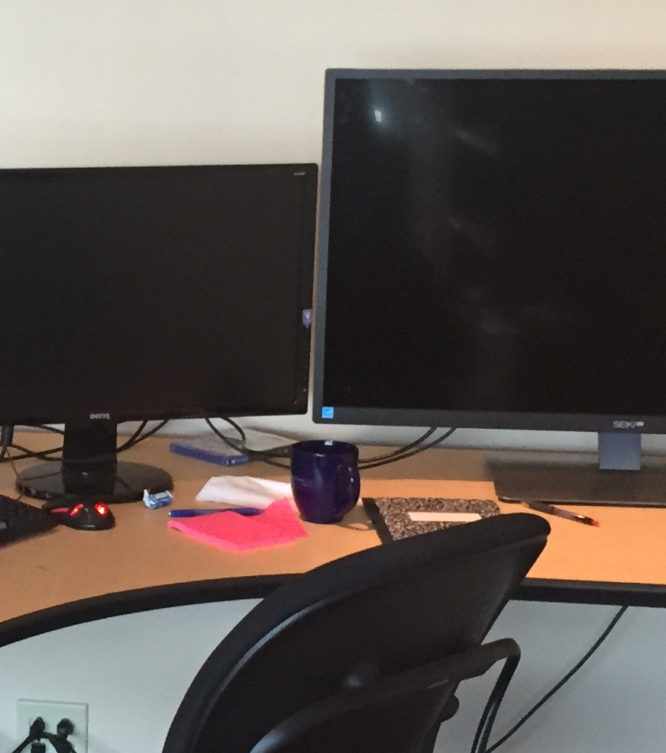
Notepad
You’ll need paper or a text editor for notes.
Write down what’s going on: sequence of operations, interesting files and functions, etc. It’s hard to keep everything in your head, especially when first figuring something out. Notes can serve as that storage and as reminders.
Consider writing your notes as a blog post or wiki to your future self.
You can also bookmark locations in your IDE.
In Visual Studio, set a bookmark with Ctrl-K Ctrl-K. Navigate bookmarks with Ctrl-K Ctrl-N or Ctrl-K Ctrl-P.

Slide 7
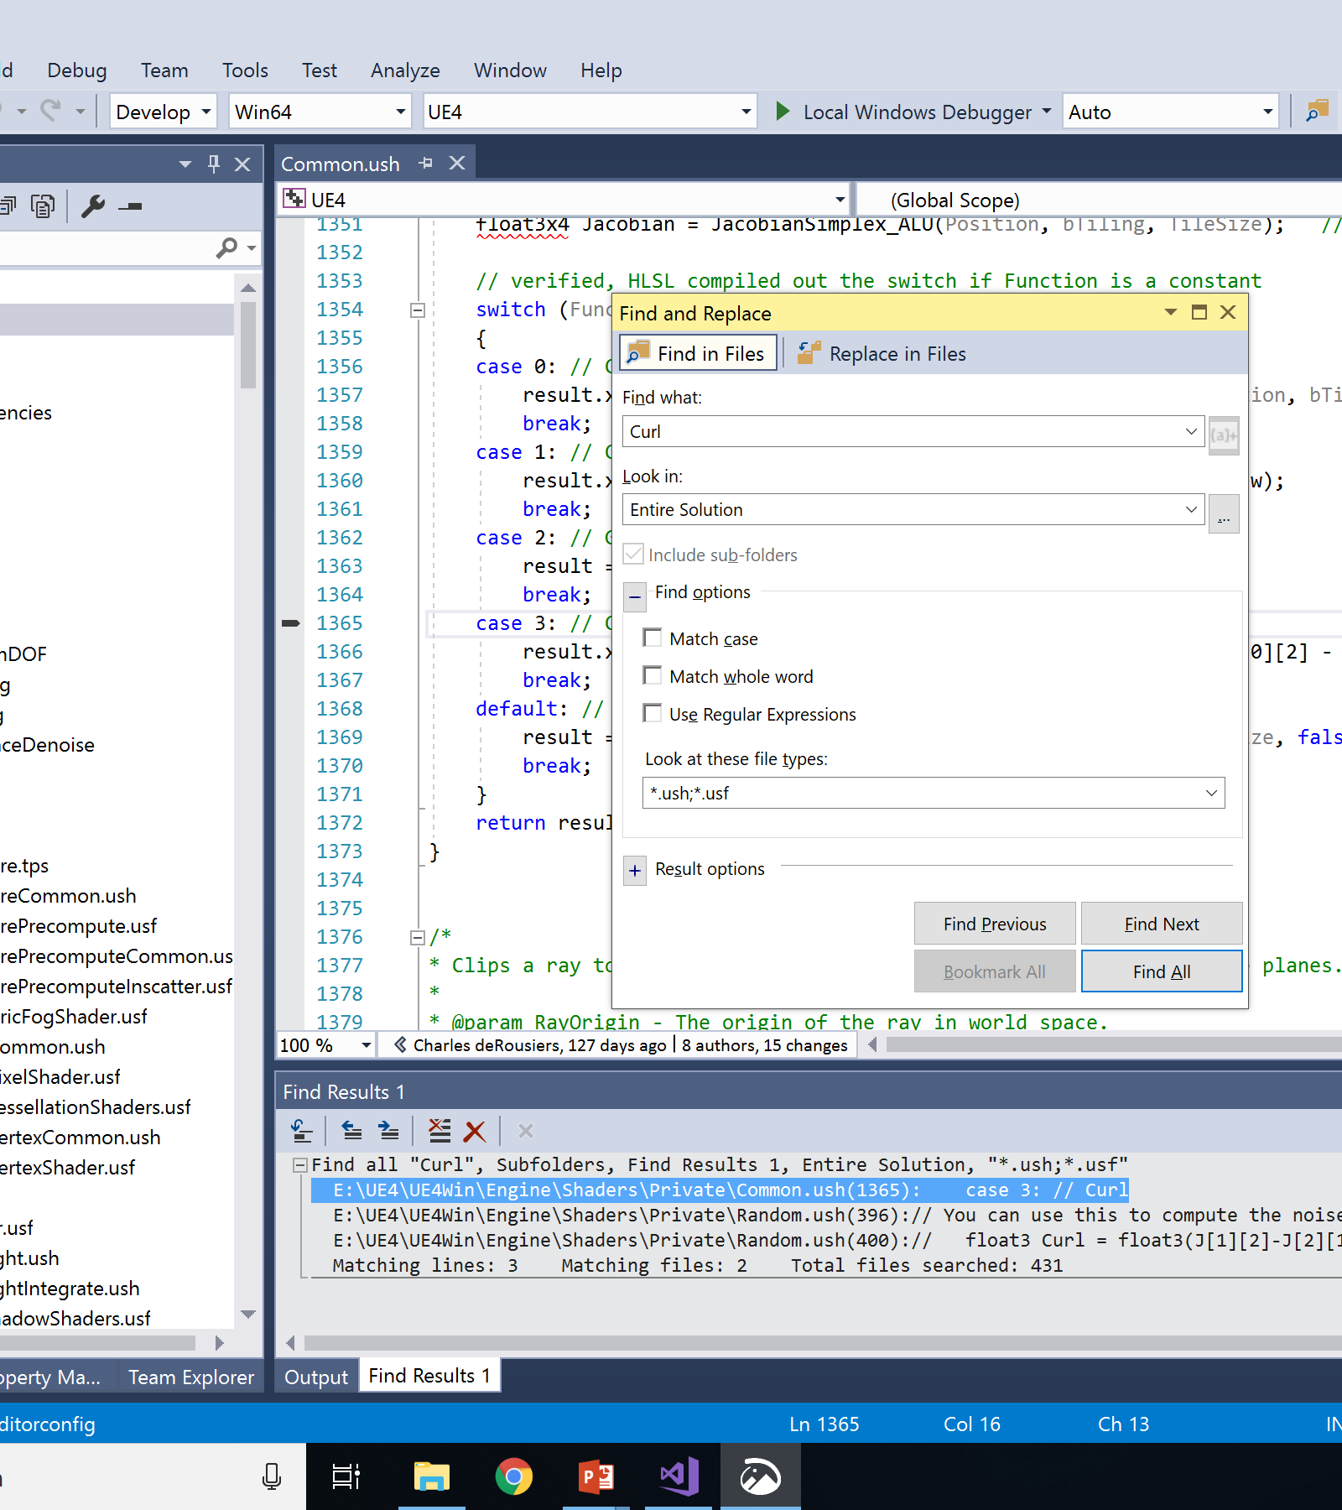
Search Tool
One of the most valuable skills for finding your way around new code is searching through the source files.
In your IDE:
Visual Studio “Find in Files” (Ctrl-Shift-F)
Xcode search (magnifying glass tool)
Add-on (e.g., Visual Assist extension / VAX)
External tool (e.g., command-line ripgrep)
Strategies to get a handful of useful results:
Limit files (single file, project, full solution).
Limit file types (.h, .cpp, .ush, .usf).
Search for exact text of a message.
Search for an Editor node name with spaces removed (e.g., “Vector Noise” node will be “VectorNoise” in the code).

Slide 8
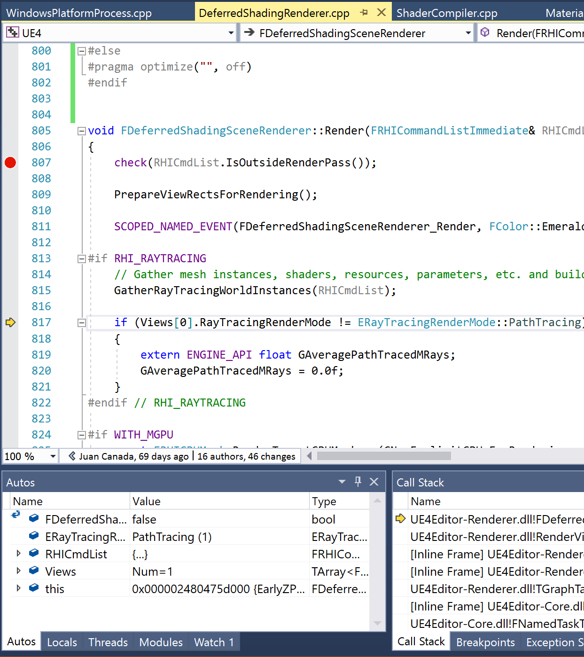
Debugger
A debugger (also known as an integrated development environment, or IDE—Visual Studio or Xcode) is one of the most powerful tools you have for understanding. Try to become an expert at what you can do.
Set a breakpoint. Look at the call stack to see how you got there. Step through the execution to see what happens. Jump ahead by running to your cursor location or until the current function returns.
Watch variables as you step through the code or even change their values to see what happens. Change values and move the execution pointer forward or backward within the current function to see what happens.

Slide 9
Big Picture
Example: Rendering

Slide 10
Big Picture
Get the basic idea of a what the application as a whole or a single system does.
Don’t sweat the details.
It’s good to start with a basic idea of what you expect to see. What algorithms do you expect? What data, inputs, and outputs?

Slide 11
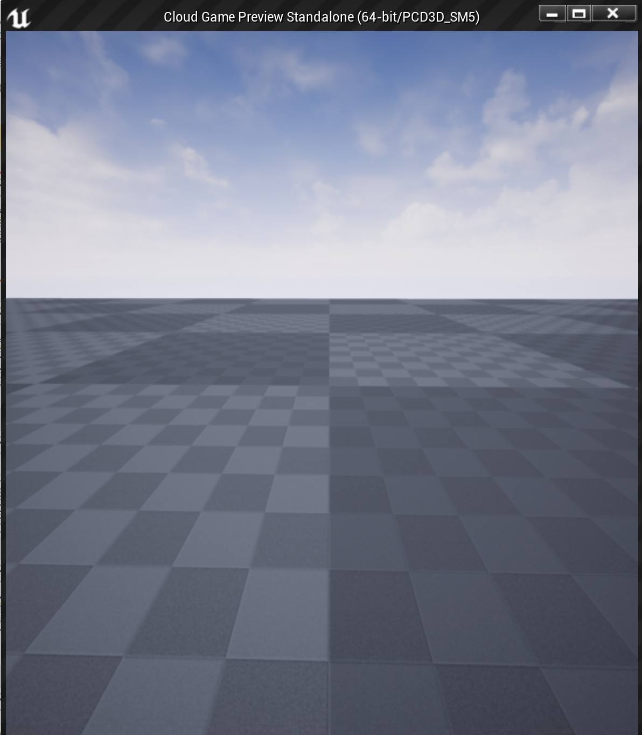
Rendering Algorithms
There are two common strategies for rendering in a game engine: forward shading and deferred shading. UE4 supports both.
How would you know that? Take a class on real-time graphics. Watch some Game Developers Conference presentations. Read some online blogs. You will need some subject-area knowledge.

Slide 12
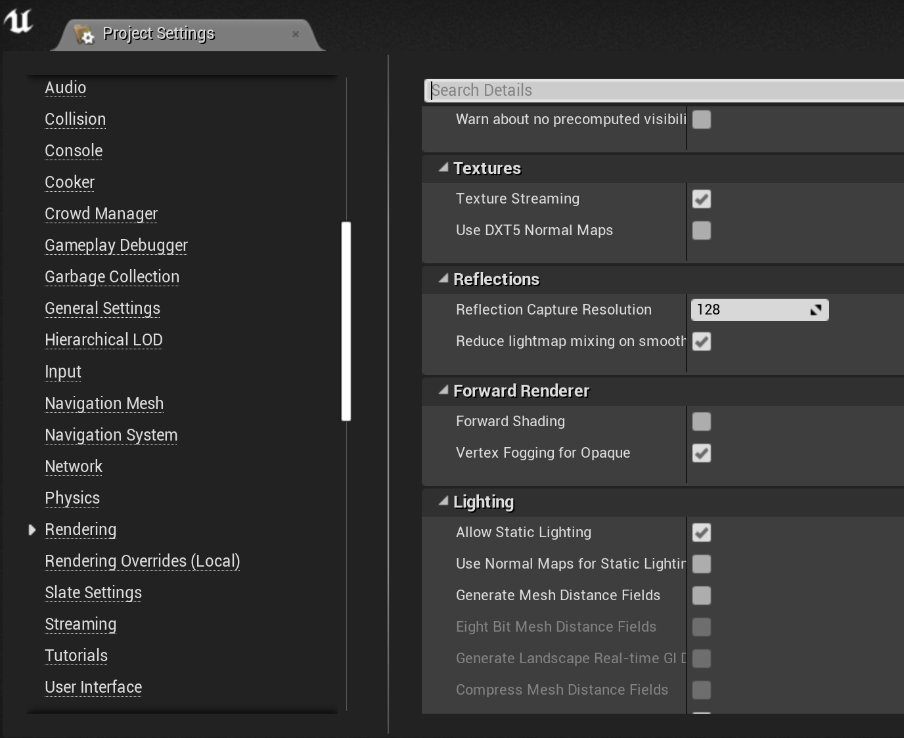
Forward Shading
Forward shading computes per-pixel shading while rendering objects.
It does redundant shading computation for pixels that are overwritten, but gives more per-object control over how the shading is done.
It can support transparency if the objects are sorted from back to front.
There are usually limits on the number and types of lights it can support, mostly because many lights will make the per-object shading functions too complex.

Slide 13
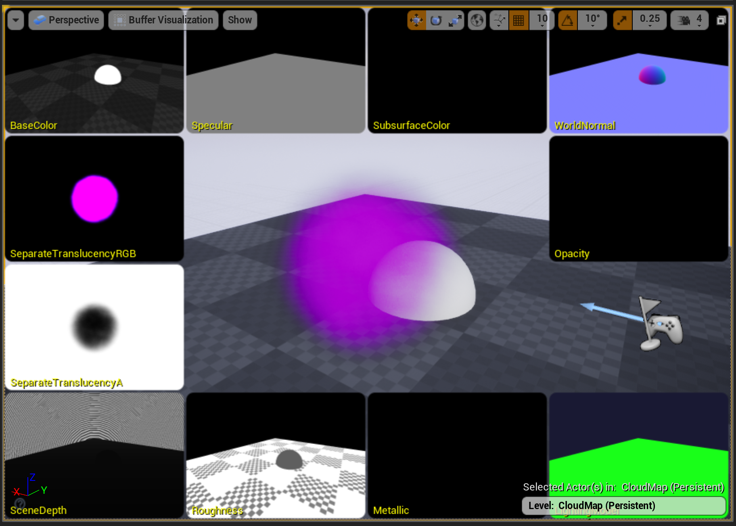
Deferred Shading
In contrast, deferred shading just saves shading parameters per pixel when doing the initial render.
In a later pass, it applies shading and lighting computations per pixel across all of the pixels at once, but these operations only need to run for the objects that were finally visible at each pixel.
The base shading code does need to be similar for all of the objects. This has been made easier by the rise of physically-based shading models in games, which more naturally deal with differing lighting situations with a single shader.
Culling lights by coverage allows tons of lights.
Transparent objects have to be handled in a separate forward shading pass.

Slide 14
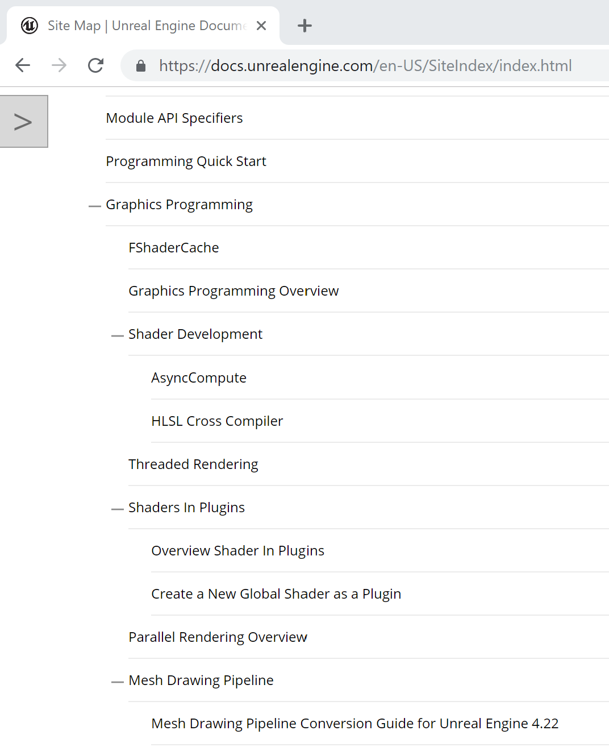
Looking for Documentation
The next step is to see what, if anything, is available to guide your search. For UE4 rendering, there’s some overview documentation.
For a publicly available engine like UE4, you can look for blog posts by others who have taken this journey before you.
Especially at a game studio, you can ask others on the team.

Slide 15
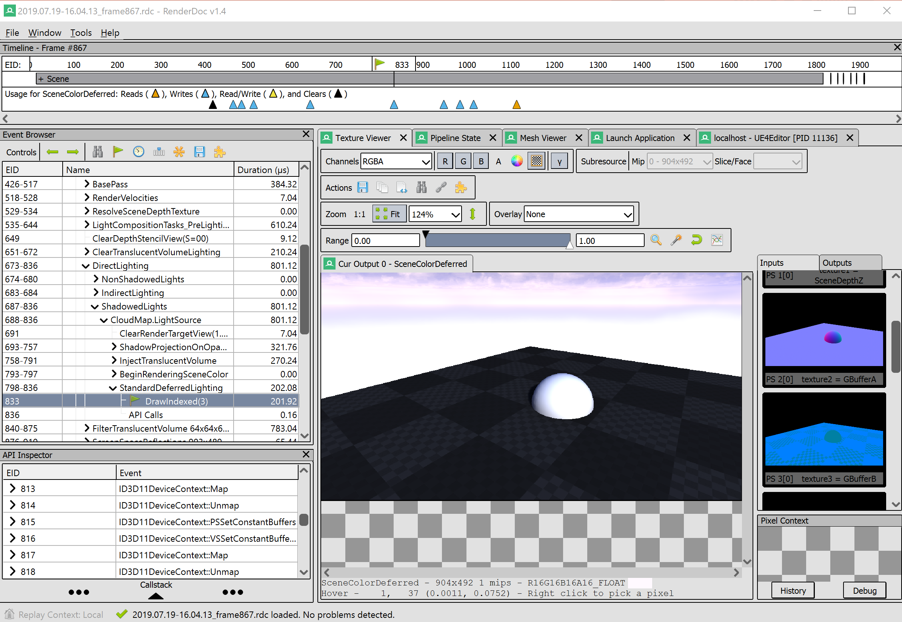
Seeing What It Does
For rendering, RenderDoc and PIX can capture every graphics operation during a frame and let you analyze the effect of each independently. There are several online sites that specialize in doing RenderDoc breakdowns of how different games render, without any need for access to the game code.
In UE4, you can open the console (` key) or Outputs window use the vis console command to look at the results from each of those passes in turn.

Slide 16
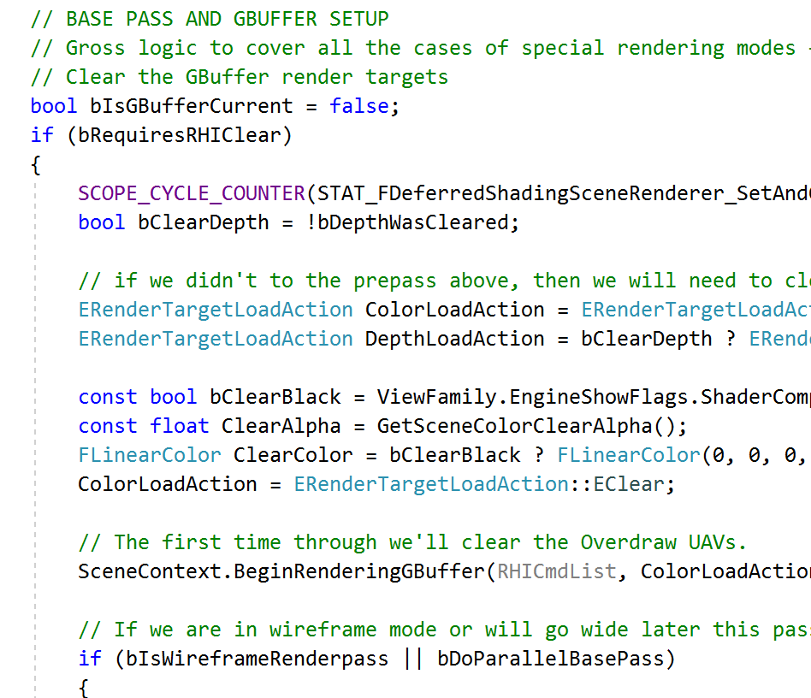
Locating Some Code
Constrain the Level you care about. Find a promising function and set a breakpoint.
Searching just the header files, “ForwardShading” appears in 16 files, “DeferredShading” in 6. If you don’t find any hits on the first thing you search, or find too many, try another search term. With only a few, “DeferredShadingSceneRenderer” sounds promising. Of its member functions, “Render” looks good.
Read through this function to see what operations it performs and in what order.

Slide 17
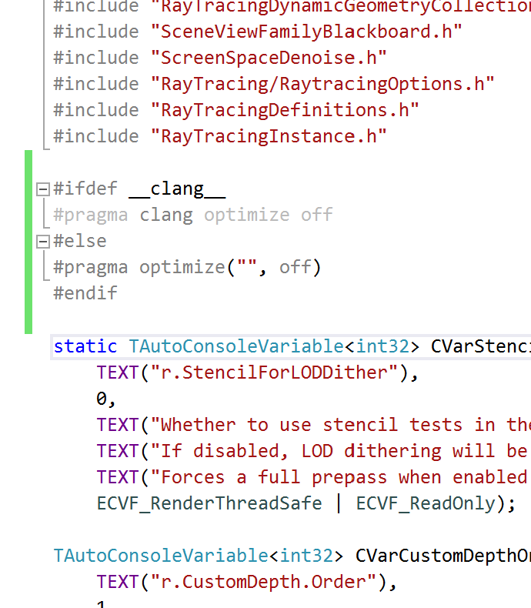
Enabling Debugging
To get a better understanding, you’ll want to step through line-by-line. The Development build of the Editor includes optimization that makes debugging difficult. You can turn it off at the top of a file, and turn it back on again at the bottom:
Visual Studio
  #pragma optimize("", off)
  #pragma optimize("", on)
Xcode
  #pragma clang optimize off
  #pragma clang optimize on
Don’t check this in!

Slide 18
Stepping Through the Code
Rebuild with optimization off only in DeferredShadingRenderer.cpp. This should be quick, since it only has to rebuild the one file and repackage the rendering library.
Set a breakpoint in the Render function. Look at the call stack to see where this fits into the other operations. Step through the functions. You can step into some, but mostly for a big-picture view you just want to see what code path is being used.

Slide 19
Local View
Example: Rendering

Slide 20
Local View
Understand how one thing works, usually to make changes, or to use as a model for creating something similar.
You need to find and understand the local code.
You want to understand who calls it, and with what assumptions.
You want to understand what it calls, and what those things do (but not necessarily how).

Slide 21
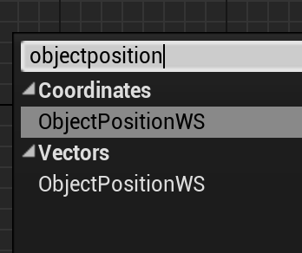
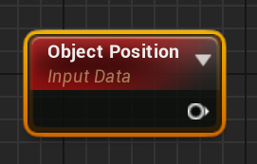
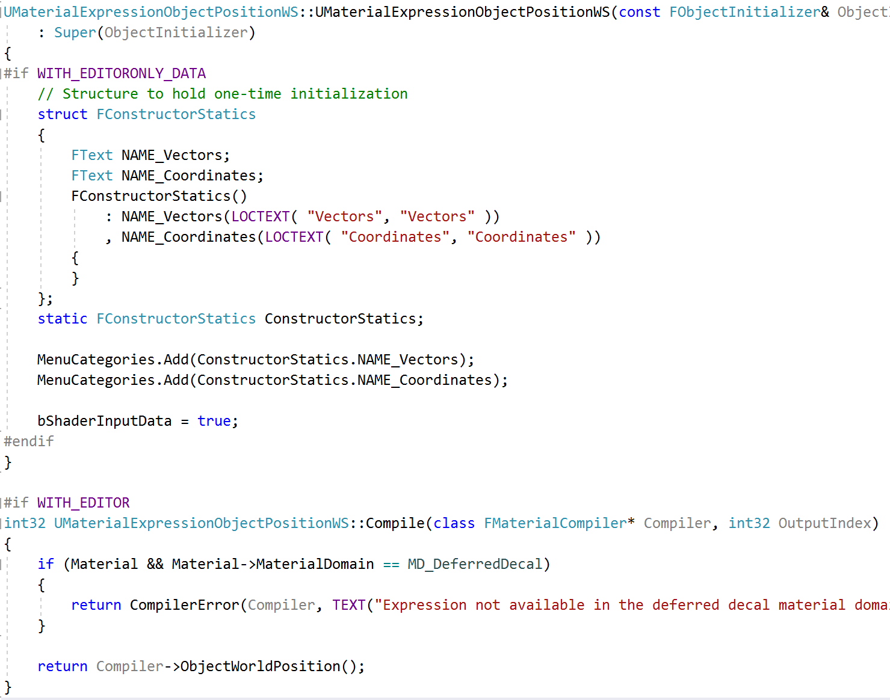
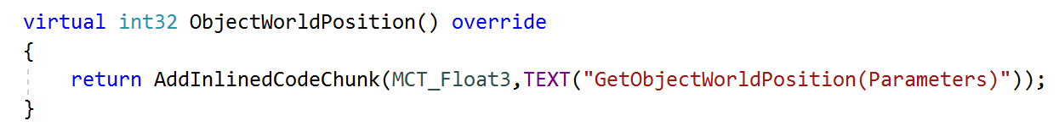
New Material Node
MaterialExpressions.cpp
Find a uniquely named Material node, similar to what you want.
Copy and rename everything it does.
Modify it to your new purpose.
HLSLMaterialTranslator.cpp

Slide 22
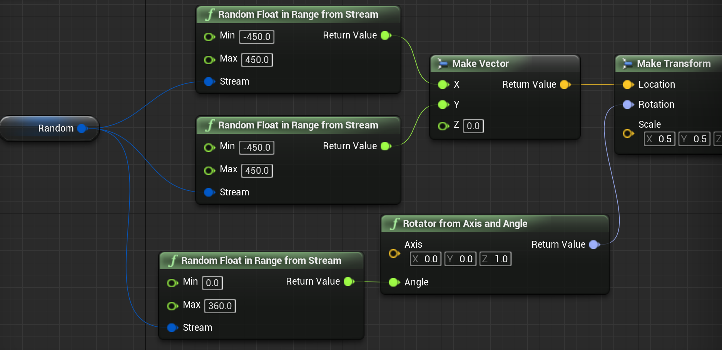
New Blueprint Node
Find a uniquely named Blueprint node, similar to what you want.
Copy and rename everything it does.
Modify it to your new purpose.
Note that generally it is preferable to put code for new Blueprint nodes into a plugin.
KismetMathLibrary.h
KismetMathLibrary.cpp

Slide 23
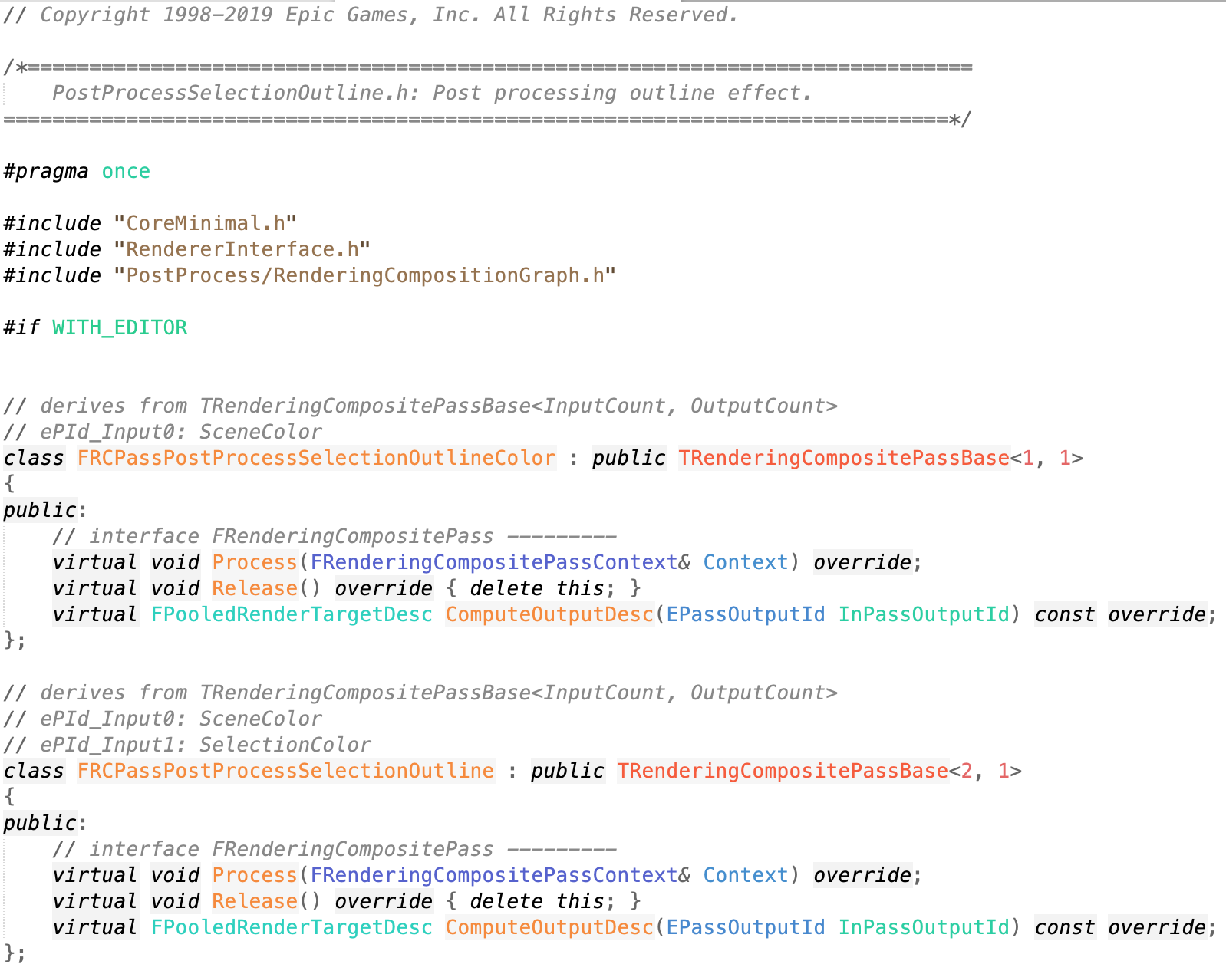
New Post Process Pass
Find a uniquely named Post Process pass, similar to what you want.
Copy and rename everything it does.
Modify it to your new purpose.
. . .
You get the idea.

Slide 24
Summary

Slide 25
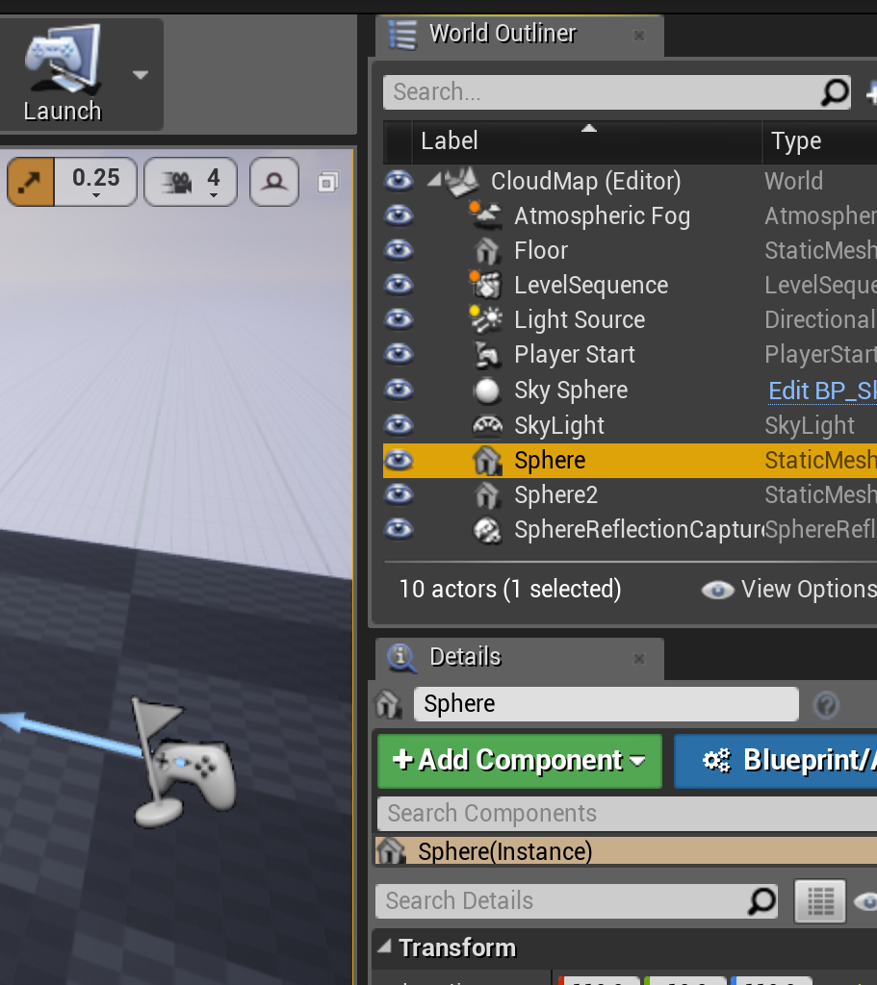
Navigating UE4 Code
Learn about the problem domain, and what algorithms might be used.
Look for external resources as a guide. These are helpful, but not necessary.
Search for algorithm names, message text, node names from the Editor, or anything to get a foothold on where to start exploring.
Use your debugger, and take notes as you step through the code to build a local understanding.
Constrain any exploration to one or two layers and one system. You don’t need to understand everything to start making changes.

