Slide 1
Graphics Hardware
UMBC Graphics for Games

Slide 2
CPU Architecture
Start 1-4 instructions per cycle
Pipelined, takes 8-16 cycles to complete
Memory is slow
  1 cycle for registers ~2⁰
  2-4 cycles for L1 cache ~2²
  10-20 cycles for L2 cache ~2⁴
  50-70 cycles for L3 cache ~2⁶
  200-300 cycles for memory ~2⁸

Slide 3
CPU Goals
Make one thread go very fast
  Avoid pipeline stalls
Branch prediction
  Don’t wait to know branch target (misprediction ~64 instructions)
Out-of-order execution
  Don’t wait for one instruction to finish before starting others
Memory prefetch
  Recognize common access patterns, get data to fast levels of cache early
Big caches
  Though bigger caches add latency

Slide 4
CPU Performance Tips
Avoid unpredictable branches
  Specialize code
  Avoid virtual functions when possible
  Sort similar cases together
Avoid caching data you don’t use
  Core of data oriented design / Structure of Arrays organization
  struct{position,velocity}[N] vs. struct{position[N],velocity[N]}
Avoid unpredictable access
  O(N) linear search faster than O(log N) binary up to 50-100 elements
    Linear access = can prefetch; branch predictable (keep looping) until final iteration
  Asymptotically worse, but for small N, constants matter
  Don’t underestimate how big small N can be

Slide 5
GPU Goals
Make 1000’s of threads running the same program go very fast
  Hide stalls
Share hardware
  All running the same program
Swap threads to hide stalls
  Large, flexible register set
  Enough for active and stalled threads

Slide 6
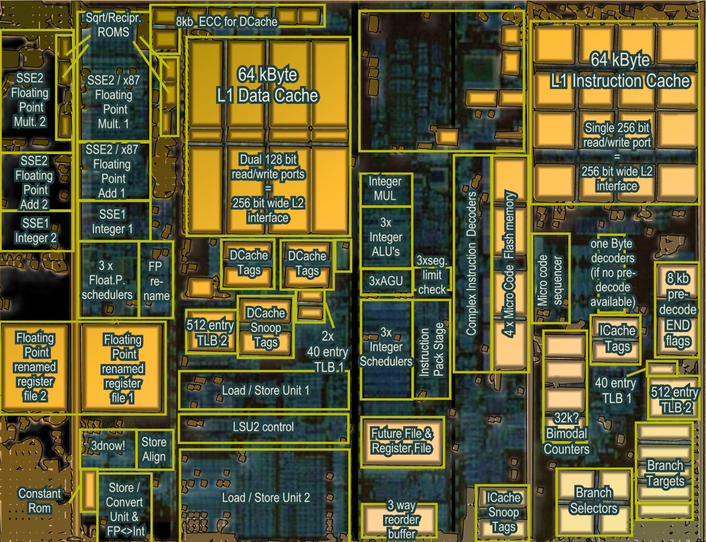
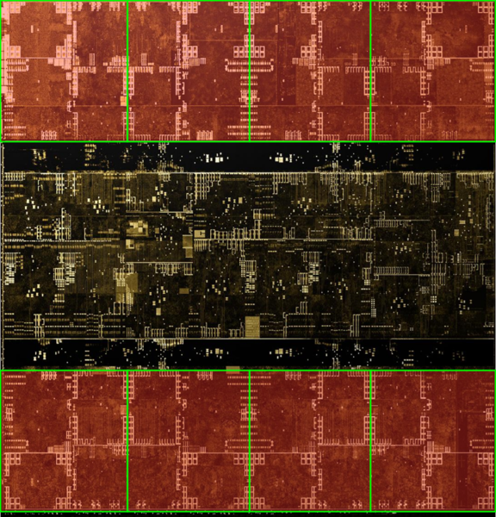
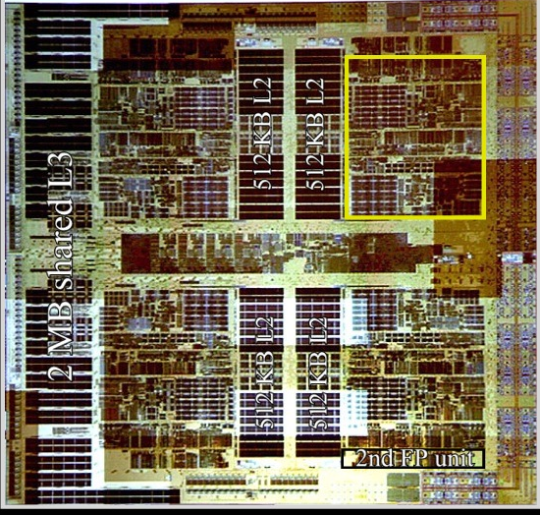
Architecture (MIMD vs SIMD)
Actual computational
Units
SIMD (GPU-Like)
MIMD (CPU-Like)
(AMD K10 chip-architect.org)
(NVIDIA Volta / wikichip.org)
Flexibility
Horsepower
Ease of Use

Slide 7
SIMD Branching
if( x ) // mask threads
{
// issue instructions
}
else // invert mask
{
// issue instructions
} // unmask
Threads agree
Threads disagree
or
THEN

Slide 8
SIMD Looping
Active
% Active = Utilization
Inactive
while(x) // update mask
{
// do stuff
}
Everyone runs as long as slowest
This example: 36% utilization
(64 blocks useful work / 176 blocks potential work)

Slide 9
GPU Programming Model
Vertex
Vertex Shader
  Runs on one
  vertex at a time
Rasterizer
  Collects sets of
  three vertices
Pixel
  Runs on one pixel
  at a time
Texture/
Buffer/
Cache
Rasterize
Displayed
Pixels
Pixel
Z-buffer/
Blend

Slide 10
GPU Processing Model
SIMD for efficiency
  Same processors
  for vertex & pixel
SIMD Batches
  Limits on # of vertices &
  pixels that can run together
  Improve Utilization
  Limit divergence
Basic scheduling
  If batch of pixels, run it
  Otherwise run some
  vertices to make more pixels
Texture/
Buffer/
Cache
Vertex
Displayed
Pixels
Pixel
Z-buffer/
Blend
Rasterize

Slide 11
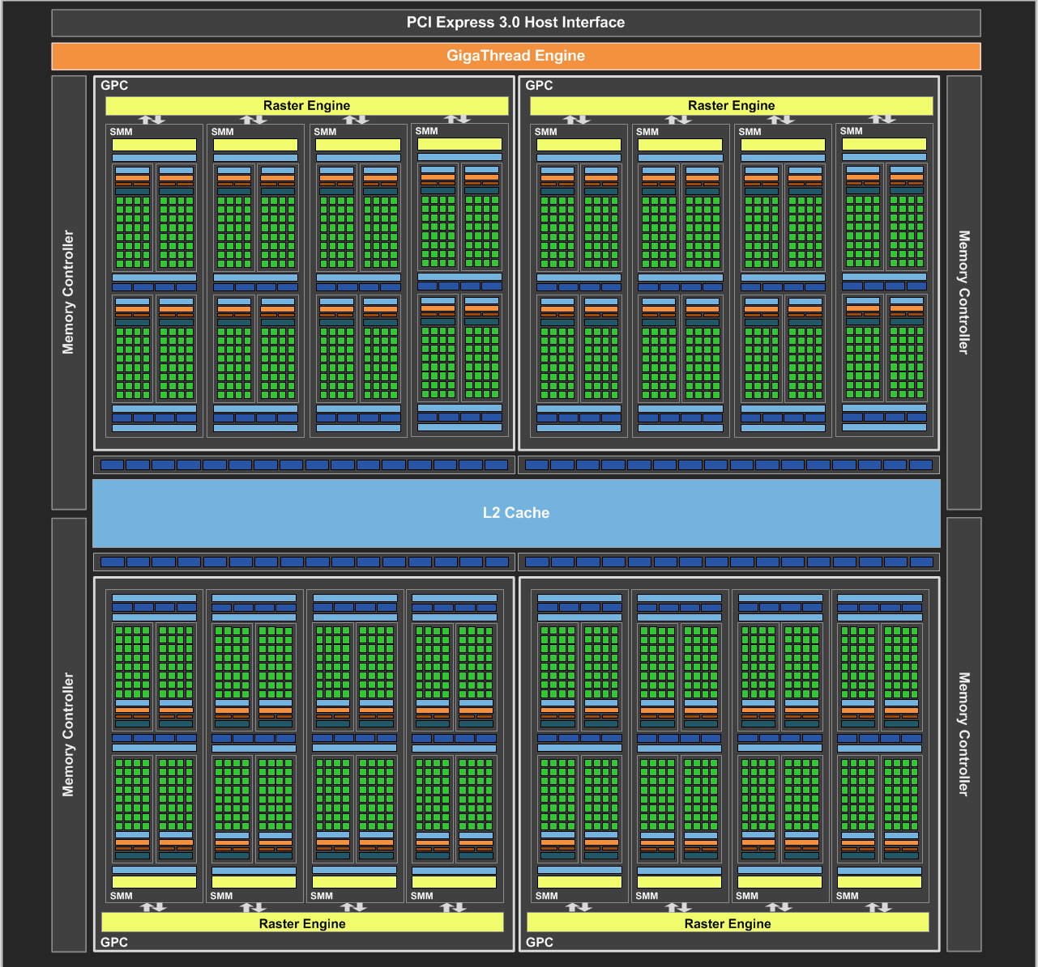
NVIDIA Maxwell
[NVIDIA GeForce GTX 980 Whitepaper, 2014]

Slide 12
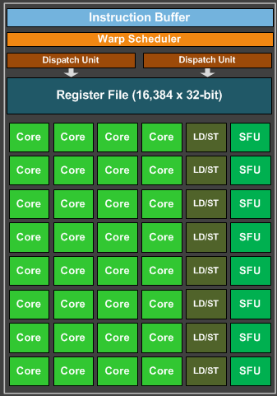
Maxwell SIMD Processing Block
32 Cores
8 Special Function Units (SFU)
  Double precision, trig, …
  Still issue 1/thread, but run ¼ rate
8 Load/Store memory access
  Hide latency by interleaving threads
Wave (AMD) / Warp (NVIDIA)
  One set of lanes (AMD) / threads (NVIDIA)
  Want at least 4-8 interleaved
  % of max = Occupancy

Slide 13
GPU Registers
Scalar General Purpose Register (SGPR)
  Same value for all threads
  AMD term — Pixar’s Renderman (& GLSL)
  called these uniform
Vector General Purpose Registers (VGPR)
  Different value in every thread
  AMD term — Pixar & GLSL called these varying
  # wavefronts usually limited by VGPR

Slide 14
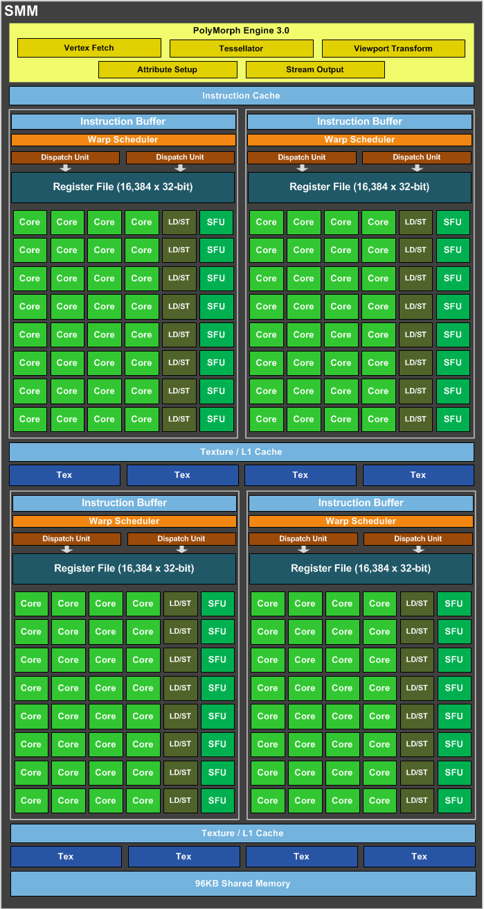
Maxwell Streaming
Multiprocessor (SMM)
4 SIMD blocks (128 total cores)
Share L1 Caches
Between-core shared memory
  Communication through this memory is fast
Share tessellation HW
  Hardware support for tessellation shaders

Slide 15
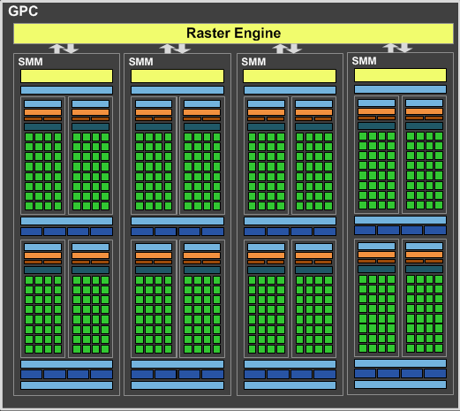
Maxwell Graphics Processing Cluster (GPC)
4 SMM (512 total cores)
Share rasterizer

Slide 16
Full NVIDIA Maxwell
4 GPC (2048 total cores)
Share L2
Share dispatch
  Decides which threads
  to launch and when

Slide 17
Newer NVIDIA Features
Tensor Cores
  4/8/16 bit matrix multiply
  Targeting AI deep learning
RT cores
  Extra ray tracing hardware at SM level
Adjust balance of float, int, and
memory units
[NVIDIA Ampere GA102 GPU Architecture, 2021]

Slide 18
Things in newer GPUs
MMMMMOOOORRRRREEEE CORES
  NVIDIA Ampere: 10,496 cores
“Tensor cores” = bunch of float16
multiply/add cores
  Targeting AI applications, but general purpose
Hardware support for new shader types
  Mesh shaders
  Ray tracing shaders
Adjust balance of float, int, and memory units
[NVIDIA Ampere GA102 GPU Architecture, 2021]

Slide 19
Graphics System Architecture
Your Code
Engine
Display
GPU
GPU
GPU(s)
API / Driver
Produce
Consume
Current Frame
(Buffering Commands)
Previous Frame(s)
(Submitted, Pending Execution)

Slide 20
Care and Feeding of a GPU

Slide 21
Parallel Submission
OpenGL and DX11 had a 1 CPU-thread bottleneck to the GPU
DX12, Vulkan and Metal are designed for multiple CPU cores to simultaneously submit work to a single GPU
Any thread can build Command Lists & submit to GPU when ready
A Command List includes all necessary state, can execute in any order
Tell GPU about resource dependencies (Barriers / Transitions)
  Enforces partial ordering of command list execution

Slide 22
Resource Transitions
What kind of memory operations does this buffer need to support?
  (CPU/GPU) (read/write) (once/many times)
  CPU write once, GPU read once; GPU write once, GPU read many times; …
Source/Target stage for the transition
  When is it ready? When will it be used?
What use should it be optimized for?
  CPU staging, Texture, Render Target, Depth Buffer, Vertex Buffer, Index Buffer,
  Graphics read/write unordered access view (UAV), Compute buffer, …
Explicitly transition between these
  E.g. between render target write in pass A and texture read in pass B

Slide 23
Setting up a Command List
What do I write?
  Render Targets, UAVs
  Transition/barrier to make sure anyone else reading or writing them is done
What do I read?
  Transition if just written or in a different format
What shader(s) am I using?
What shader parameter blocks?
  Given by Descriptors & Root Signature

Slide 24
Setting up a Graphics Command List
Begin Pass / End Pass
  Primarily necessary for batching on mobile
Rendering Graphics Pipeline State Object (PSO)
  Primitive Type: triangle list, fan, strip, quad, points, …
  Rasterizer State: Solid/wire frame, two sided / CW side / CCW side, MSAA
  Depth/Stencil State: Comparison (<, ≤,=,≠, ≥, >), update?
  Blend State:
    Transparent layer with opacity 𝛼: 𝛼 * new + (1 - 𝛼) * old
    Generalize to (a * new ^{(op)} b * old) for limited selection of a, b, and ^{(op)}

Slide 25
GPU Performance Tips

Slide 26
GPU Performance Tips: Communication
Reading results derails the CPU → GPU train…..
  Occlusion queries → Death
    When used poorly: don’t ask for the answer for 2-3 frames
  Framebuffer reads → DEATH!!!
    Almost always…
CPU-GPU communication should be one way
  If you must read, do it a few frames later…

Slide 27
GPU Performance Tips: API & Driver
Batch shader/texture/constant changes
  Batches can execute together, but not if split by other stuff
  Some engines generate a list of stuff to render, then sort it by state
Minimize Draw calls
  One instanced draw is much more efficient than many static draws
Minimize CPU → GPU traffic
  Use static vertex / index buffers if you can
    Copy from CPU to GPU once, then leave there
  Use dynamic buffers if you must
    With discarding locks: region being updated / region in queue / region being rendered

Slide 28
GPU Performance Tips: Shaders
No unnecessary work!
  Precompute constant expressions
  Divide by constant → Multiply by reciprocal
    x*(1./3.) vs. x/3.
    Not always the same in float math, compiler is not allowed to make that optimization
Minimize fetches
  Prefer compute (generally)
  If ALU/TEX < 4+, ALU is under-utilized
    4 = LD/ST to core ratio on Maxwell, worse on newer GPUs
    Worse if incoherent accesses, not in cache
  If combining static textures, bake it all down…

Slide 29
GPU Performance Tips: Shader Occupancy
Know what’s limiting you
  Memory bandwidth limited, compute limited,
  local/shared memory capacity limited, VGPR limited, …
Limit VGPR usage by specializing shaders
  In UE4, #ifdefs in shaders, compiles versions with different #define choices
  But… exponential growth in number of shader variants to compile
Limit VGPR usage with computation that’s constant across the warp
  Can re-merge with cross-wave primitives

Slide 30
GPU Performance Tips: Shaders
Careful with flow control
  Avoid divergence
  Flatten small branches (map to conditional move / predicated instructions)
  Prefer simple control structure
  Specialize shader (though can lead to 1000’s of shaders)
Double-check the compiler
  Shader compilers are getting better…
Look over artists’ shoulders
  Material editors give them lots of rope….

Slide 31
GPU Performance Tips: Vertices
Use the right data format
  Cache-optimized index buffer
  Minimal aligned packed vertex data
    E.g. (position, normal, texture coordinate); (position, normal); (position); …
    Or index into separate buffers for each vertex component used
Cull invisible geometry
  Coarse-grained (few thousand triangles) is enough
  “Heavy” Geometry load is ~2MTris and rising

Slide 32
GPU Performance Tips: Pixels
Small triangles hurt performance
  GPU always renders 2x2 pixel blocks (for texture filtering)
  Renders extra “fake” pixels to fill block → Waste at triangle edges
Respect the texture cache
  Adjacent pixels should touch same or adjacent texels
  Use mipmap if you can, adjacent in high mip level is cache miss in lowest level
  Use the smallest possible texture format
    Per texel sizes: DXT5 4b / RGBA8 4B / RGBA16F 8B / RGBA32F 16B
  Avoid incoherent texture reads (commonly from texture as data table)
Do work per vertex
  There are usually less of those (see small triangles)

Slide 33
GPU Performance Tips: Pixels
HW is very good at Z culling
  Early Z, Hierarchical Z
If possible, submit geometry front to back
“Z Priming” is commonplace (UE4 does this)
  Render with simple shader to z-buffer
  Then render with real shader
  Helps a ton for complex forward shaders, but useful even for G-buffer

Slide 34
GPU Performance Tips: Frame Buffer
Turn off what you don’t need
  Alpha blending
  Color/Z writes
Minimize redundant passes
  Multiple lights/textures in one pass
  As long as it doesn’t kill your occupancy
Use the smallest possible pixel format
Consider clip/discard in transparent regions
  Throws out pixels instead of blending them

Slide 35
GPU Performance Tips: Overall
Learn as much as possible about GPU internals
  Use that to guide your optimization decisions
Benchmark, don’t assume
  Complex interrelationships can surprise you
  Build a good A/B test timing framework
    UE4 has abtest console command: do console command A, time a bit, do B, time a bit, …
Do at least big-picture optimizations early
  “Premature optimization is the root of all evil” — Knuth

