Slide 1
Building Expertise

Slide 2
The goal of this lecture is to
  Learn strategies to build to complex engine changes
By the end of this lecture you will be able to
  Find examples in existing engine code to serve as a basis for engine changes
  Synthesize multiple sections of example code
  Use bug fixing as a strategy to build deeper knowledge of an engine subsystem

Slide 3
Learning By Example

Slide 4
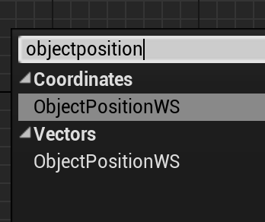
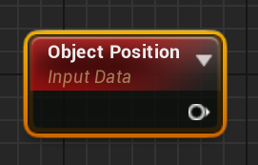
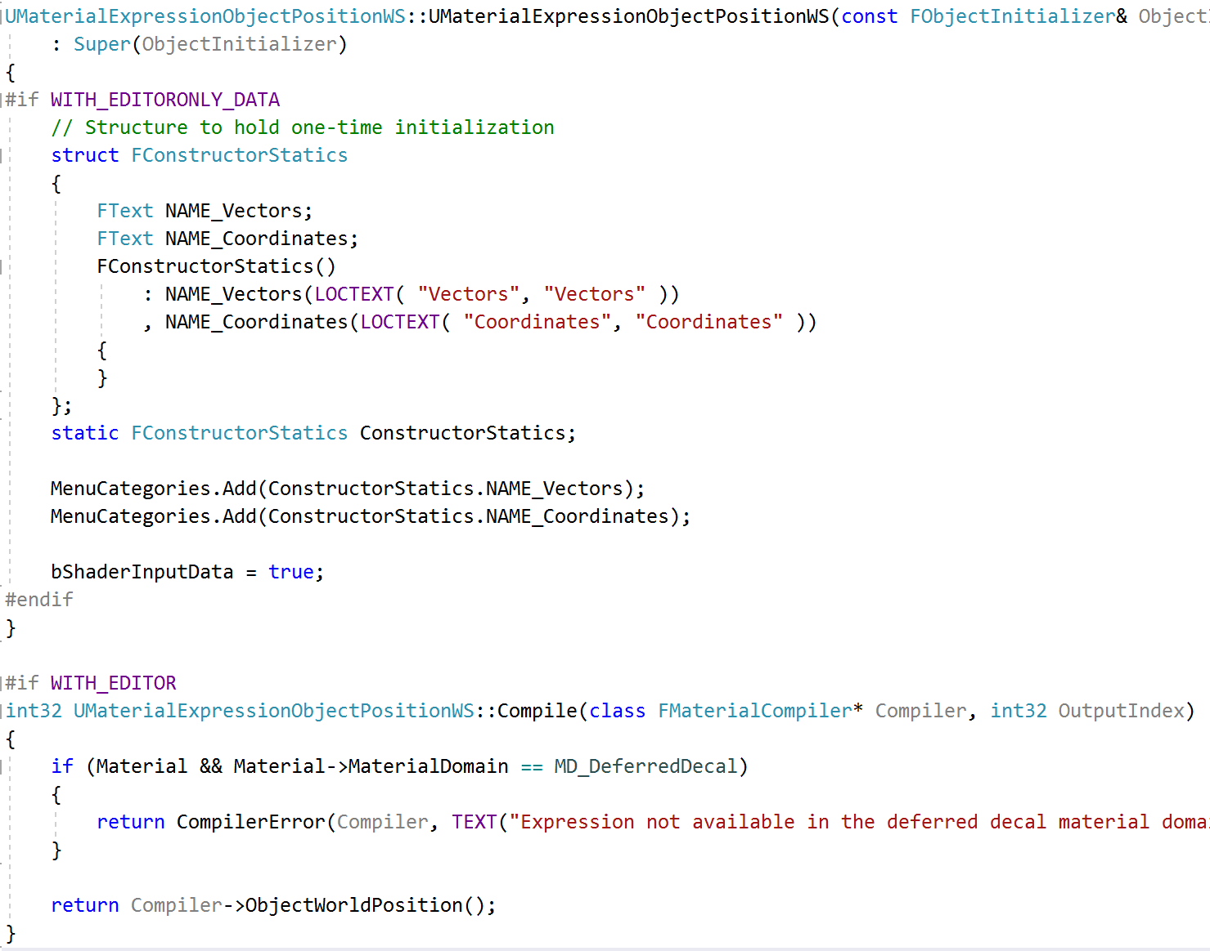
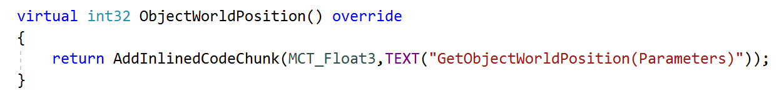
Code Examples
MaterialExpressions.cpp
Much of this course has used examples to learn about existing code. There are three keys to this method:
Find a relevant example
Build an understanding
Replicate the relevant parts (or replicate everything then trim away the irrelevant parts)
HLSLMaterialTranslator.cpp

Slide 5
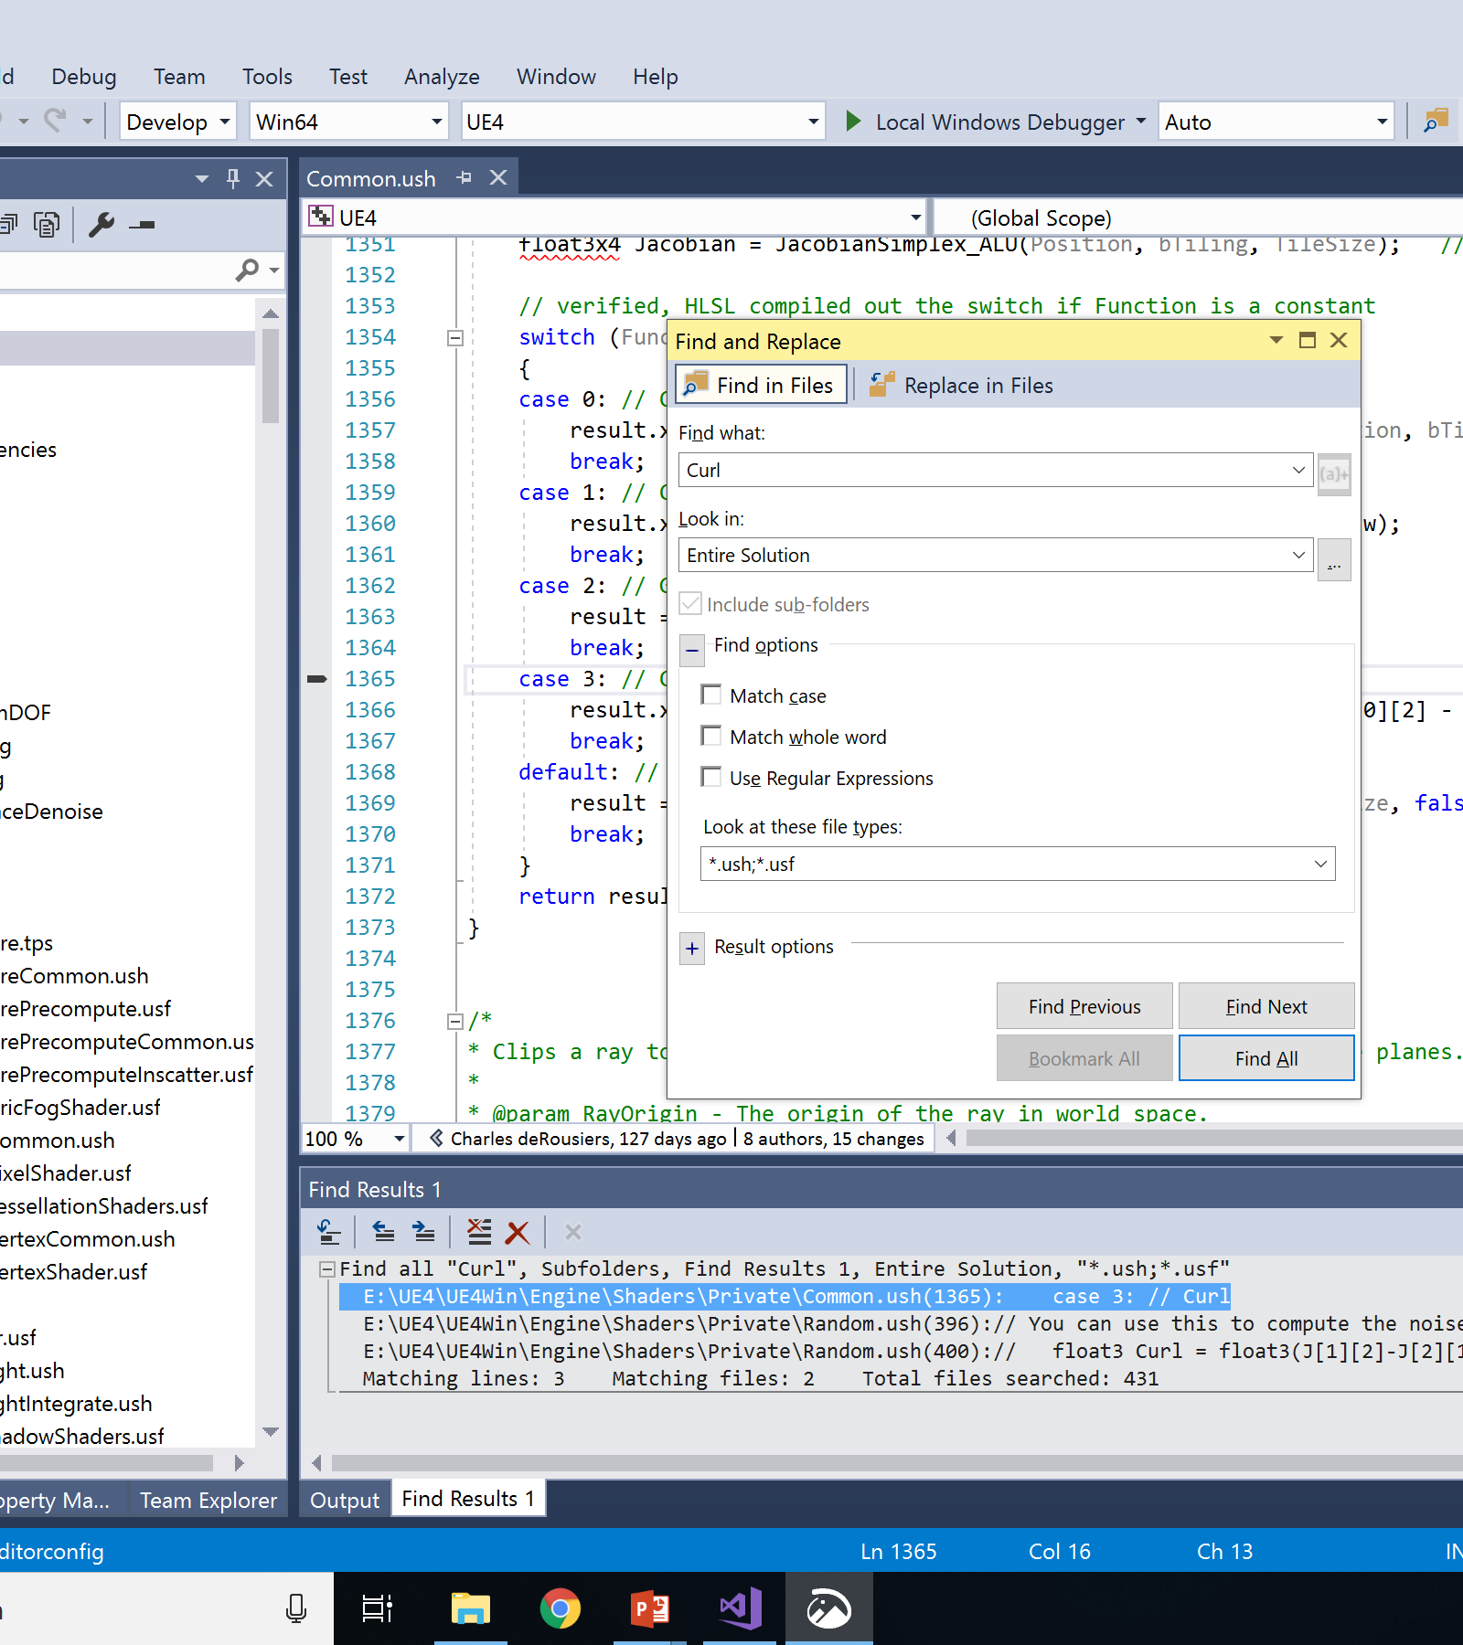
Finding Examples
The key first step is to find relevant example code
Search for strings from the Editor user interface or Log
Search in the code for relevant keywords
You are looking for something that is unique enough to have only a few hits in a search, so you can check through them.
If there are too many, try something else.

Slide 6
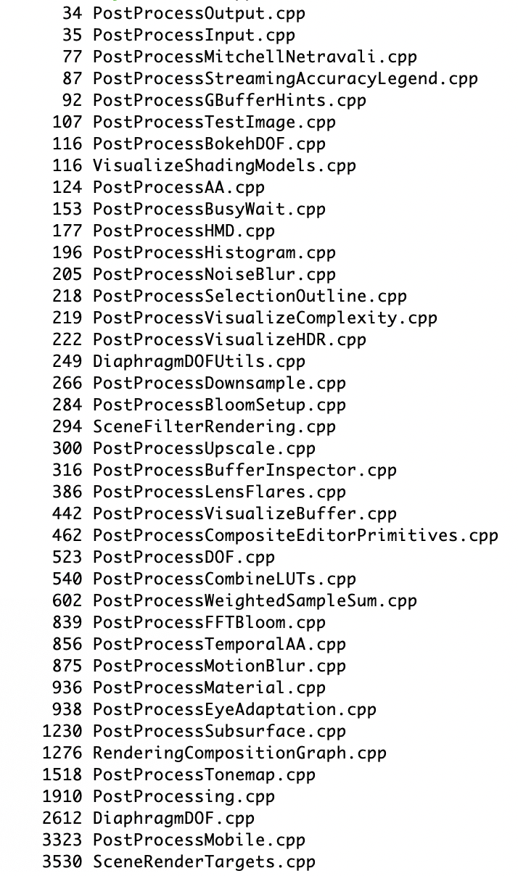
Refining The Example
Lines
File
Support Code
Simple Examples
Medium Examples
Complex Examples
Once you’ve found the directory or directories containing relevant code, check the other files there to see if another one is a better match.
Also, look at the file sizes: smaller files generally have less extra unnecessary code to wade through.

Slide 7
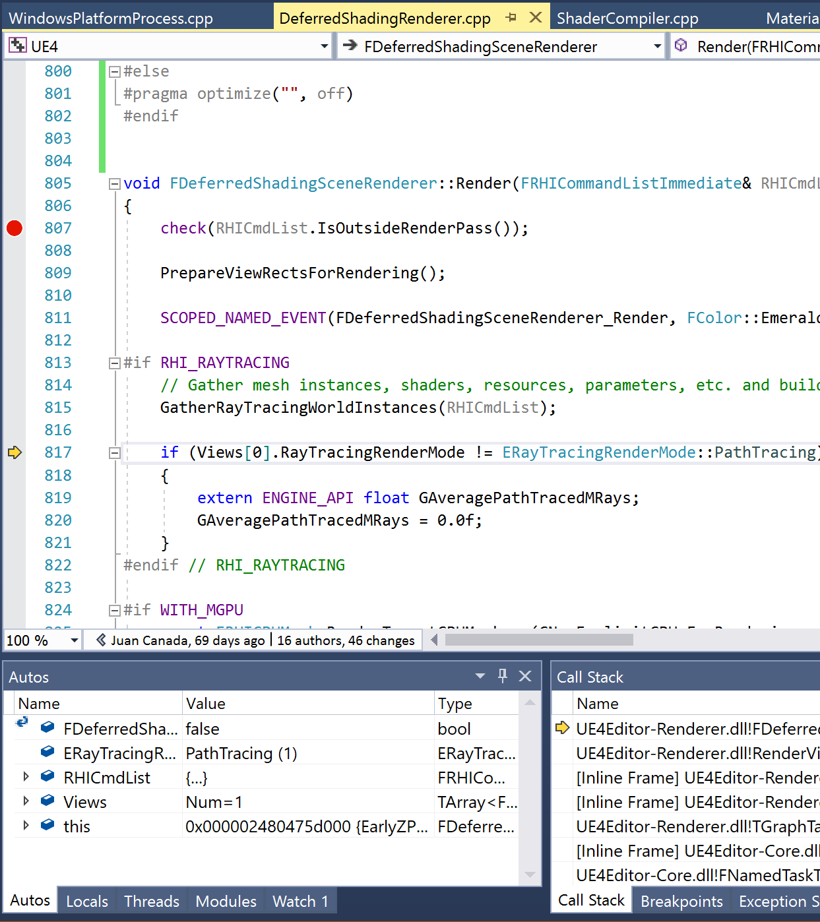
Building Understanding
Read the code, making notes about what you think it is doing.
Turn off optimization on the files you’ve found, set a breakpoint, and single step in your debugger.
Mostly step over functions, but look at the variables before and after to confirm your understanding of what they do.
Use additional breakpoints or “run to here” to skip over loop iterations.

Slide 8
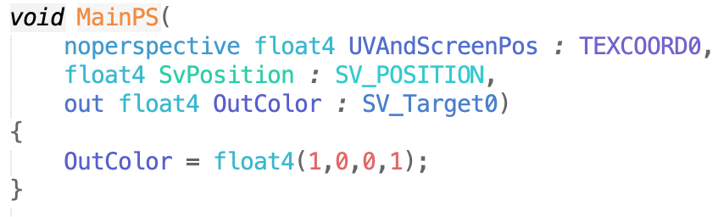
Building from an Example
Make a copy of your example code, changing the names as necessary to get it to compile without conflict.
Get it running with your new code in use (even if it doesn’t do anything new).
Work with the simplest possible test cases to ensure it’s working:
Get shader code turn the screen a solid color
Test code that’s working with textures with a simple 2x2 or 4x4 texture.
Use just 1-2 triangles in geometry code.
Trim out the code you don’t need a bit at a time to make sure it still works.
Add functionality back in.

Slide 9
Synthesizing Examples

Slide 10
New Code
Primary Rendering
Postprocessing
Plugin
Example Project
No Good Examples
Often, there is no single good example in the code for what you want to do.
Then you may have to combine multiple sources.

Slide 11



Finding Guides
You may need to find sources inside and outside the engine.
Look at external sources outside of the Unreal Engine. For example, GDC or SIGGRAPH talks, “Gems” books, published papers, developer blogs. These will give an outline of how to accomplish the task, but not how it fits into the Unreal Engine.
Look through the engine code for places that do each part of what you need. These may be in disparate parts of the engine, in plugins, or in example projects. Likely with bits here and there.

Slide 12
Building Slowly
When building from many examples, plan an implementation order that allows you to test continuously along the way. Some of the bits you find may not work together the way you expect, or do what you think. Working incrementally is the only way to catch these problems before they become insurmountable.

Slide 13
Learning with Bugs

Slide 14
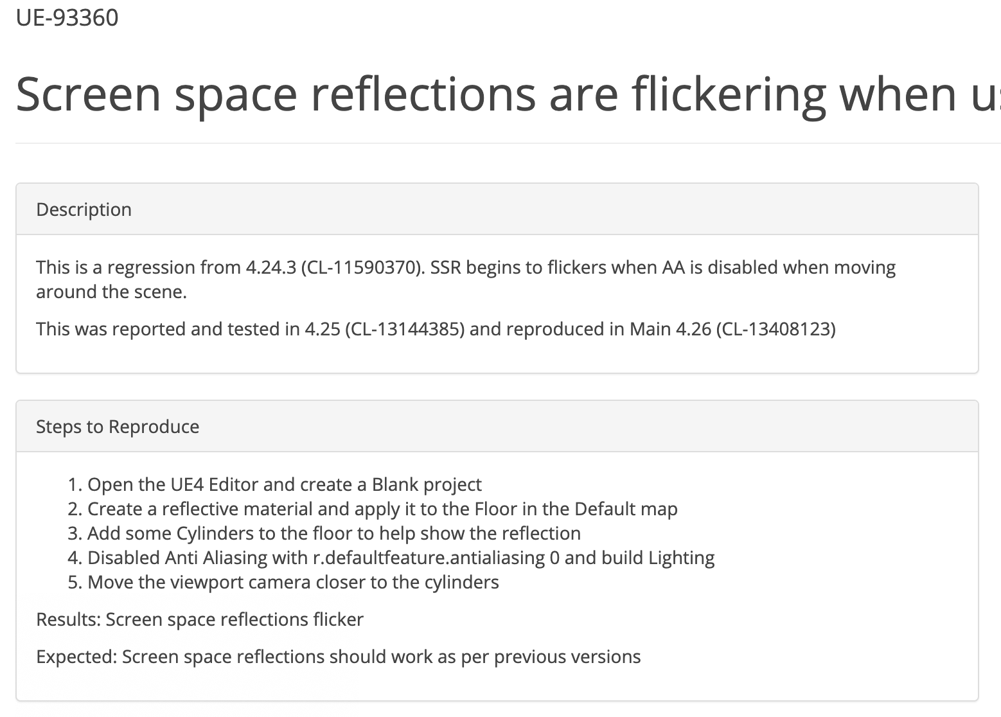
Finding Focus
When you don’t have a specific task, it is hard to figure out where to start to learn about some engine subsystem.
Chasing down an existing bug can provide that focus.
Plus you can submit a pull request to give that work back to the Unreal Engine community!

Slide 15
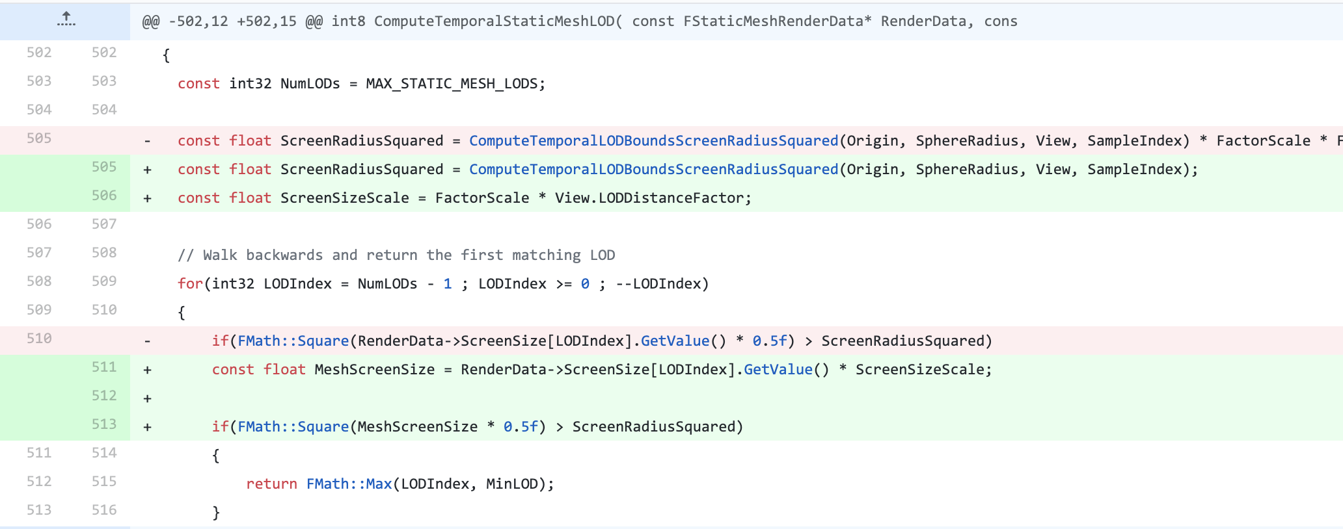
How Bugs help
A bug gives you a specific goal while digging through unfamiliar code. It also gives you documentation of reproduceable incorrect behavior, and expectation of what it should do if corrected.
Make sure you understand what the code is currently doing and what it should be doing.
Trace through current code and behavior until you understand what is going wrong.
Figure out the right way to fix the problem, not just the easiest band-aid.
Fix the bug, and test to look for any new problems introduced by your fix.

Slide 16
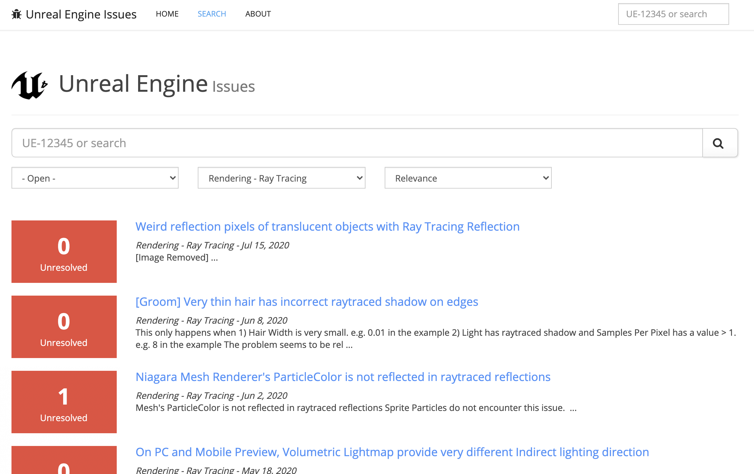
Finding Bugs
Check the bug list at issues.unrealengine.com
Filter to see only open bugs
Filter by component or search to narrow to bugs related to the subsystem you care about.

Slide 17
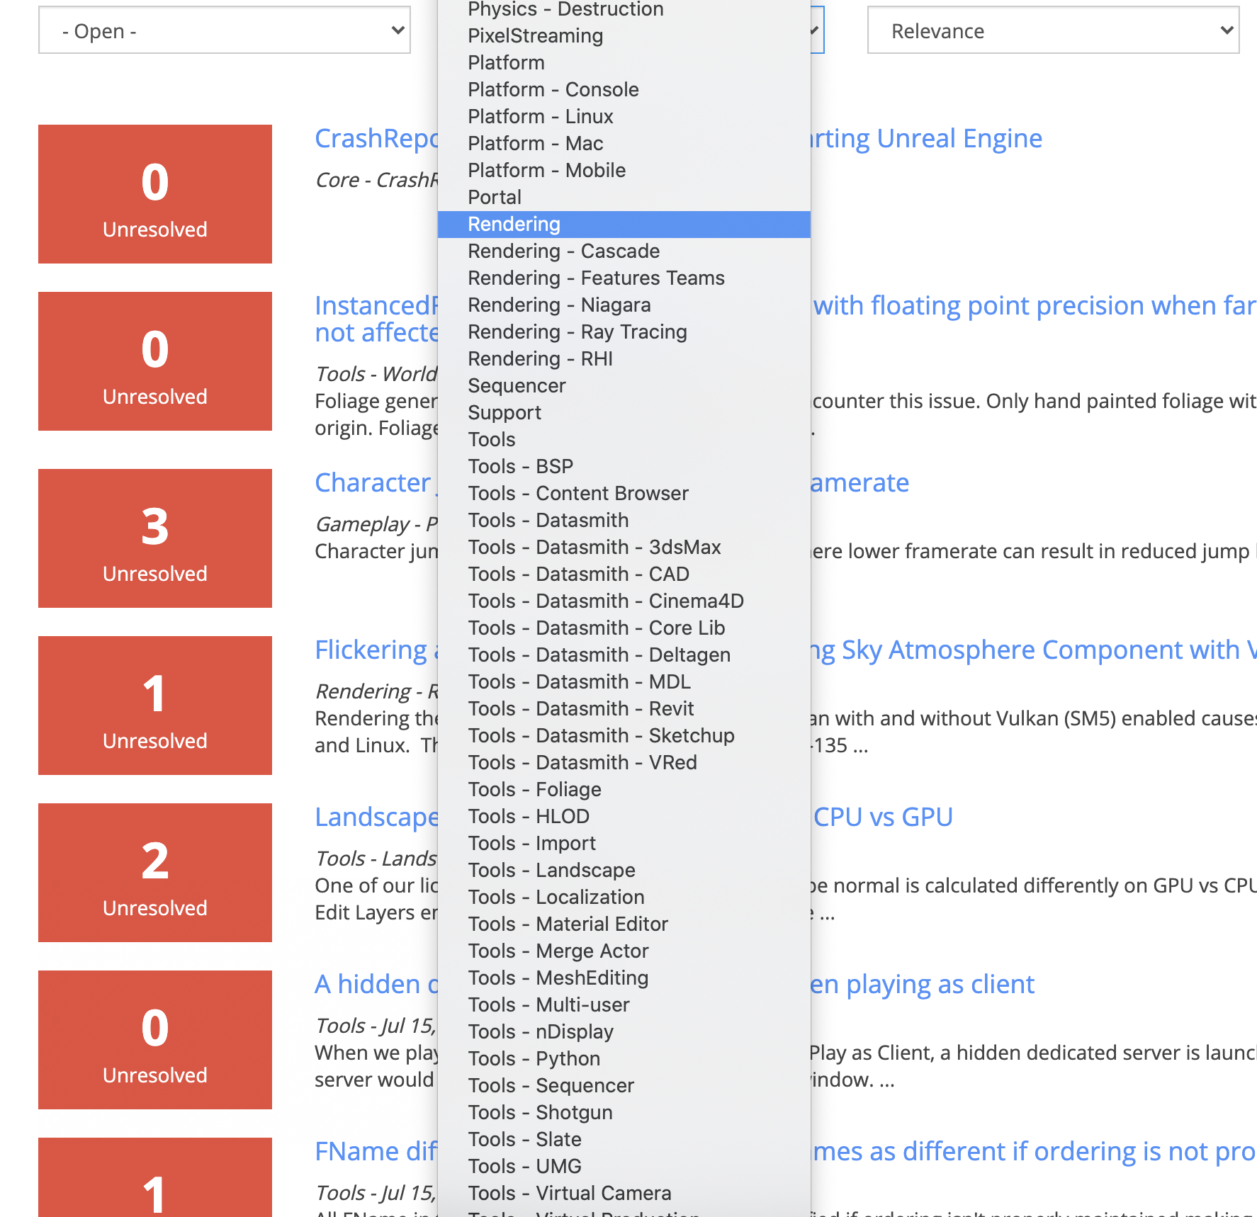
Choosing a Bug
To use a bug to learn about a part of a large codebase, you want a few properties:
Fits the area you want to learn
Localized behavioral problem to be fixed, not a major new feature.
Small in scope. Your primary goal is to use the bug to learn.

Slide 18
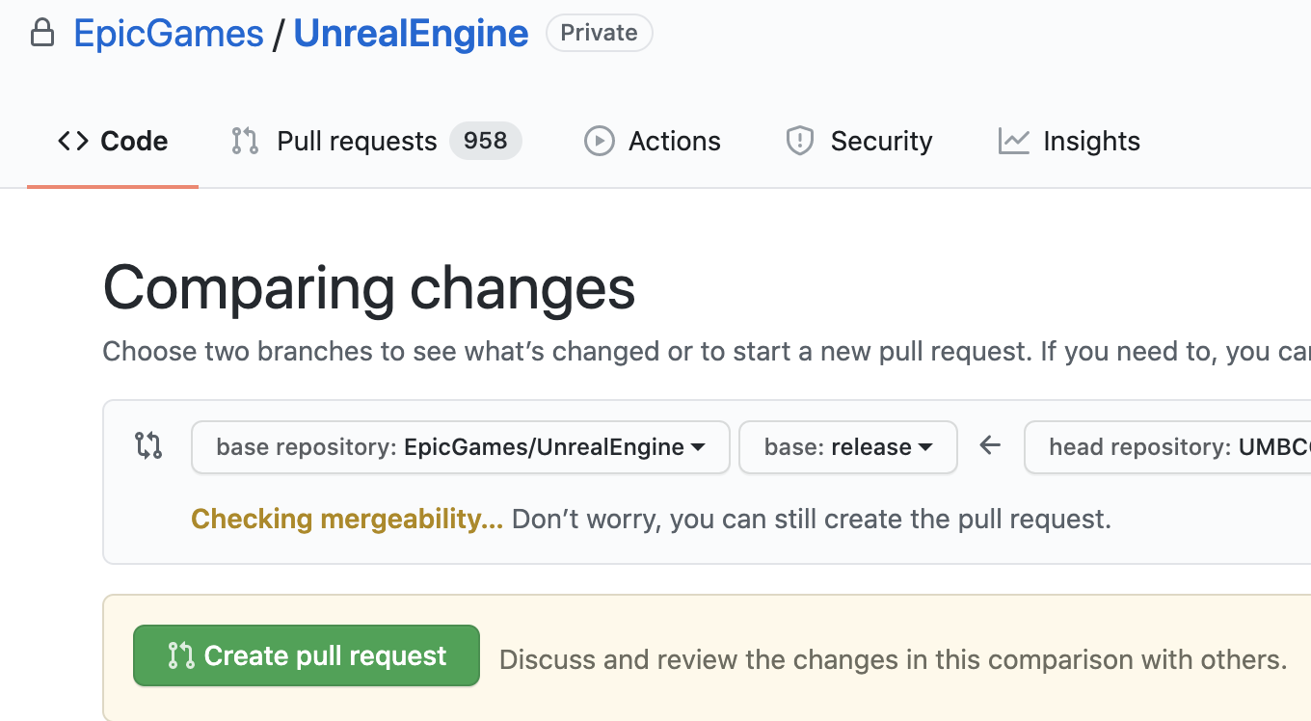
Giving Back
Once you’ve fixed a bug, submit it back as a pull request on github.
Be sure your changes follow Epic’s coding guidelines.
Be sure to reference the bug number (looks like UE-123456).

