Slide 1
Basic Actor Coding

Slide 2
The goals of this lecture are to
  Learn about Actors, Pawns, and Actor Components
  Learn how to create a C++ Actor class
  Learn about resources and strategies to find classes and functions that are available for use in Actor code
  Learn debugging strategies for Actor code
  Learn about the parallels between Blueprint and C++ Actor code
By the end of this lecture you will be able to
  Create a C++ Actor class
  Add properties to a C++ Actor class
  Add behavior to a C++ Actor class
  Find functions that can be called in a C++ Actor class

Slide 3
Actor Basics

Slide 4
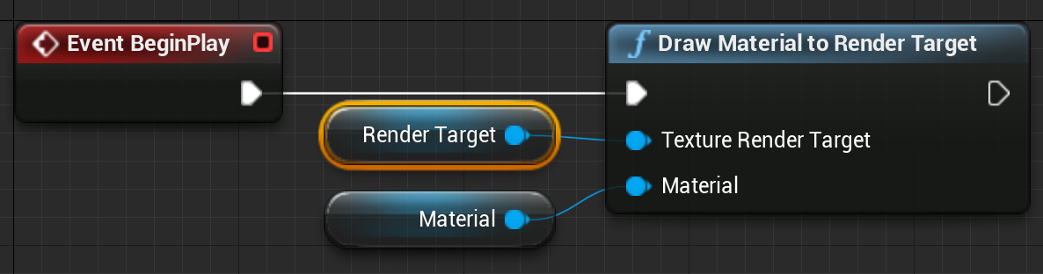
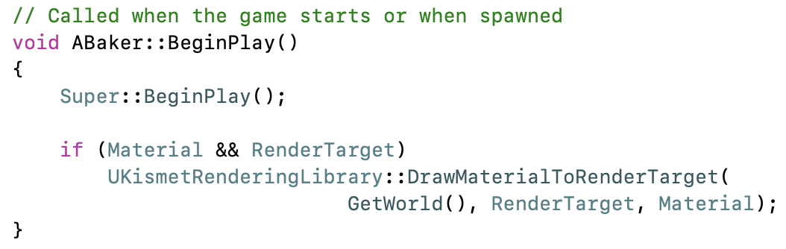
Actor Code
A UE4 Actor is any object in the Level. Actors are not used just for characters, but also for every visible scenic element, every light source, every invisible trigger region, and anything else that can have a position in the scene and possibly some attached behavior.
The best-documented way to add that behavior is with the Blueprint visual scripting system.
For more power and control, you can do the same thing in C++. C++ code has access to anything that can be done in Blueprint, plus internal functions and external libraries that are not Blueprint accessible.

Slide 5
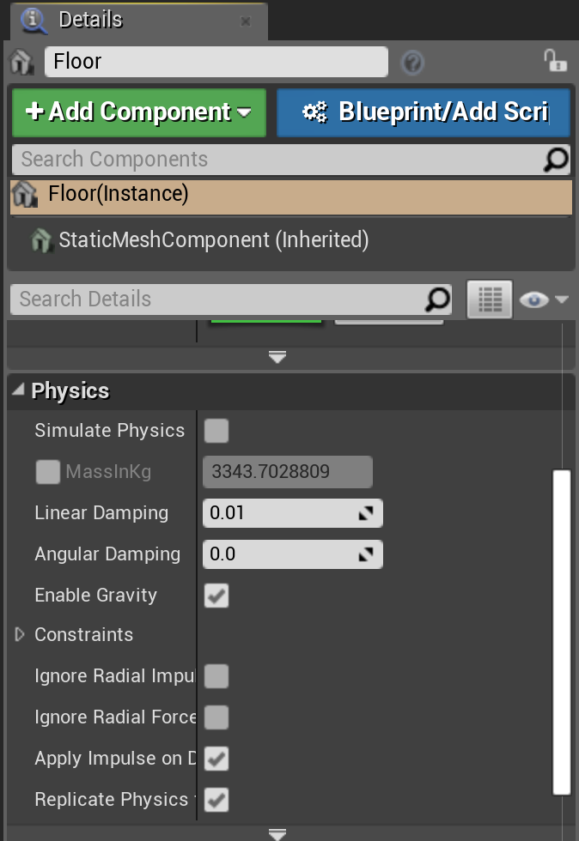
Actor Components
A component is a class that implements common behavior to be shared by many different types of Actors.
You can use components in both Blueprint and C++ Actors to add behavior, and can create new components to be used by both Blueprint and C++ Actors.
Common examples include Scene Components for Actor position, Mesh Components for rendering, physics and movement components for Actor motion, AI components for behavior, and networking components for communication.

Slide 6
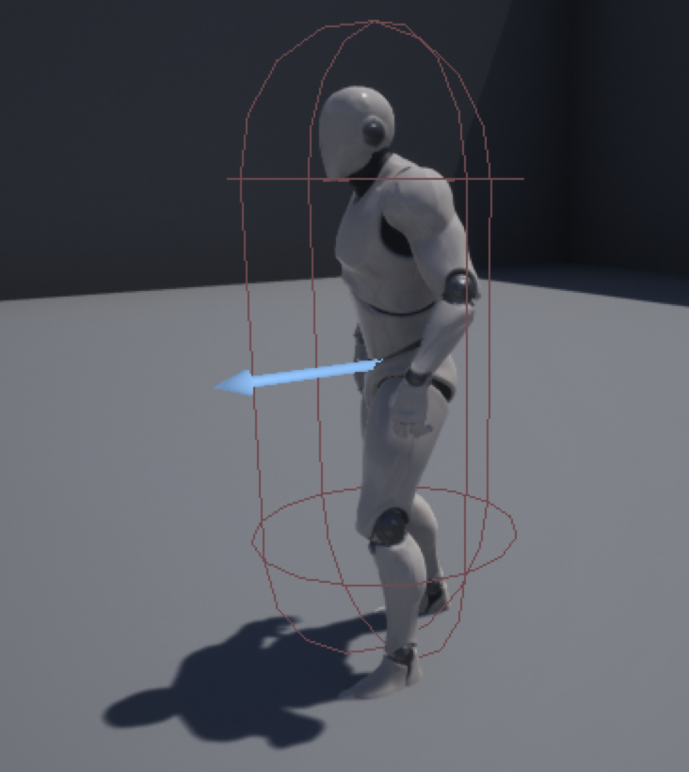
Pawns
A Pawn is an Actor that can be controlled by either the user or AI. The Pawn class is derived from the Actor class, so inherits all of the functionality of the base Actor class.

Slide 7
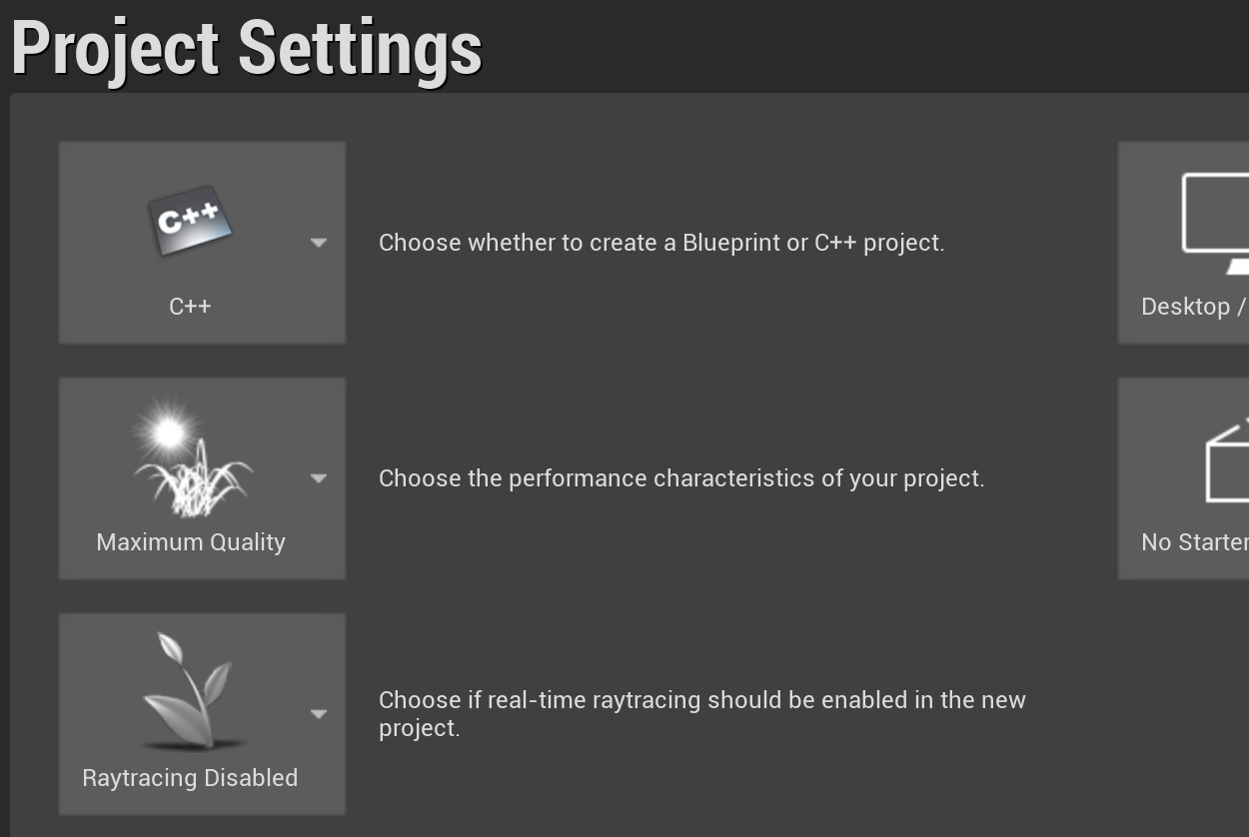
Creating a C++ Project
To do C++ Actor coding, you’ll need to create a C++ project rather than a Blueprint project.
You don’t need the engine source to do Actor and game C++ coding, but if you are going to be making any engine changes or extensions later, it’s best to put the project in the base directory of your engine repository (alongside the GenerateProjectFiles script).

Slide 8
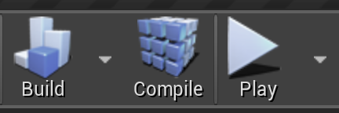
Recompiling Code
You can recompile Actor or component code when you make changes without having to exit the Editor. Just press the Compile button in the main toolbar.
The changed code will be recompiled and reloaded into your running Editor.
To manage the hot reload, UE4 saves the class data with the old class, then loads it with the new. If class data changes significantly, you may need to delete the Actor from the scene and recreate it, but most changes will just work.

Slide 9
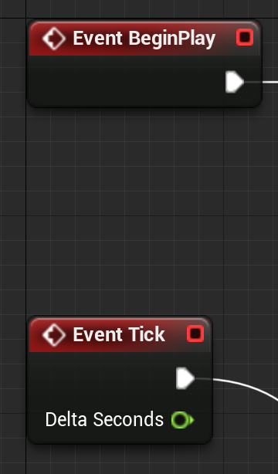
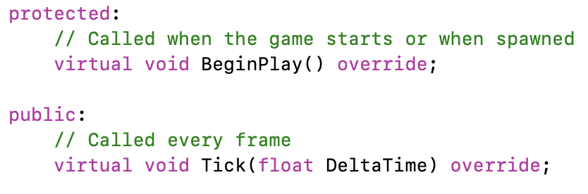
Core Blueprint Events
⇔ C++ Functions
The standard Blueprint Actor has event blocks so you can trigger something to happen on Actor Construction, Begin Play, or every game Tick.
The same options are available in C++ as virtual member functions OnConstruction, BeginPlay, and Tick.
When you create a new Actor class, it automatically creates templates for the BeginPlay and Tick functions, but you can add others. Look at the AActor base class and its parents to see what is available.
Overriding these virtual functions adds behavior for that Actor event.

Slide 10
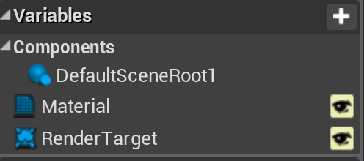
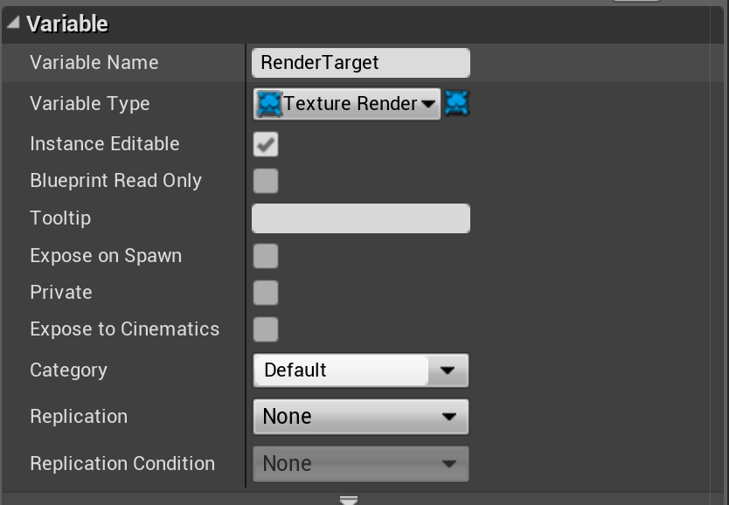
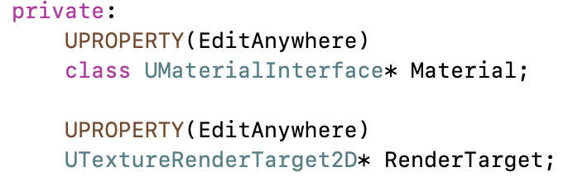
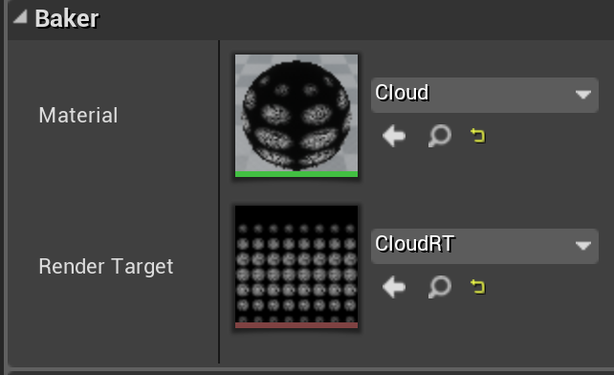
Blueprint Variables
⇔ C++ Member Data
In Blueprint, you can create variables associated with your Actor. Values for these are saved with the Actor. These can be set to be either visible in the Actor’s Details window, or internal and hidden.
In C++, any member variable preceded by the UPROPERTY() macro will be saved with the Actor, but hidden. Variables without UPROPERTY() can hold temporary data, but will not be saved.
A member variable preceded by “UPROPERTY(EditAnywhere)” will be visible and changeable in the Editor Details window.
Default values for variables are set in the class constructor, though be aware that the constructor is not run when restoring from a save.

Slide 11
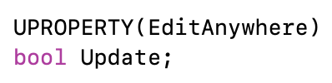
UPROPERTY Magic
The UPROPERTY macros are parsed by the Unreal build process to generate user interface and serialization (saving and loading) code.
Comments before the UPROPERTY will show up as a pop-up tooltip.
Arguments to UPROPERTY can control many aspects of how it will appear, including changing the displayed name, setting min and max slider bounds, or setting a hard min and max value for the UI (code can still create out-of-range values).
See online documentation for all of the options.

Slide 12
Converting a Blueprint Project to C++
If you start a project using Blueprint and decide later to do some C++, it is possible to switch it over.
  In the File menu, create a new C++ class (e.g., a new C++ Actor class for Actor behavior).
  After UE4 is done generating the files, quit the engine and then run the GenerateProjectFiles script.
  When you relaunch the project, it’ll be a full-fledged C++ project.
  You can identify code projects because they will have a Compile button in the toolbar.

Slide 13
Function Discovery

Slide 14
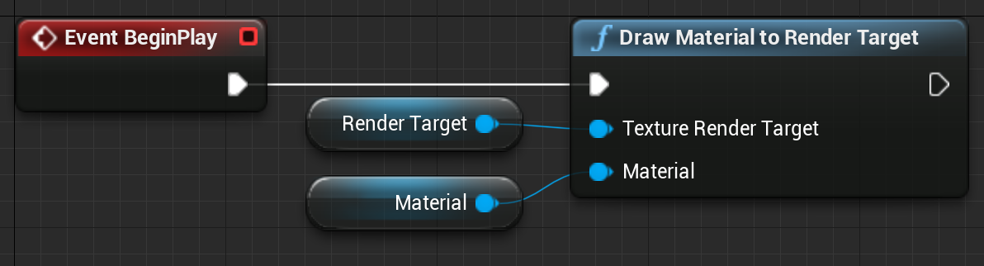
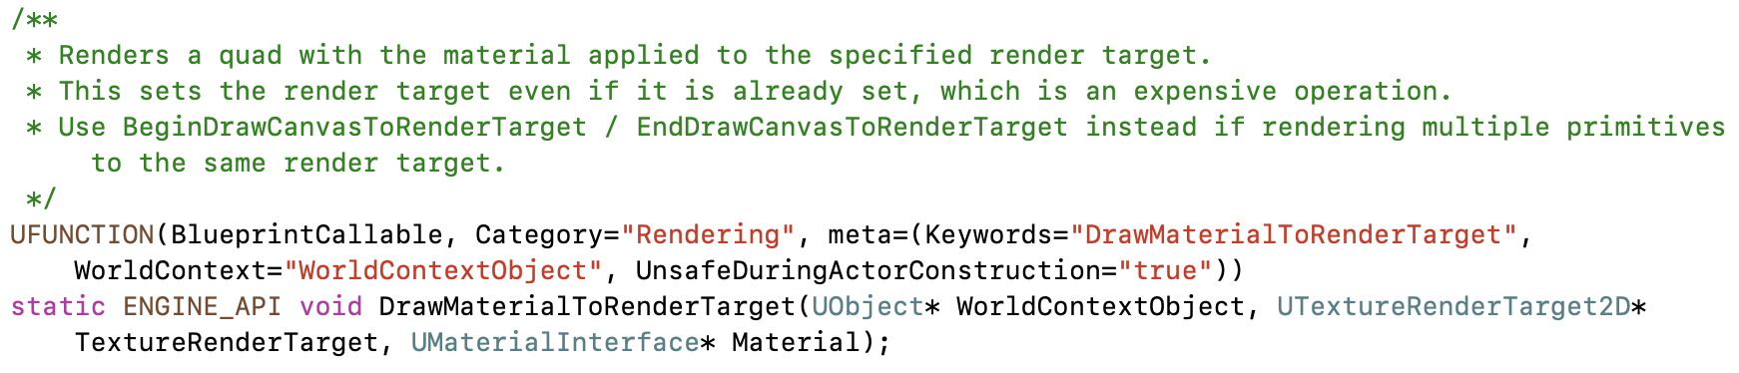
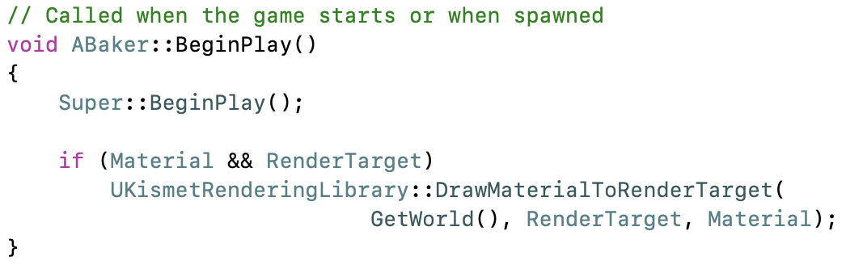
Blueprint Blocks
⇔ C++ Functions
One of the hardest things when getting started programming in an engine like UE4 is knowing what functions already exist and are available for you to use.
Fortunately, every core block in Blueprint is backed by a C++ function. Unless it was specified with a different display name, the function will have the same name as the Blueprint block, with spaces removed.
Search the code .h files for a matching function name. Include that .h at the top of your C++ file for access to the function.

Slide 15
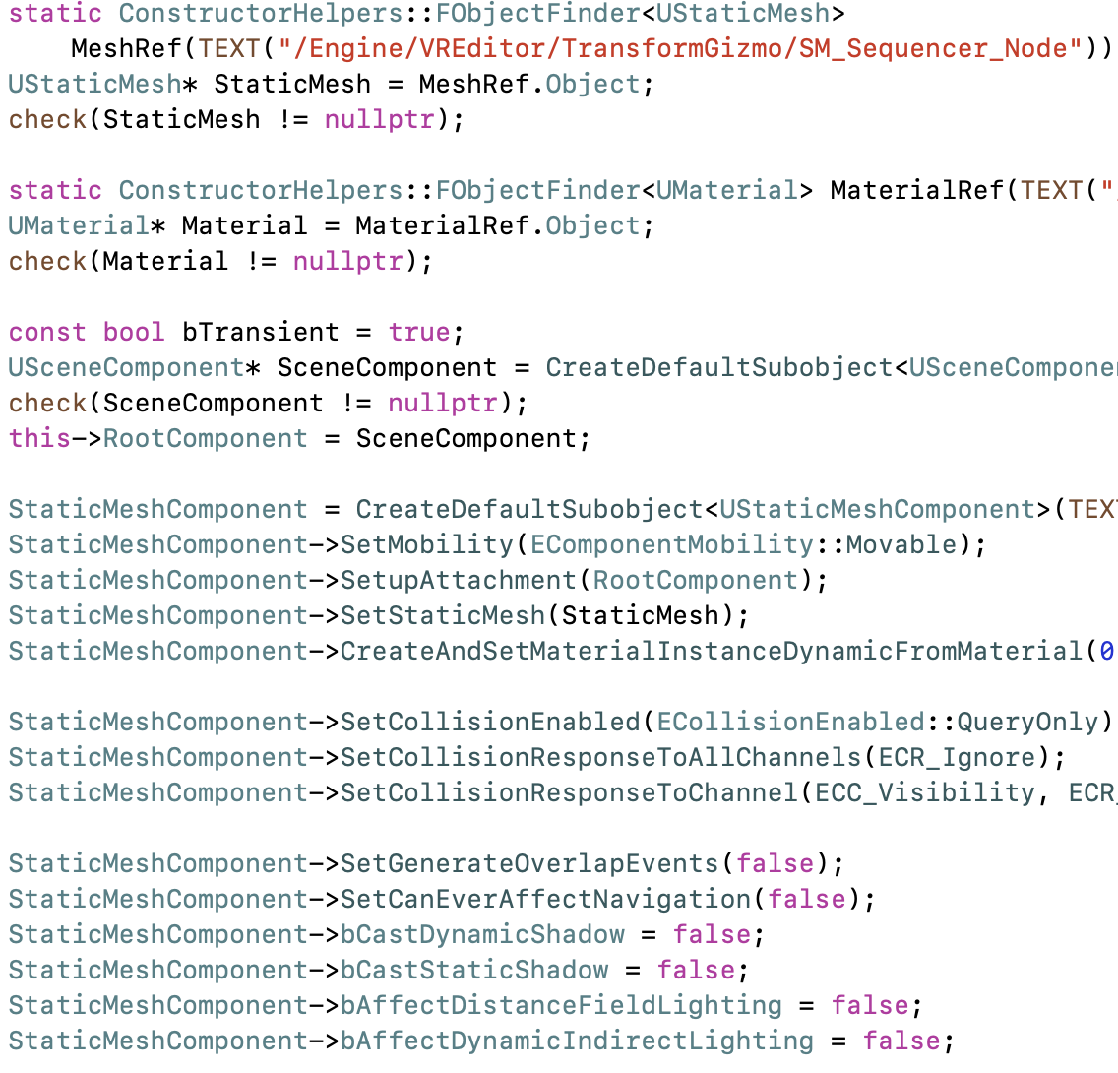
Engine Examples
Many of the things you want to do in Actor code are already done someplace in the engine. If you want to know how to use a particular component, search the engine .cpp files for someplace else where it is used.
If you don’t find an example of the particular component class, examples using its base class or a class derived from it can also prove useful.

Slide 16
Class Hierarchy
APawn
UObject
UObjectBaseUtility
AActor
UObjectBase
Character Actor
All Actors in scene
Any Object with serialization and garbage collection
Utility functions for all Objects (and Actors)
Where the garbage collection and serialization are actually implemented
While Blueprint or code examples are a great way to discover functions and classes that are available to Actor code, it is also helpful to browse the class definitions for data you can access, functions you can call, and virtual functions you can override.

Slide 17
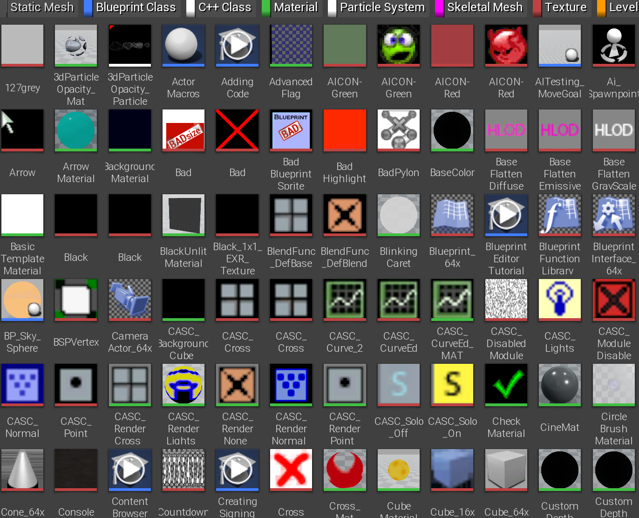
UObject
The base class for all Actors, Components, and Pawns is UObject. Most things derived from UObject have a name starting with “U” to make them easier to identify.
UObjects and classes derived from them support garbage collection and serialization (saving and loading) of all class states. All UObjects have a name, and can be looked up by name.
There are many virtual functions in the UObject base class: to run before or after a save or load, to change serialization from the default (especially for backward compatibility), and many more.
UObject also includes a GetWorld() function, which is handy for the many other functions that take the World as a parameter.

Slide 18
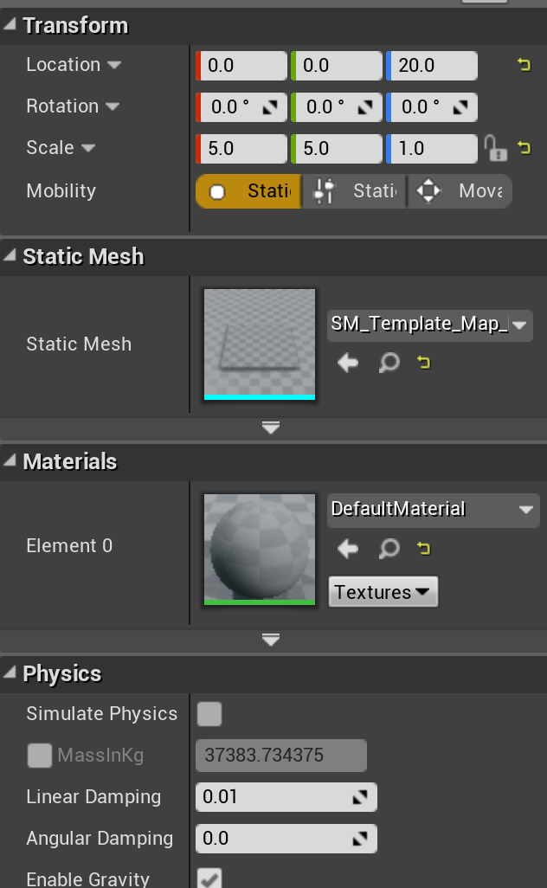
UActor Component
The base class for all components is derived from UObject, so inherits all its functions and data.
It adds the ability to activate and deactivate the component, and BeginPlay, EndPlay, and TickComponent virtual functions for overriding behavior.
Two key subclasses of UActorComponent are USceneComponent and UPrimitiveComponent.
A Scene Component is used for anything with a position in the scene. Actors often have one Scene Component set as their Root Component to provide the Actor’s position.
A Primitive Component is the base for components that can be drawn or provide a visual representation for an Actor.

Slide 19
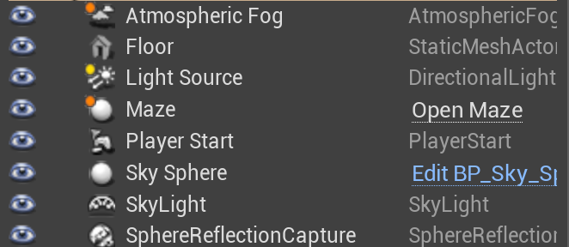
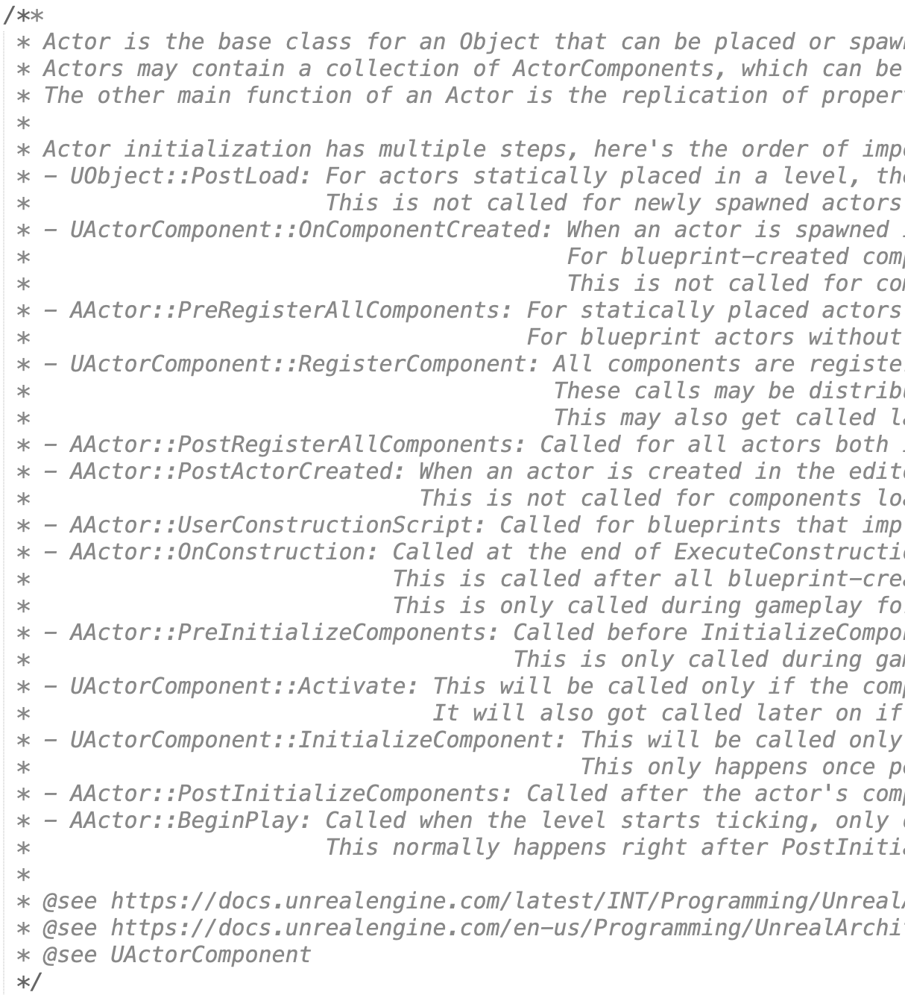
AActor
The AActor class is derived from UObject, but the leading character for the AActor class and any derived from it is switched to “A”.
It’s worth browsing through the (3,000-line!) declaration for the AActor class to see what it provides. These include the following:
  Virtual functions you can override with new behavior like BeginPlay, Tick, etc.
  Network replication functions and data
  Child Actors, Child components
  Functions and data for handling position, collisions, damage
Don’t forget to set one Scene Component as the Root Component of the Actor to be able to position it.

Slide 20
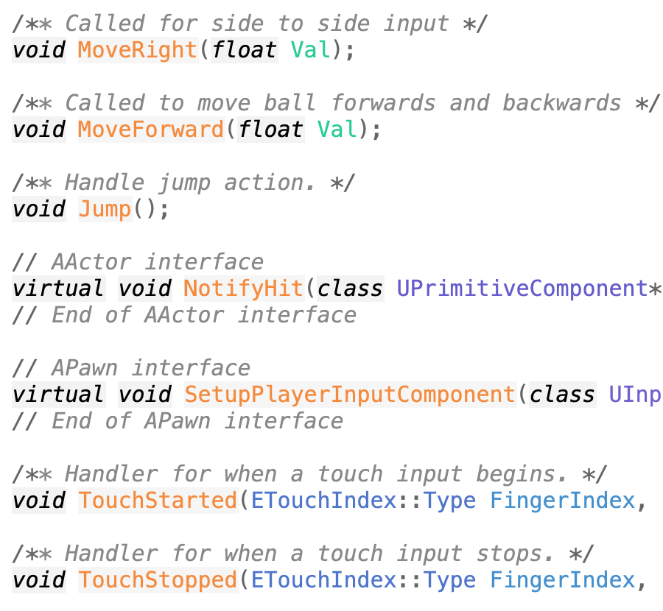
APawn
The APawn class is derived from AActor and adds virtual functions for controller and AI input.

Slide 21
Actor Debugging

Slide 22
Running in an IDE
If you are running your UE4 from a source build and place the project into the UE4 directory, it’ll be added to the UE4.sln (or UE4.xcworkspace on Mac).
Open this file in your IDE, and set your game project as the startup file.
Now you can run and debug your game project within the IDE. This includes C++ Actor code, plugins, or other code.

Slide 23
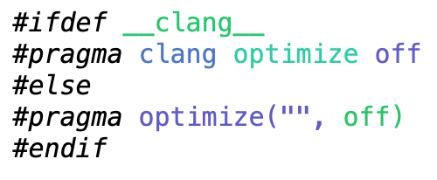
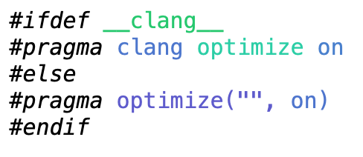
Turning Off Optimization
Compiler optimization can remove variables, rearrange code, and otherwise make debugging difficult. You can turn off optimization in a single .cpp file or around a single function using a pragma.
UE4 combines files together when building for efficiency, so be sure to turn the optimization back on after the code you are debugging.
And don’t forget to remove the pragma blocks when you are done debugging the file!

Slide 24
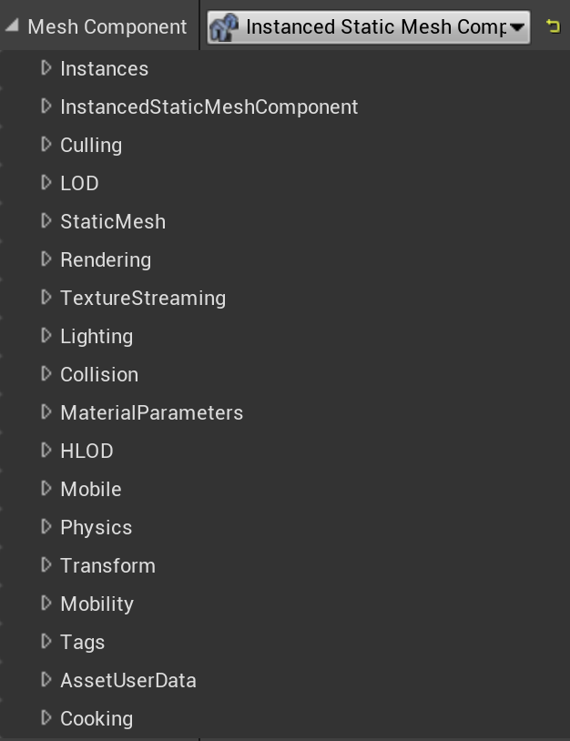
Exposing as a UPROPERTY
Even for data you don’t ultimately want to have in the editor interface for your class, it can be useful to be able to see its values while debugging. Tag the data with “UPROPERTY(EditAnywhere)” or “UPROPERTY(VisibleAnywhere)” to be able to see it in the Details window.
Don’t forget to switch back to “UPROPERTY()” when you’re done!

Slide 25
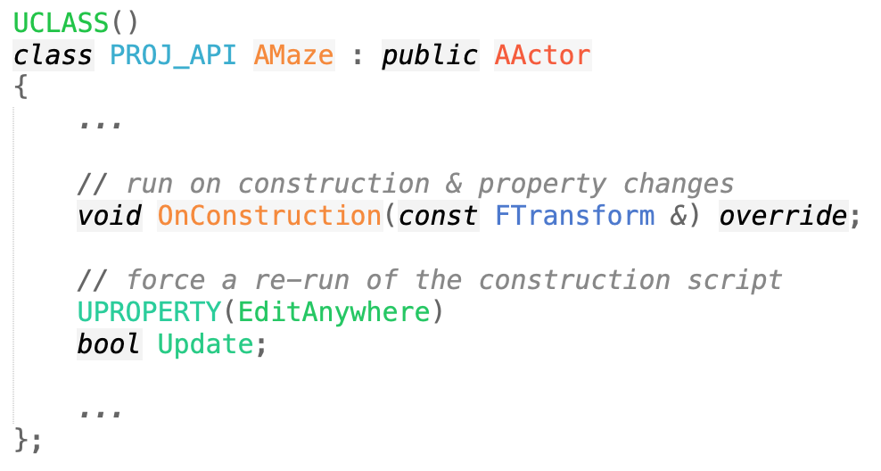
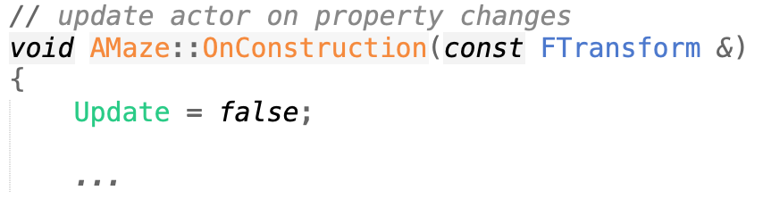
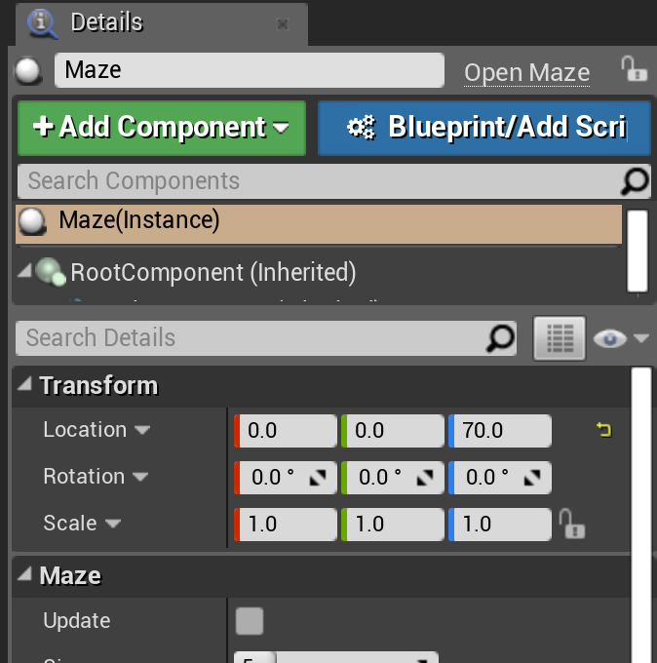
Update Button
Especially when testing an OnConstruction script, it can be handy to have a way to force it to rerun. Since it runs on any change, create a dummy Boolean data member. That will display as a check box, and your OnConstruction function will execute if it changes.
Set it back to false in the OnConstruction function to uncheck it again, ready for the next update.

Slide 26
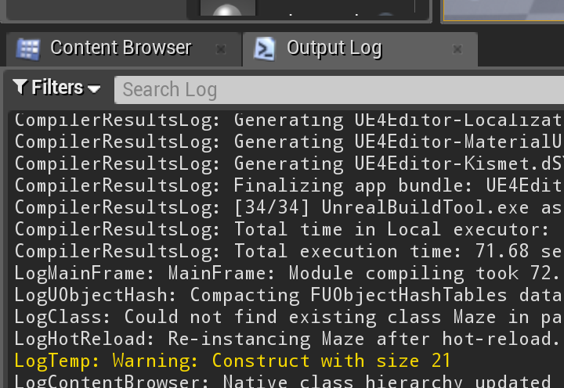
Messages
You can print log messages with UE4_LOG().These messages will appear in the Output Log window and in the console output.
For more, see the Unreal Engine wiki.

Slide 27
Summary

Slide 28
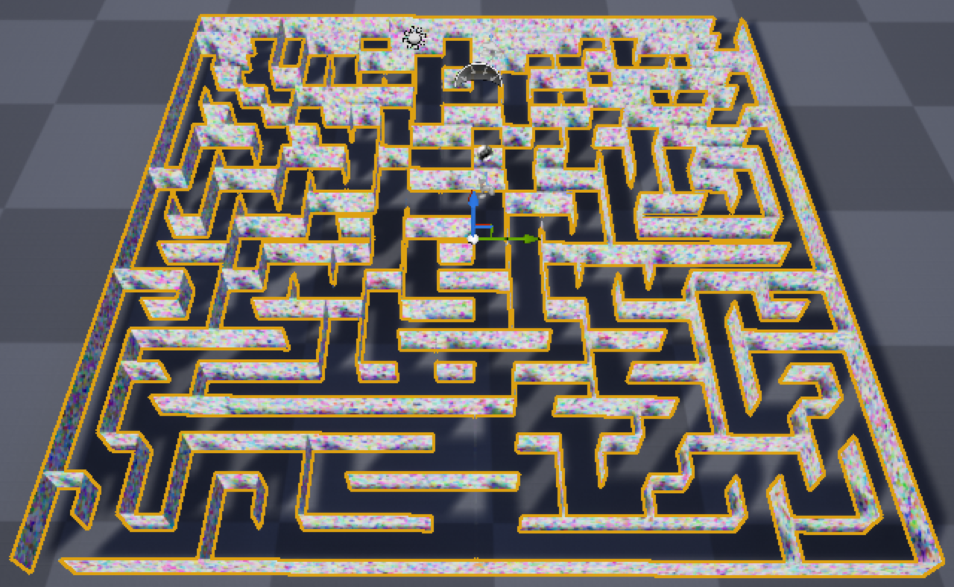
To Recap
Make a C++ project, then create a C++ Actor, Pawn, or Actor component class.
Add code to the constructor for defaults, OnConstruction for initialization, BeginPlay for start-of-game, and Tick or TickComponent for continuing action during play.
Add a SceneComponent to Actors for positioning, Primitive component(s) for rendering, and other components for other behavior.
Add member variables tagged with “UPROPERTY()” for data that can be set, saved, and loaded in the engine.
Look at Blueprint blocks, engine code examples, and base class declarations to figure out what functions and data are available.

