Slide 1
Proxy Geometry
UMBC Graphics for Games

Slide 2
Graphics Hardware likes Triangles
Turn everything into meshes of triangles
  Paragon Murdock: ~75k triangles
Draw them really fast
But not everything likes tons of
tiny triangles…
Notes:
Add Murdock to project > Murdoch Map
Select character, open skeletal mesh, counts on display

Slide 3
Physical Interaction

Slide 4
Physics Simulation
Simulate objects as rigid bodies
  Also sometimes see fluid simulation, but don’t worry about that now
Even complex objects as rigid parts with joints
Navigation (don’t run through walls)
Gravity (fall, but not through floors)
Rag doll (transition from scripted animation)

Slide 5
Collision Detection
Core component of physics simulation
Also event triggers

Slide 6
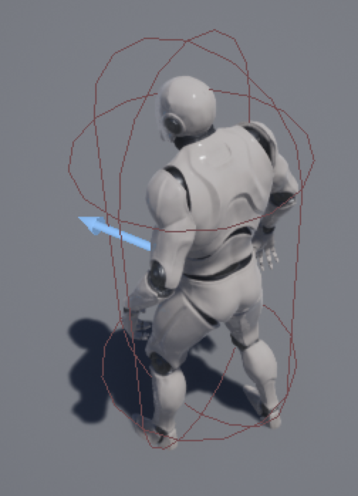
Simple Physics/Collision Proxies
Physics & collision detection with polygons is slow
Simple shapes are fast(er)
  Box, Sphere, Cylindrical Capsule
Just use one of those around each object or character.
Notes:
New 3rd person template project. Select character

Slide 7
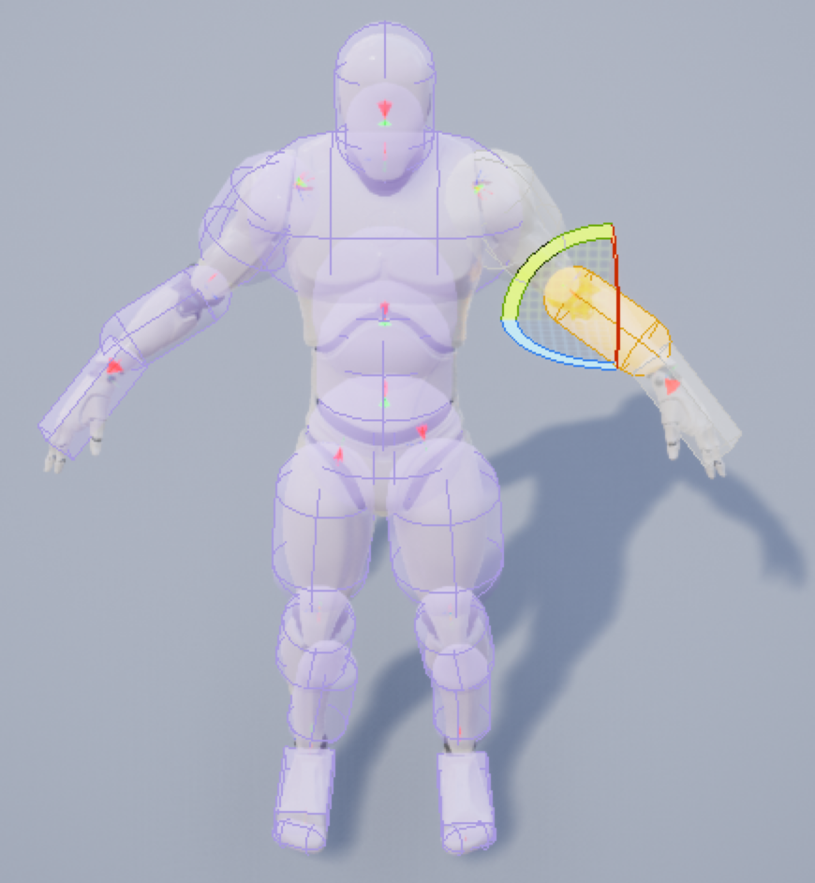
Composite Proxies
Physics animation of a character needs more
Build from basic shapes
  Sausage man!
Compute physics on basic shapes
Apply to original model
Notes:
Open character skeletal mesh. Physics view

Slide 8
Hierarchical Proxies
Only use finer proxy when you hit the coarser one
All should contain the real object
  But do not need to strictly contain the extra empty space of the other levels
Notes:
Load static mesh into scene. Bounds view. Collision view (Simple Collision, Complex Collision)

Slide 9
What to Render

Slide 10
Occlusion Queries
Graphics Hardware supports Occlusion Queries
  Lets you ask “how many pixels would this draw?”
  Or ”how many did this draw?”
Can only get the answer 1-2 frames later
Draw a simple shape to figure out whether to do the complicated one
  Often just a bounding box
Dilate box based on object and view velocities

Slide 11
Simplifying Rendering

Slide 12
Level of Detail
Switch to simpler models when far away
Most common algorithm: Edge Collapse
  Choose an edge, shrink to nothing
  Removes two triangles, one vertex
Alternative: Vertex cluster
  Cluster vertices, weld all in a group
Alternative: Volumetric remeshing
  Convert to volumetric/solid representation
  Process as volume
  Remesh
Notes:
Murdoch Paragon character, view Skeletal Mesh & select LOD levels

Slide 13
Level of Detail
75,296 Triangles
Notes:
Murdoch Paragon character, view Skeletal Mesh & select LOD levels

Slide 14
Level of Detail
42,326 Triangles

Slide 15
Level of Detail
20,597 Triangles

Slide 16
Level of Detail
10,042 Triangles

Slide 17
Level of Detail
5,172 Triangles

Slide 18
“Maps”
Map from mathematical mapping of 2D (image) domain to surface
Provides detail at a scale smaller than a triangle
Texture Map: surface color
Normal Map: normals provide shading variation
Gloss Map: shininess/roughness
Material/Metalic/Skin map: material to use

Slide 19
Displacement Map
Displace surface (typically along normal)
For fine mesh, move vertices
Proxy surface version: Relief Map or Parallax Occlusion Map

Slide 20
Rendering
Photons travel in straight lines
Photon that reaches the viewer through a pixel came from somewhere on a ray through that pixel
Rendering finds the closest thing on that ray

Slide 21
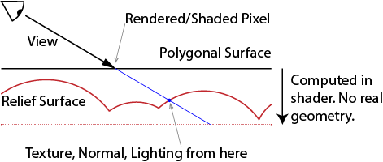
Relief / Parallax Occlusion Map
Render polygonal envelope around surface
Compute actual color and depth along ray in a shader

Slide 22
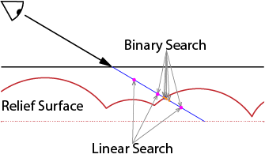
Finding the Intersection
Numerical root finding
Linear search (marching), Binary search, Secant method, …

Slide 23
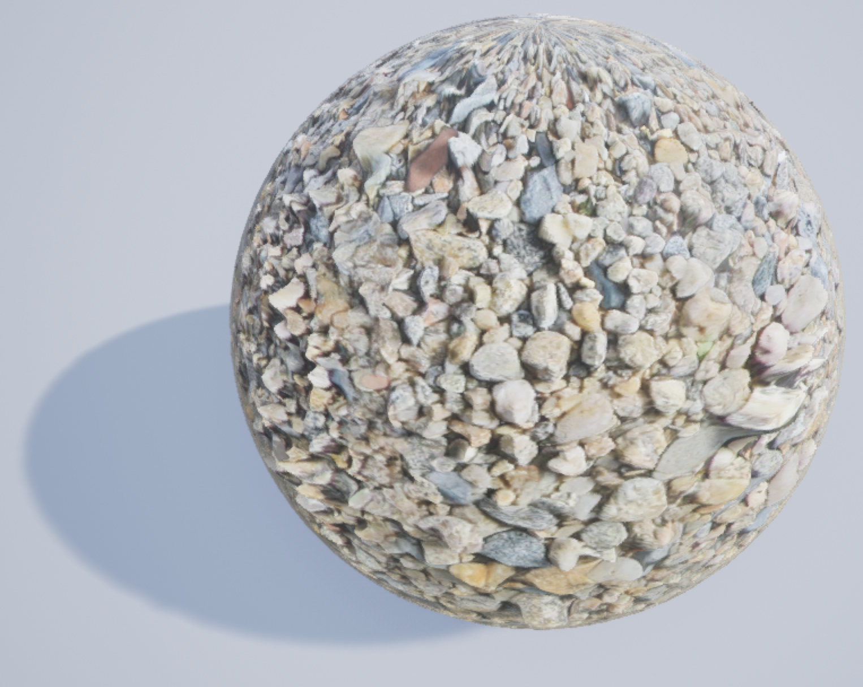
Relief Problems
Texture stretching on steep parts
  Can remap
Unbounded steps at silhouette edges
  Make displacement meet the proxy surface every so often
  Flatten when too steep
  Maximum number of steps
  Divide into prisms with side faces
Notes:
LightTest UE4 project: material with Parallax Occlusion Map node, “pebbles” diffuse, normal, height, and gloss texture from (maybe g3d?) Shader parameters for height and shadow toggle, light vector from Atmospheric Light Vector, 1-gloss as roughness, (0.5*shadow+0.5)*diffuse for Base

Slide 24
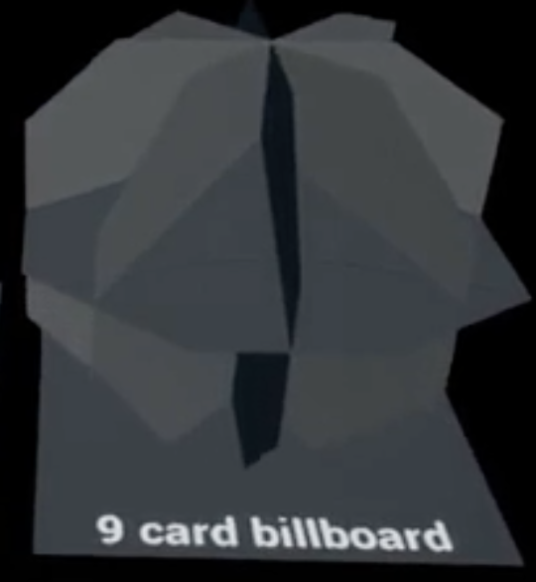
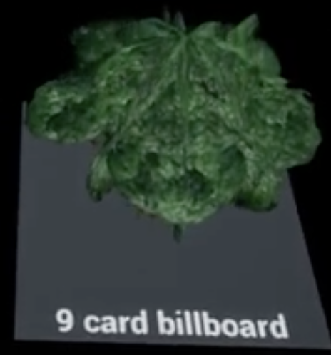
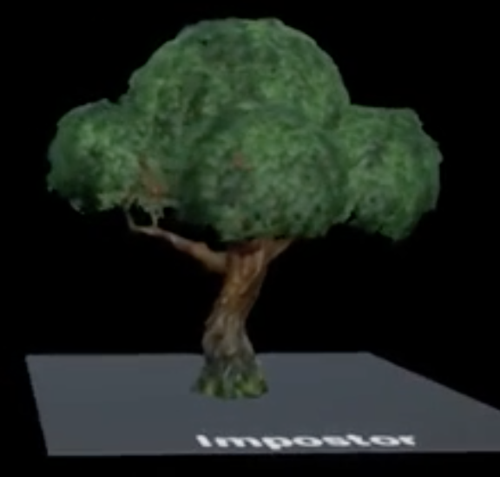
Billboards & Imposters
Billboard
  Rectangle that turns to face the viewer
  Sometimes a fixed set of intersecting planes
  Typically a fixed static texture, common for particles
  Can also billboard gbuffer data (color, normal, etc.)
Imposter
  Change texture based on view direction
  Better yet to warp with POM and blend closest
  Used for Fortnite trees
    https://shaderbits.com/blog/octahedral-impostors/

Slide 25
Volumetrics

Slide 26
Volume effects
Smoke, fog, clouds
Typical algorithm marches ray through volume
Accumulate color and opacity as you go
Total Color
Color so far
+
Segment Color * (1 - Opacity so far)
Opacity so far
+
Segment Opacity * (1 - Opacity so far)
Total Opacity

Slide 27

Proxy Volumes
Render transparent-pass proxy object around volume
  Or just as a plane in front of the viewer
Shader does ray march, returns color & opacity
  Blends over background objects
Embedded opaque objects
  Shader reads depth
  Stops ray march early
  Blend over like background object
March toward light for shadows
Notes:
From my NoiseTest map.

Slide 28
Fewer steps
Expensive to do enough steps
  Too few causes banding artifacts
Randomize first step
  Replaces bands with noise
Keep spacing consistent
  Errors don’t move
Acceleration data
  Hierarchical structure
  Distance field
  Preprocess, not great for changing data
Notes:
From my GLSL “ShaderTest” app

Slide 29
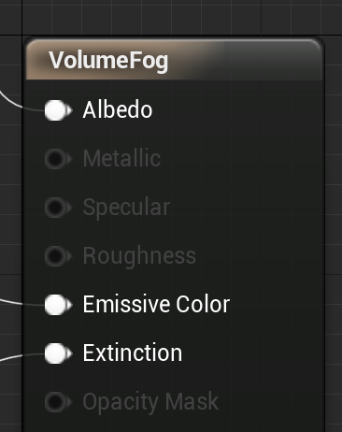
UE4 Volume Material
Re-samples volume to grid
Handles ray marching, accumulation & shadows
Albedo = Color of the material
Emissive color = Light emitted by the material
  Doesn’t act as a light source, just constant extra color
Extinction = opacity of the material
Notes:
Noise project, VectorNoise level, Volume Material example

