Slide 1
Precomputation
UMBC Graphics for Games

Slide 2
Rendering Equation
Want more than point lights
Full environment
  Integrate full hemisphere
Global Illumination
  Chain of integrals: is in somewhere else

Slide 3
Solution
Precompute (AKA Bake) some of the computation
UE4 Lightmass, launched by “Build Lighting”

Slide 4
Monte-Carlo Integration

Slide 5

Stuff from Probability
Random variable X
  Like X = rand(): different value every time
Probability Density Function (PDF),
  is density near , not probability of
  Uniform density in [0, 1]
  Uniform density in [0, 2]
  Uniform density in [0, ½]

Slide 6
Expected Value
  Average value of
Expected value estimates integral
  For
  More samples = closer estimate
  Too few samples = noise in the result: 4x the samples for ½ the noise

Slide 7
Importance Sampling
Spend your samples where they’ll help the most
Scale contribution by density of samples
Works best when is roughly proportional to

Slide 8
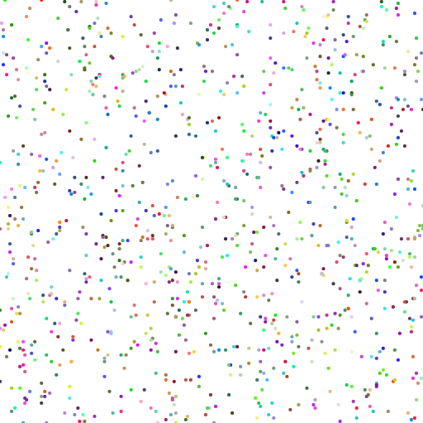
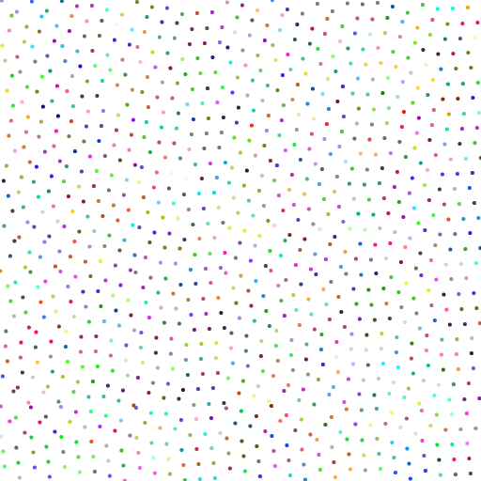
Quasi-Random & Blue Noise
Uncorrelated pseudo-random numbers are clumpy
More evenly spaced works better
  Especially at low sample counts
  Still uniformly distributed
  Samples are correlated to be aware of each other
Quasi-Random / Low Discrepancy
  Algorithm to generate a sequence
  Halton, Sobol
Blue Noise / Poisson
  Point sets with little or no low frequencies
  Usually built by some optimization algorithm

Slide 9
Denoising
Try to smooth out noise from too few samples
  Use samples from nearby pixels or previous frames
Cross-Bilateral blur
  Blur, weighted by extra terms (depths, normals, …)
Non-Local Means (NL-Means)
  Extra terms over image patches instead of individual pixels
Regression
  Linear fit over image and non-image features
Deep learning
  Train on noisy & clean images

Slide 10
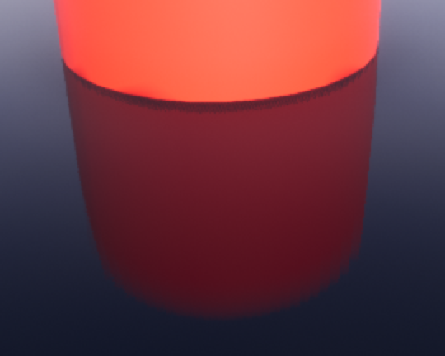
UE4 Screen Space Glossy Reflection
N Halton-distributed rays, randomized between pixels
  1, 4, or 12, determined by r.SSR.Quality
Importance sampled by BRDF
Trace against screen color & depth buffer
Blend across frames with Temporal Antialiasing
  Repeating 8 frame pattern
  Effectively 8, 32, or 96 samples per pixel

Slide 11
Path Tracing
AKA Markov Chain Monte-Carlo

Slide 12
Paths for Global Illumination
Trace a photon through the scene
Importance sample next direction at each bounce
Average over many photons

Slide 13
Unidirectional Path Tracing
Algorithm
  Start at camera
  Trace photons backwards to see where they came from
  Check direct lighting each bounce
  Randomly kill and restart new photons
Strengths
  All photons known to contribute to the image
  Handles looking through refracted surfaces well
Weaknesses
  Doesn’t handle shining lights through refractive surfaces well (caustics)

Slide 14
Photon Mapping
Algorithm
  Trace photons from light sources
  Deposit energy in a spatial data structure
  When rendering, find nearby photons
Strengths
  Handles caustics well
Weaknesses
  Not so good at refraction of primary view rays

Slide 15
Virtual Point Lights (VPL)
Algorithm
  Trace photons from light sources
  Turn hits into point lights
  Render using methods for large numbers of lights
Strengths
  Can tie into deferred shading pipeline for real-time final render
  Can handle caustics and volumetrics well
Weaknesses
  Weak singularity near each VPL, requires clamping = bias = darkening
  Can’t handle refracted primary view rays

Slide 16
Bidirectional Path Tracing
Algorithm
  Trace paths from both lights and view
  Connect view chain to light chain
  Variations like Metropolis mutate successful chains
Strengths
  Handles refracted view and caustics
  Metropolis can light even from rare paths
Weaknesses
  Complex: simpler methods can be less noisy for simple light paths

Slide 17
Simplifying Assumptions

Slide 18
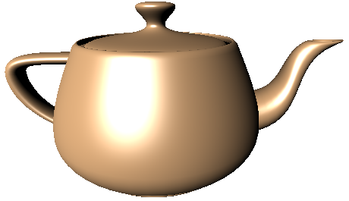
Point and Directional Direct Lighting
Light only comes from certain directions
Just sum over those directions

Slide 19
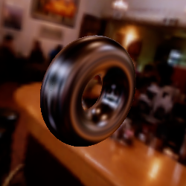
Environment Maps
Distance to reflected environment >> object size
  Incoming light only depends on direction, not position
Store reflection by direction in a texture
  Six faces of a cube
  Image of a reflective sphere
Layered maps at different distances
Warp for some local reflection effects

Slide 20
Traditional Ray Tracing
Only direct (to point lights)
+ mirror reflection (no glossy/blurry reflections)
+ simple refraction (no blurry refractions)

Slide 21
Light Maps
Diffuse integral doesn’t depend on view direction
Precompute and store in per-object textures
  Path trace
  Radiosity diffuse-only global
  illumination algorithm

Slide 22
Light Probes
Grid of precomputed environment captures
3D grid or 2D grid ~1m high (good for human-sized characters)
Represent in a compact format
At run-time, interpolate and
use for lighting

