Slide 1
Blueprint Plugins

Slide 2
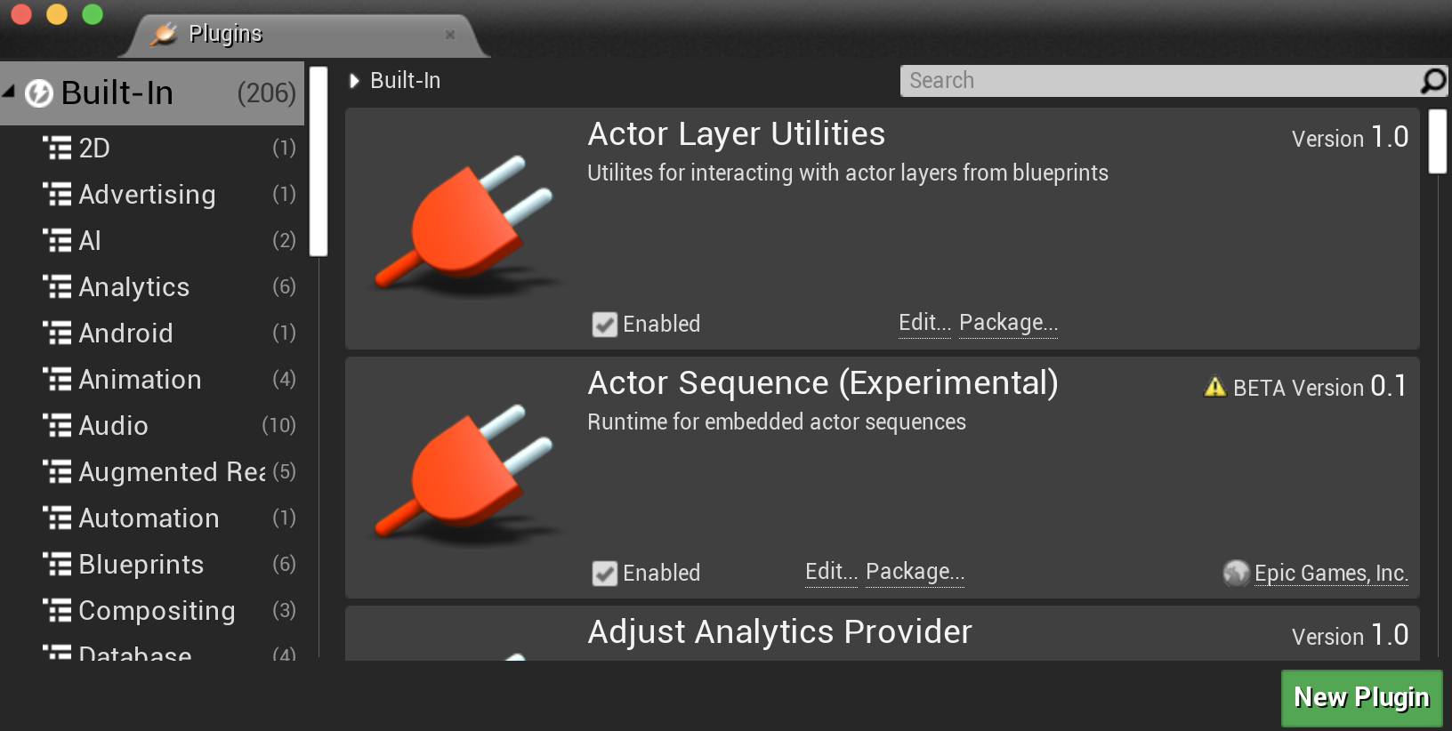
UE4 Plugins
The Unreal Engine has a very flexible Plugin system for making a wide range of engine extensions without having to make a custom engine build.
Plugins can do the following:
  Add content, including functions created in Blueprint or the Material Editor
  Add new Blueprint nodes and types
  Add Editor tools
  Add editing modes
  Add new importers or asset types

Slide 3
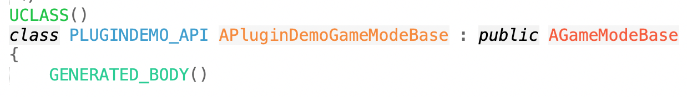
Plugins vs. Modules
All project and engine code in UE4 is divided into independent modules. When you create a C++ code project, it puts the code into a single module with its own
  build.cs file, with dependencies and build settings
  MODULE_API macro for exported symbols
  IMPLEMENT_PRIMARY_GAME_MODULE to set up module support
The engine code is also divided into modules.
You can create additional modules at the project or engine level to encapsulate code.
Plugins are cross-project and cross-engine modules that can be redistributed.

Slide 4
Code Hierarchy
Project Module
Project Module
Project Plugin
Project Plugin
Code in the Unreal Engine can use other code or data defined at the same or lower levels.
Engine Plugin
Engine Plugin
Engine Module
Engine Module

Slide 5
Blueprint Plugins

Slide 6
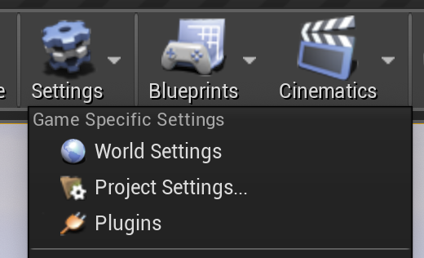
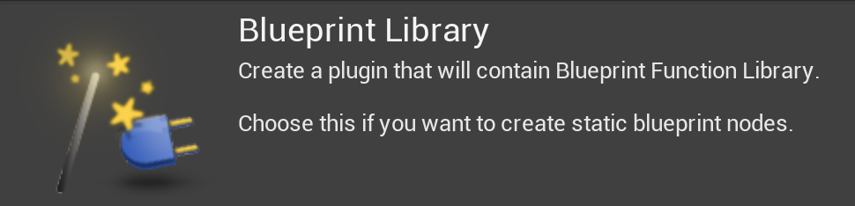
Create a Blueprint Plugin
Start with a C++ code project.
To create a new plugin, open the Plugins browser in the Settings menu.
From there, you can use the New Plugin button.
Choose the Blueprint Library plugin, and fill out the name, author, and description.
To rebuild, instead of using the Compile button, as you would for project code, open Window > Developer Tools > Modules. Each project and engine module will be listed, including the new one. Each has a Recompile button you can use to rebuild just that module.

Slide 7
What It Makes
This will create several files for you (where “PluginName” represents the name you gave your plugin):
  Icon128.png
  PluginName.uplugin
  PluginName.Build.cs
  PluginName.h, .cpp
  PluginNameBPLibrary.h, .cpp

Slide 8
What It Makes
Resources/Icon128.png
This will create several files for you (where “PluginName” represents the name you gave your plugin):
  Icon128.png
  PluginName.uplugin
  PluginName.Build.cs
  PluginName.h, .cpp
  PluginNameBPLibrary.h, .cpp
128x128 icon image with a transparent background
      Change to something else if you want a different icon in the Plugins browser.

Slide 9
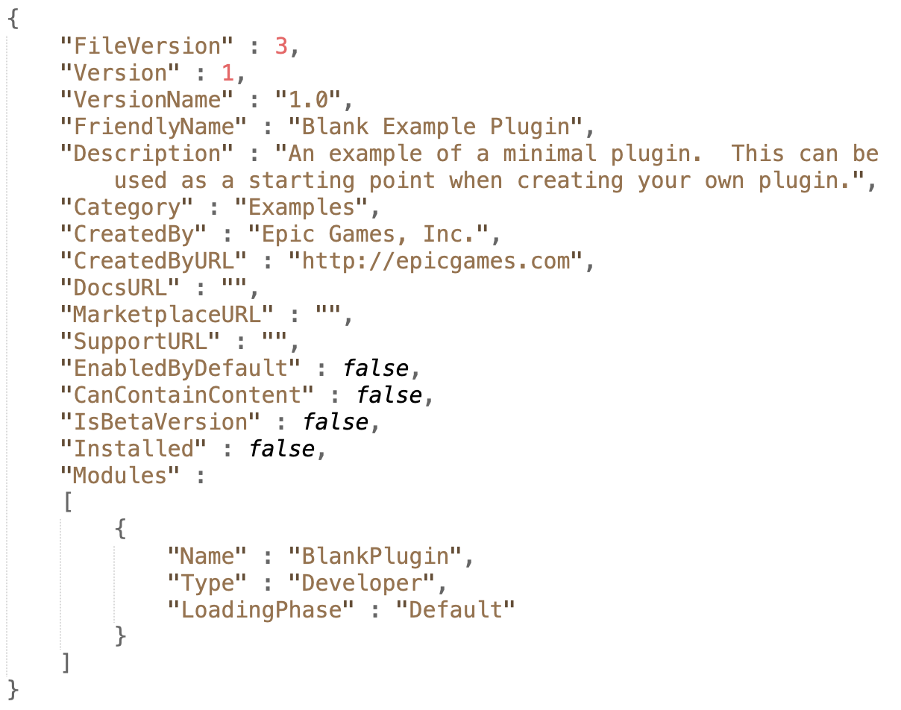
What It Makes
  PluginName.uplugin
This will create several files for you (where “PluginName” represents the name you gave your plugin):
  Icon128.png
  PluginName.uplugin
  PluginName.Build.cs
  PluginName.h, .cpp
  PluginNameBPLibrary.h, .cpp
Plugin name, author, description, URL
If you want to change these after creating the plugin, just edit this file.
Loading phase
When will it run its startup code (if any)? Only matters if you have some global initialization.

Slide 10
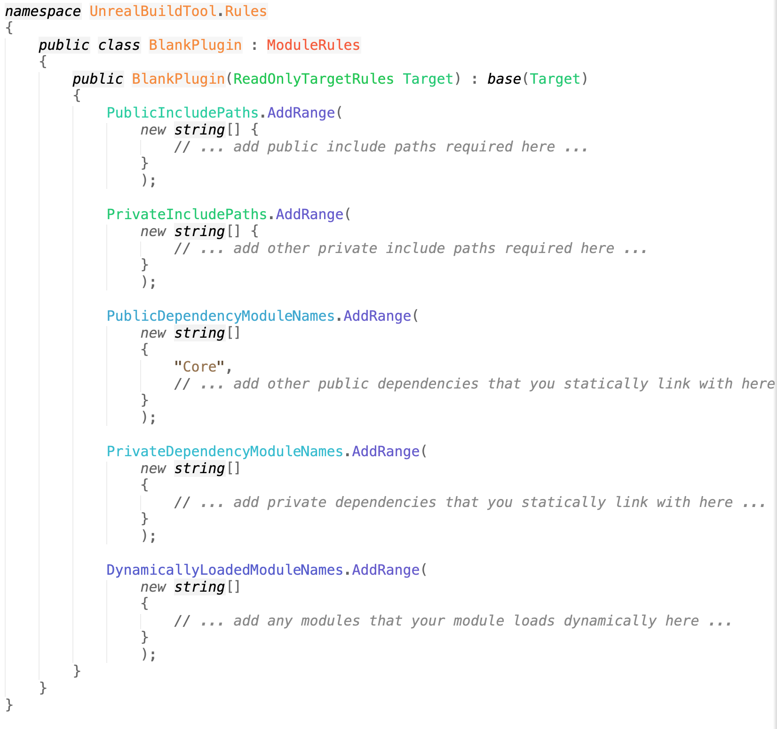
What It Makes
  Source/PluginName/PluginName.Build.cs
This will create several files for you (where “PluginName” represents the name you gave your plugin):
  Icon128.png
  PluginName.uplugin
  PluginName.Build.cs
  PluginName.h, .cpp
  PluginNameBPLibrary.h, .cpp
Includes paths to external libraries needed
Defines dependencies on other modules and plugins

Slide 11
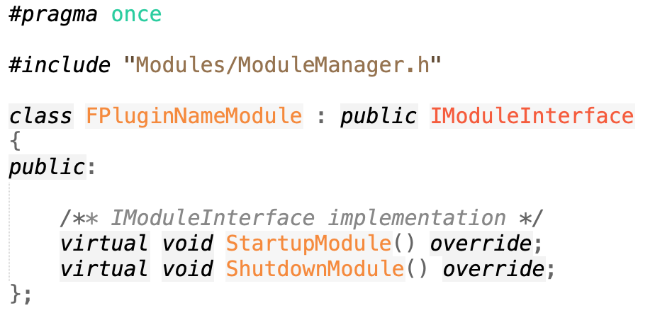
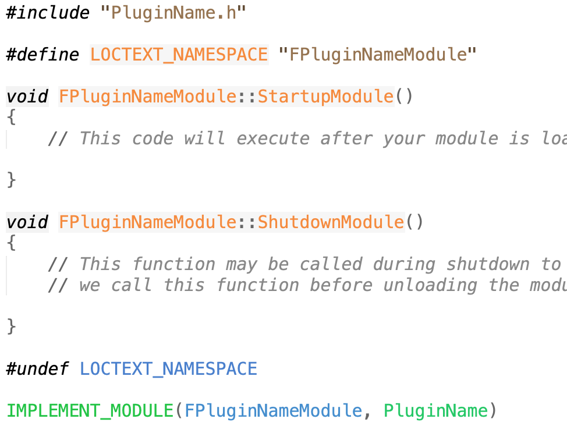
What It Makes
  Source/PluginName/Public/PluginName.h
  Source/PluginName/Private/PluginName.cpp
This will create several files for you (where “PluginName” represents the name you gave your plugin):
  Icon128.png
  PluginName.uplugin
  PluginName.Build.cs
  PluginName.h, .cpp
  PluginNameBPLibrary.h, .cpp
Module initialization code (if needed)
Code to set it up as a module
Note: Blueprint modules usually won’t need to change much here unless using an external library that has to be initialized.

Slide 12
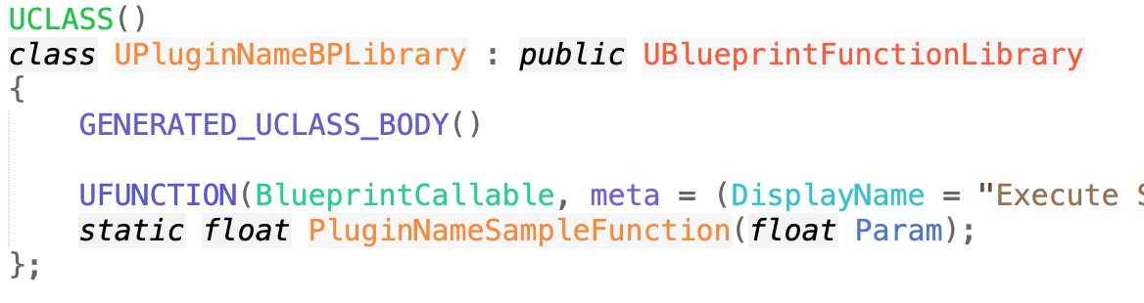
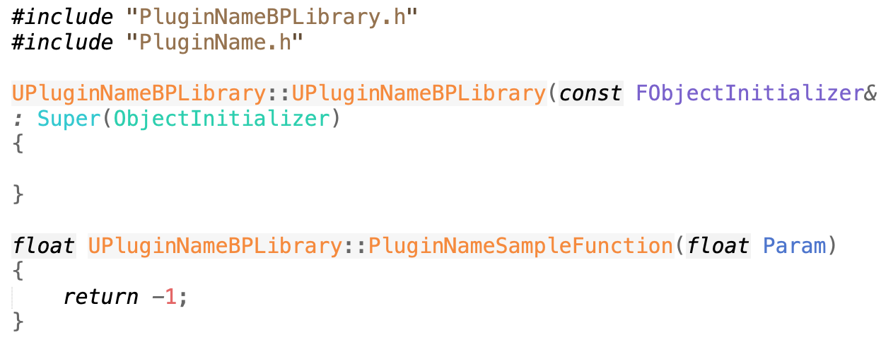
What It Makes
  . . . /Public/PluginNameBPLibrary.h
  . . . /Private/PluginNameBPLibrary.cpp
This will create several files for you (where “PluginName” represents the name you gave your plugin):
  Icon128.png
  PluginName.uplugin
  PluginName.Build.cs
  PluginName.h, .cpp
  PluginNameBPLibrary.h, .cpp
Declaration and implementation of actual Blueprint library code

Slide 13
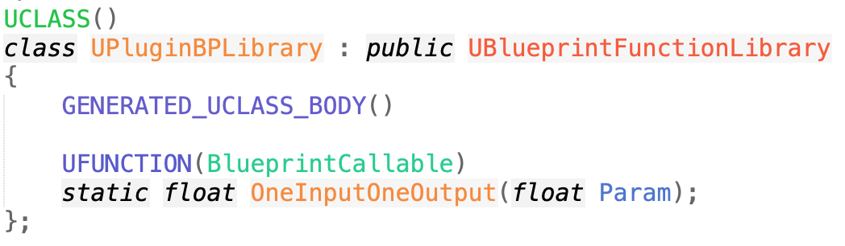
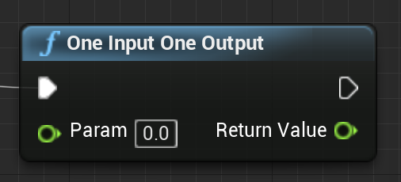
Blueprint Functions
“Library” is a class, tagged “UCLASS()”.
  Derived from UBlueprintFunctionLibrary
  Needs GENERATED_UCLASS_BODY()
Actual Blueprint functions are static class member functions.
  Can therefore be called as ClassName::Function() without needing an instance of the class
As with Blueprint functions in Actor code, these should be UFUNCTION(BlueprintCallable), but will be available to all Blueprints, not just derived Blueprint Actor classes.

Slide 14
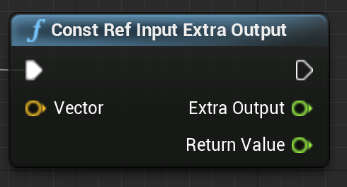
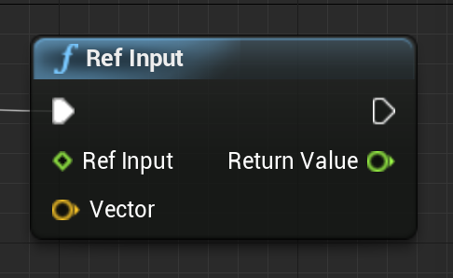
Multiple Return Values
Function return values show up as output pins, and const references show up as input pins, but values returned by (non-const) references will appear as additional outputs.
If you want a reference parameter to appear as an input, tag that parameter with “UPARAM(ref)”. In this case, as with any C++ reference, the parameter can be both read and changed.

Slide 15
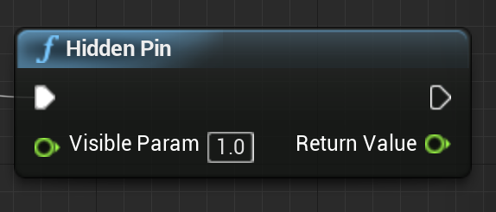
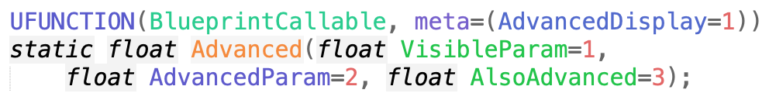
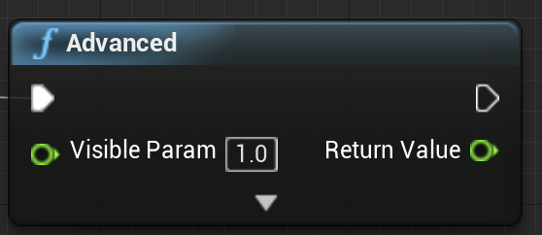
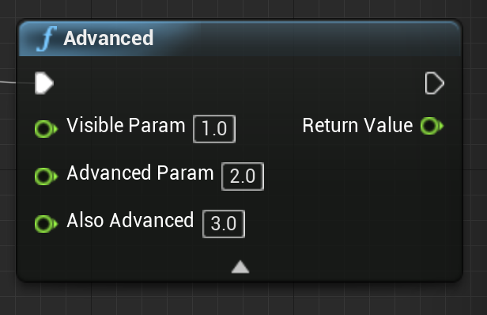
Hiding Input Pins
You can permanently hide input pins (say, if only useful when directly called from C++) by giving a default value and adding the meta=(HidePin=“PinName”) tag.
For seldom used pins, put them at the end of the argument list, with reasonable defaults, and use the meta=(AdvancedDisplay=Num) tag, where “Num” is the parameter number starting at 0.

Slide 16
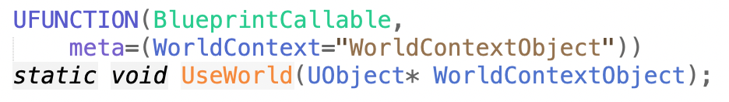
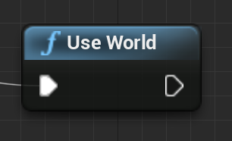
World Context Object
Blueprint nodes defined in an Actor have access to their Actor’s GetWorld() function, but if a global static Blueprint function needs access to the world context object, it has to be declared as a parameter.
If this parameter is tagged with the WorldContext meta tag, it will be hidden and automatically filled in.

Slide 17
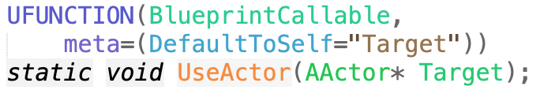
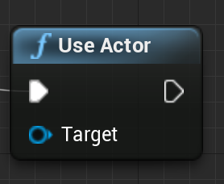
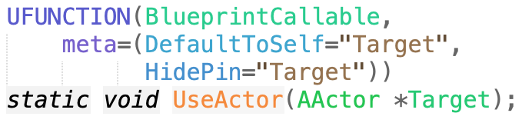
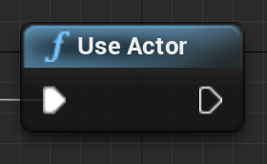
Accessing the BP Actor
A Blueprint node defined in an Actor has access to the Actor data through its this pointer. If a plugin Blueprint node needs similar Actor data access, it will need to declare an explicit parameter.
This parameter can be hidden (using HidePin) and/or filled by default (using DefaultToSelf)
If not hidden, the Blueprint can apply the node to a different Actor.

Slide 18

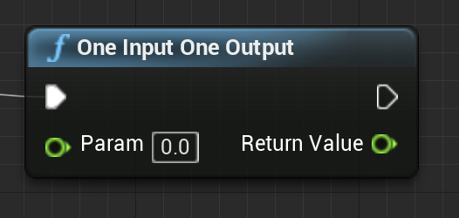

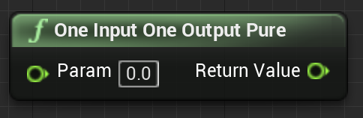
Pure Functions
BlueprintCallable functions will have the white sequence pins and in a Blueprint will be called in order. Functions with visible state changes should always be BlueprintCallable.
BlueprintPure functions do not make guarantees on their execution order. They may be called anytime between the time the inputs are ready and the time the output is needed.
BlueprintPure can be used for true pure functions, but also for any function where the outputs are consistent for a given set of inputs and execution order does not matter (e.g., including some internal caching).

Slide 19
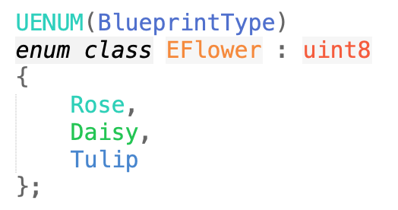

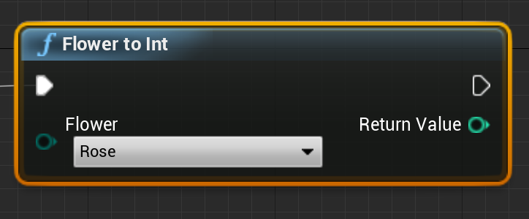
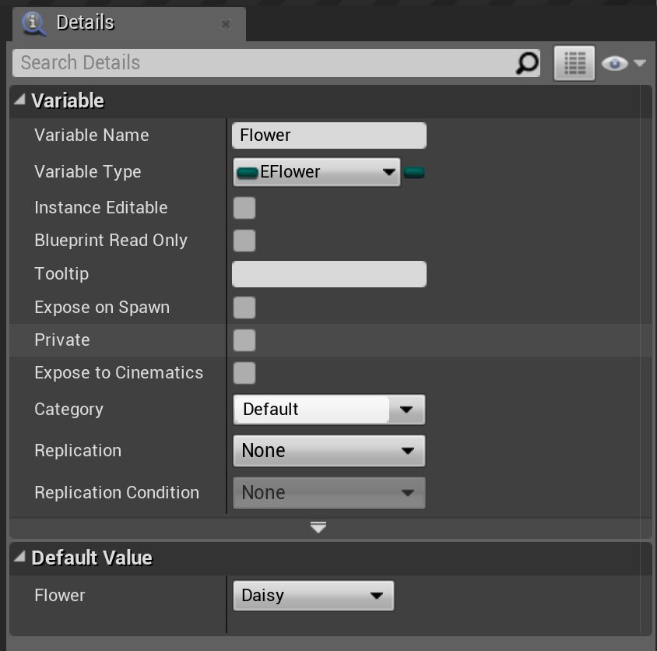
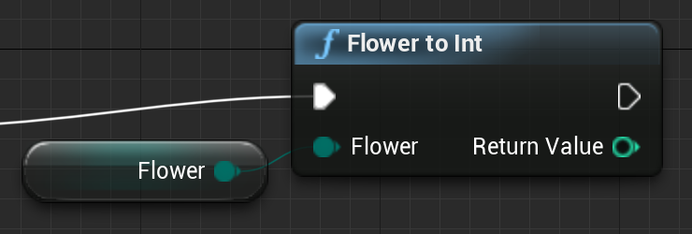
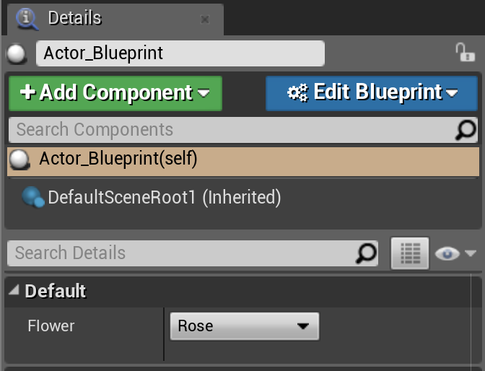
New Enumerated Types
You can create new enum types by declaring them with UENUM(BlueprintType). UENUM-type names should start with an “E”.
These will appear as a drop-down selection in the Blueprint node.
Enums declared this way can also be stored in a Blueprint variable, and made visible in the Details panel for the Actor using the Blueprint.

Slide 20
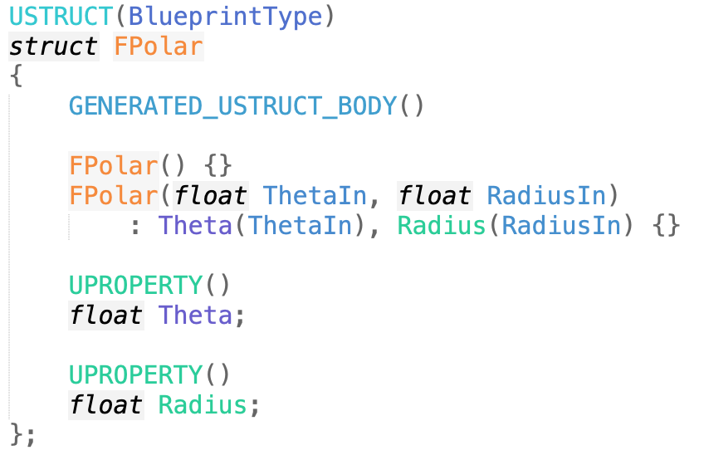
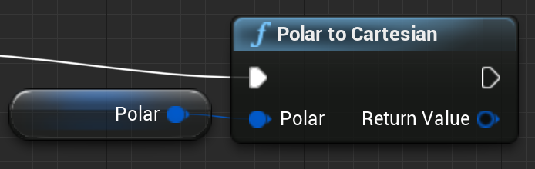
New Struct/Class Types
To group related data or states together, you can declare a struct with USTRUCT(BlueprintType) or UCLASS(BlueprintType).
Like UENUM, the struct can be used as the input or output of a Blueprint function, and stored in a Blueprint variable.
Don’t forget to tag any member data that should be serialized with “UPROPERTY()”.

Slide 21
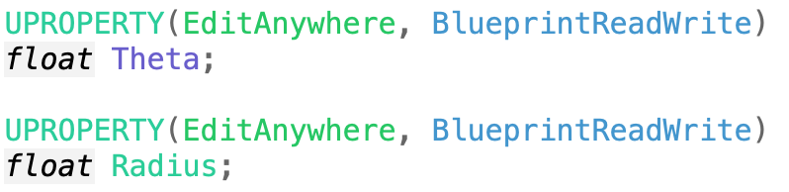
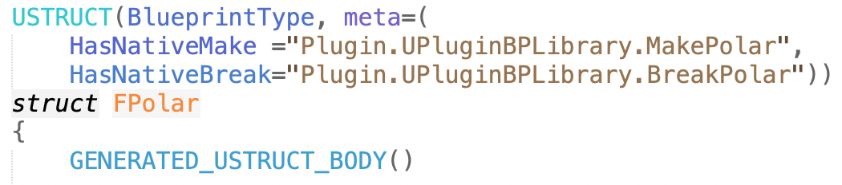
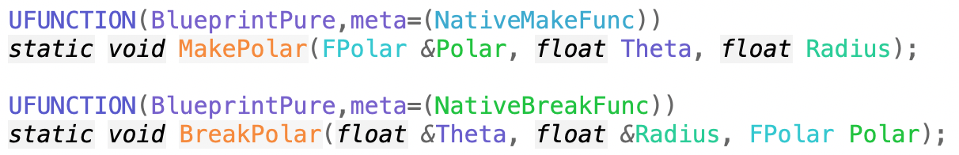
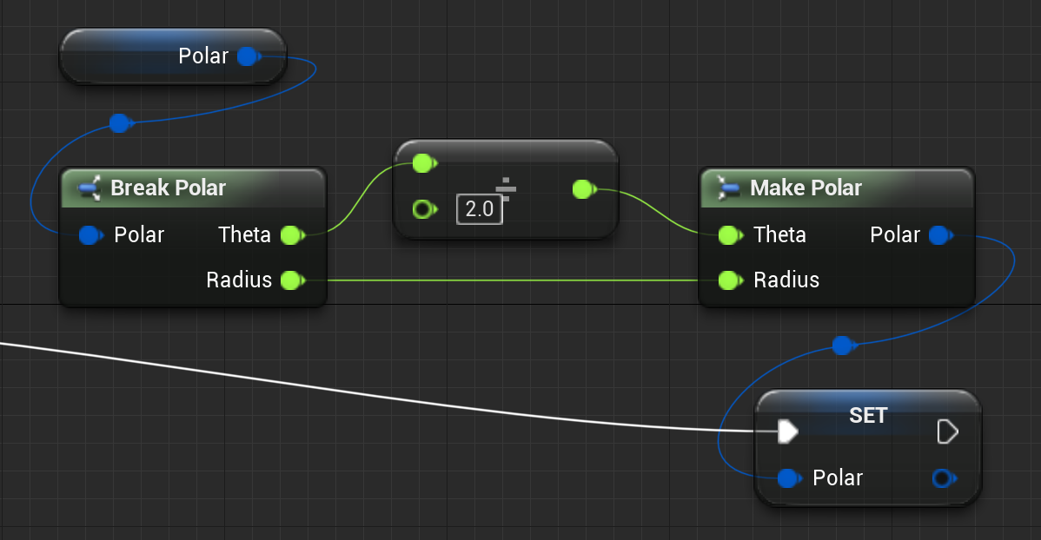
Struct Make and Break
Or
If the struct data is tagged “EditAnywhere” and “BlueprintReadWrite”, Blueprint will generate a Make function to a variable of that type, and a Break function to split it into the component properties.
You can also write your own in C++.
Tag the functions
  UFUNCTION(BlueprintPure,
  meta=(NativeMakeFunc))
  UFUNCTION(BlueprintPure,
  meta=(NativeBreakFunc))
Also, the USTRUCT() should have meta tags
  HasNativeMake=“Module.Class.Func”,
  HasNativeBreak=“Module.Class.Func”

Slide 22
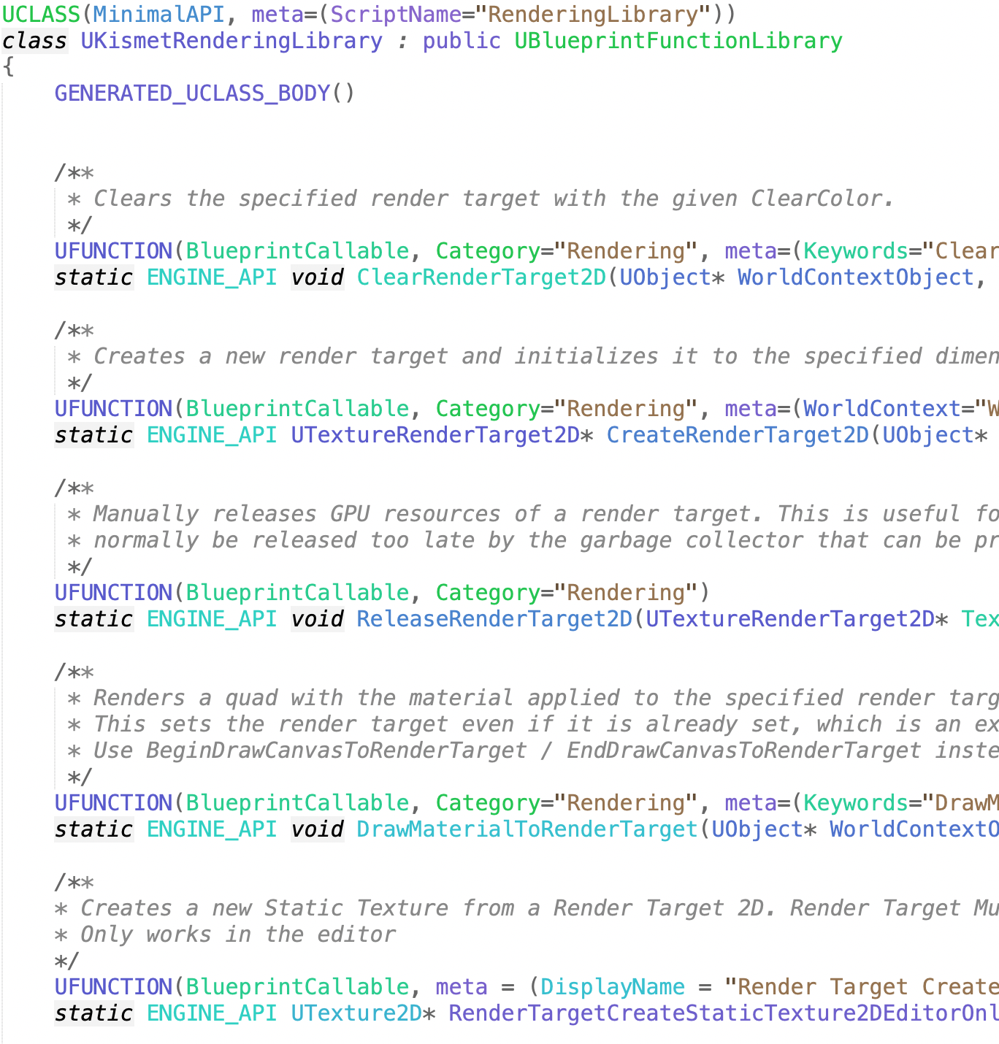
Finding More
Online documentation:
  UFUNCTION options
  Meta tag options
Examples:
  Look at code for existing Blueprint nodes.
  Look at code for existing BlueprintTypes.

