Slide 1
Engine Coding

Slide 2
Plugins vs Engine Code

Slide 3
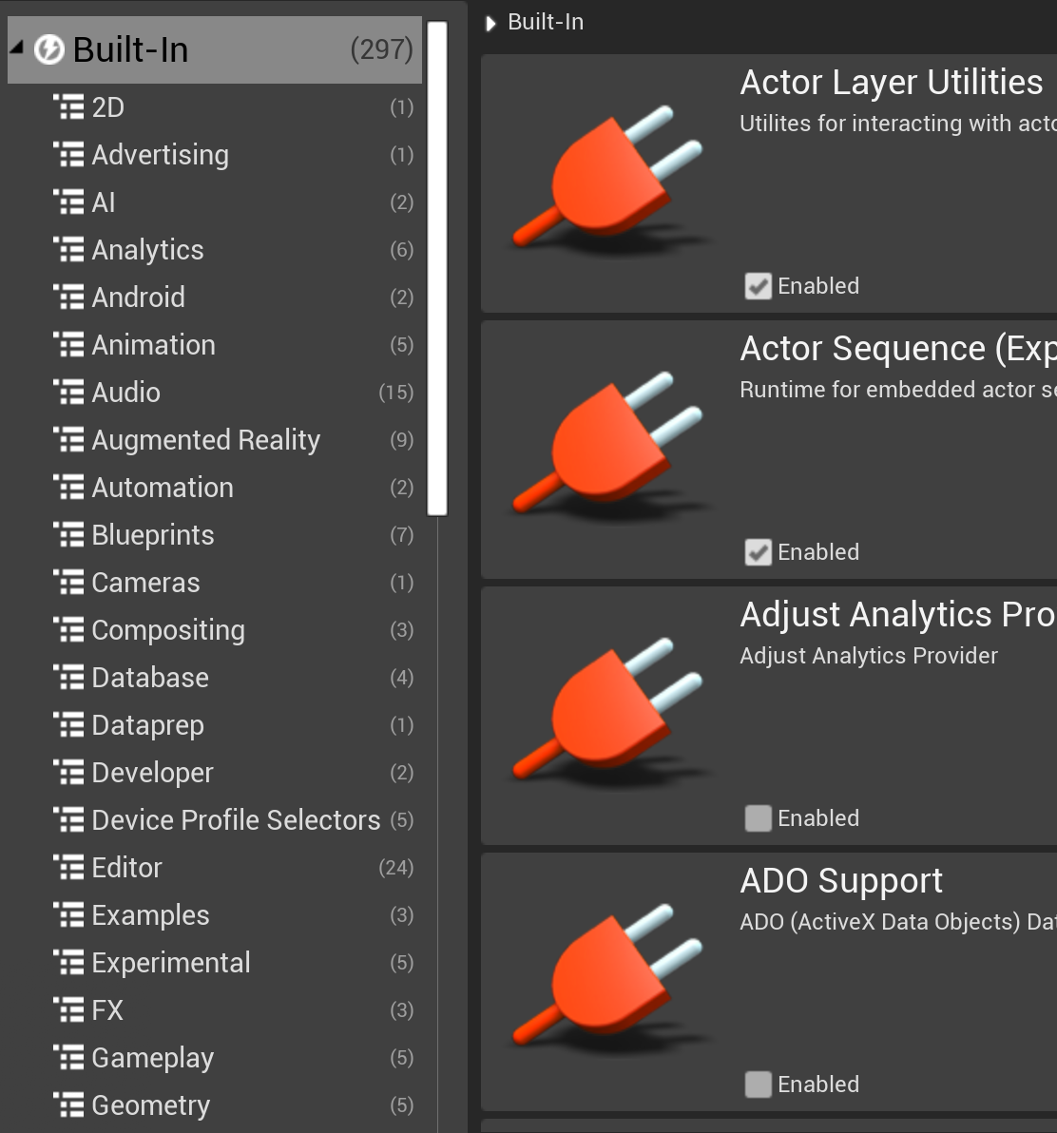
Why Not Plugin Code?
The Unreal Engine plugin system supports many kinds of extensions to core engine functionality. So why not just write game and plugin code?
There are two main reasons
  Modifying Engine Modules
  Low-level Code

Slide 4
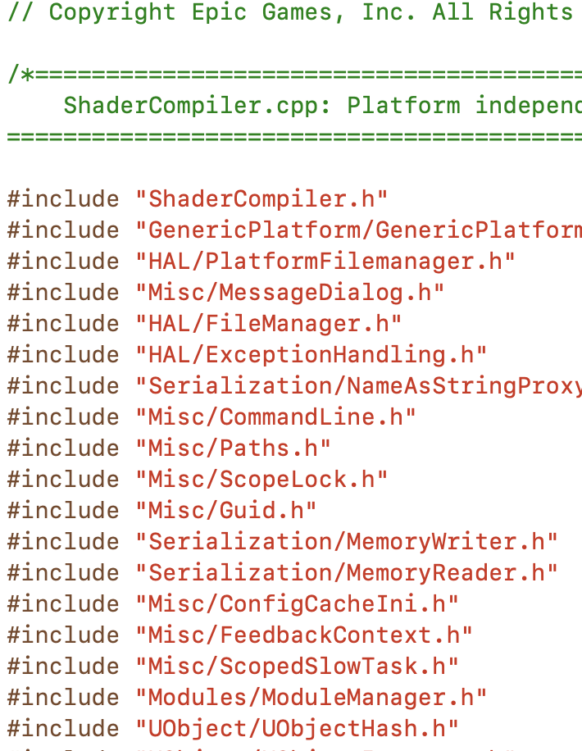
Modifying Engine Modules
This is the principal reason to modify the core engine code. Plugins allow you to extend engine behavior, but to change what is already implemented, you have to edit the code that’s already there.
  Extending systems that are not designed for plugin function discovery.
  Modifying the behavior or implementation of existing code.

Slide 5
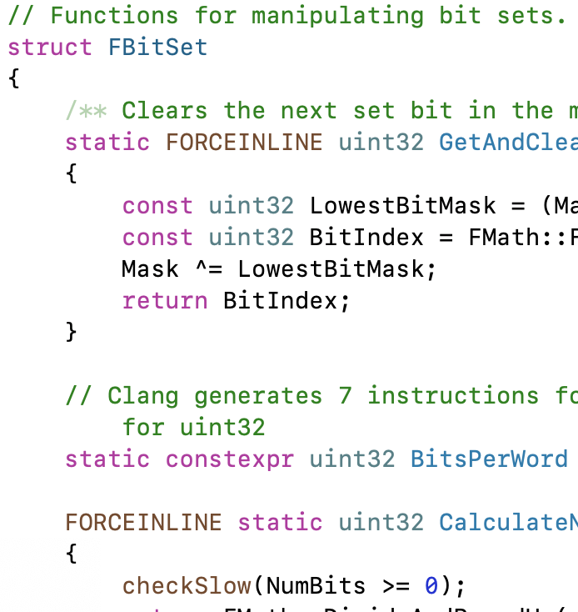
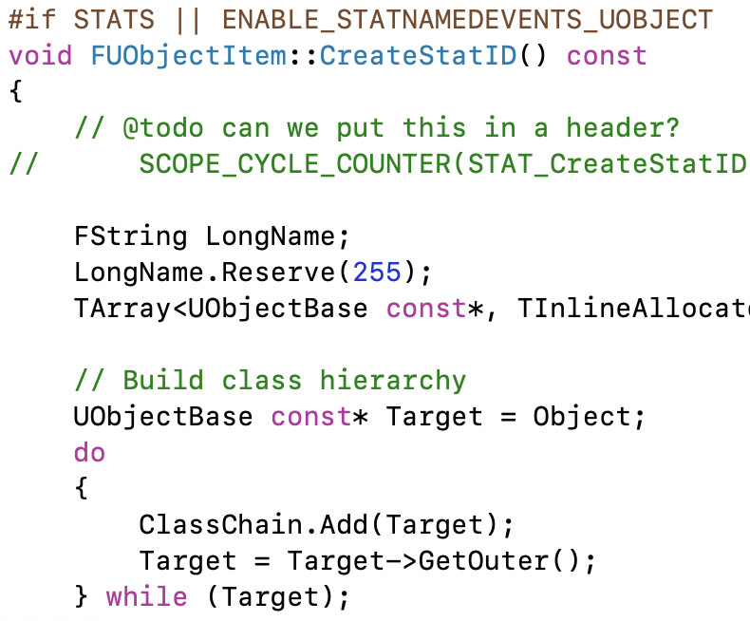
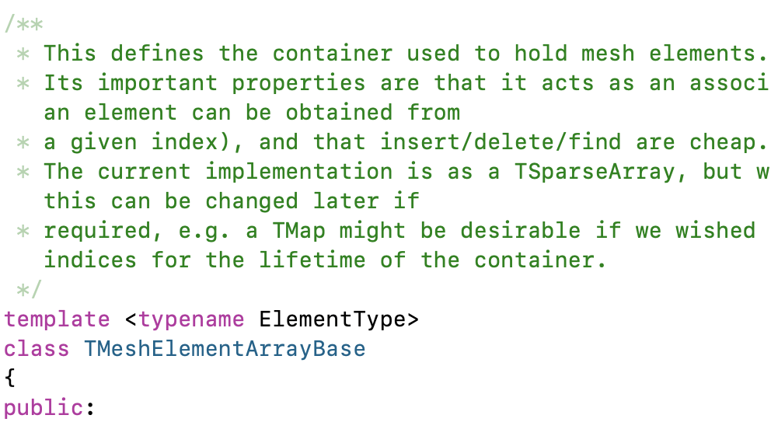
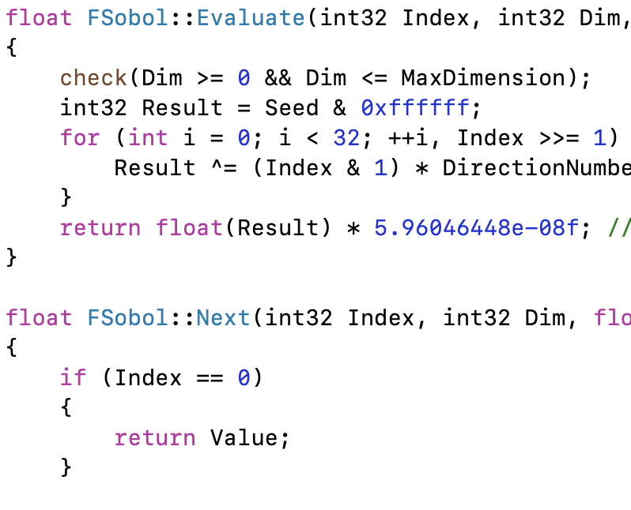
Low-Level Code
The other reason to change engine code is to add behavior to be used by other engine modules. Engine modules can only depend on other engine modules, not engine plugins, game plugins, or game code. If you want to add some core functionality for another engine class to use, it has to be in an engine module.

Slide 6
Engine Organization

Slide 7
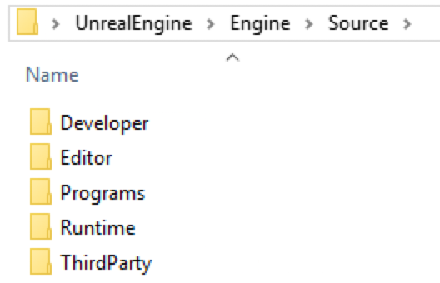
Engine Module Types
Look in the Engine/Source directory for all engine code. The major categories can be found in the directories there:
  Runtime – Code needed while the game is running.
  Editor – Code for implementing the Unreal Editor. Many systems have separate Runtime and Editor modules.
  Developer – Code for additional tools (output log, source control, profiling, cooking, derived data cache, …)
  ThirdParty – Integration for additional third-party libraries.
  Programs – Build and header tools, lightmass light baking, shader compiler, …

Slide 8
Runtime Modules
AESBlockEncryptor
AIModule
ALAudio
AVEncoder
AVIWriter
Advertising
Analytics
AnalyticsET
AnalyticsSwrve
AnalyticsVisualEditing
AndroidAdvertising
AndroidAudio
AndroidLocalNotification
AndroidRuntimeSettings
AnimGraphRuntime
AnimationCore
AppFramework
ApplicationCore
AssetRegistry
AudioAnalyzer
AudioCaptureAndroid
AudioCaptureAudioUnit
AudioCaptureCore
AudioCaptureRtAudio
AudioExtensions
AudioMixer
AudioMixerAndroid
AudioMixerAudioUnit
AudioMixerCore
AudioMixerCoreAudio
AudioMixerSDL
AudioMixerXAudio2
AudioPlatformConfiguration
AutomationMessages
AutomationWorker
BackgroundHTTP
BlockEncryptionHandlerComponent
BlowFishBlockEncryptor
BlueprintRuntime
BuildPatchServices
BuildSettings
CEF3Utils
Cbor
Chaos
ChaosCore
ChaosSolverEngine
ChaosSolvers
CinematicCamera
ClientPilot
ClothingSystemRuntimeCommon
ClothingSystemRuntimeInterface
ClothingSystemRuntimeNv
CookedIterativeFile
Core
CoreAudio
CoreUObject
CrashReportCore
D3D11RHI
D3D12RHI
DatasmithCore
EmptyRHI
EncryptionHandlerComponent
Engine
EngineMessages
EngineSettings
ExternalRpcRegistry
EyeTracker
FieldSystemCore
FieldSystemEngine
FieldSystemSimulationCore
Foliage
FriendsAndChat
GameMenuBuilder
GameplayMediaEncoder
GameplayTags
GameplayTasks
GeometryCollectionCore
GeometryCollectionEngine
GeometryCollectionSimulationCore
HTTP
HardwareSurvey
HeadMountedDisplay
HttpNetworkReplayStreaming
HttpServer
IOSAdvertising
IOSAudio
IOSLocalNotification
IOSPlatformFeatures
IOSRuntimeSettings
IPC
Icmp
ImageCore
ImageDownload
ImageWrapper
ImageWriteQueue
InputCore
InputDevice
InstallBundleManager
InteractiveToolsFramework
Json
JsonUtilities
Landscape
Launch
LaunchDaemonMessages
LauncherCheck
LauncherPlatform
LevelSequence
LiveLinkInterface
LiveLinkMessageBusFramework
LocalFileNetworkReplayStreaming
LuminRuntimeSettings
MaterialShaderQualitySettings
Media
MediaAssets
MediaUtils
MeshDescription
MeshUtilitiesCommon
Messaging
MessagingCommon
MessagingRpc
MetalRHI
MoviePlayer
MovieScene
MovieSceneCapture
MovieSceneTracks
NavigationSystem
Navmesh
NetCore
NetworkFile
NetworkFileSystem
NetworkReplayStreaming
Networking
NonRealtimeAudioRenderer
NullDrv
OpenGLDrv
Overlay
PacketHandler
PakFile
PerfCounters
PhysXCooking
PhysicsCore
PhysicsSQ
PortalMessages
PortalProxies
PortalRpc
PortalServices
PreLoadScreen
Projects
PropertyPath
RHI
RSA
RSAEncryptionHandlerComponent
RSAKeyAESEncryption
RawMesh
ReliabilityHandlerComponent
RemoteImportMessaging
RenderCore
Renderer
RigVM
RuntimeAssetCache
SSL
SandboxFile
SaveGameNetworkReplayStreaming
Serialization
SessionMessages
SessionServices
SignalProcessing
Slate
SlateCore
SlateNullRenderer
SlateRHIRenderer
Sockets
SoundFieldRendering
StaticMeshDescription
Stomp
StreamEncryptionHandlerComponent
StreamingFile
StreamingPauseRendering
SynthBenchmark
TimeManagement
Toolbox
TraceLog
TwoFishBlockEncryptor
UE4Game
UMG
UnixCommonStartup
UnrealAudio
UnrealAudioCoreAudio
UnrealAudioWasapi
UnrealAudioXAudio2
VectorVM
Voice
Voronoi
VulkanRHI
WebBrowser
WebBrowserTexture
WebSockets
WidgetCarousel
WindowsPlatformFeatures
XAudio2
XMPP
XORBlockEncryptor
XORStreamEncryptor
XmlParser
Every module has its own Build.cs file.
There are well over a hundred runtime modules, but here are some of the major categories:
  Basic functionality for the engine and major subsystems: *Core, Engine*
  Rendering: *Render*, *RHI*
  Slate UI: *Slate*
  Audio, Video: *Audio*, *Media*
  AI: AI*, Nav*

Slide 9
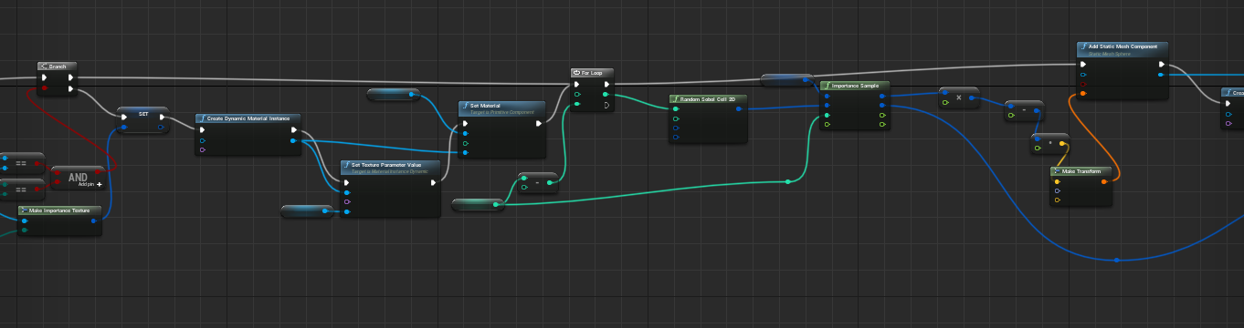
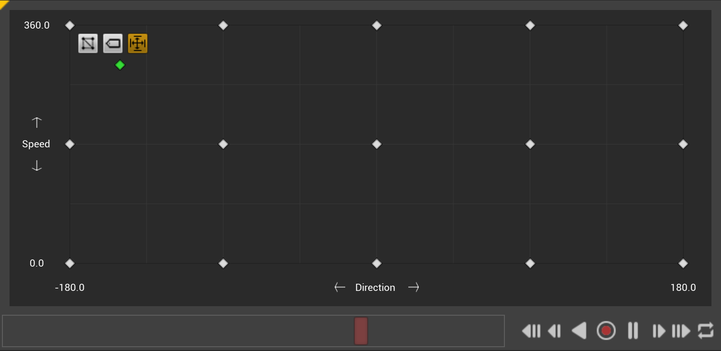
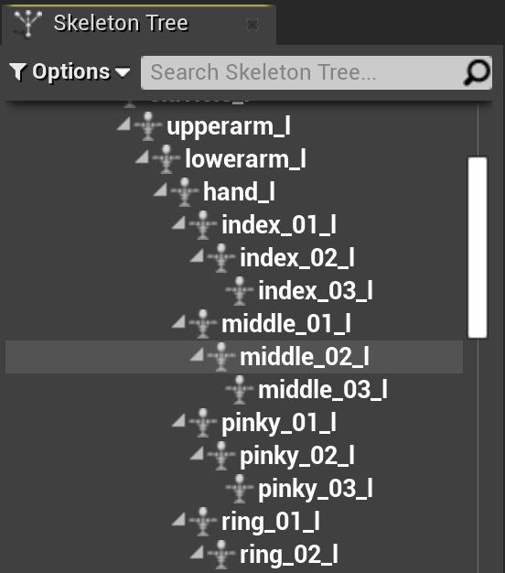
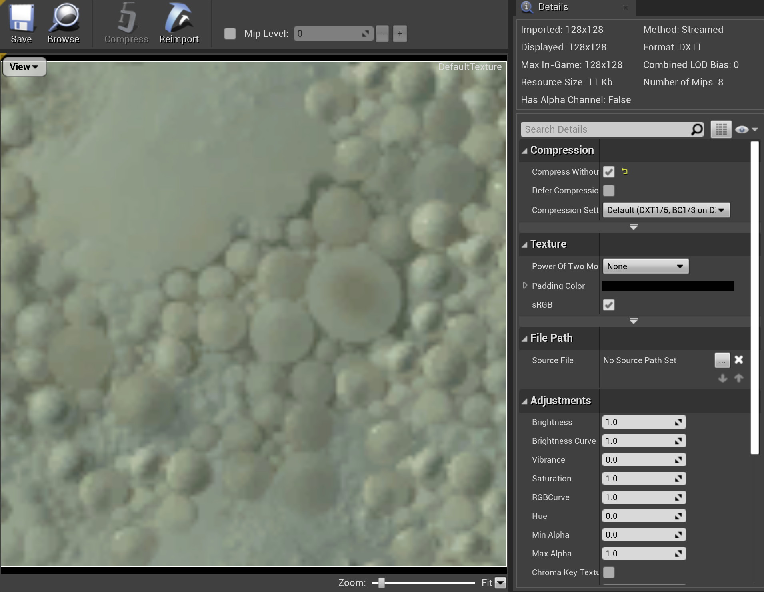
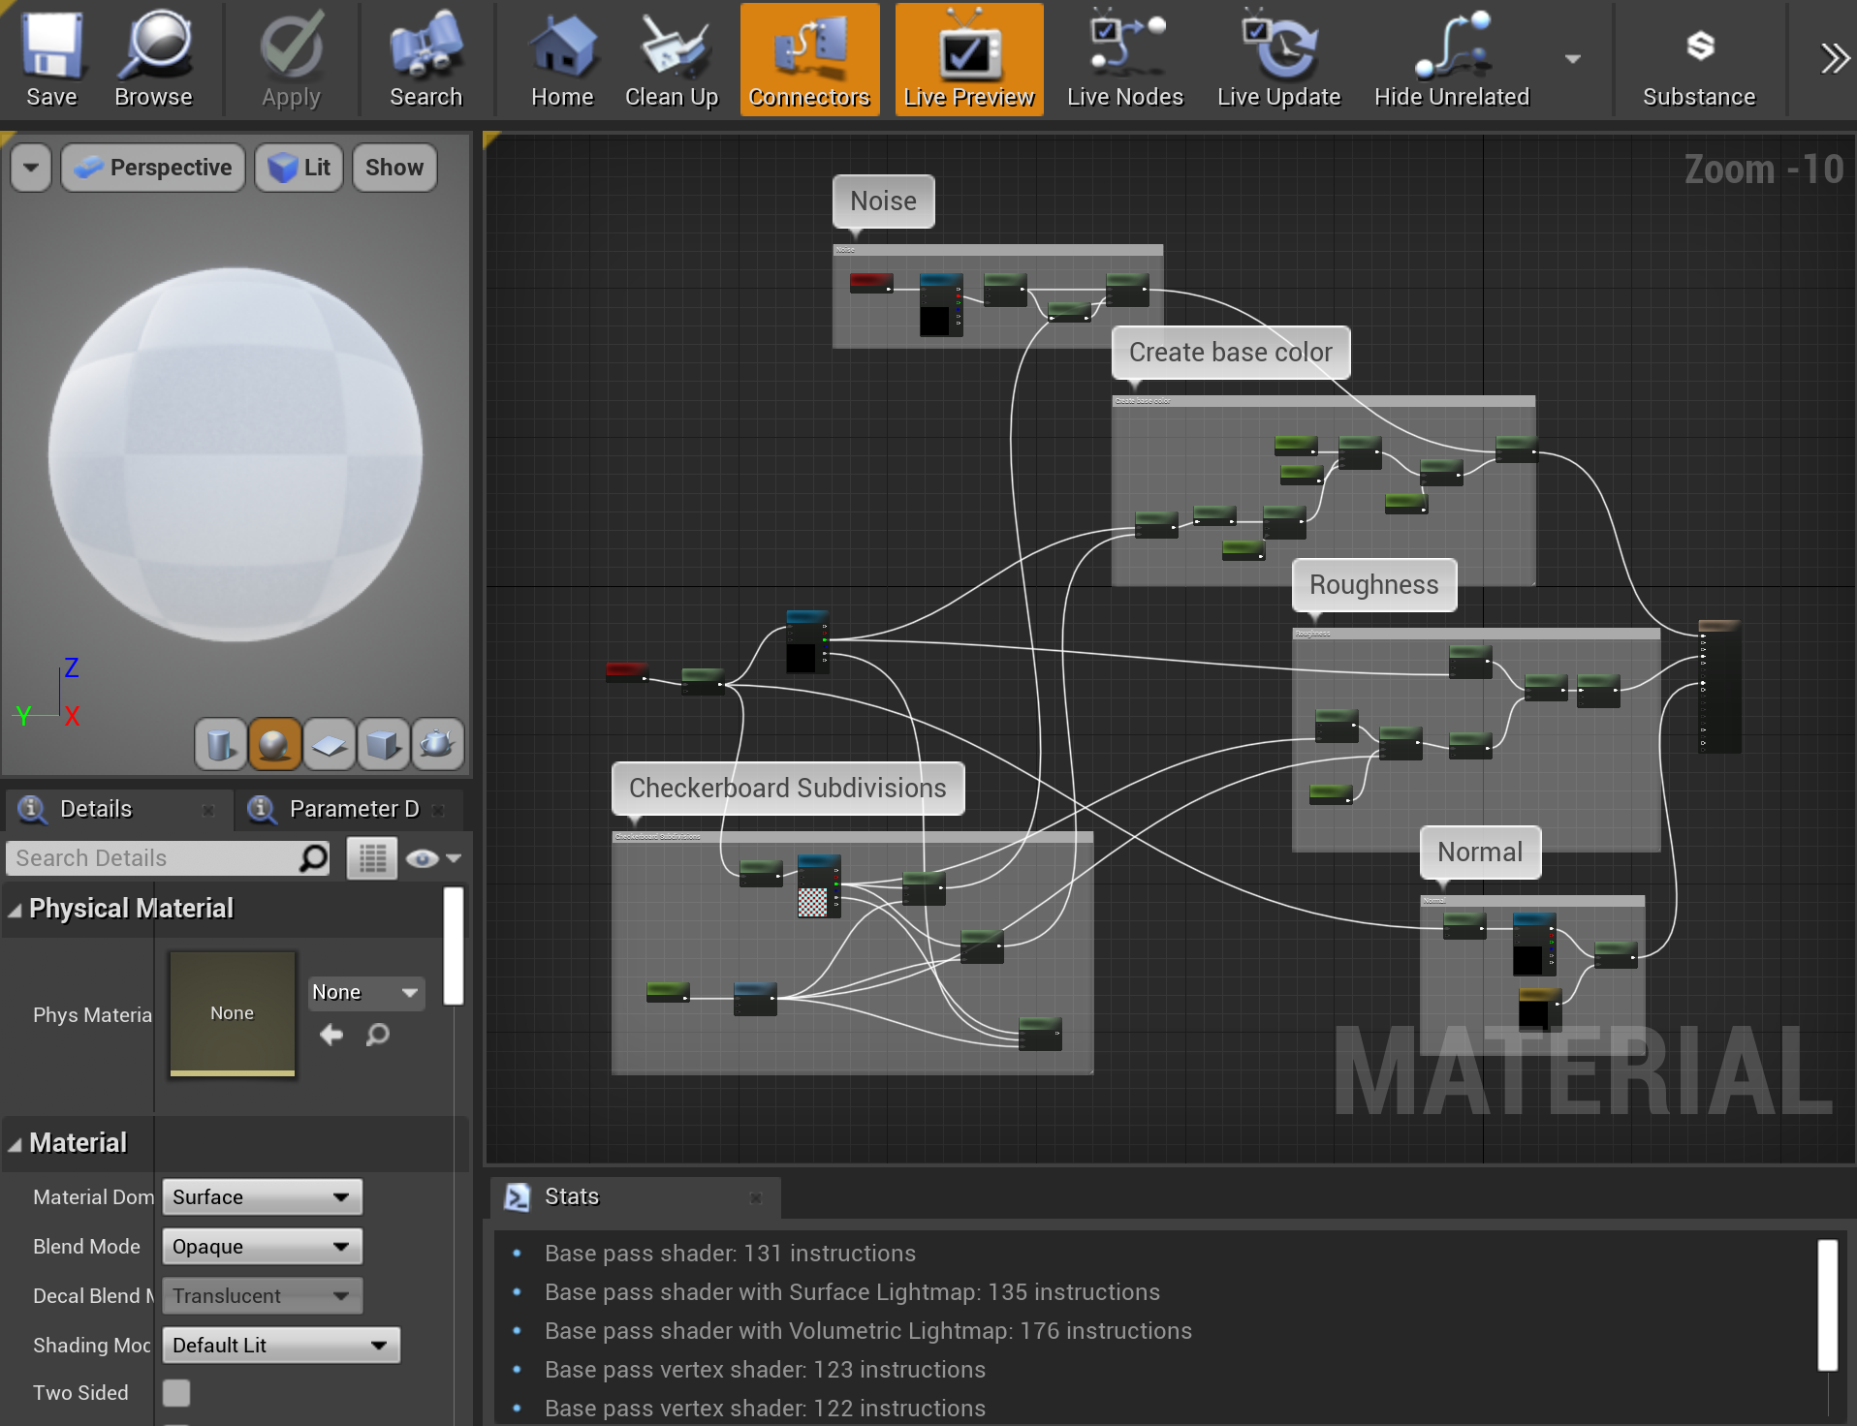
Editor Modules
There are over a hundred editor modules as well. Here are a few major categories:
  Blueprint: Kismet*, *Blueprint*
  Animation: Anim*
  Various independent editor panels: *Editor

Slide 10
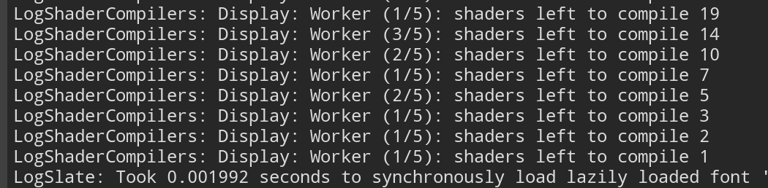

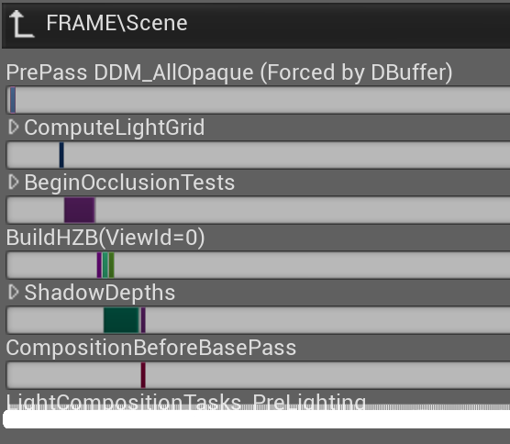
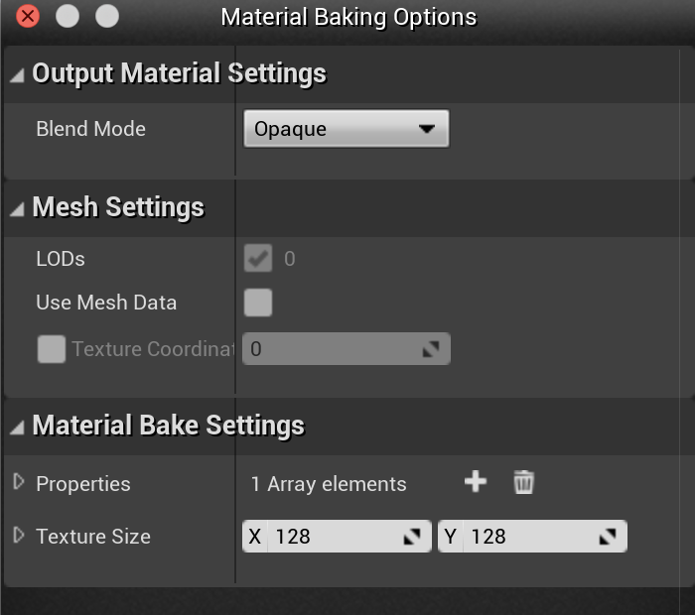
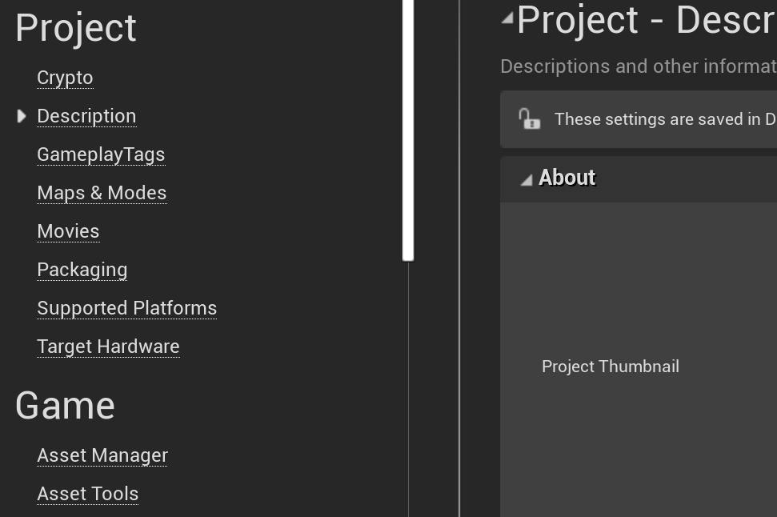
Developer Modules
Some key categories of Developer modules:
  Asset cooking: *Target*, *Format*
  Mesh tools: *Mesh*
  Profiling: Profile*
  Shader compiler support: *Shader*
  Logging: *Log*

Slide 11
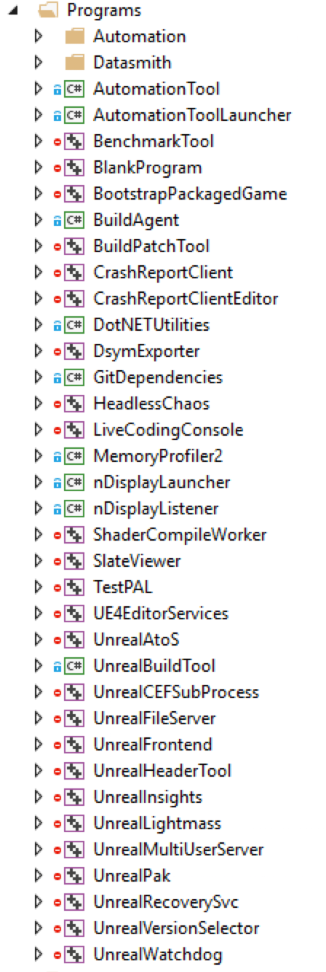
Programs
Among the separately compiled support programs, you will find
  UnrealBuildTool: Build management, based on source and Build.cs files.
  UnrealHeaderTool: UObject reflection code, auto-generated UI elements.
  UnrealLightmass: Precomputation of static lighting, with possible task distribution across computers using UnrealSwarm.
  ShaderCompilerWorker: Parallel shader compilation.

Slide 12
Engine Code Tips

Slide 13
Container Types
Rather than use C++ STL classes, use the Engine/Source/Runtime/Core/Public/Containers types.
These include
  Array (and Sparse Array, Bit Array, …)
  Binary Heap
  Circular Buffer
  Hash Table
  List (& lock-free version)
  Map

Slide 14
Why Don’t Game Developers Like STL?
STL relies heavily on C++ template metaprogramming, which promises zero (runtime) cost abstractions, but usually only on optimized builds.
Some implementations are unusably slow in Debug.
STL libraries add significantly to compile time.
In STL types, the memory allocator is a template parameter. It is part of the data type. That makes it difficult to mix objects using different allocators. Games commonly use several allocators:
A per-frame allocator that is reset without individual object deletions each frame
Pool allocators for commonly allocated and re-used types
An inline allocator, using fixed space inside the base type until it is full, then falling back to another allocator
A heap allocator used mostly for long-term persistent objects.
Any of these with more stringent alignment
constraints than the standard allocators.
The C++ standard template library (and boost project, which has created several things that ultimately became part of STL) have a lot of standard data structures and algorithms, but game developers almost universally create their own equivalents. Why?

Slide 15
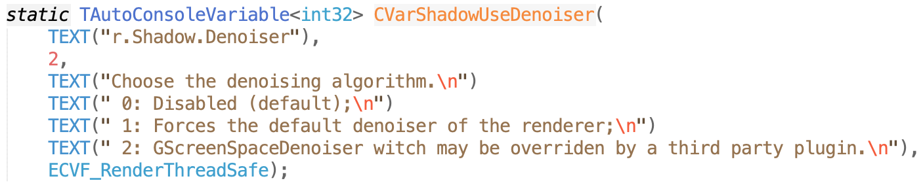
New console Variables
New console variables (CVars) can easily be added to any engine file or plugin. They are an incredibly powerful means to change parameters or turn functionality on or off.
Global Variable Holding Value
Default Value
Description
Flags
CVar Name

Slide 16
CVar Names
Game | g.
Timer | t.
Scalability Groups | sg.
Sound | s.
Network | net.
Physics | p.
Rendering | r.
Rendering Hardware Interface | rhi.
Slate | slate.
ShowFlags | ShowFlag.
Particle FX | fx.
Variable names can be almost anything, but the convention is to start with a letter indicating the primary system, then a period, then the variable name (e.g. s.AsyncLoadingTimeLimit is a variable in the sound system).
Names may be nested with more “.” separated components for clarity.
The help console command will create an html page with all current console variables and commands.

Slide 17
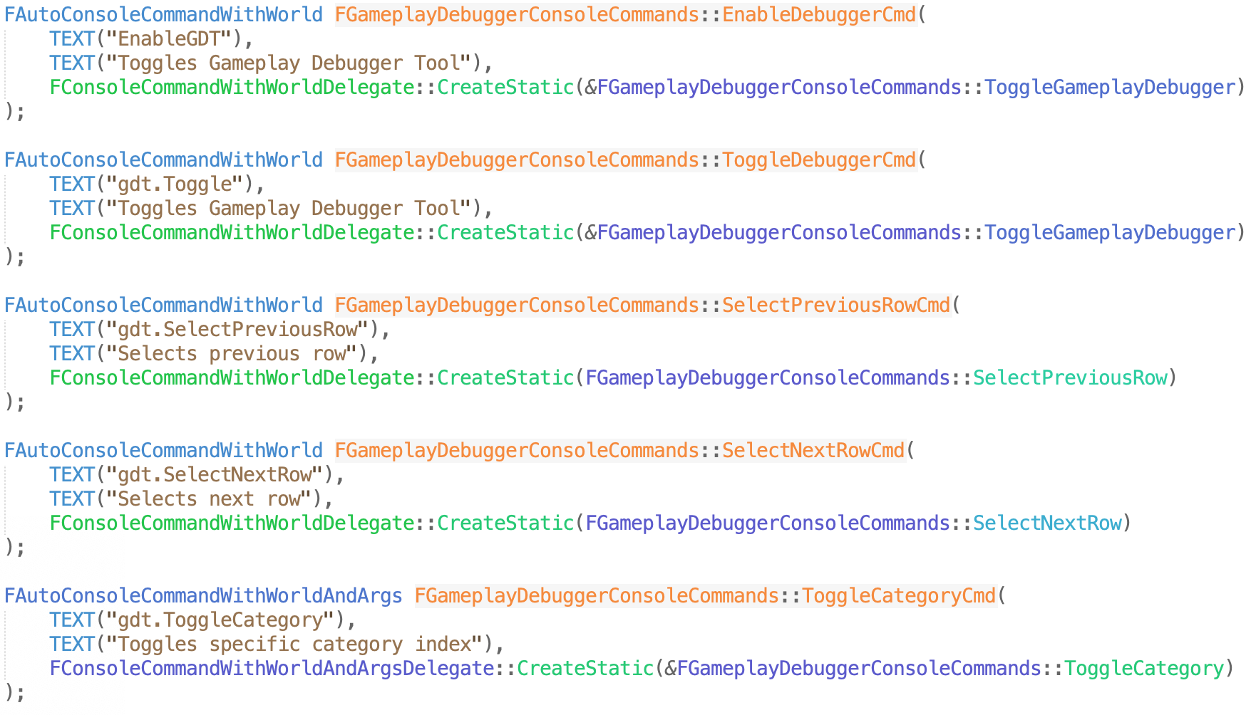
Console Commands
Console commands execute code when run, instead of just changing a value.
There are two ways to create new console commands:
  Derive a class from FSelfRegisteringExec, override the Exec function, and use FParse:Command to tell when your command was entered.
  Declare an FAutoConsoleCommand with a delegate to call when the command is entered.

Slide 18
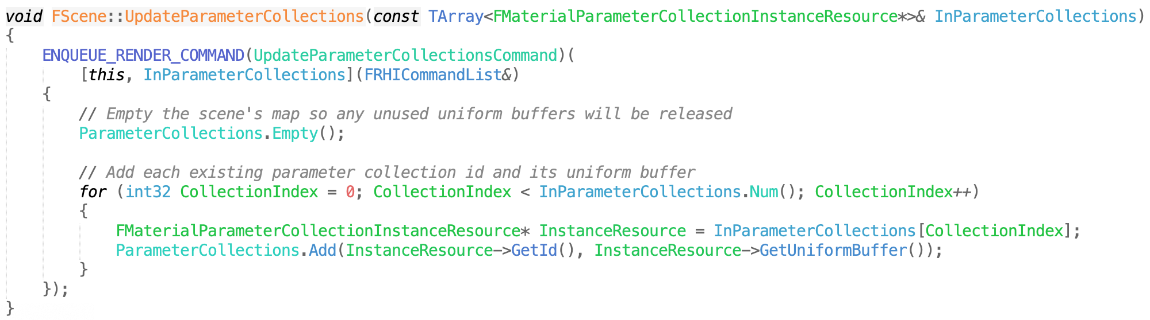
Game and Render Threads
The Unreal Engine farms work to many threads, but the primary persistent threads you may need to worry about are the game thread and the rendering thread (and possibly also the RHI thread for the rendering hardware interface)
CVars are set in the game thread. Render-thread accessible CVars are copied once per frame.
The game thread can schedule render thread work with ENQUEUE_RENDER_COMMAND. This takes a lambda function to execute on the render thread.

Slide 19
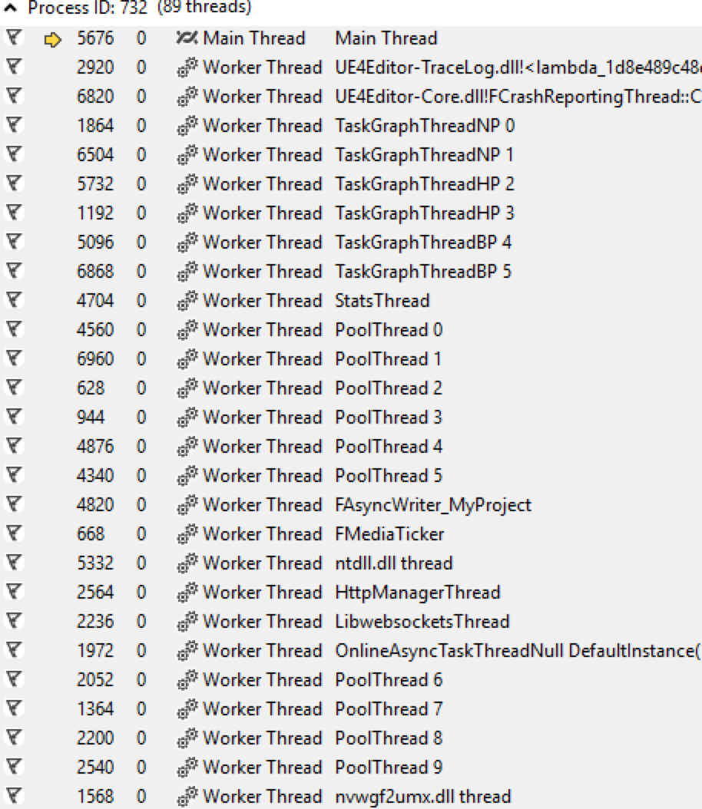
Other Threads
There is a system called the task graph to handle some parallelism and task scheduling. Schedule tasks to run in this system with TGraphTask
It can sometimes be helpful to turn off threading for debugging. Disable all threading, with the
–nothreading command-line parameter. Disable just the render thread with –norenderthread, or the RHI thread with –norhithread.

