Slide 1
Blueprint vs. C++
Actor Walkthrough

Slide 2
The goals of this lecture are to
  Demonstrate how to create a simple C++ Actor
  Highlight the parallels between C++ code and Blueprints
By the end of this lecture you will be able to
  Create a C++ game project
  Create a C++ Actor
  Add properties to the C++ Actor that can be set in the Unreal Editor
  Add behavior to the C++ Actor

Slide 3
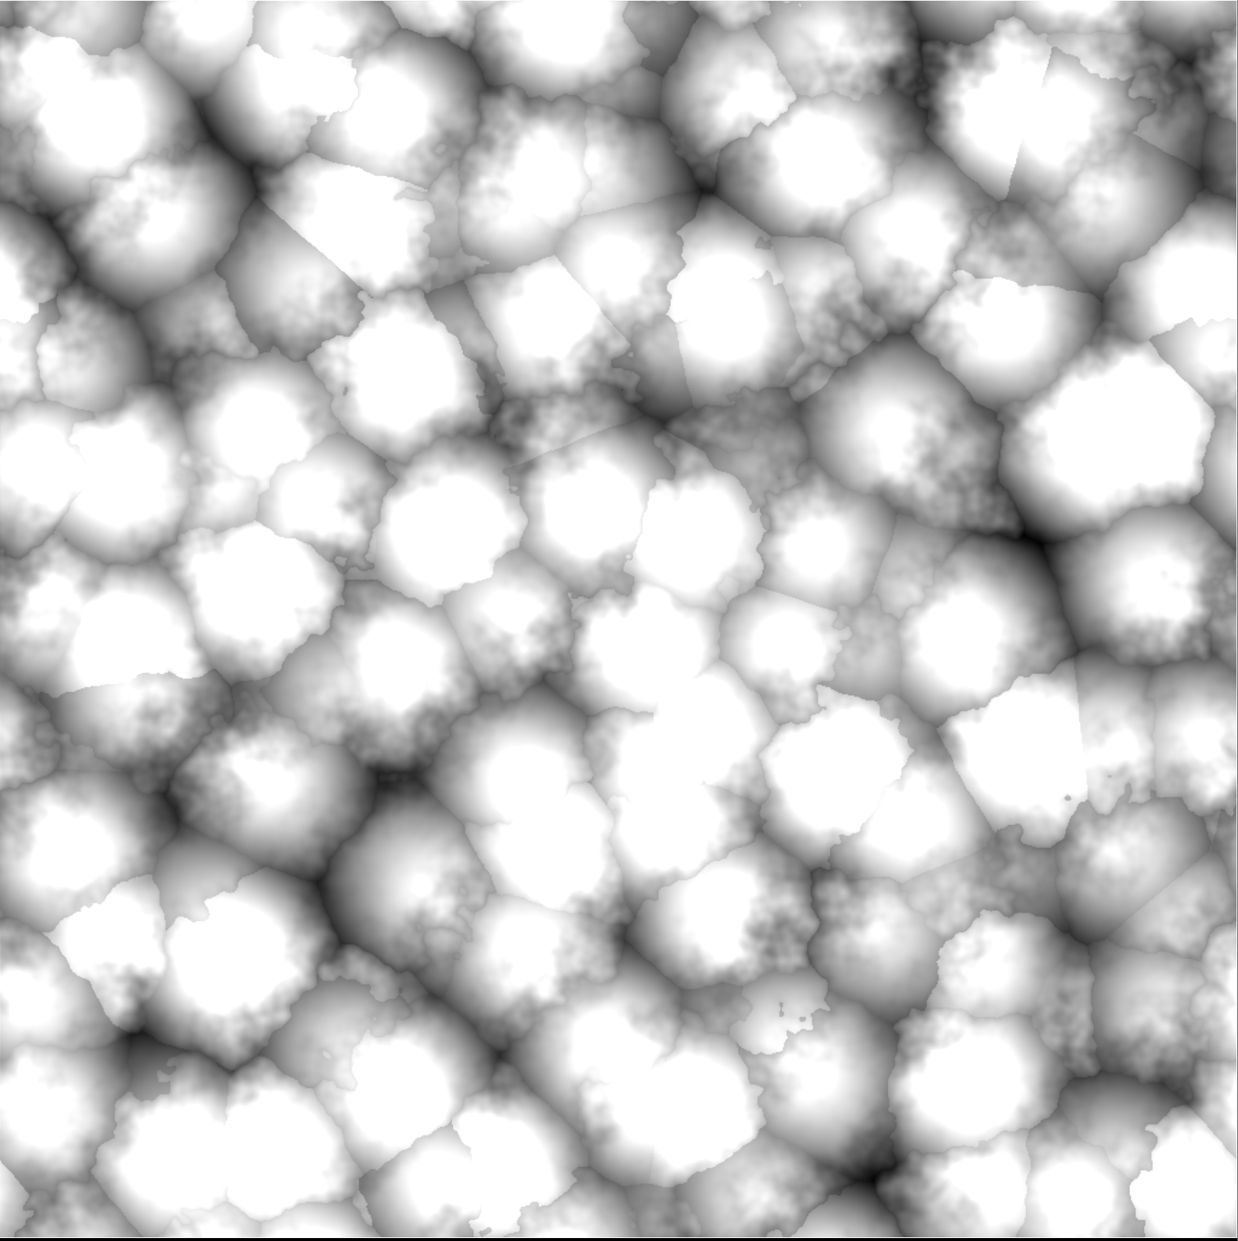
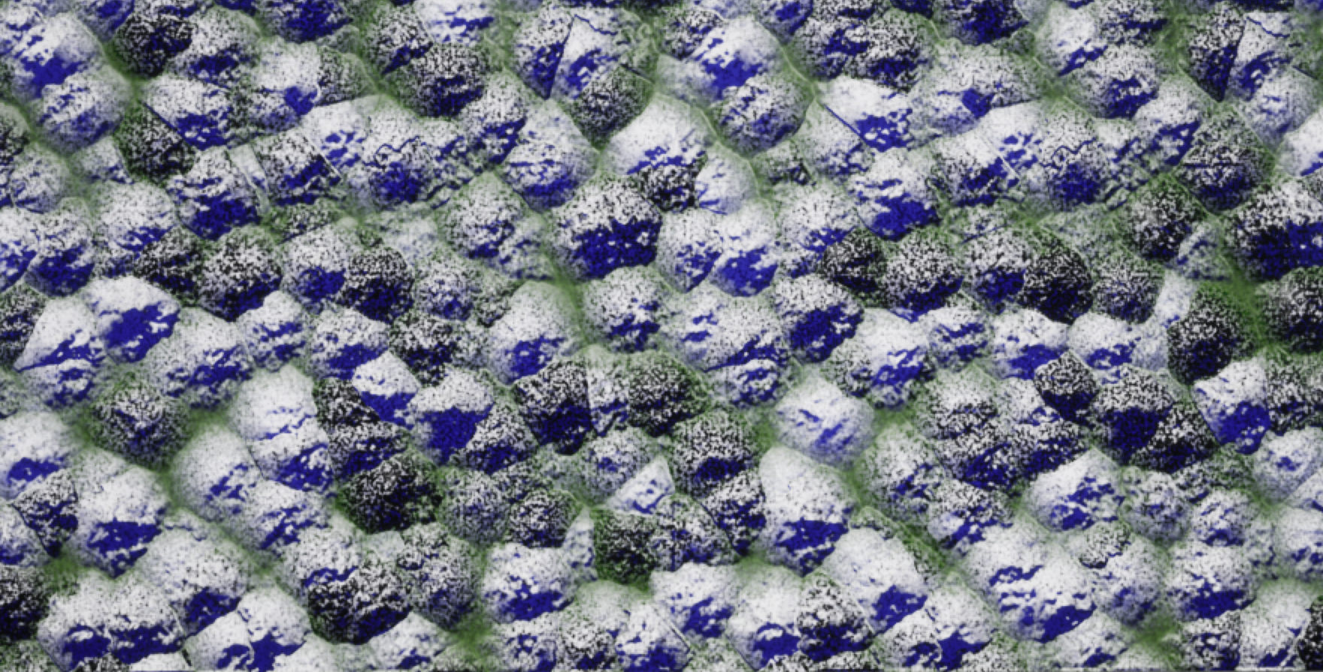
Baking Materials
An expensive Material can take significant runtime. Something like the Noise nodes or a cloud density for ray marching is used again and again in its shader.
It can be more efficient to run it once and store the result into a Texture. This is sometimes called baking the Material into a Texture.
An artist can develop a Material look with expensive operations live in the Editor, where performance does not matter as much, then all or part of the Material can be baked into Textures to be more efficient.

Slide 4
Setting Up the Project

Slide 5
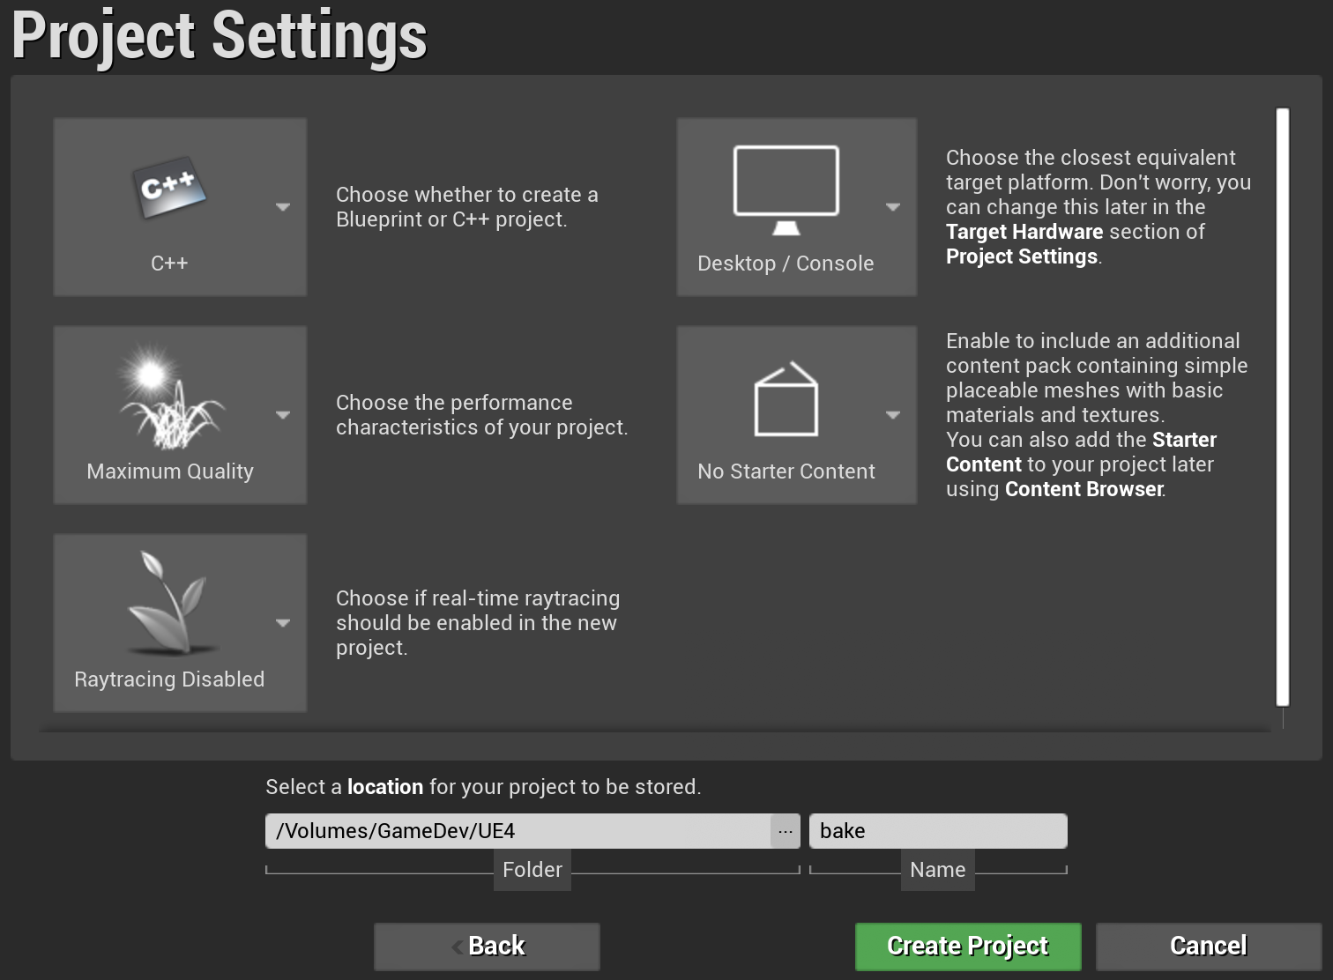
Creating a Project
Launch UE4 and click “New Project”.
Use the Blank template, with C++ and No Starter Content.
Set the folder where your project will be created to the base folder for your engine source (the directory containing the Setup and GenerateProjectFiles scripts).

Slide 6
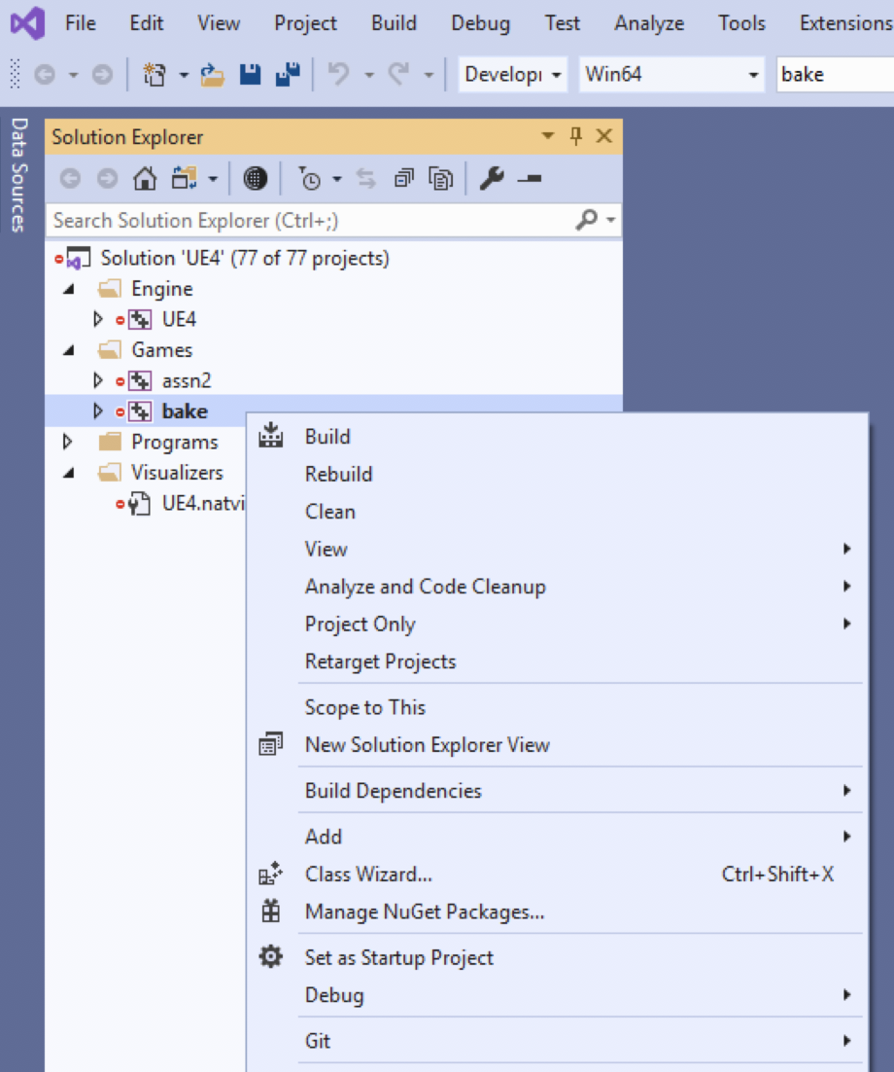
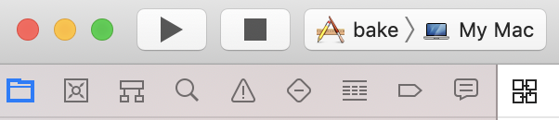
Run from Your IDE
We don’t need to run this example inside the IDE (Visual Studio or Xcode), but it’s good to learn how.
Open the UE4 solution in your IDE.
For Visual Studio, the project will have been added to the Solution Explorer. Right-click on it and choose “Set as Startup Project”.
For Xcode, the project will be added to the list in the top menu bar. Pick it.
Run (using the Play button). It’ll launch directly into the project.

Slide 7
Blueprint Version

Slide 8
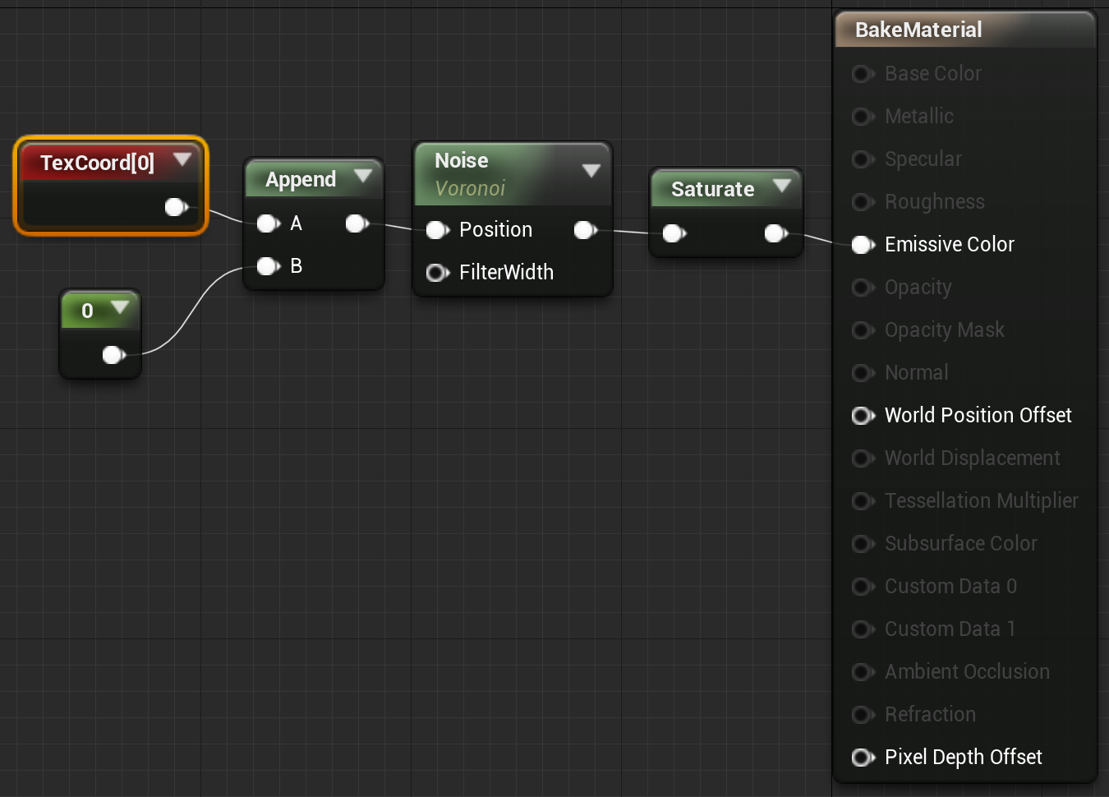
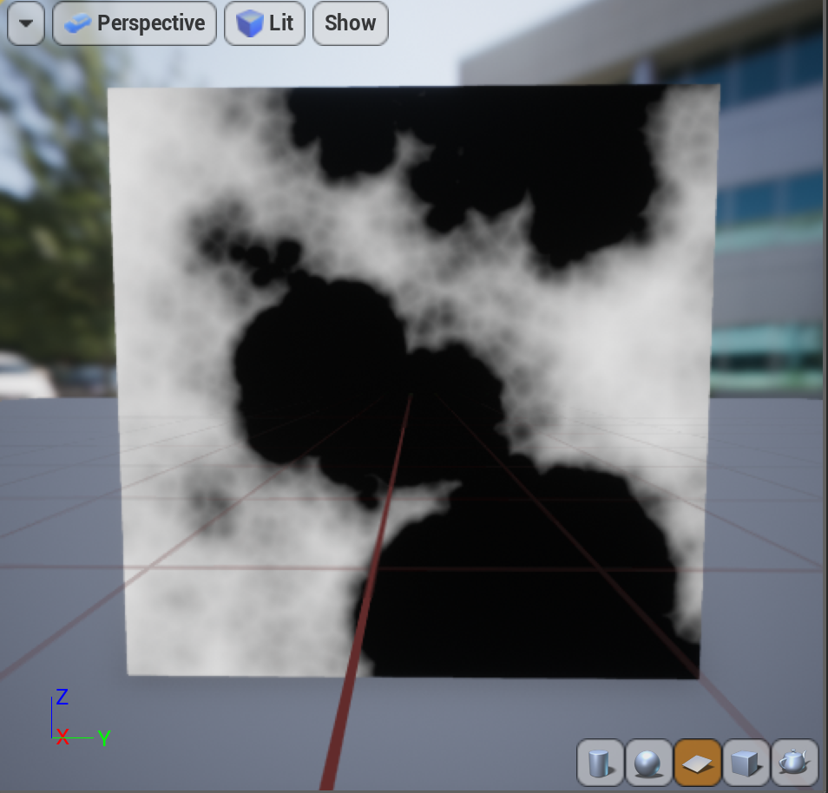
Complex Material
When drawing the Material to a Texture, we won’t have 3D position or lighting.
Create an Unlit Material, using Texture coordinates as input, and preview it on a square.
The example on the right is just using six octaves of the Voronoi noise. Though not that complex a Material expression, it is still too computationally expensive to use directly in most games.

Slide 9
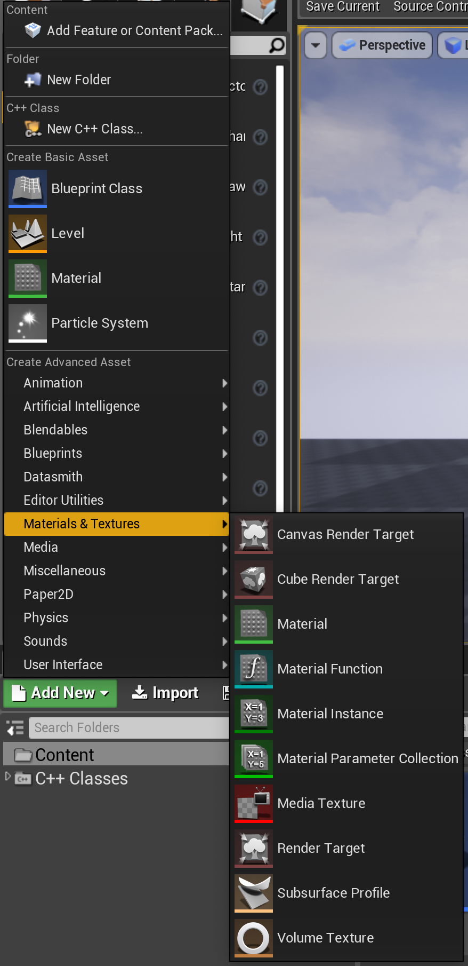
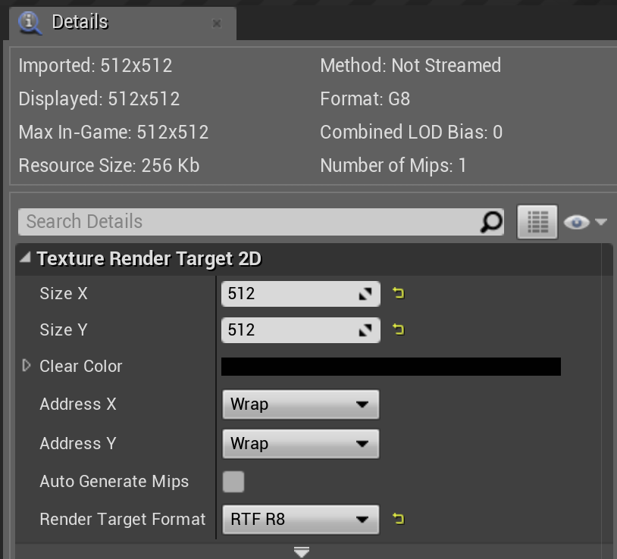
Render Target
To fill a Texture on the GPU, we need a special form of Texture called a Render Target. You can find it in the Materials & Textures section of the Create Advanced Asset menu.
Since we’re just creating a single-channel result, change the format to RTF R8, which is a single 8-bit channel holding values between 0 and 1.

Slide 10
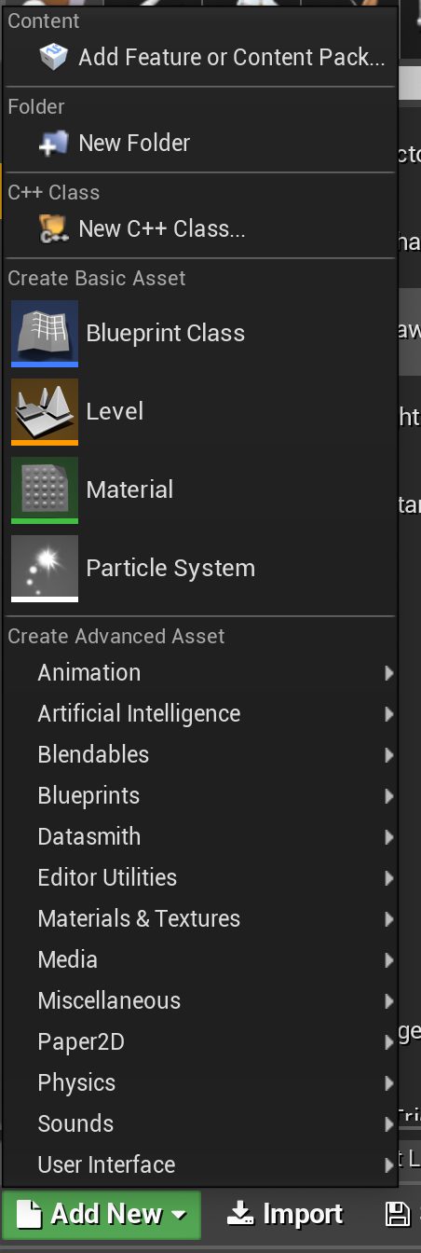
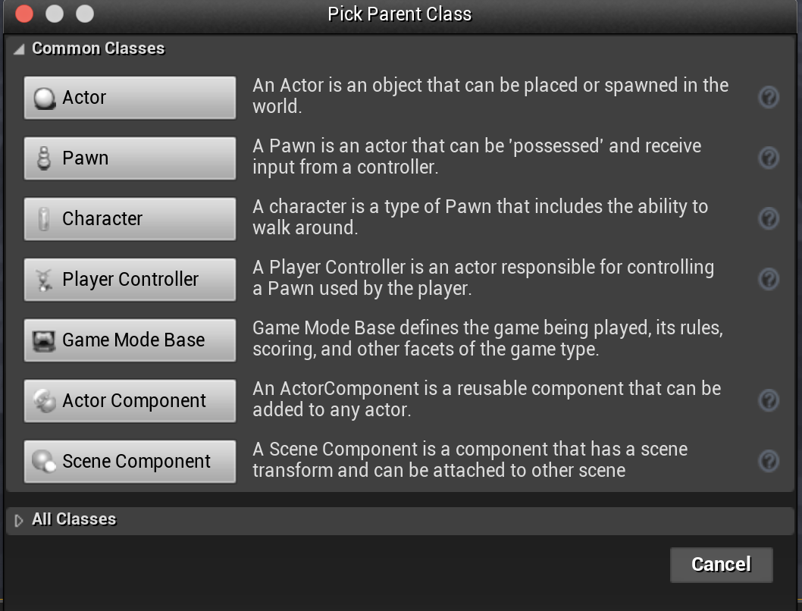
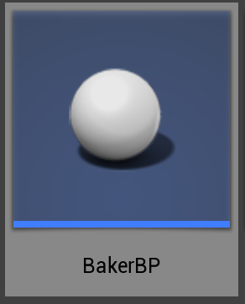
Bake with Blueprints
First, let’s see how you’d do it in a Blueprint.
Start by creating a new Blueprint Actor.

Slide 11
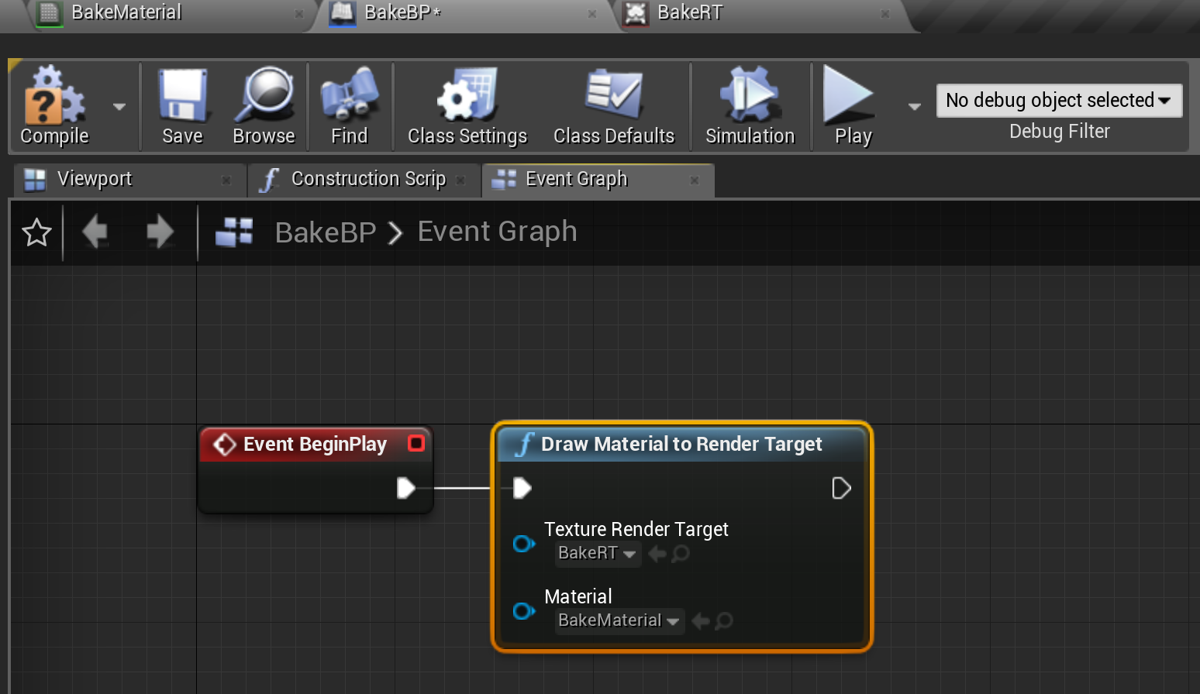
Create Blueprint
Open the Blueprint Actor.
Switch to the Event Graph.
We’ll attach one Draw Material to Render Target node to BeginPlay.
  Set Texture Render Target to the target you created.
  Set Material to the Material you created.

Slide 12
C++ Version

Slide 13
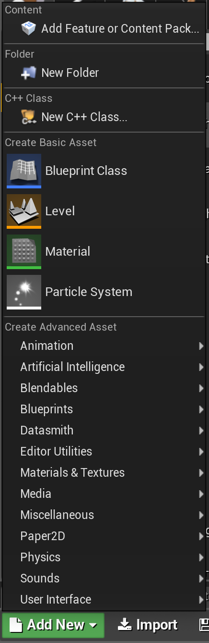
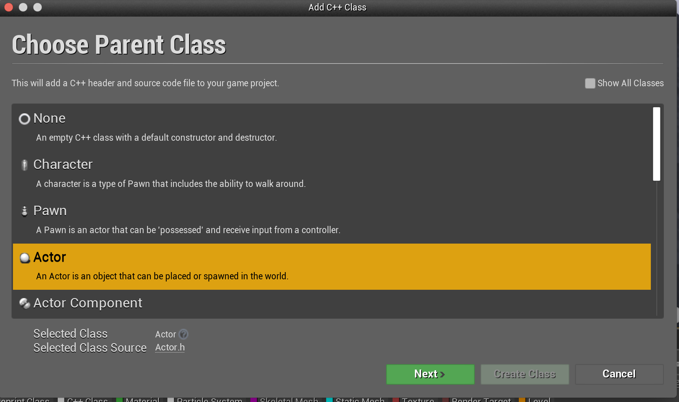
Bake in C++
To do the equivalent in C++, first create a C++ Actor class.

Slide 14
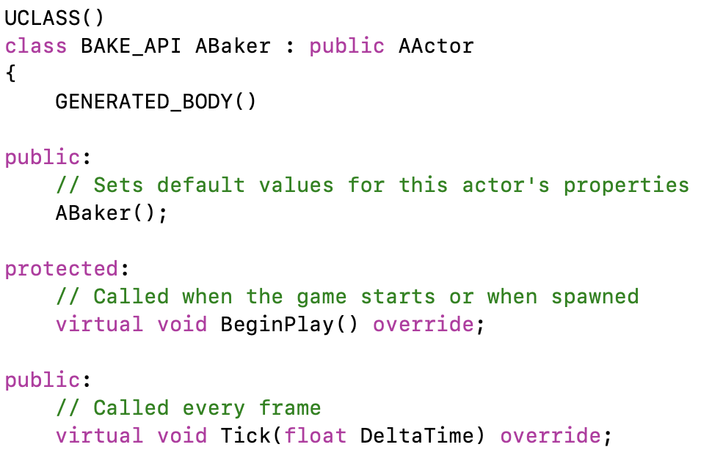
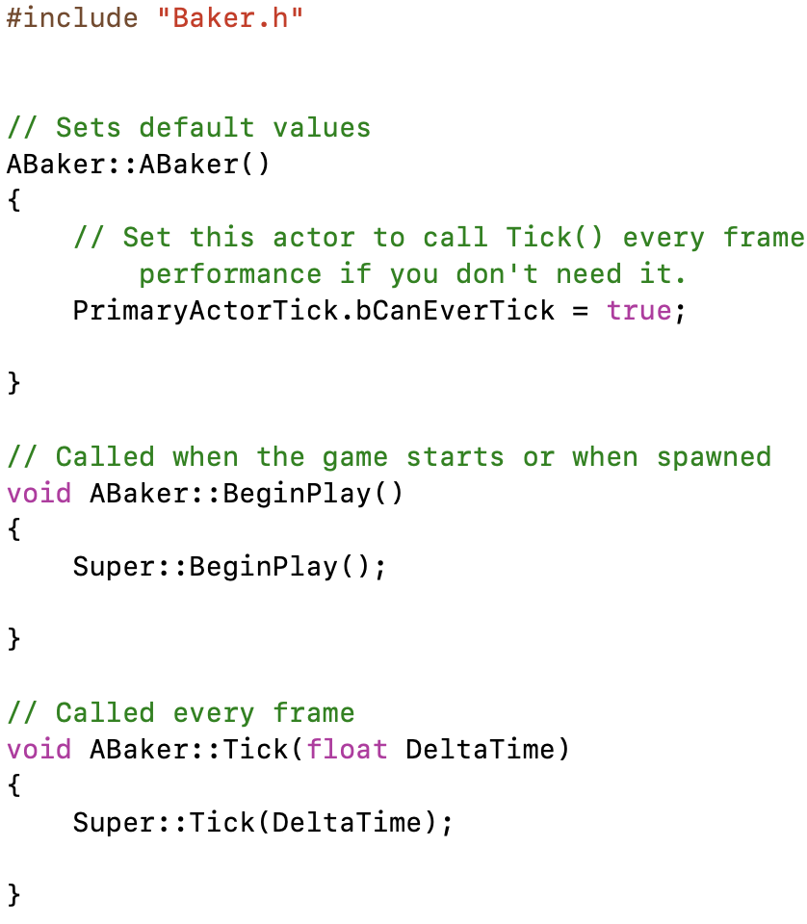
C++ Boilerplate
The new class files will be created with code necessary for BeginPlay and Tick functions.
We don’t need to tick every frame, so can remove the Tick functions.

Slide 15
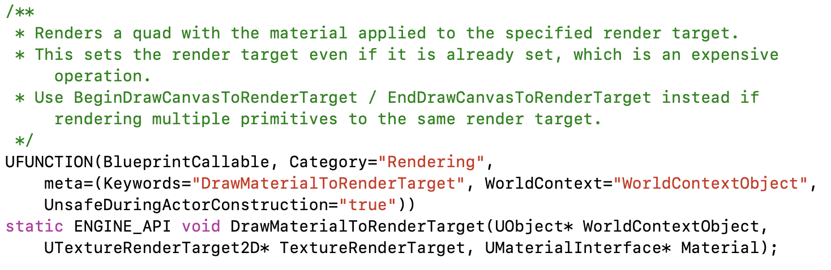
Finding Functions
Knowing a Blueprint function exists to draw a Material to render target, we can search for “DrawMaterialToRenderTarget”. To reduce the number of hits, search in just .h files.
We find it in KismetRenderingLibrary.h.
This needs a WorldContextObject, which we can get using the GetWorld() function.
It also needs a UTextureRenderTarget2D and UMaterialInterface that will have to come from somewhere.

Slide 16
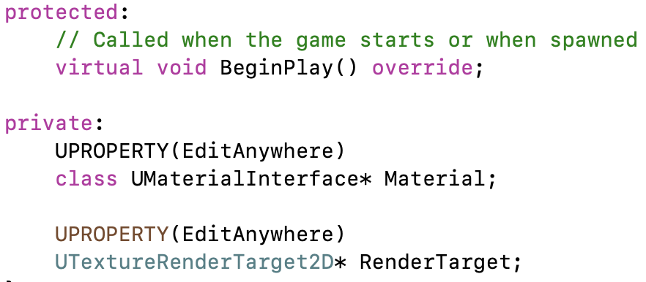
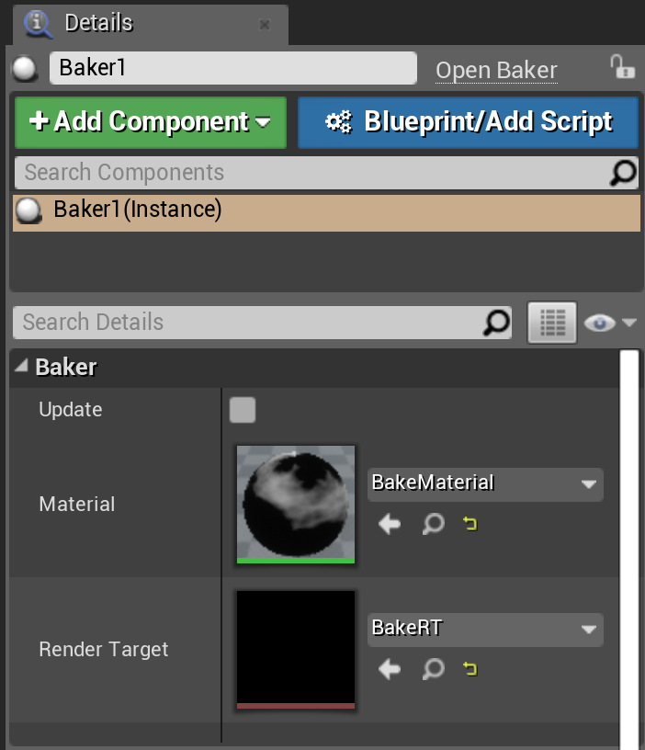
Adding Properties
We can add the RenderTarget and Material as editable RenderProperties to the Actor’s header.
After you compile, and drag the Actor into the scene, the new properties will show up in the Details panel.
You can fill those properties with the Material and render target assets created earlier.

Slide 17
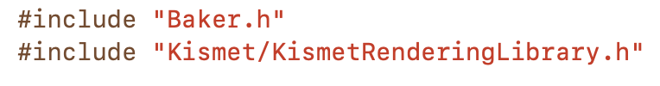
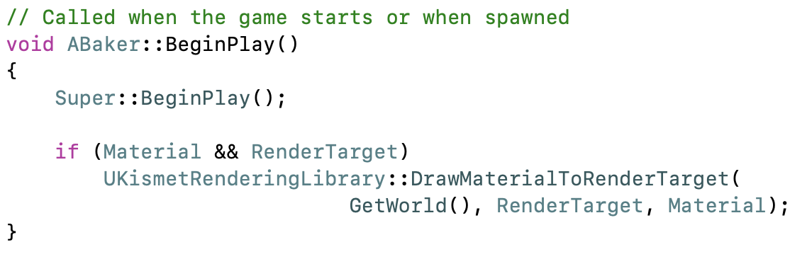
Code Implementation
For the implementation in C++ code, you just need to add the #include to get access to the KismetRenderingLibrary functions and call DrawMaterialToRenderTarget.
It’s good to include a check in case the Material or render target has not been filled in yet.

Slide 18
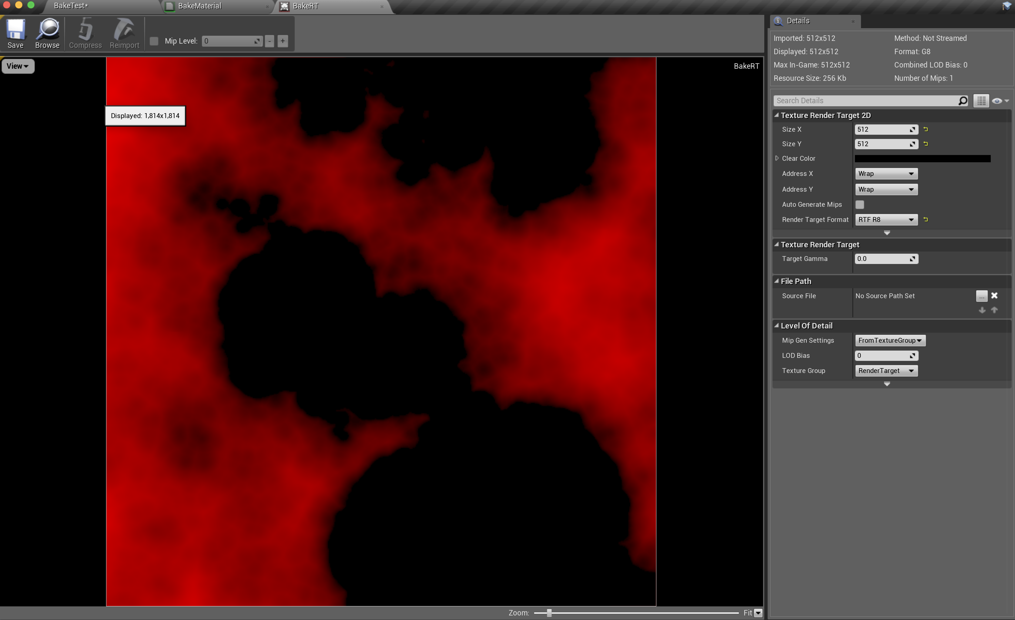
Testing
Hit “Play In Editor”. Once it has started, hit “Escape”.
Open your Render Target, and you should see the baked data filled in.
For 4-channel Textures (RGBA), you’ll need to open the RenderTarget view menu and uncheck “Alpha”, or the Render Target will appear transparent even though the data is there.

Slide 19
Extensions

Slide 20
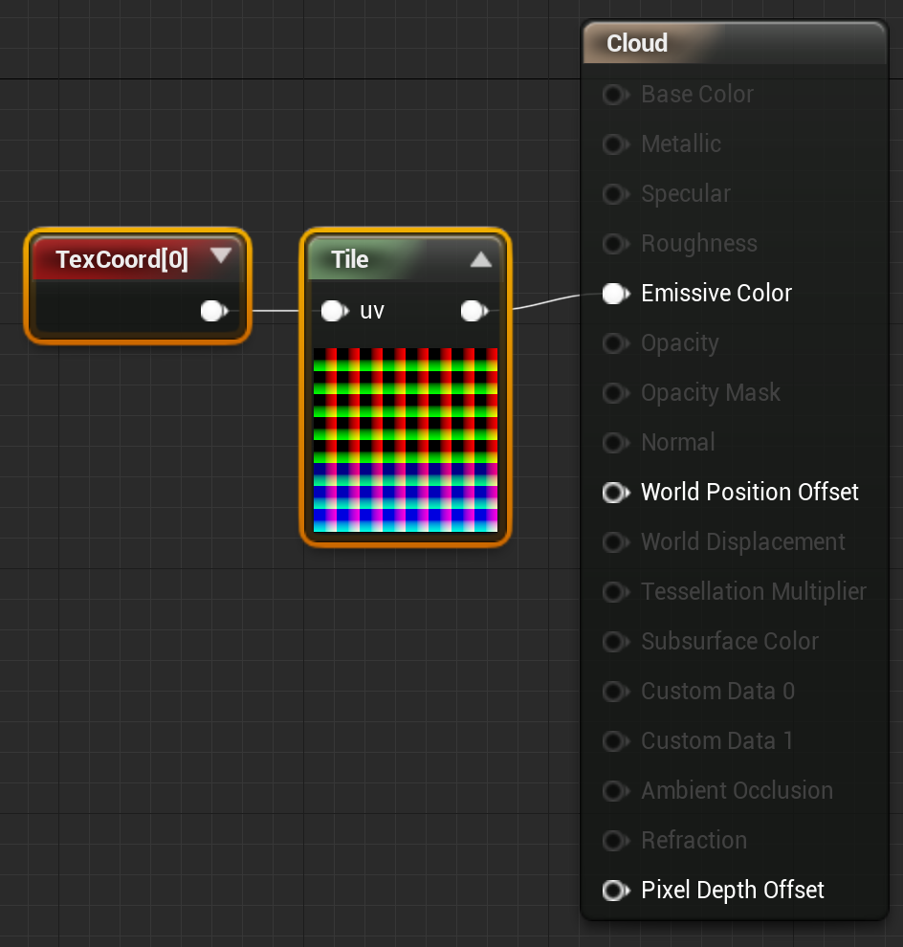
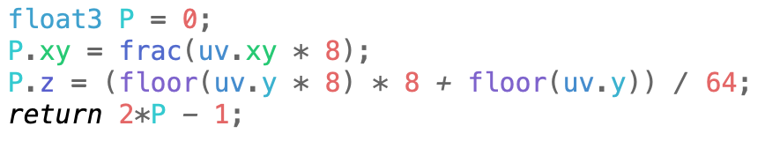
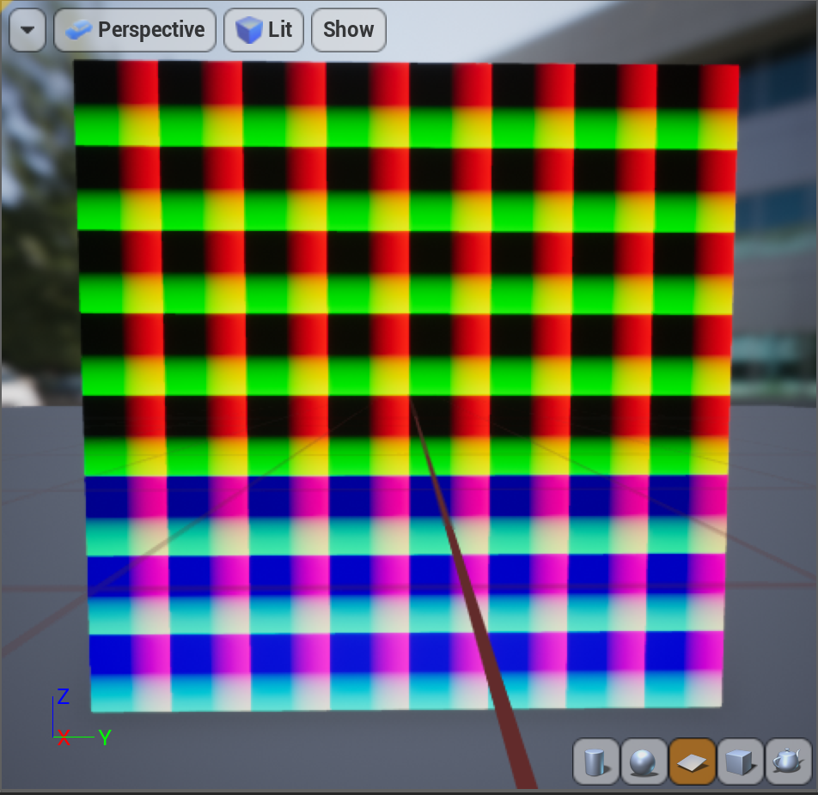
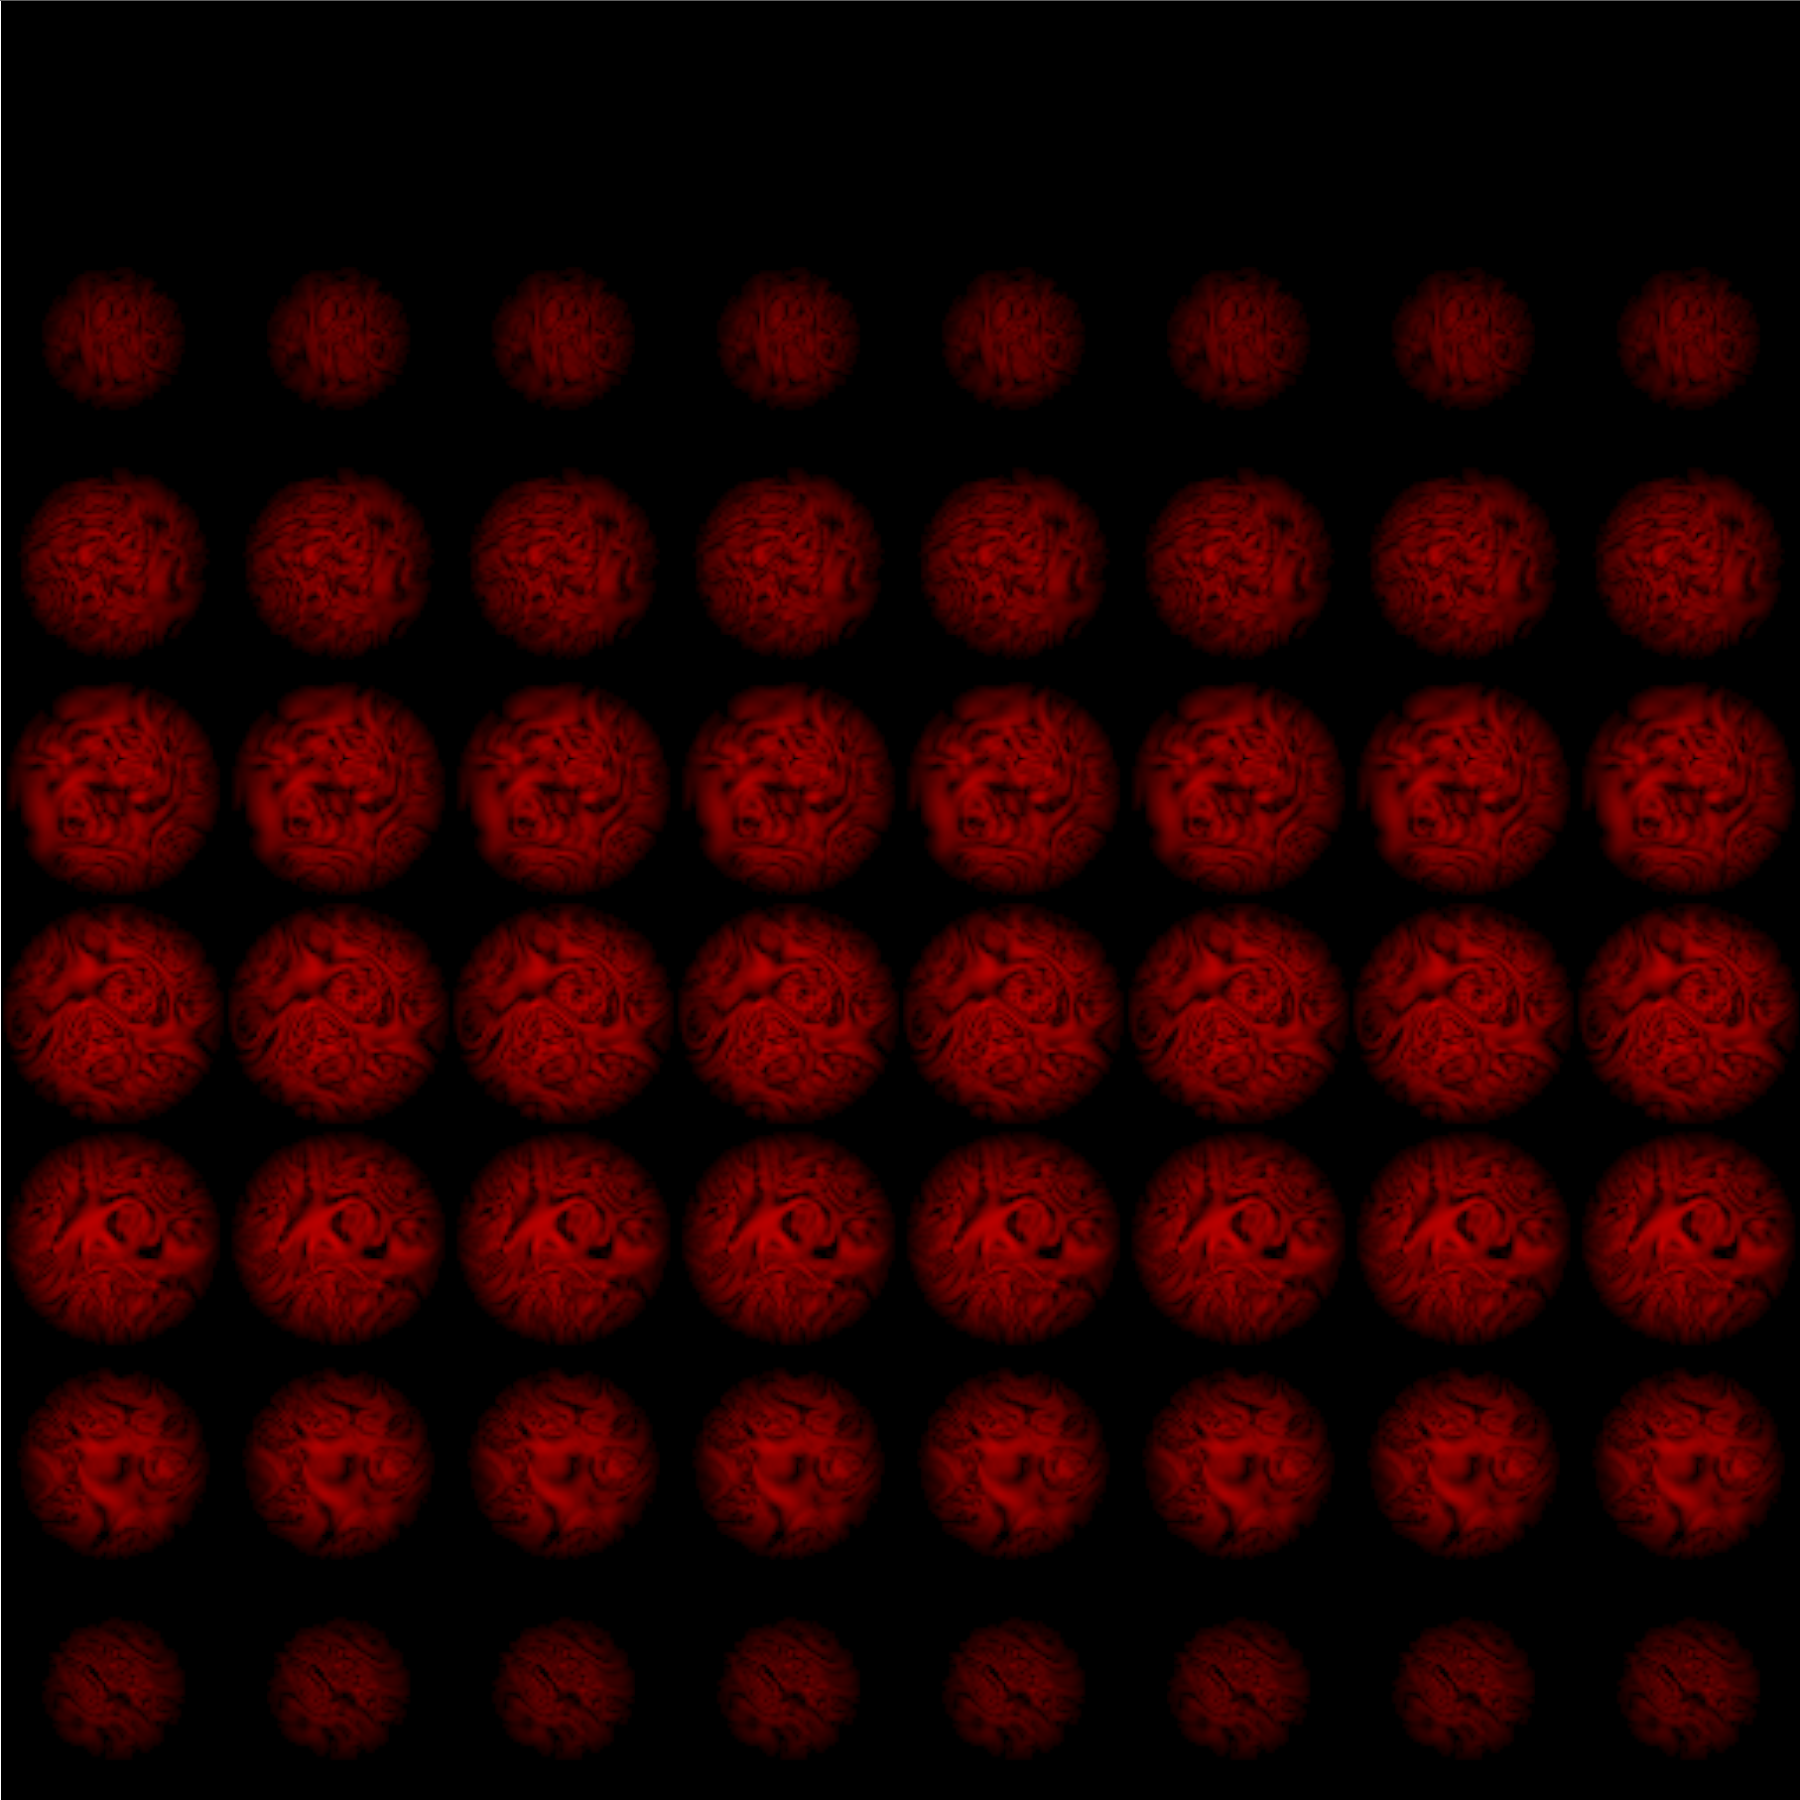
3D Materials
For 3D Materials like cloud density, set up a tiling function to turn Texture coordinates into a stack of 2D tiles.
This simple tiling works for Textures that don’t repeat, allowing 64 tiles, each 64x64 pixels in a 512x512 Texture.
If you need the volume to repeat in x, y, and z, you’d use a slightly more complex tiling function with a little overlap between the right and left sides of each tile, top and bottom, and first tile to last tile.

Slide 21
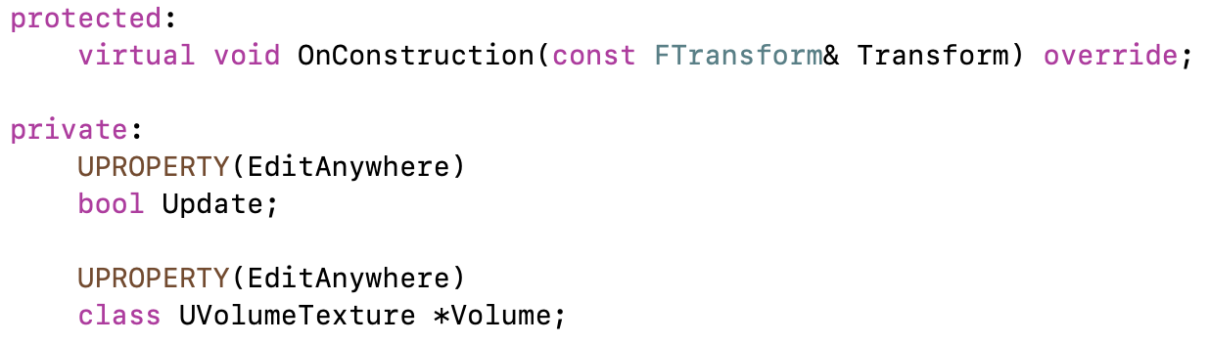
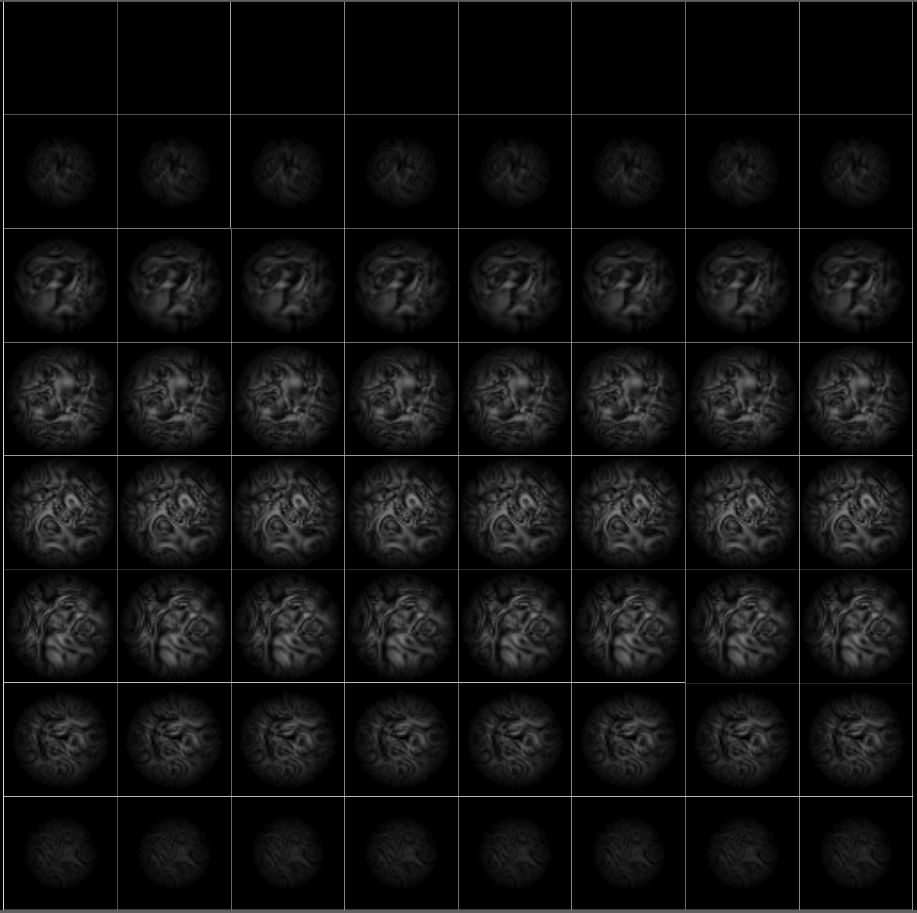
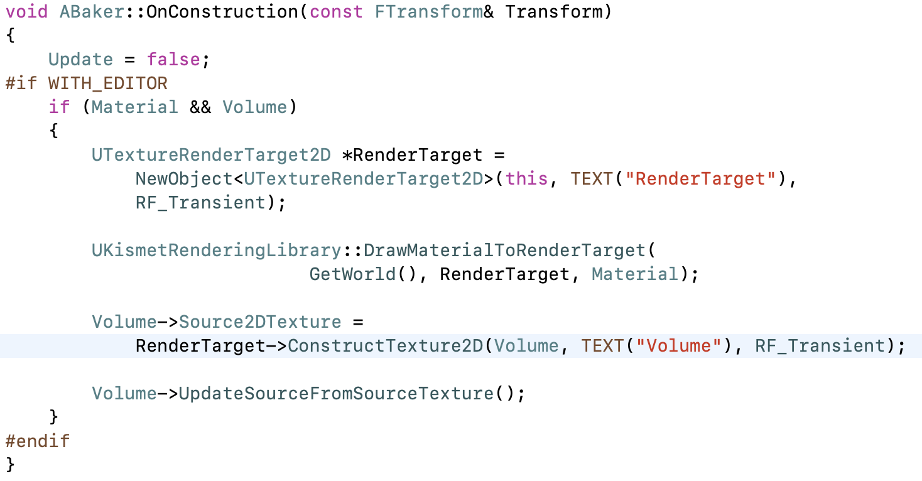
Bake on Demand
Rather than bake on BeginPlay, you could do it on another event (or just in a bake-everything Level), and add code to convert it to a regular serialized Texture after generation.
Just run the bake when something changes, then the Texture is available to use in the real Level.
The version shown on the right uses a temporary render target and 2D Texture to bake into a Volume Texture, something that is not possible in Blueprint.

Slide 22
Live Updates
In contrast to the previous extension to make baking an explicit preprocessing step, you could also use this approach to capture live data in the game to use during shading.
The approach can be used for footprints or tire tracks in snow or mud, foliage motion, velocities to drive smoke motion, damage, . . .

