Slide 1
Shader Code

Slide 2
The goals of this lecture are to
  Learn about the origins of shaders.
  Learn about GPU shader stages.
  Learn how UE4 materials map to GPU shader code.
  Learn a little about HLSL code and where to go to find more information.
By the end of this lecture, you will be able to
  Understand how UE4 Materials map to GPU shading stages.
  Find the generated shader code corresponding to a UE4 Material
  Be able to read and understand HLSL shading code.

Slide 3
Shader Background

Slide 4
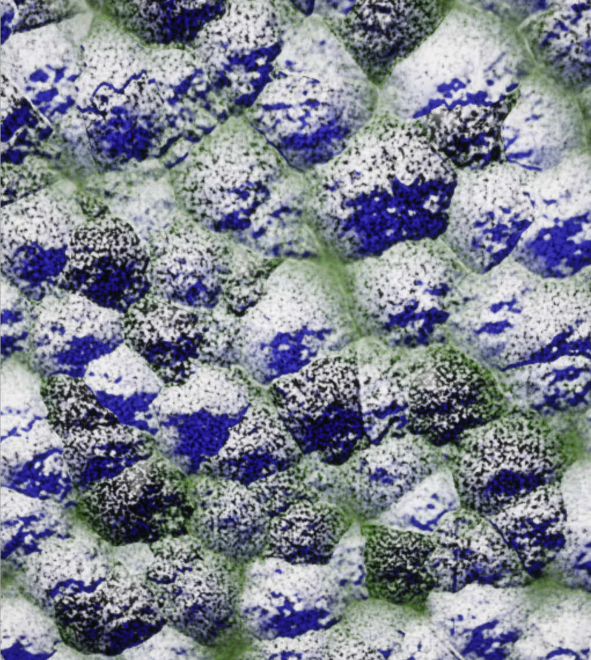
What is a Shader
A Shader is a small program, written in a GPU-domain-specific language. Shaders were originally used to compute surface appearance and shading. The term shader is now used for any GPU computation, usually with an identifying word to tell you what kind. For example, a vertex shader does computation for every vertex in a polygonal model, even if that computation has nothing to do with the surface appearance.

Slide 5
Shader History
Testbed [Whitted and Weimer 1981]
  Render buffer with all the parameters you need to compute your shading, then in a separate pass, run a program on every pixel to compute the shading. Origin of deferred shading used today.
Shade Trees [Cook 1984]
  Introduced the term “shader”. Could describe shaders for displacement, surface, light, atmosphere as an expression in a single line of code.
Image Synthesizer [Perlin 1985]
  Added control flow (loops and branches), turning shading into a true programming language. Also introduces Perlin noise.
Building Block Shaders [Abram and Whitted 1990]
  Describes shaders as a visual network of blocks. This is the basis of all visual shader programming, including UE4’s Material system, among many others.
RenderMan [Hanrahan and Lawson 1990]
  Used in decades of Pixar movies. Responsible for many of the terms and choice of functions seen in shading languages today.
PixelFlow [Olano and Lastra 1998]
  The first high-level shading language on graphics hardware. Introduced some of the data types used today (earlier shaders were just single-precision float), but shaders were the surface/light/atmosphere from RenderMan and Shade Trees.
Vertex Programs [Lindholm et al. 2001]
  Assembly-like language. This was the first PC GPU shading
RTSL [Proudfoot et al. 2001]
  High level shading on GPUs, introduces GPU shading stages of vertex, pixel, etc. Led to NVIDIA’s Cg, which led to HLSL.
There are decades of history behind the shader technology we use today. Here are some key highlights.

Slide 6
Common Shading Stages
Vertex
Vertex Shader
  Compute where each vertex will land on the screen
(Rasterize) – not programmable
  Collect triples of vertices into triangles, and figure out which pixels are covered
Pixel Shader
  Compute a color per pixel
Compute Shader
  Perform general-purpose computation
Memory
Rasterize
Compute
Pixel

Slide 7
Vertex
Less Common Shading Stages
Hull
Hull
  Run at each triangle or quad. Determine tessellation factors.
(Tessellate) – not programmable
  Turn one primitive into many as part of a spline surface patch
Domain
  Where do new vertices generated by the Tessellation stage go?
Geometry
  Run per triangle. Can make more triangles and compute new vertex locations. Suffers from poor performance on many GPUs.
Tessellate
Memory
Domain
Compute
Geometry
Rasterize
Pixel

Slide 8
Mesh Shaders
Ray Tracing
New Shader Stages
Task
Ray Generation
Mesh Generation
New hardware introduces new shading stages. These are not widely supported yet, but are supported by some recent hardware.
Any Hit
Traversal
Mesh
Intersection
Rasterize
Miss
Closest Hit
Pixel

Slide 9
Forward Shading
Depth Pre-Pass
Forward Pass
Vertex
Vertex
Hull
Hull
Tessellate
Tessellate
Not a shading stage, but one way to use the shaders for rendering. Computes color for each object as it is rendered.
Used primarily in UE4 for VR and Transparency
Optional Depth Pre-Pass
  Just the stages through Rasterize
  Generates depth for front-most surface
  Can improve performance by allowing the GPU to skip the actual shading computation in the next pass for surfaces that are not visible.
Forward Shading Pass
  All of the stages for each object
  Compute color as you render each object
Domain
Domain
Geometry
Geometry
Rasterize
Rasterize
Pixel

Slide 10
Deferred Shading
Depth Pre-Pass
Base Pass
Deferred Pass
Vertex
Vertex
Quad Vertex
Hull
Hull
Tessellate
Tessellate
Alternate way to use the shading stages for rendering.
Optional Depth Pre-Pass
  Same as in forward shading, can avoid work on hidden surfaces
Base Pass
  All of the stages for each object
  Just compute shading parameters
  A RenderTarget/Texture holding the shading parameters is called a G-Buffer
Deferred Pass(es)
  Render a shape like a screen-filling quad that covers every pixel you want to process (or use a compute shader)
  Run a pixel shader, using the data saved in the base pass
Domain
Domain
Geometry
Geometry
Rasterize
Rasterize
Rasterize
Base Pixel
Pixel

Slide 11
Shaders in UE4

Slide 12
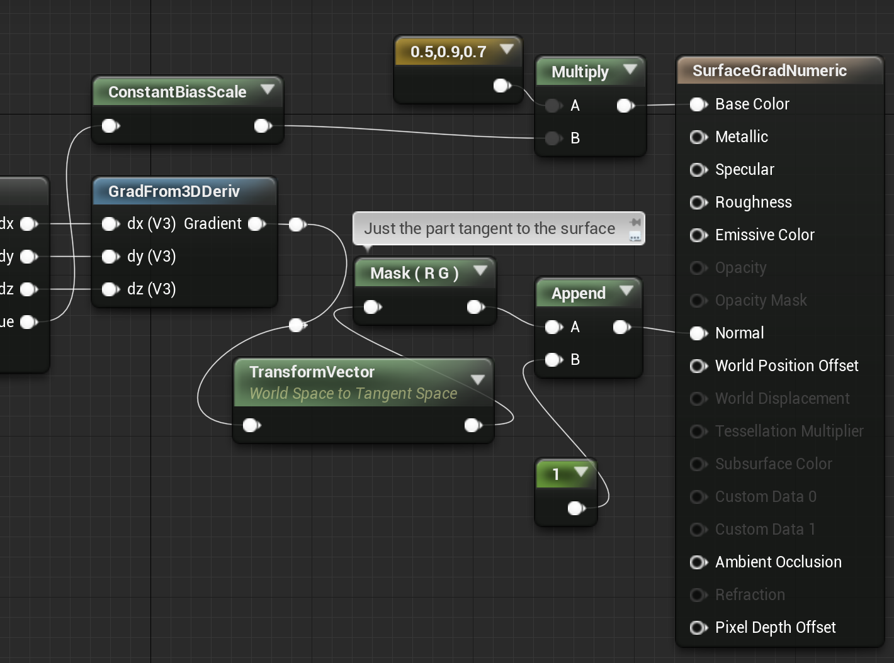
UE4 Materials
Vertex Shader
  Anything connected to WorldPositionOffset or WorldDisplacement
  Anything attached to the input of a VertexInterpolator
Pixel Shader
  Everything else goes into the G-Buffers during the base pass

Slide 13
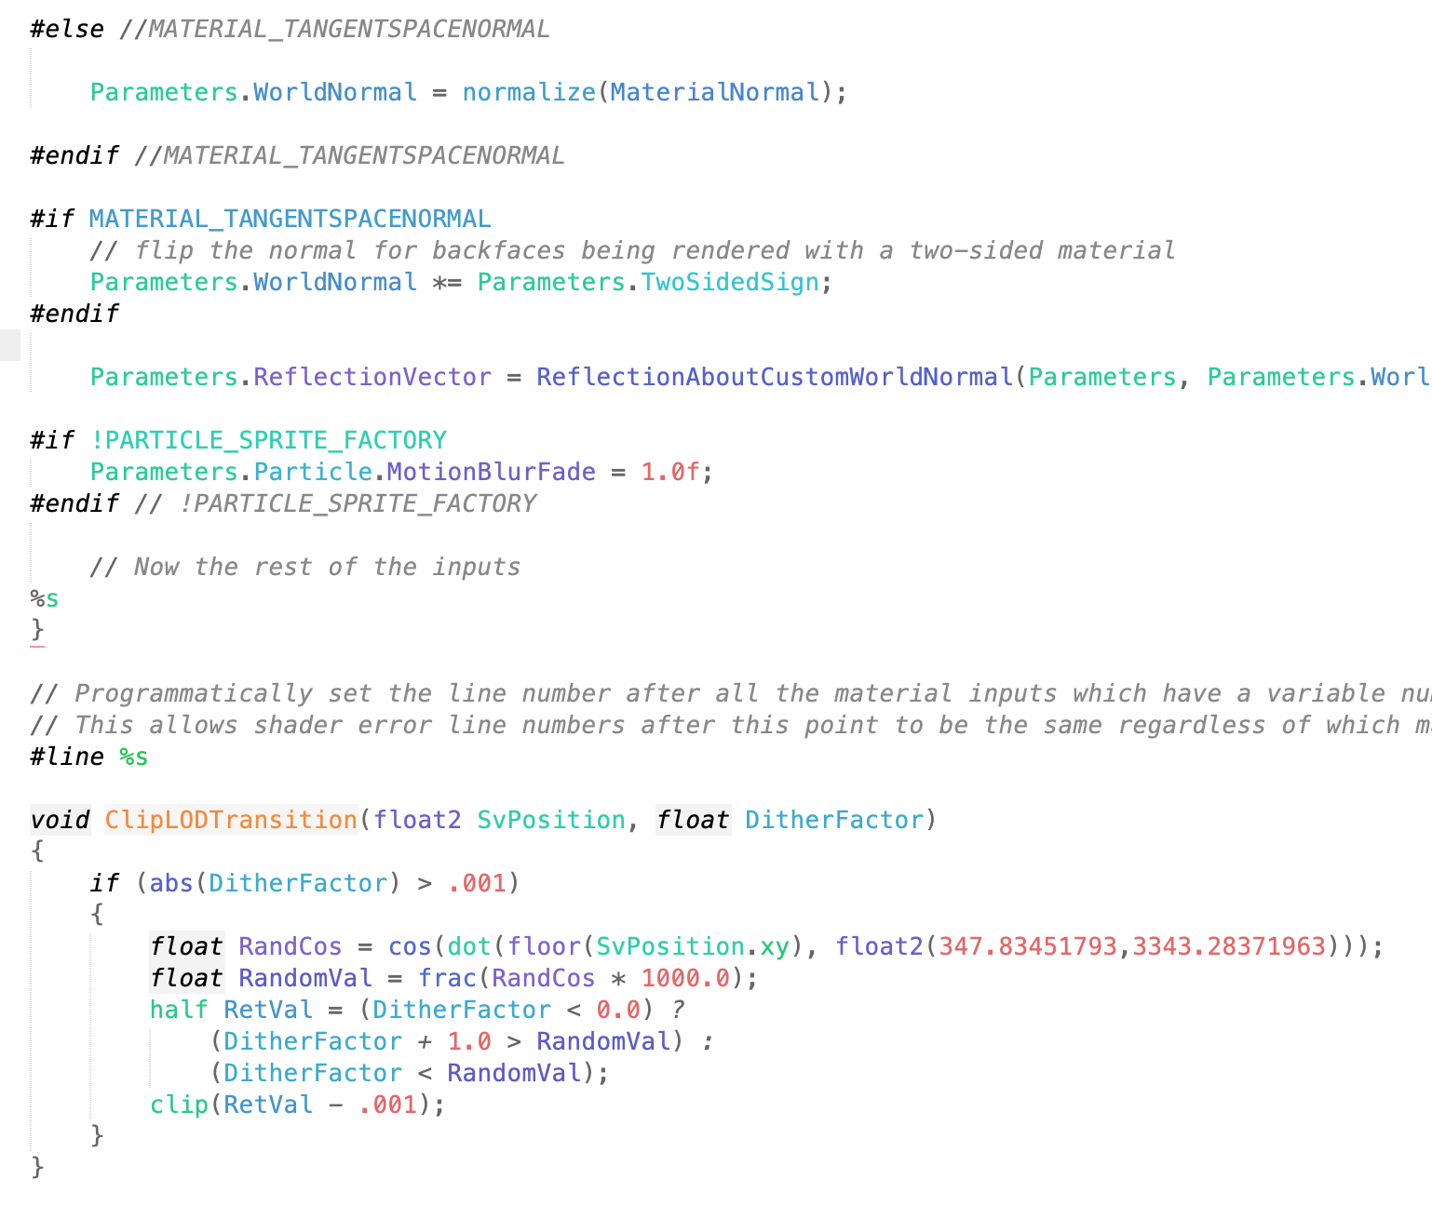
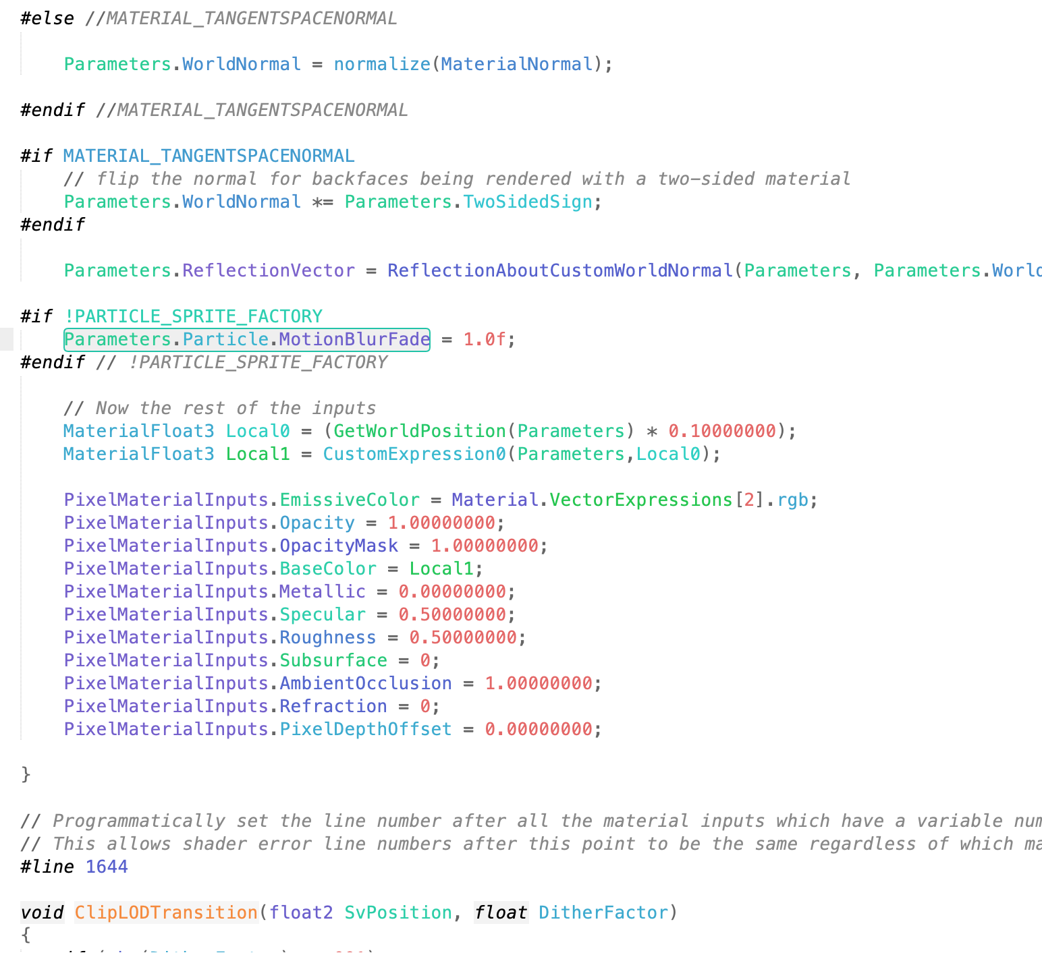
Shader Internals
Engine shader files live in Engine/Shaders
  .ush files = shader code header file
  .usf files = shader code for a pass
“MaterialTemplate.ush” = boilerplate template for all materials
  “%s” where boilerplate code pieces will go
  Material Editor > Window > Shader Code > HLSL Code to see it filled in

Slide 14
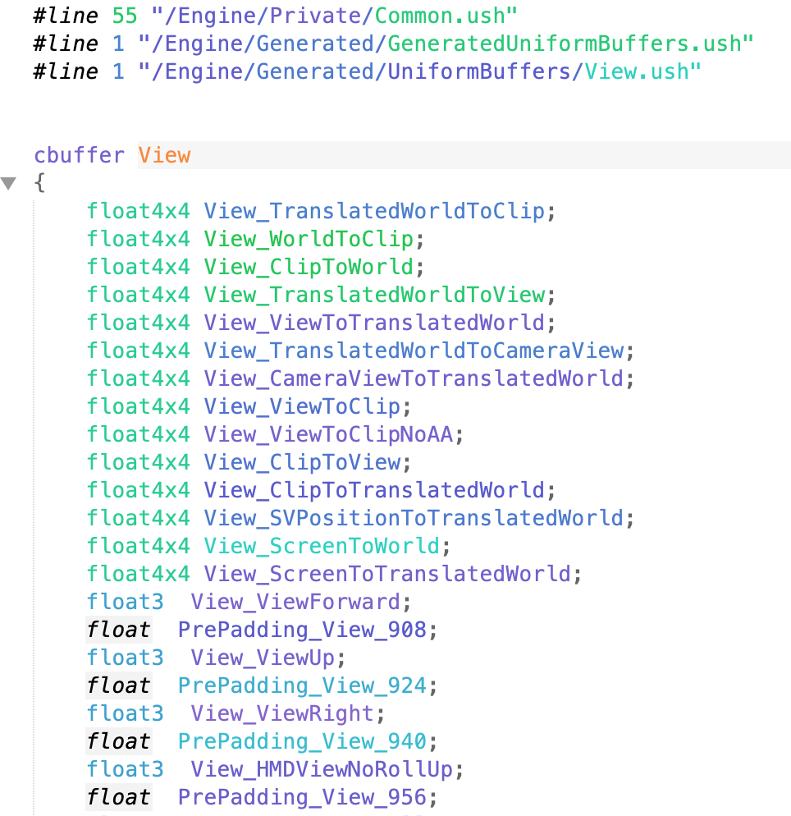
Deep Shader Details
The HLSL Code results still have all of the preprocessor commands, including references to generated #includes that define data sent between the engine and shaders. To see those, you need to dump the final shader after preprocessing.
Set the r.DumpShaderDebugInfo console variable to 1 (back-quote to bring up the console, then type “r.DumpShaderDebugInfo 1”)
Force the shader to recompile
  Can even just move a node in the Material Editor then click Apply
  Set r.DumpShaderDebugInfo back to 0 to avoid filling up your disk with shader files
In your project, look in “Saved/ShaderDebugInfo” for any of the TBasePassPS files

Slide 15
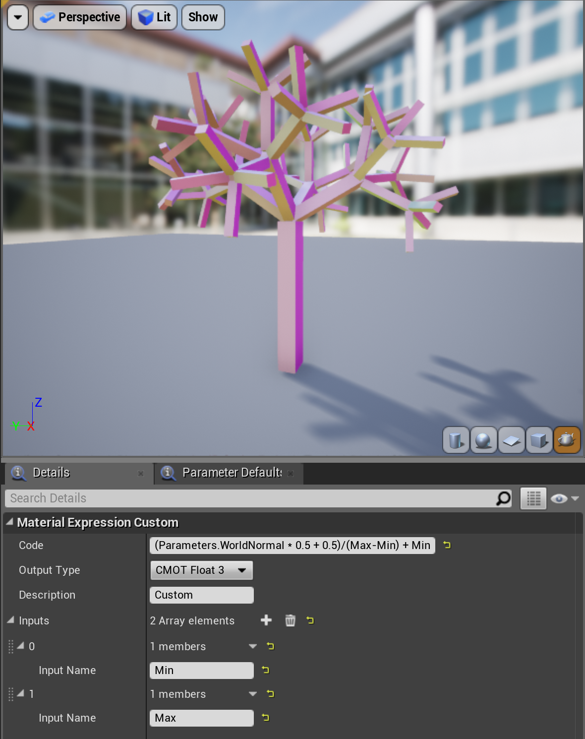
Simple Custom Node
The easiest way to write your own shader code is to create a Custom Node in the Material Editor
In its simplest form, this is a single line expression computing a result (equivalent to what Cook’s Shade Trees did)
Additional named input pins are available as variables.
Also has access to anything in the Parameters, Primitive, and View structs
  Though some data is not generated unless used by a regular material system node (e.g. Parameters.TexCoord)
  Dig into dumped shader code from DumpShaderDebugInfo to see what’s there

Slide 16
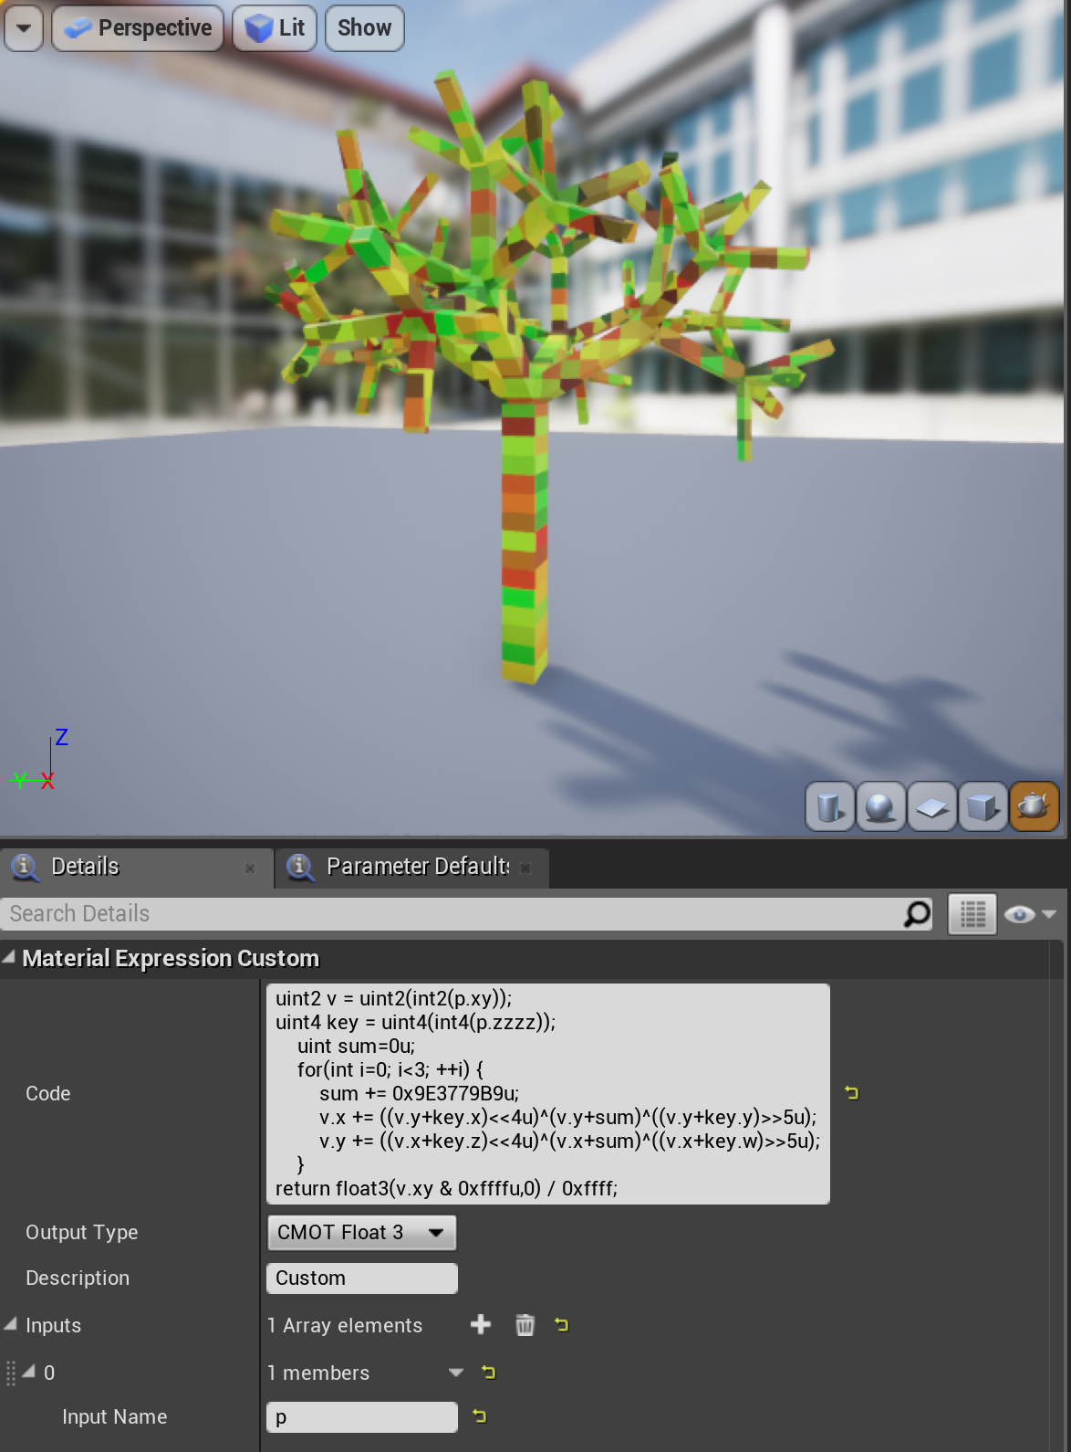
COMplex Custom Node
For more complex code, the custom node can contain a function body ending in a return statement.
The custom node box is not great for editing, so cut and paste between there and a regular editor.

Slide 17
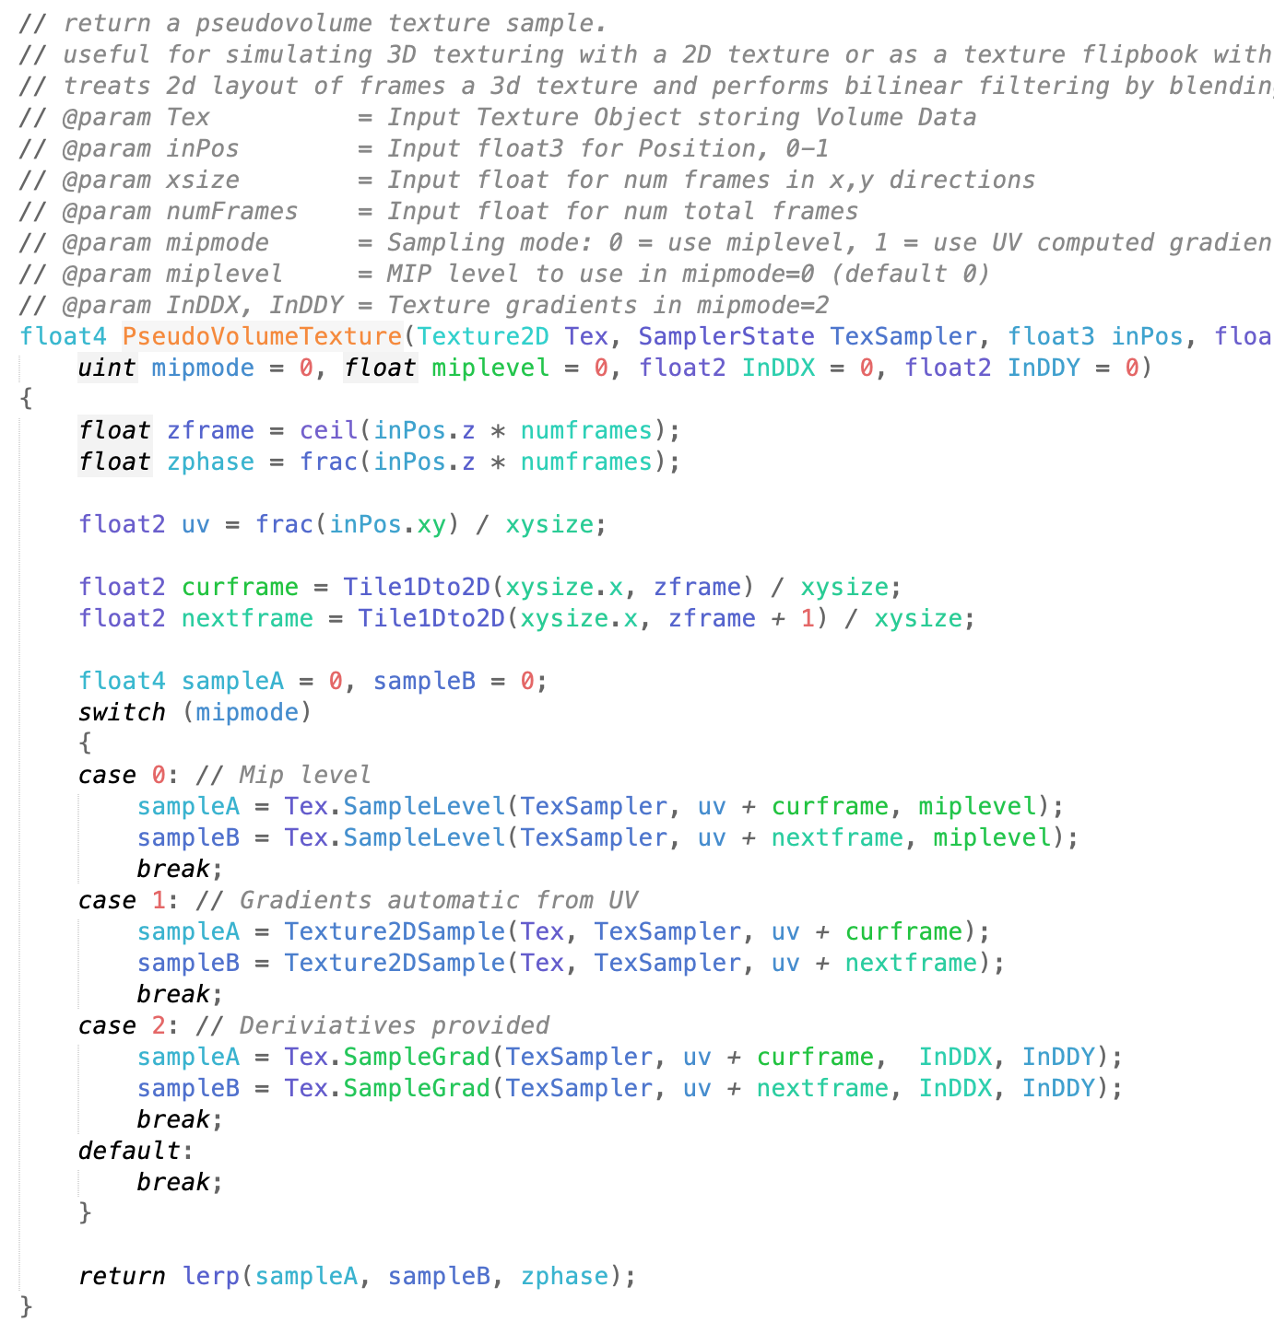
Adding Shader FUnctions
If there’s some complex code you want to call from several custom nodes, it’s easy to add it to the engine. Just add a new function to MaterialTemplate.ush or one of the files it includes (e.g. Common.ush).
Custom nodes that use the new function will only work with your modified engine.
Set r.ShaderDevelopmentMode to 1 for messages on shader errors and the chance to fix and recompile.
The RecompileShaders console command will detect which shaders need to be recompiled, but for these files that’ll be all of them. If you can work primarily in the material editor, you can just recompile the one material you are using for testing.

Slide 18
The HLSL Language
A Brief Overview

Slide 19
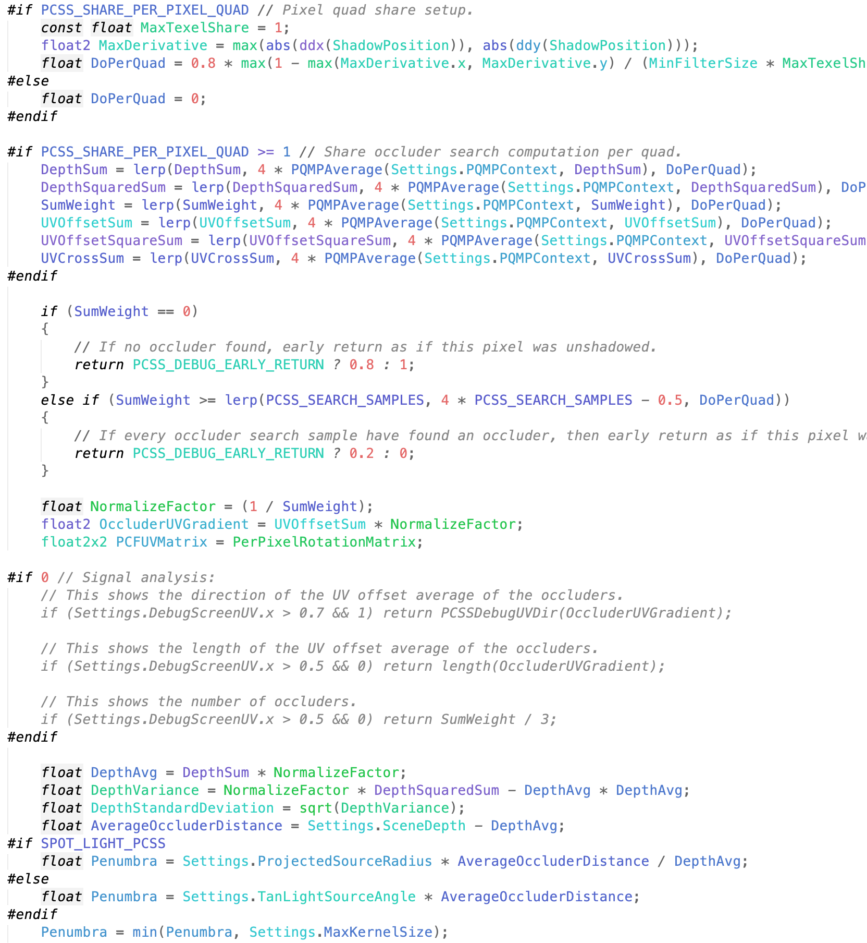
UE4 Shading Language
UE4 shader files (on all platforms) are written in a dialect of the DirectX HLSL (High Level Shading Language).
There are lots of HLSL resources online, you don’t need UE4-specific ones.
HLSL is C-like language, with familiar statement syntax, if / for / switch, struct, function call/declaration, #define / #if, …
It has some C++ features (comment syntax and function overloading), but most C++ features not in C are missing (classes, templates, etc.)
In addition, there are many extensions to support common shading operations.

Slide 20
Vector Types
HLSL has built-in types for 2D, 3D, and 4D vectors, commonly used for position or color
  float2, float3, float4
  Also other basic types: e.g. int2, int3, int4
These are initialized using any combination of enough components
  float2 f2 = float2(1, 2);
  float3 f3 = float3(f2, 0);
  float4 f4 = float4(3, f2, 4);
Swizzle operations rearrange components
  f4.xyz, f4.wxzy, f4.wwww
  Standard order is xyzw or rgba (can’t mix .xr)
Operations apply per component
  So a+b = float4(a.x+b.x, a.y+b.y, a.z+b.z)
Built-in functions exist for common vector math
  dot(a,b), cross(a,b), distance(a,b), length(a), normalize(a)

Slide 21
Matrix Types
Built-in types also exist for matrices up to 4x4
  float4x4, float3x4, float4x2, etc.
Construct from components or vectors
  float4x4 m = float4x4(v0,v1,v2, 0,0,0,1)
Operations apply component-wise. So, like vectors, addition gives standard matrix addition, but multiplication is not the same as matrix multiplication.
There are built-in functions for common matrix operations
  mul(mat,mat), mul(mat,vec), mul(vec,mat)
  determinant(mat), inverse(mat)

Slide 22

Built-in Shading Functions
Find on HLSL reference pages!
Blending
  saturate, clamp, step, smoothstep, lerp
Repeating
  floor, frac, fmod
Special purpose for common shading operations
  reflect, refract, texture
Derivatives (Pixel shaders only!)
  ddx, ddy, fwidth
  ddx(a) = ∂a/∂x for screen pixel coordinate x
    How fast is “a” changing between pixels?

Slide 23
Getting Data into Shaders (CBUFFERS)
Constant buffers
  Fast, same values for every pixel/vertex
    Constant across pixels, not from frame to frame, or necessarily even from object to object.
  Used for Primitive and View structs. Definitions must match in CPU & shader code.
  UE4 defines in C++ code, then generates shader code to match (e.g. View struct is defined in SceneView.h)
How to find out that the View struct is defined in SceneView.h?
  Find something reasonably unique looking in the shader definition, (e.g. TranslatedWorldToClip)
  Search for it in .h files (or .h and .cpp)
  In this case, single .h file hit is the right place!

Slide 24
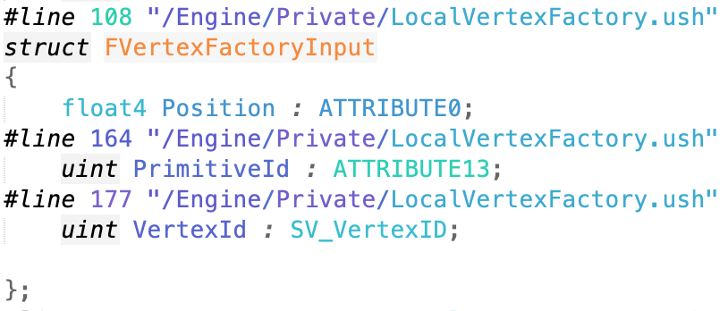
Getting Data into Shaders (Vertex Data)
Vertex buffers
  Struct of data per vertex, optionally containing position, normal, texture coordinates, etc.
  Array of these for the CPU, one element per thread in the vertex shader.
  Vertex buffers are generated by UE4 Vertex Factories
Index buffers
  Array of integers
  GPU uses to tell which vertices go together

Slide 25
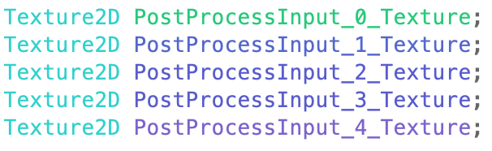
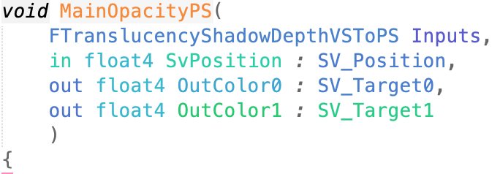

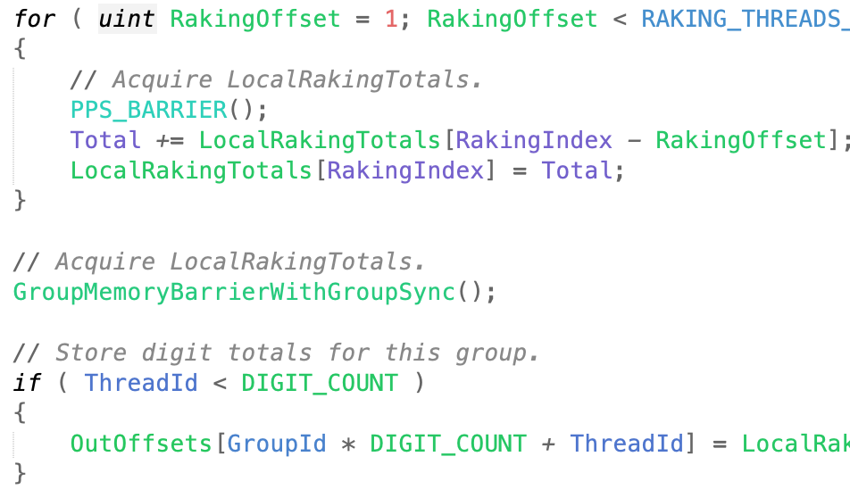
Getting Data into Shaders (Buffers & Textures)
Large memory buffers can have multiple views
Shader Resource View (SRV): read only
  Texture2D, etc.
Render Target View: write only
  Limited number of outputs per pixel shader
Unordered Access View (UAV): read/write
  Buffer<uint>
  Access as array from shader
  Atomic access functions if there might be overlap
GPU may need to do a transition or resolve to change access type or to make sure all writes are done before you start reading again.

Slide 26
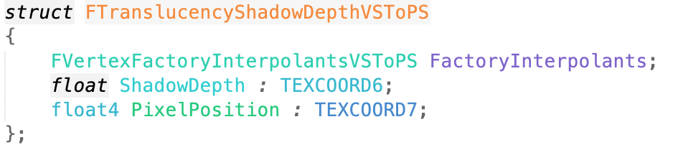
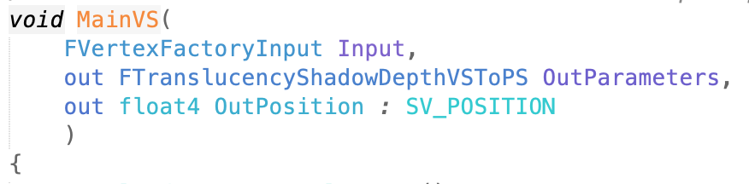
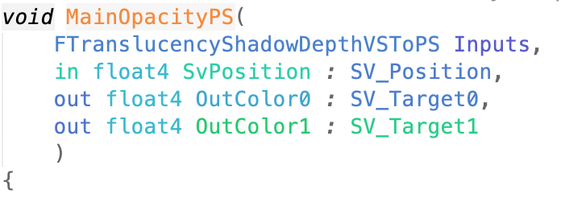
Shader Stage I/O
Each shader stage = function
  Usually with a name like MainVS for a vertex shader, or MainPS for a pixel shader, but that’s just UE4 convention.
Input
  parameters or struct
  Label with special hardware semantics
    Tells the GPU if this parameter has special meaning
    e.g. float4 Position : SV_Position
Output
  “out” parameters, struct, or function return value
  Label with semantics
Output from one stage should match input to next

Slide 27
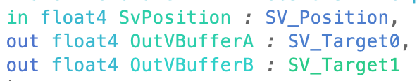
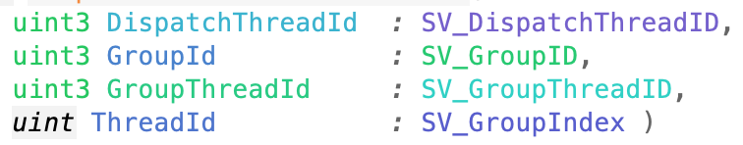
Hardware Semantics
Vertex input
  Position, Texcoord, Color, …
    Convention, but no meaning to GPU
  SV_VertexID (SV = system value)
Vertex output
  SV_Position (used by rasterizer)
Vertex to Pixel
  On some GPUs, this is limited by the number of hardware interpolators. Make sure you don’t run out by using some semantic tag for every vertex-to-pixel parameter.
Pixel output
  Color (RGBA) or SV_Target* for many

