Slide 1
Proxy Geometry
UMBC Graphics for Games

Slide 2
Graphics Hardware likes Triangles
Turn everything into meshes of triangles
Paragon Murdock: ~75k triangles
Draw them really fast
But not everything likes tons of tiny triangles…
Notes:
Add Murdock to project > Murdoch Map
Select character, open skeletal mesh, counts on display

Slide 3
Physical Interaction

Slide 4
Physics Simulation
Simulate objects as rigid bodies
Also sometimes see fluid simulation, but don’t worry about that now
Even complex objects as rigid parts with joints
Navigation (don’t run through walls)
Gravity (fall, but not through floors)
Rag doll (transition from scripted animation)

Slide 5
Collision Detection
Core component of physics simulation
Also event triggers

Slide 6
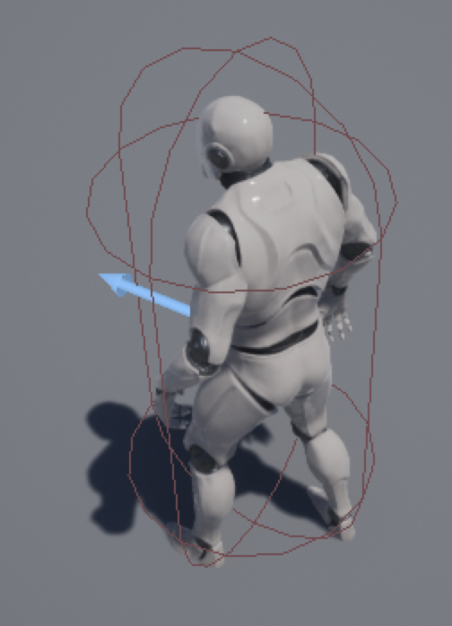
Simple Physics/Collision Proxies
Physics & collision detection with polygons is slow
Simple shapes are fast(er)
Box, Sphere, Cylindrical Capsule
Just use one of those around each object or character.
Notes:
New 3rd person template project. Select character

Slide 7
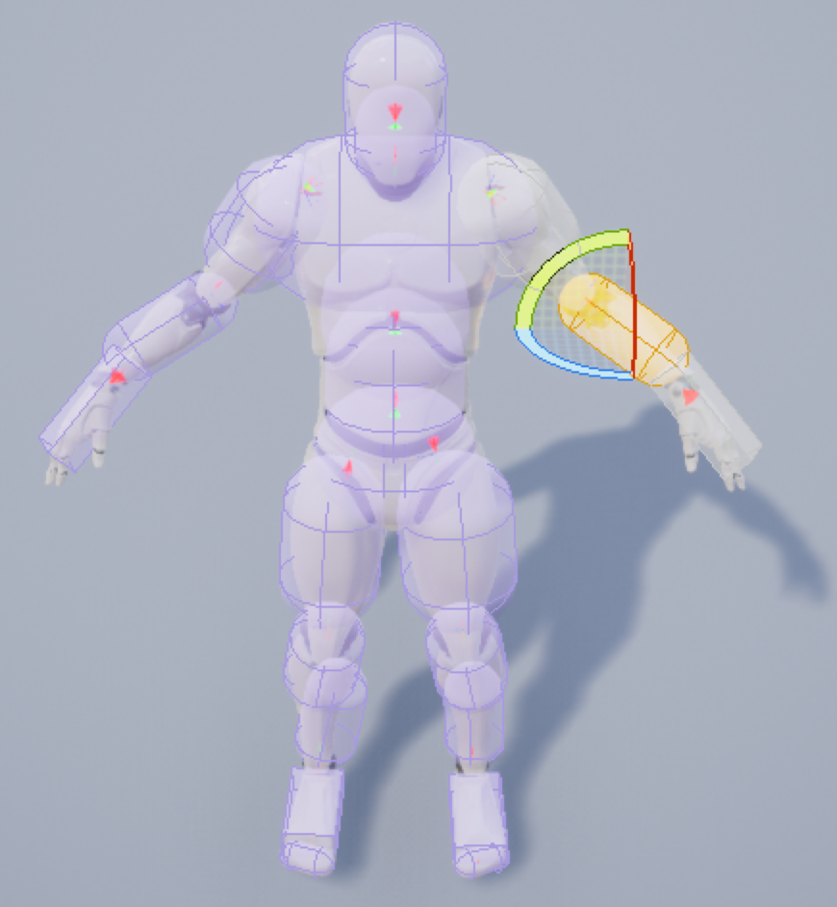
Composite Proxies
Physics animation of a character needs more
Build from basic shapes
Sausage man!
Compute physics on basic shapes
Apply to original model
Notes:
Open character skeletal mesh. Physics view

Slide 8
Hierarchical Proxies
Only use finer proxy when you hit the coarser one
All should contain the real object
But do not need to strictly contain the extra empty space of the other levels
Notes:
Load static mesh into scene. Bounds view. Collision view (Simple Collision, Complex Collision)

Slide 9
What to Render

Slide 10
Occlusion Queries
Graphics Hardware supports Occlusion Queries
Lets you ask “how many pixels would this draw?”
Or ”how many did this draw?”
Can only get the answer 1-2 frames later
Draw a simple shape to figure out whether to do the complicated one
Often just a bounding box
Dilate box based on object and view velocities

Slide 11
Simplifying Rendering

Slide 12
Level of Detail
Switch to simpler models when far away
Most common algorithm: Edge Collapse
Choose an edge, shrink to nothing
Removes two triangles, one vertex
Alternative: Vertex cluster
Cluster vertices, weld all in a group
Alternative: Volumetric remeshing
Convert to volumetric/solid representation
Process as volume
Remesh
75,296 Triangles
Notes:
Murdoch Paragon character, view Skeletal Mesh & select LOD levels

Slide 13
Level of Detail
Switch to simpler models when far away
Most common algorithm: Edge Collapse
Choose an edge, shrink to nothing
Removes two triangles, one vertex
Alternative: Vertex cluster
Cluster vertices, weld all in a group
Alternative: Volumetric remeshing
Convert to volumetric/solid representation
Process as volume
Remesh
42,326 Triangles

Slide 14
Level of Detail
Switch to simpler models when far away
Most common algorithm: Edge Collapse
Choose an edge, shrink to nothing
Removes two triangles, one vertex
Alternative: Vertex cluster
Cluster vertices, weld all in a group
Alternative: Volumetric remeshing
Convert to volumetric/solid representation
Process as volume
Remesh
20,597 Triangles

Slide 15
Level of Detail
Switch to simpler models when far away
Most common algorithm: Edge Collapse
Choose an edge, shrink to nothing
Removes two triangles, one vertex
Alternative: Vertex cluster
Cluster vertices, weld all in a group
Alternative: Volumetric remeshing
Convert to volumetric/solid representation
Process as volume
Remesh
10,042 Triangles

Slide 16
Level of Detail
Switch to simpler models when far away
Most common algorithm: Edge Collapse
Choose an edge, shrink to nothing
Removes two triangles, one vertex
Alternative: Vertex cluster
Cluster vertices, weld all in a group
Alternative: Volumetric remeshing
Convert to volumetric/solid representation
Process as volume
Remesh
5,172 Triangles

Slide 17
“Maps”
Map from mathematical mapping of 2D (image) domain to surface
Provides detail at a scale smaller than a triangle
Texture Map: surface color
Normal Map: normals provide shading variation
Gloss Map: shininess/roughness
Material/Metalic/Skin map: material to use

Slide 18
Displacement Map
Displace surface (typically along normal)
For fine mesh, move vertices
Proxy surface version: Relief Map or Parallax Occlusion Map

Slide 19
Rendering
Photons travel in straight lines
Photon that reaches the viewer through a pixel came from somewhere on a ray through that pixel
Rendering finds the closest thing on that ray

Slide 20
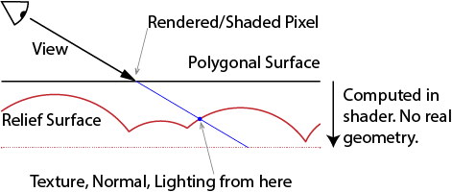
Relief / Parallax Occlusion Map
Render polygonal envelope around surface
Compute actual color and depth along ray in a shader

Slide 21
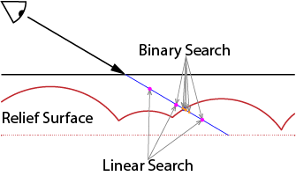
Finding the Intersection
Numerical root finding
Linear search (marching), Binary search, Secant method, …

Slide 22
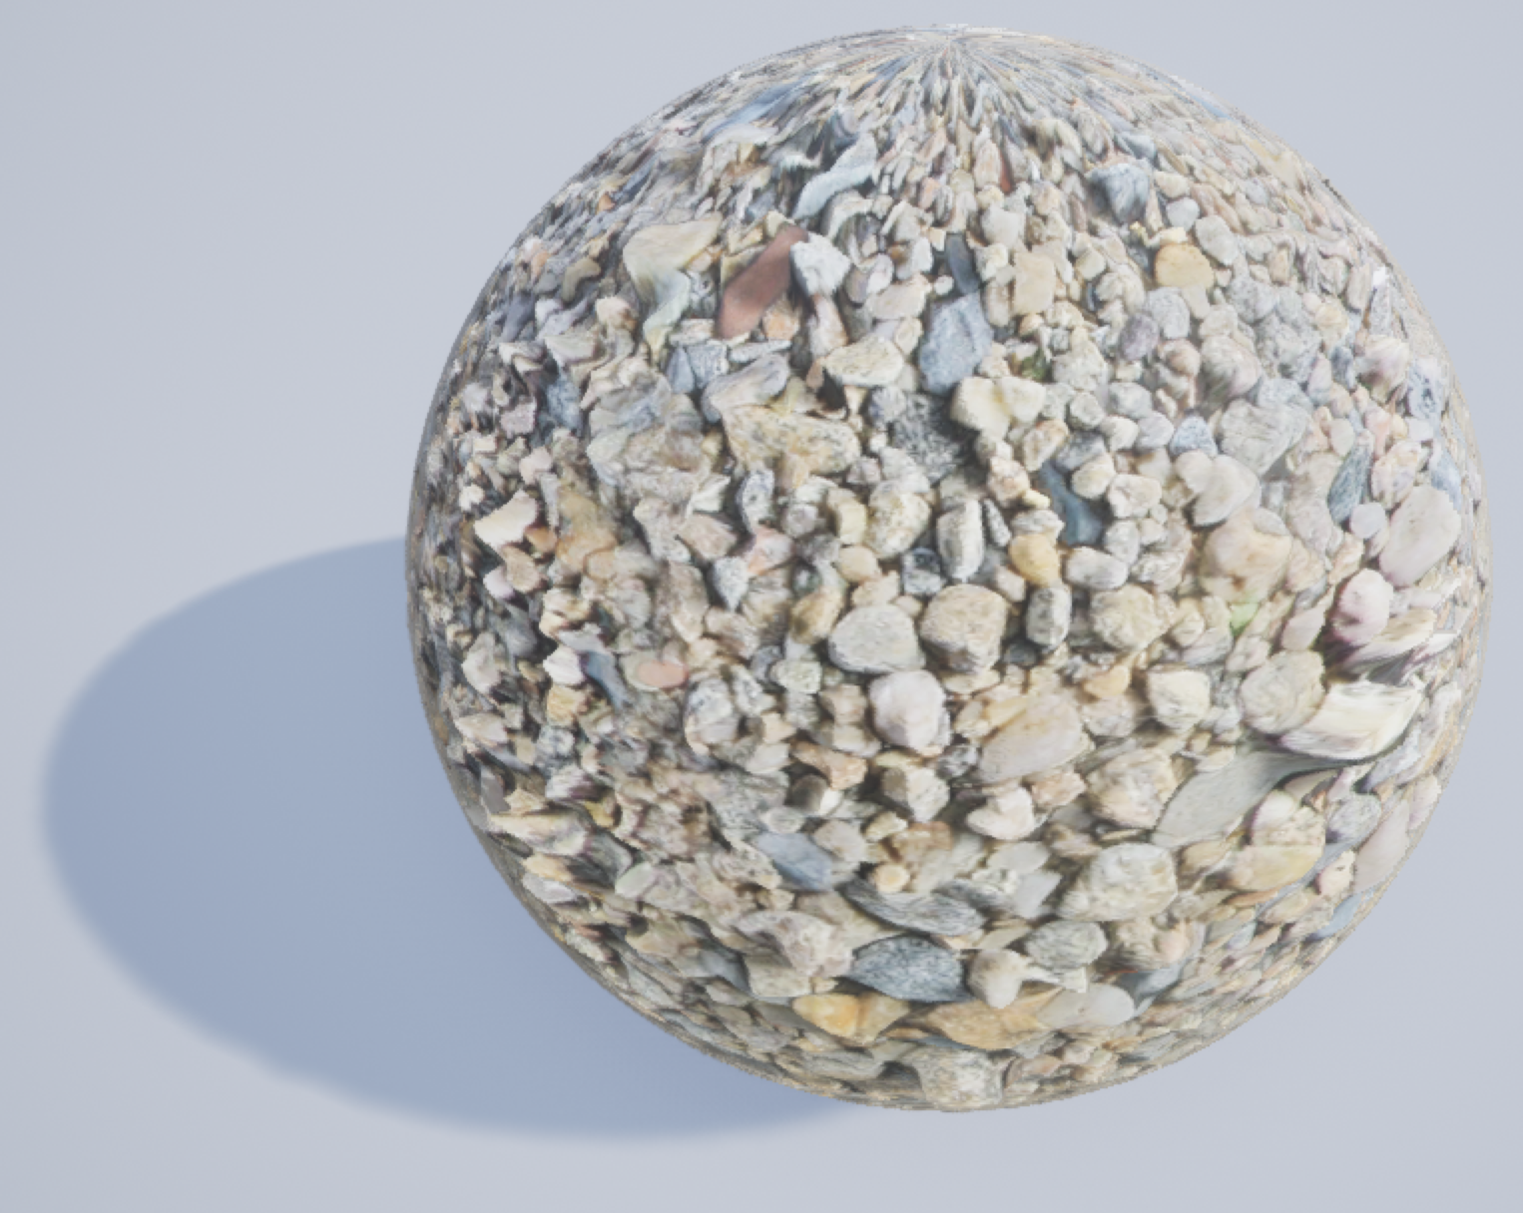
Relief Problems
Texture stretching on steep parts
Can remap
Unbounded steps at silhouette edges
Make displacement meet the proxy surface every so often
Flatten when too steep
Maximum number of steps
Divide into prisms with side faces
Notes:
LightTest UE4 project: material with Parallax Occlusion Map node, “pebbles” diffuse, normal, height, and gloss texture from (maybe g3d?) Shader parameters for height and shadow toggle, light vector from Atmospheric Light Vector, 1-gloss as roughness, (0.5*shadow+0.5)*diffuse for Base

Slide 23
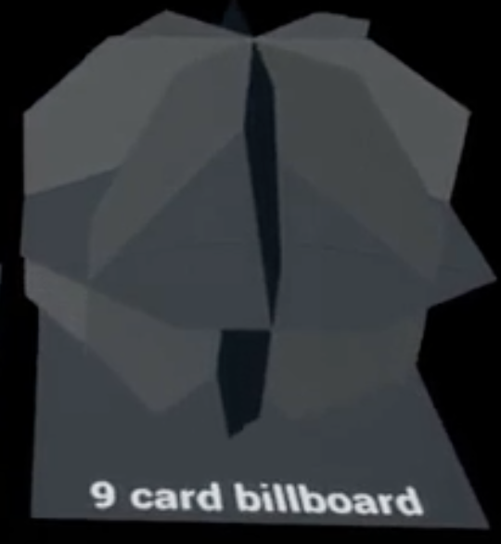
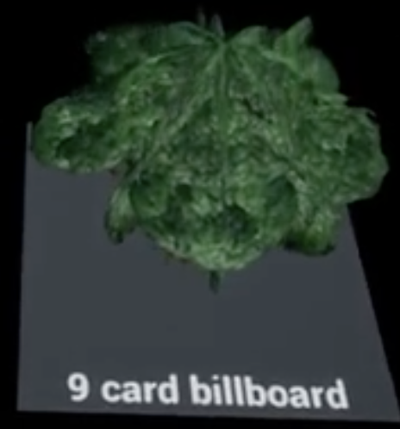
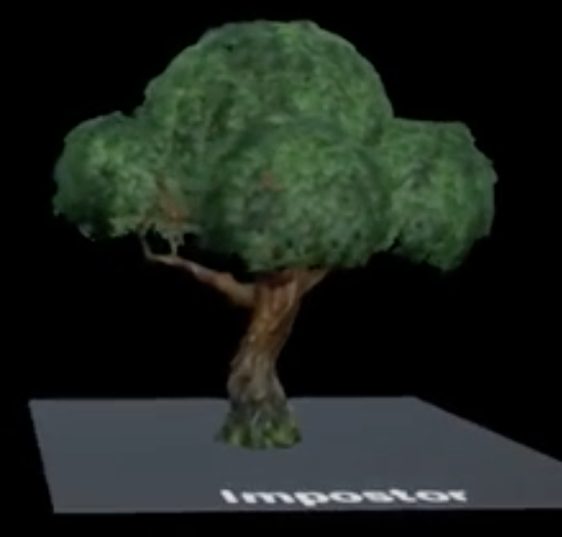
Billboards & Imposters
Billboard
Rectangle that turns to face the viewer
Sometimes a fixed set of intersecting planes
Typically a fixed static texture, common for particles
Can also billboard gbuffer data (color, normal, etc.)
Imposter
Change texture based on view direction
Better yet to warp with POM and blend closest
Used for Fortnite trees
https://shaderbits.com/blog/octahedral-impostors/

Slide 24
Volumetrics

Slide 25
Volume effects
Smoke, fog, clouds
Typical algorithm marches ray through volume
Accumulate color and opacity as you go
Total Color
Color so far
+
Segment Color * (1 - Opacity so far)
Opacity so far
+
Segment Opacity * (1 - Opacity so far)
Total Opacity

Slide 26
Proxy Volumes
Render transparent-pass proxy object around volume
Or just as a plane in front of the viewer
Shader does ray march, returns color & opacity
Blends over background objects
Embedded opaque objects
Shader reads depth
Stops ray march early
Blend over like background object
March toward light for shadows
Notes:
From my NoiseTest map.

Slide 27
Fewer steps
Expensive to do enough steps
Too few causes banding artifacts
Randomize first step
Replaces bands with noise
Keep spacing consistent
Errors don’t move
Acceleration data
Hierarchical structure
Distance field
Preprocess, not great for changing data
Notes:
From my GLSL “ShaderTest” app

Slide 28
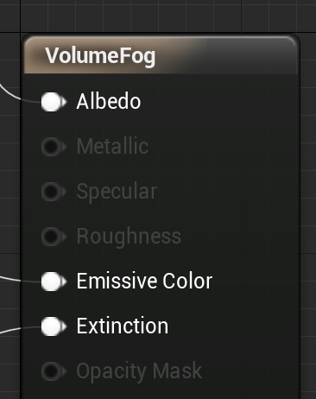
UE4 Volume Material
Re-samples volume to grid
Handles ray marching, accumulation & shadows
Albedo = Color of the material
Emissive color = Light emitted by the material
Doesn’t act as a light source, just constant extra color
Extinction = opacity of the material
Notes:
Noise project, VectorNoise level, Volume Material example

