Slide 1
Blueprint Plugins

Slide 2
UE4 Plugins
The Unreal Engine has a very flexible Plugin system for making a fairly wide range of engine extensions having to actually make a custom engine build.
Plugins can
Add content, including functions created in blueprint or the material editor.
Add new blueprint nodes and types
Add editor tools
Add editing modes
Add new importers or asset types

Slide 3
Plugins vs. Modules
All project and engine code in UE4 is divided into independent modules. When you create a C++ code project, it puts the code into a single module with its own
build.cs file, with dependencies and build settings
MODULE_API macro for exported symbols
IMPLEMENT_PRIMARY_GAME_MODULE to set up module support
The engine code is also divided into modules.
You can create additional modules at the project or engine level to encapsulate code.
Plugins are cross-project and cross-engine modules that can be redistributed.

Slide 4
Code Hierarchy
Project Module
Project Module
Project Plugin
Project Plugin
Code in the Unreal Engine can use other code or data defined at the same or lower levels
Engine Plugin
Engine Plugin
Engine Module
Engine Module

Slide 5
Blueprint Plugins

Slide 6
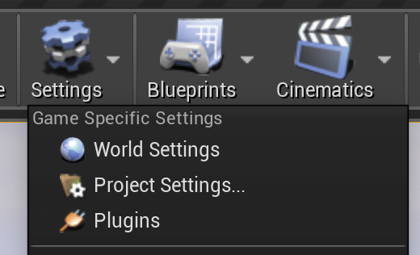
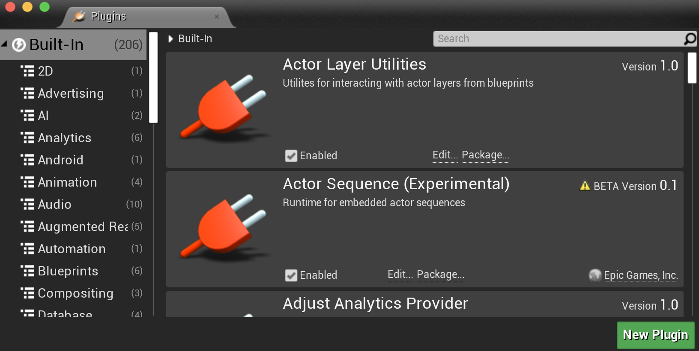
Create a Blueprint Plugin
Start with a C++ code project.
To create a new plugin, open the plugin browser in the Settings menu.
From there, you can use the New Plugin button.
Choose Blueprint Library plugin, and fill out the name, author, and description.
To rebuild, instead of the Compile button used for project code, open Window > Developer Tools > Modules. Each project and engine module will be listed, including the new one. All have a Recompile button you can use to rebuild just that module.

Slide 7
What it Makes
This will create several files for you (where PluginName is the name you gave your plugin):
Icon128.png
PluginName.uplugin
PluginName.Build.cs
PluginName.h, .cpp
PluginNameBPLibrary.h, .cpp

Slide 8
What it Makes
Resources/Icon128.png
This will create several files for you (where PluginName is the name you gave your plugin):
Icon128.png
PluginName.uplugin
PluginName.Build.cs
PluginName.h, .cpp
PluginNameBPLibrary.h, .cpp
128 x 128 icon image with a transparent background
Change to something else if you want a different icon in the plugins browser

Slide 9
What it Makes
PluginName.uplugin
This will create several files for you (where PluginName is the name you gave your plugin):
Icon128.png
PluginName.uplugin
PluginName.Build.cs
PluginName.h, .cpp
PluginNameBPLibrary.h, .cpp
Plugin name, author, description, URL.
If you want to change these after creating the plugin, just edit this file
Loading Phase
When will it run its startup code (if any). Only matters if you have some global initialization.

Slide 10
What it Makes
Source/PluginName/PluginName.Build.cs
This will create several files for you (where PluginName is the name you gave your plugin):
Icon128.png
PluginName.uplugin
PluginName.Build.cs
PluginName.h, .cpp
PluginNameBPLibrary.h, .cpp
Include paths and external libraries needed
Dependencies on other modules and plugins

Slide 11
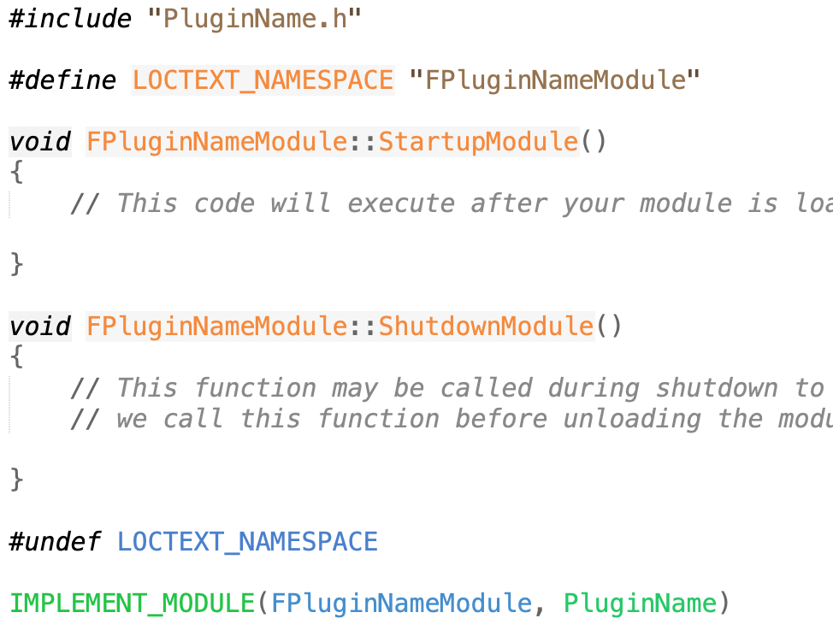
What it Makes
Source/PluginName/Public/PluginName.h Source/PluginName/Private/PluginName.cpp
This will create several files for you (where PluginName is the name you gave your plugin):
Icon128.png
PluginName.uplugin
PluginName.Build.cs
PluginName.h, .cpp
PluginNameBPLibrary.h, .cpp
Module initialization code (if needed)
Code to set it up as a module
Blueprint modules usually won’t need to change much here unless using an external library that has to be initialized

Slide 12
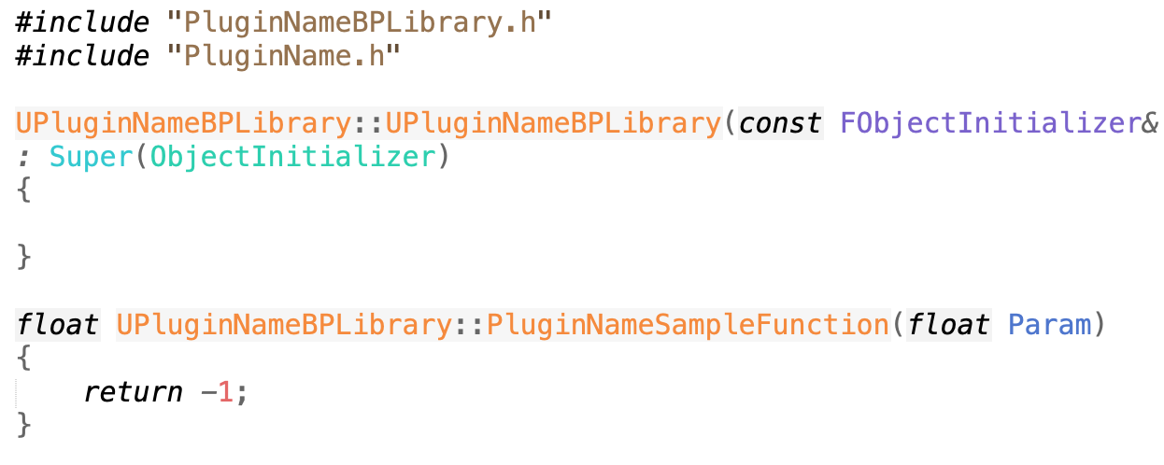
What it Makes
…/Public/PluginNameBPLibrary.h …/Private/PluginNameBPLibrary.cpp
This will create several files for you (where PluginName is the name you gave your plugin):
Icon128.png
PluginName.uplugin
PluginName.Build.cs
PluginName.h, .cpp
PluginNameBPLibrary.h, .cpp
Declaration and implementation of actual Blueprint library code

Slide 13
Blueprint Functions
Library is a class, tagged UCLASS()
Derive from UBlueprintFunctionLibrary
Needs GENERATED_UCLASS_BODY()
Actual Blueprint functions are static class member functions
So can be called as ClassName::Function() without needing an instance of the class.
As with blueprint functions in actor code, these should be UFUNCTION(BlueprintCallable), but will be available to all blueprints, not just derived blueprint actor classes.

Slide 14
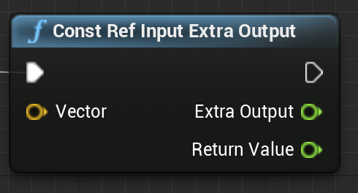
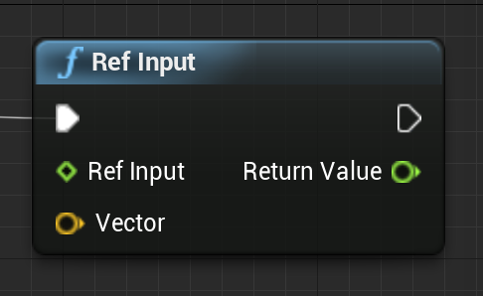
Multiple Return Values
Function return values shows up as an output pin, and const references show up as input pins, but values returned by (non-const) reference will appear as additional outputs.
If you want a reference parameter to appear as an input, tag that parameter with UPARAM(ref). In this case, as with any C++ reference, the parameter can be both read and changed.

Slide 15
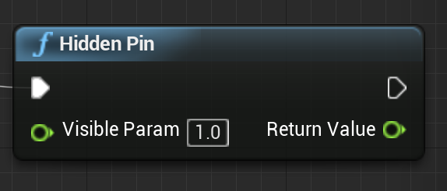
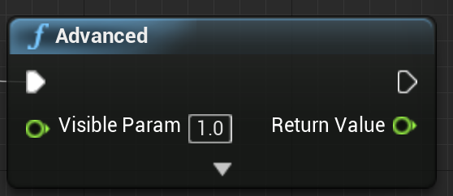
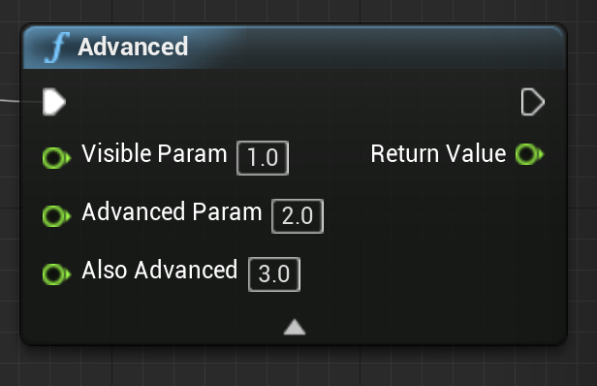
Hiding Input Pins
You can permanently hide input pins (say if only useful when directly called from C++) by giving a default value and adding the meta=(HidePin=“PinName”) tag.
For seldom used pins, put them at the end of the argument list, with reasonable defaults, and use the meta=(AdvancedDisplay=Num) tag, where Num is the parameter number starting at 0

Slide 16
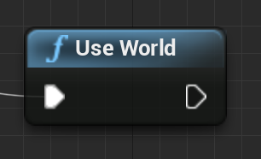
World Context Object
Blueprint nodes defined in an actor have access to their actor’s GetWorld() function, but if a global static blueprint function needs access to the world context object, it has to be declared as a parameter.
If this parameter is tagged with the WorldContext meta tag, it will be hidden and automatically filled in

Slide 17
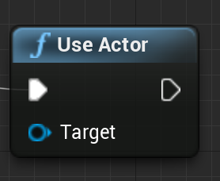
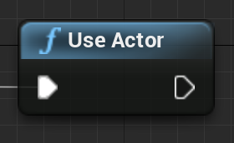
Accessing the BP Actor
A Blueprint nodes defined in an actor has access to the actor data through its this pointer. If a plugin Blueprint node needs similar actor data access, it will need to declare an explicit paramater.
This parameter can be hidden (using HidePin) and/or filled by default (using DefaultToSelf)
If not hidden, the Blueprint can apply the node to a different actor

Slide 18
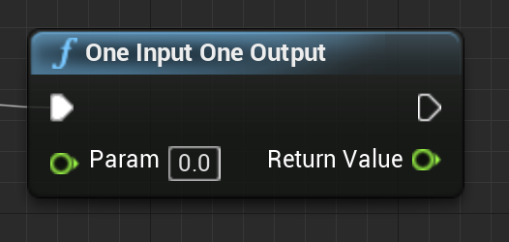
Pure Functions
BlueprintCallable functions will have the white sequence pins and in a Blueprint will be called in order. Functions with visible state changes should always be BlueprintCallable.
BlueprintPure functions do not make guarantees on their execution order. They may be called anytime between the time the inputs are ready and when the output is needed.
BlueprintPure can be used for true pure functions, but also for any function where the outputs are consistent for a given set of inputs and execution order does not matter (e.g. including some internal caching).

Slide 19
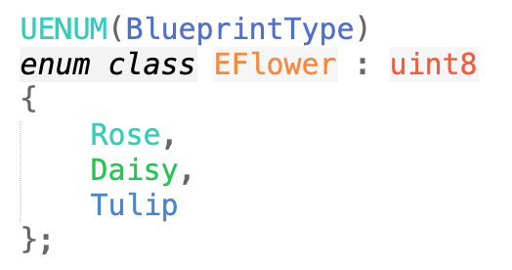
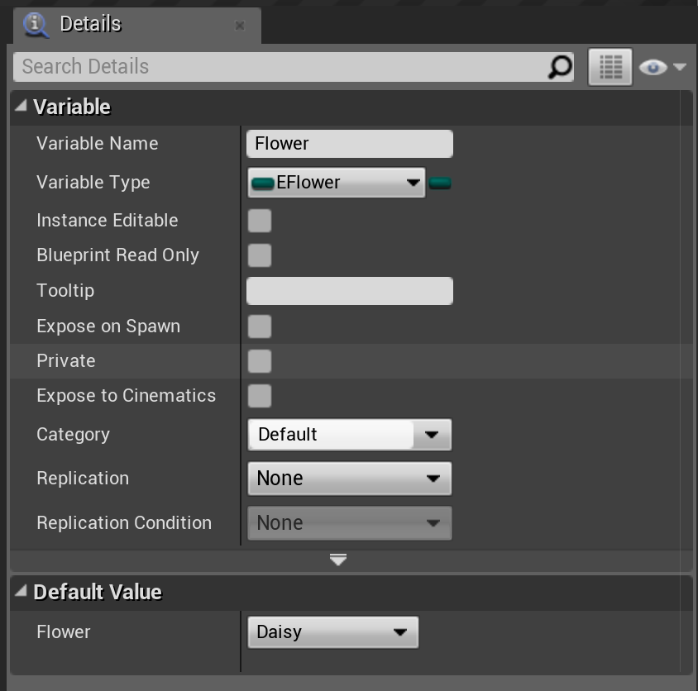
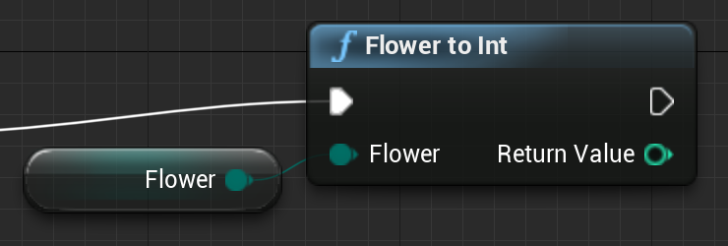
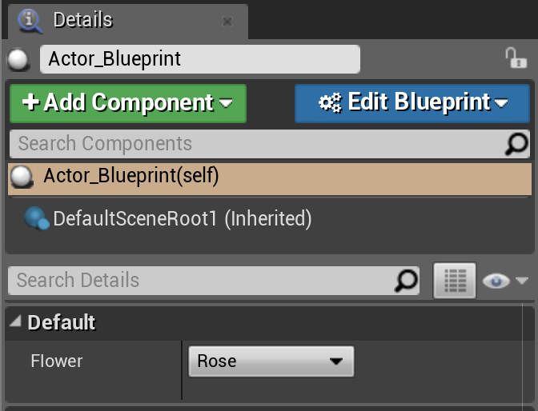
New Enumerated Types
You can create new enum types by declaring them with UENUM(BlueprintType). UENUM type names should start with an E.
These will appear as a drop-down selection in the Blueprint node
Enums declared this way can also be stored in a Blueprint variable, and made visible in the Details pane for the actor using the Blueprint.

Slide 20
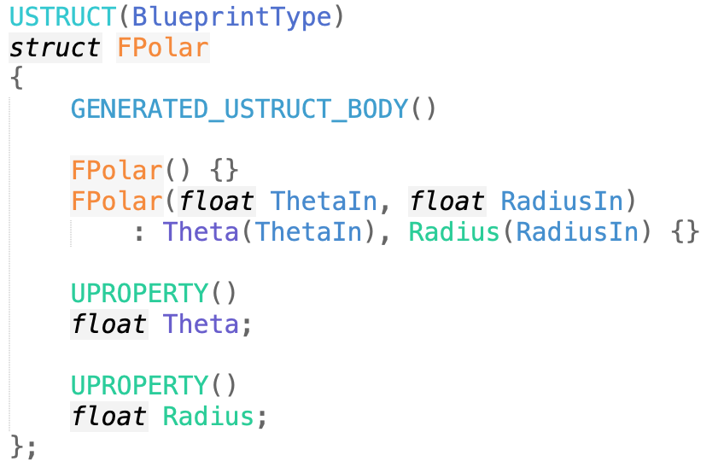
New Struct/Class Types
To group related data or state together, you can declare a struct with USTRUCT(BlueprintType) or UCLASS(BlueprintType).
Like UENUM, the struct can be used as the input or output of a Blueprint function, and stored in a Blueprint variable.
Don’t forget to tag any member data that should be serialized with UPROPERTY()

Slide 21
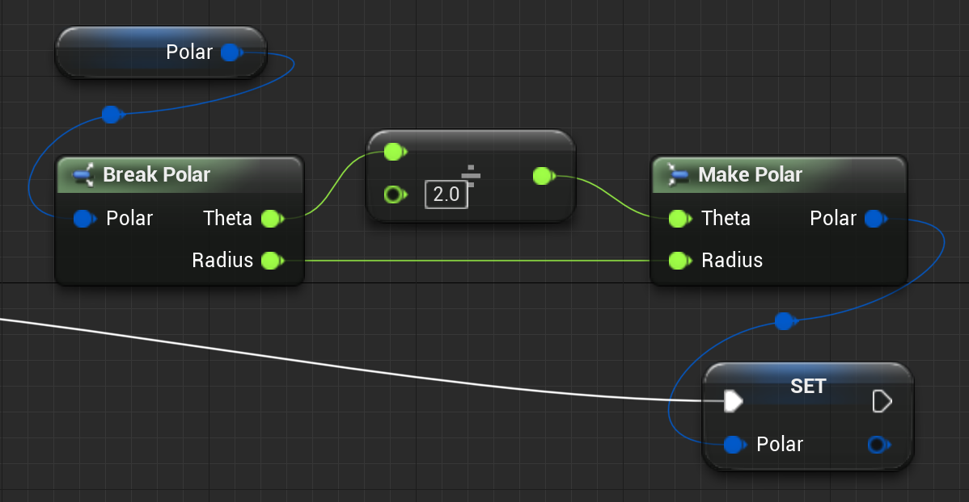
Struct Make and Break
A Blueprint type make function builds a variable of that type, while a break function returns the construction parameters given the variable.
Ideally, the break should return everything needed by the make, so break/make is the same as using the original variable.
Tag the functions
UFUNCTION(BlueprintPure, meta=(NativeMakeFunc))
UFUNCTION(BlueprintPure, meta=(NativeBreakFunc))
Also, the USTRUCT() should have meta tags
HasNativeMake =“Module.Class.Func”, HasNativeBreak=“Module.Class.Func”

Slide 22
Finding More
Online documentation
UFUNCTION options
Meta tag options
Examples
Look code for existing Blueprint nodes
Look at code for existing BlueprintTypes.

