Slide 1
Shading
UMBC Graphics for Games

Slide 2
Shader?
Small program, domain-specific language
Originally to compute surface appearance and shading
“Shader” is now used for any GPU computation

Slide 3
History
Shade Trees [Cook 1984]
Expressions for displacement, surface, light, atmosphere
Image Synthesizer [Perlin 1985]
Add control flow, also introduces Perlin noise
RenderMan [Hanrahan and Lawson 1990]
Decades of Pixar movies
PixelFlow [Olano and Lastra 1998]
First high-level shading language on graphics hardware
Vertex Programs [Lindholm et al. 2001]
Assembly-like, first PC GPU shading
RTSL [Proudfoot et al. 2001]
High level shading on GPUs, introduces GPU shading stages

Slide 4
Common Shading stages
Compute
Vertex
Mem
Vertex
Run each vertex
Where does vertex land on screen
(Rasterize)
Not programmable
Collect verts to triangles, turn into pixels
Pixel
Compute color per pixel
Compute
General-purpose
Rasterize
Pixel

Slide 5
Less Common Stages
Vertex
Compute
Hull
Mem
Hull
Run each triangle/quad
Determine tessellation factors
(Tessellation)
Not programmable
Turn one primitive to many
Domain
Where do the new vertices go?
Geometry
Run per triangle
Make more triangles
Tessellate
Domain
Geom
Rasterize
Pixel

Slide 6
Language
DirectX: HLSL = High Level Shading Language
Windows, Xbox, UE4, Unity, …
OpenGL: GLSL = GL Shading Language
Linux, Mobile, WebGL
Both
C-like
Statement syntax, if / for / switch, struct, function call/declaration, #define / #if, …
Some C++ features
Comments, function overloading
Extensions for shading
HLSL/GLSL use different names, but otherwise almost identical
Metal: Mac, even more C++ like

Slide 7
Vector Types
float2, float3, float4 (only to 4)
GLSL calls these vec2, vec3, vec4
Also int2-4, bool2-4, etc.
Constructor with any combination of enough components
float2 f2 = float2(1, 2);
float3 f3 = float3(f2, 0);
float4 f4 = float4(3, f2, 4);
Swizzle
f4.xyz, f4.wxzy, f4.xxxx
Operations per component (e.g. a+b = vector addition)
Vector functions
dot(a,b); cross(a,b); length(a); distance(a,b); normalize(a);
bool vectors: all(a), any(a)

Slide 8
Matrix types
float2x2, float3x4, float4x2, …
GLSL float2x2 = mat2, float3x4 = mat3x4, etc.
Construct from components or vectors
Component-wise operations
Matrix functions
mul(mat,mat), mul(vec,mat), mul(mat,vec)
determinant(m)

Slide 9
Built-in Shading Functions
Find on HLSL reference pages!
Blending
saturate, clamp, step, smoothstep, lerp
Repeating
floor, frac, fmod
Crazy-special purpose
reflect, refract
Derivatives (Pixel shaders only!)
ddx, ddy, fwidth

Slide 10
Data
Constant buffers
Fast, same for everybody
Defined in shader or CPU code
Limited number and size (D3D11 = 15 x 4096-value buffers)
Regular constants in your shader get stuffed into one.
Vertex buffers
Array for CPU, one element per vertex shader
Index buffers
Array for CPU, GPU uses to tell which vertices go together

Slide 11
Data
Memory buffers: multiple views
Shader Resource View (SRV): read only
Texture2D, etc.
Render Target View: write only
SV_Target0 or Color output semantics
Unordered Access View (UAV): read/write
Buffer<uint>
Access as array from shader
Atomic access functions if there might be overlap
GPU may need to do a transition or resolve to change access type

Slide 12
Shader Stage I/O
Each shader stage = function
Input
“in” parameters or struct
Label with special hardware semantics
e.g. in float4 Position : SV_Position
Output
“out” parameters, struct, or function return value
Label with semantics
Output from one stage should match input to next

Slide 13
Hardware semantics
Vertex input
Position, Texcoord, Color, …
Convention, but no meaning to GPU
SV_VertexID (SV = system value)
Vertex output
SV_Position (used by rasterizer)
Vertex to Pixel
Limited number of interpolators.
Pixel output
Color (one output) or SV_Target* for many

Slide 14
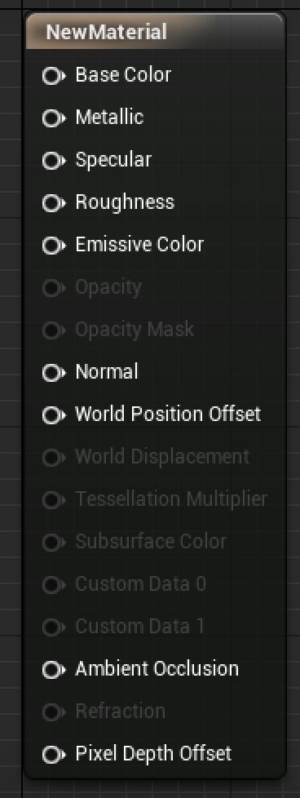
UE4 Shaders
Engine
.ush = Unreal Shader Header
.usf = Unreal Shader Function
Materials
Compiled into boilerplate code
Ends up in Vertex Shader:
Anything attached to WorldPositionOffset or WorldDisplacement
Anything attached to the input of a Vertex Interpolator
Ends up in Pixel Shader:
Everything else

Slide 15
UE4 Custom node
Node in Material editor
Minor editing possible, but better to paste into an external editor
External editor can give syntax highlighting, auto indenting, etc.
Single HLSL function
Declare inputs, single float4 output
Access to internal data structs
Especially Primitive, Parameters and View
But some not generated unless their node is used (e.g. TexCoord)

Slide 16
UE4 Shader Internals
Shaders in Engine/Shaders
Even on binary engine builds
ush = headers, lots of functions useable even in custom nodes
usf = actual shader
MaterialTemplate.ush = boilerplate template for Materials
See filled in from Material Editor: “Window” > “Shader Code” > “HLSL Code”
Some (postprocessing, shadows, etc.) used directly from usf.

Slide 17
UE4: What’s in a Material Node
Follow a somewhat unique example (e.g. VectorNoise)
Common.ush: MaterialExpressionVectorNoise shader function
MaterialExpressionVectorNoise.h
UENUM() with DisplayNames and comments = tooltips
UCLASS() defining node inputs
HLSLMaterialTranslator.h
Function that outputs an HLSL code string, with GetParameterCode for inputs
MaterialExpressions.cpp
Defaults for inputs, code to grey-out inactive UI elements
Boilerplate to compile
MaterialCompiler.h
Boilerplate to declare virtual functions

