Slide 1
Graphics Hardware
UMBC Graphics for Games

Slide 2
CPU Architecture
Start 1-4 instructions per cycle
Pipelined, takes 8-16 cycles to complete
Memory is slow
1 cycle for registers ~2⁰
2-4 cycles for L1 cache ~2²
10-20 cycles for L2 cache ~2⁴
50-70 cycles for L3 cache ~2⁶
200-300 cycles for memory ~2⁸

Slide 3
CPU Goals
Make one thread go very fast
Avoid pipeline stalls
Branch prediction
Misprediction up to 64 instruction penalty
Out-of-order execution
Don’t wait for one instruction to finish before starting others
Memory prefetch
Recognize access patterns, get data to fast levels of cache early
Big caches
Though bigger caches add latency

Slide 4
CPU Performance Tips
Avoid unpredictable branches
Specialize code
Avoid virtual functions when possible
Sort similar cases together
Avoid caching data you don’t use
Core of data oriented design
Avoid unpredictable access
O(n) linear search faster than O(log n) binary up to 50-100 elements
Linear access = can prefetch; branch predictable until final found it iteration
For small numbers, constants matter
Don’t underestimate how big small numbers can be

Slide 5
GPU Goals
Make 1000’s of threads running the same program go very fast
Hide stalls
Share hardware
All running the same program
Swap threads to hide stalls
Large, flexible register set
Enough for active and stalled threads

Slide 6
Architecture (MIMD vs SIMD)
MIMD (CPU-Like)
SIMD (GPU-Like)
CTRL
ALU
CTRL
ALU
CTRL
ALU
ALU
ALU
ALU
CTRL
ALU
ALU
ALU
ALU
CTRL
ALU
ALU
ALU
ALU
Flexibility
Horsepower
Ease of Use

Slide 7
SIMD Branching
if( x ) // mask threads
// issue instructions
else // invert mask
// issue instructions
// unmask
Threads agree, issue if
Threads agree, issue else
Threads disagree, issue if AND else

Slide 8
SIMD Looping
Useful
% Useful = Utilization
Useless
while(x) { // update mask
// do stuff
}
They all run ‘till the last one’s done….

Slide 9
GPU graphics processing model
CPU
Vertex
Texture/Buffer
Geometry
Fragment
Rasterize
Displayed
Pixels
Z-Buffer

Slide 10
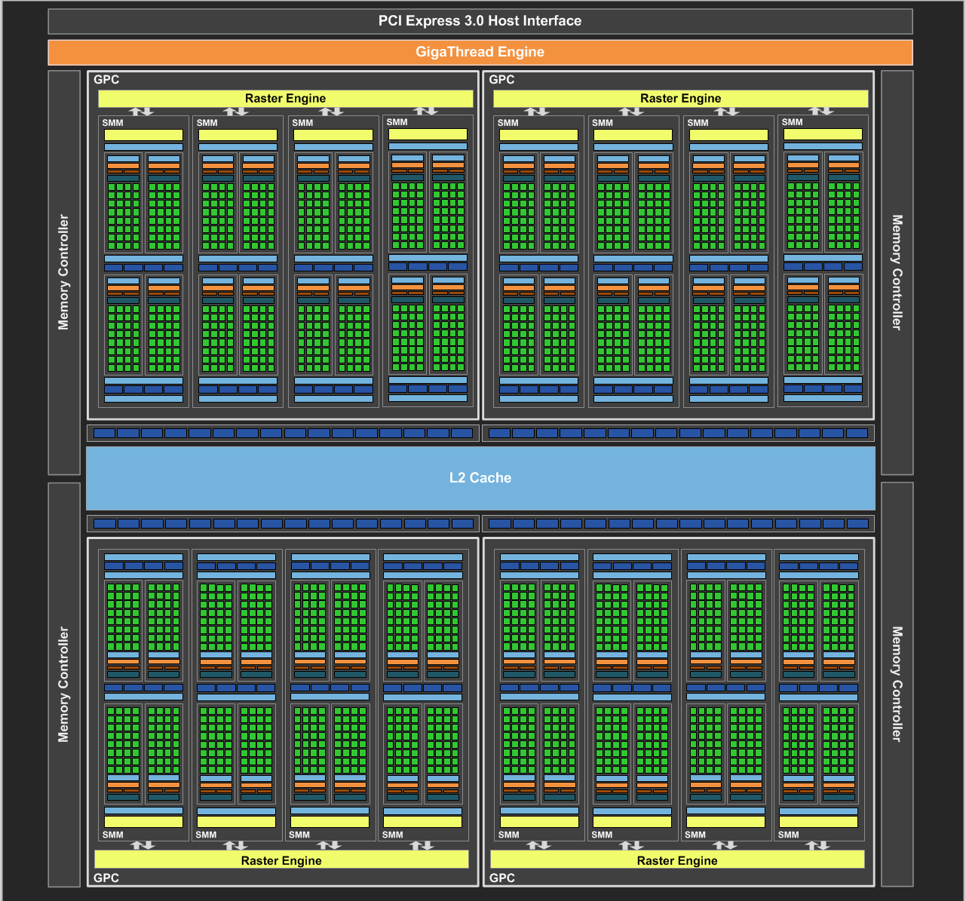
NVIDIA Maxwell
[NVIDIA, NVIDIA GeForce GTX 980 Whitepaper, 2014]

Slide 11
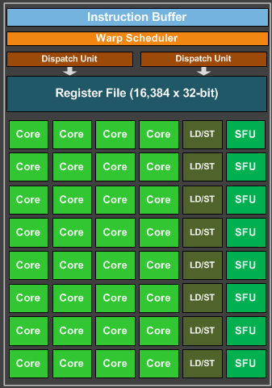
Maxwell SIMD Processing Block
32 Cores
8 Special Function
One set of threads
NVIDIA: Warp, AMD: Wavefront
Want at least 4-8 interleaved
% of max = Occupancy
Flexible Registers
Vector General Purpose Registers (VGPR)
AMD term: Different value at each core
# warps usually limited by registers

Slide 12
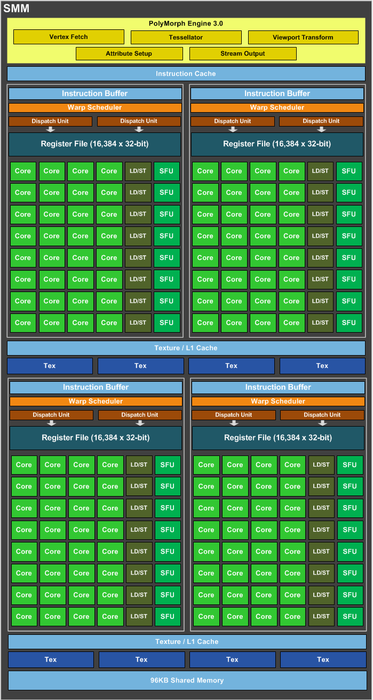
Maxwell Streaming Multiprocessor (SMM)
4 SIMD blocks
Share L1 Caches
Share memory
Share tessellation HW

Slide 13
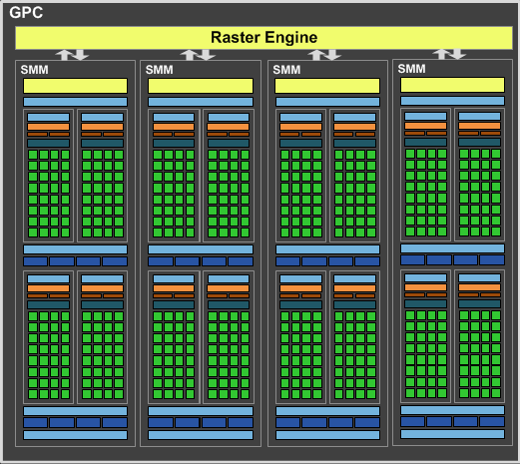
Maxwell Graphics Processing Cluster (GPC)
4 SMM
Share raster

Slide 14
Full NVIDIA Maxwell
4 GPC
Share L2
Share dispatch

Slide 15
NVIDIA Volta
[NVIDIA, NVIDIA TESLA V100 GPU ARCHITECTURE]

Slide 16
GPU Performance Tips

Slide 17
Graphics System Architecture
Your Code
Display
GPU
GPU
GPU(s)
API
Driver
Produce
Consume
Current Frame
(Buffering Commands)
Previous Frame(s)
(Submitted, Pending Execution)

Slide 18
GPU Performance Tips: Communication
Reading Results Derails the train…..
Occlusion Queries → Death
When used poorly: don’t ask for the answer for 2-3 frames
Framebuffer reads → DEATH!!!
Almost always…
CPU-GPU communication should be one way
If you must read, do it a few frames later…

Slide 19
GPU Performance Tips: API & Driver
Minimize shader/texture/constant changes
Flush pipeline, change state, restart
Minimize Draw calls
One instanced draw is much more efficient than many static draws
Minimize CPU → GPU traffic
Use static vertex / index buffers if you can
Use dynamic buffers if you must
With discarding locks: region being used, region in queue, region being updated

Slide 20
GPU Performance Tips: Shaders
NO unnecessary work!
Precompute constant expressions
Divide by constant → Multiply by reciprocal
Use x*(1./3.) vs. x/3.
Not always the same in float math, compiler is not allowed to make that optimization
Minimize fetches
Prefer compute (generally)
If ALU/TEX < 4+, ALU is under-utilized
If combining static textures, bake it all down…

Slide 21
GPU Performance Tips: Shader Occupancy
Know what’s limiting you
Occupancy only helps when stall limited (typically memory stalls)
Often VGPR limited
Could be local/shared memory
Limit VGPR usage by specializing shaders
Limit VGPR usage with computation that’s constant across the warp

Slide 22
GPU Performance Tips: Shaders
Careful with flow control
Avoid divergence
Flatten small branches
Prefer simple control structure
Specialize shader (though can lead to 1000’s of shaders)
Double-check the compiler
Shader compilers are getting better…
Look over artists’ shoulders
Material editors give them lots of rope….

Slide 23
GPU Performance Tips: Vertices
Use the right data format
Cache-optimized index buffer
Small, 16-byte aligned vertices
Cull invisible geometry
Coarse-grained (few thousand triangles) is enough
“Heavy” Geometry load is ~2MTris and rising

Slide 24
GPU Performance Tips: Pixels
Small triangles hurt performance
GPU always renders 2x2 pixel blocks (for texture filtering)
Renders extra “fake” pixels to fill block → Waste at triangle edges
Respect the texture cache
Adjacent pixels should touch same or adjacent texels
Use the smallest possible texture format
Avoid incoherent texture reads
Do work per vertex
There’s usually less of those (see small triangles)

Slide 25
GPU Performance Tips: Pixels
HW is very good at Z culling
Early Z, Hierarchical Z
If possible, submit geometry front to back
“Z Priming” is commonplace (UE4 does this)
Render with simple shader to z-buffer
Then render with real shader
Helps a ton for complex forward shaders, but useful even for g-buffer

Slide 26
GPU Performance Tips: Frame Buffer
Turn off what you don’t need
Alpha blending
Color/Z writes
Minimize redundant passes
Multiple lights/textures in one pass
As long as it doesn’t kill your occupancy
Use the smallest possible pixel format
Consider clip/discard in transparent regions
Throws out pixels

Slide 27
GPU Performance Tips: Overall
Learn as much as possible about GPU internals
Use that to guide your optimization decisions
Benchmark, don’t assume
Complex interrelationships can surprise you
Build a good A/B test timing framework
Do at least big-picture optimizations early

