Slide 1
CMSC 491/691
Sampling and Antialiasing

Slide 2
Vectors and Functions
Vector | Discrete | Continuous
V | V[I] | V(x)
a V + b U | a V[I] + b U[I] | a V(x) + b U(x)
V • U | ∑ V[I] U*[I] | ∫ V(x) U*(x) dx

Slide 3
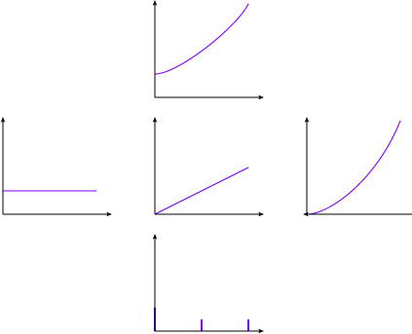
Vectors and Functions
2^{t} projected onto 1, t, t²
2^{t}
1
t
t²

Slide 4
Function Bases
Time: δ(t)
Polynomial / Power Series: t^{n}
Discrete Fourier: e^{i π t K/N} / √2N
  K, N integers
  t, K ∈ [-N, N]
  (where e^{iθ} = cos θ + i sin θ)
Continuous Fourier: e^{i ω t} / √2π

Slide 5
Fourier Transforms
 | Discrete Time | Continuous Time
Discrete Frequency | Discrete Fourier Transform | Fourier Series
Continuous Frequency | Discrete-time Fourier Transform | Fourier Transform

Slide 6
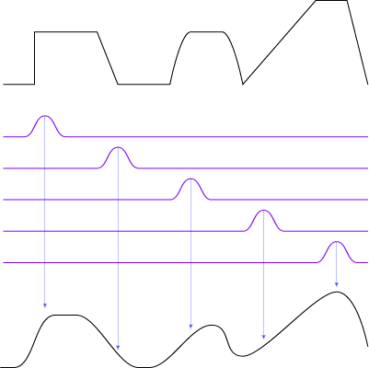
Convolution
f(t) g(t) ⇔ F(ω) ＊ G(ω)
g(t) ＊ f(t) ⇔ F(ω) G(ω)
Where f(t) ＊ g(t) = ∫ f(s) g(t-s) ds
  Dot product with shifted kernels

Slide 7
Filtering
Filter in frequency domain
  FT signal to frequency domain
  Multiply signal & filter
  FT signal back to time domain
Filter in time domain
  FT filter to time domain
  Convolve signal & filter

Slide 8
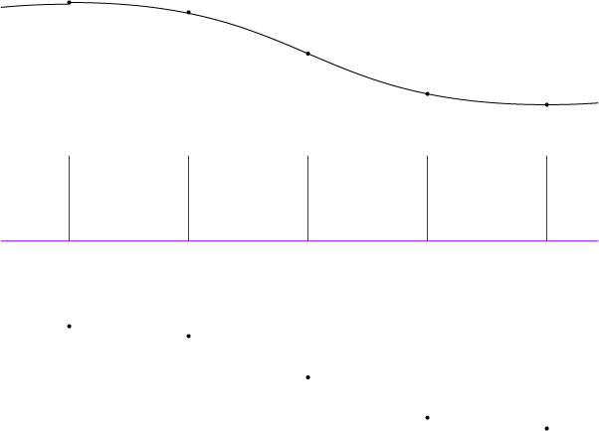
Sampling
Multiply signal by pulse train

Slide 9
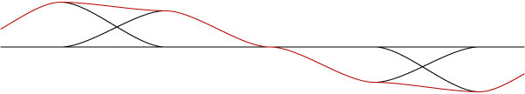
Reconstruction
Convolve samples & reconstruction filter
Sum weighted kernel functions

Slide 10
Aliasing
High frequencies
alias as low
frequencies

Slide 11
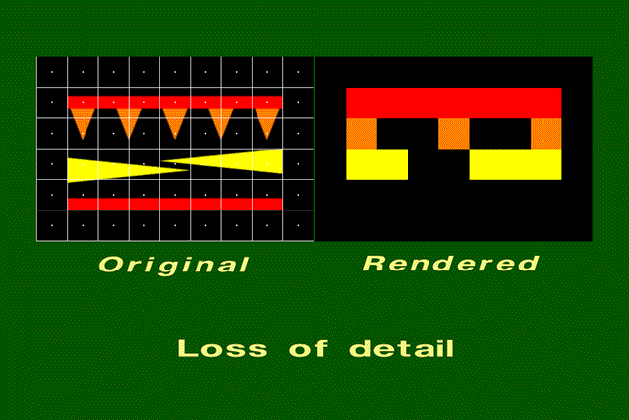
Aliasing in images

Slide 12
Antialiasing
Blur away frequencies that would alias
Blur preferable to aliasing
Filter kernel size
  IIR = infinite impulse response
  FIR = finite impulse response
    Windowed filters

Slide 13
“Ideal” Sinc
Low pass filter eliminates all high freq
  box in frequency domain
    Gets rid of all (& only) aliasing frequencies
  sinc in spatial domain (sin x / x)
    Possible negative results
    Ringing
    Infinite kernel
Exact reconstruction to Nyquist limit
  Sample frequency ≥ 2x highest frequency
  Exact only if reconstructing with ideal low-pass filter (=sinc)

Slide 14
Graphics Kernels: Spatial Box
Easy to implement
Sinc in frequency domain
Significant residual aliasing
Really pretty bad quality

Slide 15
Graphics Kernels: Gaussian
Wide Image Gaussian → Narrow Frequency Gaussian
Narrow Image Gaussian → Wide Frequency Gaussian
Mostly zero a few standard deviations out
  Window to make finite
Can over-blur
→

Slide 16
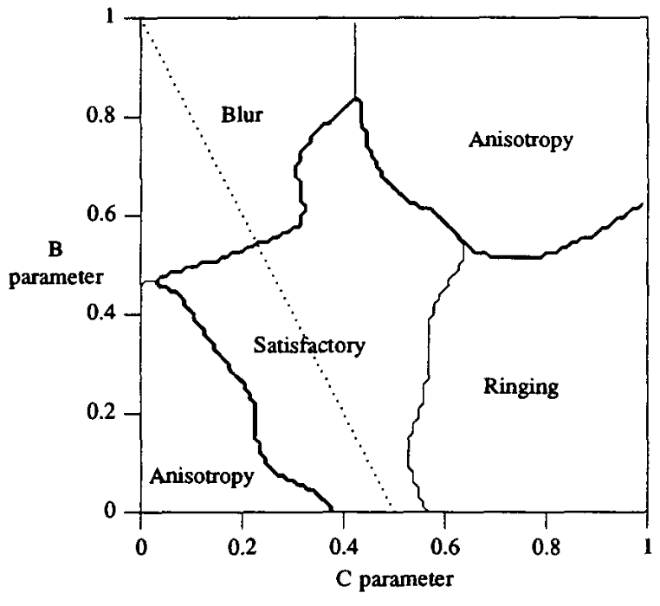
Graphics Kernels: Mitchell
Class of cubic filters
Mitchell & Netravalli,
Reconstruction Filters in Computer
Graphics, SIGGRAPH 1988
Recommend B=C=1/3

Slide 17
Graphics Kernels: Lanczos
Windowed sinc
  Windowed by central lobe of a wider sinc
  Class by how many lobes
Lanczos-2 is popular

Slide 18
Filtering & Reconstruction
Ideal Continuous Image
Sample
Sampled Image Pixels
Reconstruction Filter
Continuous Display

Slide 19
Filtering, Sampling, Reconstruction
Ideal Continuous Image
Filter
Filtered Continuous Image
Sample
Sampled Image Pixels
Reconstruction Filter
Continuous Display

Slide 20
Combine Filter & Sample
Can combine filter and sample
  Evaluate convolution at samples
Ideal Continuous Image
Sampling Filter
Sampled Image Pixels
Reconstruction Filter
Continuous Display

Slide 21
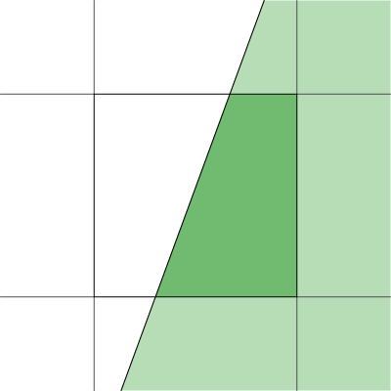
Analytic Area Sampling
Compute “area” of pixel covered
Box in spatial domain
  Nice finite kernel
    easy to compute
  sinc in freq domain
    Plenty of high freq
    still aliases

Slide 22

Analytic higher order filtering
Fold better filter into rasterization
  Can make rasterization much harder
  Usually just done for lines
    Draw with filter kernel
    “paintbrush”
Only practical for
finite filters

Slide 23
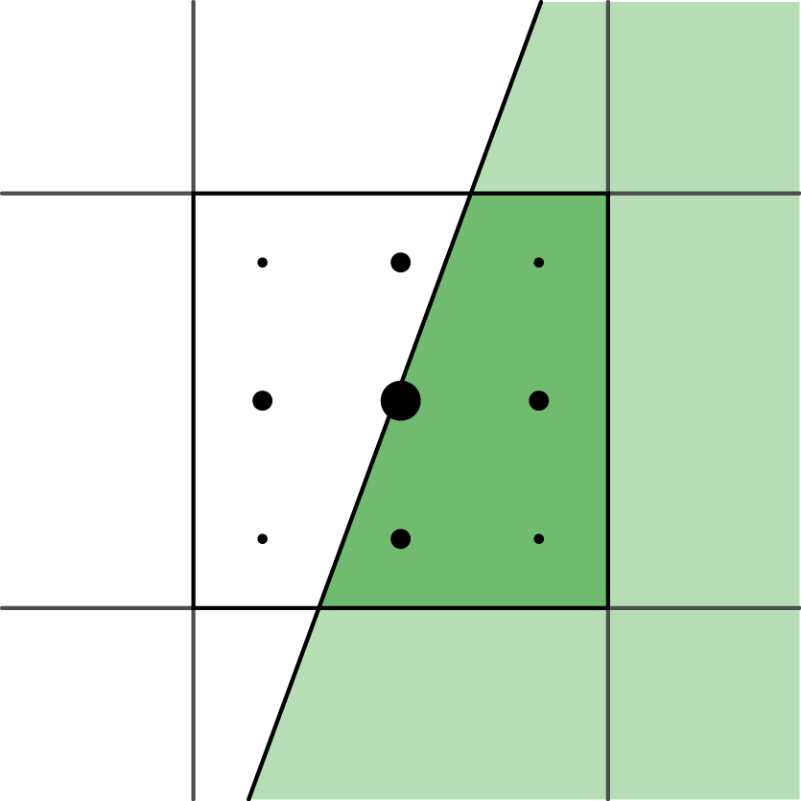
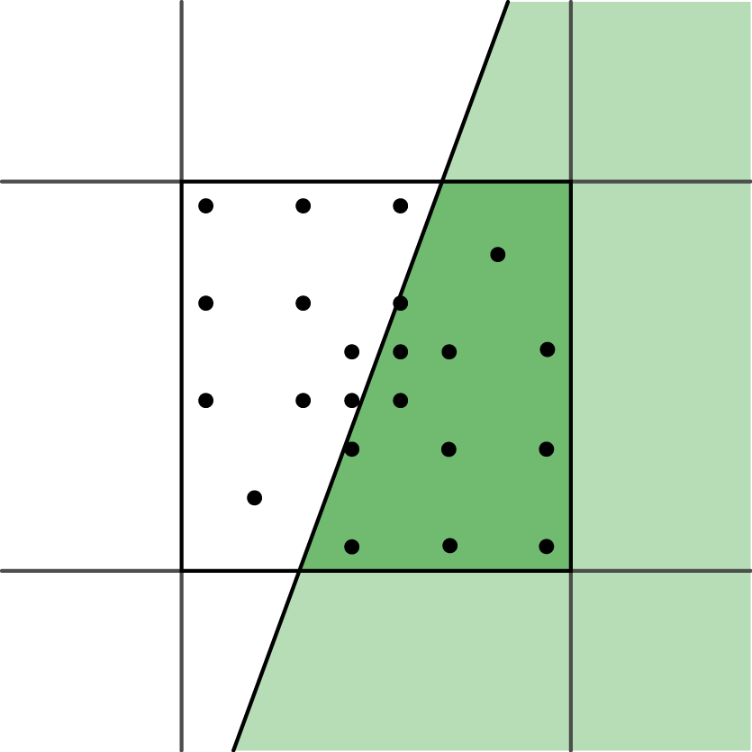
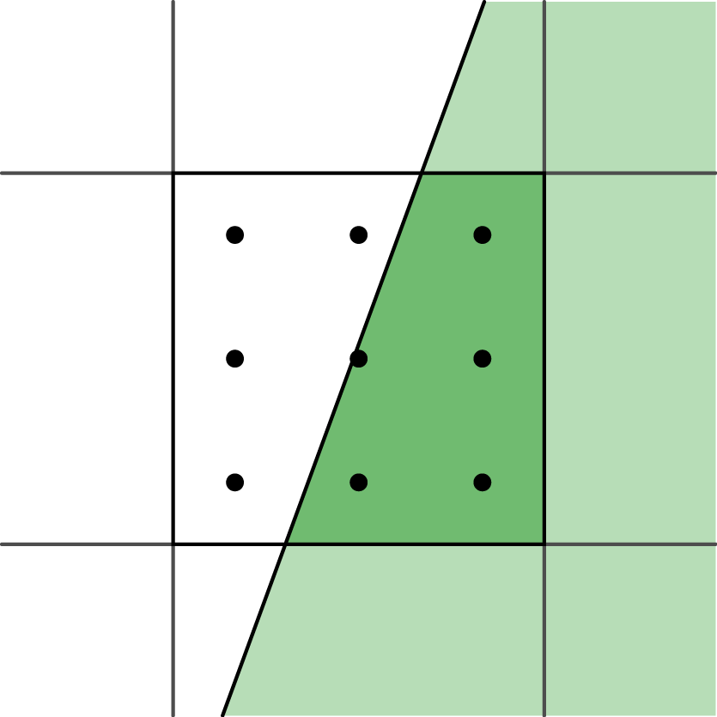
Supersampling
Numeric integration of filter
Grid with equal weight = box filter
Push up Nyquist
frequency
  Edges: ∞ frequency,
  still alias
Other filters:
  Grid with unequal
  weights
  Priority sampling

Slide 24
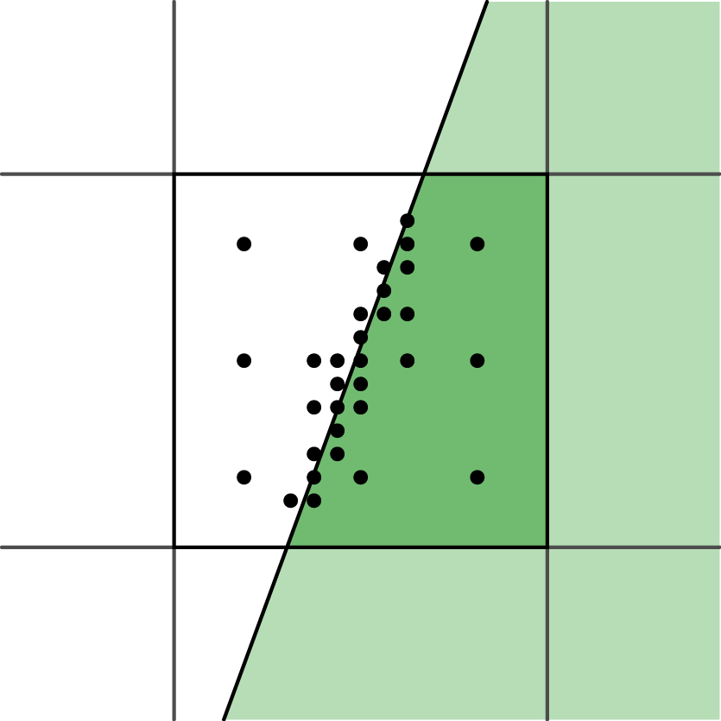
Adaptive sampling
Vary numerical integration step
More samples in
high contrast areas
Easy with ray
tracing, harder for
others
Possible bias

Slide 25
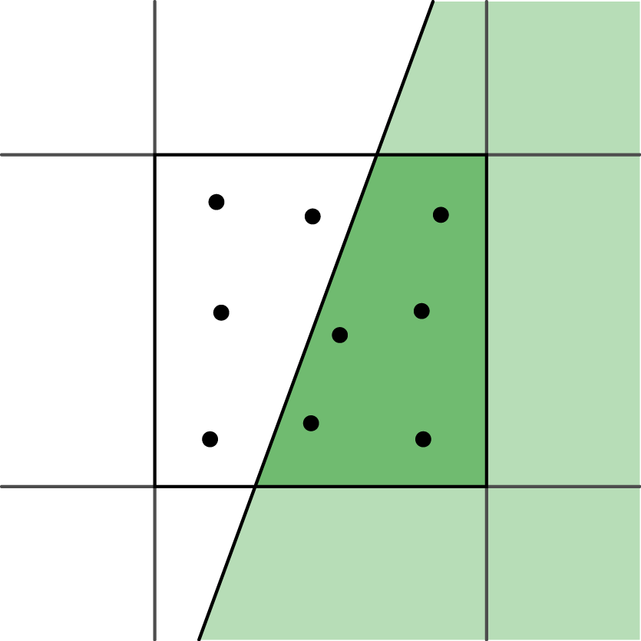
Stochastic sampling
Monte-Carlo integration of filter
Sample distribution
  Poisson disk
  Jittered grid
Aliasing ⇔ Noise

Slide 26
Common Antialiasing Techniques
SSAA
MSAA
MLAA / FXAA
TAA

Slide 27
SSAA: Supersampled Antialiasing
Render higher resolution
  N x per-pixel rasterization samples
  N x pixel shading samples
  N x buffer sizes
Filter & resample
N-sample

Slide 28
MSAA: Multisample Antialiasing
N-sample rasterization and visibility, only shade one
  N x per-pixel rasterization samples
  1 x pixel shading samples
  1 x buffer sizes
Hardware support, including sample placement

Slide 29
MLAA: Morphological Antialiasing
Postprocessing pass on aliased image
  1 x per-pixel rasterization samples
  1 x pixel shading samples
  1 x buffer sizes
Algorithm
  Look for jaggy edges
  Infer original edges
  “Fix” image
FXAA is a popular variant
  Available shading code

Slide 30
TAA: Temporal Antialiasing
Share samples across frames
  N x rasterization samples (1 per frame)
  N x shading samples (1 per frame)
  2 x buffer sizes (add history buffer)
Exponential weighted average
Must find previous data for “this” pixel in history

Slide 31
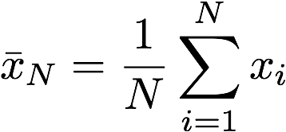
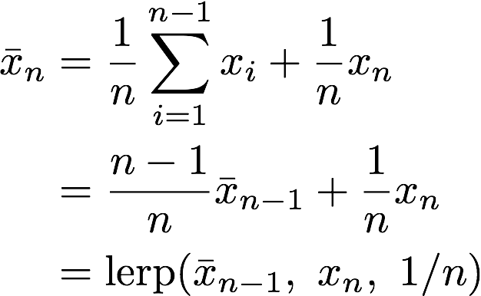
Exponential Average
Regular average
Incremental average

Slide 32

Exponential Average
Incremental
Exponential: don’t change weight

Slide 33
History
Account for motion
  Camera motion: current and previous transform
  Object motion: velocity buffer
    Also useful for motion blur
Resampling
  Land between pixels
  Avoid blurring history data
Rejection
  Occlusion, Disocclusion = stuff in buffer may be a different object
  Color clamping

Slide 34
TAA problems
Start-up aliasing
  Alias until you get enough samples
Disocclusion aliasing
  No history when things appear
Ghosting
  Rejection/clamping failure on noisy backgrounds
Pulsing
  Cycle of reject/average
Fireflies
  Single bright sample hard to antialias

Slide 35
TAA wins
Monte Carlo all the things
  Some samples per frame
  Multiply by TAA
Screen Space Reflection
  1-12 samples per pixel * 8 frames ≈ 8-96 samples
Ambient Occlusion
  1-6 samples per pixel * 8 frames ≈ 8-42 samples
Percentage Closer Soft Shadows
  32 samples per pixel * 4 pixels/quad * 8 frames = 1024 samples

Slide 36
Resampling
Image Pixels
Reconstruction Filter
Continuous Image
Sampling Filter
Resampled Image Pixels

Slide 37
Resampling
Image Pixels
Resampling Filter
Resampled Image Pixels

Slide 38
Resampling with less blur
Samples → continuous image = diffusion
What samples at the new rate give the same continuous image?
Solution
  Laplacian ≈ Difference of Gaussians ≈ Unsharp Mask ≈ Lanczos 2 ≈ Mitchell
  All same shape and width
UE4 mostly uses 5-sample Mitchell

