Slide 1
Path/Ray Tracing Examples

Slide 2
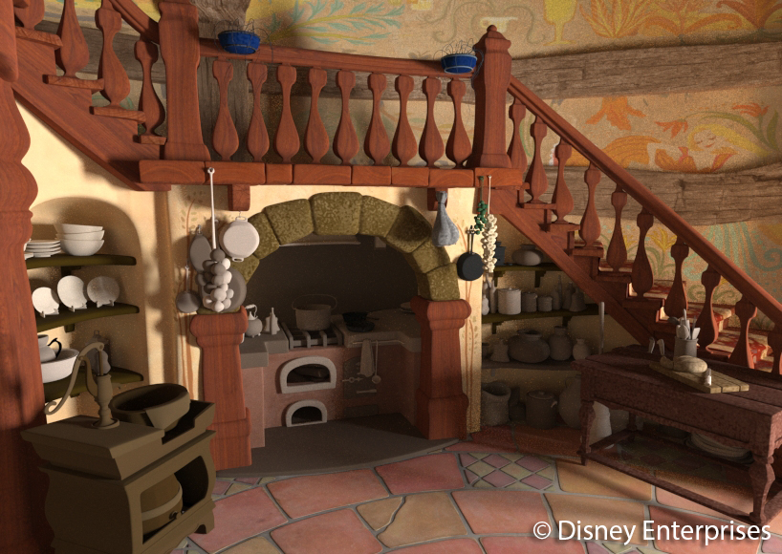
Path/Ray Tracing
Rendering algorithms that trace photon rays
Trace from eye
Where does this photon come from?
Trace from light
Where does this photon go?

Slide 3
What does ray intersect
Just represent surfaces as polygonal mesh
First hit
Normal case
Any hit (usually any hit before here)
Shadows
Multi-hit
Tell me everything on this ray

Slide 4
What happens when you hit
Compute direct lighting
Reflect
Scatter
Probability distribution of directions
Average many rays
This is “path tracing”
Movies use this a lot

Slide 5
Acceleration Structures
Bounding Volumes
Put stuff in an invisible box
If ray doesn’t hit box, don’t test stuff inside
Bounding Volume Hierarchy (BVH)
Put your invisible boxes in invisible boxes
Spatial Subdivision
Divide space (grid or K-D Tree)
Stop early when you find a cell with a hit

Slide 6
Computational Complexity
o objects, p pixels, n rays per pixel, b bounces
Naïve: O(o*n*p*b)
With data structure: O(log(o)*n*p*b)

Slide 7
An Evaluation of Multi-Hit Ray Traversal in a BVH using Existing First-Hit/Any-Hit Kernels
Amstutz, Gribble, Günther, Wald
JCGT v4n4 2015

Slide 8
Memory considerations
Minimal “hit point” data structure
Cache density
Memory bandwidth
Can recompute derived data

Slide 9
Data Layout
SoA
Better cache efficiency for ordered access
Many reads/writes for scattered access
AoS
Better cache efficiency for unordered access
Including during sort operations
Fewer cache lines to write on unordered update

Slide 10
Hit point sorting
As hits are found
Insertion sort
Adjacent hit points likely already in cache
After all hits have been found
Simplifies hit processing (cache, SIMD divergence)
Better sorting algorithms
Sort less cache coherent

Slide 11
Testing
Intel Xeon E5
18 cores (full modern x86)
8-way AVX SIMD vector operations
Intel Xeon Phi
61 cores (Pentium-class in-order execution)
16-way SIMD vector operations
NVIDIA GTX Titan
3072 GPU cores
24 groups of 128-core SIMD

Slide 12
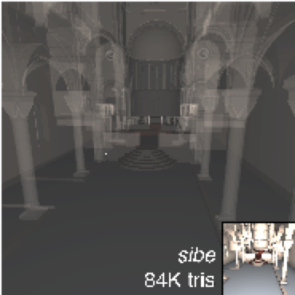
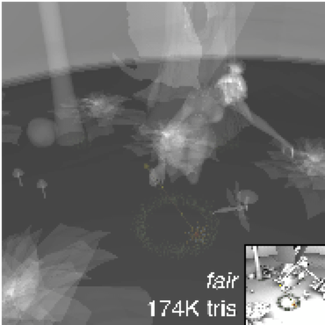
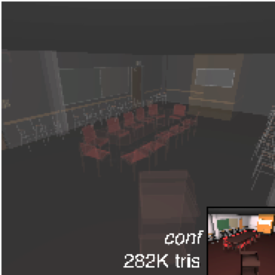
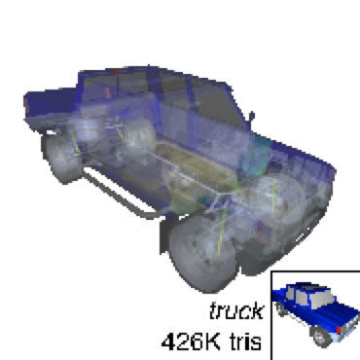
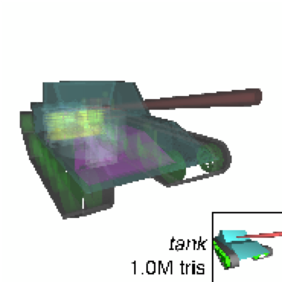
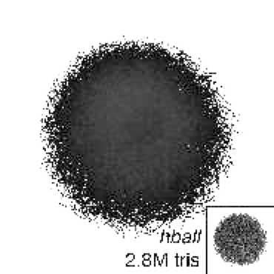
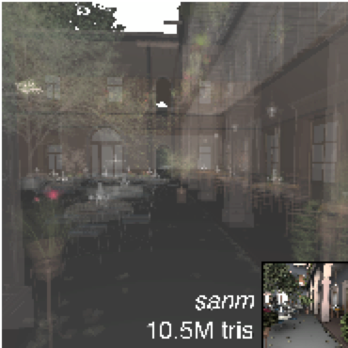
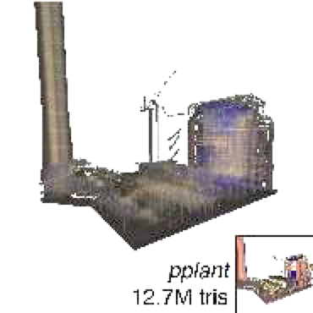
Test Scenes

Slide 13
Intersections per Second (CPU)
Notes:
Best: progressive, structure of arrays. Visits in order, all in cache

Slide 14
Intersections per Second (Phi)
Notes:
Best(ish): Array of Structures, deferred sort. Random access of deferred sort favors AoS

Slide 15
Intersections per Second (GPU)
Notes:
Mildly best: AoS, progressive sort. GPU shares cache between 128 cores, possibly not enough for SoA coherence
Rayforce = alternate code, not relevant to data structure comparison

Slide 16
Sorted Deferred Shading for Production Path Tracing
Eisenacher, Nichols, Selle, Burley
EGSR 2013

Slide 17
Disney Hyperion Renderer
Path tracer
2-level BVH
“Production” = movies
Can handle long render time per frame
Still display 24 frames per second
But still need to finish the movie!

Slide 18
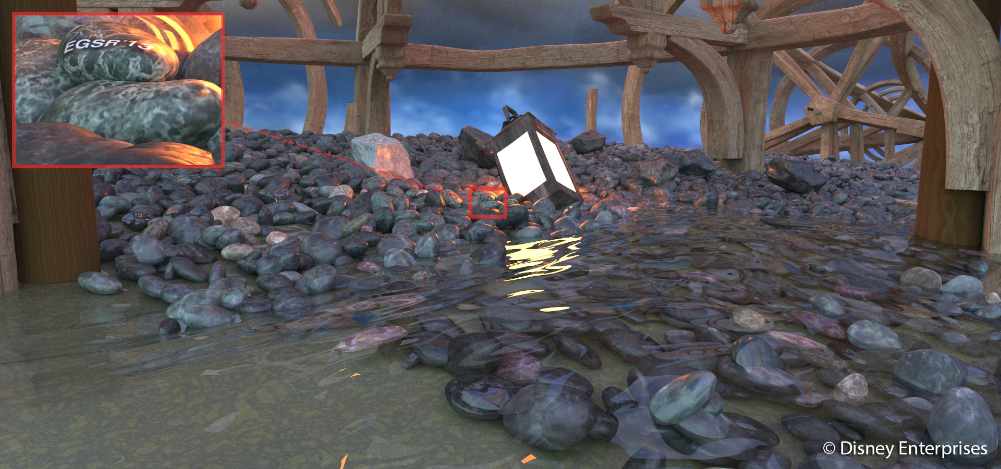
Production rendering
Render time: 35 minutes. Image size: 1920x900. 512 photons per pixel ≤ 5 bounces
133M polygons. 15.6 GB texture.

Slide 19
Production rendering
Render time: 68 minutes. Image size: 818x580. 1024 photons per pixel ≤ 6 bounces
70.5M polygons. 13.6 GB texture.

Slide 20
Cache problem
Algorithm requires random rays
Random access to BVH
Random access to polygons
Random access to textures
NO cache coherence

Slide 21
Sort

Slide 22
Sort

Slide 23
Hit Point Sorting
Sort shading hit points into groups by surface
Surface accesses same texture
Improves texture cache

Slide 24
Sort

Slide 25
Ray Sorting
Bin by starting point and direction
Likely to hit the same polygons
Improve cache behavior for BVH and Polys

Slide 26
Improvement

